Slide 1
ISTC Project #3831
Development and experiments at large-scale installation
for heating and retention of corium
Project Manager Kondrashenko A. V.
2009

Slide 2
Specific information on Project
The main goal of the Stage I of the project #3831 is to experimentally test corium behavior and corium interaction with concrete. It is planned to develop a medium scale installation that is to heat corium along with the complex of diagnostic and measuring equipment. The installation should have the following characteristics: corium volume ~15-18 L, corium mass ~100-120 kg, corium temperature ~2500-3000С , heat fluxes into concrete ~100 kw/m2 , corium retention time ~ 10-12 min.

Slide 3
Task 1: Development of the technologies of pyrotechnic briquettes producing, initiating and dumping into corium. Subtask 1.1: To develop the technology of pyrotechnic briquettes producing.
Fulfilled work
1. Zr powder was ordered at Open JSC “Chepetsk mechanical plant” to produce PTC briquettes.
2. Testing and perfection of PTC briquettes producing technology by means of pressing was started.
3. One cylindrical PTC briquette was produced: d=50mm, h=20mm, m=135g, ρ=3,44g/cm3.

Slide 4
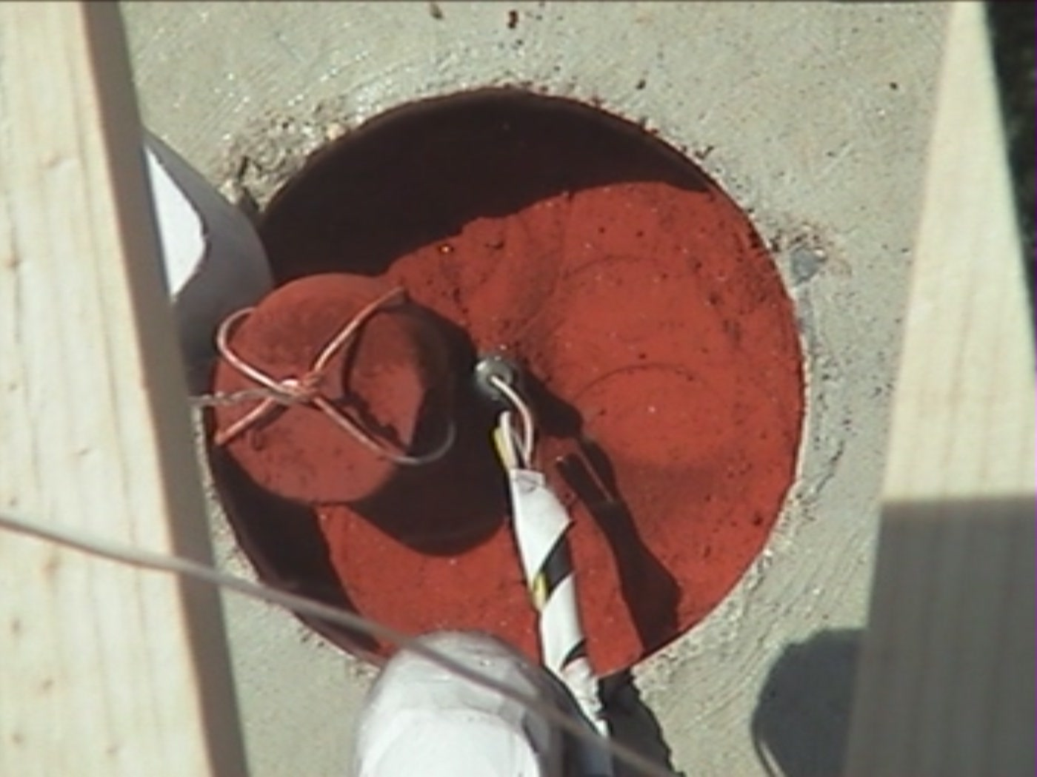
Prepared cylindrical briquette and PTC
PTC
Electric igniter
briquette
Results by the end of the I quarter
PTC and one briquette were produced of available Zr and FeO powders (total mass ≈3 kg) to carry out a preliminary small-scale experiment.

Slide 5
Subtask 1.2: To develop the technology of pyrotechnic briquettes initiating.
Fulfilled work
1. On the basis of preliminary experiments it was decided to initiate PTC with the help of electric igniter and to subsequently sustain the process by means of three gas burners (that are also used for additional heating of corium) operating on the propane-oxygen mixture.
2. Gas equipment was purchased (gas cylinders, gas burner-cutting torches, hoses, reducers, etc).
3. The system of remote operating with the complex of gas burners was finalized.

Slide 6
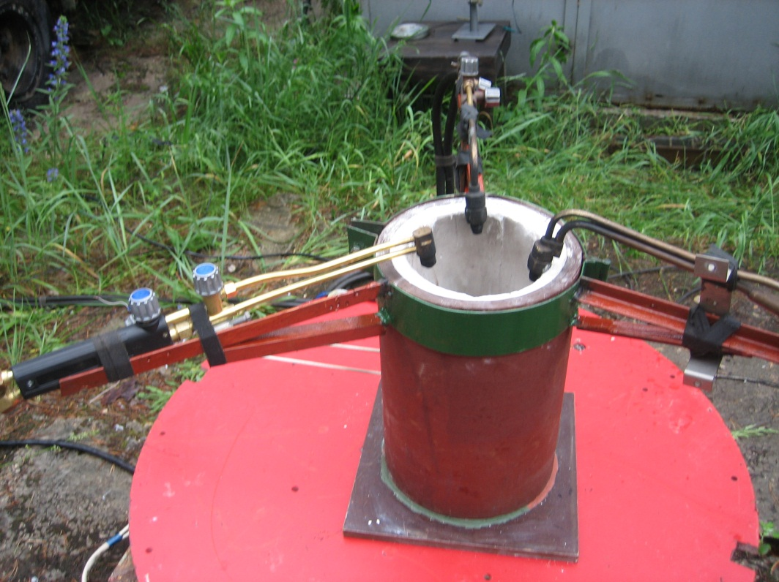
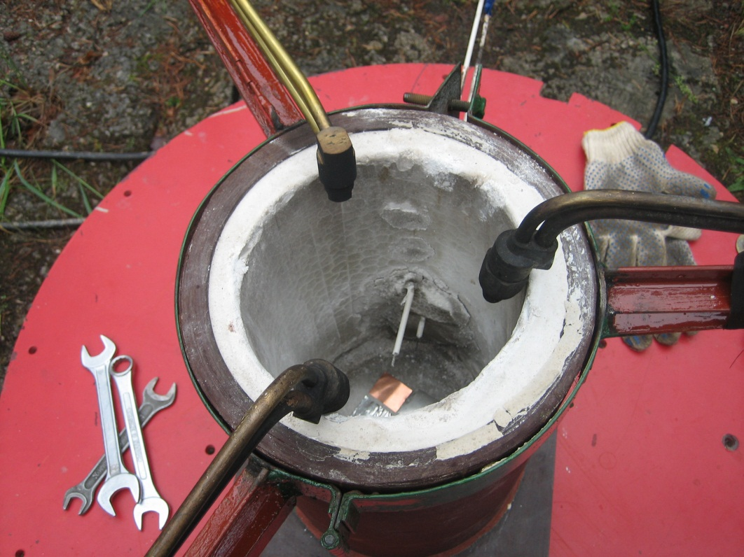
Experimental installation overview with mounted system of gas burners.

Slide 7
Temperature versus time diagram, obtained by means of two thermocouples
Results by the end of the I quarter
The complex of three gas burners for the small-scale experiment was prepared to test and perfect the system of PTC initiating and for additional corium heating.

Slide 8
Subtask 1.3: To develop the technology of pyrotechnic briquettes dumping into corium.
Fulfilled work
1. Some estimates were made to optimize the shape and mass of PTC briquettes.
2. The testing of the system of remote-controlled dumping of PTC briquettes into corium was started.
Results by the end of the I quarter
One PTC briquette was produced for dumping into corium during the preliminary small-scale experiment (total mass of corium ≈3 kg) to test the system of PTC initiating and for additional corium heating.

Slide 9
Task 2: Development of the measuring equipment complex for the diagnosis of corium temperatures, thermal fields in concrete.
Subtask 2.1: To develop and make the measuring system of the melt temperature by means of pyrometry.
Fulfilled work
To measure the corium surface thermal radiation a four-channel pyrometer was developed. As a basis for photo detectors in the pyrometer we used photo electronic multipliers (PEMs) Hamamatsu R1925A. PEM output current from the load resistor flows to the input of a registrator (oscilloscope, analog-digital converter).

Slide 10
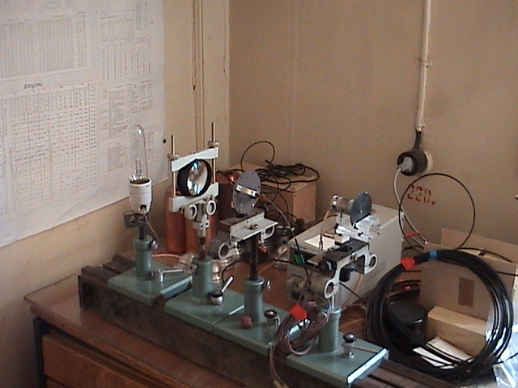
Pyrometric system overview
Results by the end of the I quarter
A four-channel pyrometer was developed for measuring the corium surface thermal radiation.

Slide 11
Subtask 2.2: To develop and make the measuring system of the melt temperature and heat flows in concrete by means of thermocouples.
Fulfilled work
1. 8 temperature detectors CENTER-309 were purchased.
2. A personal computer was purchased to operate the system for the diagnosis of temperature and thermal flows.
3. The system for the diagnosis of temperature was developed and made. The system contained of 8 thermocouples built into the concrete tank bottom for the preliminary small-scale experiment (with ≈ 3 kilos of PTC).

Slide 12
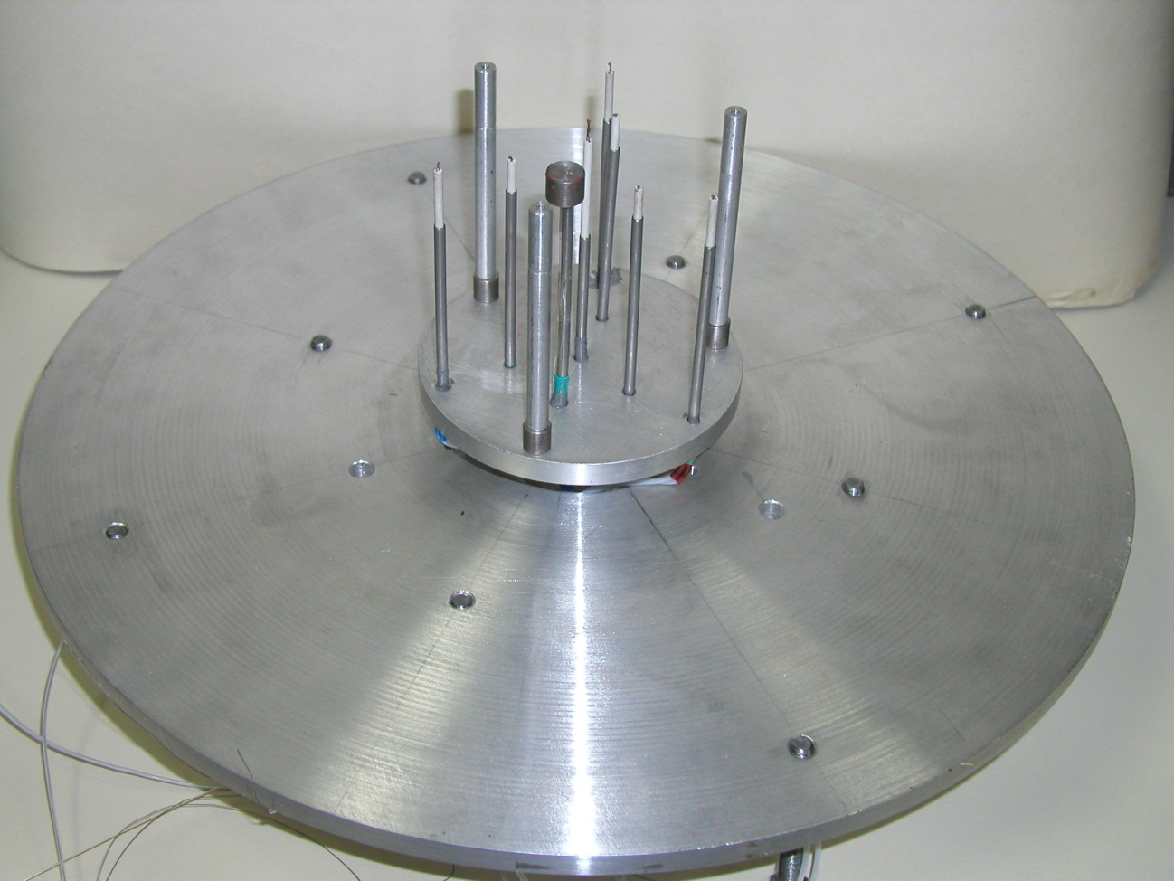
Disposition of thermocouples in the experiment #1
Base diameter: 90 mm; Depth of thermocouple disposition inside the concrete: 0 mm
(1 item), 2 mm (1 item), 5 mm (3 items), 10 mm (3 items).
Results by the end of the I quarter
The system for the diagnosis of temperature in the concrete tank was developed and mounted for the preliminary small-scale experiment with ~3 kilos of PTC.

Slide 13
Subtask 2.3: To conduct the calibration tests. Test result analysis.
Fulfilled work
Thermocouples were calibrated by the well known temperatures of liquid nitrogen (-196°С) and boiling water (100°С). Using obtained data we graphed calibration curves that would be used for processing the experimental results.
Results by the end of the I quarter
The system for the diagnosis of temperature by means of thermocouples was calibrated.

Slide 14
Task 3: Development of the medium scale installation for corium heating with characteristics: corium volume ~15-18 L corium mass ~100-120 kg, corium temperature ~2500-3000C, heat fluxes towards walls and a bottom of a tank ~100 kw/m2, melt retention time 10-12 min.
Preliminary small-scale experiment #1. PTC mass ~ 3 kg.
1. A concrete tank with built-in thermocouples (8 items) for the small-scale experiment with ~3 kg of PTC was prepared. Tank dimensions: inner diameter=150 mm, full height=260 mm, bottom thickness=100 mm, side walls thickness=100 mm.

Slide 15
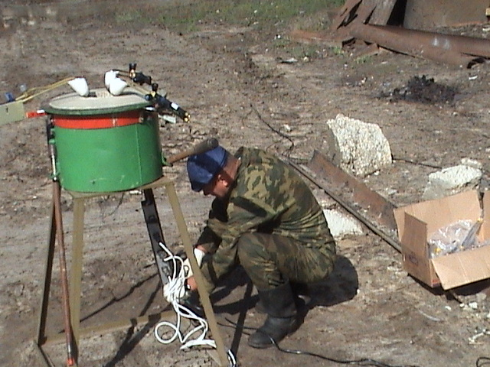
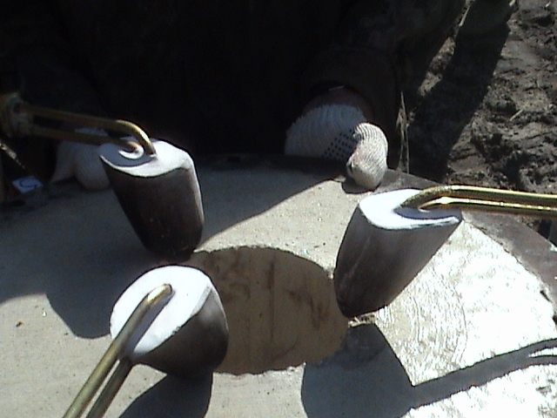
Steel container with concrete tank overview in the experiment #1.
Overview of the concrete tank with disposed gas burners.

Slide 16
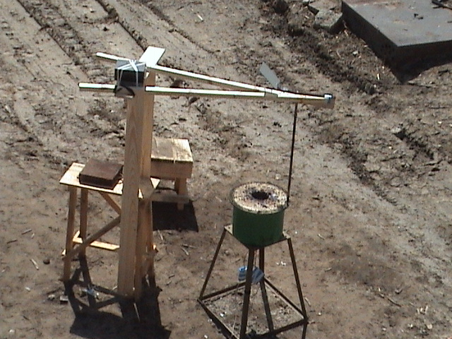
Post-experimental installation overview.
video camera
mirror

Slide 17
OVERALL RESULTS:
The following experimental technologies were developed and approved:
1.The technology of concrete tank producing inside a steel container. 2.The technology of pyrotechnic briquettes producing of Zr and FeO mixture.
3.The diagnosis complex for measuring concrete temperature by means of thermocouples.
4.The technology of PTC initiation by means of electric igniter and a system of 3 gas burners (they also serve to additionally heat corium) that use propane-oxygen mixture.
5.The technology of carrying out the experiment.

Slide 18
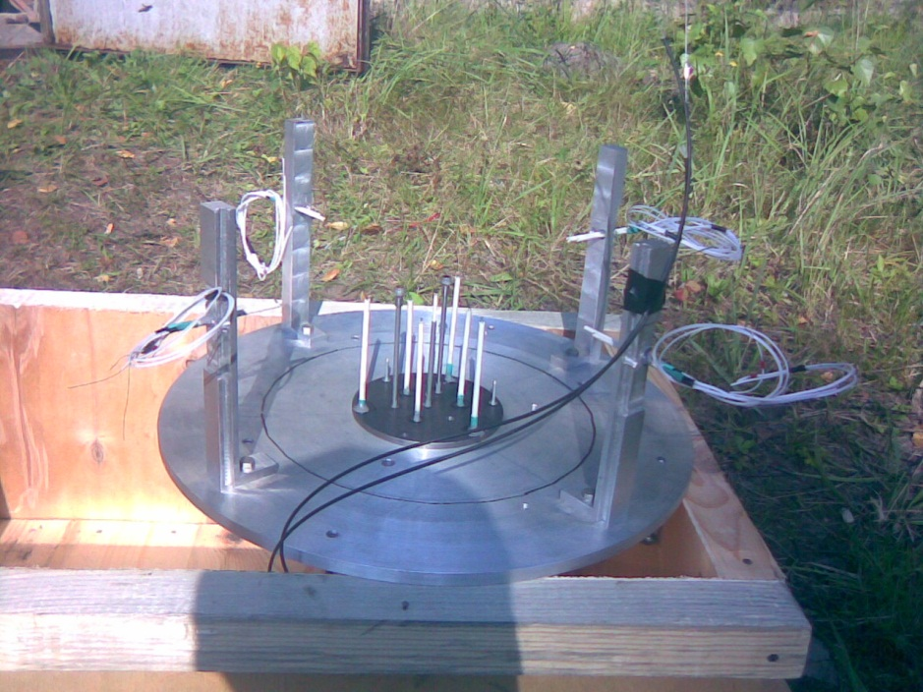
Preliminary small-scale experiment #2. PTC mass ~ 30 kg.
1. A concrete tank with built-in thermocouples (16 items) for the small-scale experiment with ~30 kg of PTC was prepared. Tank dimensions: inner diameter=250 mm, full height=300 mm, bottom thickness=100 mm, side walls thickness=220 mm.
Disposition of thermocouples in the experiment #2
Base diameter: 90 mm,
Depth of thermocouple disposition inside the bottom of the concrete tank: 0 mm (1 item), 5 mm (3 items), 10 mm (3 items).
Thermocouple disposition inside the concrete tank side-walls:
height – 20 mm above the bottom
depth – 5 mm (4 items), 15 mm (4 items).

Slide 19
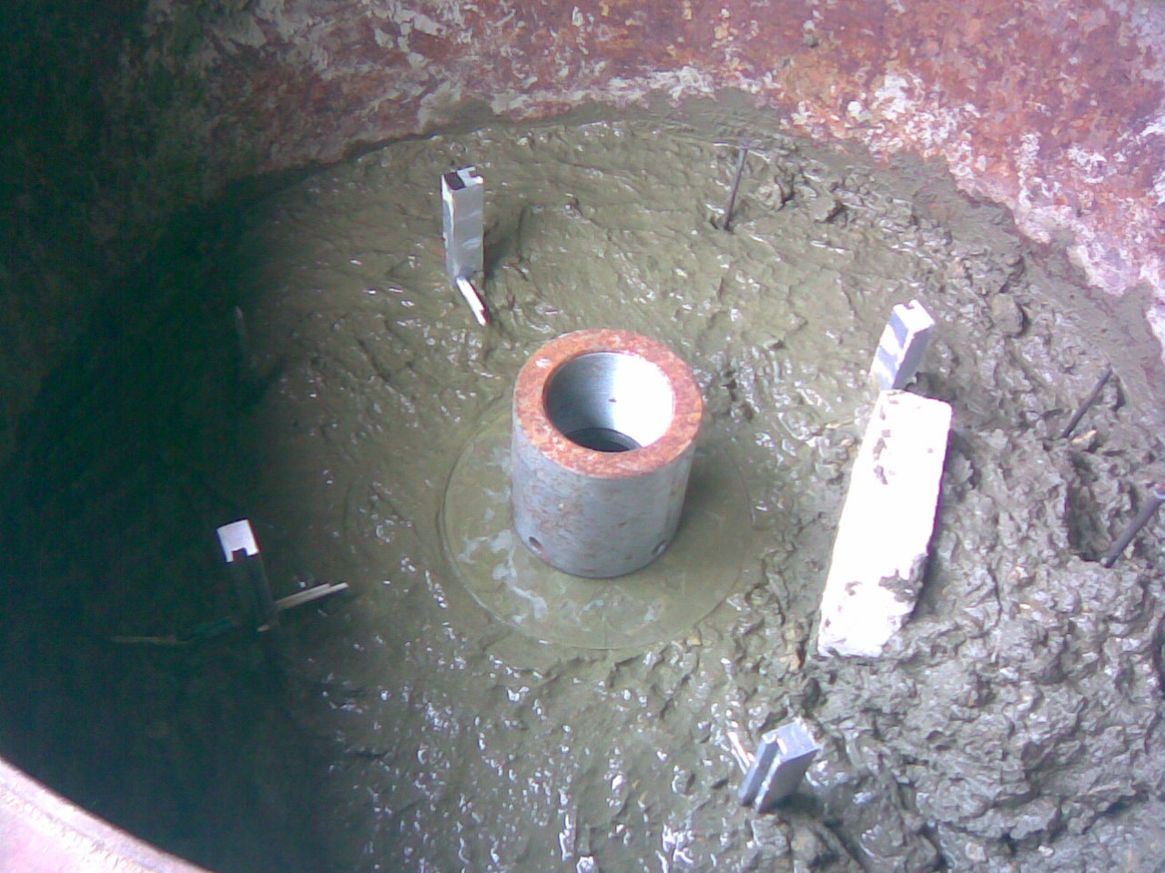
Overview of the steel container and concrete tank in the experiment #2.
2. A diagnosis system of measuring the temperature and thermal fluxes in the concrete was developed and prepared. The system consists of 15 thermocouples built-in the bottom and side walls of the concrete tank for the small-scale experiment with ~30 kg of PTC.

Slide 20
3. General scheme of the experiment
briquette
concrete tank
steel container
chute
15 m
1m
10 m
corium

Slide 21
SCHEDULED TASKS:
These experimental technologies are scheduled to develop and approve:
1. The system of melt temperature measuring by means of pyrometry.
2. The system of measuring the concrete temperature and thermal fluxes by means of thermocouples.
3. The system of PTC briquettes dumping by means of chute.
4. Experimental results analysis.

