Slide 1
The report is presented by Ukrainian State Nuclear Regulatory Committee I&C System Certification Center p/o 9871, Academic Proskury str., 1, Kharkiv, 61070, Ukraine Tel/fax: +380 057 760-35-98, 760-38-61 Director: Georgiy Chertkov web-site: http://scasu.com, e-mail:admin@scasu.com
STCU project proposal #4726
Safety-critical software independent verification and latent faults assessment based on diverse measurement of invariants
Project manager : Professor, Doctor of Science, Head scientific researcher Borys Konorev Contact Expert Group on Severe Accident Management (CEG-SAM) Kiev, Ukraine Science & Technology Center in Ukraine (STCU) September 9-11, 2008

Slide 2
Introduction
I&C (Instrumentation and Control) systems are the key factor providing the dependability and the safety characteristics of the projects for the critical areas such, as nuclear industry, space, etc.
The trend in the sphere of I&C system development is the enlarging of the software-based I&C system critical functions important to the safety of NPP. Faults of critical I&C software could cause the failure of such systems.
Latent software faults (not revealed on test stages) are the risk factors of system abnormal operation and emergency hazard. That is why the quality of critical software is the important element of the normative regulation determining dependability and safety of NPP I&C systems.
The main procedures of I&C system normative regulation are the independent verification and qualification of critical software. One of the basic objectives of qualification consists in the cost effective assessment of the risks of system failure due to latent faults of critical software.

Slide 3
Introduction (cont.)
Development of methodology and tools for proven independent verification and validation of critical software is relative to the investigation program “Theoretical basis and engineering solution for cost-effective assessment of software-based I&C systems” suggested IAEA.
Intensive usage of the software in I&C systems, important for NPP safety stipulate the urgency of the presented project.

Slide 4
The project purpose
The project purpose is the development of methodology and the tool environment, providing trustworthiness of critical software qualification. The aim of the project is the development of the advanced information technology of proven (demonstrative) independent verification and forecasting of software latent faults for critical I&C systems related to NPP safety.
The main tasks are:
forecasting of the software latent faults;
estimation of the test coverage completeness;
cost-effective management (achievement of the required level of uncertainty of the estimation at the minimal resource inputs)
The results of project are intended for the application by relevant organizations at the development, certification, qualification and normative regulation (licensing activity) of the software for critical I&C systems related to the safety of NPP

Slide 5
The concept
The concept of the project consists in realization of the following key statements:
Use of methodology of source software static analysis as platforms of proven independent verification and forecasting of latent faults.
Use of the model-checking approach for diverse invariant-based measurement and an estimation of critical software quality.
Formal verification of critical software with use of constancy (persistence) criterion of invariants for all possible cases of use, defined by the specification.
Experimental calibration using the method of test faults injection for the assessment of the sensitivity and the variety degree of invariant-based models of source software for a quantitative estimation of latent faults probability.
Use of the method of a "drop" injection of test faults at calibration for exception of errors due to "interference - mutation" effect on the address field of source software.

Slide 6
The theoretical basis of proposed technology is presented by set of mathematical models, including:
Functional model of scenario
Assessment model of software residual faults for the composition of diverse invariants measurement methods
Model of experimental calibration of sensitivity and degree diversity of invariant measurement methods on the basis of the test faults drop injection.

Slide 7
Proven technology of independent verification: Functional IDEF0 model .
Control means:
Scenario
SW project normative profile
restrictions
Parametric control of calibration of the methods for invariants checking
The scheme of software invariants measurement
Input
Results of invariants checking at all software hierarchy levels
Technical documents
of SW project
Normalization of software project
Invariants measurement
Output
Assessment of:
• software quality characteristics;
• latent faults probability prediction;
• completeness of test coverage;
• cost-efficiency
Calibration.
Integral
assessment.
Cost-
efficiency
Implementation means:
techniques
tools
instructions
stuff
The scenario of proven technology presented by three stages ‘Normalization of software project’, ‘Invariants measurement’, ‘Calibration. Cost-efficiency’. Realization mechanism of these stages includes the techniques and utilities. Utilities support the work according to scenario on the analytical, information and organization levels.
The feature of scenario is experimental calibration of the sensitivity and the diversity degree and parametric control of calibration of invariant measurement methods.

Slide 8
Safety-critical software independent verification and latent faults assessment based on diverse measurement of invariants
Assessment model of software residual faults for the composition of diverse invariants measurement methods
A
D_{all}
For the assessment of attained effect the indicator I is used. Indicator I defines the value (%), of probability of latent faults Р (D_{lat}) decrease after using the invariant measurement methods
If D_{lat} will not be detected then the I=0 value and the value of the ratio
could be the assessment of the latent faults probability.
D1
Di
1
Dlat
2
Dn
3
Possible variants:
а) theoretically possible case of latent faults probability decrease to 100%
(item 3)
b) ultimate unfavorable variant
(item 2)
c) common case
(item1)
8
8

Slide 9
Model of experimental calibration of sensitivity and degree diversity of invariant measurement methods on the basis of the test faults drop injection.
Defines the parametrically controlled procedure of accessible required cost-effectiveness of an critical software assessment.
Controll parameters:
<profile of faults>
<invariant>
<number of test faults>
N
Steps (layers) of calibration (number of “dropped” test fault)
For the specified calibration volume is defined:
1) total sensitivity of each method
i
U Мpart i.
At every step
defines:
1. Disjunction of undetected test faults of the for
each Мi.
2) in pairs for all Мi
(each taken together)
the diversity degree
i j
∩ (U Мpart i) and the development of diversification matrix
2. Conjunction of undetected test faults on each fault type of the profile for
each Мi..
М1
Мi
Мn
3. Partial sensitivity
Мpart i on each fault type .
Methods
 | М1 | М2 | … | Мn
М1 | 0 |  | mij
М2 |  | 0
… | mji |  | 0
Мn |  |  |  | 0
Faults profile
(types and percentage composition)
___
mij = 1,0
mij ≠ mji

Slide 10
The practical project part is presented by the results of development of utility for static analysis
Static analysis utility is intended for the analysis and estimation of software quality on the base of software invariant measurement.
Invariant is the constant software property during software life-cycle. Samples of invariants: physical dimensions, interval and precision of software variables, logic of execution, normality.
The quality control implies software invariant measurement and their comparison with invariants values specified in technical documents.
The inputs for static analysis are the list of the files containing the analyzed source code and the characteristics of measured software invariants. Characteristics of measured software invariants are specified on the basis of the software specifications.
Currently, the static analysis utility is intended for the analysis of source code files in С/С ++ language.
The structure of utility allows to extend both types of measured invariants and analyzable programming languages.
The invariants which are checked by the utility now:
semantics (dimension) - physical dimension of a variable;
interval - allowed range of values for a variable;
precision - allowed accuracy of variable representation;
memory usage - bound of arrays, initialization and release of memory blocks, etc.

Slide 11
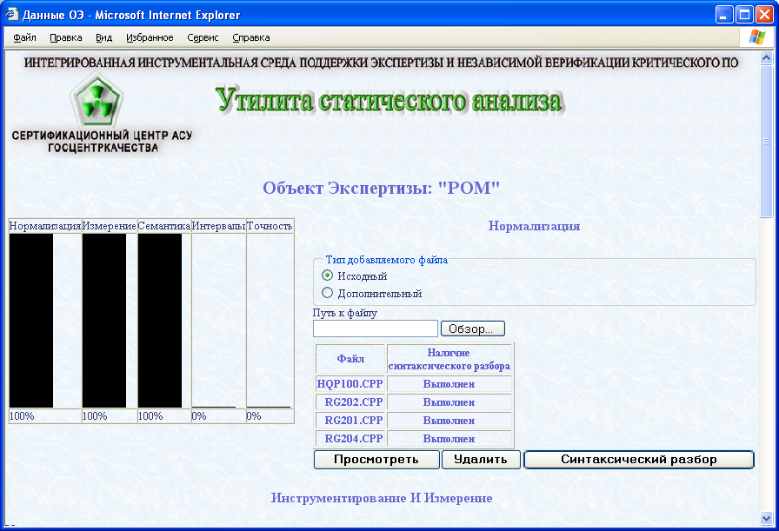
Screenshot of developed utility of static analysis: normalization
Выполненный объем верификации

Slide 12
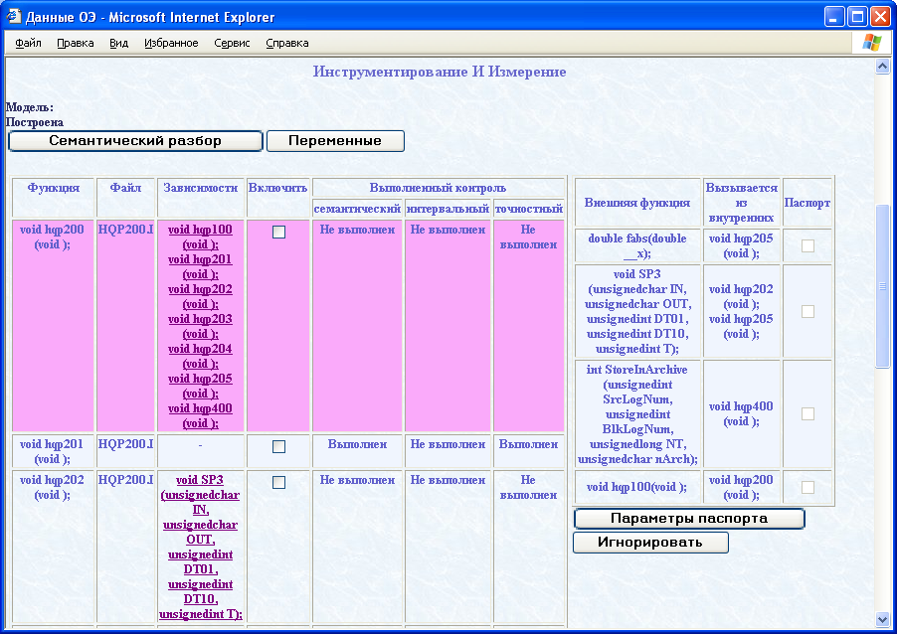
Screenshot of utility of static analysis: code walkthrough

Slide 13
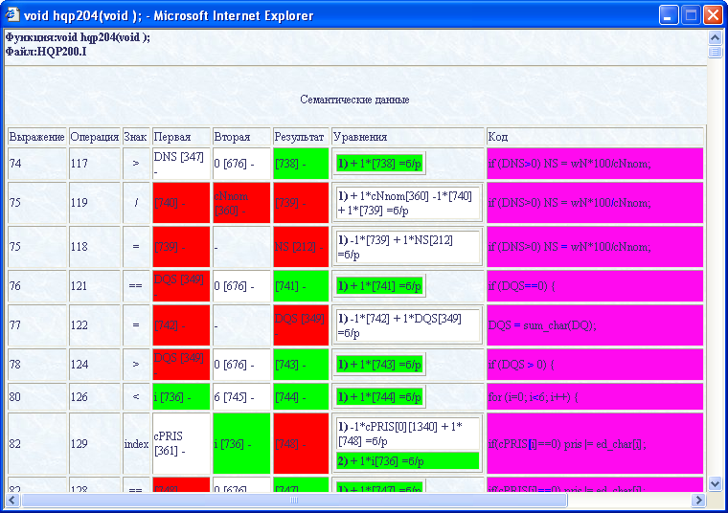
Screenshot of utility of static analysis: results of invariant checking

Slide 14
Proven technology of critical software independent verification : innovation and advantages.
Proven independent verification of the critical software on the basis of model-checking approach for the sourcecode static analysis.
Increasing of the assessment confidence for the software characteristics on the base of technological diversity.
Experimental calibration of sensitivity and degree diversity of invariant measurement methods in a particular software project.
Usage of the improved “injection” method - drop injection of faults. This method eliminates “interference” and "mutation" effects of injected faults in software address field.
Exhaustive (direct and inverse) tracing the invariant measurement scheme for clauses «Specifications of the software requirements», «Invariant specification», «Normative profile of the project», «Specifications of project definitions and justifications» and estimation of software test coverage on this basis.
The achievement of the cost-effectiveness of the critical software assessment on the base of iterative procedure controlled by parameters < software invariant type > - < software fault profile>.
The presented proven technology determines actual capabilities of organizations - developers and regulative bodies in prediction of abnormal I&C system operation risks caused by the software faults.
The presented proven technology meets the requirements of IAEA and ECSS and the state of the art in the area of cost-effective quality assessment during critical software qualification.

Slide 15
Areas of Application:
Advanced technology of proven independent verification on the base of invariant measurement can be applied in the following areas:
atomic engineering – I&C systems, important for safety of the NPP;
space branch - software for onboard and ground I&C systems of space complexes (guide and control systems, carrier rocket, actual load, launching complex, mission control);
other safety-critical and mission-critical IT-based applications (transport, finance and so on).
The normative base is harmonized according to the international industrial standards:
IEC 61508, IEC 60815, IEC 61025, ISO/IEC 12207, ISO/IEC 9126, ISO/IEC 14598, ISO/IEC 15504, ISO/IEC 25 000TR
the international branch standards:
а) For atomic engineering: IEC 1226, IEC 608801,2; IAEA NS-G 1.1, IAEA TR No 384
b) For space branch: ECSS - Е40, ECSS-Q-30, 40, 80-xx; ESA PSS 05-xx

Slide 16
Stage of Development:
Already developed:
the theoretical justification and models for invariant-oriented software quality assessment and latent faults prediction;
prototypes of utilities of the integrated tool environment for proven technology support.
The engineering feasibility of utilities and readiness for full-scale development are confirmed laboratory tests using of real assessed objects – critical software for I&С systems of Rovno NPP.
The main decisions of technology were protected by 2 patents.

Slide 17
Summary
The cost-efficiency of critical software dependability and functional safety assessment is considered as achievement of reasonable level of predicted risks of I&C systems abnormal functioning due to latent software faults, at reasonable resources inputs. The general context of assessment is implementation of fundamental practices of the analysis and qualification of I&C systems criticality - FMECA, FTA, PHA, HSIA, etc.
Presented technology of critical software cost-effective assessment:
а) extends real opportunities of the developers and regulative bodies in forecasting the risks of I&C systems abnormal functioning due to software faults in frameworks of risk-informed approaches to safety regulation in critical spheres of technical activity (atomic engineering, space technic, etc.).
b) is the important element of long-term programs of refurbishment, modernization and life time extension of I&C systems important for NPP safety .
c) provides an opportunity of quantitative assessment of limit values and decrease of probability of critical software latent faults.
d) Corresponds to the state of the art and general IAEA policy in sphere of critical I&C system software qualification.

Slide 18
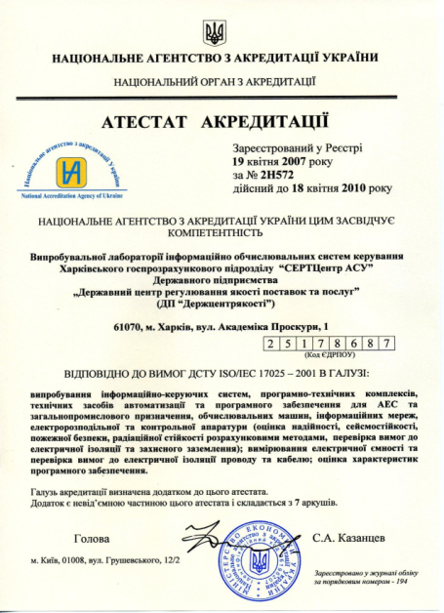
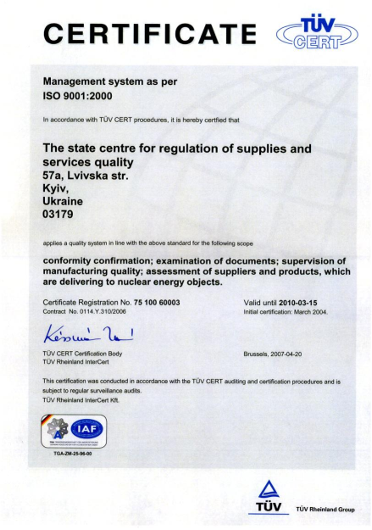
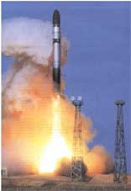
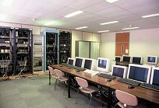
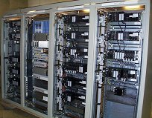
The coordinator of the project is the Certification center of Instrumentation & Control Systems the Ukrainian State Agency for Supply and Service Quality Control of Ukrainian Nuclear Regulation Committee
Leading scientists and specialists of organization are involved into the project, among them 4 professors (Dr.Sci.Tech.), 2 PhD. The participants have the experience in the field of software engineering, information technologies, reliability and safety of space-rocket technique of the former USSR. Our personal participated in the development of safety-critical software for missiles and space vehicles:
intercontinental ballistic missiles SS18 (“Satan”), SS19, SS20, etc.,
heavy lift launch vehicle "Energiya“ for the space shuttle “Buran”,
series of heavy orbital modules " Quant", "Priroda", "Technologiya“for manned orbital space stations " Salut", "Mir", MKS.
Some of this missiles and vehicles are still operating.
Also project participants have experience of development, certification, normative regulation of quality and safety of I&C systems for Ukrainian, Russian, Bulgarian NPPs.
The work is planned with cooperation with National University of Kharkiv, National aerospace university (KhAI)

Slide 19
THANK YOU FOR YOUR ATTENTION
The report about project proposal #4726 was presented by Professor, Doctor of Science, Head scientific researcher Borys Konorev Ukrainian State Nuclear Regulatory Committee I&C System Certification Center p/o 9871, Academic Proskury str., 1, Kharkiv, 61070, Ukraine Tel/fax: +380 057 760-35-98, 760-38-61 Director: Georgiy Chertkov web-site: http://scasu.com, e-mail:admin@scasu.com

