Slide 1

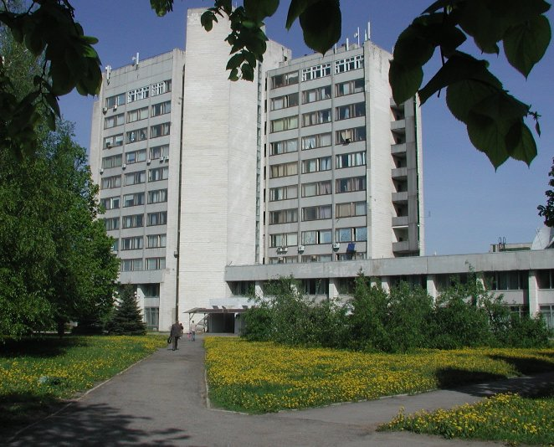
Status of the STCU project proposal #5243 on “Interaction studies of improved VVER structural materials at severe accident conditions”
“Nuclear Fuel Cycle” Science and Technology Establishment
National Science Center “Kharkov Institute of Physics and Technology”
www.kipt.kharkov.ua
Presented by V. Kornyeyeva
NFC STE NSC KIPT
CEG-SAM 18th Meeting,
September, 28 – 30, 2010
St.Petersburg, Russian Federation

Slide 2
Introduction
The operation of water-moderated reactors (VVER) does not exclude a possibility of beyond design-basis accidents with a core materials meltdown.
Currently, activities are underway to extend the operation life and reliability of reactor cores through application of new materials and structural improvements. Knowledge of how the use of new materials and structures will affect core melt formation during beyond design-basis accidents is a sine qua non of activities to increase NPP safety in general.
Knowledge of melt fluidity parameters versus phase composition allows predicting accident development scenarios and staging more detailed experiments on interaction of melts with non-recoverable trap materials to predict their integrity as a function of interaction intensity with the melt, melt mixing, and various stratifications as a function of melt phase state.
To identify solutions for the above listed issues NFC STE propose to carry out scientific and material testing research within the frame of the STCU Project Proposal #5243: «Interaction Studies of Improved VVER Structural Materials at Severe Accident Conditions»

Slide 3
General information on Project Proposal
Participating Institutions:
The work will be performed at the site of the National Science Center "Kharkiv Institute of Physics and Technology" (NSC KIPT) of National Academy of Science of Ukraine
Project Duration: 24 months
Total Estimated Project Cost: 230000 USD

Slide 4
Status of the Project Proposal:
Ministry of Education and Science of Ukraine has approved of the Project Proposal #5243 and forwarded his Concurrence to STCU Affiliate
The Project Proposal #5243 is coordinated by Mr. V. Stepanenko (STCU)
Collaborator Letter from Dr. D.Bottomley (JRC Institute for Transuranium Elements of the European Commission) is received and forwarded to Mr. Andrew Hood, STСU Executive Director
Collaborator Letter from Dr. W.Tromm and Dr. J.Stuckert (KIT – Karlsruhe Institute of Technology) is received and forwarded to Mr. Andrew Hood, STСU Executive Director
Collaborator Letter from Mr. P.Líška (VUJE, Inc. – engineering company, major provider of services for nuclear industry in Slovakia) is received and forwarded to Mr. Andrew Hood, STСU Executive Director
The Project Proposal #5243 was submitted to STCU and will be discussed at the STCU Governing Board in November-December 2010

Slide 5
Objective of the Project Proposal
The objective of the project is to obtain data:
on interaction parameters of the materials used in upgraded designs of core components of water-cooled water-moderated reactors during simulation of severe accidents;
on temperature parameters of melt formation, first and foremost of structural materials and of fuel and absorber rod components;
identifying phase composition of the generated melts in solid state;
identifying physical characteristics of viscosity and fluidity of the generated melts from materials used in standard and upgraded designs of VVER components.

Slide 6
The main tasks of the Project Proposal
The project intends to:
Based on the analysis of the data available in the literature to identify a probable scenario for heavy accident development at NPP
To upgrade and prepare process equipment and instrumentation for carrying out research
To upgrade design and manufacturing of sample fuel and absorber rods for research
To upgrade methodologies to conduct experiments and study the structure and composition of power reactor core materials before and after their interaction (in the solid state and after melting)

Slide 7
The main tasks of the Project Proposal (2)
To study the effects of fuel and absorber rod structural features (close contact, presence of oxides on the surface) on the nature of the beginning of their materials' interaction. To obtain data on the temperature parameters of the beginning of melt formation as a function of material state
To obtain melts of VVER fuel and absorber rods, namely combination of UO₂ + Gd₂O₃ materials with the alloy Zr1%Nb (E110) and stainless steel with boron carbide
To study processes of melt formation for new combinations of absorber materials B₄C, Dy₂O₃•TiO₂, Hf and interaction of these components with the melt of fuel materials
To identify phase composition of melts thus formed
To identify melt viscosity and fluidity parameters depending on their phase composition

Slide 8
Work Schedule of the Project Proposal
Stage 1 Analyze literature data on interaction of materials in the core during severe accidents with core meltdown. Prepare categorized materials for conducting experiments (1-2 QUATERS):
1.1 Analyze literature data on interaction of materials in the core during severe accidents with core meltdown | 1 QUATER
1.2 Identify the ratio of structural, fuel and neutron-absorbing materials in the core | 1 QUATER
1.3 Prepare categorized materials for conducting experiments | 2 QUATER

Slide 9
Work Schedule of the Project Proposal (2)
Stage 2 Prepare model items from the researched structural elements. Obtain data on temperature parameters of the beginning of melt formation. Identify structural and phase composition of the mix (1-6 QUATERS):
2.1 Prepare model items from the researched structural elements | 1-2 QUATERS
2.2 Upgrade and prepare process facilities and equipment for experiments on melting of core materials and structures | 1-2 QUATERS
2.3 Adapt the existing experiment methodologies to the research objectives | 1-2 QUATERS
2.4 Elaborate methodologies to study structure and composition of power reactors' core materials before and after their interaction (in solid state and after melting) | 1-2 QUATERS
2.5 Experimentally determine the melting temperature of the material mix stainless steel+Dy₂TiO₅; stainless steel+B₄C+ Dy₂TiO₅; Zr+Hf+B₄C; UO₂+Gd₂O₃+Zr | 3-6 QUATERS
2.6 Identify structural and phase composition of the mix | 3-6 QUATERS

Slide 10
Work Schedule of the Project Proposal (3)
Stage 3 Determine the effects of structural peculiarities (close contact, availability of oxide on the surface) on the nature of the beginning of interaction of fuel and absorber rod materials. Study the structural state peculiarities of structural elements (3-7 QUATERS):
3.1 Prepare model items from the researched structural elements with close contact and with a pre-oxidized surface | 3-4 QUATERS
3.2 Experimentally determine the melting temperature of the material mix stainless steel+Dy₂TiO₅; stainless steel+B₄C+ Dy₂TiO₅; Zr+Hf+B₄C; UO₂+Gd₂O₃+Zr depending on availability of oxides on their surfaces | 5-7 QUATERS
3.3 Study the structural state of the materials after melting | 5-7 QUATERS

Slide 11
Work Schedule of the Project Proposal (4)
Stage 4 Determine melt viscosity and fluidity parameters as a function of phase composition. Compare the results of the structural and phase state of the melts after primary and secondary melting. Analyze the results obtained. To prepare a report (4-8 QUATERS):
4.1 Upgrade the facilities used to determine melt viscosity and fluidity parameters as a function of phase composition | 4-6 QUATERS
4.2 Check and calibrate the facilities used to determine melt viscosity and fluidity parameters as a function of phase composition | 6-7 QUATERS
4.3 Determine melt viscosity and fluidity parameters as a function of phase composition | 6-8 QUATERS
4.4 Study the structural and phase state of the melts after primary and secondary melting Analyze the results obtained. To prepare a report | 6-8 QUATERS

Slide 12
Technical Methodology
National Science Center "Kharkiv Institute of Physics and Technology" has a license (AB No. 112916) to carry out activities with ionizing radiation sources. A Certificate by the Sanitary and Epidemiological Station of the Specialized Medical and Sanitary Division of the Ministry of Health of Ukraine confirmed readiness of the workstations for Category 2 activities with open radioactive materials as of Sept. 5, 2007.
Implementation of the project will employ experimental research equipment to obtain melts of fuel and structural materials, and to study their phase composition, viscosity and fluidity.
Methodologies for investigating material viscosity using plane-parallel plates and fluidity by pressing the melt through a calibrated aperture will be updated; there will be developed methodologies of lava-like fuel-containing mass fluidity by rotating a rod in the melt.
Methodologies of metallographic research and of material chemical state analysis will be elaborated.

Slide 13
Conclusions
The physical infrastructure, methodology and experimental experience accumulated by NFC STE allow:
to plan and carry out research into interaction of all structural elements in conditions coincident with melt formation;
to set new objectives of the in-depth study for obtaining melts of different materials in all component ratios.

Slide 14
Acknowledgments
We are grateful very much to Dr. D.Bottomley from JRC Institute for Transuranium Elements of the European Commission, Dr. W.Tromm and Dr. J.Stuckert from Karlsruhe Institute of Technology, Mr. P.Líška from VUJE, Inc. for their support of the STCU Project #5243

Slide 15
Thank you for attention!

