Slide 1
Proposed Project Interaction Studies of WWER Materials Used in Improved Structural Core Components during Severe Accidents Followed by High-Temperature Melt Formation
www.kipt.kharkov.ua
V. Kornyeyeva
“Nuclear Fuel Cycle” Science and Technology Establishment
National Science Center “Kharkov Institute of Physics and Technology”
1 Akademicheskaya str., Kharkov, 61108, Ukraine

Slide 2
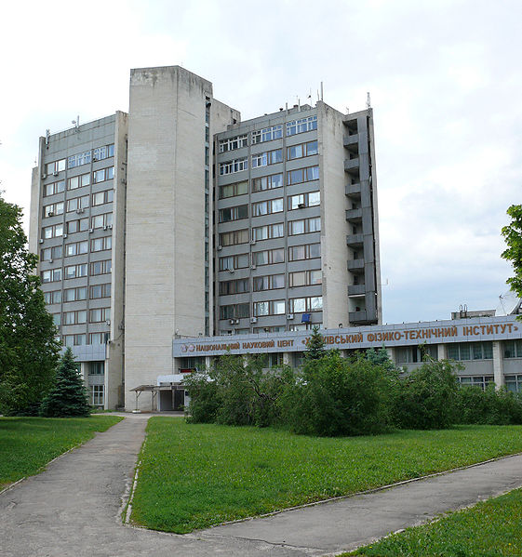
In 1993 by President’s decree the Institute was awarded a status of the first National Scientific Centre in Ukraine (NSC KIPT)
NSC KIPT has a great experience in carrying out scientific research of nuclear fuel and structural materials.
“Nuclear Fuel Cycle” Science and Technology Establishment was established at NSC KIPT in order to organize, coordinate and carry out scientific research and engineering development into nuclear fuel cycle in Ukraine

Slide 3
The main areas of NFC STE activity
Development and study of nuclear fuel and absorber materials
Development and treatment of structural materials for different types of nuclear reactors (high-speed, high-frequency thermal treatment of products manufactured from zirconium alloys)
Development of nuclear fuel for nuclear reactors of various types and purposes
Design and manufacturing technology of fuel and absorber elements and the fuel assembly
Scientific and technical support for the nuclear fuel cycle in Ukraine

Slide 4
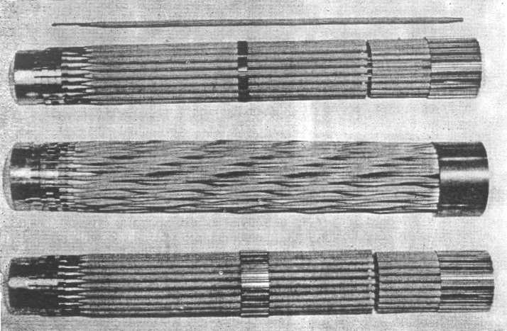
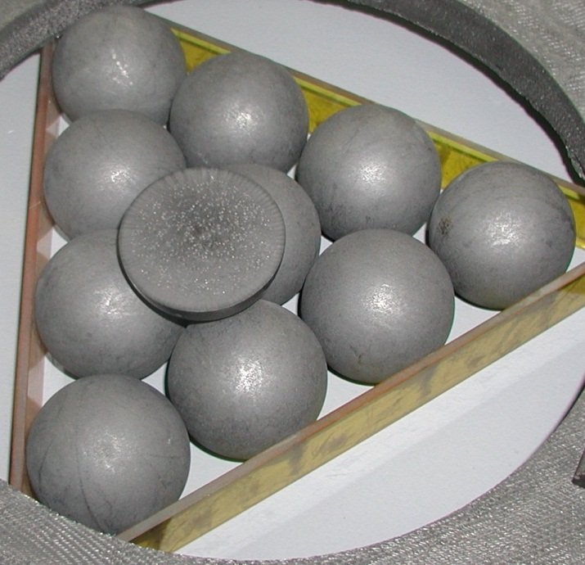
The main areas of NFC STE activity
Design of nuclear fuel for various types of nuclear reactors
Fig. 1 Fuel assembly for heavy-water reactor КС-150
Fig. 2 Spherical fuel elements for high-temperature reactors

Slide 5
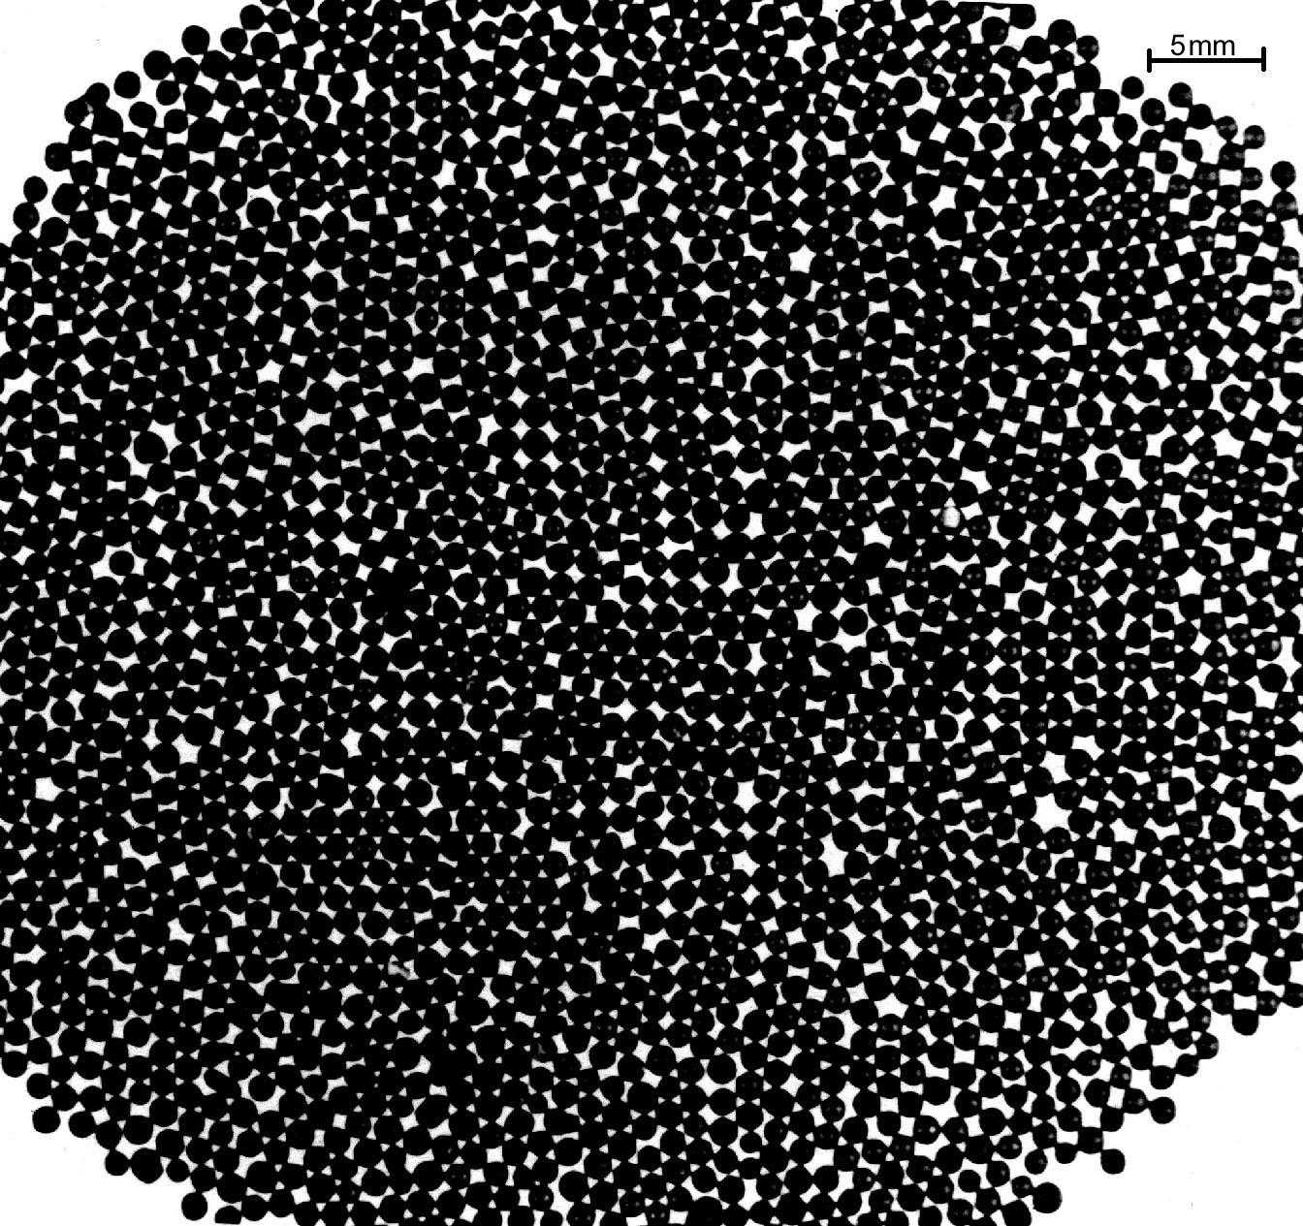
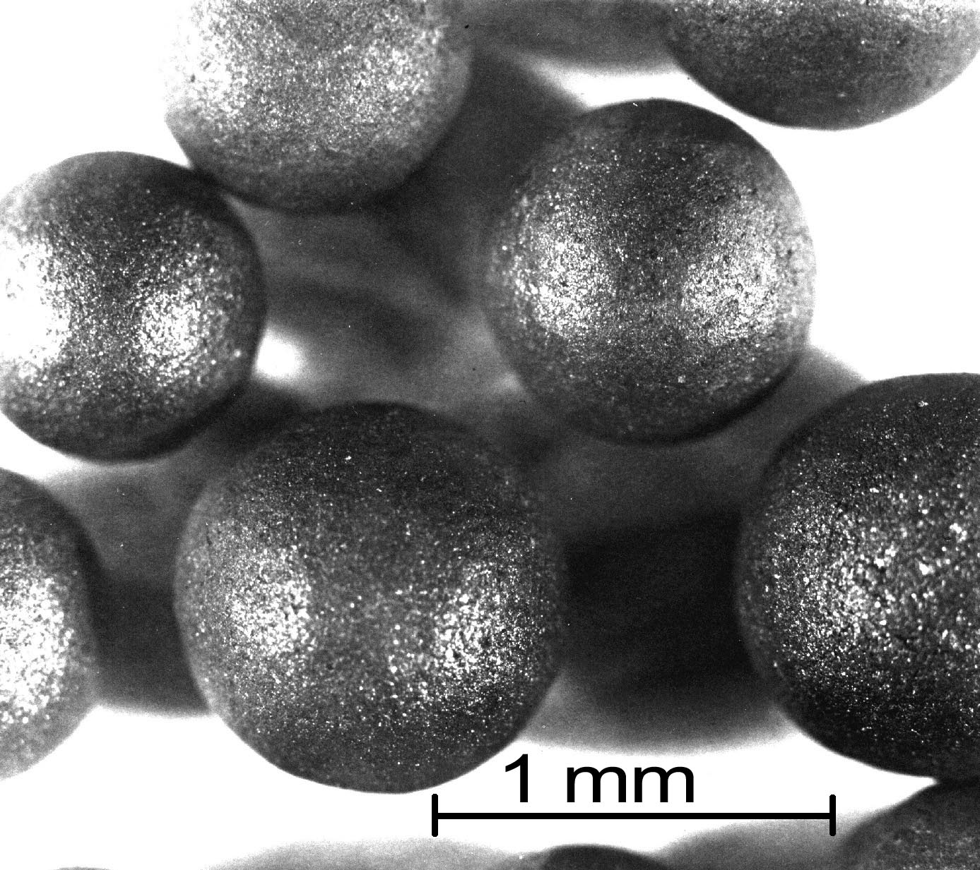
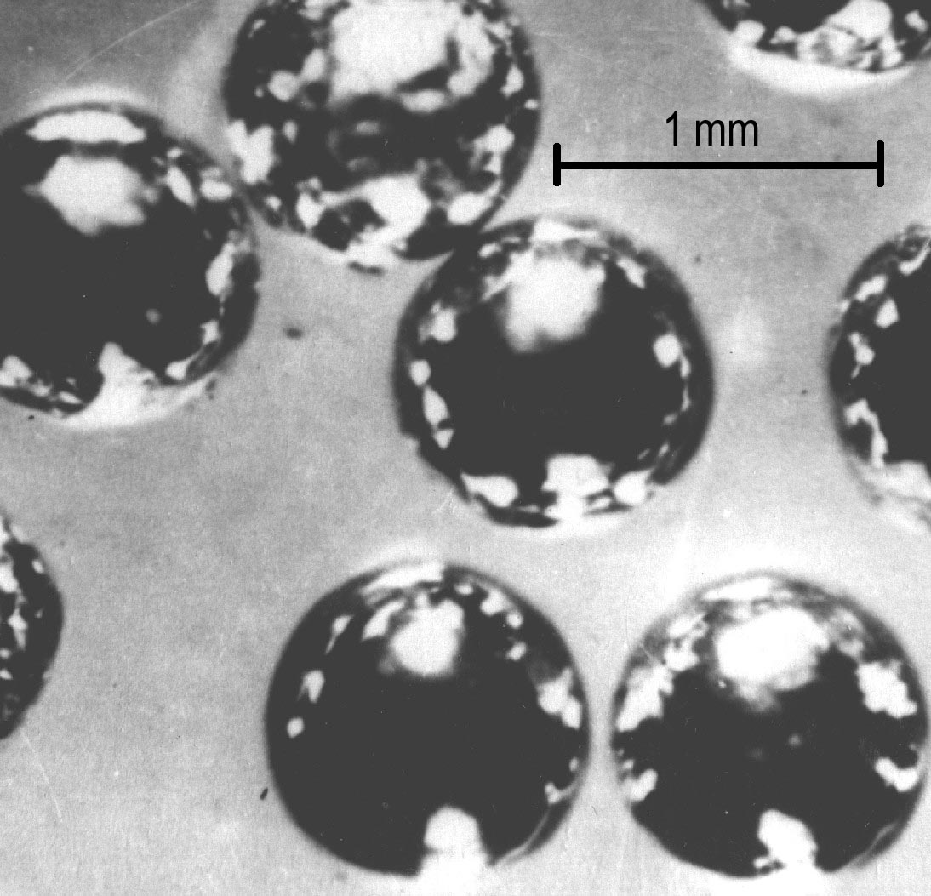
The main areas of NFC STE activity
Design of nuclear fuel for various types of nuclear reactors
Fig. 3 Dispersion fuel elements for reactor with gas coolant

Slide 6
The essence of problem
The operation of water-moderated reactors (WWER) does not exclude a possibility of beyond design-basis accidents with a core materials meltdown.
To avoid environmental consequences of accidents the modern reactor designs are completed with a trap for melt materials.
To prove reliability of melt keeping in the traps, some experiments on melting of standard core reactor materials and their interaction with consumable materials of the traps were performed.
Nevertheless, a number of issues have to be resolved in this respect.

Slide 7
The essence of problem
Firstly, measures must be developed to manage beyond design-basis accidents. To create an accident scenario, including such stages as core components' damage, melt formation and its variation with time, it is necessary to know:
behavior of the fuel and absorber elements and the fuel assembly during an accident;
processes, kinetics and parameters of interaction of the materials used in all core structural components with the environment and with each other at melt formation conditions;
melt parameters, namely viscosity, fluidity and chemical activity during interaction with other solid state materials.

Slide 8
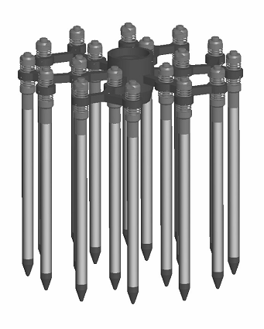
The essence of problem
Secondly, to design the most reliable and efficient melt traps it is necessary to have data on melt parameters versus qualitative and quantitative composition of materials in the actual core structures that are subjected to continuous enhancement.
Configuration of the absorber elements framing for spent fuel dry storage at ZapNPP
Fig. 5 RCCA
Fig. 4 General view of the TVSA fuel assembly

Slide 9
The essence of problem
Thirdly:
After a severe accident and conversion of materials into the solid state, it is necessary to develop management measures for such materials.
Since all materials during the post-damage period will be situated in the reactor building under water it is necessary to carry out experiments on interaction between these materials and water.
For this purpose it is essential to know solid state melt characteristics as a function of their transformation from the liquid to the solid state.
First and foremost, such characteristics include elemental and phase compositions of the melt which affect corrosion-resistance and others properties.

Slide 10
Proposed project
To identify solutions for the above listed issues NFC STE propose to carry out scientific and material testing research within the frame of the project :
Interaction Studies of WWER Materials Used in Improved Structural Core Components during Severe Accidents Followed by High-Temperature Melt Formation
The project is designed to:
obtain data on interaction parameters of materials in WWER improved core structural components;
obtain data on melt formation, first and foremost of fuel and neutron absorbers with the structural materials;
identify phase composition of the resulting melts in the solid state;
determine physical parameters of viscosity and fluidity of melts from materials of WWER resident and improved structural core components.

Slide 11
The main objectives of the project
The first stage of the project:
develop designs and technological procedures to manufacture fuel element and absorber samples for research;
develop procedures for experiments and investigations of the core material structures and compositions before and after their interaction (in the solid state and after melting);
obtain melts of standard WWER fuel and absorber elements' materials, namely, a combination of UO2, zirconium 1% niobium alloy (E110), stainless steels (EI 847, 630), and boron carbide;
evaluate melt viscosity and fluidity depending on phase composition.

Slide 12
The main objectives of the project
The second stage of the project:
study the effects of fuel and absorber elements' design (hard contacts, oxides on the surface) on the nature of initial interaction of such combinations as UO2–Zr and stainless steel–B4C leading to melt formation, followed by research into the interaction of the first and second type melts;
research melt formation processes in the new combinations of materials such as Zr+B4C, Zr+dysprosium titanate, and Zr+B4C+Hf and interaction of these components with the melt of UO2+Zr fuel materials
study phase composition of the resulting melts and the effects of changes in phase composition of melts on their viscosity

Slide 13
Expected results
This project is expected to obtain data on the interaction of new materials’ combinations. Mainly, these materials are:
Zr + B4C
Zr + dysprosium titanate
Zr + B4C +Hf
The results of the interaction between these materials and the fuel material (UO2 + Zr) melt will be obtained
Phase composition of the resulting melt will be investigated, their fluidity and viscosity characteristics will be defined
The impact of melt phase composition changes on melt fluidity will be studied. This will allow for a more accurate description of melt formation and spread kinetics of WWER core materials during beyond design-basis accidents

Slide 14
Equipment and methodology
National Science Center “Kharkov Institute of Physics and Technology” has a licence to work with sources of ionizing radiation (licence series AB No.112916).
Work station readiness for operations with open sources of radioactive materials was confirmed in a Certificate by the Sanitary-and-Epidemiologic Service of the Ministry of Health of Ukraine of 29th August 2007

Slide 15
Equipment and methodology
The project will use experimental and research equipment for obtaining melts of fuel and structural materials, phase composition investigation, viscosity and fluidity analysis.
The methods of viscosity materials study by parallel-slide plate and the methods of fluidity analysis by melt punching shear through calibration hole will be improved; the methods LFCM fluidity by rod rotation in melt will be developed.
The methods of material science research and materials’ chemical state analysis will be complemented.

Slide 16
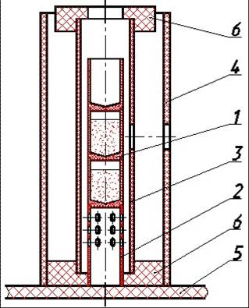
Equipment
Experimental research equipment for obtaining melts of fuel and structural materials
1 – graphite crucible
2 – support
3 – graphite heater
4 – shield from CCCM
5 – lower current feedthrough
6 – graphite shoe
Fig.6 High-temperature oven scheme for experiments at the air atmosphere

Slide 17
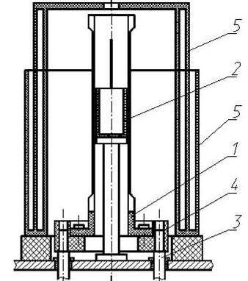
Equipment
Experimental research equipment for obtaining melts of fuel and structural materials
1 – split graphite heater
2 – crucible
3 – copper current feedthrough
4 – graphite shoe
5 – multisectional graphite shield
Fig.7 Vacuum high-temperature graphite oven scheme

Slide 18
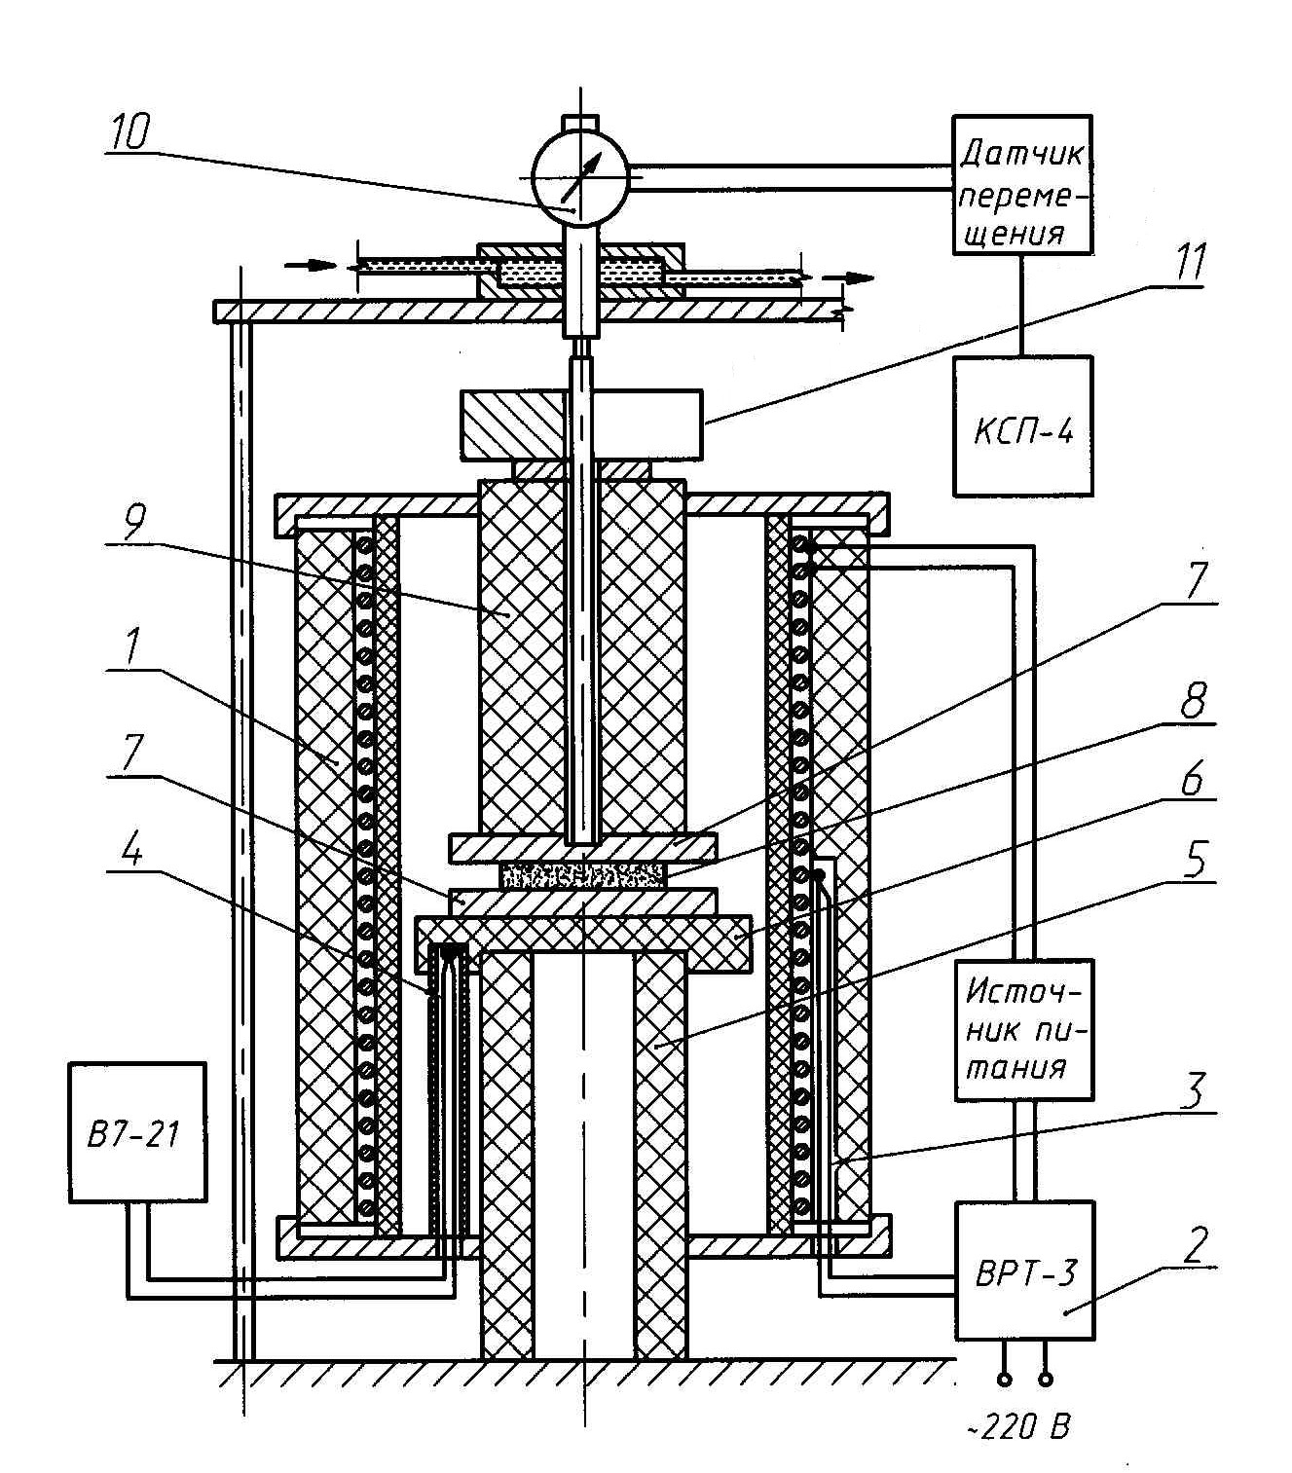
Equipment
Viscosity determination by the parallel-slide method
1 – heating high-temperature oven
2 – temperature regulation high- accuracy block
3 - control thermocouple
4 – measuring thermocouple
5 – alundum pipe
6 – pyrophyllite support
7 – tantalum washer
8 – LFCM pillet
9 – graphite cylinder
10 - measuring inductive sensor
11 – load
Fig. 8 Installation for viscosity determination by the parallel-slide method

Slide 19
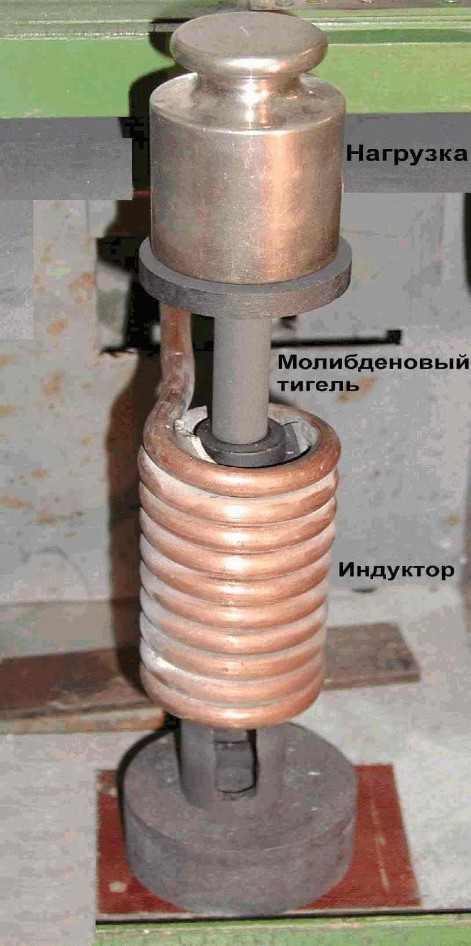
Equipment
Fluidity analysis by melt punching shear through calibration hole
Fig. 9 Working area of the installation for fluidity determination
Fig. 10 Molybdenum crucible in graphite heater

Slide 20
Experience in research into melts of fuel and structural materials
At NSC KIPT, in the framework of the International Chernobyl Centre co-operation programme, experiments on LFCM simulator synthesis in laboratory environment have been carried out and simulator characteristics have been investigated in order to specify the scenario of Chernobyl LFCM formation.

Slide 21
Experience in research into melts of fuel and structural materials
Areas of previous investigations:
accurate temperature definition of fuel composition melting
62,5%U02 + 37,5%ZrO2
research of the interaction between melted fuel composition and materials of building structures – sand, serpentinite, concrete
experiment on the long-term holding of melts at different temperatures
LFCM simulator fluidity determination

Slide 22
Experience in research into melts of fuel and structural materials
Previous results:
There were defined technological parameters of LFCM simulator generation that could form during NPP severe accidents in case of nuclear fuel melting and its subsequent interaction with the core structural materials and materials of building structures under the reactor.
The experiments of fuel mixture melting parameters were carried out, the influence of the melting parameters (temperature, medium, time) on the resulting materials’ characteristics were identified, the structure and the element composition of synthesized LFCM were investigated, and the dynamic viscosity research into LFCM simulators in the range of 1350-1840 ˚C was carried out.

Slide 23
Conclusions
The physical infrastructure, methodology and experimental experience accumulated by NFC STE allow
to plan and carry out research into interaction of all structural elements in conditions coincident with melt formation,
to set new objectives of the in-depth study for obtaining melts of different materials in all component ratios,
to further study LFCM storage conditions and their effects on LFCM parameters, and
to solve the issues of LFCM reprocessing.

Slide 24
Please send your comments and suggestions to crcd@kipt.kharkov.ua
http://www.kipt.kharkov.ua

Slide 25
Thank you for attention!

