Slide 1
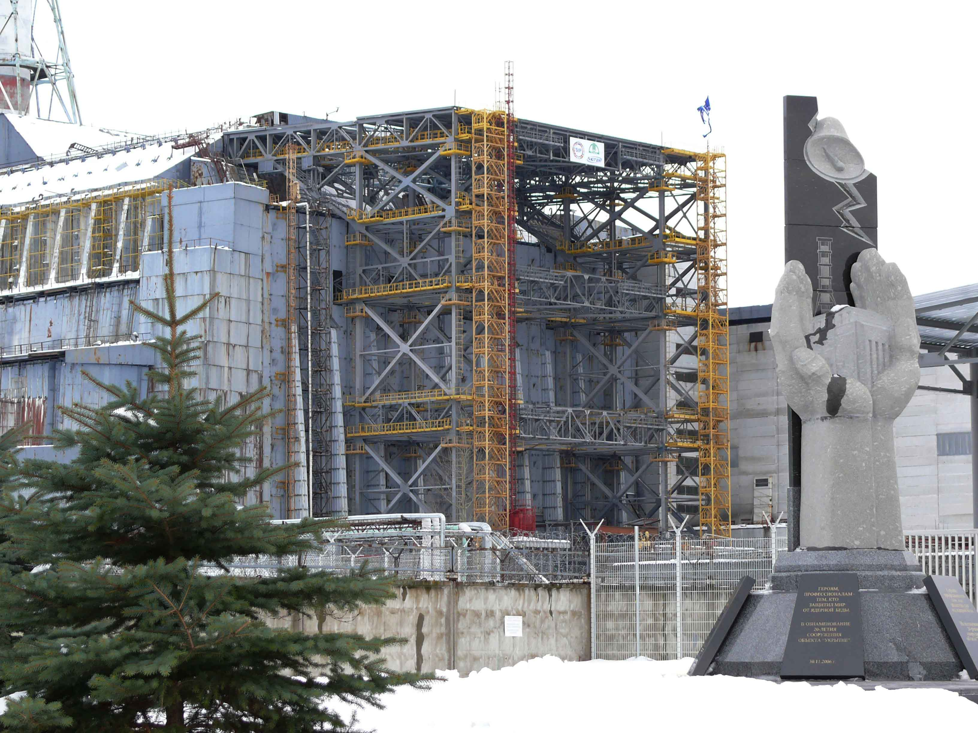
Status of STCU Project # 4207
«Long-term prognosis of behavior of the fuel dust in Chernobyl Shelter»
Presented by
Viktor Krasnov
16th CEG-SAM meeting, Moscow, September 08-09, 2009

Slide 2
Participating Institutions
Ukrainian Institute of Agricultural Radiology of National University of Life and Environmental Sciences of Ukraine.
Institute of Safety Problems of Nuclear Power Plants
of National Academy of Sciences of Ukraine
Project duration | 30 months
Participating personnel | 19 (13 “weapon” scientists)
Funding | 300,000 USD
Funding party | Canada
Project status | Started (initial stage)
Foreign Partners
Krause Matt | Canada, Thermalhydraulics Branch, AECL Chalk River Laboratories
Bottomley Paul | Germany, European Commission, DG Joint Research Centre, Institute for Transuranium Elements (ITU)
Journeau Christophe | France, CEA
16th CEG-SAM meeting, Moscow, September 08-09, 2009

Slide 3
The project aim
The main aim of the project is to create a prognosis of the long-term (50-100 years) behaviour of the radioactive dust in Shelter. It will describe both transformation of the existing fuel dust and the processes of the dust formation from the main types of FCM under the current & future Shelter conditions.
Year 1 |  |  |  | Year 2 |  |  |  | Year 3
Task 1. Mechanisms of formation and classification of the Chernobyl FP, updating the DB
Task 2. Characteristics and behavior of RA and water in Shelter
 | Task 3. Experimental study of the FP destruction
 |  |  |  | Task 4. Creation of the model of the FP transformation
 |  |  |  |  | Task 5. Long-term prognosis of the fuel dust behavior in Shelter
Quarter 1 | Quarter 2 | Quarter 3 | Quarter 4 | Quarter 5 | Quarter 6 | Quarter 7 | Quarter 8 | Quarter 9 | Quarter10
16th CEG-SAM meeting, Moscow, September 08-09, 2009

Slide 4
Current status of the project
1st task
(Mechanisms of formation and classification of the Chernobyl FP, updating the DB)
According to the technical plan of the project, during the first quarter we have
searched and analyzed the literature data describing the principal mechanisms
of formation of Chernobyl hot particles (HP) and the factors determining their
variety, as well as the HP classification by the physical-chemical properties.
During the reported period we have determined the criteria of modernization of the
existing database “Hot particles” aimed in its extension (updating with the new
information) and improving the interface for formulation of various correlations
between the HP parameters which will be used for modeling the HP behavior in
Shelter conditions.
According to the most optimistic prognoses, the radiation destruction of LFCM
will be possible only in millions years, while the pessimistic assessments predict
such a dangerous scenario for the nearest future. Analysis of the literature data
shows the urgency and complicity of the researches planned within the
frameworks of out project.
16th CEG-SAM meeting, Moscow, September 08-09, 2009

Slide 5
2nd task
(Characteristics and behavior of RA and water in Shelter)
During the first quarter the various sources have been reviewed for acquiring the data relevant to the whole period of Shelter exploitation, which describe the dynamics of the radioactive aerosols release through the leakages in the light roof, and the data characterizing the moisture collections in the premises at the low levels in the B block and in the rooms of the auxiliary system of the reactor. The acquired information have been analyzed and systematized.
Also during the reported period we have collected the data for upgrading the information concerning the physical-chemical characteristics of the fuel-containing materials (FCM), in particular, we have processed the data relevant to the premises of the bubbler reservoir at the ground floor. In this concern, we have performed the visual observations enabling to precise the geometrical parameters and physical state of FCM in these premises.
16th CEG-SAM meeting, Moscow, September 08-09, 2009

Slide 6
For identification of the main sources of radioactive aerosol (RA) in Shelter the experimental works have begun aiming in sampling aerosols and water. During the reported period we studied the airborne concentrations and dispersal composition of RA which passed through the ventilation pipe VT-2 from the central hall of Shelter to the atmosphere. The samples were taken in the room 2016/2 through the hatch in the “Bypass” pipe. For this purpose the packages consisting of the three-layer filters of Petryanov tissue were utilized. In all, 23 samples were collected. For determination of the inventory and forms of the radionuclides in the moisture collections in Shelter, during the 1st quarter 18 samples were taken from the main water agglomerations at the low levels of Shelter. Gamma- and alpha-spectrometric analyzes of the collected samples are in process now. These works are aimed on confirming of the assumption that the radionuclides in the aerosols and water fluxes are originated from the LFCM which now are considered as the main potential sources of the additional fuel dust.
16th CEG-SAM meeting, Moscow, September 08-09, 2009

Slide 7
Experimental study of the FCM destruction
Fragments of the active zone
Condensed
UO2
UO2+X
U-Zr-O
LFCM
Shelter conditions
destruction
dispersion
transformation
Radionuclides transfer into the mobile forms
Formation of the secondary HP
16th CEG-SAM meeting, Moscow, September 08-09, 2009

Slide 8
3rd task
(Experimental study of the FP destruction)
UO2
UO2+X
U-Zr-O
We have placed the samples collected in Shelter in the model fluids with pH 3-10 for determination of the FP destruction rate.
Our samples represent the main forms of the fuel in Shelter
Shelter conditions
destruction
Radionuclides transfer into the mobile forms
16th CEG-SAM meeting, Moscow, September 08-09, 2009

Slide 9
Thank you for your attention
16th CEG-SAM meeting, Moscow, September 08-09, 2009

