Slide 1

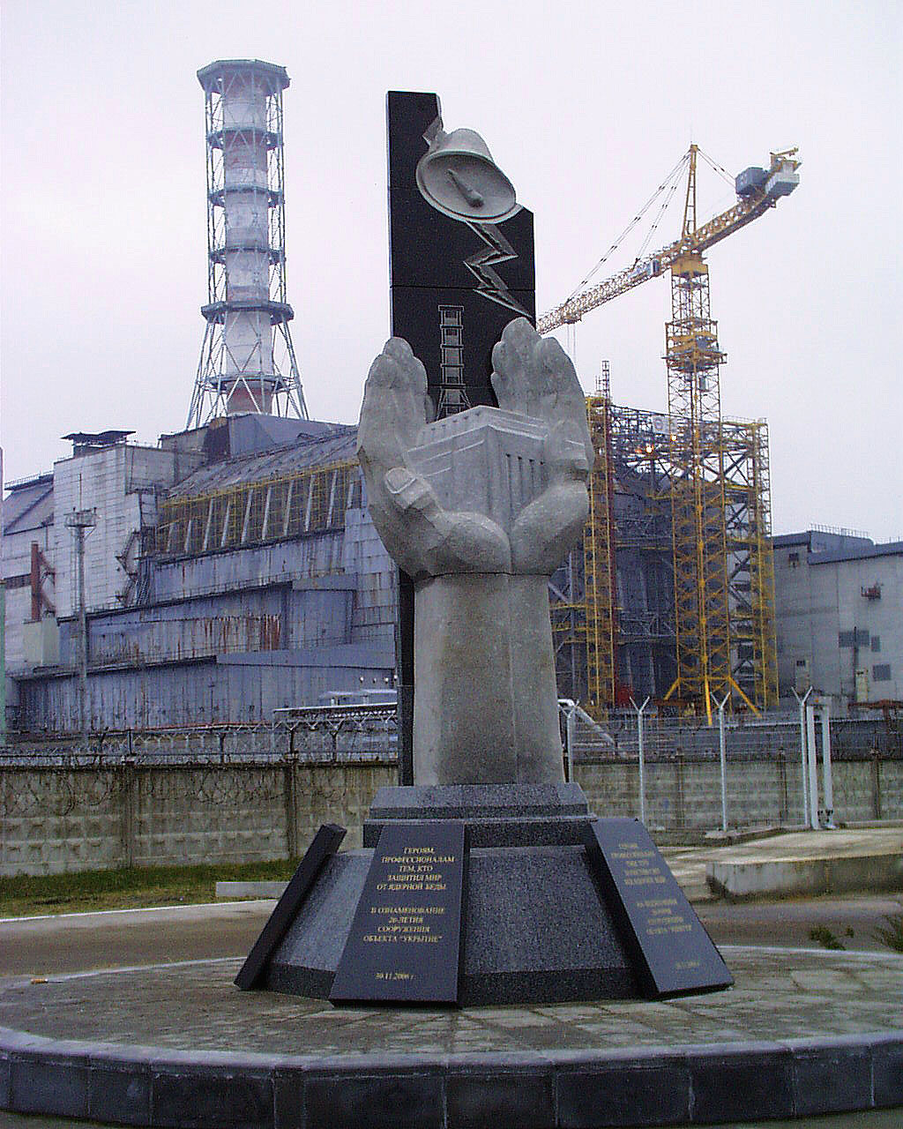
Presented at 15th
CEG-SAM Meeting
Viktor Krasnov
Director of Division for Nuclear and Radiation Safety
Institute for Safety
Problems of NPP,
National Academy of
Sciences of Ukraine
March 10-13
2009
Villigen, Switzerland
Status of STCU Project #4758:
«Estimate - experimental research of hidden nuclearly -hazardous clusters of fuel-containing materials in ruined ChNPP Unit 4»
1

Slide 2
Contents:
Preliminary remarks concerning Project #4758:
Collaborators
Expected results
Status of the project
2. Main work results for Project #4758
over September 2008- February 2009.
2

Slide 3
Preliminary remarks concerning Project #4758
3

Slide 4

Collaborators
GRS, Germany
Dr. H.Teske - Head of International Programmers
Dr. G.Pretzsch - Director of Radiation and Environmental Protection Division
CEA Cederech,
DEN/ DTN/STRI, France
Dr. M. Labatut - Safety Program Manager
JRC-ITU Institute of Trans-uranium Elements Karlsruhe, Germany
Dr. P. Bottomley – Senior Scientific Officer- Hot Cells Unit
Coordinator
Project is coordinated by:
Viktor Stepanenko (STCU)
STCU,
Kyiv, Ukraine
Operation Agent: Institute for NPP safety problems of UNAS, Ukraine, Chornobyl
ChNPP
Ukraine, Chornobyl
Project Duration: 30 months
Total Project Cost : 199080 USD
4

Slide 5
Expected results:
In this Project will be analyzed:
visual observation data;
information obtained when drilling research boreholes;
results of sampled fuel-containing materials (FCM) analysis ;
instrumental measurement data;
mechanisms of FCM cluster production with high - content uranium.
Considering above data, as well on the basis of neutron and heat estimates, new instrumental measurement data and research results of physicochemical properties of newly taken samples from cluster area, will be:
defined, structure, geometry, and FCM physicochemical properties in two critmass risk areas, in south-west quadrant of room 305/2 ChNPP Unit 4 (object «Shelter»);
researched, neutron physical processes occurring in clusters under impact of external factors .
5

Slide 6
Status of the project:
1. Permission for Project #4758 work implementation is obtained from Ukraine’s Ministry of Sciences and forwarded to STCU Affiliate.
2. Project Collaborator Letter from Dr. Pretsch is received and also forwarded to STCU.
3. From STCU Affiliate the Project is coordinated by Viktor Stepanenko (STCU).
4. Dr. Bottomley’s Support Letter is received and forwarded to Mr. Andrew Hood, STСU Executive Director address.
5. Support Letter is received from Dr. M. Labatut - Safety Program Manager CEA Cederech, DEN/ DTN/STRI, France.
6. The proposal is ready to sent to party reviewers by STCU (March 2009).
7. For today, Project funding was not yet initiated. But in spite of this fact the works being planned in Project were performed by us in 2008 year and they are in progress in 2009 year.
6

Slide 7
2. Main work results over September 2008 - February 2009.
7

Slide 8
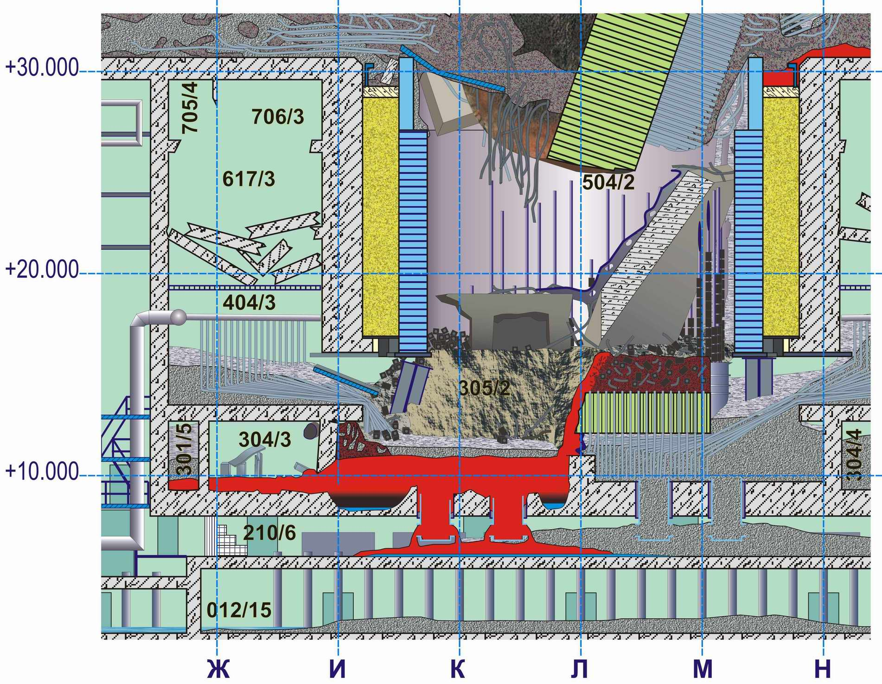
Based on the last researches (data on borehole core’s activities, temperature and neutron fields’ dynamics), it was stated that ChNPP accident in the year of 1986 had provoked a melting in foundation plate of reactor vault.
As a result, two fusion penetration areas had produced, which contain FCM with fuel concentration making 40% (on mass) and more.
Fusion penetration area No 1
Fusion penetration area No 2
Reactor vault’s foundation plate – 2 х 24 х 24 (m)
8

Slide 9
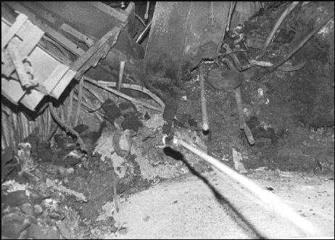
Direct access to clusters is impossible.
Data on temperature, neutron fluxes, as well as samples can be solely obtained from cluster peripheries via boreholes.
Currently, fusion penetration areas are covered with post-accident concrete («new» concrete) and produce so called «hidden» FCM clusters.
9

Slide 10
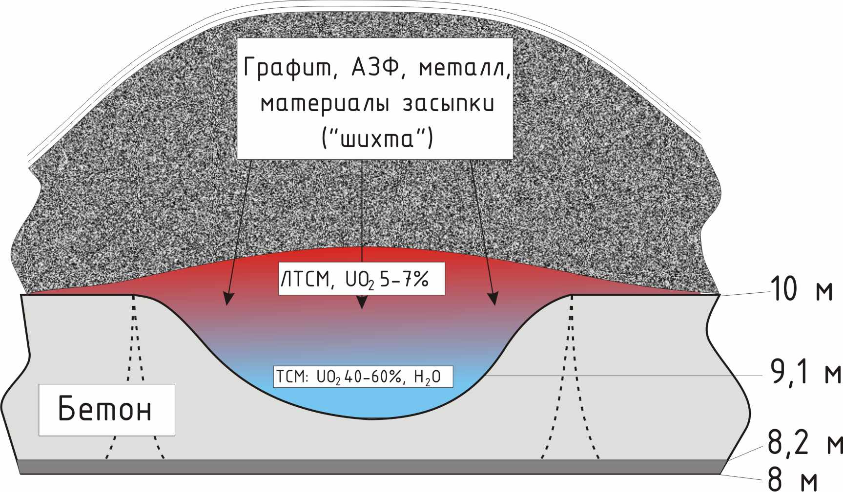
Clusters have produced as result of interaction of fuel melt with foundation plate concrete, graphite, metal structures, filling materials (batch).
The melt consists of upper layer of black FCM (light) with uranium content 5-7% (mass) and bottom (heavy) with uranium content 40% (mass) and more.
Graphite, core fragment, metal, filling materials (batch)
Light FCM
FCM, UO₂ - 5-7 %
m
Heavy FCM
Reactor vault’s foundation plate
FCM, UO₂ – 40% and more
m
m
m
Upper (light) FCM layer, during its production process, was flowing down via a breach in room 304/3 object «Shelter» wall with forming horizontal flow of more 50-m length.
10

Slide 11
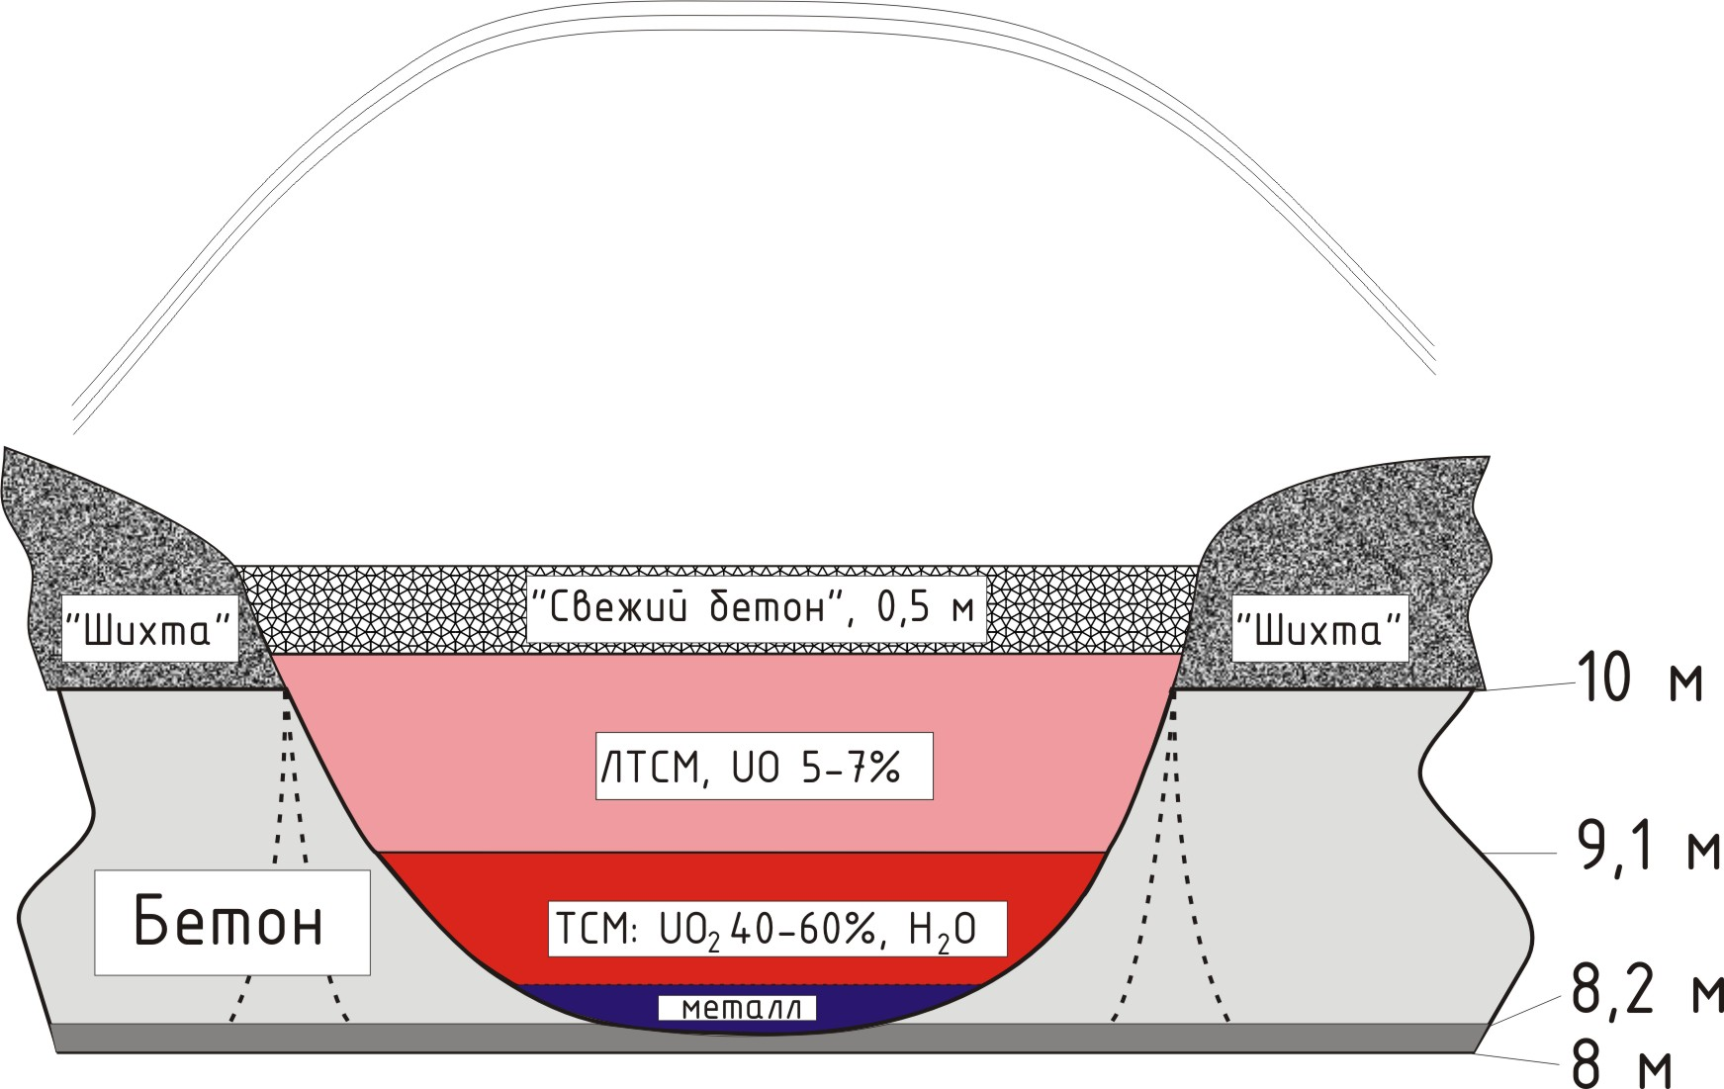
In 2008, researches of structure and chemical composition of light layer FCM were initiated in produced horizontal FCM flow.
In 2009, we plan to continue these works.
«new» concrete -0.5 m
batch
«new» concrete -0.5 m
batch
m
FCM, UO₂ - 5-7 %
m
Reactor vault’s foundation plate
FCM, UO₂ – 40% and more
Reactor vault’s foundation plate
m
m
The works are in progress for estimated simulation of mass- and geometry parameters of heavy layer in fusion penetration areas.
Metal
11

Slide 12
In 2008, we have carried out a preliminary evaluation of mass- and geometry parameters of multiplying systems (homogenous and heterogenous with U content from 40-65%).
Estimate results have demonstrated that the systems, whose geometry is inscribed in volume of fusion penetration area No1, reach their criticality under a specified wetting. Water excess does bring that systems in subcritical state.
12

Slide 13
Clusters in fusion penetration area No1 are constantly covered with water.
Temperature in cluster area exceeds temperature on foundation plate periphery at more than 20 °С.
Leakage of heated water is constantly observed from cluster area.
13

Slide 14
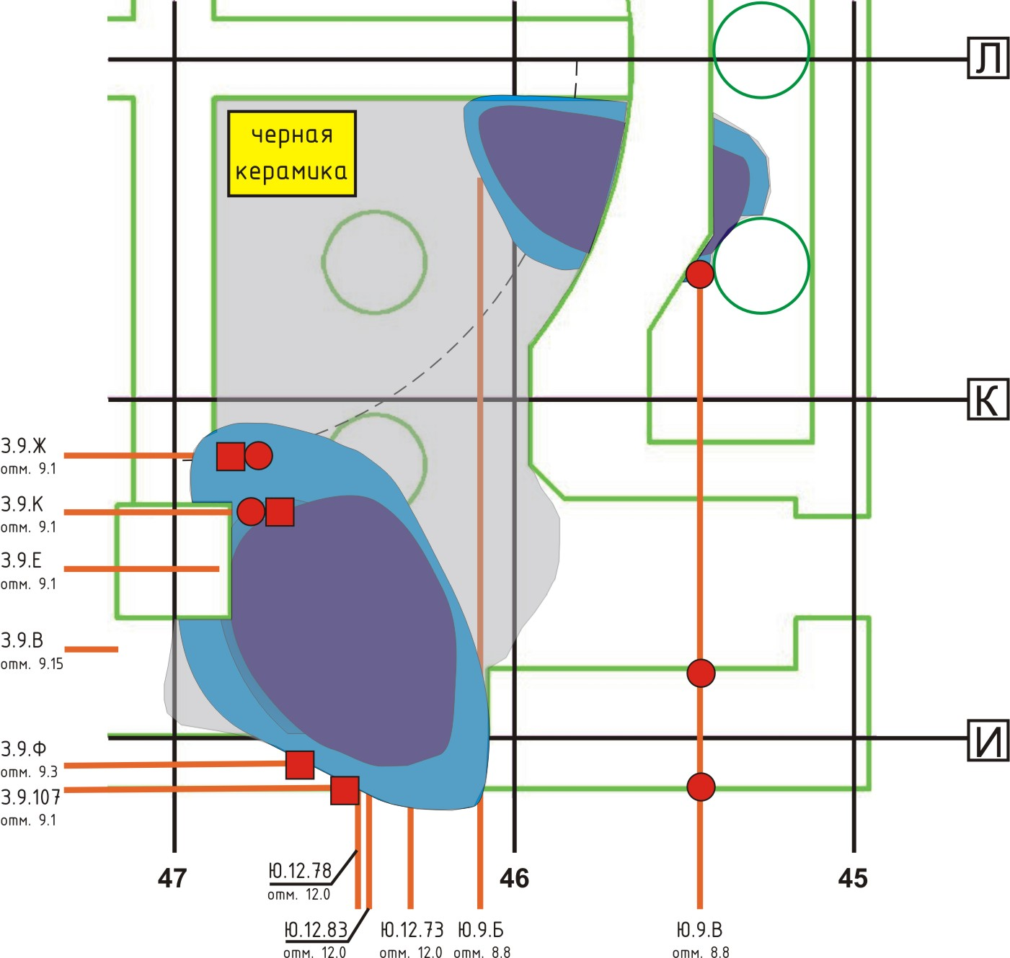
Fusion penetration areas of foundation plate
L
To obtain data (on temperature, neutron activity), in 2008 year, we have conducted the works for cleaning and equipping new boreholes Ю.9.Б and Ю.9.В, which are in close vicinity to these fusion penetration areas of foundation plate.
Black ceramics
№2
K
№1
I
Within the framework of this Project we plan to develop new boreholes: З.9.Ф and З.9.107
14

Slide 15
Measurement of temperature in boreholes have shown that in borehole Ю.9.Б (fusion penetration area No 1) temperature discharges in water effusing from this borehole are observed.
In fusion penetration area No2 (borehole Ю.9.В), water is, assumedly, absent or located below the mark +8.80 m.
15

Slide 16
Thank You for attention and support of Project: #4758
16

