Slide 1
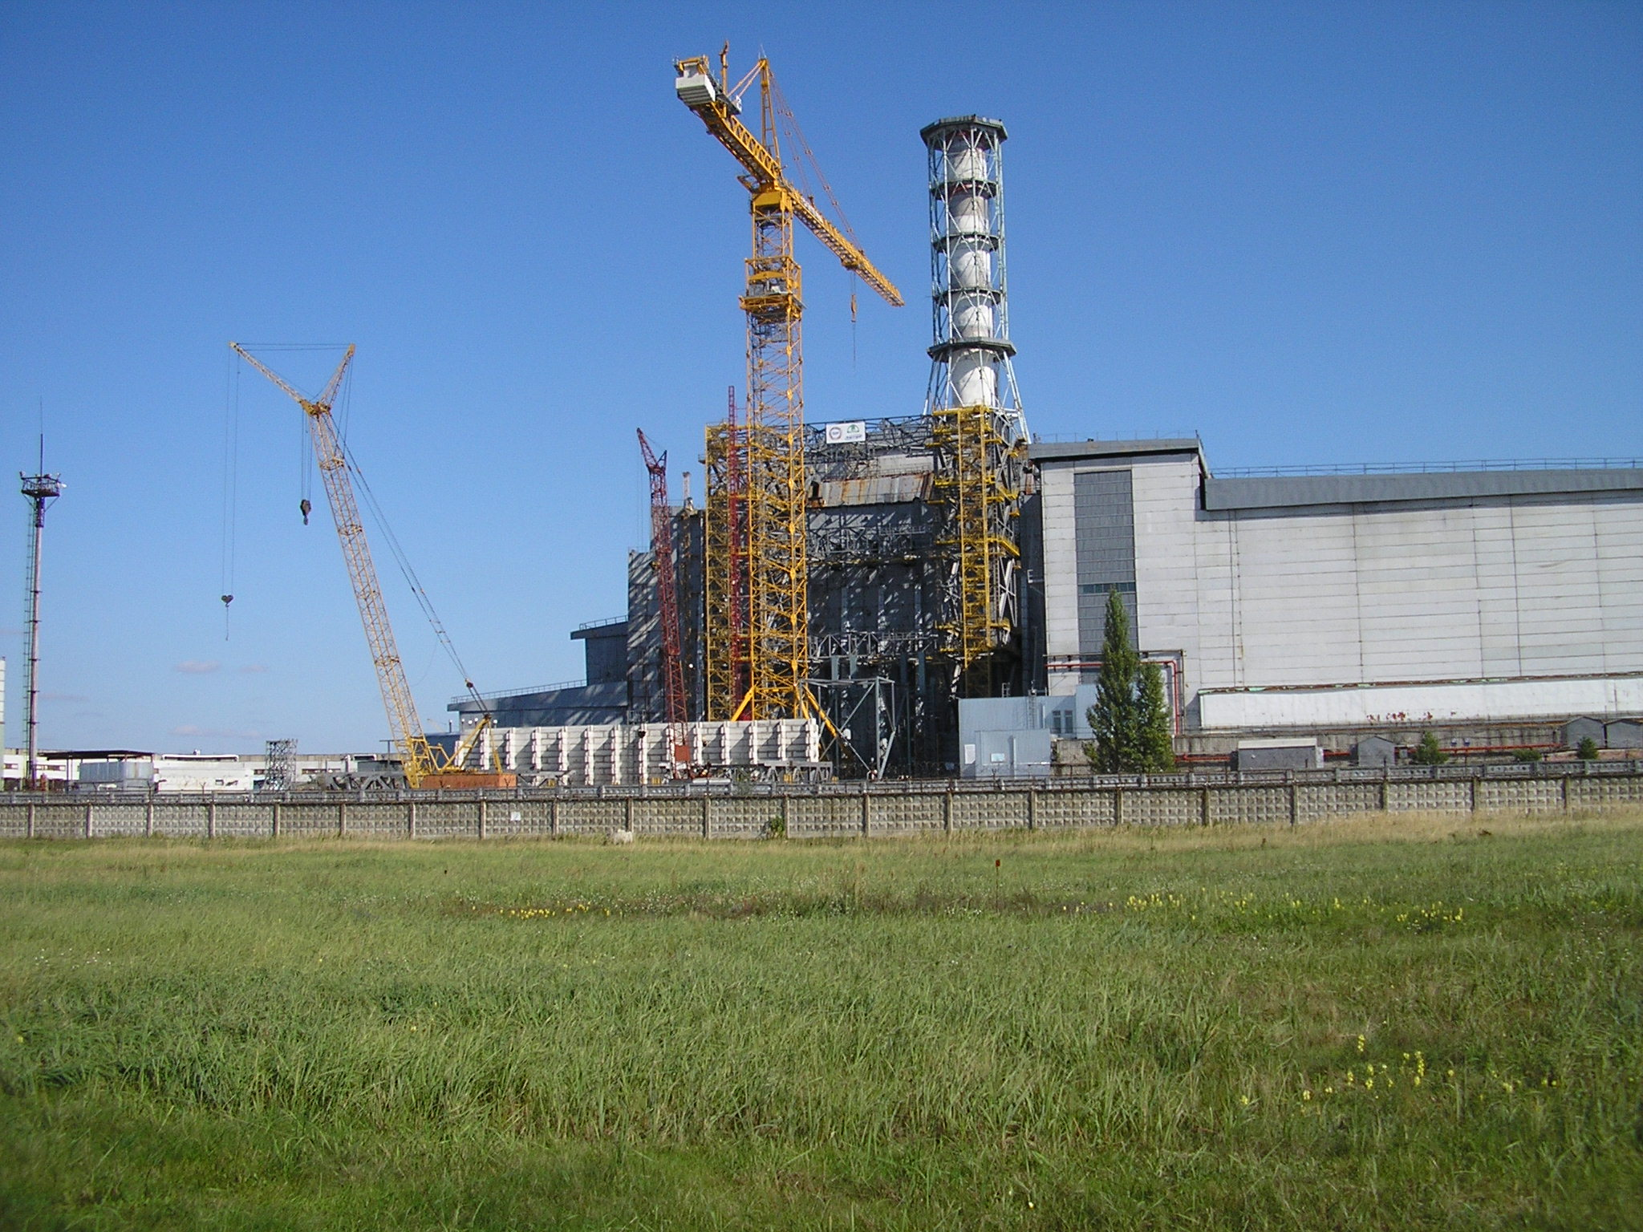

Institute for Safety Problems of Nuclear Power Plants of National Academy of Sciences of Ukraine
Ukrainian Institute of Agricultural Radiology of National University of Life and Environmental Sciences of Ukraine.
Status of STCU Project # 4207
«Long-term prognosis of fuel dust behaviour in the Chernobyl Shelter»
19th CEG-SAM meeting, Pisa, March , 14-16, 2011
Presented by Viktor Krasnov

Slide 2
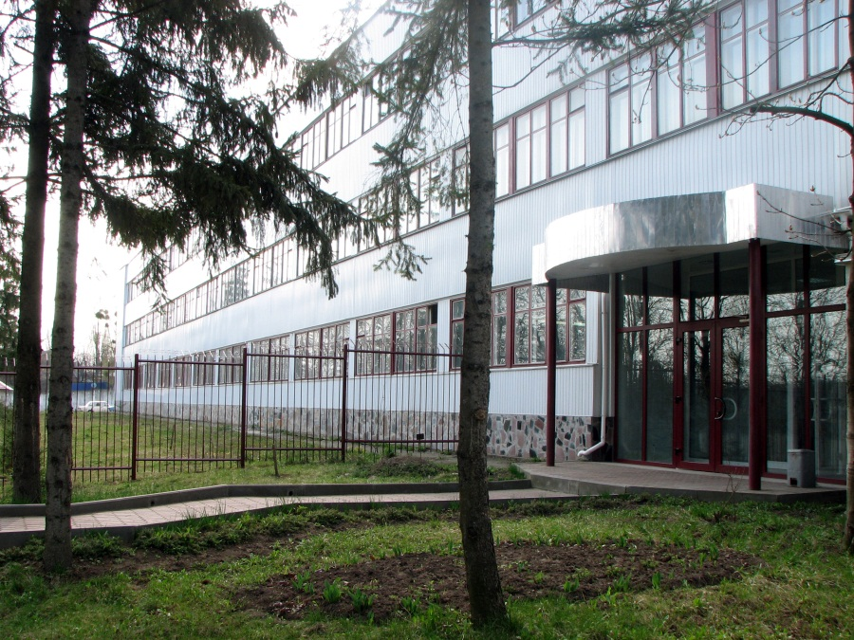
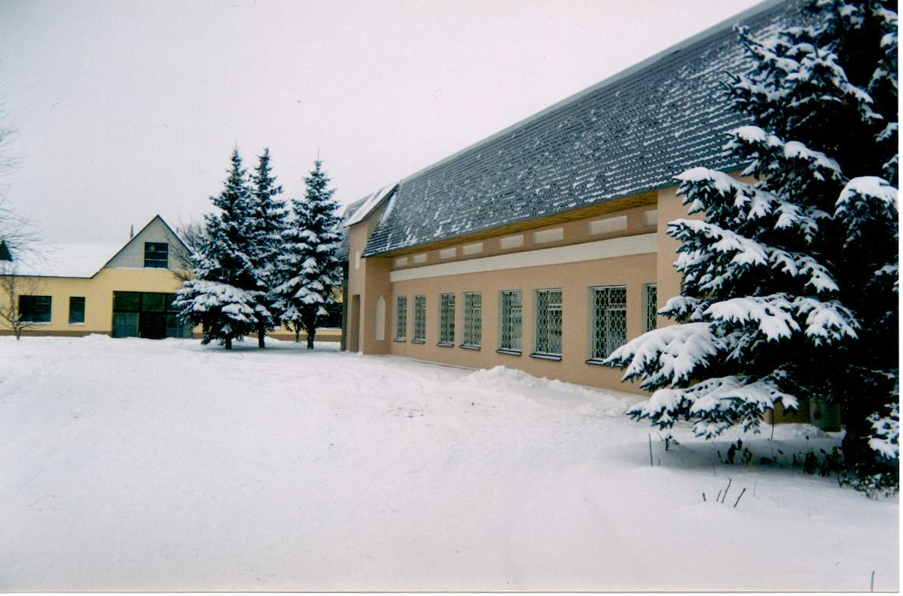
1 Participating Institutions
Ukrainian Institute of Agricultural Radiology of
National University of Life and Environmental
Sciences of Ukraine.
Institute for Safety Problems of Nuclear Power
Plants of National Academy of Sciences of Ukraine
Project duration | 30 months
Participating personnel | 19
Funding | 300,000 USD
Funding party | Canada
Foreign partners:
Krause Matt | Canada, Thermalhydraulics Branch, AECL Chalk River Laboratories
Bottomley Paul | Germany, European Commission, DG Joint Research Centre, Institute for Transuranium Elements
Journeau Christophe | France, CEA
19th CEG-SAM meeting, Pisa, March 14-16, 2011

Slide 3
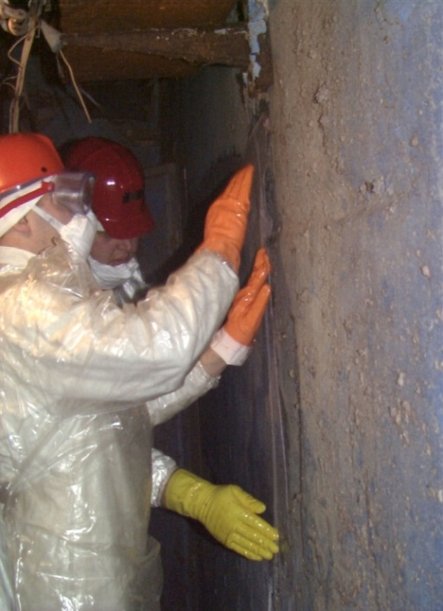
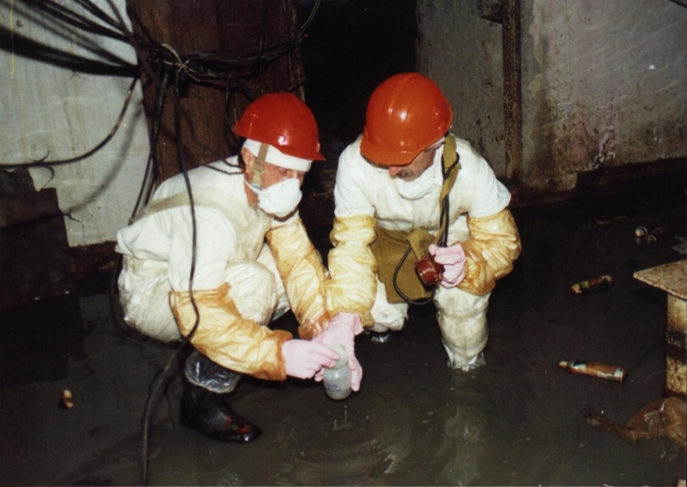
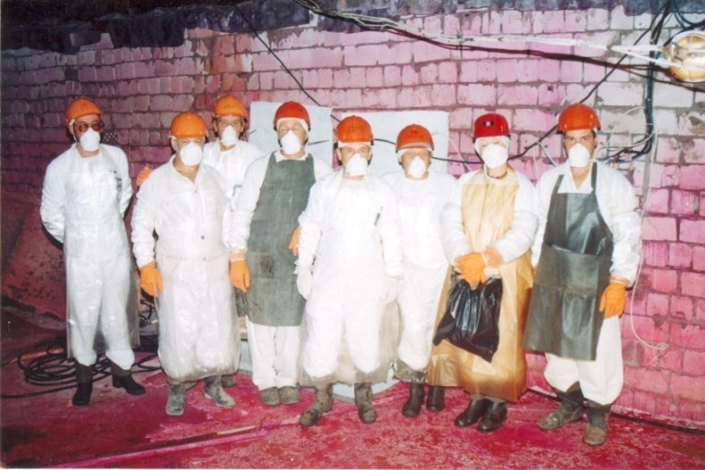
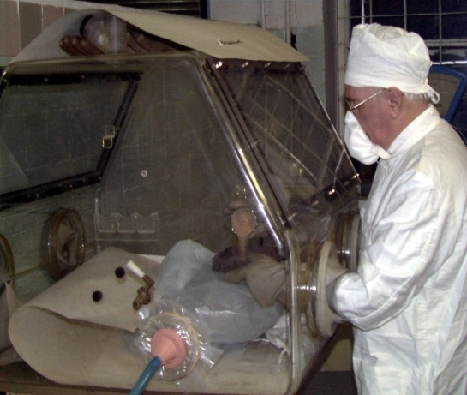
2 Main objectives of project
2009 |  |  |  | 2010 |  |  | 2011
Task 1. Mechanisms of formation and classification of the Chernobyl FP, updating the DB
Task 2. Characteristics and behavior of RA and water in Shelter
 | Task 3. Experimental study of FP destruction
 |  |  |  | Task 4. Creation of FP transformation model
 |  |  |  |  | Task 5. Long-term prognosis of the fuel dust behavior in the Shelter
 |  |  | Task 6. Marketing. Advertising the results obtained
Quarter 1 | Quarter 2 | Quarter 3 | Quarter 4 | Quarter 5 | Quarter 6 | Quarter 7 | Quarter 8 | Quarter 9 | Quarter10
19th CEG-SAM meeting, Pisa, March 14-16, 2011

Slide 4
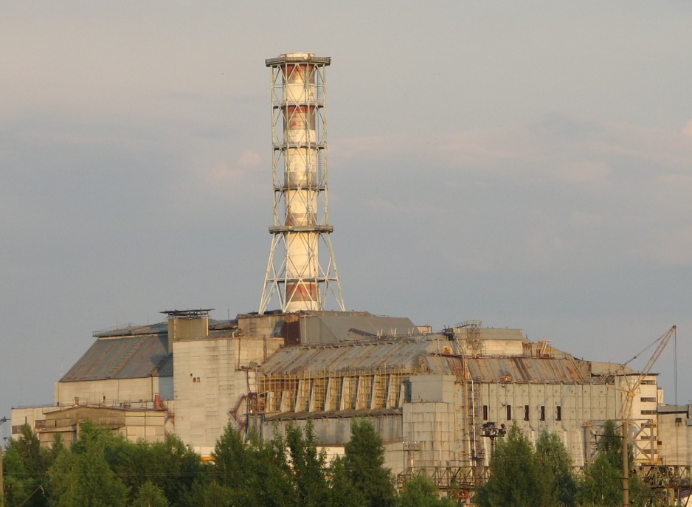
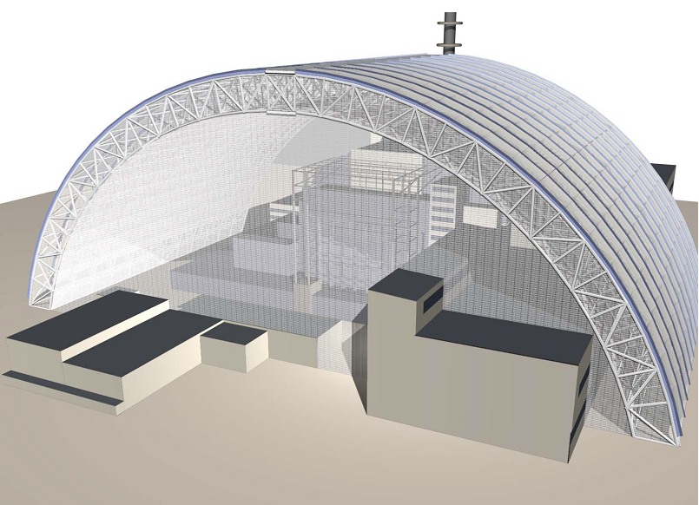
3 The project objective
The main objective of the project is to create a prognosis of the long-term
(50-100 years) behaviour of radioactive dust in the Shelter. It will describe
the both transformation of existing fuel dust and processes of dust formation
from the main FCM types under the current and future Shelter’s conditions.
19th CEG-SAM meeting, Pisa, March 14-16, 2011

Slide 5
4 Project problems to be researched
According to diverse estimates, around 500 to 2000 kg of irradiated nuclear fuel in shape of fuel dust are located in the SO.
The analysis of existing technologies points the fact the time needed to retrieve and to rebury the SO fuel-containing materials can make 50-100 years.
The dust rise and radioactive dust spread in the SO occurs not only during any emergency situations associated with building structures’ demolition, but as well as under any personnel’s activities.
In spite of a huge amount of data collected on characteristics, content and spread of fuel dust in the SO, the issues of its origination mechanisms, and that is the most important thing, forecasting estimates of radioactive dust transformation in the future are remained as open up to now.
19th CEG-SAM meeting, Pisa, March 14-16, 2011

Slide 6
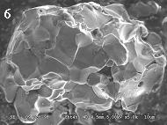
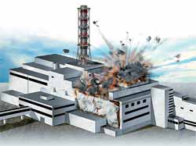
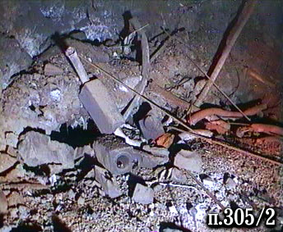
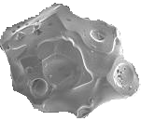
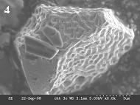
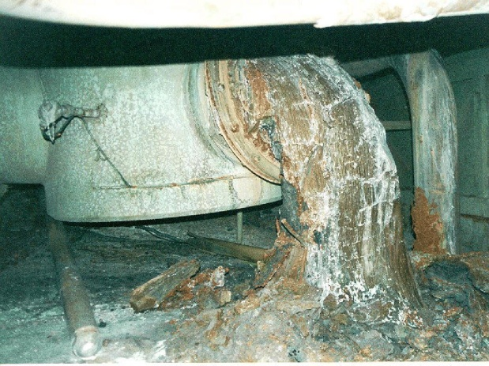
5 Object of research
Steam-gas constituent of release
Fuel rod fragments
Fuel particles
LFCM
19th CEG-SAM meeting, Pisa, March 14-16, 2011

Slide 7
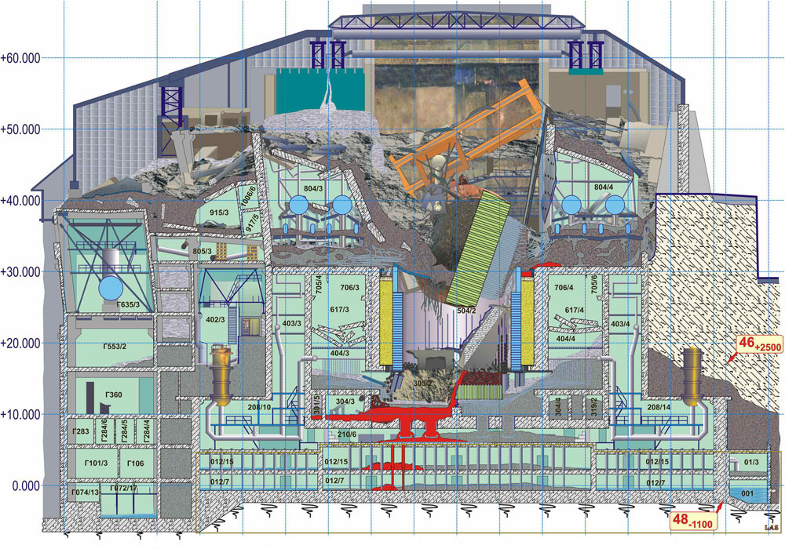
6 Current state of «Shelter object»
19th CEG-SAM meeting, Pisa, March 14-16, 2011

Slide 8
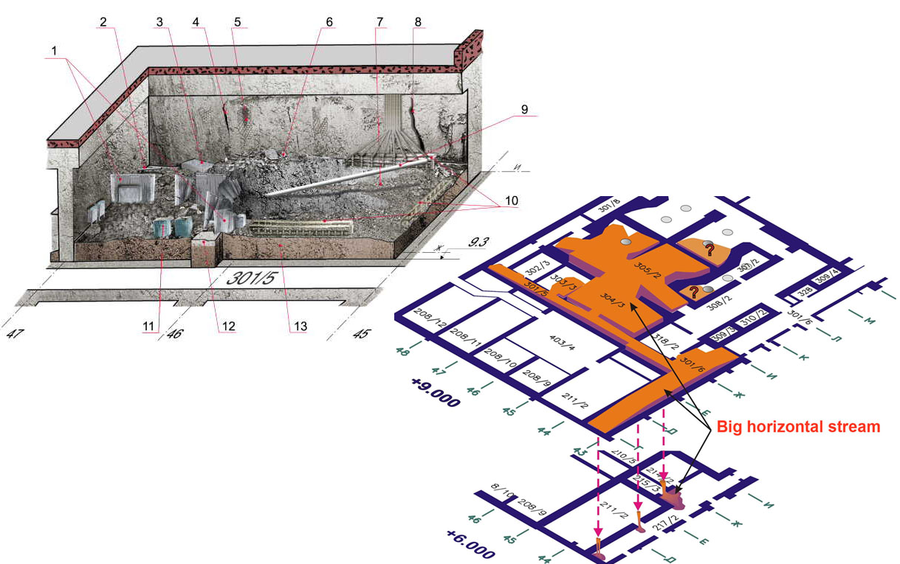
7 Assessment of LFCM surface area:
а) the room 305/2
To estimate the FCM open surface, we analyze video- and photo documents and apply the mathematical methods of image processing.
19th CEG-SAM meeting, Pisa, March 14-16, 2011

Slide 9
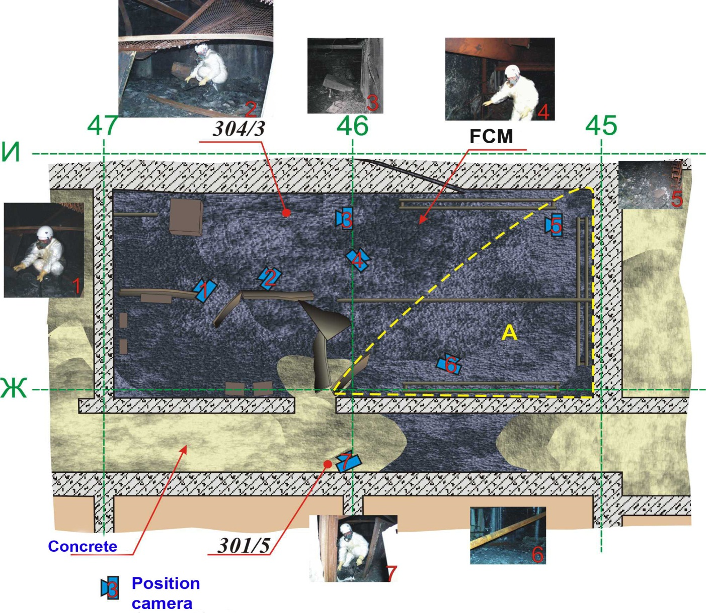
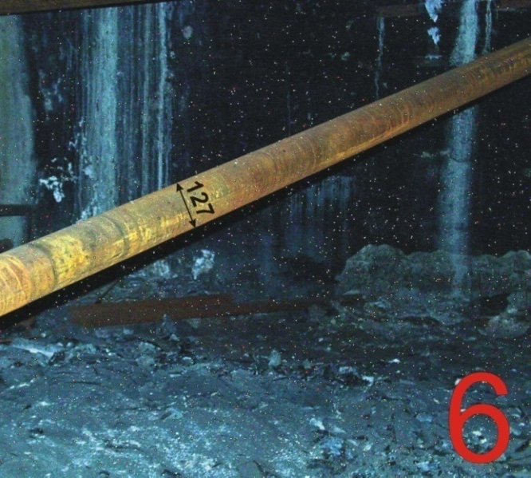
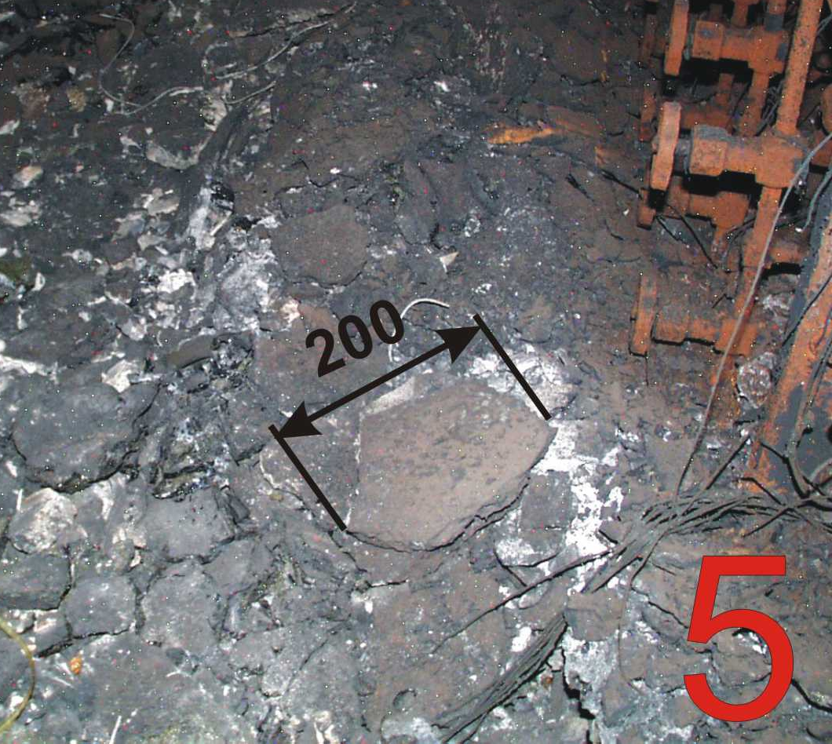
b) the room 304/3
LFCM volume = 60-65 m³
LFCM surface square = 1327 m²
19th CEG-SAM meeting, Pisa, March 14-16, 2011

Slide 10
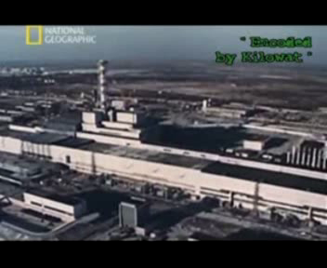

Slide 11
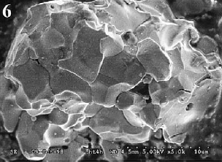
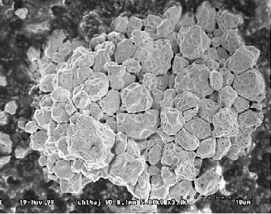
8 Three types of FP according to their dissolution rates under natural conditions:
Сhemically extra-stable particles (U-Zr-O). These particles were formed at the first moment of the accident on 04/26/86 and were deposited within the narrow western trace;
U-Zr-O
Super stable
Non-oxidized chemically stable fuel particles (UO₂) of the first release (04/26/86), formed as a result of the mechanical destruction of nuclear fuel. These particles were also deposited along the narrow western trace of fallout;
UO₂
Stable
Chemically low stable particles (UO_{2+x}), formed as a result of oxidization of the nuclear fuel in the period 04/26/86-05/05/86. These particles were predominantly deposited in the northern and southern traces of fuel fallout.
UO_{2+x}
Non-stable
19th CEG-SAM meeting, Pisa, March 14-16, 2011

Slide 12
9 Experimental study of FCM destruction
Condensed
UO₂
UO_{2+X}
U-Zr-O
Core fragments
LFCM
Shelter conditions
destruction
dispersion
transformation
Radionuclides’ transfer into the mobile forms
Formation of the secondary HP
19th CEG-SAM meeting, Pisa, March 14-16, 2011

Slide 13
10 Results of model experiments on dissolution of nuclear fuel particles (UO₂ and UO_{2+x}, obtained by annealing in UO₂ air)
19th CEG-SAM meeting, Pisa, March 14-16, 2011

Slide 14
MBq
Dynamics of uncontrolled airborne particulates matter release from the SO.
Bq/m³
Average annual concentrations of radioactive airborne particulates (Σβ: 90Sr + 90Y, 137Cs and 241Pu) in the north, north-west and south areas of the SO Industrial Site in 1993 – 2010.

Slide 15
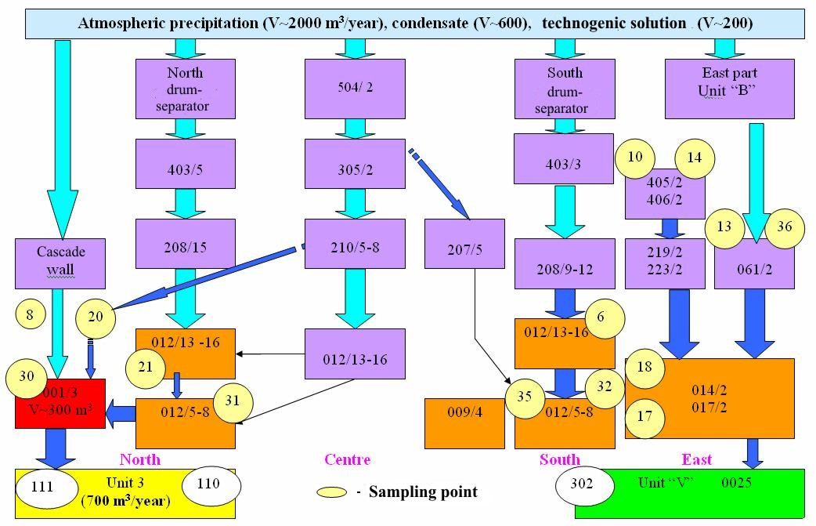
11 Main water flows in the Shelter rooms
19th CEG-SAM meeting, Pisa, March 14-16, 2011

Slide 16
MBq/m³
Dynamics of average annual concentration of ²³⁸⁺²³⁹⁺²⁴⁰Pu in LRAW accumulation in room 001/3.
Bq/m³
Dynamics of ²³⁸⁺²³⁹⁺²⁴⁰Pu concentration in LRAW accumulation in room 017/2

Slide 17
ГВq/m³
Dynamics of average annual concentration of 137- Cs in LRAW accumulation in steam-distributing corridor and room 001/3 .
Y
ГВq/m³
Dynamics of average annual concentration of 90- Sr in LRAW accumulation in steam-distributing corridor and room 001/3 .
Y

Slide 18
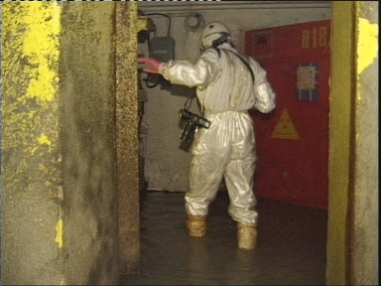
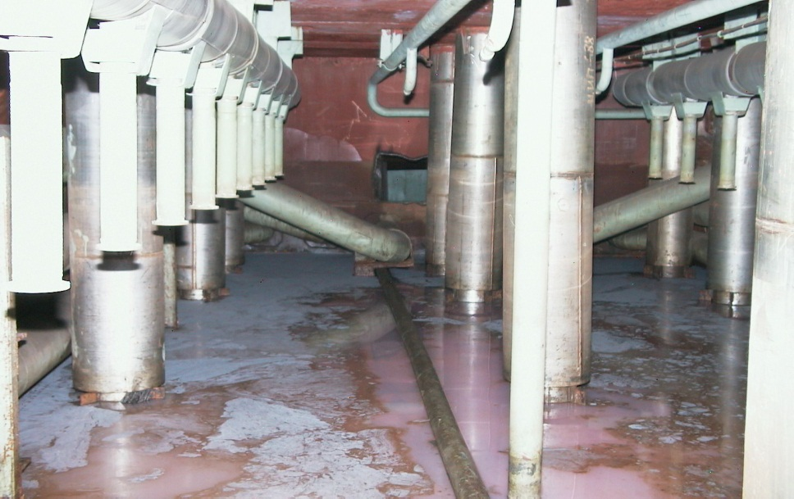
g/m³
Y
Dynamics of average annual concentration of U in LRAW accumulation in steam-distributing corridor and room 001/3 .

Slide 19
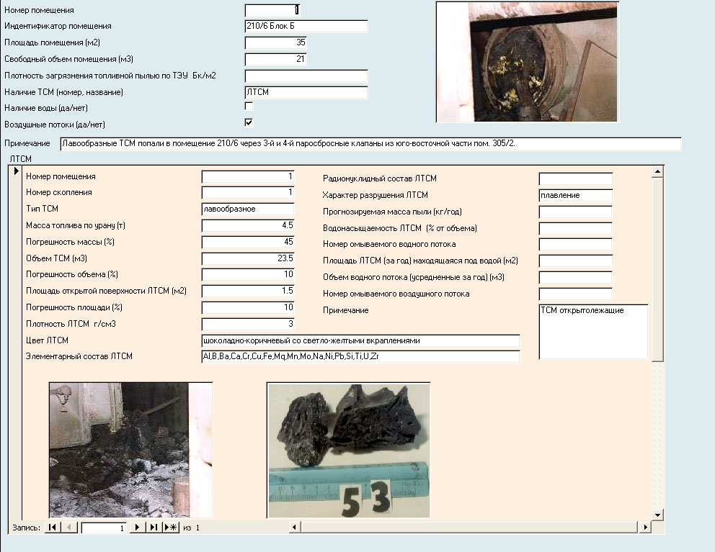
12 Creation of Database of hot particles
Basic fields of Database:
room number in SO;
room characteristics;
- fuel dust availability;
FCM availability and type;
FCM parameters;
water flow availability and parameters;
airflow availability;
- FCM destruction model.
The DB final version will be organized in such a manner, which would allow not only storing and accumulating the needed information, but also evaluating the FCM clusters’ destruction according to built-in models, and calculating, correspondingly, amount and characteristics of fuel dust in the “Shelter” Object rooms.
19th CEG-SAM meeting, Pisa, March 14-16, 2011

Slide 20
13 Work results
Accessible information pertaining to Project topics was analyzed and classified.
DB pilot version for project was created (room number → FCM availability and parameters → water availability → FCM destruction model). Currently, the DB filling by information is occurring.
A procedure to evaluate effective square of FCM clusters was developed. Assessment of squares of main FCM clusters is being performed.
Regular sampling and analysis of water and aerosol samples in SO rooms is made to genetically attach them to FCM clusters.
The researches for estimating the velocity of main FCM types etching in model environments is performed.
Generation of radioactive aerosol by LFСМ surface is carried out .
Model structure describing fuel particle destruction within the SO conditions is adopted.
19th CEG-SAM meeting, Pisa, March 14-16, 2011

Slide 21
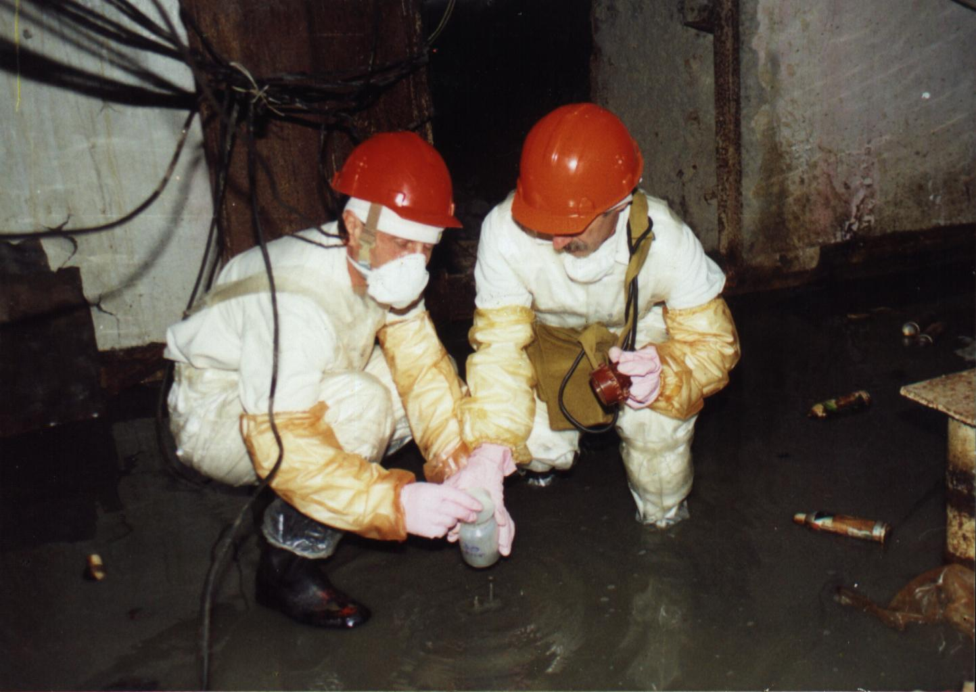
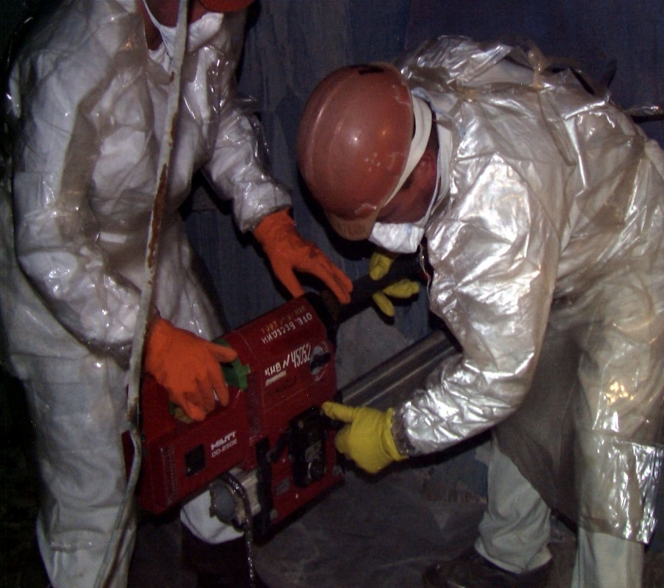

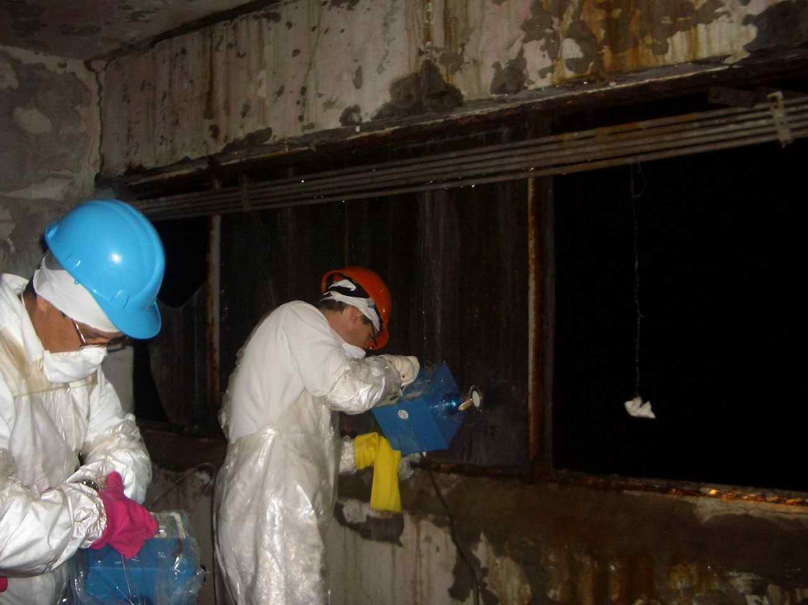
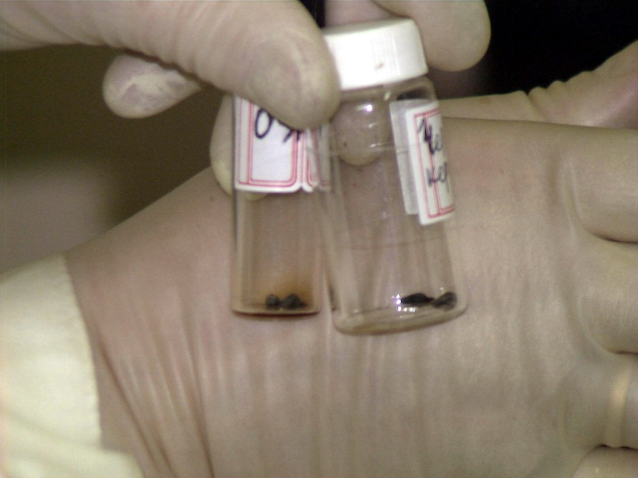

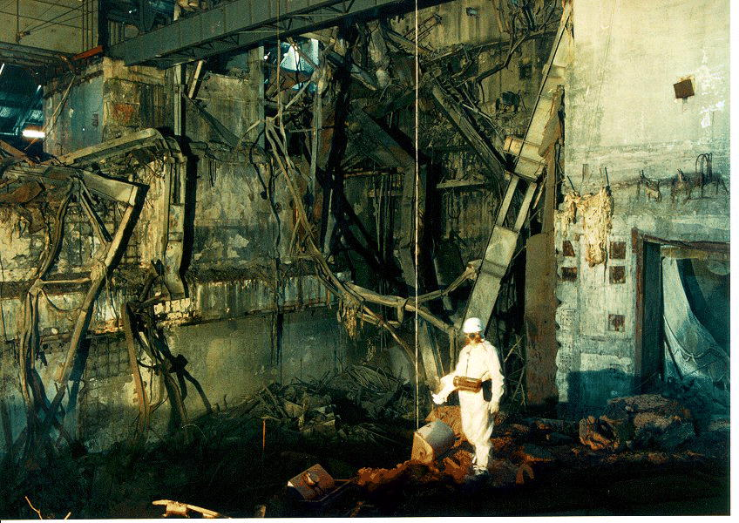
Thank you very much
for attention!

