Slide 1
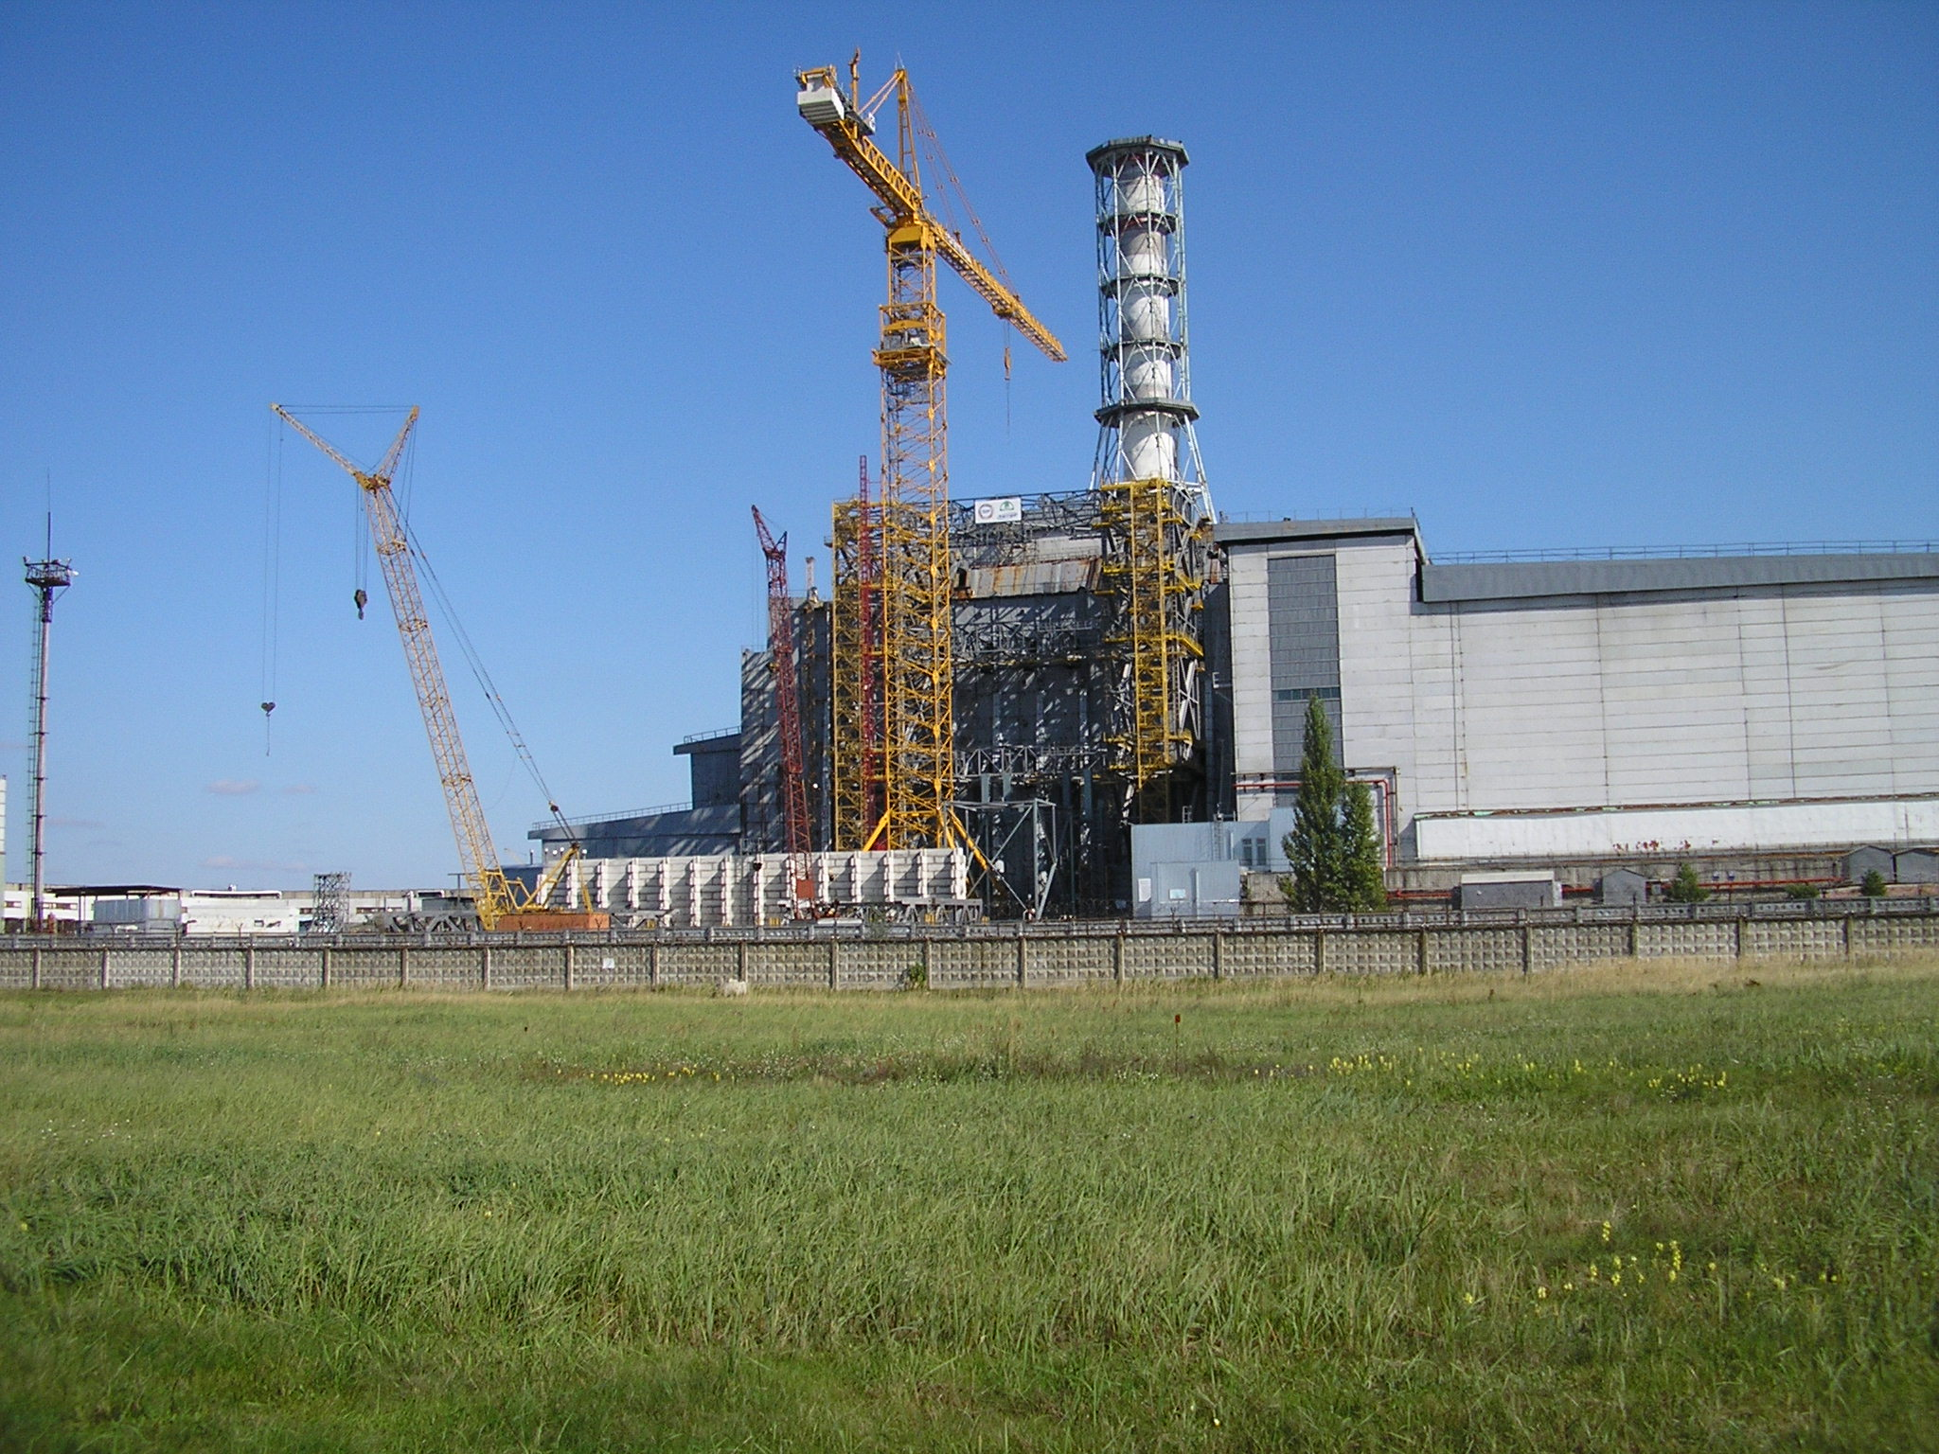

Presented at 18th
CEG-SAM Meeting
Institute for Safety
Problems of NPP
National Academy of
Sciences of Ukraine
September 28-30. 2010
St.Petersburg
Status of STCU Project #5244:
«Research of objects - nuclear fuel interaction products with structural materials under heavy
nuclear-radiation accidents»
Notes:
1

Slide 2
Contents:
Collaborators
Objectives & Expected results
Status of the project

Slide 3
Project #5244 manager – Dr. Victor Krasnov (ISP NPP NAS Ukraine)

Slide 4

Collaborators
GRS, Germany
Dr. G. Pretzsch
CEA Cadarache,
DEN/ DTN/STRI, France
Dr. C. Journeau
JRC-ITU Institute of Trans-uranium Elements Karlsruhe, Germany
Dr. P. Bottomley
Coordinator
STCU,
Kyiv, Ukraine
Operation Agent: Institute for NPP safety problems of UNAS, Ukraine, Chornobyl
ChNPP
Ukraine, Chornobyl
Project Duration: 30 months
Total Project Cost : 279,180 USD

Slide 5
Objectives of the project
To improve existing data and to obtain new data on the structure and content of FCM produced as result of fuel melt interaction with sub-reactor plate concrete and melting of reactor materials: graphite, fuel channels, metal and materials of the sand/gravel filling.

Slide 6
What’s new?
The existing data bank obtained from the GRS-IPSN -KI studies and annexes or any other relevant reports, will be improved, in particular:
refinement of nuclear fuel balance in sub-reactor room 305/2 will be performed;
more accurate information assessment based on the structure, composition of the FCM mass as well as the corium's neutron physical and physicochemical characteristics will be made;
a more realistic scenario of cluster production with high fuel content at accident active stage will be proposed.

Slide 7
Why the works specified in Project #5244 have such importance?
Improved estimates for nuclear hazardous cluster would increase safety and reliability under construction of New Safe Confinement (NSC).
In connection with this, Concept of nuclear safety of “Shelter” Object should be revised in terms of preventive criticality suppression in critmass risk areas, that will be the objective of Project works.

Slide 8
Expected results:
In this Project will be analyzed:
visual observation data;
information obtained when drilling research boreholes;
results of sampled lava-like fuel-containing materials (LFCM) analysis;
instrumental measurement data;
mechanisms of LFCM cluster production with high - content uranium.
Considering above data, as well on the basis of neutron and heat estimates, new instrumental measurement data and research results of physicochemical properties of newly taken samples from cluster area, will be:
defined: structure, geometry, and LFCM physicochemical properties in two critmass risk areas, in south-west quadrant of sub-reactor room 305/2 ChNPP Unit 4 («Shelter» object);
studied: neutron physical processes occurring in clusters under impact of external factors.

Slide 9
Diagram of criticality state of hidden nuclearly hazardous LFCM clusters in sub-reactor room 305/2 of «Shelter» Object
Heterogeneous
Structure
Homogeneous
structure
Reactivity, β
4. During the NSC erection, temperature growth and moisture decrease can entail, with high probability, repeated nuclear incident.
1988 y.
t 200 ºC
Nuclear incident in 1990
t 100 ºC
2010 y.
t 40-50 ºC
Water volume, %
1. 1988 y. – temperature of LFCM – more 200 ºC.
Cluster is dry and is in subcritical state.
2. 1990 y. - temperature of LFCM– less 100 ºC.
Water penetrates in cluster –self-sustaining chain reaction occurs.
3. 2010 y. - temperature of LFCM– of order 50 ºC.
Cluster is covered with water and is in subcritical state.

Slide 10
Status of the project:
1. Project Collaborator Letter from Dr. Pretsch (GRS) is received and registered in STCU.
2. Project Collaborator Letter from Dr. Bottomley (ITU) is received and registered in STСU.
3. Project Collaborator Letter from Dr. Journeau (CEA) is received and registered in STСU.
4. April 2010 – Government of Ukraine concurrence for the Project #5244 is obtained in STCU.
5. June 2010 - the Project Full Form is published and sent by STCU for Western parties review.

Slide 11
Thank You for attention and support of Project #5244

