Slide 1
ISTC Project «Scale experimental investigation of the thermal and structural integrity of the VVER pressure vessel Lower Head in severe accident» (#3635) prepared by V.Loctionov
Participating Institutions:
- «Moscow Power Engineering Institute» (MPEI): Leading Institution
- OKB “GIDROPRESS” (OKB «GP»)
- Lavrentyev Institute of Hydrodynamics of the Siberian Branch of the Russian Academy of Sciences (IGiL)
Start: Sept. 01, 2007
Duration: 36 months
1
15th CEG-SAM meeting, PSI, Switzerland, March 10-12, 2009

Slide 2
Collaborators:
Forschungszentrum Karlsruhe GmbH (Germany)
Material and Components Safety Department, Institut fur Sicherheitsforschung, Forschungszentrum Rossendorf (Germany)
CEA Saclay, DEN/DANS/DM2S/SEMT, Laboratoire de Mecanique Systeme et Simulation (France)
EC JRC, Institute for Transuranium Elements (Karlsruhe), Hot Cell Technology (Germany)
Division of Nuclear Power Safety, Department of Physics, Royal Institute of Technology (Sweden)
Department of Engineering Physics, College of Engineering, University of Wisconsin (USA)
Institute of Nuclear Technology, Institute of Nuclear Safety System, Incorporated (Japan)
Mechanical & Nuclear Engineering, The Pennsylvania State University (USA)
2
15th CEG-SAM meeting, PSI, Switzerland, March 10-12, 2009

Slide 3
The project efforts are focused on the following problems:
- the designing and construction of the test facility for test examinations of the VVER-440 vessel scale models on the conditions which correspond to SA in the VVER;
- manufacturing of the VVER-440 reactor vessel scale models (scale 1:5) . Material and technology, as well as thermal treatment have to correspond the same conditions of the regular VVER vessels manufacturing;
- pursuance of the material creep test experiments with samples from the VVER vessel steel on the time range 2-50 h and temperature range 700 - 1200 C to receive the creep data for refinement of the constitutive creep model and ordinary mechanical characteristics of this steel;
- the carrying out the scale experiments with VVER vessel models on the high-temperature heat-up and creep deformation of the vessel;
- the mathematical treatment and analysis of scale experiments, carrying out the numerical pre- and post-test structural analyses of scale experiments with vessel models
15th CEG-SAM meeting, PSI, Switzerland, March 10-12, 2009
3

Slide 4
Task “A”
Task “A”: analytical studies that include:
- the choosing of the accident scenarios and test conditions of the scale experiments;
- carrying out of the pre- and post-tests of the scale experiments
Expected Results:
- SA scenarios and SA conditions will be reproduced during the scale experiments with VVER vessel models;
- Expected thermal and deformation behaviour of the vessel models (as a result of the pre-test calculations) during the scale tests, and the post-test calculation results of the performed experiments on the VVER vessel scale models
4
15th CEG-SAM meeting, PSI, Switzerland, March 10-12, 2009

Slide 5
Estimation of possibility of the melt keeping in the RP vessel using the computer code SOKRAT and the module GEFEST (1)
1. The parametric studies of the thermal condition of the VVER-440 reactor vessel lower head were carried out within the framework of study of the possibility and the conditions under which through melting of the vessel wall does not occur in the course of SA.
2. The Power Unit 1 of Kola NPP has been chosen as the reactor plant for which the calculation and analytical analysis was carried out. At analysis carrying out nominal parameters and characteristics of this RP equipment were accepted.
3. The objective of calculations consisted in estimation of the decay heat power level in the lower plenum at that achievement of quasi-stationary thermal condition in the reactor vessel in the conditions of the heat removal owing to free convection (air) is possible at SA.
4. Parametric calculations were carried out using the code SOKRAT at variation of the debris mass arriving in the lower plenum after the core disruption.
The main varied parameter in parametrical calculations was the mass of fuel (UO₂) which moves from the core to the reactor lower plenum. The mass varied from its nominal value of 40 tons to the minimal value equal to 1/8 of nominal (5 tons). Owing to incomplete moving of fuel at SA the fuel rest should remain in the not fully disrupted core and continue to heat up. A condition of such SA scenario realization is cooling of the fuel material by water both in the core, and in the lower plenum. According to this, on the top border of the material which has arrived into the lower plenum the boundary condition corresponding to cooling by water at film boiling was set.
5. Moving of the core materials to the lower plenum is simulated as a volley receipt.
5
15th CEG-SAM meeting, PSI, Switzerland, March 10-12, 2009

Slide 6
Estimation of possibility of the melt keeping in the RP vessel using the computer code SOKRAT and the module GEFEST (2)
At that the following factors of the material arrival and the initial condition remained in all calculations:
Beginning of the material arrival − 9000s (2,5 h) from the beginning of SA.
Total weight of zirconium − 16 tons
Zirconium oxidation level − 40 %.
Mass of the arrived RVI steel − 27 tons
Initial mass of water in lower plenum − 6,3 tons .
Thus, the value of the decay heat Q (t) is connected with fuel amount M_{UO2} in accordance with the following correlation
Q(t)=q(t)M_{UO2}
Power of Q (t) is determined taking
into account specific decay heat q (t) (fig. 1.1).
Fig. 1.1. - Decay heat (from the SA start)
15th CEG-SAM meeting, PSI, Switzerland, March 10-12, 2009
6

Slide 7
Estimation of possibility of the melt keeping in the RP vessel using the computer code SOKRAT and the module GEFEST (3)
Numerical Results
According to the above considered scheme of the debris moving and the melt formation in the LH of VVER-440, parametric calculations of investigated system thermal condition (the reactor vessel, debris and melt pool) have been carried out. Main results of performed calculations are presented in table 1 and Fig. 1.2-1.5. Power of decay heat is specified in this table by the moment of the vessel through melting. For all considered variants of SA, absence of water supply into the reactor vessel during SA was supposed.
Table 1
Results of calculations of the VVER-440 reactor vessel condition at SA using the code GEFEST (*)
77
*) Power of decay heat is specified at the moment of the vessel through melting
No. Var. | Mass of UO₂, tons | Decay heat, MW | Time to the wall through melting, hour | Melting Pool condition
1 | 40 | 12 | 4 | Stratification
2 | 20 | 6 | 4,5 | Stratification
3 | 12 | 3 | 6 | Stratification
4 | 7 | - | - | Stratification is absent
5 | 7 | 1,2 | 25 | Stratification
6 | 3.7 | - | - | Stratification
7
15th CEG-SAM meeting, PSI, Switzerland, March 10-12, 2009

Slide 8
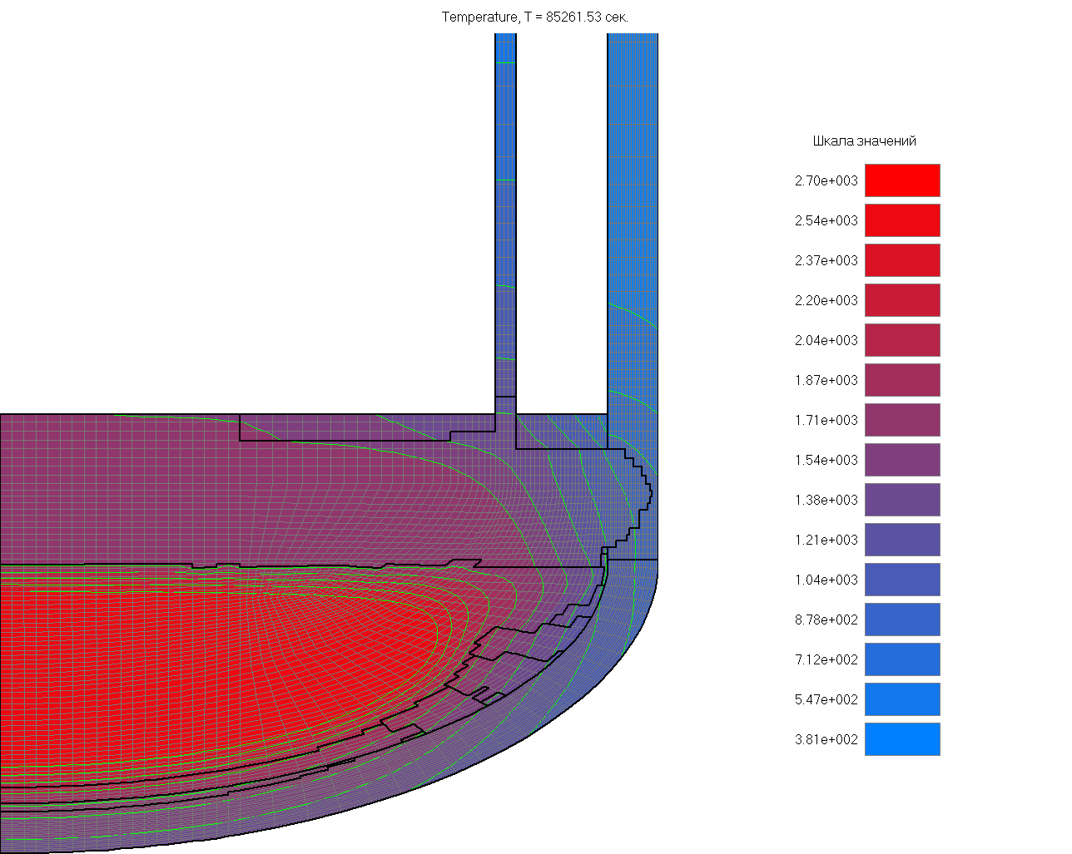
Estimation of possibility of the melt keeping in the RP vessel using the computer code SOKRAT and the module GEFEST (4)
Fig.1.2 – Var. #1
Fig.1.3 – Steady state temperature distribution. Var.# 3
15th CEG-SAM meeting, PSI, Switzerland, March 10-12, 2009
8

Slide 9
Estimation of possibility of the melt keeping in the RP vessel using the computer code SOKRAT and the module GEFEST (5)
Fig.1.4 - Heat flux distribution on the inner
RPV wall surface (Var.#2)
Fig.1.5 - Heat flux distribution on the inner
RPV wall surface (Var.#6)
9
15th CEG-SAM meeting, PSI, Switzerland, March 10-12, 2009

Slide 10
Estimation of possibility of the melt keeping in the RP vessel using the computer code SOKRAT and the module GEFEST (6)
It follows from the presented results, that:
1) limiting value of decay heat power, at which keeping of melt in the vessel is possible without effective cooling, is ~1 MW, that corresponds as a whole to an estimation received from the balance correlations. The deviation in the smaller party is concerned with non-uniform distribution of the heat flow at the melt border;
2) the calculation results obtained for variants No. 4 and No. 5 show, that the more favorable variant (the vessel through melting has not occurred) corresponds to variant No. 4 where there is no stratification in the melt.
It is reasonable in further investigations to carry out numerical calculations of SA by means of the computer code SOKRAT in the more realistic performance. In particular, it will be necessary to consider in these calculations post-phase disruption of the core, as well as water supply restoration in the course of SA.
15th CEG-SAM meeting, PSI, Switzerland, March 10-12, 2009
10

Slide 11
Task “B”: development and manufacturing of the experimental test facility
and supporting systems for the VVER scale vessel models testing (1)
Expected Results:
- Produced experimental test facility and its auxiliary systems ;
Experimental test facility IVRSA-VVER (Investigation of the Vessel Rupture during SA on the VVERs) is intended for thermomechanical tests of scale models of the VVER reactor vessels in the conditions simulating a stage of SA in
reactor installations with VVER, when the molten fragments of the core accumulate in the LH of the RPV;
Produced VVER-440 vessel scale models;
- Produced heater;
- Produced test facility control system and DAS and its assembling on the test installation
15th CEG-SAM meeting, PSI, Switzerland, March 10-12, 2009
11

Slide 12
Task “B”: development and manufacturing of the experimental test facility
and supporting systems for the VVER scale vessel models testing (2)
The experimental test facility consists of a protective casing, an auxiliary premise for placing of auxiliary systems, system of the model heating, water and gas systems, video monitoring system, and also data acquisition system (DAS).
Construction of the experimental test facility consists
of the basic protective casing and auxiliary housing.
Auxiliary systems of the experimental test facility
(gas, electric, water systems) are located in the
auxiliary housing. The electric system consists
of two dry-type power transformers (OSU-100)
– 2x 100 kW and devices controlling them.
Electric load from transformers is transferred
to the model’s heater by
means of aluminium conductor run and flexible
copper current-carrying arrangements.
15th CEG-SAM meeting, PSI, Switzerland, March 10-12, 2009
12

Slide 13
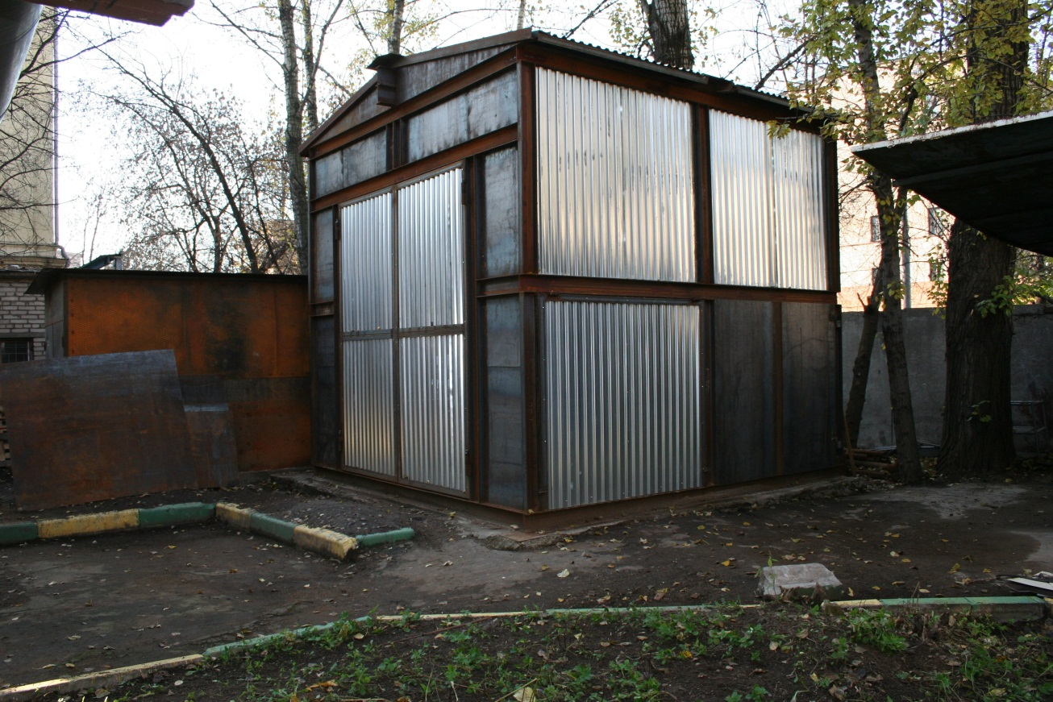
Task “B”: development and manufacturing of the experimental test facility
and supporting systems for the VVER scale vessel models testing (3)
Now the construction of the basic protective and auxiliary housings has been completed and assembling of auxiliary (gas, electric and water) systems is carried out.
Dimensions of the experimental
test facility
are ~4900x4800x4700 mm.
Final assembly of auxiliary systems
(water, gas, electric) and
painting of the main and auxiliary
housings will be carried out in a
warm season (April-May, 2009)
because experimental test
facility is out-of-doors.
The completion of work on
experimental test facility
construction (according to the
working schedule): Qv. #7.
15th CEG-SAM meeting, PSI, Switzerland, March 10-12, 2009
13

Slide 14
Experimental VVER-440 vessel scale model (1)
The object of investigations in the present project is the model of the VVER-440 reactor vessel lower head, made on scale ~1:5. At that, the material and technological features of scale models manufacturing should correspond as much as possible to the manufacturing technique of original VVER vessels. First of all, the following is meant herein:
a) the material of the vessel model should be of the original VVER vessel steel;
b) the technique of manufacturing of the vessel model components (manufacturing of forgings for steel bars of cylindrical course and the bottom), their welding and heat treatment should correspond to standard technique of the VVER vessels manufacturing.
Geometrical Scale: 1:5
The inner diameter: ~700 mm
Wall thickness: 20-30 mm
15th CEG-SAM meeting, PSI, Switzerland, March 10-12, 2009
14

Slide 15
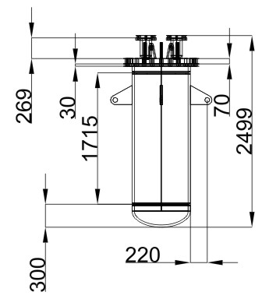
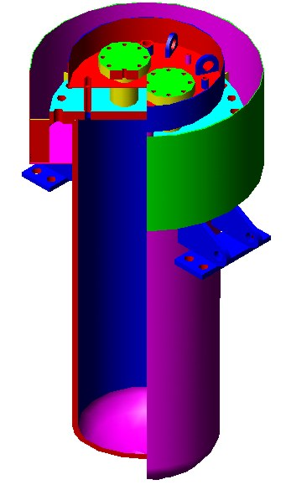
Experimental VVER-440 vessel scale model (2)
A construction of the vessel model, presented in fig. 3.1, was developed as a base variant.
In connection with economic conditions which have developed in Russia in the autumn 2008 and in the winter 2009, manufacturing of the given model construction has been suspended. Works on continuation of this model construction manufacturing can be begun not earlier than autumn of 2009, or can be shifted for later terms.
This is due to the fact that fabrication of this model construction is carried out together with the other metal constructions intended for the real NPP power unit, and plans on their manufacturing have undergone essential changes owing to economic situation.
Fig. 3.1-Variant No. 1 of the VVER vessel model construction
15th CEG-SAM meeting, PSI, Switzerland, March 10-12, 2009
15

Slide 16
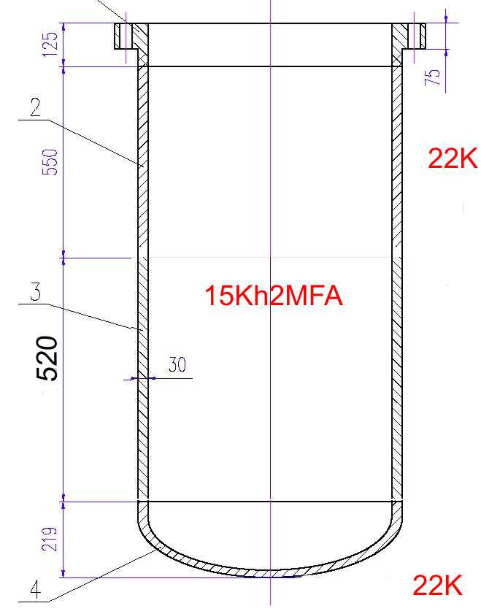
Experimental VVER-440 vessel scale model (3)
Therefore, possibility of manufacturing of the vessel model of more simplified design (fig. 3.2), than the “base” variant considered above is under consideration now.
Unlike a basic construction (fig. 3.1) in these construction the VVER vessel steel is used only for those components of the construction (cylindrical course, the bottom) which will be investigated during tests. Less critical components of the construction (flange) are supposed to be made of a cheaper steel 22K. Besides, the vertical sizes of the model variants No. 2 are much less than corresponding sizes of construction No. 1, that also reduces total weight of the VVER vessel steel in the model construction. Use of this type of constructions will allow to reduce cost of the vessel models manufacturing more than by 40 % in comparison with a basic construction (fig. 3.1).
Fig. 3.2-Variant No. 2 of the VVER vessel model construction
15th CEG-SAM meeting, PSI, Switzerland, March 10-12, 2009
16

Slide 17
Experimental VVER-440 vessel scale model (4)
Such construction of the model can be used for tests in case when the area of the most intensive heating is on a cylindrical part of the model (fig. 3.3).
At the present moment there are no yet sufficient means for start in manufacture of this model construction and intensive negotiations with a number of the Russian organizations on search of necessary financial assets are carried on. The model estimated cost in the given execution is about 80 000 Euro.
In the presence of sufficient financial assets time of manufacturing of the given construction is about 6 months.
Planned date of the models manufacturing completion (according to the Working schedule): 7th quarter (the end of May, 2009). Therefore, in the given direction of work the time delay at least for 3 months is expected.
Fig. 3.3– Scheme of heating of the
vessel model cylindrical part
17
15th CEG-SAM meeting, PSI, Switzerland, March 10-12, 2009

Slide 18
Automated scientific data acquisition and control system (DAS) of IVRSA-VVER test facility (1)
The following parameters shall be registered in the course of tests in the continuous mode:
a) temperature of the vessel outer surface
(20-1500º С): - number of channels: up to 120;
b) temperature of the vessel inner surface
(20-1800º С): - number of channels: up to 50;
c) displacements of the model outer surface
(1-120 mm): - number of channels: up to 60;
d) overpressure value in the model and auxiliary systems (0.1-8 MPa): - number of channels: 2;
e) parameters of auxiliary systems status (electric, gas, water systems): - number of channels: up to 6;
Accuracy of measuring channels is better than 0,2%.
DAS has a hierarchical structure composed of the lower and upper levels. Structural diagram of the DAS is represented in fig. 4.1.
Communication among the hardware of upper and lower levels is performed through Ethernet at 10/100 Mbit/s exchange speed.
Fig. 4.1– Scheme of DAS
15th CEG-SAM meeting, PSI, Switzerland, March 10-12, 2009
18

Slide 19
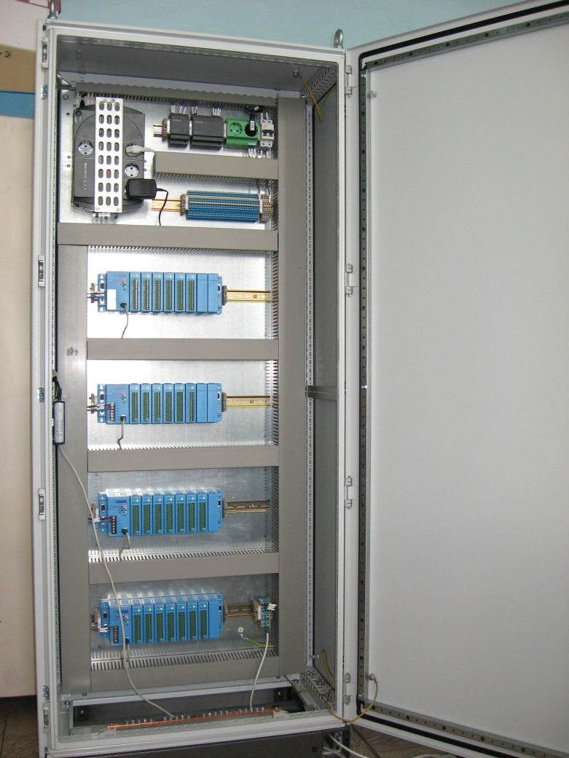
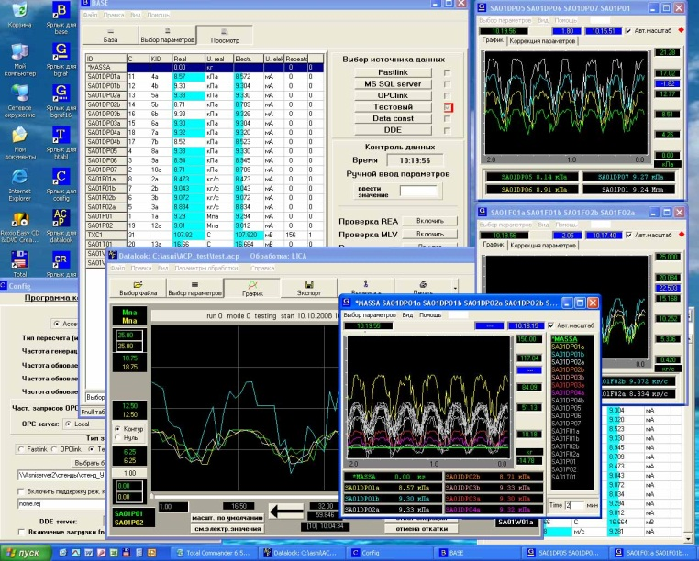
Automated scientific data acquisition and control system (DAS) of IVRSA-VVER test facility (2)
A suggested soft- and hardware complex consists of distributed data acquisition stations ADAM-5000/TCP of Advantech Company.
Modules ADAM-5017 is used as analog input modules.
Modules ADAM-5018 is used as a thermocouples input modules.
Modules ADAM-5024 is used as an analog output modules.
Modules ADAM-5055S and ADAM-5060 are used for input and output of discrete signals.
By the present moment, DAS system manufacturing has been completed (fig. 4.2).
Fig. 4.2
15th CEG-SAM meeting, PSI, Switzerland, March 10-12, 2009
19

Slide 20
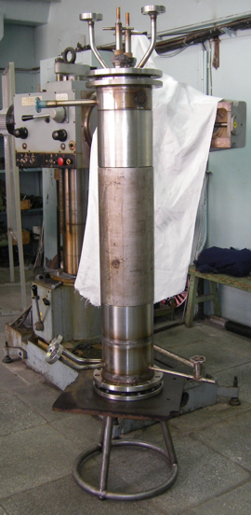
Heater of the IVRSA-VVER test facility.
Tests of heating elements at small-scale experimental test facility (1)
In order to choose the type, construction and thermal and physical parameters of the heating elements to be used in the heater during reactor vessel models testing, the small-scale experimental test facility was developed (Fig.5.1). This construction is a cylindrical vessel with diameter and height of 220 and 1200 mm, respectively. Thickness of the vessel wall in the working area is 9 mm. The heating elements to be tested are placed inside the vessel by means of special cooled current-carrying arrangements. Gas medium filling the inside vessel cavity of the test facility during test is argon.
For the purpose of check of heating elements operability which will be used in the heater of the vessel model, the tests of the 1st series of spiral heaters have been carried out.
Spiral heaters were made of molybdenum wire of 1 mm diameter.
Besides, objectives of the carried out tests was the following:
- determination of electrophysical properties of heating elements at high temperatures;
determination of heat flow density on the wall of experimental test facility;
life tests of heating elements.
Fig. 5.1
20
15th CEG-SAM meeting, PSI, Switzerland, March 10-12, 2009

Slide 21
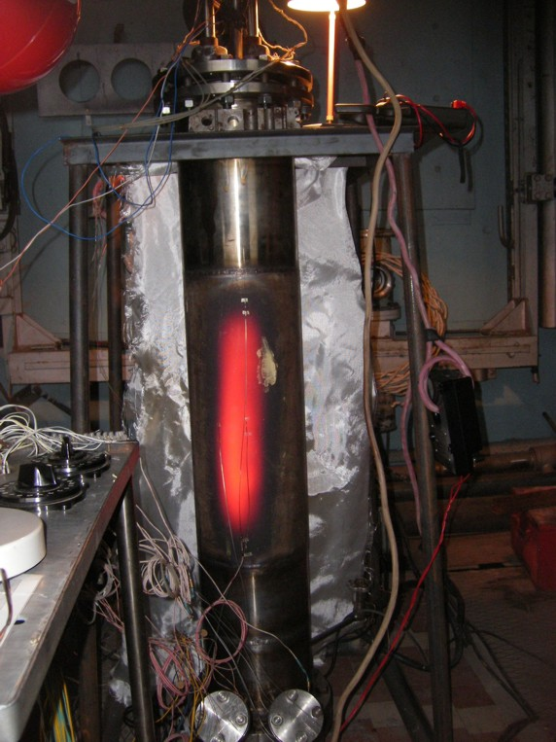
Heater of the IVRSA-VVER test facility.
Tests of heating elements at small-scale experimental test facility (2)
To obtain thermal and physical and electrophysical parameters of heating elements, thermocouples were fastened on the top surface of cylindrical course of the test facility, as well as on its inner surface and on spiral heating elements (W-Re).
Some fragments of tests are presented in fig. (5.2-5.4). In these photos the conditions corresponding to various levels of electric power (P) supplied to the heater are presented (Max P < 14 kW).
At that, value of the heat flow density on the inner wall of the vessel model of about 0.37 MW/m2 has been reached.
The further increase of supplied electric power was unreasonable owing to that it was impossible to provide corresponding heat removal from the outer surface of the heater model by air.
Fig. 5.2
21
15th CEG-SAM meeting, PSI, Switzerland, March 10-12, 2009

Slide 22
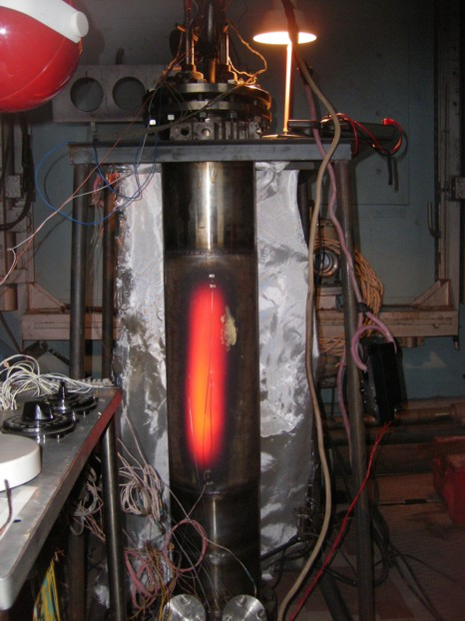
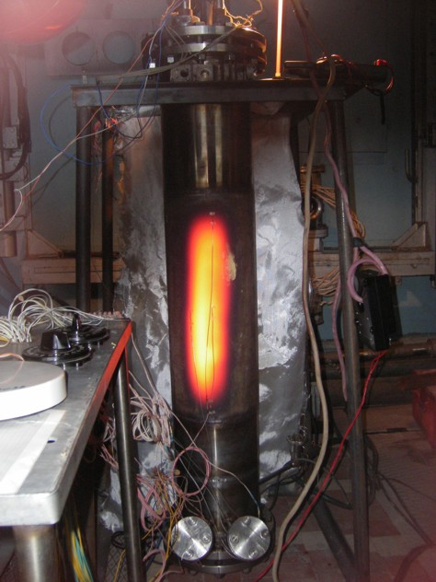
Heater of the IVRSA-VVER test facility.
Tests of heating elements at small-scale experimental test facility (3)
Fig. 5.3
Fig. 5.4
22
15th CEG-SAM meeting, PSI, Switzerland, March 10-12, 2009

Slide 23
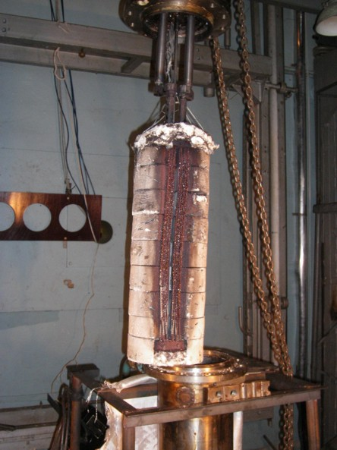
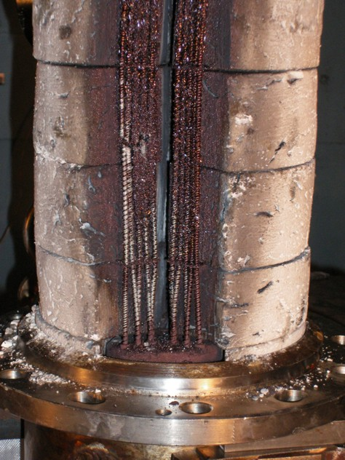
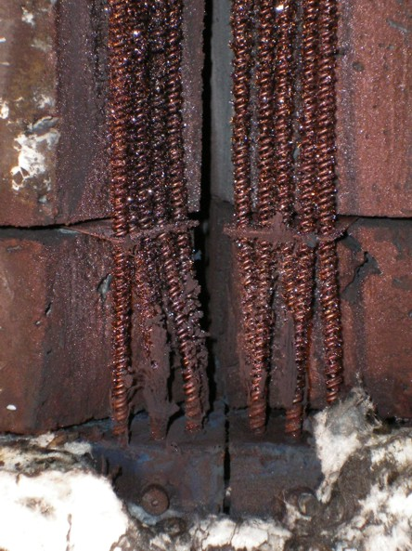
Heater of the IVRSA-VVER test facility.
Tests of heating elements at small-scale experimental test facility (4)
At carrying out of life tests of heating elements, depressurization of cooled current-carrying arrangements has occurred and water has got to internal volume of the device. It has led to melting and destruction of heating elements (fig. 5.5-5.7).
Fig. 5.6
Fig. 5.5
Fig. 5.7
23
15th CEG-SAM meeting, PSI, Switzerland, March 10-12, 2009

Slide 24
Heater of the IVRSA-VVER test facility.
Tests of heating elements at small-scale experimental test facility (5)
The main conclusions from the carried out tests:
1) heating elements of molybdenum provide a necessary mode of heating (heat flux on the vessel model wall) which should be realized at test of scale vessel models;
2) constructive improvement of junctions of experimental test facility is required for
tests of heating elements.
At present, the following activities have been carried out or are at the
stage of performance:
a) improvement of cooled current-carrying arrangements has been carried out;
b) the external casing for providing of water cooling of the vessel model is manufactured that will allow to carry out tests at higher electric power supplied to the heater;
c) tests of heating elements of tungsten are under preparation;
d) tests of heating elements of a lamellar design of molybdenum alloy are under preparation.
24
15th CEG-SAM meeting, PSI, Switzerland, March 10-12, 2009

Slide 25
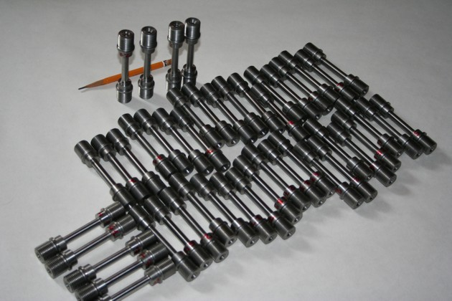
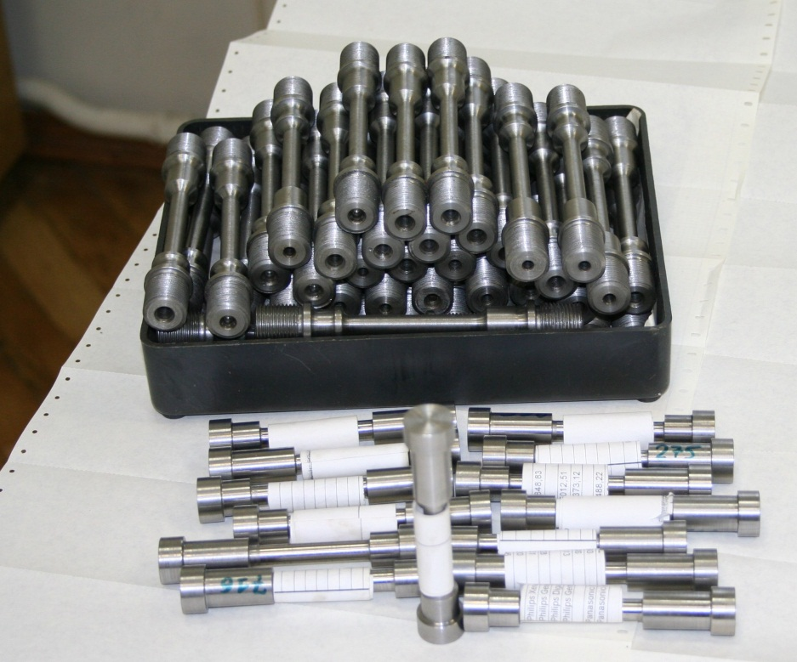
The task “D”: The manufacturing and material creep testing of the samples from VVER vessel steel and material property creep testing of the samples cut from the tested VVER vessel models (1)
The steel 15Kh2NMFA (TS 108-765-78) of which the LH of the VVER RPV No. 1152.02.70.000
(number of fusion 107210), number of forgings 5015 has been made was the material which physical
and mechanical properties were subject to definition in process of material property studies.
The specimens fabricated for the tests had circular cross-section of 8 mm diameter and working length
of 45 mm. The specimens were made in two variants: without a thread part and with a thread part for
fastening in pinchers of the testing machine (fig. 6.1).
Fig. 6.1
25
15th CEG-SAM meeting, PSI, Switzerland, March 10-12, 2009

Slide 26
The task “D”: The manufacturing and material creep testing of the samples from VVER vessel steel and material property creep testing of the samples cut from the tested VVER vessel models (2)
Main results:
-
- manufacturing of the VVER vessel steel specimens has been completed;
modernization of the test machines and equipment for high-temperature creep tests (over 950 C)
on the time base above 20 hours is carried out.
Current state:
a) manufacturing of specimens:
100 %;
b) the protocols of the high temperature creep tests of the VVER vessel steel specimens:
40 %.
26
15th CEG-SAM meeting, PSI, Switzerland, March 10-12, 2009

Slide 27
Thank You!
End
15th CEG-SAM meeting, PSI, Switzerland, March 10-12, 2009

