Slide 1
ISTC Project «Scale experimental investigation of the thermal and structural integrity of the VVER Pressure Vessel Lower Head in severe accident» (#3635)
Participating Institutions:
- «Moscow Power Engineering Institute» (MPEI): Leading Institution
- Federal State Unitary Enterprise «Experimental and Design Organization “GIDROPRESS” (EDO «GP»)
- Lavrentyev Institute of Hydrodynamics of the Siberian Branch of the Russian Academy of Sciences (IGiL)
Start: Sept. 01, 2007
Duration: 36 months
16th CEG-SAM meeting, Moscow, IBRAE, Russian Federation , September 8-9, 2009

Slide 2
Collaborators:
Forschungszentrum Karlsruhe GmbH (Germany)
Material and Components Safety Department, Institut fur Sicherheitsforschung, Forschungszentrum Rossendorf (Germany)
CEA Saclay, DEN/DANS/DM2S/SEMT, Laboratoire de Mecanique Systeme et Simulation (France)
EC JRC, Institute for Transuranium Elements (Karlsruhe), Hot Cell Technology (Germany)
Division of Nuclear Power Safety, Department of Physics, Royal Institute of Technology (Sweden)
Department of Engineering Physics, College of Engineering, University of Wisconsin (USA)
Institute of Nuclear Technology, Institute of Nuclear Safety System, Incorporated (Japan)
Mechanical & Nuclear Engineering, The Pennsylvania State University (USA)
16th CEG-SAM meeting, Moscow, IBRAE, Russian Federation , September 8-9, 2009

Slide 3
The project efforts are focused on the following problems:
- the designing and construction of the test facility for test examinations of the VVER-440 vessel scale models on the conditions which correspond to SA in the VVER;
- manufacturing of the VVER-440 reactor vessel scale models (scale 1:5) . Material and technology, as well as thermal treatment have to correspond the same conditions of the regular VVER vessels manufacturing;
- pursuance of the material creep test experiments with samples from the VVER vessel steel on the time range 2-50 h and temperature range 700 - 1200 C to receive the creep data for refinement of the constitutive creep model and ordinary mechanical characteristics of this steel;
- the carrying out the scale experiments with VVER vessel models on the high-temperature heat-up and creep deformation of the vessel;
- the mathematical treatment and analysis of scale experiments, carrying out the numerical pre- and post-test structural analyses of scale experiments with vessel models
16th CEG-SAM meeting, Moscow, IBRAE, Russian Federation , September 8-9, 2009

Slide 4
Task “A”
Task “A”: analytical studies that include:
- the choosing of the accident scenarios and test conditions of the scale experiments;
- carrying out of the pre- and post-tests of the scale experiments
Expected Results:
- SA scenarios and SA conditions will be reproduced during the scale experiments with VVER vessel models;
- Expected thermal and deformation behaviour of the vessel models (as a result of the pre-test calculations) during the scale tests, and the post-test calculation results of the performed experiments on the VVER vessel scale models
16th CEG-SAM meeting, Moscow, IBRAE, Russian Federation , September 8-9, 2009

Slide 5
Estimation of possibility of the melt keeping in the RP vessel using the computer code SOKRAT and code NARAL (1)
1. The parametric studies of the thermal condition of the VVER-440 reactor vessel lower head were carried out within the framework of study of the possibility and the conditions under which through melting of the vessel wall does not occur in the course of SA.
2. Standard VVER-440/V-230 of the Power Unit 1 of Kola NPP has been chosen as the reactor plant for which the calculation and analytical analysis was carried out. At analysis carrying out nominal parameters and characteristics of this RP equipment were accepted.
Table 1 – The main parameters of RP
Parameters
Nominal value
Reactor power, MW 1375
Maximum linear fuel rod load, W/cm 325
Decay heat MS ISO 10645-92
Pressure in RCC, Mpa 12,26
Temperature of the loop cold leg 268 C
Maximum linear fuel rod load, W/cm 325
Level in PRZ, m 5,12 m
Coolant flow rate through:
- reactor, kg/s 8851
- core, kg/s 8022,5
- operating fuel assembly, kg/s 24,4
ERC, kg/s 34,37
16th CEG-SAM meeting, Moscow, IBRAE, Russian Federation , September 8-9, 2009

Slide 6
Estimation of possibility of the melt keeping in the RP vessel using the computer code SOKRAT and code NARAL (2)
3. The objective of calculations is the analysis of SA scenarios in RP with VVER-440 and determination of conditions of scale experiments carrying out on VVER reactor pressure vessel models (RPV VVER):
a) the 1st variant of SA scenarios : “Partial break of MCP cold leg within the range of Dnom 32 with further restoration of water supply to reactor from the primary circuit normal makeup pump with the flow rate of 1,64 kg/s”.
b) the 2nd var. of SA scenarios : “Partial break of MCP cold leg within the range of Dnom 32 with further restoration of water supply to reactor from two normal makeup pumps with the flow rate of 3,28 kg/s”.
c) the 3rd var. of SA scenarios: “Leak Dnom 120 from MCP cold leg at the reactor inlet with water supply from one emergency makeup pump to the inlet nozzle area (after drying of the core)”.
*) NPP blackout is superimposed on the initiating event of the accident. Blackout of the station entails failure of the primary circuit emergency makeup system.
The beginning of the accident corresponds to nominal parameters and equipment characteristics
of the reactor plant.
The following was accepted for calculations carrying out:
- heat removes from the external surface of the RP vessel with heat removal coefficient 120 W/m²K;
- composition of a liquid phase is as follows: 44% of UO₂, 38% of steel, 11% of ZrO₂, 7% of Zr.
16th CEG-SAM meeting, Moscow, IBRAE, Russian Federation , September 8-9, 2009

Slide 7
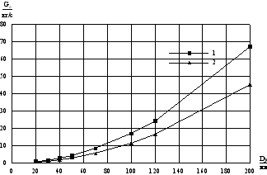
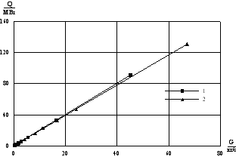
Estimation of possibility of the melt keeping in the RP vessel using the computer code SOKRAT and code NARAL (3)
Characteristic feature of considered SA scenarios is the following:
- at restoration of water supply into reactor from normal or emergency makeup pumps, steam generated at evaporation of makeup water leads to rise in the reactor pressure to the value at which the amount of generated steam will be equal to the amount of steam entrained into leak. In particular, the dependences of steam generation intensity necessary for achievement of pressure in the VVER-440 primary circuit equal to 1 and 1,5 MPa for the leak sizes (as a result of partial break of MCP cold leg) in a range from Dnom 20 to Dnom 200 are presented in fig.1.1. Dependence of energy release amount on the flow rate for steam generation is presented in fig. 1. 2
1- for primary circuit pressure 1,5 MPa; 2- for primary circuit pressure 1,0 MPa
Fig.1.1 – Dependence of steam Fig.1.2-Energy release necessary for
generation intensity on the leak size generation of steam with specified flow rate
16th CEG-SAM meeting, Moscow, IBRAE, Russian Federation , September 8-9, 2009

Slide 8
Estimation of possibility of the melt keeping in the RP vessel using the computer code SOKRAT and code NARAL (4)
4. Results of SA calculation
Numerical simulation of SA course in VVER-440 was carried out using the best estimate code SOKRAT/В1. The results received in the course of simulation are presented and discussed bellow.
4.1 Analysis of SA No.1: “Partial break of MCP cold leg within the range of Dnom 32 with further restoration of water supply to reactor from the primary circuit normal makeup pump with the flow rate of 1,64 kg/s”.
Chronological sequence of this SA scenario and operation of the equipment are presented in Table 2. The most significant events in the given table are coloured.
Table 2 - Chronological sequence of main events and operation of the NPP equipment (SA scenario No.1)
Time, s Event
0,0 Initiating event – leak in partial break of MCP at the reactor inlet nozzle within the range of Dnom 32
0,0 Blackout of NPP. Due to NPP blackout the following equipment does not operate:
- heaters and PRZ injection;
- the primary circuit normal makeup system;
- the secondary circuit feed pumps;
- BRU-K
- RCPs coastdown
0,5 Closing of the stop valves of both TGs by NPP blackout signal
~900-3300 Stabilization of coolant level within 1,85- 2,00 m
3900,0 Decrease in coolant level below the core top, start of the fuel rods heating
(65min)
≤ 3410,0 Periodic operation of BRU-A, pressure change in SG from 5,04 to 5,7 MPa
5100,0 Total drying of the core
(85min)
5385,0 Maximum temperature of fuel rod cladding surfaces reaches the value of 1200 K – beginning of the developed steam-zirconium reaction
16th CEG-SAM meeting, Moscow, IBRAE, Russian Federation , September 8-9, 2009

Slide 9
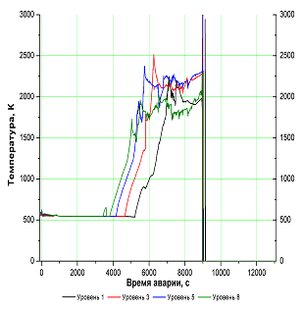
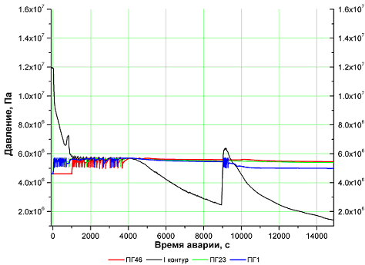
Estimation of possibility of the melt keeping in the RP vessel using the computer code SOKRAT and code NARAL (5)
Table 2 (continuation) (SA scenario No.1)
Time, s Event
7200,0 Beginning of water supply from 1 feed water pump with flow rate of 1,64 kg/s
9000,0 Beginning of the core disruption
13000,0 Beginning of the reactor vessel destruction
15000,0 Through melting of the RP vessel
15000,0 End of calculation. Pressure in the primary circuit decreases below 1,0 MPa
Results of calculation in the form of diagrams of change of reactor plant parameters which are characteristic
for considered conditions are presented in fig. 1.3-1.7.
Fig.1.3- Dynamics of pressure in the 1-st and secondary circuits
Fig. 1.4– Change of temperature of fuel rod claddings in operating assembly (OA) of I-II years of the fuel life-time
16th CEG-SAM meeting, Moscow, IBRAE, Russian Federation , September 8-9, 2009

Slide 10
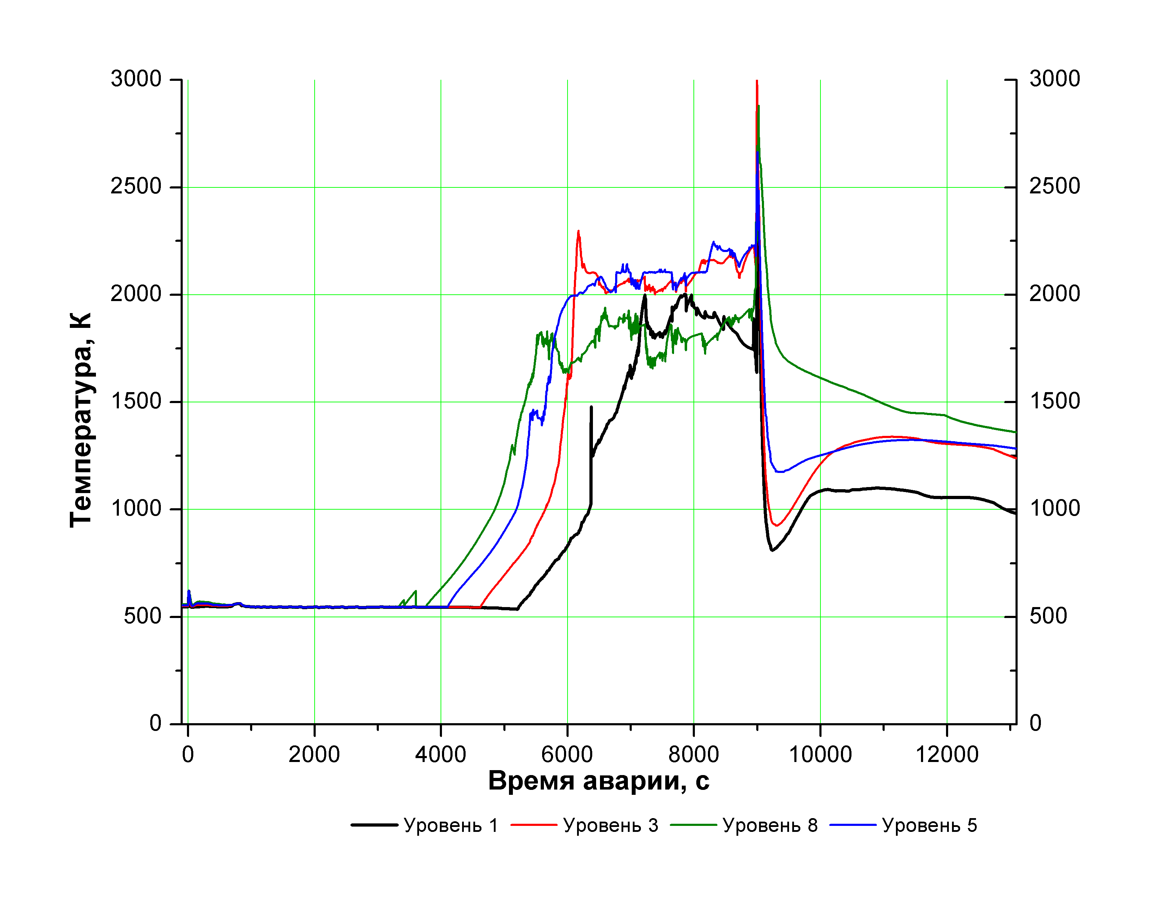
Estimation of possibility of the melt keeping in the RP vessel using the computer code SOKRAT and code NARAL (6)
It is possible to note the following basic features of processes in the RP at the stage of the core disruption for considered SA scenario: intensive rise of temperature of fuel rod claddings is observed after 3900 s (fig. 1.4-1.5);
- when the fuel rod claddings reach the temperature of 1200 К at 5850 s a developed steam-zirconium reaction is started that leads to considerable increase in the fuel rod heating-up rate;
at ~9000 s intensive melting of operating assembly fuel rods of I-IV years of the fuel life-time starts with moving of the melt downwards to the supporting (upper) grid of the core barrel. Accumulation of the molten core materials causes the melting through of the basket, the reactor core barrel baffle with further arrival of the melt in the reactor downcomer.
It was accepted in the calculation, that the core falls into the lower plenum practically entirely (except for channels of the 5th year of the fuel life-time, located on periphery);
Fig.1.5- Change of temperature of fuel rod claddings in operating assembly (OA) of the 5th year of the fuel life-time
16th CEG-SAM meeting, Moscow, IBRAE, Russian Federation , September 8-9, 2009

Slide 11
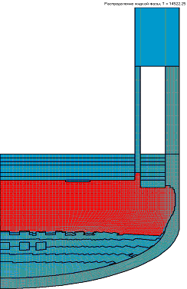
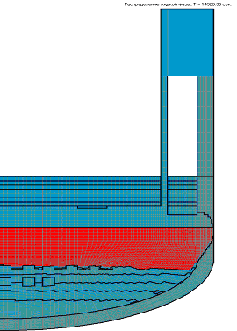
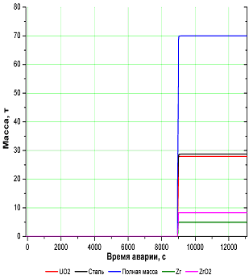
Estimation of possibility of the melt keeping in the RP vessel using the computer code SOKRAT and code NARAL (7)
- about 70 tons of debris, 28 tons of fuel, 29 tons of steel, 8,4 tons of zirconium oxide and 5 tons of metal zirconium arrive in the lower plenum (fig. 1.6);
- interaction of the melt with the vessel wall causes its heating, through melting and destruction of the RP vessel at 15000 s (~4 hours) (fig. 1.7).
Time = 14522 s
Time = 14926 s
Fig.1.7- Distribution of a liquid phase of the melt at the stage of the RP vessel wall through melting
Fig.1.6- Arrival of the core material into lower plenum.
16th CEG-SAM meeting, Moscow, IBRAE, Russian Federation , September 8-9, 2009

Slide 12
Estimation of possibility of the melt keeping in the RP vessel using the computer code SOKRAT and code NARAL (8)
3.2 Calculation analysis of SA No.2:
“Partial break of MCP cold leg within the range of Dnom 32 with further restoration of water supply to reactor from two normal makeup pumps of the primary circuit with the flow rate of 3,28 kg/s”.
Similarly to the above considered SA scenario, a case of SA was considered when at 7200 s of accident water is supplied in the reactor from two primary circuit normal makeup pumps with flow rate of 3,28 kg/s.
Comparison of the given accident scenarios is presented in table 3 where the following designations are accepted:
Х- there is a destruction
О – integrity remains
* - 80% of fuel assemblies of control rod assembly were filled in by the moment of the beginning of the RP vessel through melting
** - time is counted from initiating event
Table 3. Comparison of key events of SA scenarios No.1 and No.2 in RP with VVER-440
4.2 Analysis of SA No.2: “Partial break of MCP cold leg within the range of Dnom 32 with further restoration of water supply to reactor from two normal makeup pumps of the primary circuit with the flow rate of 3,28 kg/s”.
Similarly to the above considered SA scenario, a case of SA was considered when at 7200 s of accident water is supplied in the reactor from two primary circuit normal makeup pumps with flow rate of 3,28 kg/s.
Comparison of the given accident scenarios is presented in Table 3 where the following designations are accepted:
Х- there is a destruction
О – integrity remains
Table 3. Comparison of key events of SA scenarios No.1 and No.2 in RP with VVER-440
No. of variant 1 2
Water flow rate from NMP, kg/s 1,64 3,28
Destruction of operating assemblies
of I-II years of the fuel life-time Х Х
Operating assemblies of the
III-IV years of the fuel life-time Х О
Operating assemblies of the 5th
year of the fuel life-time О Х
Time** of the core fall, s 9000 9000
Precipitated mass of fuel, t 28 20
Pressure in the pressurizer, Mpa 1,0 1,6…1,8
Mass of water in lower plenum at the
moment of the vessel destruction, kg 6500 9600
The moment of the beginning of the
vessel destruction, s 13000 21000
The moment of through destruction
of the vessel, s 15000 25600
16th CEG-SAM meeting, Moscow, IBRAE, Russian Federation , September 8-9, 2009

Slide 13
Estimation of possibility of the melt keeping in the RP vessel using the computer code SOKRAT and code NARAL (9)
The analysis of the data presented in Table 3 allows to conclude the following:
1) integrity of the vessel remains within not less than 4 7 hours after the beginning of SA in case of water supply into reactor from makeup pumps with flow rate of 1,64 and 3,28 kg/s, respectively;
2) destruction of the vessel at availability of feeding is caused by that only approximately 50 % of thermal energy released in the melt goes to the coolant in lower plenum and intensity of convective heat removal from the RP external vessel wall is insufficient for ensuring necessary heat removal;
3) it is necessary to consider a less conservative variant of the calculation diagram of the core
disruption and arrival of the melt in the bottom part of the reactor vessel. In the presented calculations it was postulated, that disruption of the core occurs at a time.
16th CEG-SAM meeting, Moscow, IBRAE, Russian Federation , September 8-9, 2009

Slide 14
Estimation of possibility of the melt keeping in the RP vessel using the computer code SOKRAT and code NARAL (10)
4.3 Analysis of SA No.3: “Leak Dnom 120 from MCP cold leg at the reactor inlet with water supply from one emergency makeup pump to the inlet nozzle area (after drying of the core)”
Chronological sequence of events is presented in Table 4.
Table 4 - Chronological sequence of SA No 3 events
Time, s Event
0,0 Initiating event – leak Dnom 120 mm in partial break of MCP at the reactor inlet nozzle
0,0 Blackout of NPP. Due to NPP blackout the following equipment does not operate:
- heaters and PRZ injection;
- the primary circuit normal makeup system;
- the secondary circuit feed pumps;
- BRU-K
- RCPs change over to their own coastdown
0,0 Failure of diesel-generators to start
0,0 Actuation of EP-1
0,5 Closing of the stop valves of both TGs by NPP blackout signal
260,0 Decrease in coolant level below the core top, start of the fuel rods heating
~500,0 Total drying of the core
800,0 Maximum temperature of fuel rod cladding surfaces reaches the value of 1000-1200 K – beginning of the developed steam-zirconium reaction
800,0 Beginning of water supply from 1 primary circuit emergency makeup pump (~ 16,4 kg/s)
4550,0 Destruction of the core operating assembly, beginning of corium interaction with the RPV
7500,0 Destruction of the RPV. Pressure at the moment of the RPV destruction is 0,37 MPa
20000,0 End of calculation
16th CEG-SAM meeting, Moscow, IBRAE, Russian Federation , September 8-9, 2009

Slide 15
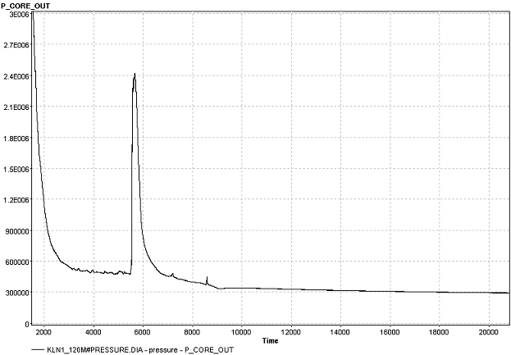
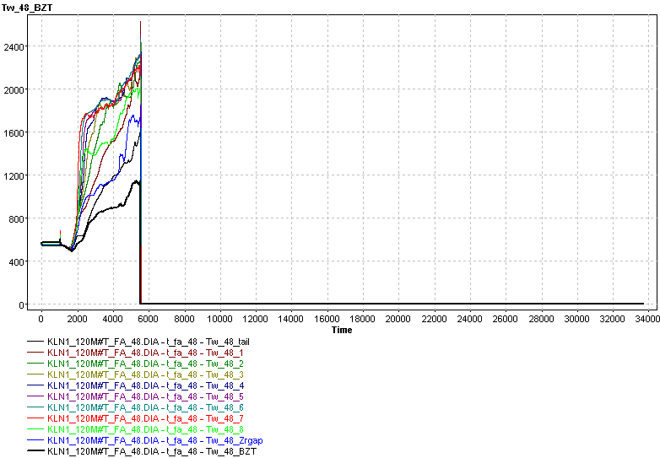
Estimation of possibility of the melt keeping in the RP vessel using the computer code SOKRAT and code NARAL (11)
The diagrams of change of the reactor plant main parameters are presented in fig. 1.8-1.9.
Fig.-1.8. Dynamics of pressure in the primary circuit. SA scenario No. 3
Fig.-1.9. Change of temperature of fuel rod claddings
in operating assembly (OA) of I-II years of the fuel life-time.
SA scenario No. 3.
16th CEG-SAM meeting, Moscow, IBRAE, Russian Federation , September 8-9, 2009

Slide 16
Estimation of possibility of the melt keeping in the RP vessel using the computer code SOKRAT and code NARAL (12)
The analysis of the received results of SA scenario No.3 showed the following:
- destruction of all operating assembly channels, moving of the melt to area of fuel rod assembly and lower plenum and interaction with the reactor vessel occur at 4550 s after initiating event;
- destruction of the vessel wall occurs at 7500 s after initiating event. At this moment pressure in the vessel is 0,37 MPa.
- increase in the leak size from Dnom 32 (scenarios No.1 and No.2) to Dnom 120 reduced a period of reactor vessel integrity remaining from 15000 to 7500 s;
- it is possible to expect, that calculations of accident with the intermediate leak size Dnom 70 - Dnom 80 should give more optimistic results regarding duration of the vessel integrity remaining.
16th CEG-SAM meeting, Moscow, IBRAE, Russian Federation , September 8-9, 2009

Slide 17
Estimation of possibility of the melt keeping in the RP vessel using the computer code SOKRAT and code NARAL (13)
5. Simulation of thermal condition of the melt pool and the reactor vessel by the code NARAL
Simulation of thermal condition of the melt pool and the reactor vessel lower head by means of code NARAL had the following objectives:
a) obtaining of an estimation of value and character of thermal load distribution on the vessel wall internal surface, that is important due to adequacy of the thermal load reproduction in the course of scale experiments;
b) study of conservative approaches and models application limits at simulation of thermal processes in the system “melt – reactor vessel wall”.
5.1 Initial data and the analysis of results
One of the basic features of code NARAL for simulation of the melting processes in corium, representing a multicomponent system, is a pseudo-homogeneous model of binary system realised in it.
The model of binary system is formulated for the single-phase medium possessing effective properties of a mixture.
Basic feature of the suggested model is refusal of solving the movement equations and taking into account of turbulent convection in a liquid phase by effective heat conductivity and diffusion coefficients including molecular and turbulent components. Earlier a similar approach was used by a number of researchers with reference to pure substances at solving only a heat conduction equation without consideration of the melt components transfer.
b) A calculation case when the melt composition includes 7 tons of UO2 was considered in the course of simulation. Such composition of corium corresponds to earlier considered calculation case No.4 at carrying out of parametric calculations by means of code GEFEST.
c) There is no stratification in the melt.
16th CEG-SAM meeting, Moscow, IBRAE, Russian Federation , September 8-9, 2009

Slide 18
Estimation of possibility of the melt keeping in the RP vessel using the computer code SOKRAT and code NARAL (14)
5.2 Numerical simulation of the studied system thermal condition was carried out
for two values of the heat generation density (initial) in corium: 0,66 and 0,29 MW/m3.
Two calculation cases of a studied system were considered for each of these values:
Calculation case “A”:
- a system “the melt – reactor vessel wall” is studied;
Calculation case “B” (conservative approach ):
thermal condition of the melting pool is studied with specifying of corresponding boundary
conditions at the border of the melt interaction with the vessel wall surface.
Some results of the carried out calculations are presented in fig. 1.10-1.13.
Fig. 1.10 - Liquid mass fraction distribution. Air cooling of the vessel. Initial q_{v}=0.66 MWt/m³
16th CEG-SAM meeting, Moscow, IBRAE, Russian Federation , September 8-9, 2009

Slide 19
Estimation of possibility of the melt keeping in the RP vessel using the computer code SOKRAT and code NARAL (15)
Fig. 1.11 – Temperate (K) and liquid mass fraction
distribution (corium as eutectic material, melting
at T=2673 K). Initial q_{v}=0.66 MWt/m³
16th CEG-SAM meeting, Moscow, IBRAE, Russian Federation , September 8-9, 2009

Slide 20
Estimation of possibility of the melt keeping in the RP vessel using the computer code SOKRAT and code NARAL (16)
Fig. 1.12 – Heat flux density on the evolvent length
of the RPV wall. Initial q_{v}=0.66 MWt/m³
Fig. 1.13 – Heat flux density on the evolvent length of the RPV wall. Initial q_{v}=0.29 MWt/m³
It is necessary to note some features of investigated processes course:
1) Melting of the vessel wall under a formed crust of corium is observed. The most intensive melting of the vessel is observed in the top part of the vessel bottom. In a ground part of the bottom also there is a vessel melting area;
2) In the course of time these melting areas reduce owing to reduction of energy release level in the melt pool;
3) Maximum value of the heat flux density from the melt pool on the reactor vessel does not exceed 0.7 and 0.26 MW/m2 in case of volume energy release equal to 0.66 0.29 MW/m³, respectively (fig. 1.12-1.13);
4) Use of the conservative approach (determination of heat flux density on the vessel wall from the melt pool
without consideration of the adjoint thermal problem “the melt pool – vessel wall interaction“.
16th CEG-SAM meeting, Moscow, IBRAE, Russian Federation , September 8-9, 2009

Slide 21
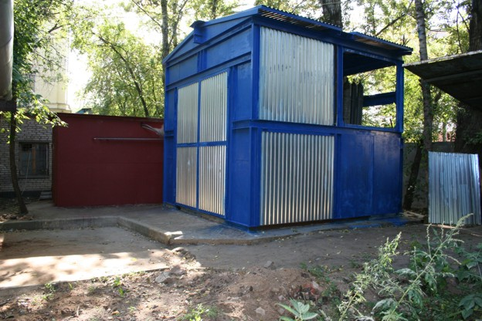
2. Task “B”: development and manufacturing of the experimental test facility
and supporting systems for the VVER scale vessel models testing (1)
Assembling of IVRSA experimental test facility and auxiliary systems (electric, water, gas) is completed now.
Fig.2.1 – Protective and auxiliary housings of IVRSA experimental test facility
16th CEG-SAM meeting, Moscow, IBRAE, Russian Federation , September 8-9, 2009

Slide 22
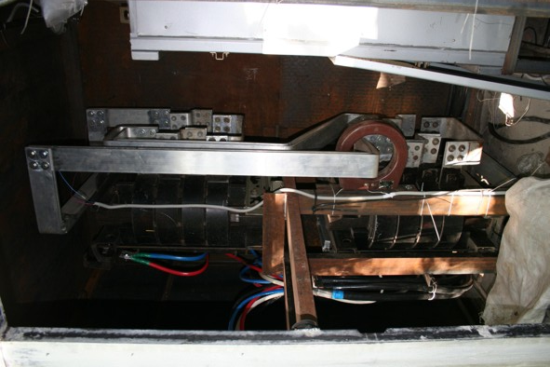
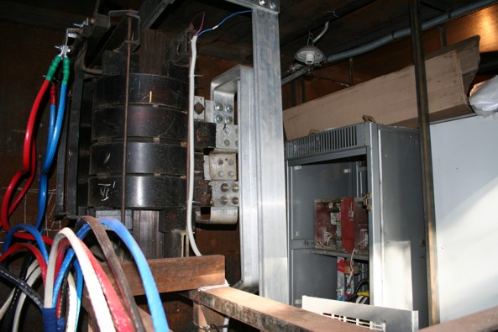
Task “B”: development and manufacturing of the experimental test facility
and supporting systems for the VVER scale vessel models testing (2)
For heating of experimental vessel models it is planned to use 2 power transformers with the total capacity
up to 200 kW which have already been assembled with corresponding control systems in auxiliary housing (fig. 2.2). Further, if necessary, it will be possible to assemble additional power transformers with the total capacity up to
400 kW.
Fig.2.1 – The power transformers installed in the housing and
arrangements for their control
It is planned, that connection of experimental test facility to MPEI electric substation will be completed by October, 10th, 2009.
16th CEG-SAM meeting, Moscow, IBRAE, Russian Federation , September 8-9, 2009

Slide 23
3. Experimental VVER-440 vessel scale model (1)
The object of investigations in the present project is the model of the VVER-440 reactor vessel lower head, made on scale ~1:5. At that, the material and technological features of scale models manufacturing should correspond as much as possible to the manufacturing technique of original VVER vessels. First of all, the following is meant herein:
a) the material of the vessel model should be of the original VVER vessel steel;
b) the technique of manufacturing of the vessel model components (manufacturing of forgings for steel bars of cylindrical course and the bottom), their welding and heat treatment should correspond to standard technique of the VVER vessels manufacturing.
Geometrical Scale: 1:5
The inner diameter: ~700 mm
Wall thickness: 20-30 mm
Fig.3.1 – heating of the vessel scale model
16th CEG-SAM meeting, Moscow, IBRAE, Russian Federation , September 8-9, 2009

Slide 24
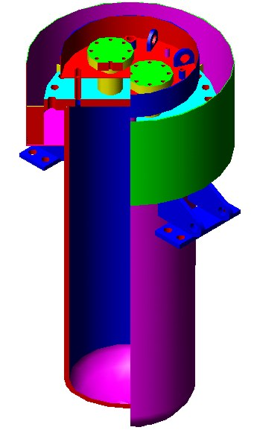
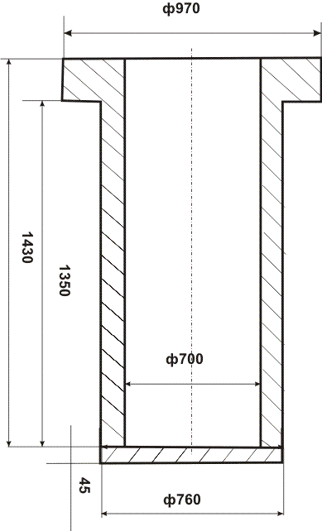
Experimental VVER-440 vessel scale model (2)
Experimental VVER-440 vessel scale model
A construction of the vessel model, presented in fig. 3.2, was developed as a base variant.
In connection with economic conditions which have developed in Russia in the autumn 2008 and in the winter 2009, manufacturing of the given model construction has been suspended.
Because continuation of work on manufacturing of this vessel model construction has been suspended, considerable efforts were made to solve this problem. In particular, it was decided to start development and manufacturing of a simplified scale model construction (Fig. 3.3). It was decided to use a flat bottom in this construction to simplify and reduce the price of the model manufacturing.
This decision is justified because it is planned in the scheduled experiment to study heating and deformation of the model cylindrical part (course).
This vessel model will be of the VVER
vessel steel 15Kh2NMFA.
Fig. 3.3- Variant of the VVER vessel model construction
Fig.3.2 – Base Variant of the VVER vessel model construction
16th CEG-SAM meeting, Moscow, IBRAE, Russian Federation , September 8-9, 2009

Slide 25
Experimental VVER-440 vessel scale model (3)
Manufacturing of this vessel model construction has been started now. A forging from steel 15Kh2NMFA is used as the initial one (Fig 3.4)
After mechanical treatment and welding of the vessel model course with the bottom, the thermal and final mechanical treatments will be carried out.
Planned date of the models manufacturing completion (according to the Working schedule): 7th quarter (the end of May, 2009).
It is planned, that the vessel model (1 piece) will be fabricated in November-December, 2009
Fig. 3.4- Forging for manufacturing of the vessel model course in initial condition and before mechanical treatment
16th CEG-SAM meeting, Moscow, IBRAE, Russian Federation , September 8-9, 2009

Slide 26
4. Heater of the IVRSA-VVER test facility (1)
The electrical heater consisting of the following constructive elements was fabricated for heating of the vessel models:
- spiral heaters made of tungsten wire of 1 mm diameter (fig. 4.1);
- water-cooled current-carrying arrangements, which consist of an upper (fig. 4.2) and a lower (fig. 4.3) parts.
Assemble of the heater will be carried out at final installation and assembling of the vessel scale model.
Fig. 4.1-Spiral heaters
Fig. 4.2-The upper part of the heater
current-carrying arrangement
Fig. 4.3-The lower part of the heater current-carrying arrangement
16th CEG-SAM meeting, Moscow, IBRAE, Russian Federation , September 8-9, 2009

Slide 27
5. The task “D”: The manufacturing and material creep testing of the samples from VVER vessel steel and material property creep testing of the samples cut from the tested VVER vessel models (1)
Main results:
1) Creep experiments were carried out in the temperature range from 750 to 1050 C and on the time base up to 50 hours at constant load.
2) The main results of these tests are presented in the below mentioned diagrams.
3) Tests were carried out, as a rule, in the protective medium of argon, but some modes of tests were carried out in the air medium.
Fig. 5.1- Creep diagrams at 750 and 800 C
16th CEG-SAM meeting, Moscow, IBRAE, Russian Federation , September 8-9, 2009

Slide 28
5. The task “D”: The manufacturing and material creep testing of the samples from VVER vessel steel and material property creep testing of the samples cut from the tested VVER vessel models (2)
Fig. 5.2- Creep diagrams at 850, 900 and 950 C
16th CEG-SAM meeting, Moscow, IBRAE, Russian Federation , September 8-9, 2009

Slide 29
5. The task “D”: The manufacturing and material creep testing of the samples from VVER vessel steel and material property creep testing of the samples cut from the tested VVER vessel models (3)
Fig. 5.3- Creep diagrams at 1050 C
It is necessary to note some features of investigated steel behaviour in the studied range of tests:
Absence of protective medium (argon) leads to considerable hardening of material and slowing-down of deformation process at creep of this steel.
It is connected, first of all, with formation of hard oxide film on the tested specimens surface;
2) with increase of the process duration, deformation at the moment of the specimens destruction considerably increases;
16th CEG-SAM meeting, Moscow, IBRAE, Russian Federation , September 8-9, 2009

Slide 30
6. Concerning selection of conditions of the VVER-440 reactor vessel scale model testing
Main point:
In connection with the developed situation, testing of 1 vessel model is scheduled instead of 3 planned experiments.
In this connection, obtaining of maximum information on deformation and destruction features of the vessel model in the conditions of vessel steel high-temperature creep is extremely actual.
How can we realize it?
One of the ways is choosing of a step-by-step mode of heating and load change (owing to change of internal pressure in the vessel). At that, at each level of temperature (of the vessel wall) it is reasonable to execute not less than 2 or 3 load steps. Duration of retention at each intermediate step of test will be determined proceeding from the value of the vessel model deformation which would allow to estimate speed of creep at each test step with sufficient accuracy.
Choosing of such test mode presuppose carrying out of justified pre-test calculations.
The final decision concerning a choice of the tests mode must be agreed by all interested parties of the project (participants and collaborators of the project).
16th CEG-SAM meeting, Moscow, IBRAE, Russian Federation , September 8-9, 2009

Slide 31
Thank You!
End
16th CEG-SAM meeting, Moscow, IBRAE, Russian Federation , September 8-9, 2009

