Slide 1
ISTC Project «Scale experimental investigation of the thermal and structural integrity of the VVER Pressure Vessel Lower Head in severe accident» (#3635)
Participating Institutions:
- «Moscow Power Engineering Institute» (MPEI): Leading Institution
- Federal State Unitary Enterprise «Experimental and Design Organization “GIDROPRESS” (EDO «GP»)
- Lavrentyev Institute of Hydrodynamics of the Siberian Branch of the Russian Academy of Sciences (IGiL)
Start: Sept. 01, 2007
Duration: 36 months
Prolongation: 12 months
ISTC Project #3635. 18th CEG-SAM meeting, St. Petersburg, RF, September 28-30, 2010

Slide 2
Collaborators:
Forschungszentrum Karlsruhe GmbH (Germany)
CEA Saclay, DEN/DANS/DM2S/SEMT, Laboratoire de Mecanique Systeme et Simulation (France)
Material and Components Safety Department, Institut fur Sicherheitsforschung, Forschungszentrum Rossendorf (Germany)
EC JRC, Institute for Transuranium Elements (Karlsruhe), Hot Cell Technology (Germany)
Division of Nuclear Power Safety, Department of Physics, Royal Institute of Technology (Sweden)
Department of Engineering Physics, College of Engineering, University of Wisconsin (USA)
Institute of Nuclear Technology, Institute of Nuclear Safety System, Incorporated (Japan)
Mechanical & Nuclear Engineering, The Pennsylvania State University (USA)
ISTC Project #3635. 18th CEG-SAM meeting, St. Petersburg, RF, September 28-30, 2010

Slide 3
The project efforts are focused on the following problems:
- the designing and construction of the test facility for test examinations of the VVER-440 vessel scale models on the conditions which correspond to SA in the VVER;
- manufacturing of the VVER-440 reactor vessel scale models (scale 1:5) . Material and technology, as well as thermal treatment have to correspond the same conditions of the regular VVER vessels manufacturing;
- pursuance of the material creep test experiments with samples from the VVER vessel steel on the time range 2-50 h and temperature range 700 - 1200 C to receive the creep data for refinement of the constitutive creep model and ordinary mechanical characteristics of this steel;
- the carrying out the scale experiments with VVER vessel models on the high-temperature heat-up and creep deformation of the vessel;
- the mathematical treatment and analysis of scale experiments, carrying out the numerical pre- and post-test structural analyses of scale experiments with vessel models
ISTC Project #3635. 18th CEG-SAM meeting, St. Petersburg, RF, September 28-30, 2010

Slide 4
1. Task “А”: Development and manufacturing of the experimental test facility and supporting systems for the VVER scale vessel models testing (1)
Experimental test facility IVRSA-VVER (Investigation of the Vessel Rupture during Severe Accident on the VVERs) is intended for thermomechanical tests of scale models of the VVER reactor vessels in the conditions simulating a stage of SA in reactor installations with VVER, when the molten fragments of the core accumulate in the lower head of the reactor vessel.
The test facility consists of a protective casing, an auxiliary premise for placing of auxiliary systems, system of the model heating, water and gas systems, video monitoring system, and also data acquisition system (DAS).
Fig.1.1 – The sketch of the IVRSA experimental test facility
ISTC Project #3635. 18th CEG-SAM meeting, St. Petersburg, RF, September 28-30, 2010

Slide 5
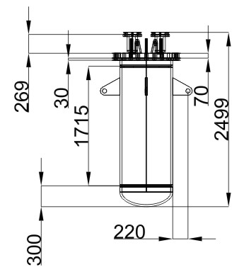
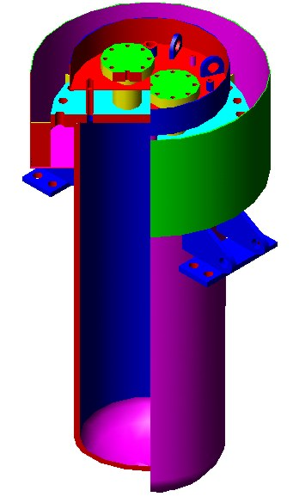
2. Task “B”: Experimental VVER-440 vessel scale model (1)
The object of investigations in the present project is the model of the VVER-440 reactor vessel (lower part) on scale ~1:5.
The material and technological features of scale models manufacturing should correspond as much as possible to the manufacturing technique of original VVER vessels. First of all, the following is meant herein:
- the material of the vessel model is the original VVER vessel steel (15Kh2NMFA);
- the technique of manufacturing of the vessel model components (manufacturing of forgings for steel bars of cylindrical course) and heat treatment should correspond to standard technique of the VVER vessels manufacturing.
Fig.2.1 – design of the vessel scale model. Var. #1 (“Base variant”)
During the project implementation some designs of the vessel model have been developed.
A design of the vessel model, presented in fig. 2.1, was developed as a base variant. In this construction the cylindrical course, the bottom and the flange of the vessel model have been made of the VVER vessel steel 15Kh2NMFA.
In connection with economic conditions which have developed in Russia in 2008-2009, manufacturing of the given model construction has been suspended.
ISTC Project #3635. 18th CEG-SAM meeting, St. Petersburg, RF, September 28-30, 2010

Slide 6
2. Task “B”: Experimental VVER-440 vessel scale model (2)
-This decision is justified because it is planned in the scheduled experiment to study heating and deformation of the model cylindrical part. In this vessel model the VVER steel (15Kh2NMFA) is used for the cylindrical course of the vessel. The bottom of model is made of the Steel 20.
Features of the given vessel model design are the following:
there is a thermal insulation an internal surfaces of the bottom and cover. It will lead to decreasing of the thermal action from the heater to model construction.
presence of water cooling of a cover and the top part of the model.
Fig.2.2 – Var. #4 of the vessel scale model design
ISTC Project #3635. 18th CEG-SAM meeting, St. Petersburg, RF, September 28-30, 2010

Slide 7
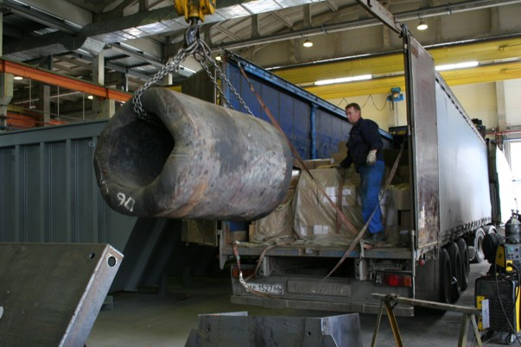
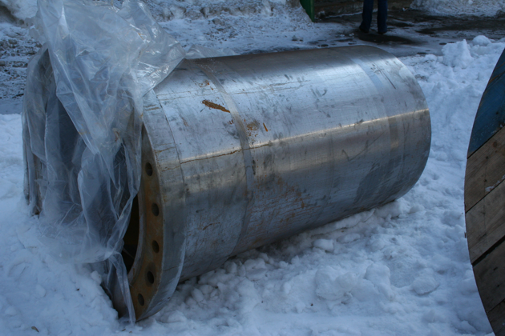
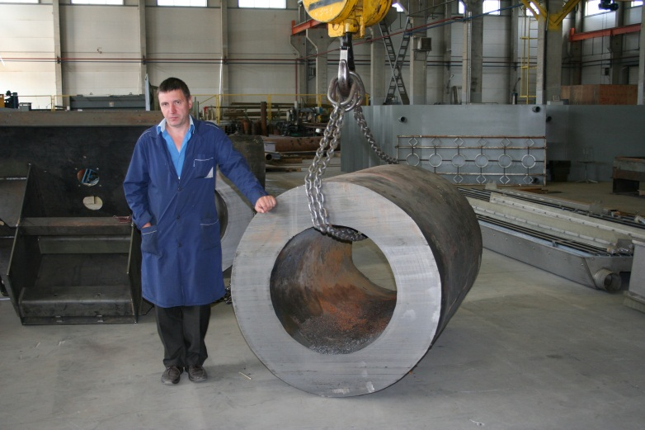
2. Task “B”: Experimental VVER-440 vessel scale model (3).
The main stages of the vessel model manufacturing
The billet from 15Kh2NMFA steel was used for the manufacturing of the vessel model (fig. 2.6).
Fig.2.3 – Preparation and machining of the
vessel models from the billet
ISTC Project #3635. 18th CEG-SAM meeting, St. Petersburg, RF, September 28-30, 2010

Slide 8
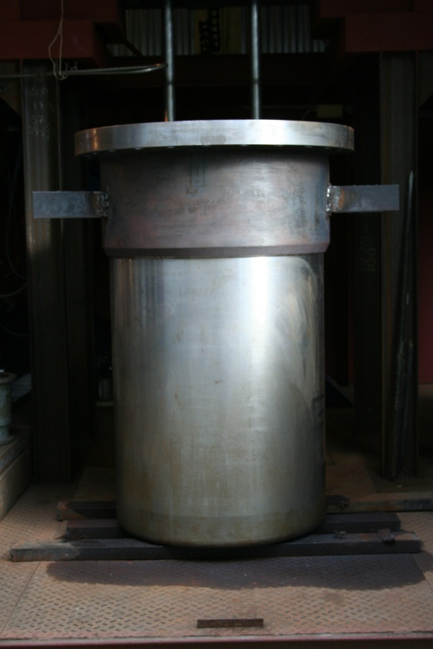
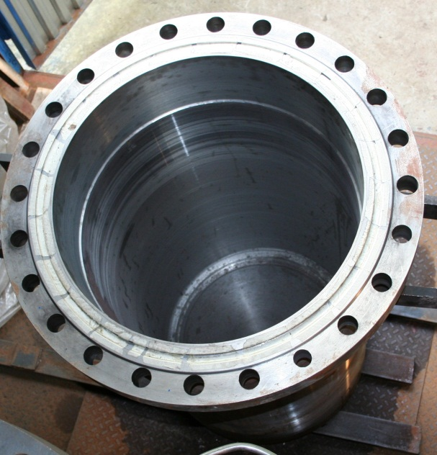
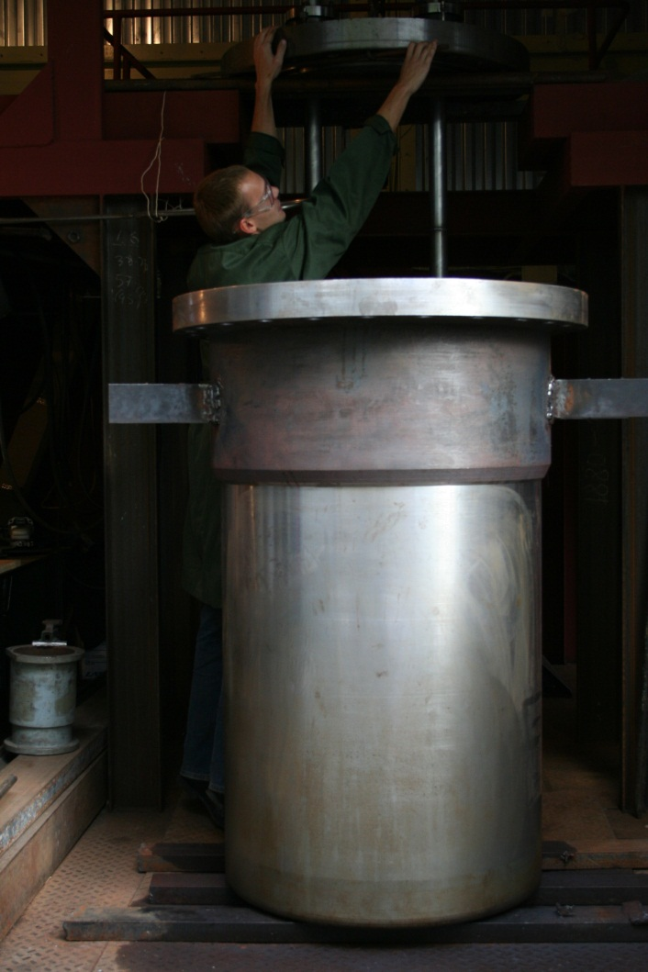
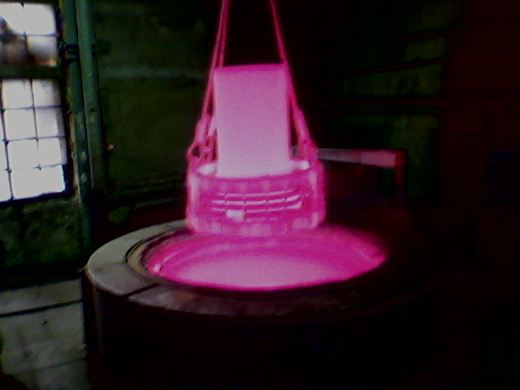
2. Task “B”: Experimental VVER-440 vessel scale model (4).
After thermal treatment and of the vessel model, the final mechanical treatments were carried out.
ISTC Project #3635. 18th CEG-SAM meeting, St. Petersburg, RF, September 28-30, 2010

Slide 9
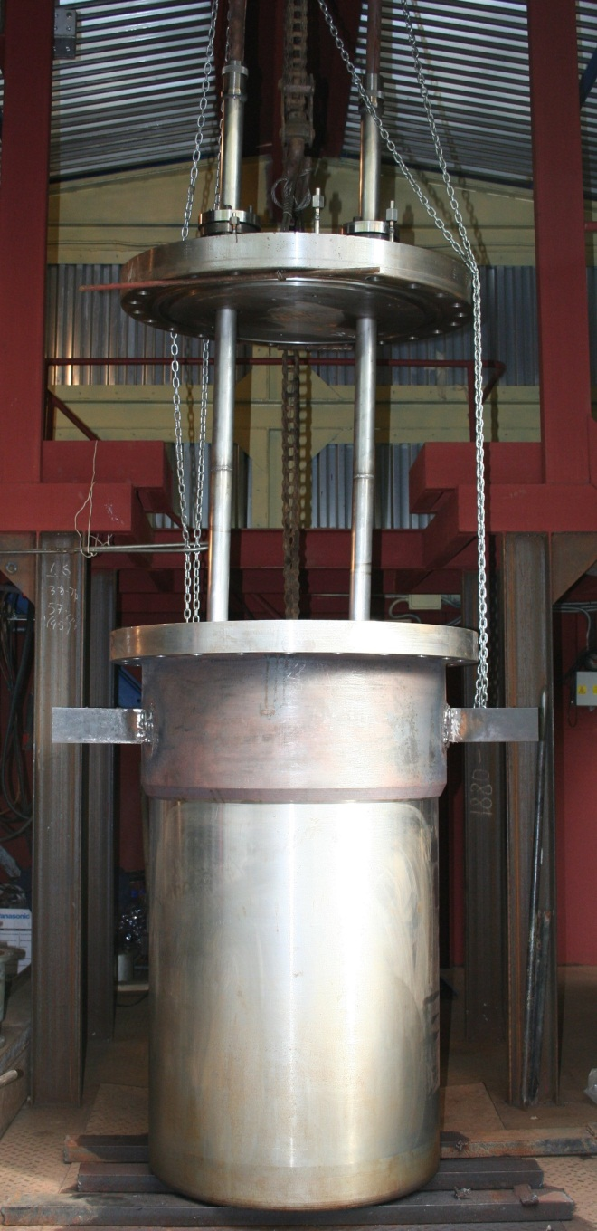
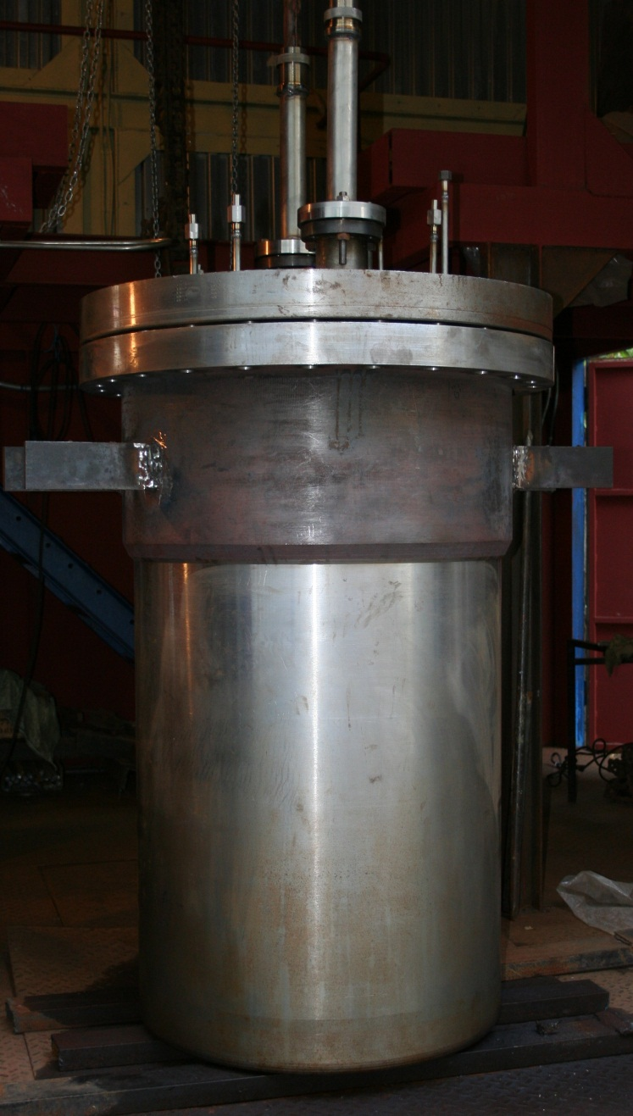
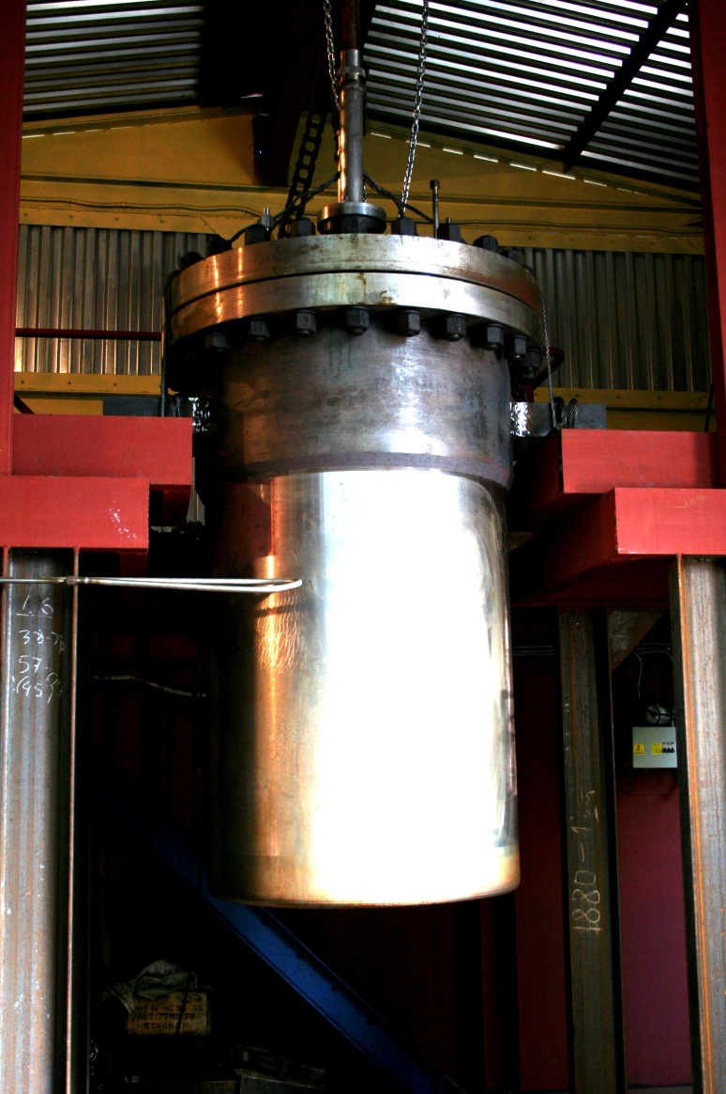
2. Task “B”: Experimental VVER-440 vessel scale model (5).
ISTC Project #3635. 18th CEG-SAM meeting, St. Petersburg, RF, September 28-30, 2010

Slide 10
3. Task “C”: Pre-test calculations. Analysis of the test conditions and numerical pre-test simulations of the upcoming scale experiment on the IVRSA test facility (1)
At the previous CEG-SAM-17 meeting the basic testing procedure was agreed. The ranges of the vessel wall temperature and overpressure value in the vessel were determined. Particularly it was decided to use stepwise
change of the thermal load and pressure during the testing. Meanwhile, it was noted that in the process of testing the wall temperature should increase and pressure should decrease, respectively.
The main problem for realization of such testing scheme is to exclude premature failure of the model construction. To determine more precisely conduct of the vessel model the pre-test calculations have been carried out.
Numerical pre-test simulations of the vessel models behaviour during scale experiment for the chosen test conditions were carried out by means of the commercial MSC.MARC *) (EDO “Gidropress”) and domestic ATM-VVER (MPEI- Moscow Power Eng. Inst.) codes.
The following work has been carried out within the current stage:
- the test conditions of the planned first scale experiment have been chosen;
- carrying out of the numerical pre-test calculations for the chosen test conditions of the scale experiment.
In the course of the executed pre-test calculations the final scenario of the scale experiment has been determined. Results of the pre-test calculations for this scenario are presented in Fig. 3.1 and considered below.
*) Code MSC.MARC-2005 (MSC.Software Gmbh, 2005)
Fig. 3.1 – Scenario of the scale experiment
P= from 5.2 to 3 MPa;
T_out= from 1053 to 1265 К
ISTC Project #3635. 18th CEG-SAM meeting, St. Petersburg, RF, September 28-30, 2010

Slide 11
3. Task “C”: Pre-test calculations. Initial data and boundary conditions (2)
The following boundary conditions are assumed within pre-test calculations (see Fig. 1):
1) heat flux of the preset intensity is distributed on the model internal surface. In the course of experiment the value of heat flux is changed to provide the required temperature on the vessel external surface.
2) a maximum of the heat flux peak is located on the inner surface of the cylindrical vessel wall and is above (~ 250-300 mm) the welded seam (joining the bottom and a cylindrical part of the vessel model) (Fig. 3.2).
3) the heat transfer conditions (convective and radiant) on the external vessel surface is accomplished with ambient air with temperature of 333 K;
4) the assigned value of overpressure in the vessel model is created inside the model vessel by argon;
5) Heating of the model is carried out on the inner surface of the vessel by means of the special internal electric heater placed inside the vessel model.
The ring heater of the model is located in the lower part of the vessel and that leads to the peaked heat flux distribution on an internal surface of the scale model during testing.
Fig.3.2 – Thermal/structural model for pre-test calculations
ISTC Project #3635. 18th CEG-SAM meeting, St. Petersburg, RF, September 28-30, 2010

Slide 12
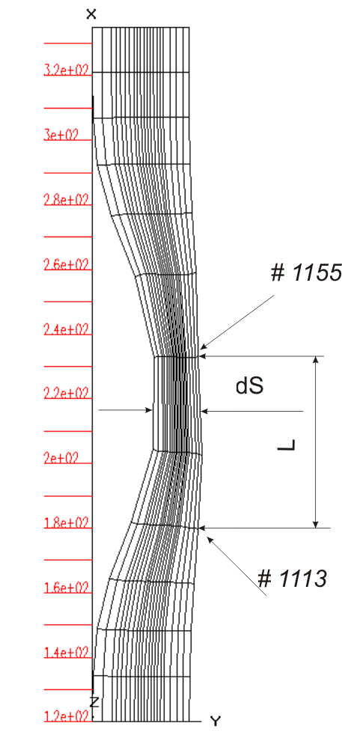
3. Task “C”: Pre-test calculations. Main results (3)
In the course of numerical calculations the temperature condition of the structure and its deformation were determined till the model failure.
Creep strain of the vessel model (axial - along the longitudinal axis Z, and transverse strain of the wall) and creep strain rate (along of the axis Z) were determined at the most loaded section of the structure – in the region of maximum heating according to scheme in the Fig. 3.3.
Deformation:
εz= (L/L0)
εr= (dS/dS0)
a=aconv+aradiation
T∞= 330 K
e= 0.7
Heat flux distribution
Fig.3.3 – Thermal/structural model for pre-test calculations
Fig.3.4 – Thermal/structural model
for pre-test calculations
ISTC Project #3635. 18th CEG-SAM meeting, St. Petersburg, RF, September 28-30, 2010

Slide 13
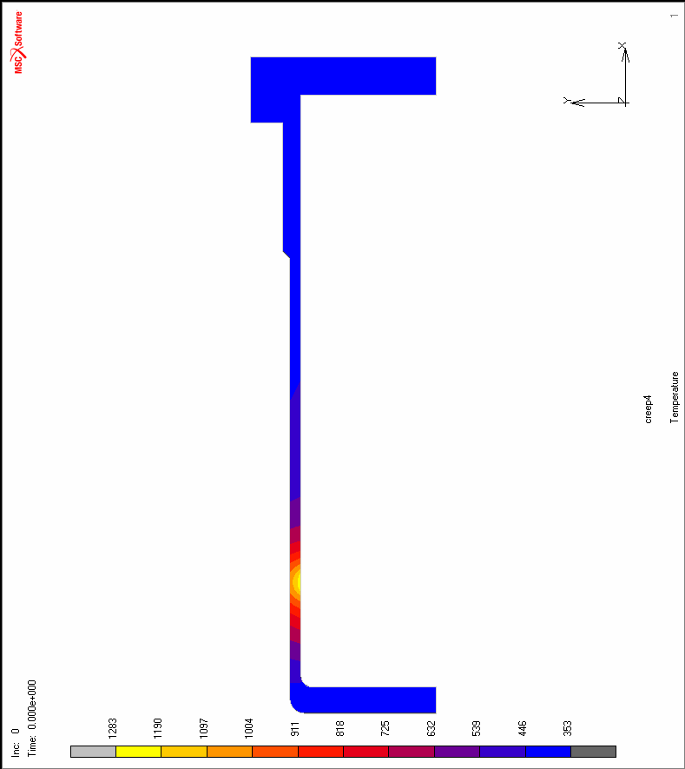
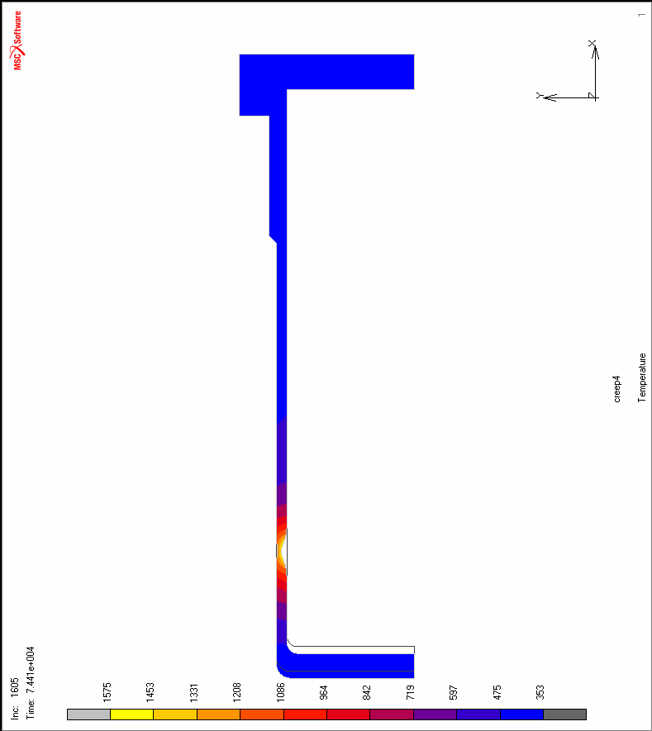
3. Task “C”: Pre-test calculations. Main results (4)
b)
a)
Fig.3.5 – Temperature distribution in the vessel model at initial time (a) and 74410 s (b)
ISTC Project #3635. 18th CEG-SAM meeting, St. Petersburg, RF, September 28-30, 2010

Slide 14
3. Task “C”: Pre-test calculations. Main results (5)
The analysis of the pre-test calculation results enables to draw the following conclusions:
1) the failure time of the vessel model was equal to 20.7 and 42,3 h obtained as a result of the numerical calculations executed by EDO “GIDROPRESS” and MPEI-TU teams respectively (Fig. 3.6);
2) a maximal vertical displacement of the vessel bottom at the moment of the model failure is equal to 20 (by the MARC code) and 75 mm (by the ATM-VVER code). The character of the vertical displacement of the vessel bottom obtained by these codes is similar practically up to 20 h;
Fig.3.6 – Vertical creep displacement of the
vessel bottom during testing
ISTC Project #3635. 18th CEG-SAM meeting, St. Petersburg, RF, September 28-30, 2010

Slide 15
3. Task “C”: Pre-test calculations. Main results (6)
The analysis of the pre-test calculation results. Conclusions:
3) the maximal value of the radial displacement of the vessel wall does not exceed 2 mm (EDO “GP”) and 13 mm (MPEI results ), respectively (Fig. 3.7).
Because the results of the pre-test calculations obtained by EDO “GP” have appeared more critical than results obtained by MPEI (from the view point of the failure time of the vessel model) it is reasonable to consider and analyze the pre-test results obtained by the EDO “GP” only.
Main results of this analysis are presented below.
Fig.3.7 – Radial displacement of the vessel
wall model during testing
ISTC Project #3635. 18th CEG-SAM meeting, St. Petersburg, RF, September 28-30, 2010

Slide 16
3. Task “C”: Pre-test calculations. Main results (7)
Relative stress distributions across the vessel wall during the test:
as can be seen the maximal relative stresses in the vessel wall are observed in its external layers of the vessel wall;
Initial vessel failure may occur after 12 hours of the test process when the actual wall stresses exceed a yield stress of the vessel steel
Fig.3.8
ISTC Project #3635. 18th CEG-SAM meeting, St. Petersburg, RF, September 28-30, 2010

Slide 17
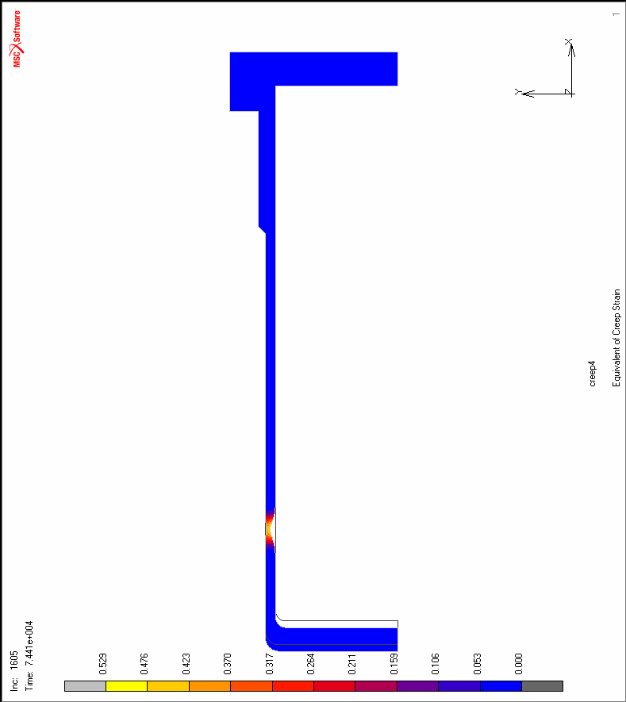
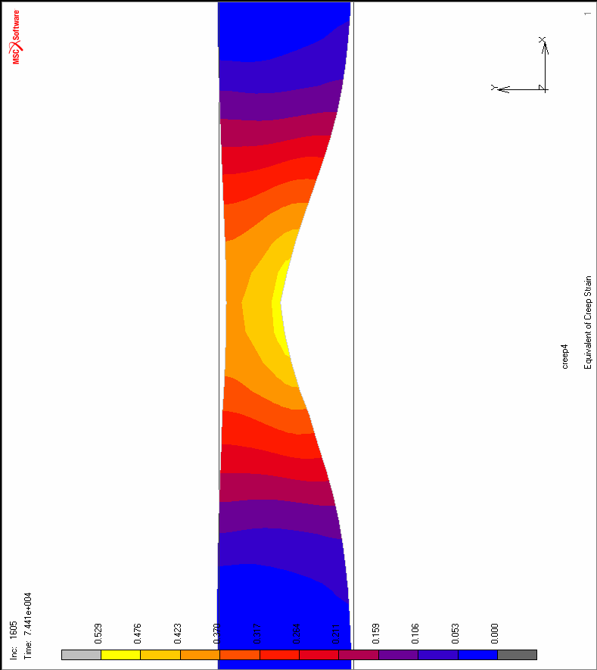
3. Task “C”: Pre-test calculations. Main results (8)
The analysis of the pre-test calculation results:
- maximal vertical displacement of the vessel bottom at the moment of the model failure has appeared equal to 20 (by the MARC code) and 75 mm (by the ATM-VVER code);
- the maximal value of the radial displacement of the vessel wall does not exceed 2 (EDO “GP”) and 13 mm (MPEI results ), respectively;
- the most intensive vessel creep deformation is observed in the most heated zone (Z= 220- 250 mm)
Fig.3.9 – Creep strain distribution in the vessel model fragment at 74410 s
ISTC Project #3635. 18th CEG-SAM meeting, St. Petersburg, RF, September 28-30, 2010

Slide 18
3. Task “C”: Pre-test calculations. Conclusion (9)
The analysis of the presented results allows to conclude the following:
a) the failure time of the vessel model is equal to 20.7 and 42,3 h. These results are obtained by means of the numerical calculations executed by EDO “GIDROPRESS” and MPEI-TU teams respectively;
b) maximal vertical displacement of the vessel bottom at the moment of the model failure has appeared equal to 20 (by the MARC code) and 75 mm (by the ATM-VVER code);
c) the maximal value of the radial displacement of the vessel wall does not exceed 2 mm (EDO “GP”) and 13 mm (MPEI results ), respectively;
d) the most intensive vessel creep deformation is observed in the most heated zone (Z= 220- 250 mm);
e) the maximal relative stresses in the vessel wall are observed in its external layers of the vessel wall. Initial vessel failure may occur after 12 hours of the test process when the actual wall stresses exceed a yield stress of the vessel steel.
Remark
As is evident from the foregoing the EDO “GP” results that the moment of the model failure can occur much earlier than the results received by MPEI imply it (EDO “GP” at 4 MPa & 948°C at 20,7h against MPEI’s failure time as 42.3 h). That means the implementation of the experiment requires possibility of adjusting temperature and pressure to avoid damage of the model construction at an early stage.
Therefore Dr. Bottomley’s comment seems well-grounded substantiated:
“..Nevertheless Eberhard Altstadt noted that it was better to have failure under constant or slightly falling temperature and constant pressure. Given this remark of Eberhard's then if the vessel's creep behaviour during the test tends towards the more severe prediction of the GP model, I would propose that you forego the last temperature rise in order to see failure under a 'constant regime' without the interference of a late change in conditions. By constrast, if creep was proceeding more slowly than expected then possibly maintaining the pressure (at 4MPa) instead of reducing it to 3MPa could give you more interesting results. ”
ISTC Project #3635. 18th CEG-SAM meeting, St. Petersburg, RF, September 28-30, 2010

Slide 19
4. The Task “D”: Creep testing of the VVER vessel steel (1)
A vessel steel 15Kh2NMFA (TS 108-765-78) of which the lower course of the VVER vessel No. 1152.02.70.000 (number of fusion 107210), number of forgings 5015 has been made was the material which mechanical properties were subject to definition in process of material property studies.
The specimens fabricated for the tests had circular cross-section of 10 mm diameter and working length of 45 mm. Besides, the specimens with diameter of 5.5 mm and working length of 30 mm were fabricated. These specimens were used for testing when tensile elongation exceeded 120%(Fig. 4.1).
Main results:
1) Creep experiments in the vacuum at 900, 1000, 1100 and 1200 C and on the time base up to 50 hours at constant load have been carried out and finished;
2) creep tests in the range from 700 to 1100 С in argon medium have been carried out and finished;
3) The basic results representing dependence of time to failure via the applied stress are presented in fig. 4.2.
4) At present the analysis and mathematical treatment of test results are in progress which will be presented in the final report.
ISTC Project #3635. 18th CEG-SAM meeting, St. Petersburg, RF, September 28-30, 2010

Slide 20
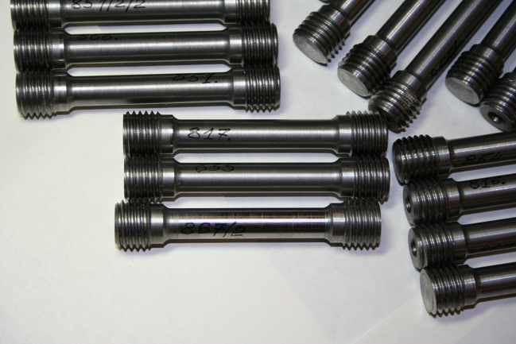
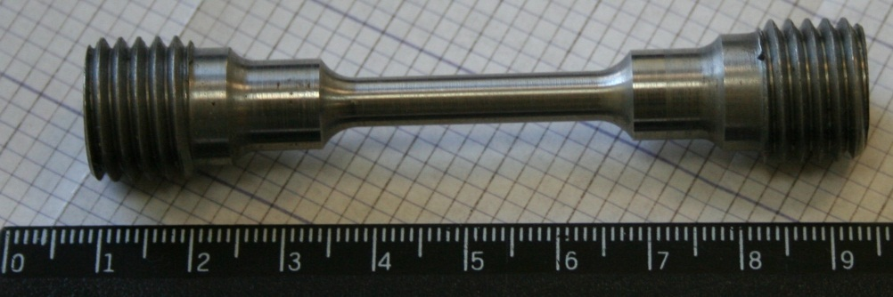
4. The Task “D”: Creep testing of the VVER vessel steel (2)
The specimens for testing in vacuum at temperature 900-1200 C
fabricated from 15Kh2NMFA vessel steel and have circular cross-section of 10 mm diameter and working length of 45 mm.
The specimens for testing in vacuum at temperature 900-1200 C.
Diameter 5.5 mm and working length of 30 mm.
Fig. 4.1- Specimens for creep testing of the VVER vessel steel in vacuum
ISTC Project #3635. 18th CEG-SAM meeting, St. Petersburg, RF, September 28-30, 2010

Slide 21
4. The Task “D”: Creep testing of the VVER vessel steel (3)
Creep experiments have been carried out and finished:
- in the range from 700 to 900 С in argon;
- in the range from 900 to 1200 С in vacuum
as a rule, elongation of the specimens considerably exceeds 100%;
- In some cases there were two or three necks at working length of the specimen;
-use of argon as the protective medium leads to considerable reduction (in 2 times and more) of time to failure of the specimen.
It probably depends on oxidation of the surface of the specimens owing to partial ingress of air to the test cell.
Formation of the oxide film and its destruction under deformation leads to earlier failure of the specimens in comparison with vacuum testing.
- there is similarity in the curve behavior (diagrams “time to failure- Stress” ) within given temperature range from 700 to 1200 C.
Fig. 4.2- “Time to failure via stress” diagrams of the VVER 15Kh2NMFA Steel
ISTC Project #3635. 18th CEG-SAM meeting, St. Petersburg, RF, September 28-30, 2010

Slide 22
4. The Task “D”: Creep testing of the VVER vessel steel (4)
Conclusions:
1) Creep experiments in the range from 700 to 1100 С in argon and vacuum have been carried out and finished;
2) The creep testing of the specimens from VVER vessel steel in the temperature range of 900-1200 C showed the following:
- as a rule, elongation of the specimens considerably exceeds 100%. In some cases there were two or three necks at working length of the specimen;
-use of argon as the protective medium leads to considerable reduction (in 2 times and more) of time to failure of the specimen.
It probably depends on oxidation of the surface of the specimens owing to partial ingress of air to the test cell.
Formation of the oxide film and its destruction under deformation leads to earlier failure of the specimens in comparison with vacuum testing.
3) there is similarity in the curve behavior (diagrams “time to failure- Stress” ) within given temperature range from 700 to 1200 C.
ISTC Project #3635. 18th CEG-SAM meeting, St. Petersburg, RF, September 28-30, 2010

Slide 23
Thank You!
End
ISTC Project #3635. 18th CEG-SAM meeting, St. Petersburg, RF, September 28-30, 2010

