Slide 1
ISTC Project «Scale experimental investigation of the thermal and structural integrity of the VVER pressure vessel Lower Head in severe accident» (#3635)
Participating Institutions:
- «Moscow Power Engineering Institute» (MPEI): Leading Institution
- Federal State Unitary Enterprise «Experimental and Design Organization “GIDROPRESS” (EDO «GP»)
- Lavrentyev Institute of Hydrodynamics of the Siberian Branch of the Russian Academy of Sciences (IGiL)
Kiev, September 9-12, 2008, Loktionov V.D.

Slide 14
there is essential
tightening of the vessel wall
in the most heated area.

Slide 15
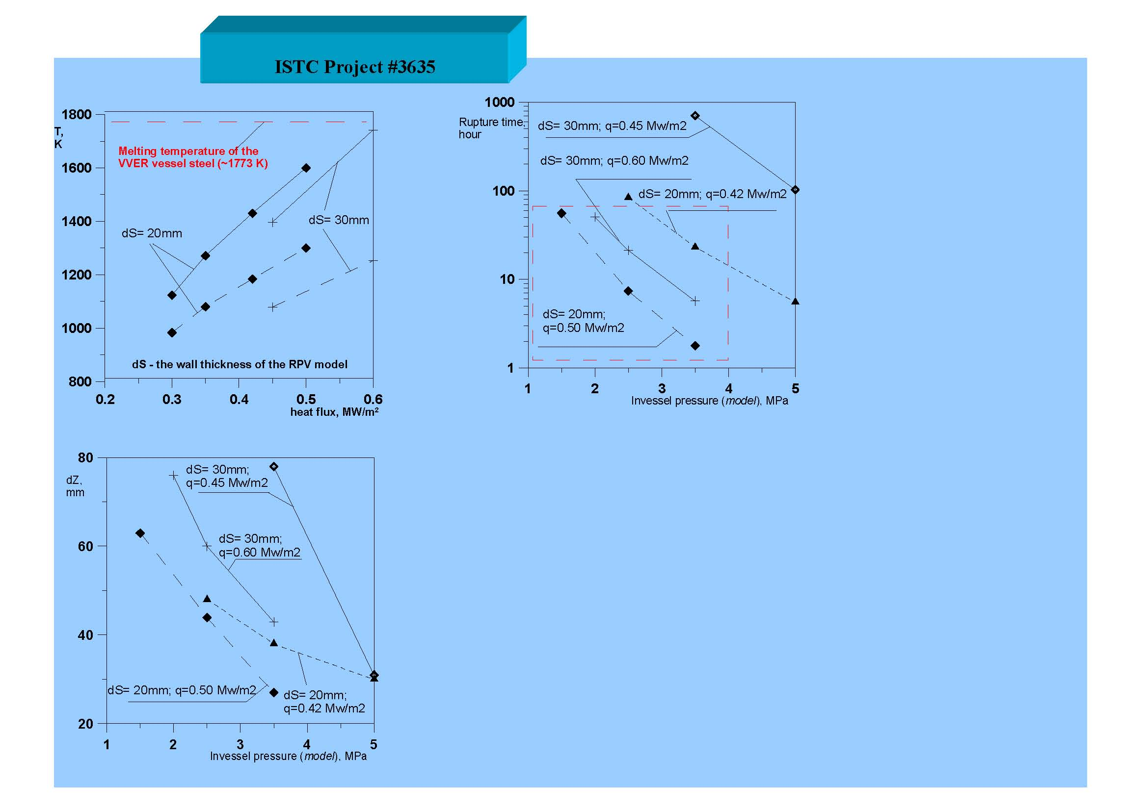
The results of numerical experiments
The following conclusions can be made up based on the presented results:
- when the vessel wall thickness equals to 30 mm, the temperature on the inside surface of the vessel reaches the melting temperature (~ 1773 К) at the heat flux about 0.6 MW/m2;
- at reduction of the model wall thickness both the time before destruction reduces and also the vertical displacement of the model bottom;
- for the wall thickness from 20 to 30 mm and pressure level in the model no more than 4.0 MPa it is necessary to ensure the heat flux at the level no less than 0.4 MW/m2 in order to ensure the duration of the tests no more than 100 hours;
- the value of the vertical displacement of the model bottom does not exceed 90 mm at the moment of the model destruction.

Slide 17
The diagram of the housing of the experimental test
The length, width and height of
the protective housing are
5, 4.5 and 5 m respectively
Current Technical Status
- at the present time, construction of the protective
housing has been completed and assembling
of the electric and water auxiliary systems
of the experimental test facility has been started;
- manufacturing of DAS system approaches to the completion.

Slide 22
At the present time, the tests of the heating elements are at the stage of preparation

Slide 24
Main Results:
- cutting out of the plates from the unirradiated VVER reactor vessel was carried out;
- the samples (1-st series) were fabricated of the VVER vessel steel;
- the material property creep and short-term tensile tests of the VVER vessel steel samples have been started and they are carried out now.

Slide 29
Thank You! End

