Slide 1
ISTC Project «Scale experimental investigation of the thermal and structural integrity of the VVER Pressure Vessel Lower Head in severe accident» (#3635)
Participating Institutions:
- «Moscow Power Engineering Institute» (MPEI): Leading Institution
- Federal State Unitary Enterprise «Experimental and Design Organization “GIDROPRESS” (EDO «GP»)
- Lavrentyev Institute of Hydrodynamics of the Siberian Branch of the Russian Academy of Sciences (IGiL)
Start: Sept. 01, 2007
Duration: 36 months
Prolongation: 12 months
ISTC Project #3635. 19th CEG-SAM meeting, Pisa, Italy, March 14-16, 2011

Slide 2
Collaborators:
Forschungszentrum Karlsruhe GmbH (Germany)
CEA Saclay, DEN/DANS/DM2S/SEMT, Laboratoire de Mecanique Systeme et Simulation (France)
Material and Components Safety Department, Institut fur Sicherheitsforschung, Forschungszentrum Rossendorf (Germany)
EC JRC, Institute for Transuranium Elements (Karlsruhe), Hot Cell Technology (Germany)
Division of Nuclear Power Safety, Department of Physics, Royal Institute of Technology (Sweden)
Department of Engineering Physics, College of Engineering, University of Wisconsin (USA)
Institute of Nuclear Technology, Institute of Nuclear Safety System, Incorporated (Japan)
Mechanical & Nuclear Engineering, The Pennsylvania State University (USA)
ISTC Project #3635. 19th CEG-SAM meeting, Pisa, Italy, March 14-16, 2011

Slide 3
The project efforts are focused on the following problems:
- the designing and construction of the test facility for test examinations of the VVER-440 vessel scale models on the conditions which correspond to SA in the VVER;
- manufacturing of the VVER-440 reactor vessel scale models (scale 1:5) . Material and technology, as well as thermal treatment have to correspond the same conditions of the regular VVER vessels manufacturing;
- pursuance of the material creep test experiments with samples from the VVER vessel steel on the time range 2-50 h and temperature range 700 - 1200 C to receive the creep data for refinement of the constitutive creep model and ordinary mechanical characteristics of this steel;
- the carrying out the scale experiments with VVER vessel models on the high-temperature heat-up and creep deformation of the vessel;
- the mathematical treatment and analysis of scale experiments, carrying out the numerical pre- and post-test structural analyses of scale experiments with vessel models

Slide 4
2. Task “B”: The preparation of the scale experiment (0)
Starting from September 2010 works connected to the preparation of testing of the scaled model of the vessel have been carried out.
One of the stages of this work has been the examination of the working capacity of all the systems of IVRSA test facility. In fact the following tests have been planned:
- testing of the gas system;
- testing of the leak integrity of the model with the electric heater;
- testing of the systems of electrical load regulation;
- testing of the cooling system of the vessel model and electrical conductors of the heater.
ISTC Project #3635. 19th CEG-SAM meeting, Pisa, Italy, March 14-16, 2011

Slide 5
2. Task “B”: Experimental VVER-440 vessel scale model (1)
- In the vessel model the VVER steel (15Kh2NMFA) is used for the cylindrical course of the vessel. The bottom of model is made of the Steel 20.
it is planned in the scheduled experiment to study heating and deformation of the model cylindrical part.
Fig.2.1 – the vessel scale model design
ISTC Project #3635. 19th CEG-SAM meeting, Pisa, Italy, March 14-16, 2011

Slide 6
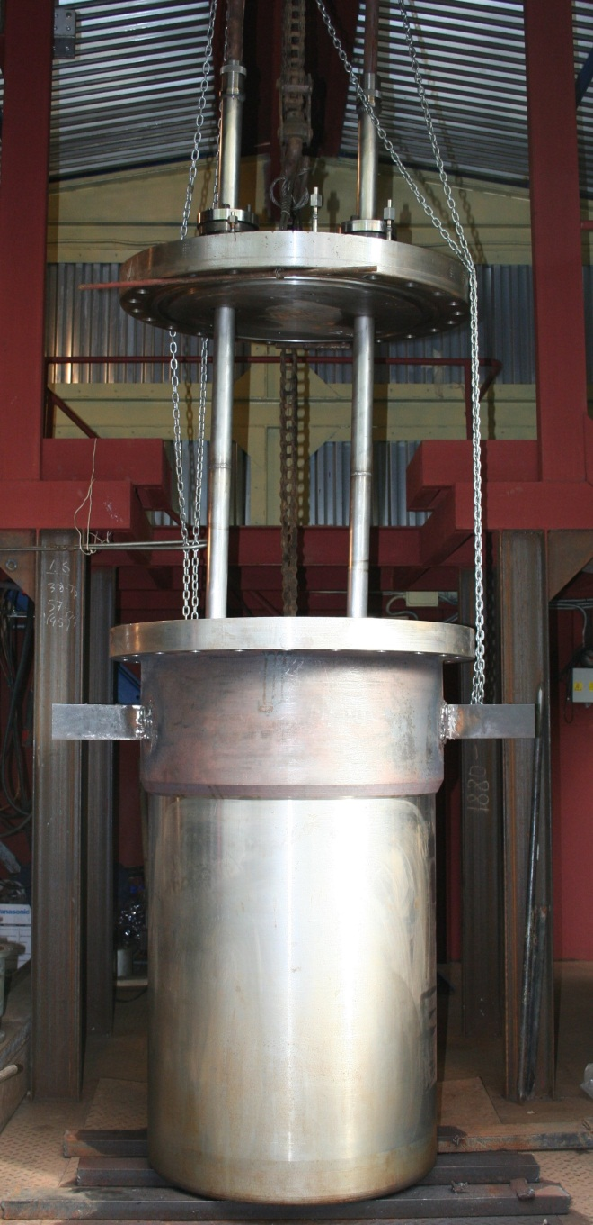
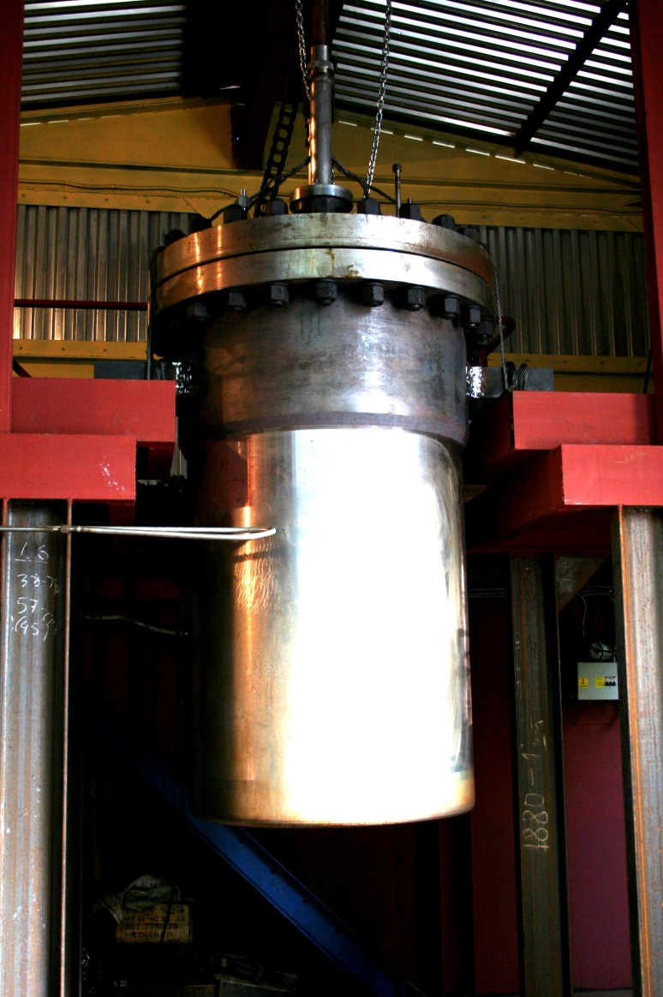
3. Task “C”: The preparation of the scale experiment on the high-temperature heat-up and creep deformation of the vessel model (1)
Test for leak integrity of the scale model and auxiliary systems of the IVRSA facility
It was assumed according to the test plan that the excess pressure in the vessel model will be about 7.5 MPa.
In the course of the test the assembled vessel model with a lid and a heater was filled with water.
The overpressure in the model was due to the gas pressurization.
The test was carried out in November 2011.
ISTC Project #3635. 19th CEG-SAM meeting, Pisa, Italy, March 14-16, 2011

Slide 7
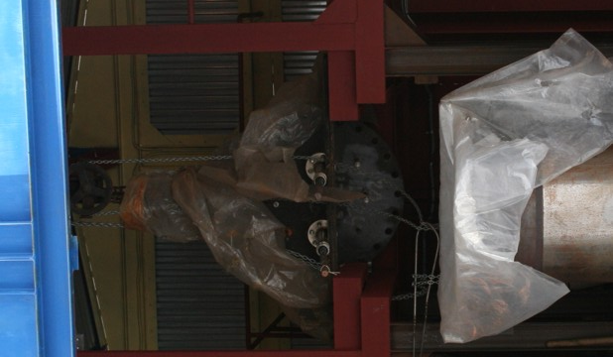
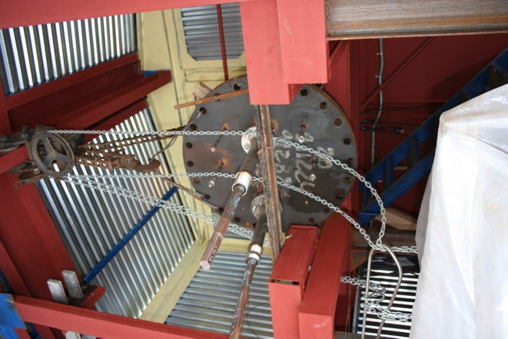
3. Task “C”: The preparation of the scale experiment (2)
In the course of the test one of the electrical conductors lost an integrity at the pressure of 2.5 MPa.
It has been decided to dismantle the defective electrical conductor
and either to repair it or to replace it to make up for the damage.
As far as the electrical conductor
is indecomposable it can be dismantled only if cut into several fragments.
In this case the repairing works will amount to the manufacturing of a new conductor.
ISTC Project #3635. 19th CEG-SAM meeting, Pisa, Italy, March 14-16, 2011

Slide 8
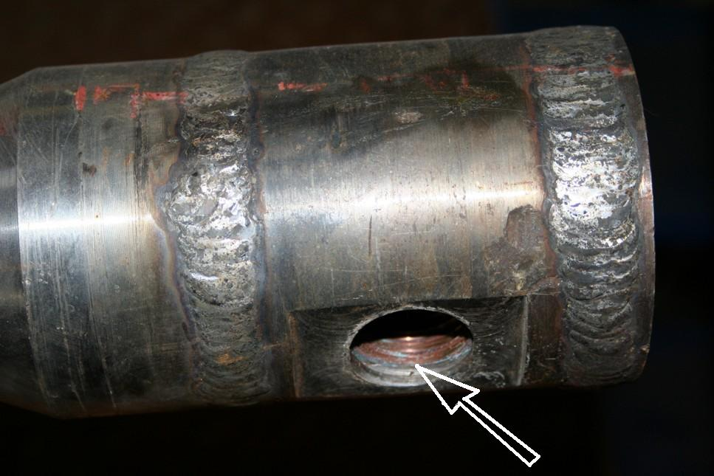
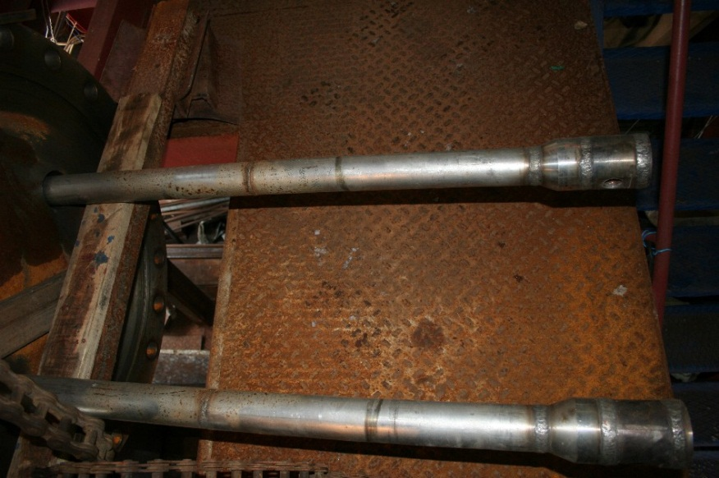
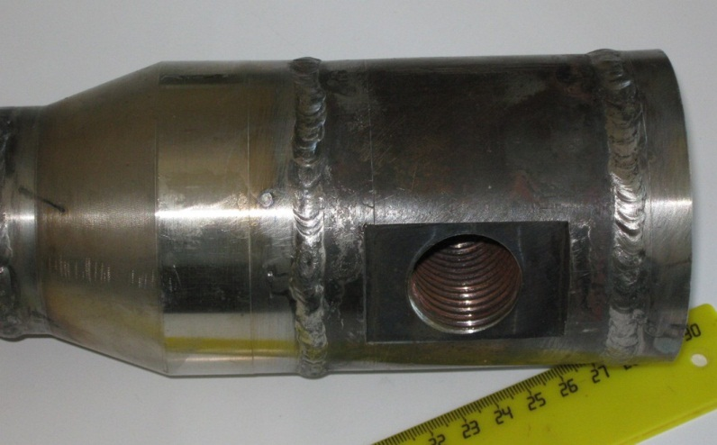
3. Task “C”: The preparation of the scale experiment (3)
The loss of the integrity occurred because of an internal engineering flaw of the welded seam connecting the two parts of the electrical conductor made of copper and the stainless steel
Test of tightness of the scale model and auxiliary systems of the IVRSA facility. Autumn 2010
ISTC Project #3635. 19th CEG-SAM meeting, Pisa, Italy, March 14-16, 2011

Slide 9
3. Task “C”: The preparation of the scale experiment (3A)
1) as far as the electrical conductor is indecomposable it can be dismantled only if cut into several fragments. In this case the repairing works will amount to the manufacturing of a new conductor;
2) as an alternative it has been decided to repair the pathway directly at the IVRSA experimental unit.
According to this plan it has been decided to make additional engineering elements and to weld them to the conductor. In this case complete dismantling of the conductor from the lid can be avoided, and only new additional engineering elements will be added.
3) If the repairing works will not take effect, compete dismantling of the conductor will be carried out, and it will be replaced by a new one.
4) At the present moment additional engineering elements for necessary for the conductor have been prepared. The repairing works will be carried out when the atmospheric temperature of the environment will be over 5ºC. This is an essential requirement for the box of the IVRSA unit is not heated, and the tests are also planned to take place when the season is warm;
5) It is planned to carry out the repairing works after March 25;
6) It the repairing works will be successful the electrical conductor will be ready for work at the end of April – beginning of May this year;
7) All the necessary materials and documents for a new conductor have been prepared. It may take about one month to make a new conductor .
ISTC Project #3635. 19th CEG-SAM meeting, Pisa, Italy, March 14-16, 2011

Slide 10
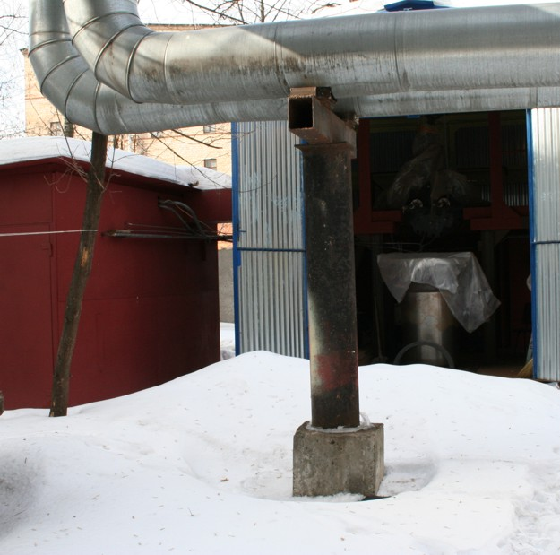
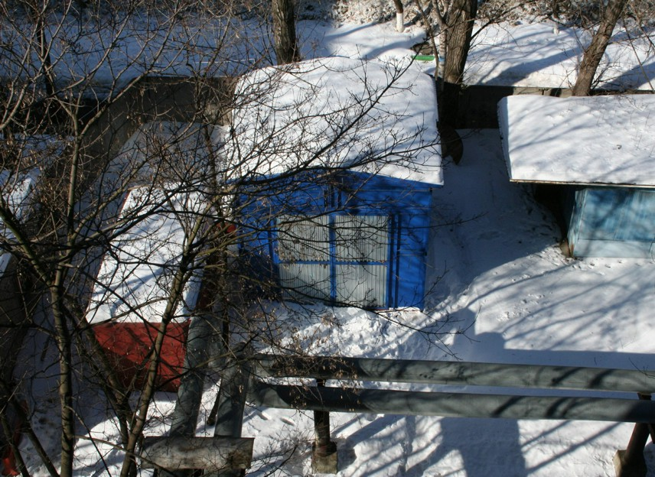
3. Task “C”: Preparation of the scale experiment (4)
Fig.2.1 –IVRSA test facility. March 07, 2011
ISTC Project #3635. 19th CEG-SAM meeting, Pisa, Italy, March 14-16, 2011

Slide 11
4. The Task “D”: Testing of the VVER vessel steel (0)
- During the reporting period the experimental data of the tests of the mechanical characteristics of the 15Х2НМФА steel was accumulated and analyzed.
- Mechanical characteristics tests were carried out in air atmosphere, in the protective argon environment and in vacuum;
- The tests in the air atmosphere were, as a rule, short-time, with a temperature up to 600 ºС;
The tests for short-time mechanical characteristics and creep tests were carried out with a temperature from 650ºC to 1050ºС in argon;
- The tests in vacuum were short-time and creep tests, with a temperature from 900ºС to 1200 ºС.
ISTC Project #3635. 19th CEG-SAM meeting, Pisa, Italy, March 14-16, 2011

Slide 12
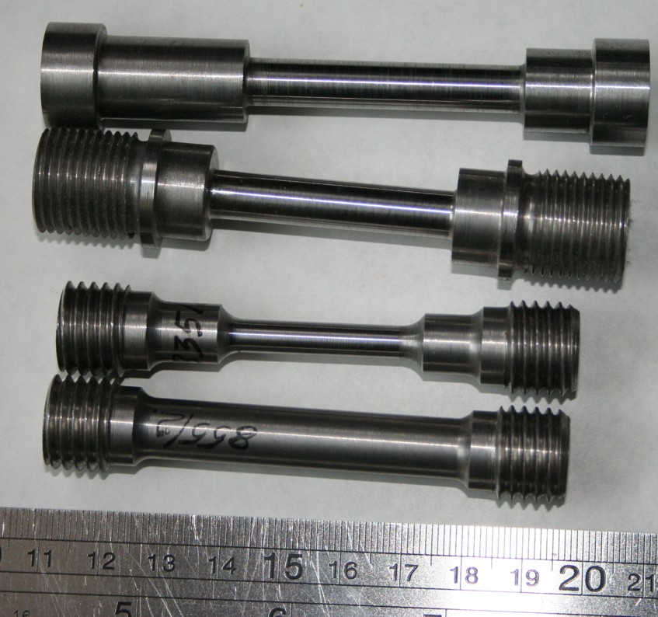
4. The Task “D”: Creep testing of the VVER vessel steel (1)
A vessel steel 15Kh2NMFA (TS 108-765-78) of which the lower course of the VVER vessel No. 1152.02.70.000 (number of fusion 107210), number of forgings 5015 has been made was the material which mechanical properties were subject to definition in process of material property studies.
The specimens fabricated for the tests had circular cross-section of 8 (and 10 mm) diameter and working length of 45-50 mm. Besides, the specimens with diameter of 5.5 mm and working length of 30 mm were fabricated. These specimens were used for testing when tensile elongation exceeded 120%(Fig. 4.1).
The specimens for testing in argon at temperature up to 1100 C.
Diameter 8 mm and working length of ~50 mm.
The specimens for testing in vacuum at temperature 900-1200 C with a
circular cross-section of 10 mm diameter and working length of 30 and 45 mm.
Fig. 4.1- Specimens for creep testing of the VVER vessel steel in vacuum
ISTC Project #3635. 19th CEG-SAM meeting, Pisa, Italy, March 14-16, 2011

Slide 13
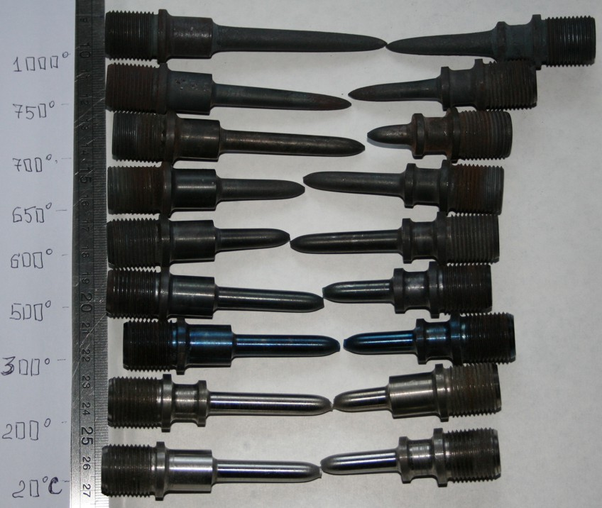
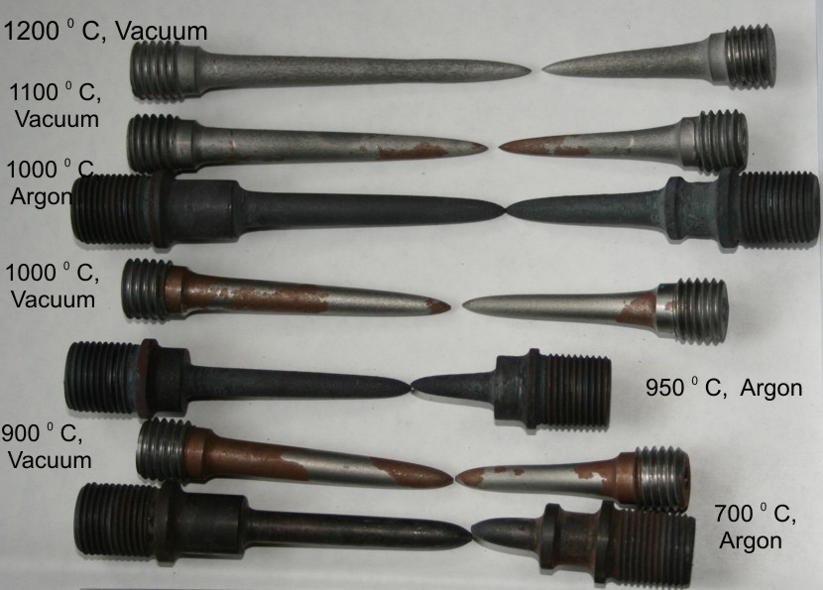
4. The Task “D”: Testing of the VVER vessel steel (2)
T= 700…1200 C . (Argon and Vacuum)
T= 20…1000 C ( without a protective environment (up to the temperature of 600ºС and in the protective argon environment with the temperature of over 600ºС.
It is important to mention one peculiarity that was noticed during the tests (short-time and creep tests) when the temperature was over 700ºС:
this peculiarity is the appearance of reddish spots on the surface of samples. They were more intensive when the temperature was 700-900ºС. When the temperature was increased, the number of the spots reduced.
The appearance of these spots most possibly is due to structural transformations of the examined steel.
Fig. 4.2- Samples after short-time tests with a temperature from 20ºC to 1000ºС
ISTC Project #3635. 19th CEG-SAM meeting, Pisa, Italy, March 14-16, 2011

Slide 14
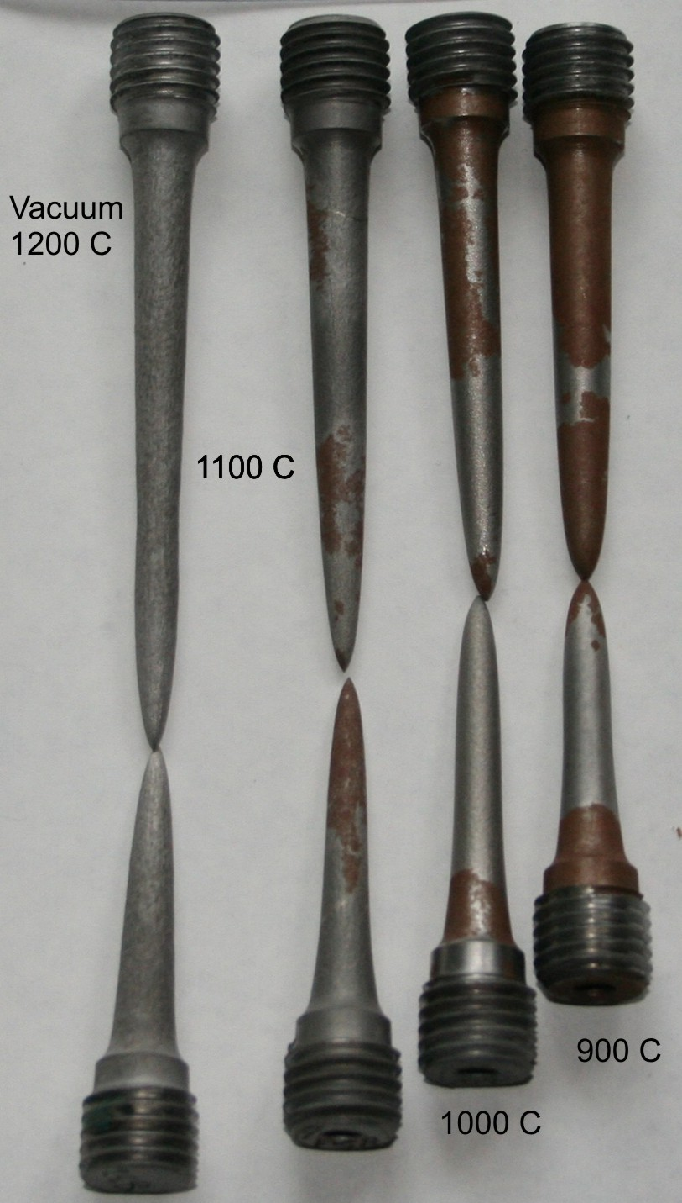
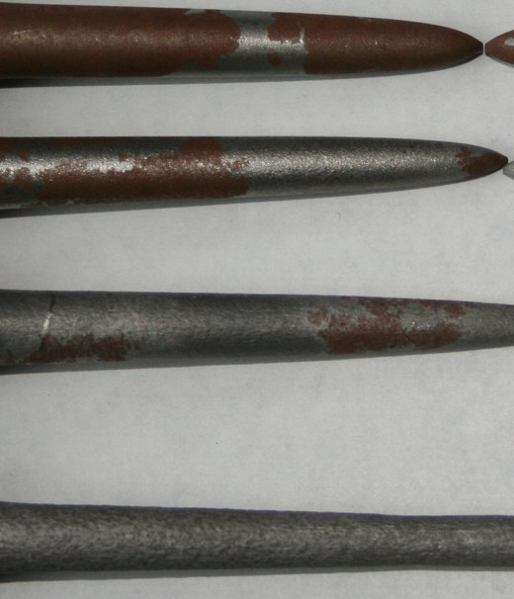
4. The Task “D”: Testing of the VVER vessel steel (3)
When the temperature was increased, the number of the spots reduced.
The appearance of these spots most possibly is due to structural transformations of the examined steel.
Fig. 4.3- Specimens after testing of the VVER vessel steel in vacuum
ISTC Project #3635. 19th CEG-SAM meeting, Pisa, Italy, March 14-16, 2011

Slide 15
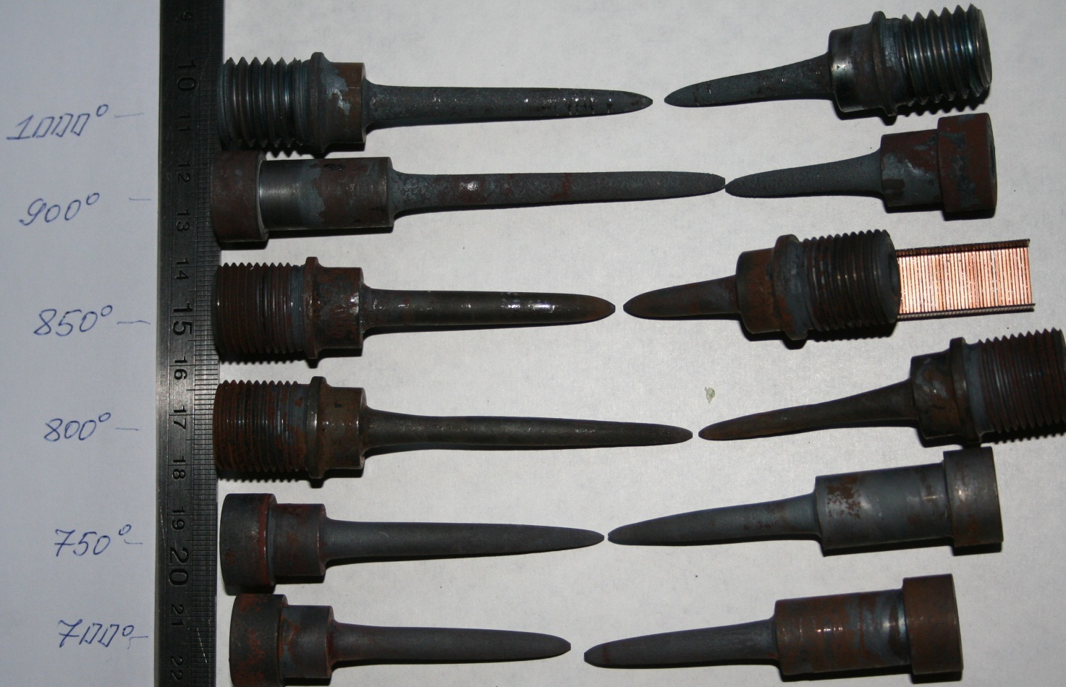
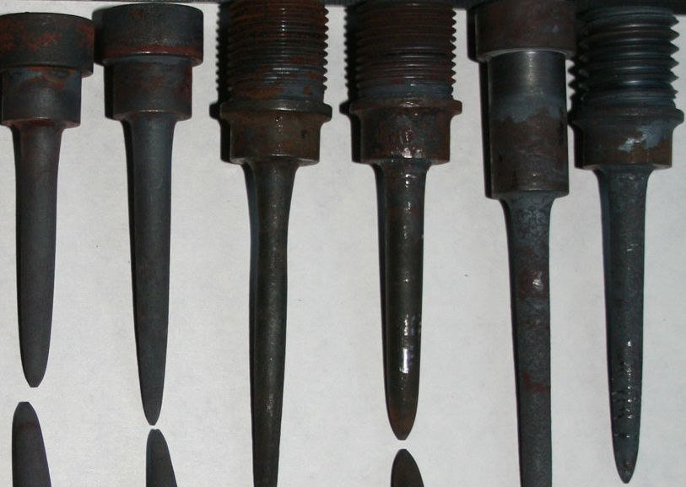
4. The Task “D”: Creep testing of the VVER vessel steel (4)
Fig. 4.4- Specimens after creep testing of the VVER vessel steel in argon. T= 700…1000 C
ISTC Project #3635. 19th CEG-SAM meeting, Pisa, Italy, March 14-16, 2011

Slide 16
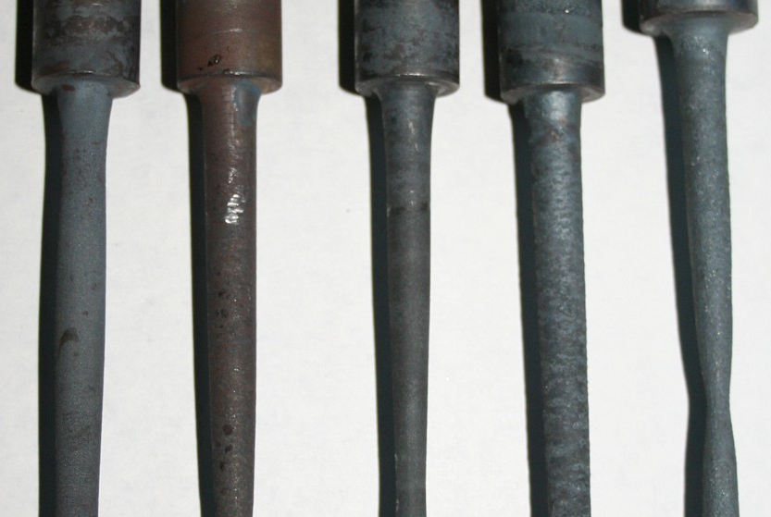
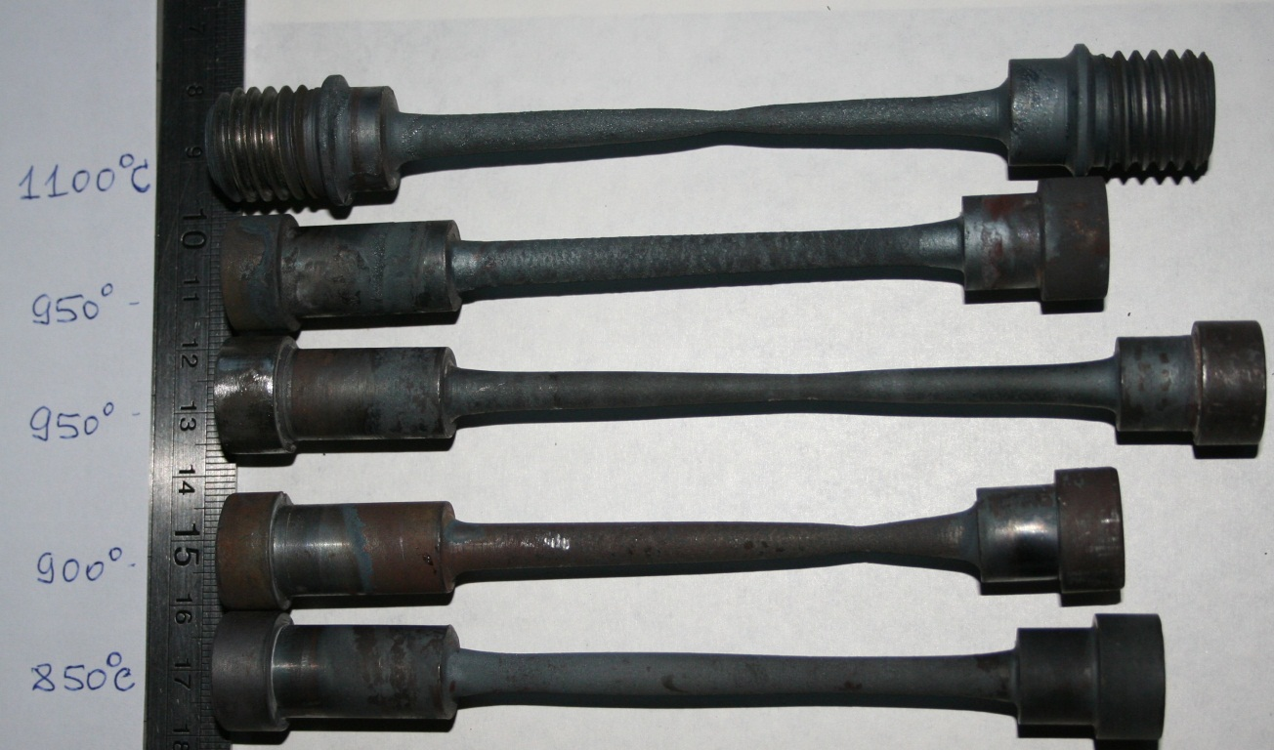
4. The Task “D”: Creep testing of the VVER vessel steel (5)
The samples were not completely failed, and the examined data may be used to be compared with the results of the numerical calculation of the deformation of the given samples
Fig. 4.5- The samples after creep testing of the VVER vessel steel in argon. T= 850…1100 C
ISTC Project #3635. 19th CEG-SAM meeting, Pisa, Italy, March 14-16, 2011

Slide 17
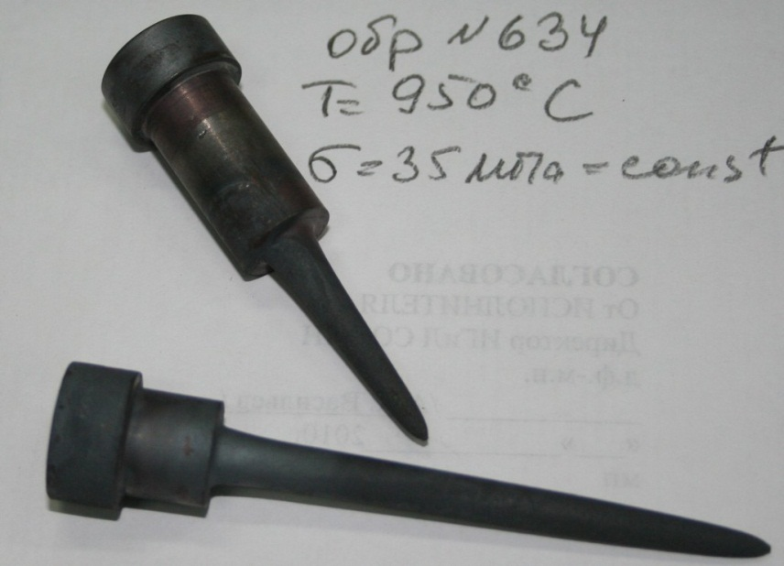
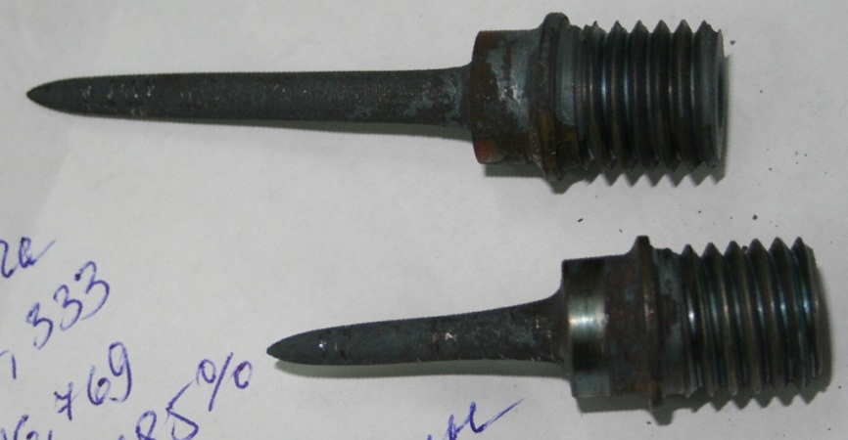
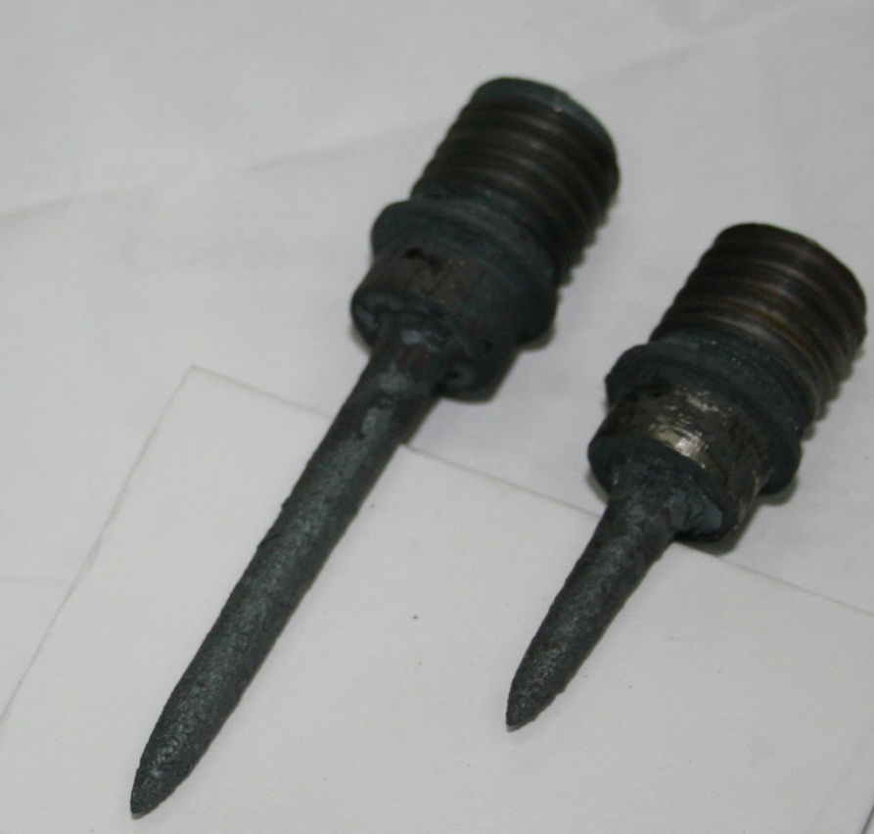
4. The Task “D”: Creep testing of the VVER vessel steel (6)
T= 1000 C; 25 MPa
T= 950 C; 35 MPa
As one may see in response to the increase of the temperature the surface of the working part of the sample is partly oxidized, and the surface is loosened and flaky.
In response to the increase in the duration of testing the process oxidation becomes more intensive.
Partial oxidation is connected to incomplete leak integrity of the furnace where the sample is kept during the test.
To estimate the influence of partial oxidation on the creeping process it was decided to conduct an additional series of creep tests in vacuum. These tests were conducted at the temperature of 900, 1000, 1100 and 1200ºС.
T= 1050 C; 16 MPa
Fig. 4.6- Specimens after creep testing of the VVER vessel steel in argon
ISTC Project #3635. 19th CEG-SAM meeting, Pisa, Italy, March 14-16, 2011

Slide 18
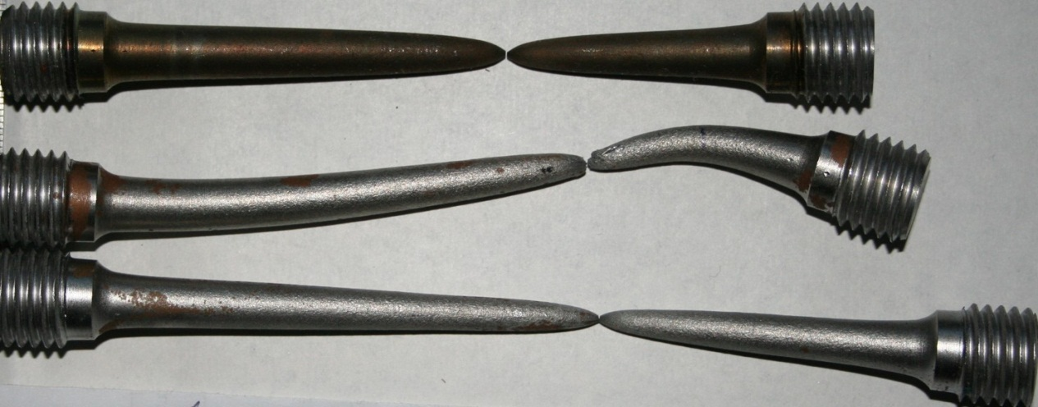
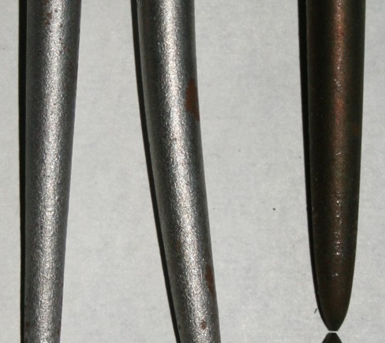
4. The Task “D”: Creep testing of the VVER vessel steel (7)
As one may see when the test temperature is 900ºС there sample is almost completely covered with reddish/brown film.
So it is possible to say that the appearance of a reddish film can be observed in the argon environment and in vacuum.
As one may see on the presented photos in response to increase in duration of the test the surface became lighter, and the brown film disappeared.
Fig. 4.7- Specimens after creep testing of the VVER vessel steel in Vacuum. T= 900 C; 22… 45 MPa
ISTC Project #3635. 19th CEG-SAM meeting, Pisa, Italy, March 14-16, 2011

Slide 19
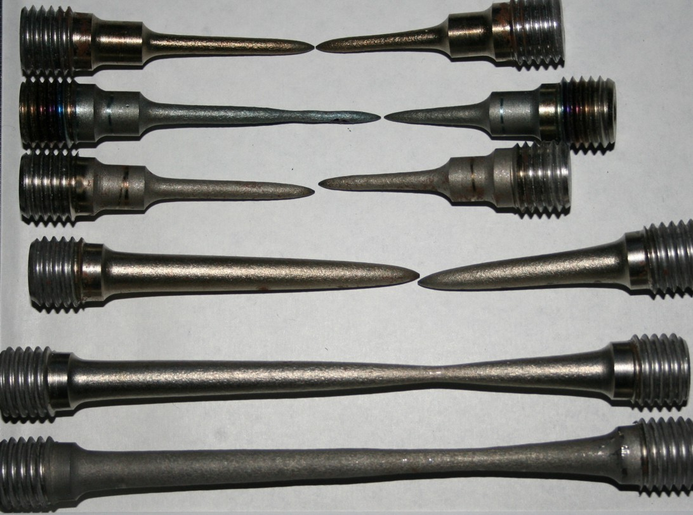
4. The Task “D”: Creep testing of the VVER vessel steel (8)
Fig. 4.8- Specimens after creep testing in vacuum. T= 1000 C; 13,5 … 20 MPa
ISTC Project #3635. 19th CEG-SAM meeting, Pisa, Italy, March 14-16, 2011

Slide 20
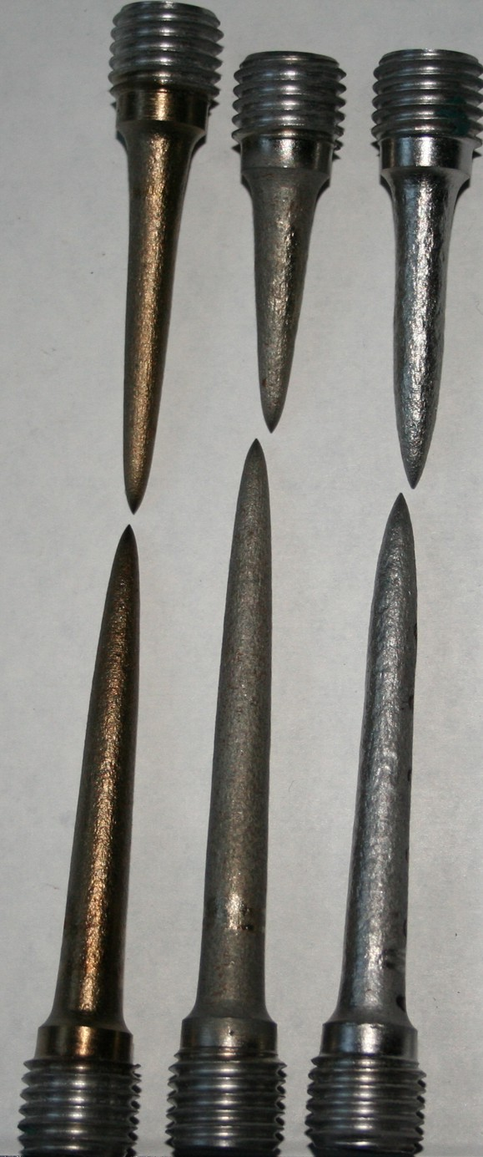
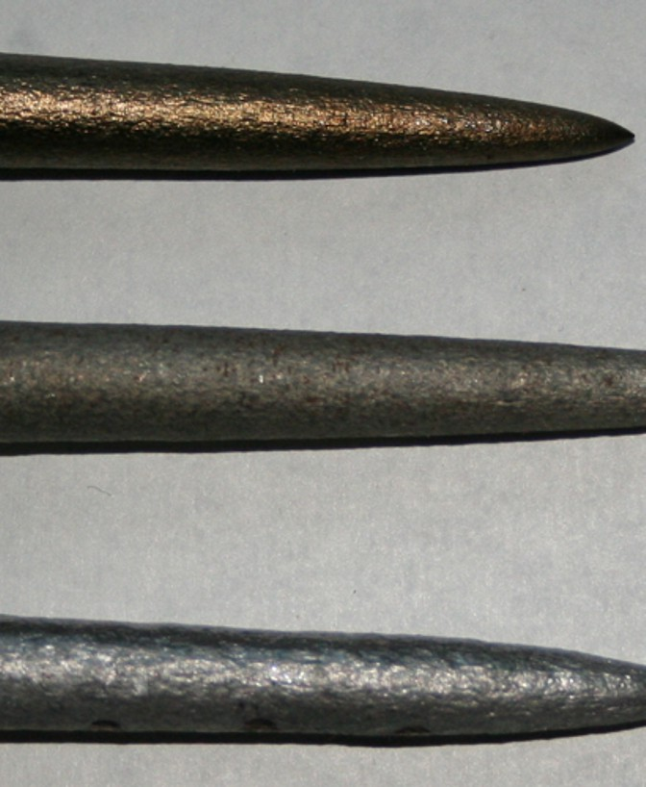
4. The Task “D”: Creep testing of the VVER vessel steel (9)
Fig. 4.9- Specimens after creep testing of the VVER vessel steel in vacuum. T= 1100 C; 9 … 19 MPa
ISTC Project #3635. 19th CEG-SAM meeting, Pisa, Italy, March 14-16, 2011

Slide 21
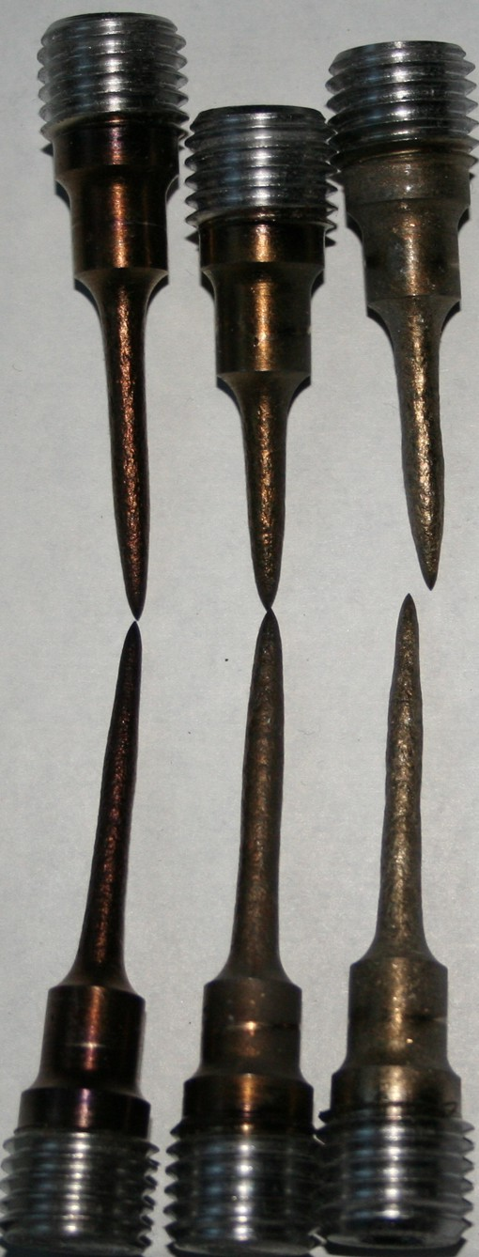
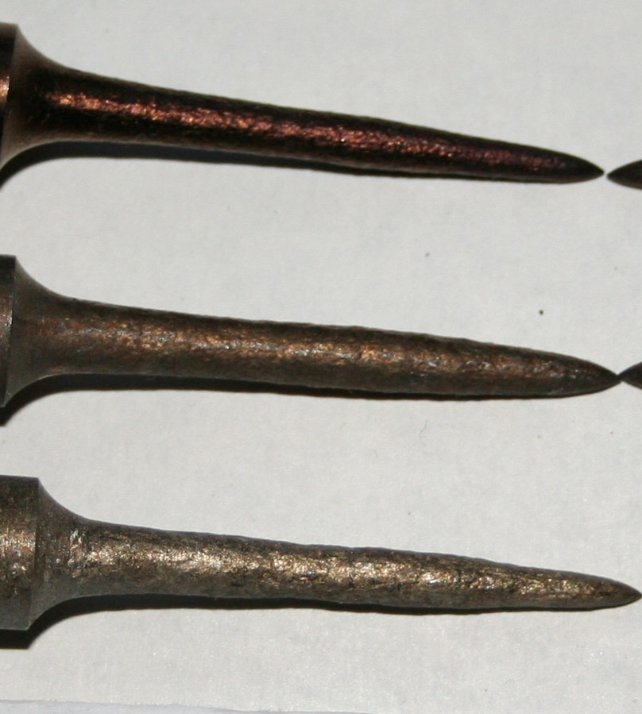
4. The Task “D”: Creep testing of the VVER vessel steel (10)
Fig. 4.10- Specimens after creep testing of the VVER vessel steel in vacuum.
T= 1100 C;
7,7 … 14,3 MPa.
Diameter is 5 mm
ISTC Project #3635. 19th CEG-SAM meeting, Pisa, Italy, March 14-16, 2011

Slide 22
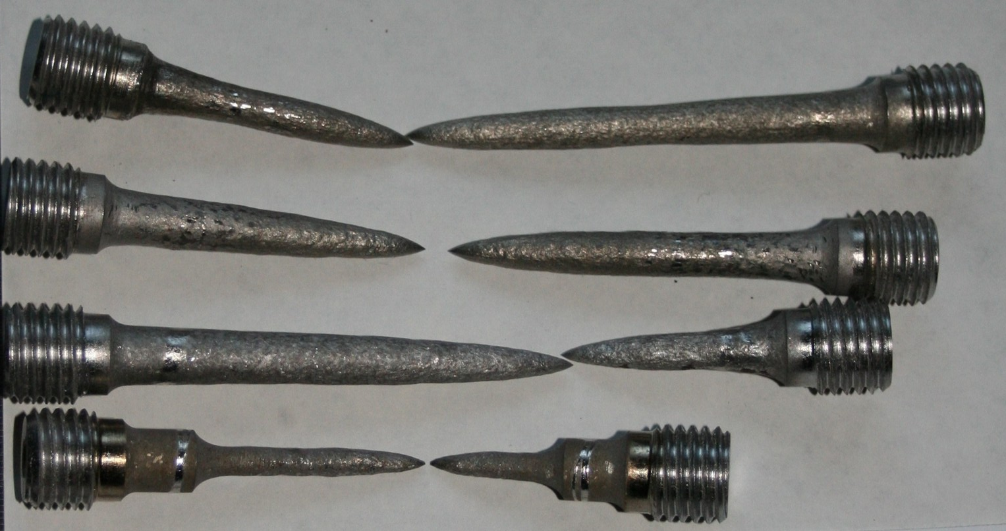
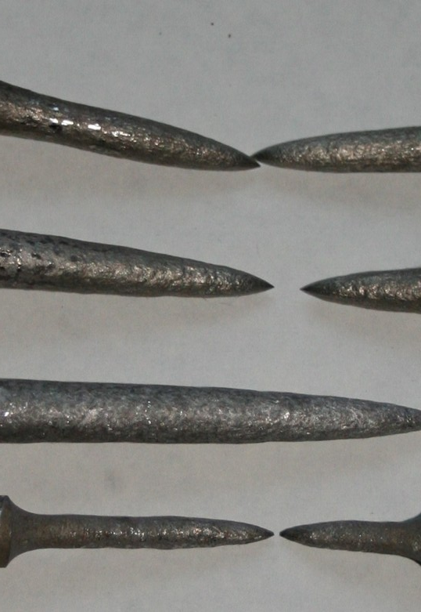
4. The Task “D”: Creep testing of the VVER vessel steel (11)
Fig. 4.11- Specimens after creep testing of the VVER vessel steel in vacuum. T= 1200 C; 4,4 … 10 MPa
When the temperature was 1100 1200ºС there was almost no reddish-brown film on the sample.
ISTC Project #3635. 19th CEG-SAM meeting, Pisa, Italy, March 14-16, 2011

Slide 23
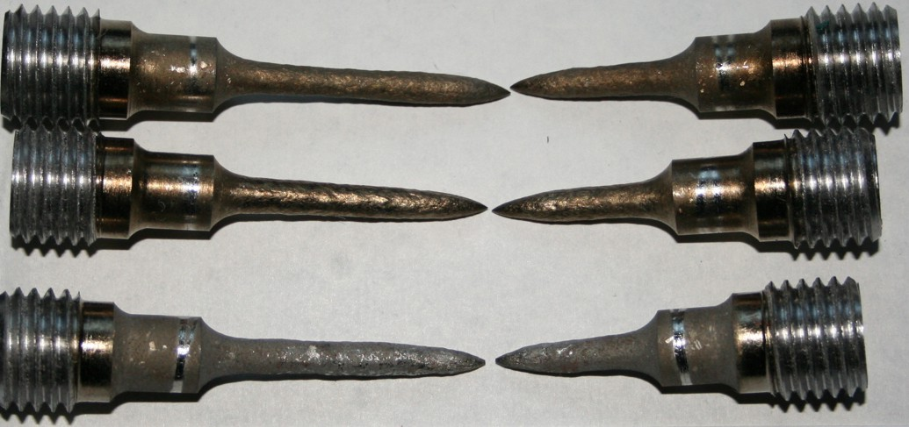
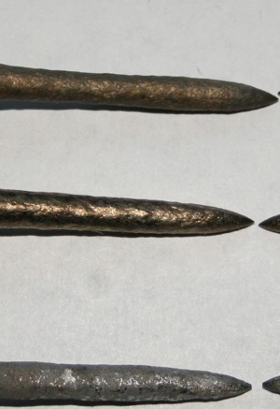
4. The Task “D”: Creep testing of the VVER vessel steel (12)
4,4 … 7,6 MPa
As one may see in response to the increase of temperature and duration of creep tests, the condition of the sample’s surface changes drastically.
First of all, the working part of the sample became more “rough” in response to the increase in duration, and a few deformation neck-zones appeared on the working part of the sample.
Fig. 4.12- Specimens after creep testing of the VVER vessel steel in vacuum. T= 1200 C; 4,4 … 7.6 MPa
ISTC Project #3635. 19th CEG-SAM meeting, Pisa, Italy, March 14-16, 2011

Slide 24
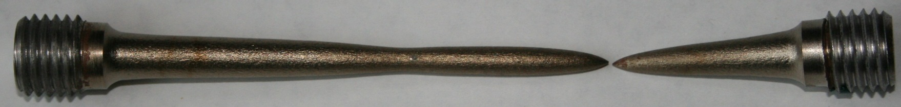
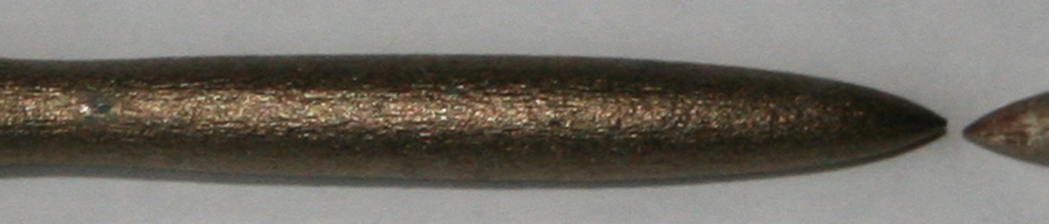
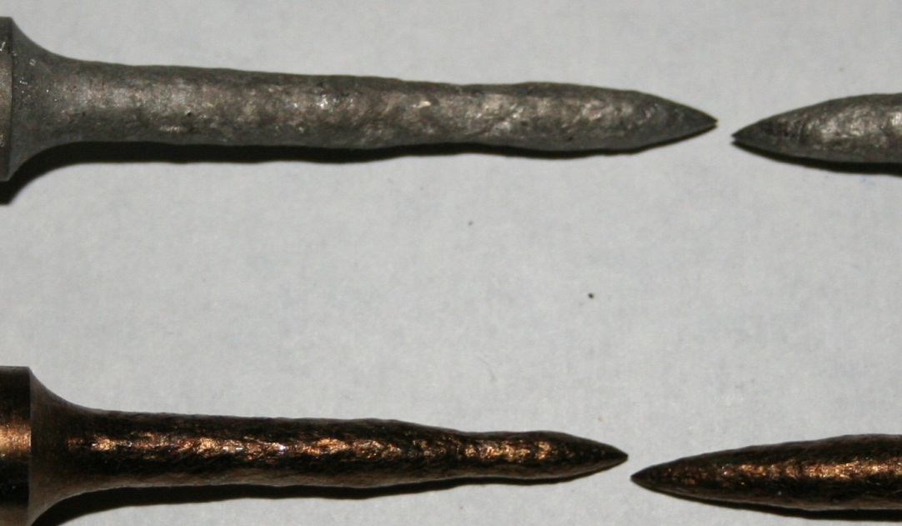
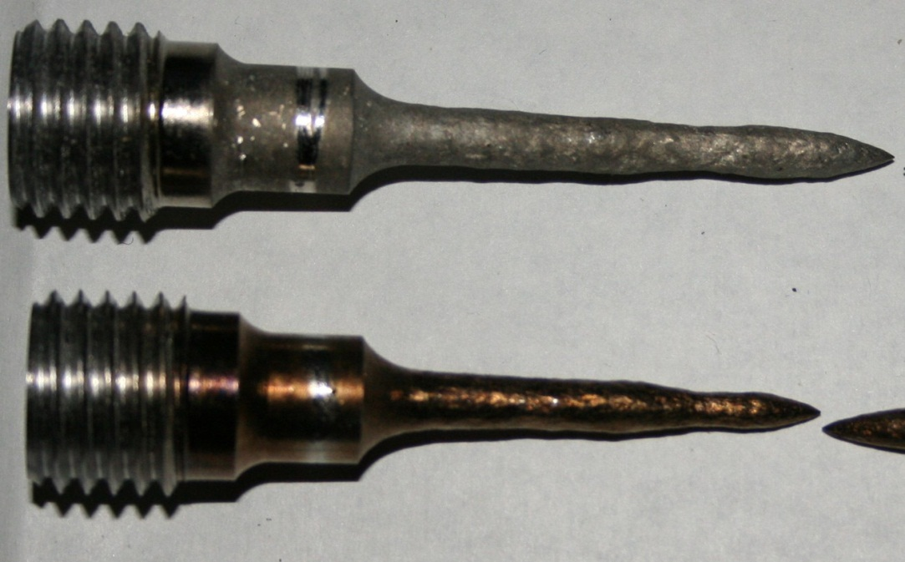
4. The Task “D”: Creep testing of the VVER vessel steel (13)
In some cases there were two or three necks at working length of the specimen
- With the increase of the temperature a few necks (two, three or more) formed on the samples.
- Also with the increase of the temperature the surface of the working parts of the samples changed, and local irregularity appeared. It can be explained by the formation local flowage zones in the body samples and the simultaneous processes of hardening and weakening in the examined material. Such instability in the deformation process becomes more profound when the temperature is increased.
Fig. 4.13- Specimens after creep testing of the VVER vessel steel in vacuum. T= 1200 C
ISTC Project #3635. 19th CEG-SAM meeting, Pisa, Italy, March 14-16, 2011

Slide 25
4. The Task “D”: Creep testing of the VVER vessel steel (14)
Creep experiments have been carried out and finished:
- in the range from 700 to 900 С in argon;
- in the range from 900 to 1200 С in vacuum
-use of argon as the protective medium leads to considerable reduction (in 2 times and more) of time to failure of the specimen.
It probably depends on oxidation of the surface of the specimens owing to partial ingress of air to the test cell.
Formation of the oxide film and its destruction under deformation leads to earlier failure of the specimens in comparison with vacuum testing.
- there is similarity in the curve behavior (diagrams “time to failure- Stress” ) within given temperature range from 700 to 1200 C.
Fig. 4.14- “Time to failure via stress” diagrams of the VVER 15Kh2NMFA Steel

Slide 26
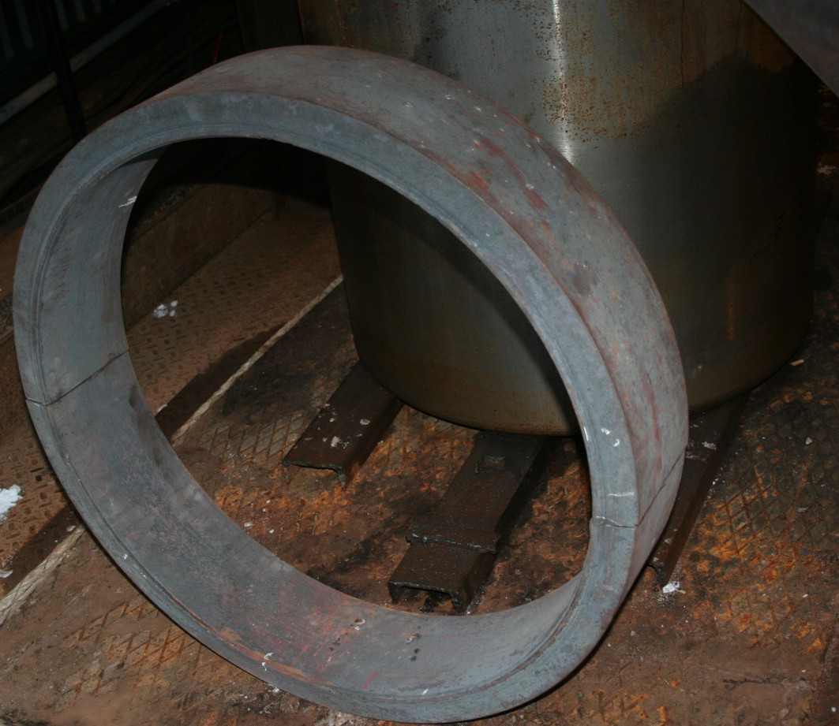
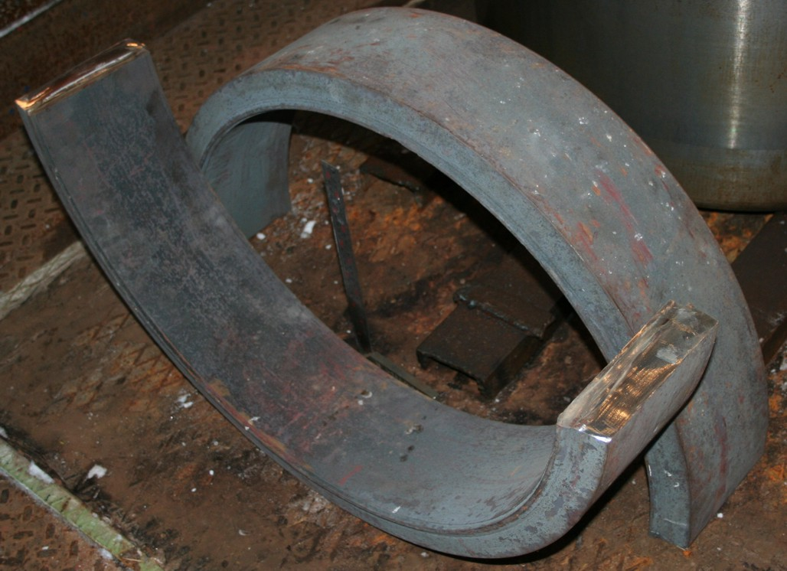
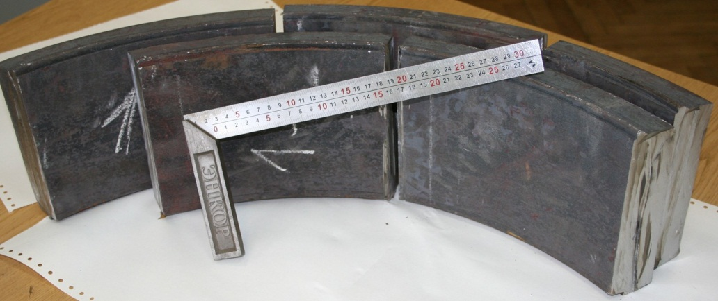
4. The Task “D”: Creep testing of the VVER vessel steel (15)
Fig. 4.15- the ring from the vessel model steel
With the purpose of identification of high-temperature mechanical characteristics of the steel the vessel scale model is made of it was decided to make a control batch of samples from the test and to conduct a creep test of this steel.
It is necessary to conduct such test because real mechanical characteristics of steel, the scale model is made of, are needed for numerical after-test calculations of the planned experiment.
That is why after preliminary stages of the heat treatment of body frame model (before welding of the bottom) a ring was cut from it. This ring was used in the final stage of heat treatment with the assembled model (after the welding of the bottom).
The scope and possibility of the whole complex of creep tests will be determined by the financial capacity of Russian counterpart. At present the works are carried out at the expense of the Russian counterpart.
ISTC Project #3635. 19th CEG-SAM meeting, Pisa, Italy, March 14-16, 2011

Slide 27
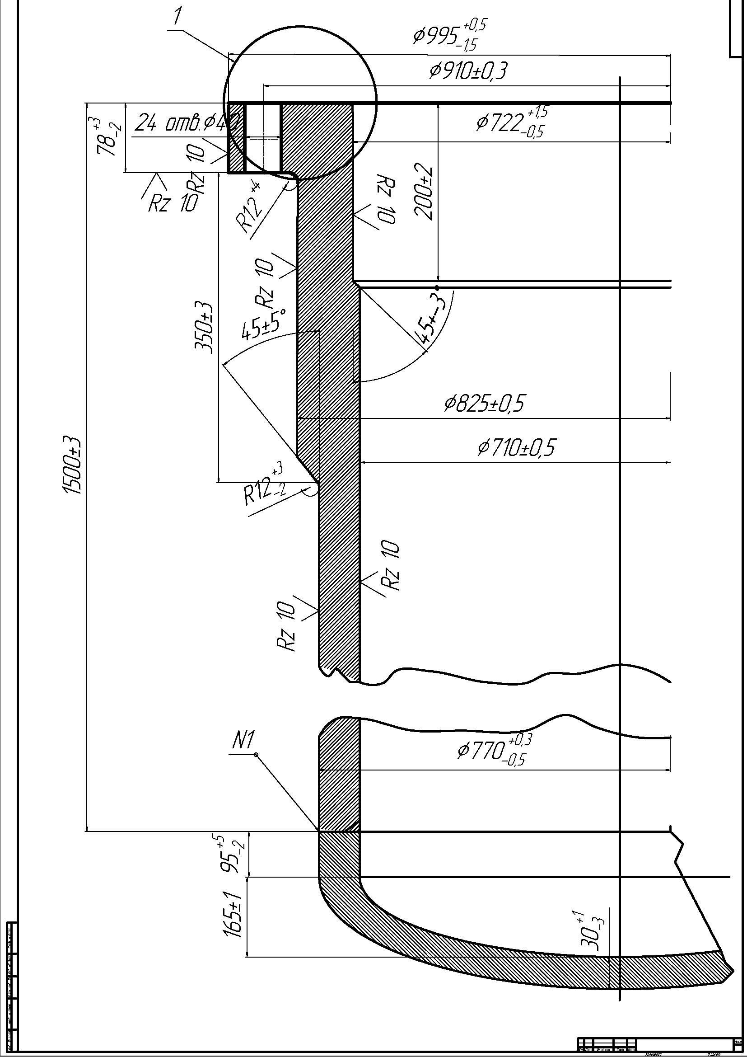
5. Task “B”: Experimental VVER-440 vessel scale model. Var #2
There is a hope that the works in the frame of the theme of this project may be financed by the concerned Russian organizations (The Ministry of Science and Education and RosEnergoAtom Concern).
Retrospectively, works connected to the making of the second vessel model have been carried out.
Talks with the concerned parties in Russia were held, and the technical parameters of the scaled model were preliminary approved.
The construction of the model will have an elliptical bottom that will be weld to the cylindrical course. The bottom and the course of the model will be made of 15Kh2NMFA steel.
It is assumed that when this model will be tested, the heated area of the construction will be at the elliptic bottom, lower than the welding seam of the bottom and the course.
The final decision as to the making of this model will be taken this May.
Fig.5.1 – Design of the Var. # 2 of the vessel scale model
ISTC Project #3635. 19th CEG-SAM meeting, Pisa, Italy, March 14-16, 2011

Slide 28
Scale Experiment
We plan that the repairing works on the electrical conductor, model assembly and preparation of the first scale experiment will start at the end of March, because at that time average daily temperature will be over +5ºC.
ISTC Project #3635. 19th CEG-SAM meeting, Pisa, Italy, March 14-16, 2011

Slide 29
Thank You!
End

