Slide 1

Project Title
#3831 (MCCI) «Development and experiments at large-scale installation for heating and retention of corium» Part I.
(Work Plan)
Tasks: - to develop a technology of PTC producing and retention of corium;
- to develop a measuring system for corium temperature and concrete heat flow diagnosis;
- to establish a middle-scale installation and to carry out experiments on corium and concrete interaction.
Installation characteristics:
- m_{fin} ≈100-120 kg;
- V_{fin} = 15-18 l;
- Т_{fin} = 2500-2700 °С;
- Р = 100 kW/m²;
- t = 10-12 min.

Slide 2
I. General geometry of a middle-scale experiment
PTC: 2Fe₂O₃ + 3Zr = 3ZrO₂ + 4Fe + 2800 kJ/kg
∅ 300
200
200
∅_{н} | 1 m
H | 0.6 m
∅_{в} | 0.3 m
H_{в} | 0.4 m
m₀ | 25-30 kg
m_{fin} | 100-120 kg
62%ZrO₂+38%Fe
P | 100kW/m²
T | 2500-2700°C
H_{p} | 0.15-0.2 m
200
150
50
200
∅ 120
∅ 1000
1

Slide 3
II. Composition recommended for the middle-scale experiment
Test | VB-U4 | VB-U5 | VB-U6
Corium load composition | 45 wt.% UO₂, 19% ZrO₂, 20% SiO₂, 15% Fe₂O₃ | 45 wt.% UO₂, 19% ZrO₂, 20% SiO₂, 15% Fe₂O₃ | 45 % UO₂, 19% ZrO₂, 20% SiO₂, 15% Fe₂O₃
Corium mass | 45 kg | 28 kg | 31 kg
Concrete chemical composition (after drying) | 63 wt.% SiO₂, 25% CaO, 5% Ai₂O₃, 9% CO₂, 3% H₂O | 63 wt.% SiO₂, 25% CaO, 5% Ai₂O₃, 9% CO₂, 3% H₂O | 25 wt.% SiO₂, 41% CaO, 2% Ai₂O₃, 25% CO₂, 3% H₂O
Initial Temperature | ∼2200 К | ∼2200 К | ∼2200 К
Test duration | 2 hr | 2.5 hr | 2 hr
Ratio of horizontal to vertical ablation | 2.5 : 1 | 5 : 1 | 2 : 1 the first hour 1: 1 the next hour
Concrete composition recommended
for the middle-scale experiment
2

Slide 4
III. Equipping scheme of PTC into the concrete tank.
Initiating
system
Igniting wire
Collector
Injector
PTC
(3Zr + 2Fe₂O₃)
∼30 kg
Concrete tank
3

Slide 5
IV. PTC initiating and burning scheme
Initiating of PTC burning by means of igniting wire
Collector
Gas mixture
(propane + air)
20-30 kW
Injector
Burning compound
(3Zr + 2Fe₂O₃=
=3ZrO₂+4Fe+Q)
Concrete tank
4

Slide 6
V. Scheme of melt temperature and heat flows support using briquettes burning
m₀=25-30 kg
m_{fin}≈100 kg
t = 10-12 min
m=0.5-1kg
Δt=5-10 s
Briquette
Collector
Gas mixture
(propane + air)
Injector
Melt
3ZrO₂+4Fe
Concrete tank
5

Slide 7


VI. Briquettes production process scheme
Zr
Fe₂O₃
Preparation of
powder compounds
Preparation of PTC
3Zr+2Fe₂O₃
Blocks pressing
(m=0,1kg)
Briquettes producing
(m=0,5-1kg)
6

Slide 8
VII. Scheme of carrying out the temperature measurements
Optical monofilament (∅=400mkm)
N=24 (6 groups of 4 items)
Zirconium oxide tube (ZrO₂)
250
N=8
32 thermocouples
Δ₄
P1
P2
…………………………….
P8
Δ₂
Δ₁=5
Δ₂=10
Δ₃=15
Δ₄=20
Δ₁
Δ₃
PC

7

Slide 9
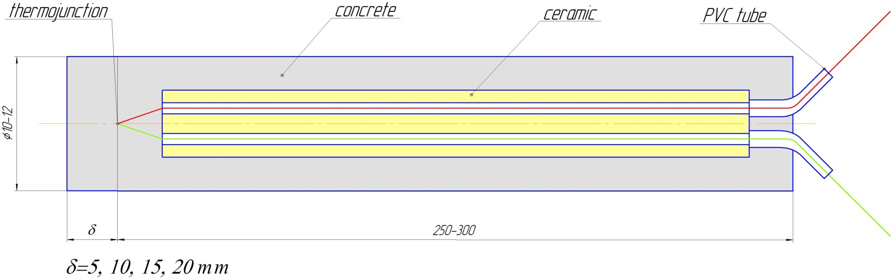
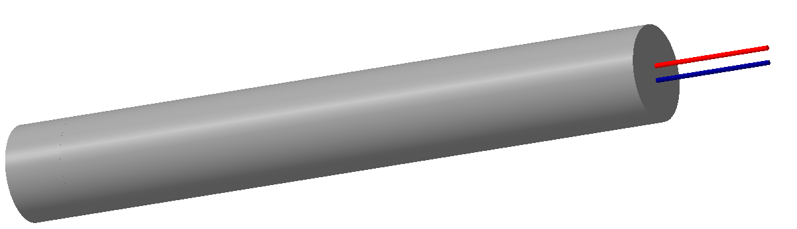
VIII. Thermocouples construction and preparation technology
Chromel-Allimel thermocouples – up to 1500°
Rhenium-Tungsten thermocouples – up to 2500°
8

Slide 10
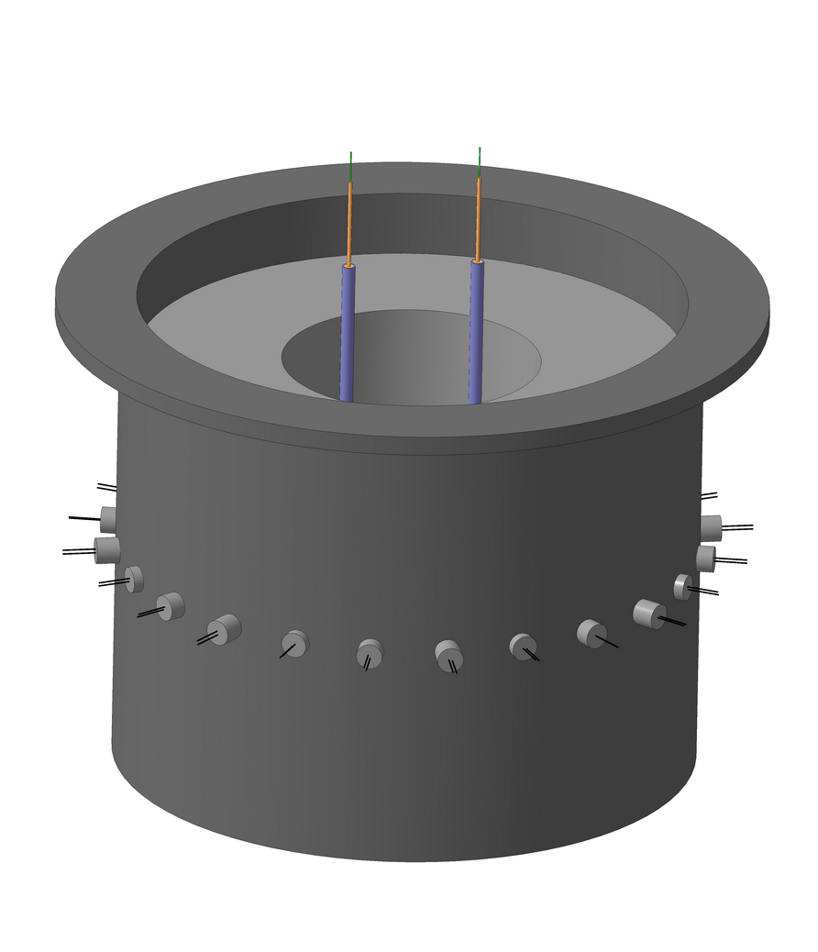
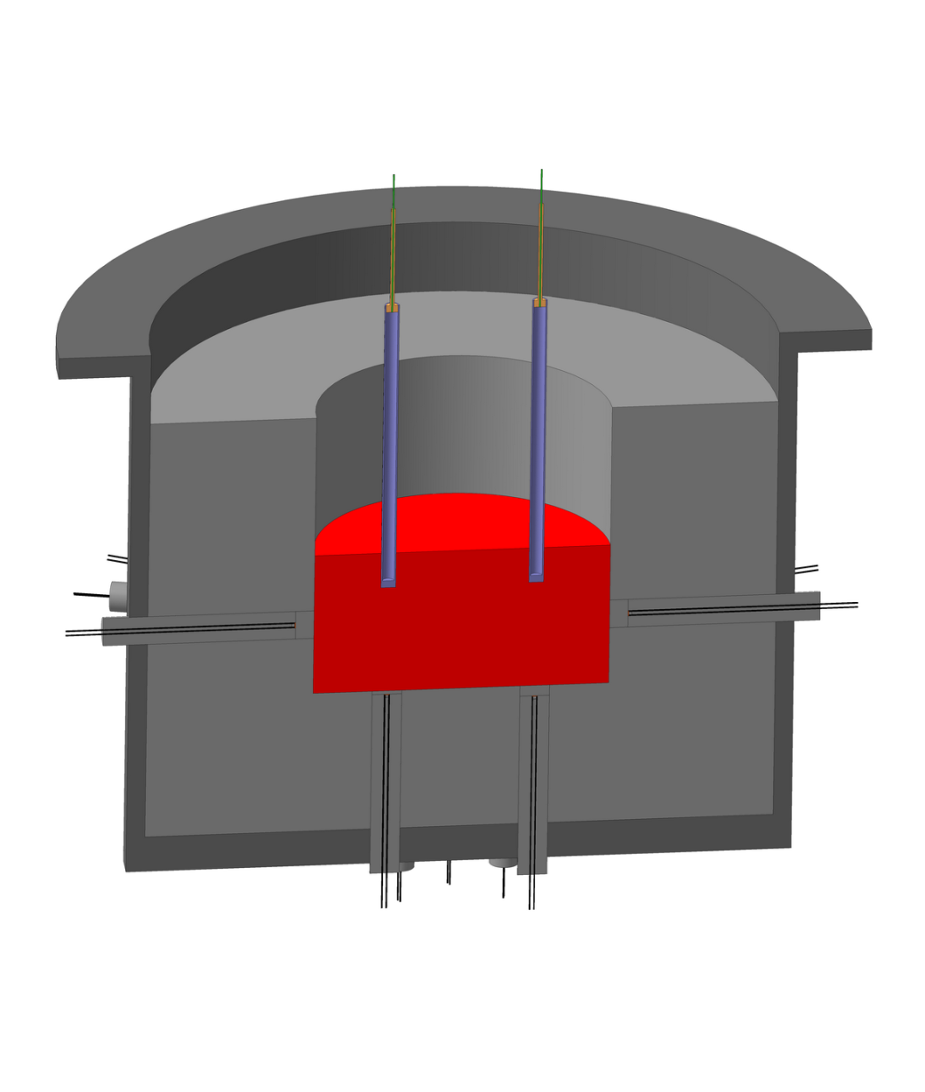
IX. Experiment visualization
9

Slide 11
X. Scope of activities
Middle-scale experiment | Large-scale experiment
1. To develop and produce the concrete tank for corium | 1. The same
2. To develop the technology and produce pyrotechnic briquettes Fe₂O₃+Zr (100 kg) | 2. To develop the technology and produce pyrotechnic briquettes Fe₂O₃+U (1000 kg)
3. To develop the technology of pyrotechnic briquettes initiating | 3. The same
4. To develop the technology of pyrotechnic briquettes dumping into the molten pool | 4. The same
5. To develop and make the measuring system of the melt temperature by means of pyrometry | 5. The same
6. To develop and make the measuring system of the melt temperature and heat flows in concrete by means of thermocouples | 6. The same
7. To develop the technology of the frozen melt cutting | 7. The same
8. Metallographic analysis of the frozen melt composition | 8. The same
9. Design-theoretical analysis of experimental results | 9. The same

