Slide 1
Preliminary Analysis of VNIIEF Pre-proposal for a large scale MCCI test
Presented by Christophe JOURNEAU with contributions from A. Miassoedov FZK

Slide 2
Why corium-concrete interaction ?
Current NPP safety requires a study of the consequences of a corium-concrete interaction, especially in the context of life extension.
In most current NPP, esp. those with large power, it is not possible to demonstrate In Vessel Retention. Thus, ex-vessel sequences must be studied.
In several countries, including France, the Severe Accident Management aims at having a dry reactor pit to prevent steam explosion risk. So there will be slow ablation of the basemat concrete.
  At which rate ?
  Until which depth ?
Several experimental programmes exist:
  MCCI-OECD (Argonne National Lab, USA) 300 kg Direct Electrical Heating
  VULCANO (CEA, France) Induction
  BETA, COMET-L (FZK, Germany) “
  COTELS (NNC, Kazakhstan) “

Slide 3
Current Issues
1D experiments are satisfactorily modelled by codes even though there are 2 approaches:
  Interface ~solidus; mushy zone; small value of h
  Interface ~liquidus; no mushy zone; large h
2D oxidic melt experiment have shown puzzling results
  Concrete with large limestone content are isotropically ablated.
  Siliceous concretes are more ablated horizontally than vertically (ratios 3 to 7).
    Questions on the effects of
      Heating system
      Size
No experiment up to now with
  Oxidic + metallic corium layers
  Heat supplied to oxidic layer (90% of decay heat in oxides)
Medium scale (~50 kg) Oxide + Metal experiment under preparation in the VULCANO facility with induction heating + shielding.
Synergies with other CEGSAM supported Experimental Projects ?

Slide 4
MCCI Main Characteristics
Long term phenomenon. Ablation rate magnitude ~meter/day
Radiological decay heat => ~150 kW/m² heat fluxes
Initial composition:
  UO2,ZrO2 + most of power-generating FPs
  Molten steel
  Zr will be rapidly oxidized (~3 hrs)
Ablation can be a step-wise process.
  Possibility of crust instabilities with periods ~1/2 hr.
  Experiment duration should be of the order of 2 hrs.
  Requires 30 cm ablation depth.
Effects to study
  Concrete nature
  Sequence in MCCI (early vs late phases)
    Consequences on melt composition/ properties/temperature

Slide 5
MCCI: Open Problems and Uncertainties
1. Melt layering during the ex-vessel sequence
  layering of oxide/metal or mixed melt, transition from mixed to layered?
2. Heat transfer between the oxide and metal layers
  strong influence on axial/radial erosion?
3. Early crust formation, crust stability, crust failure
  Dependence on melt release? Duration of crusts, failure? Residual crusts? Strong local erosions? Influence of metal layer?
4. Late crust formation or volume crystallisation
  Onset of crystallization as stable crust or volume crystallization (stirred melt) with slurry boundary layer?
5. Long-term concrete erosion and cavity formation
  5.1 Heat transfer from corium to concrete, axial/radial erosion
    Recent ANL experiments: Oxidic melt erosion, COMET/BETA experiments: Metallic melt erosion. Influence of concrete type (gas release, change of viscosity)
  5.2 Concrete decomposition at low heat fluxes
    Dehydration of cement matrix and lime burning under low heat flux
    Formation of various boundaries (CCI-2 and CCI-3)

Slide 6
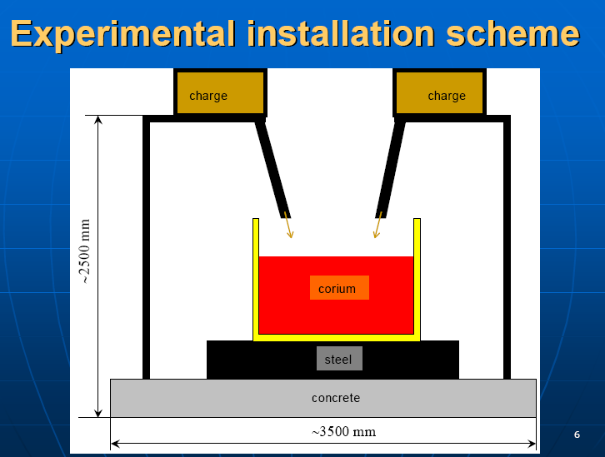
VNIIEF Corium Melting
Thermitic reaction
2Fe₂ O₃ + 3Zr = 3ZrO₂ + 4Fe + 2840 kJ/kg
2Fe₂ O₃ + 3U = 3UO₂ + 4Fe + 1550 kJ/kg
Melting of 1300 kg (150 L) in 1 – 1.5 hrs
Heat fluxes ~100 kW/m²
Homogeneity of heat generation is guaranteed by throwing thermitic briquettes at different locations.
Final pool height 30 cm
Internal diameter 80-100 cm
Wall thickness 50 cm
Ignition Temp 600-800°C

Slide 7
Melt Generation / Heating
Initial pool will have only a part of the total corium
  Reactor pool size are typically 6m diameter vs 60 cm high
  Tend towards prototypic aspect ratio
  Beware of not freezing a too-thin initial layer
Validation status of the technique for melting of the corium pool.
  Capabilities for 300 kg masses
  The concrete shall not be preheated before melting, otherwise physically-bound water would evaporate from concrete at 100°C, chemically bound water around 500°C.
  Up to which size is the technique validated ?
  Have you experience at large scale with other compositions ?
  What is the expected composition after this first phase.
  How long can the melt remain before freezing without adjunction of heat sources ?

Slide 8
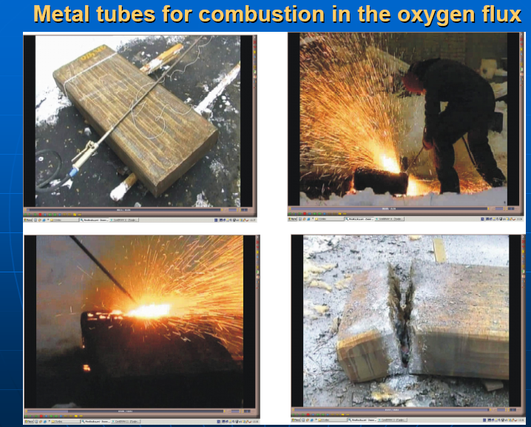
Decay Heat simulation (Fe+O2 oxidation). Withdrawn.

Slide 9
New proposal for Decay Heat simulation
Continuous introduction of thermite briquettes in the melt proposed by A. V. Kondrashenko:
0.2-0.3 kg/s . 5-600 kJ/kg => ~ 100 kW/m²
Several pouring positions to honogeneize heat source location
Advantages:
  Totally different than electrical heating.
  Possibility to add rebars in concrete.
  No limitations on concrete thickness.
Questions:
Experience in sending thermitic briquettes inside a high temperature pool ?
Density of briquettes compared to melt ?
  Will it sink, or burn at the surface ?
Interactions with gas bubbling due to concrete heating ?
Possible evolution of the pool height- surface-heat flux to be estimated in more details.
Maximum final size ? What does control this maximum size ?

Slide 10
Instrumentation proposed
Pyrometric measurement of the pool surface temp
~100 TC embedded in concrete walls & substrate
  To estimate heat fluxes/ ablation rates
~10 TC in ZrO2 sheaths will measure the pool temperature
Questions:
  Experience with high temperature measurements
  Life expectancy of high temperature TCs
    in oxidic melt
    In molten iron/steel.

Slide 11
Financial Aspects
Project n°2 : 18 months – 750-800 k$
  Test with 1200-1300 kg during 1-2 hrs 100 kW/m²
  Thermal computational developments
Project n°1 is joined inside n°2
Project n°3 18 months - 476 k$ (may be reevaluated)
  3000-3500 kg 3-5 hrs 100 kW/m²
CEG-SAM requires more details on the way the costs are elaborated
  What is the part of development work vs consumables ?
  How would cost vary if we modify the corium mass ?
  Compared to the proposed 1000 kg experiment at ANL within OECD extension of MCCI project, the price for 1 test seems high. Why ?

