Slide 1
Interaction of molten corium with
European vessel steel in oxidizing atmosphere (air)
Test MCP- 4
A.P. Alexandrov Research Institute of Technology (Russia)
Presented by V. Granovsky
4th METCOR-P Meeting
St. Petersburg, Russia,
June 1, 2010

Slide 2
Contents
Experimental objectives
Schematics of test facility
Experimental procedure
Summary of test results
Comparison of corrosion rates for the European and Russian vessel steels
Influence of oxygen potential in the melt on the corrosion rate at high temperature on the interface
Conclusions

Slide 3
Objectives
Comparison of corrosion rates for the European and Russian vessel steels in the oxidizing atmosphere

Slide 4
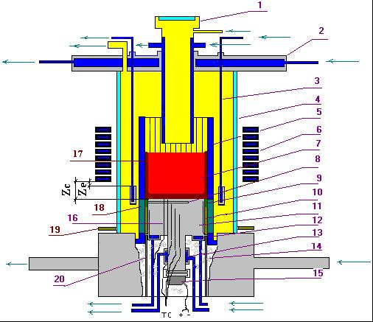
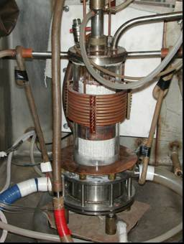
RASPLAV-3 Installation
Furnace schematics
1 –pyrometer shaft; 2 –cover; 3 –electromagnetic screen; 4 – quartz tube; 5 – crucible section;
6 – inductor; 7 –melt; 8 – acoustic defect; 9 – molten ZrO₂; 10 –ZrO₂ powder thermal insulation;
11 – vessel steel specimen; 12 –top calorimeter of the specimen;
13 – bottom calorimeter of the specimen; 14 – kaolin wool insulation; 15 –ultrasonic sensor;
16 –thermocouples; 17 – crust, 18 – electromagnetic screen; 19 – uncooled electromagnetic screen; 20 – cylindrical support of the specimen

Slide 5
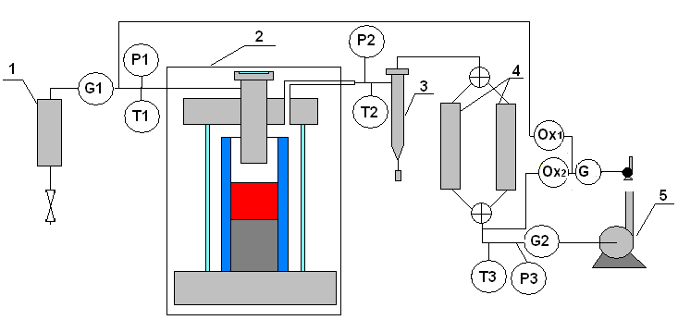
Gas-aerosol system
1 - silica gel dryer; 2 - furnace; 3 – cyclone; 4 – Large Area Filters (LAF); 5 - vacuum pump; P1-P3 – pressure transducers; G1,2 – flow transducers; Т1-Т3 – thermocouples; Ox- electrochemical oxygen sensor

Slide 6
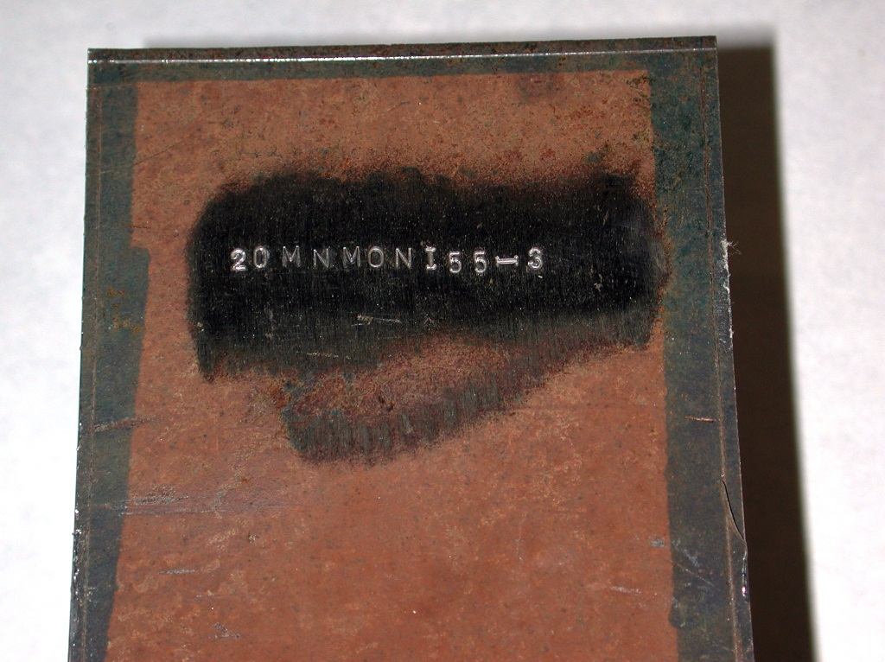
Vessel Steel Specimen
Blank

Slide 7
Location of K-type thermocouples in the specimen

Slide 8
Experimental procedure

Slide 9
Specimen temperatures versus time
T, °C
1 2 3 4 5 6
t, s
1, 2, 3 – UO_{2+x}- ZrO₂
4, 5, 6 - UO_{2+x}- ZrO₂- FeO_{y}
9

Slide 10
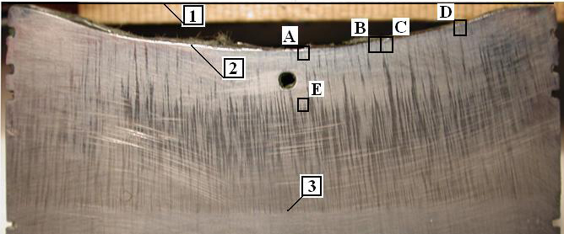
Corrosion depth dynamics
⎯ US measurement
• – Post test measurement of specimen section
The maximum corrosion depth was ∼ 6 mm
1, 2, 3 – UO_{2+x} - ZrO₂
4, 5, 6 – UO_{2+x} - ZrO₂ - FeO_{y}

Slide 11
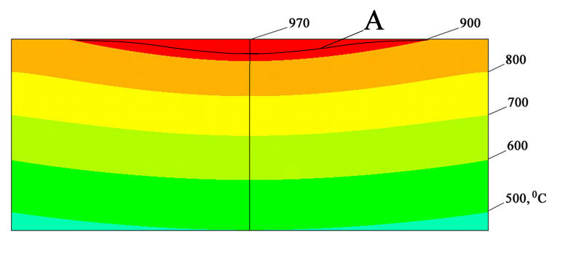
Post test modeling and resulting experimental data
Temperature profile and field in the
specimen upper part (Reg. 4)
Т,°С
Resulting data used in comparison
h, mm

Slide 12
Corrosion rate values for European steel
Insignificant difference for different corium compositions
It can be described by linear correlation (in Arrhenius coordinates)
Data are not sufficient for more specific correlations

Slide 13
Comparison of corrosion rates for the European and Russian vessel steels
Difference of data between European and Russian steels is insignificant
Russian steel corrosion rate correlations can be used for European steel with a certain degree of approximation

Slide 14
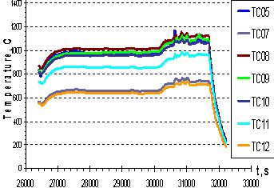
Specific features of corrosion at the
final stage of MCP-4 experiment
final stage
final stage
5 6
Temperature on the interaction interface is the highest, it is close to the temperature at regime 6
Corrosion rate is much smaller than in regime 6, it is close to the rate at regime 5
Why?

Slide 15
Specific features of corrosion at the final stage of MC11 test (Russian steel)
The phenomenon of the corrosion rate drop, which follows the regime of maximum corrosion rate, is qualitatively similar to that of European steel

Slide 16
Dynamics of oxygen concentration in the off- gas and melt oxygen potential evolution versus time
O₂ concentrations in gas are measured with a delay due to the gas line and furnace volume transients
Drop of the melt oxygen potential at the last experimental stage is evident both from gas and melt sample composition measurements
Lower corrosion rate at the final stage of experiment is attributed to a decrease of melt oxygen potential. I.e. Oxygen spent on steel oxidation was not compensated by air supplied to the melt surface
%
steel
addition
○
∆
Ox₁ – concentration of oxygen in
Ox₂ – concentration of oxygen out
•, •, ○ – Fe³⁺/ (Fe²⁺+Fe³⁺); ▲, ▲, ∆ –U⁶⁺/ (U⁴⁺+U⁶⁺)
•, ▲ – samples; ∆, •, ▲– ingot; ○, ∆ - МС11

Slide 17
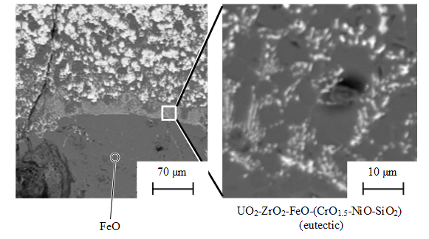
SEM/EDX of MC12 (terminated at fast corrosion)
Corium crust
Vertical distribution of components
h, mm
Corium
bulk
Corium
crust
Fe_{1-x}O
Steel
Corrosion layer
concentrations, mol%
Fussable Fe₂SiO₄ is found both in corrosion layer and in corium crust
Liquified layer adjusted to the corrosion layer, which is connected with corium bulk by percollation channels through corium crust

Slide 18
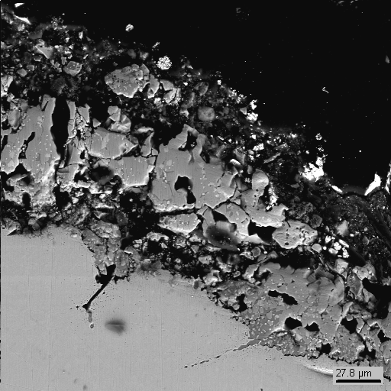
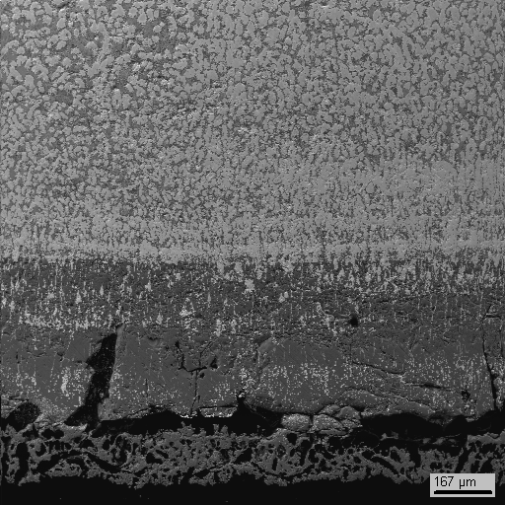
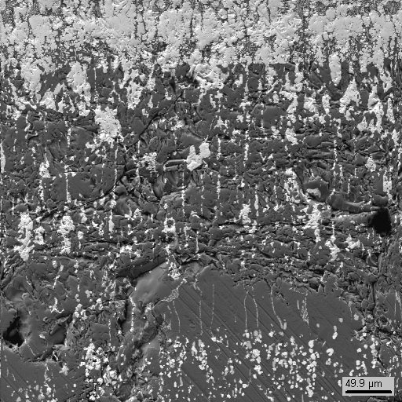
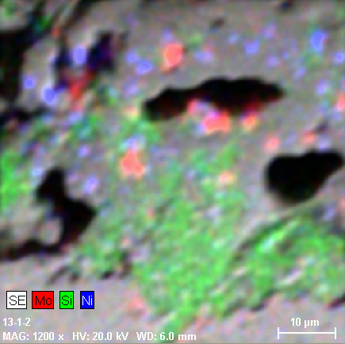
SEM/EDX of MCP-4 (terminated at slow corrosion)
Corrosion layer
Corium crust
SQ6
SQ5
Mo
Si
Ni
No Silicon in crust. Fe₂SiO₄ is concentrated just near the steel surface in corrosion layer
No liquid phase in corium crust. In the percollation chanels it is replaced by the (U;Zr)O₂ ss
Fe

Slide 19
Summary of additional data on corrosion rate in the conditions of oxygen potential reduction in the melt
There is no liquid phase in the corium crust at low oxygen potential in the melt
Corrosion rate is close to the correlation for solid-phase diffusion

Slide 20
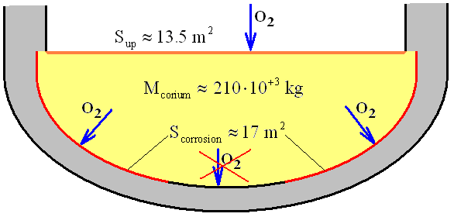
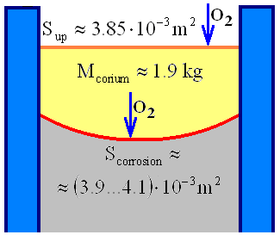
Comparison of parameters influencing the oxygen balance in the VVER molten pool, METCOR tests
VVER-1000
METCOR-P tests
<<
The melt mass vs. corrosion area do not comply with the requirements for prototypic experimental conditions
Oxygen potential of the melt on the vessel bottom is less sensitive to the vessel wall corrosion than in the tests

Slide 21
Conclusions
The data on European steel are too limited for developing correlations specific for this steel
The МСР-4 last regime had such a high vessel steel corrosion rate that oxygen spent on steel oxidation was not compensated by the oxygen from air supplied into the pool. This caused a decrease of melt oxygen potential followed by a drop in steel corrosion rate
The above-mentioned phenomenon can take place in other experiments, in which a high corrosion rate is reached, in MC11 in particular
The sensitivity of corrosion rate to oxygen potential in the melt requires a special study
A steadily high oxygen potential can be kept in the melt in tests with a high temperature on the interaction interface, if
− the rate of oxygen supply to the surface is increased by changing gas composition or the velocity field in the furnace;
− the melt mass is increased;
− the diameter of vessel steel specimen is reduced (crucible diameter staying the same)

