Slide 1
Interaction of suboxidized molten corium with European vessel steel
A.P. Alexandrov Research Institute of Technology (Russia)
TEST MCP-5
Presented by V. Granovsky
4th METCOR-P Meeting
St. Petersburg, Russia,
June 1, 2010

Slide 2
Contents
Experimental objectives
Schematics
Experimental procedure
Experimental results
Post-test analysis
Comparison of corrosion characteristics for the European and Russian vessel steels
First conclusions

Slide 3
Objectives
Comparison of corrosion rate and depth for European and Russian vessel steels at their interaction with suboxidized molten corium

Slide 4
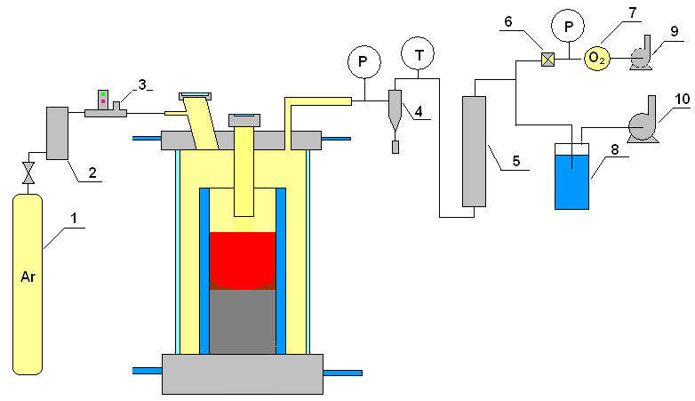
Gas-aerosol system
1 – Ar tank; 2 – silica gel drier; 3 – flow-rate transducer; 4 – cyclone; 5 – LAF filter; 6 – AFA filter;
7 – electrochemical oxygen detector; 8 – hydro lock;
9,10 – vacuum pump

Slide 5
Experimental procedure

Slide 6
Specimen temperatures versus time
Thermocouple readings in the plot are interrupted when a TC breaks down
As the heated top-level TCs break down, the stationary regime is controlled using the
indications of lower and cooler thermocouples

Slide 7
Corrosion depth dynamics
MCP-5
12
10
8
h, mm
6
4
Uncertaint sounding interpretation
2
Uncertaint sounding
interpretation
0
0
10000
20000
30000
40000
50000
Time, s
⎯ – US measurement; • – Post test measurement of specimen section
Long incubation period - approximately 20 000 s
Corrosion decreases as its front progresses into the specimen bulk –
a lower-temperature region
Corrosion process is not finished ?

Slide 8
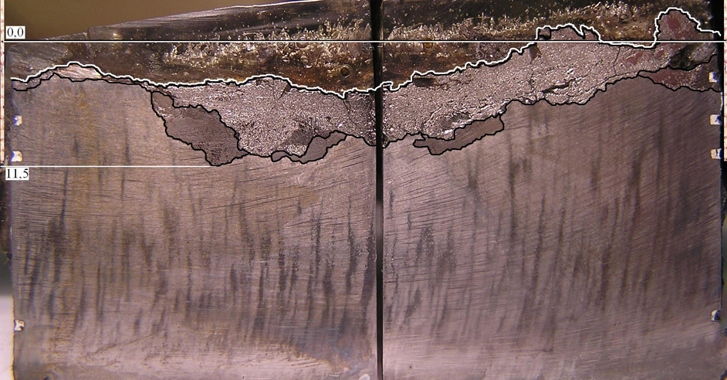
Specimen axial section
mass.%
U – 40
Zr – 16
Fe – 42
?
Molten oxidic pool having free surface
C-30; T_{B}=1060-1250°C; h_{B}=10mm
The section is perpendicular to the ultrasonic defect axis
Non-even boundary of the interaction zone
2 different structures in the IZ visible at the macrolevel

Slide 9
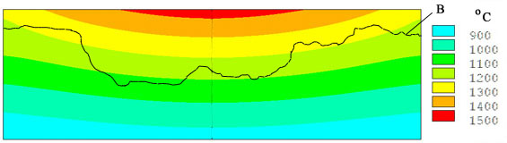
Specimen temperature conditions and IZ final boundary position in the end of the test
Т,ºC
A
h, m
Calculated by the ANSYS code using the measured boundary conditions and temperatures in TC locations
A – initial position of the specimen surface, В – final boundary of the interaction zone
The IZ boundary is located in the 1060 - 1250° C temperature region

Slide 10
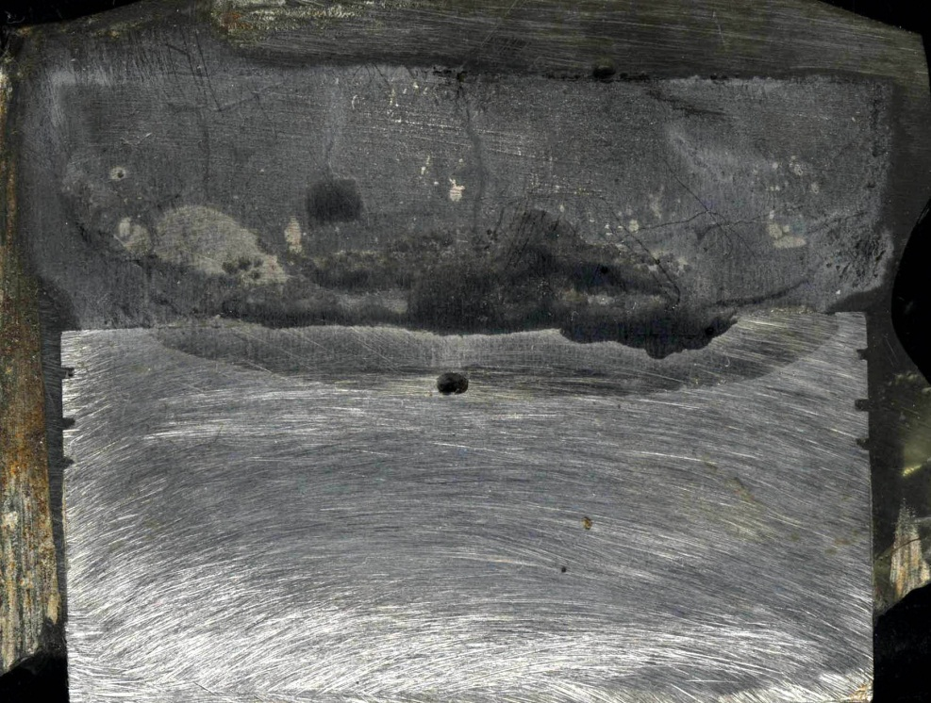
Comparison with corrosion of Russian vessel steel
MC6
mass.%
U – 25.6
Zr – 5.4
Fe – 64.4
Molten oxidic pool with the surface crust
C-30; T_{B}=1120-1200°C; h_{B}=6mm; 1 layer in IZ

Slide 11
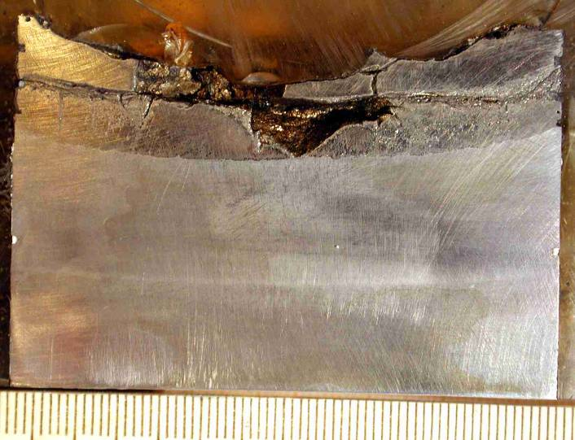
Comparison with corrosion of Russian vessel steel (2)
MC9
mass.%
U – 39.5
Zr – 5.4
Fe – 50.0
U – 27.0
Zr – 11.0
Fe – 56.0
Molten oxidic/metallic pool having free surface
C-30; T_{B}=1060-1100°C; h_{B}=15mm; 2 layers in IZ

Slide 12
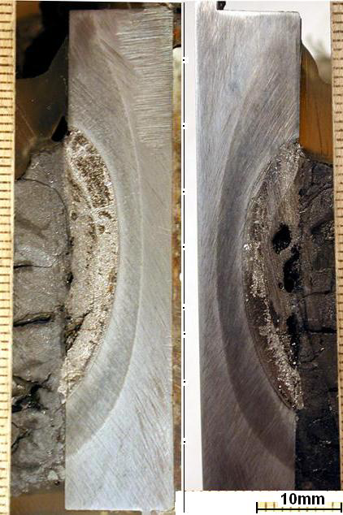
Comparison with corrosion of Russian vessel steel (3)
Vertical position of interface
MCP-1
mass.%
U – 52.4
Zr – 13.7
Fe – 32.2
U – 36.4
Zr – 14.3
Fe – 49.1
Molten oxidic pool
with the surface crust
C-17; T_{B}=1000-1190°C; h_{B}=6mm
2 layers in IZ

Slide 13
Corrosion kinetics of Russian vessel steel

Slide 14
Comparison with corrosion kinetics of Russian vessel steel
Corrosion kinetics
Correlations for corrosion rates
h, mm
Russian steel (4 summarized tests)
Exp.
2
European steel
1
t, s

Slide 15
First conclusions
Corrosion kinetics in MCP-5 and МС6 tests are qualitatively similar and have an incubation phase, transient to fast corrosion and saturation phase
In comparison with МС6 the MCP-5 incubation period increased from 16000 s to 20000 s
Differently from МС6 the final boundary of interaction zone is irregular (not smooth)
The final position of the interaction zone boundary was found in the temperature range of 1060-1250 °С ( for comparison: МС6 – 1120…1200°С)
Posttest analysis is in progress

