Slide 1

МСР-6 preparation.
Oxidation kinetics of metallic melt containing uranium and zirconium
A.P. Alexandrov Research Institute of Technology
ISTC METCOR-P Project
#3592
Presented by A. Sulatsky
4th METCOR-P Meeting
St. Petersburg, Russia,
June 1, 2010

Slide 2
Contents
Objectives
Furnace charge
Furnace schematics
Gas-aerosol sampling system
Experimental procedure
Post-test analysis
Post-test modeling of crust growth
Estimate of oxidation time
Conclusions

Slide 3
Objectives
Study oxygen diffusion through oxidic crust on the surface of metallic pool containing uranium and zirconium when neutral atmosphere is replaced with steam

Slide 4
Furnace charge
Component | Mass, g | Composition, mass.%
SS 08Kh18N10T | 1760 | 65
U | 581 | 21
Zr | 387 | 14
Total | 2728 | 100
This metal composition corresponds metallic liquid of system C-32 corium + SS (40 mass.%)

Slide 5
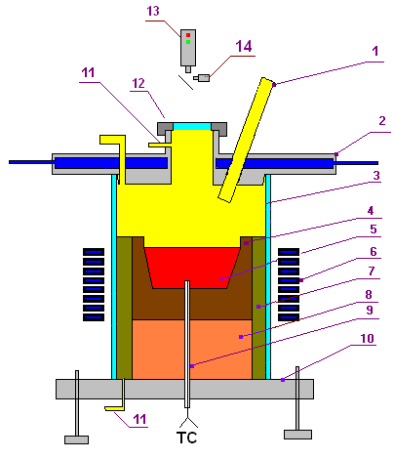
Furnace schematics
Hot crucible (4) made of ZrO₂ concrete
To prevent steam penetration into the melt through crucible walls its outer surfaces (side, bottom and top edge) are covered with aluma-silicate enamel with ZrO₂ filling
Outer crucible surface is separated from water-cooled inductor by thermal insulation (7) made of mullite cotton and ZrO₂ filling
To exclude steam condensation on the furnace cover a water-cooled lid (2) having hot downward surface will be used
Molten pool surface is raised to the maximum possible level
Furnace volume including thermal insulation (7) is separated from the ambient atmosphere by hot quartz tube (3)
Furnace atmosphere is Ar/steam
1 – two ports of corrosion-resistant tube: for steam supply and for the introduction of W/Re thermocouple in a tungsten sheath; 2 – water-cooled furnace cover; 3 – quartz tube; 4 – crucible made of ZrO₂ concrete; 5 – metallic melt; 6 – inductor; 7 – thermal insulation; 8 – lightweight bottom; 9 – two W/Re thermocouples in the ZrO₂ sheath; 10 – corrosion-resistant bottom; 11 – Ar supply port; 12 – lid of monitoring window; 13 – pyrometer; 14 – video camera

Slide 6
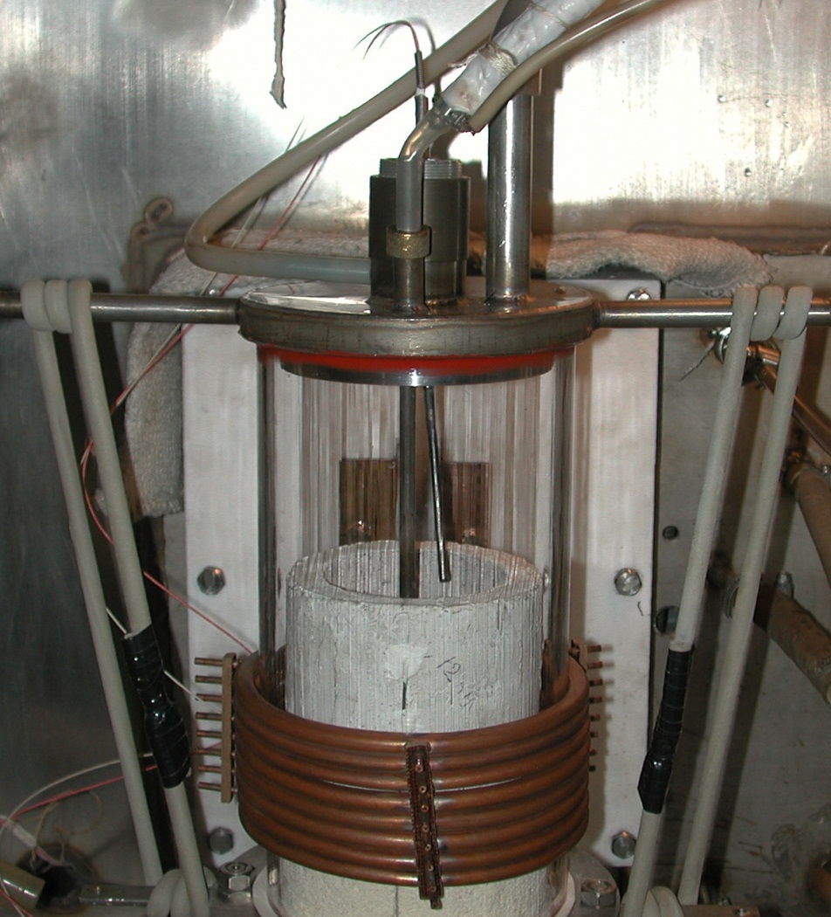
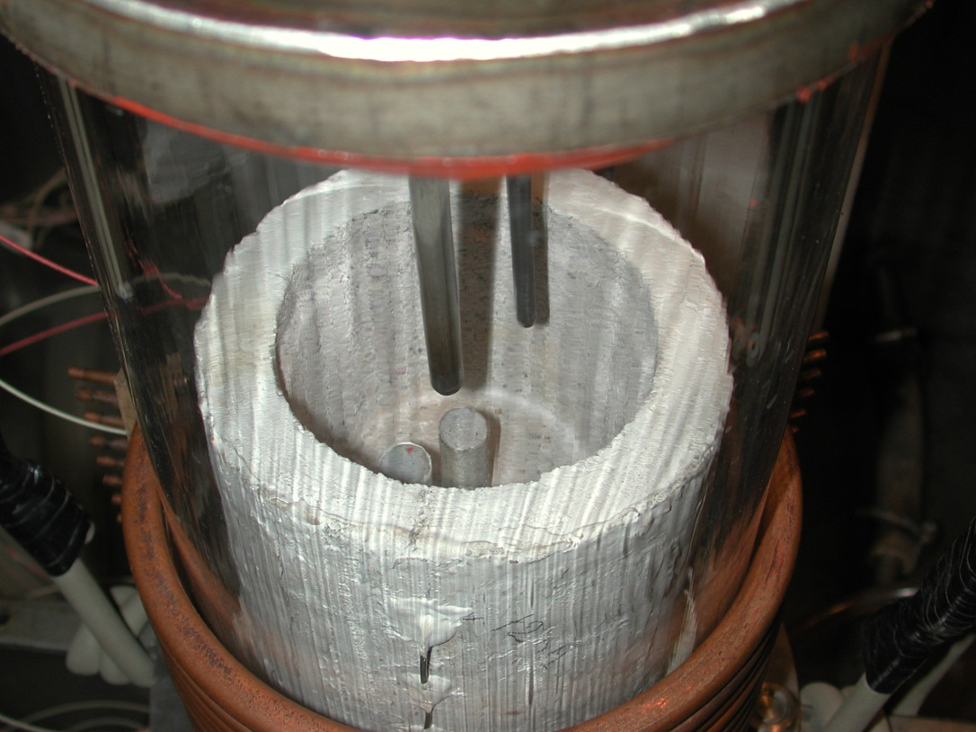
Furnace schematics (2)
W/Re thermocouple in a tungsten sheath
Steam supply
Steam supply
W/Re thermocouple in
a tungsten sheath
2 W/Re thermocouples in the ZrO₂ sheath
Coating made of alumo-silicate enamel with из ZrO₂ filling
2 W/Re thermocouples in the ZrO₂ sheath
Ar supply port

Slide 7
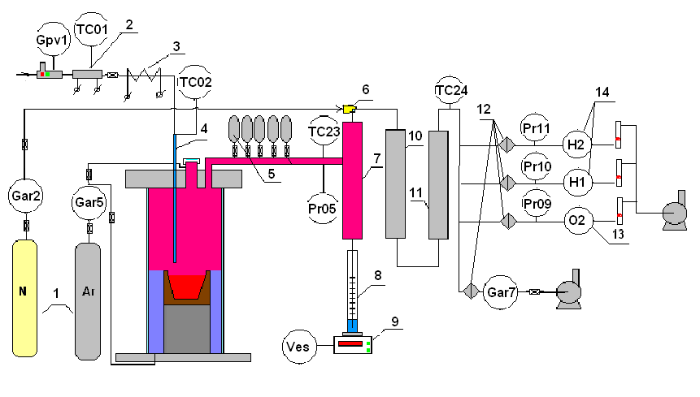
Gas-aerosol sampling system
1 – Ar, N₂ tanks; 2 – water regulator – flow-rate meter to the direct-flow steam generator; 3 – direct-flow steam generator; 4 – heated steam supply line; 5 – evacuated burettes; 6 – ejector; 7 – steam condenser; 8 – condensate collector; 9 – tensiometric weight sensor; large-area filter (LAF); 10 – large-area filter (LAF); 11 – silica gel dehumidifier; 12 – Petrianov filter (AFA); 13 – electrochemical oxygen sensor; 14 – electrochemical hydrogen sensors; Gpv1, Gar2, Gar5 – flow-rate regulators (Bronkhost); TC02 – thermocouple (K); TC23, TC24 – thermocouples (L); Pr05-11 – absolute pressure gauges (Honeywell)

Slide 8
Experimental procedure
1. Ar is flushed during 10 min at a 10 slm flow rate to remove oxygen from the furnace
2. Gradual heating of metallic charge and molten pool production, Ar flow rate – 10 slm
3. After complete melting of metallic components the pool is heated to 1700°С
4. The molten pool surface is shifted to the inductor field edge to reduce meniscus
5. The electrical and thermal characteristics of the molten pool, its surface temperature are measured
by pyrometer. Temperature in the pool is measured by 2 W/Re thermocouples
6. If oxidic film is observed on the metallic top, the surface is cleaned by melt freezing on the
corrosion-resistant rod
7. The startup line is disconnected, condenser is connected and sparged with Ar
8. Ar supply disconnected, steam is supplied at a flow rate of 100…200 g.H₂O/hour with
a simultaneous nitrogen supply to the ejector
9. Melt oxidation regime. In the beginning the carrier-gas flow rate is regulated to limit the H₂ content
in the flue gases (not more than 4 vol.%). After crust formation on the pool surface its temperature
is measured by the W/Re thermocouple in the tungsten sheath
10. In the beginning of oxidation regime after crust formation additional monitoring of the furnace gas
composition by sampling it into vacuum burettes for the chromatographic analysis from the gas
mixture sampling point to furnace outlet
11. The criterion of stopped oxidation – the content of hydrogen in furnace gases should reduce to
the level of hydrogen sensor sensitivity. Also, the quantities of the oxidized U and Zr will be
calculated on-line during the test, so it is proposed to stop the test upon reaching the predicted
instant of the unoxidized U and Zr depletion, unless termination is caused before that by reaching
the hydrogen sensor sensitivity threshold
11. Furnace is flushed with Ar. The HF heating is disconnected after the oxidation stops
12. Ingot is crystallized in the Ar atmosphere until complete cooling

Slide 9
Post-test analysis
Post-test analysis will include the following:
Experimental file processing to determine:
Hydrogen release during oxidation
Steam spent on oxidation
Melt temperature condition
Crust temperature condition at oxidation
Physicochemical analysis to determine:
Final amount of oxidized melt components
Thickness of final crust
Crust composition
Post-test analysis will be followed by:
Theoretical modeling of oxidic crust growth on the pool surface
Direct numerical modeling of the molten pool temperature
conditions
Estimate of diffusion coefficient

Slide 10
Post-test modeling of crust growth
3 way of crust growth modeling:
Using of parabolic growth law
Processing of hydrogen release data
Processing of melt and crust temperature data
+
For all ways:
Using of final crust thickness for fitting
The 1st way (parabolic law)

Slide 11
Post-test modeling of crust growth (2)
gas+steam
crust
melt
The 2nd way (hydrogen release)
1. Oxidation process and corresponding crust growth are controlled by oxidant
supply
2. Oxidant (oxygen) supply is limited by its diffusion through the crust
3. Its thickness is evaluated in the following way

Slide 12
Post-test modeling of crust growth (3)
The 3rd way (melt and crust temperature)
Crust thickness is determined by the equality of two heat fluxes
– heat flux radiating from the crust top surface
– heat flux through the crust by thermal conductivity
2. Temperature of the crust bottom surface is close to the melt temperature due to a high heat exchange coefficient in the metallic melt :

Slide 13
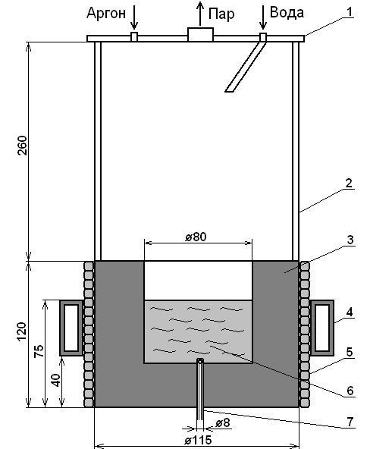
Estimate of oxidation time
Ar
steam
water
Referense:
Granovsky, V.S., Bechta, S.V., Lopukh, D.B. et al. Hydrogen generation at water boiling on the zirconium-bearing metallic melt // Proceedings of the 4th Russian national conference on heat transfer,
23-27 Oct., 2006, Moscow, V.1, PP.219-222. (in Russian)
Furnace charge:
SS 12Kh18N10T – 95 mass.%
Zr – 5 mass.%
Total: 1400 g
1 – metallic furnace cover, 2 – quartz tube,
3 – crucible made of magnesite refractory, 4 – inductor,
5 – thermal isolation, 6 – melt, 7 – W/Re thermocouple

Slide 14
Estimate of oxidation time (2)
Melt oxidation derived through oxidic crust
Characteristic
times:
Prediction for MCP-6: Within ≈2 min hydrogen release rate and
corresponding rates of oxidation and crust growth will drop by 100 times

Slide 15
Conclusions
Experimental procedure has been developed
Gas-aerosol system has been assembled
New furnace design has a minimum surface for uncontrolled steam condensation
Alternative methodologies for post-test evaluation of oxidic crust growth are developed

