Slide 1
Interaction of suboxidized corium melt with a vertically-positioned specimen.
Test МСР-1. Results of analysis
A.P. Alexandrov Research Institute of Technology
International Science and Technology Center
Presented by V. Granovsky
2nd METCOR-P project meeting
July 9, 2008, St. Petersburg

Slide 2
Contents
Experiment specifications
Results
Posttest analysis
Systematization of tests with suboxidized corium
Model of stabilized corrosion condition
Comparison with GEMINI / NUCLEA calculations
IVR application
Requirements to the test on the interface orientation relevance
Conclusions

Slide 3
Objectives of the test
Comparison with results of MC6 test with horizontally
positioned interface
Test parameters are similar to MC6 test of METCOR-2:
C-30 corium charge
15Kh2NMFA vessel steel
Pure argon above the melt
10 h exposition

Slide 4
Furnace design
1 – Water-cooled screen
2 – Lid
3 – Water in
4 – Quartz tube
5 – Crucible sections
6 – Specimen
7 – Inductor
8 – Bottom calorimeter
9 – Welded crucible sections
– SS support
– Water out
12 – Electromagnetic screen
13 – Crucible collector

Slide 5
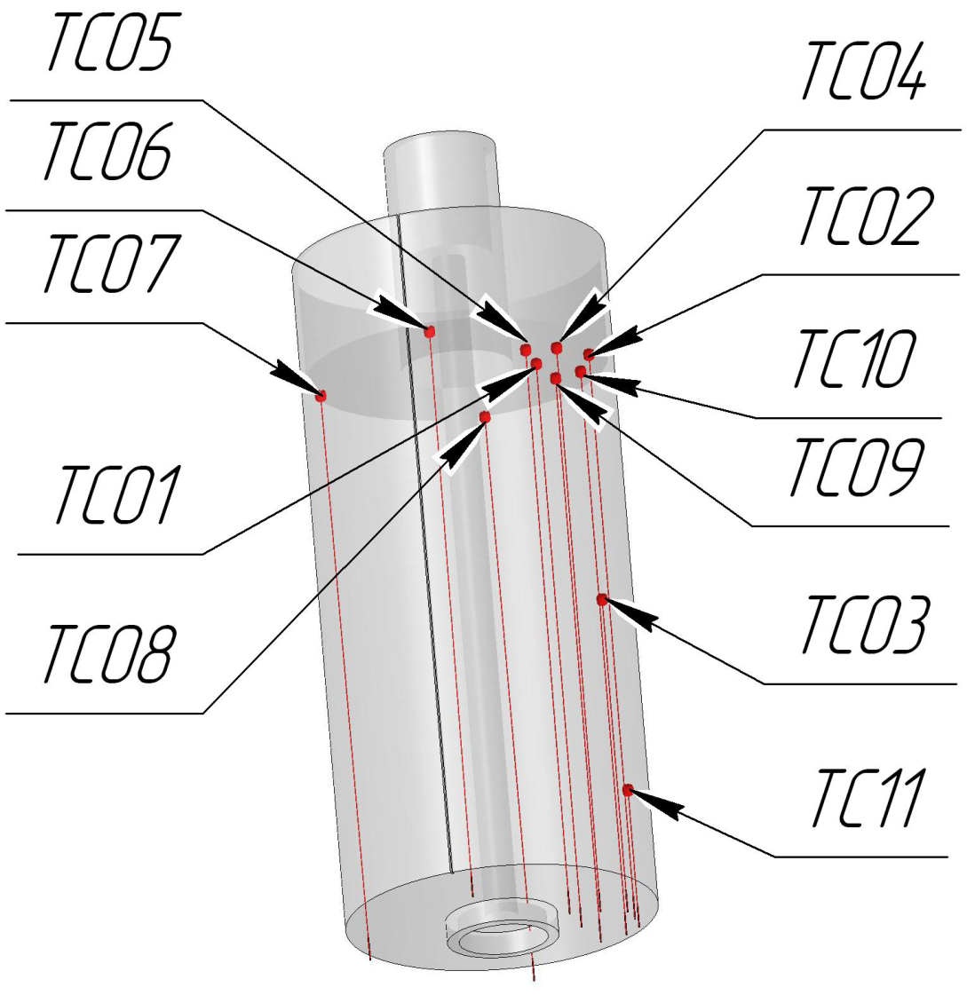
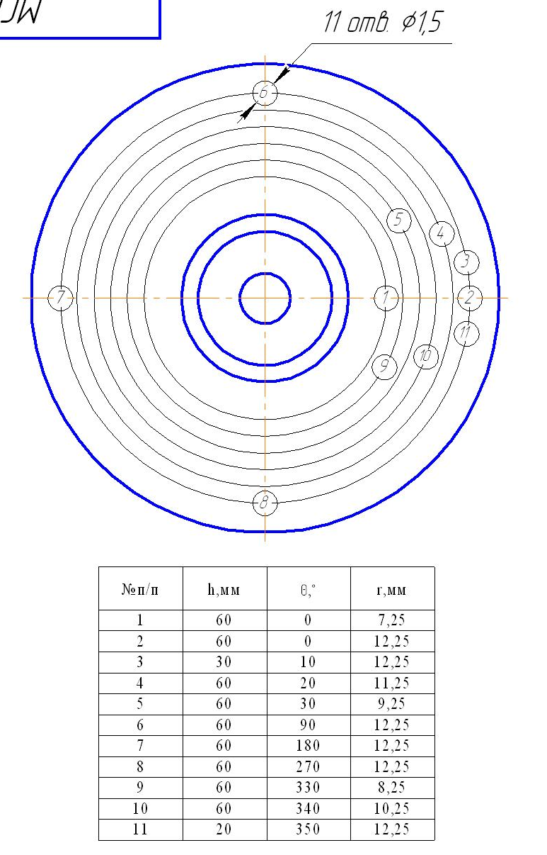
TC locations in the specimen
Coordinates of TC hot junctions
Majority of TC were installed at H=50 mm elevation, where the maximum depth of specimen corrosion was expected according to the pretest calculations

Slide 6
Test procedure
Time, s | Operation mode
0-963 | Furnace deoxygenation by argon flow
963-3550 | Formation and homogenization of the molten pool. Increase of power in the melt to get 1400 ºC on the specimen surface
3550-39874 | Surface temperature and specimen - water power kept constant by inductor voltage control
39875-42000 | Heating disconnection, melt solidification and ingot cooling in argon

Slide 7
Test results: TC readings (1)
Wrong readings of several thermocouples due to corrosion of wires below the hot junctions

Slide 8
Test results: TC readings (2)
Estimation of IZ progression from TC readings
Different lifetime of TCs in the mushy interaction zone
Not possible to estimate interaction kinetics
Short incubation period
(or no incubation)

Slide 9
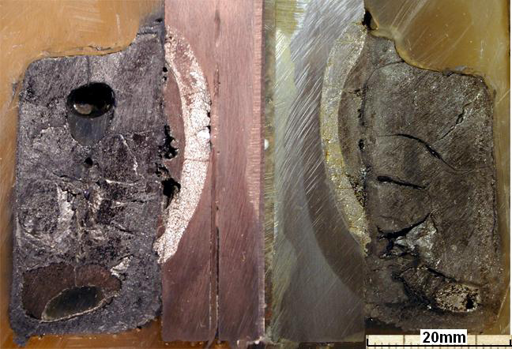
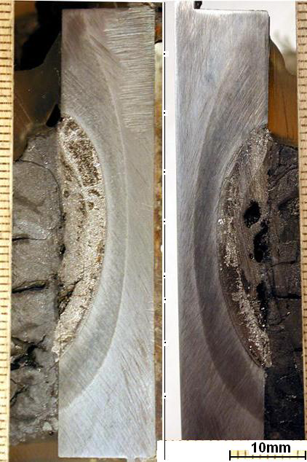
Posttest examination
Axial sections of ingot
Axial sections of ingot
Axial sections of ingot
Corium upper crust is removed
Metal inclusions in corium ingot
Example of TC location
The maximum depth of corrosion is in the middle section of the specimen
(Н ≈ 30 mm) due to formation of a thick corium upper crust and decrease in the melt depth

Slide 10
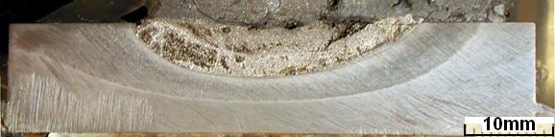
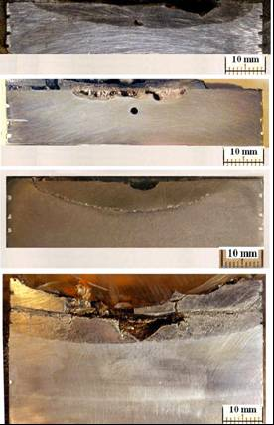
Posttest examination (2)
Axial sections of specimen
MCP-1 (90º rotated)
Corium
1st layer
2nd layer
Zone of thermal influence
Steel of initial structure
MC 6
IZ
Steel

Slide 11
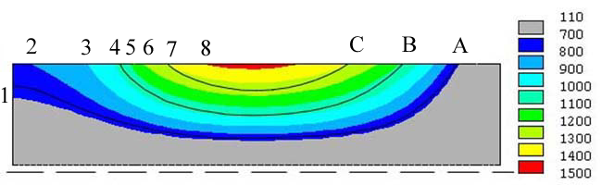
Posttest examination (3)
Temperature profile of the specimen
T, ºC
90° rotated
Upper surface
bottom
A – boundary of the thermal influence zone (lamellar pearlite structure indicating eutectic composition formation at 727 ºC)
B – boundary of the 2nd layer (1000-1090 ºC)
C – boundary of the 1st layer (1240-1300 ºC)
1 – 700 ºC 5 – 1100 ºC
2 – 800 ºC 6 – 1200 ºC
3 – 900 ºC 7 – 1300 ºC
4 – 1000 ºC 8 – 1400 ºC

Slide 12
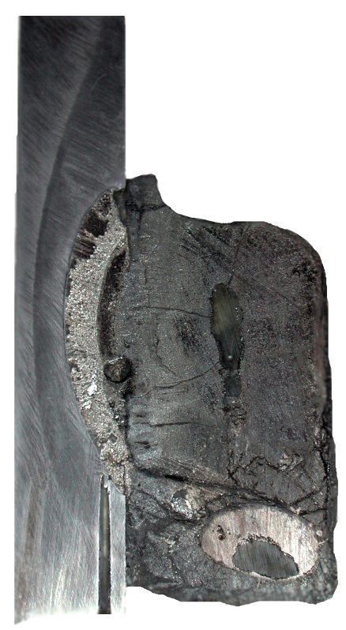
Posttest examination (4)
XRF and chemical analysis
XRF
ChA
XRF,mass.%
ChA,mass.%
U=66.1
Zr=20.1
Fe=1.7
Cr=0.06
Ni=0.02
U=66.8
Zr=22.3
Fe=2.1
Average
sample of
crust
C_{n}≈48
2nd layer:
U=36.4
Zr=14.3
Fe=47.8
Cr=0.8
Ni=0.5
1st layer:
U=52.4
Zr=13.7
Fe=30.9
Cr=0.6
Ni=0.3
29-31mm
U=65.6
Zr=22.1
Fe=1.0
Cr=0.02
Ni=0.03
U=66.6
Zr=23.2
Fe=1.0
Average
sample of ingot upper part C_{n}≈40
∼25mm
Average
sample of ingot lower part C_{n}≈32
U=57.5
Zr=24.2
Fe=17.8
Cr=0.2
Ni=0.3
U=64.4
Zr=21.7
Fe=3.5
Cr=0.04
Ni=0.08
U=66.7
Zr=22.3
Fe=5.7
∼23mm
Reduction of C_{n} up to ≈17% (instead of 30) at the interaction start is explained by a high oxygen content in the upper crust
Higher content of U and Zr in IZ (40-50 and 13-14 mass %) in comparison with
МС6 IZ (24 and 5 mass %)
High content of U and Zr in metal inclusion (∼ 58 and ∼ 24 mass %), as in MC6

Slide 13
Posttest examination (5)
SEM/EDX analysis
1 mm
Steel
Corium
____________
U(Zr)O₂
α-Zr(O)
Crust
__________
U(Zr)O₂
intermetalics
1st layer
__________
U(Zr)O₂
Zr(U)Fe₂
U₆Fe
U(Zr)- Fe
eutectic
2nd layer
_________
U(Zr)Fe₂
Fe- U(Zr)
eutectic
UFe₃
U(Zr)Fe₃
No liquid in the crust
Small solid fraction in the 1st layer
Small liquid fraction in the 2nd layer (only in a thin layer contacted with steel)

Slide 14
Comparison of MCP-1 and MC6 data
Conditions Results
Different conditions not only in the interface orientation, but also in corium oxidation index and heat flux
Reason of result differences?

Slide 15
Discussion of results
Possible reason of shorter incubation period in МСР-1 in comparison with МС6:
- thinning of crust between melt and IZ caused by increased
heat flux and surface temperature
Lower temperature of MCP-1 IZ final boundary in comparison with MC6 can be explained by :
- a significantly decreased C_{n}, i.e. increased content of
Zr- free in the melt ?
- vertically- positioned interface ?

Slide 16
Results of tests with suboxidized corium
Test | Corium oxidation index, С_{n} | Temperature on the IZ boundary, T_{B} ,°С | Mass fraction of interacting specimen steel, ,% | IZ composition, mass.% |  |  | Composition of the in-corium metallic body, mass.%
 |  |  |  | U | Zr | Fe | U | Zr | Fe
МС6 | С-30 | 1120 … 1200 | 3,4 | 25,6 | 5,4 | 64,4 | 55,0 | 25,0 | 15,0
МС7 | С-30 | 1030 … 1100 | 0,4 | 44,0 | 2,2 | 50,0
МС8 | С-70 | 1200 | 2,9 | 22,0 | 6,1 | 68,2
МС9 | С-30 | 1060 … 1100 | 9,2 | 33,3 | 8,3 | 53,0 | − | − | −
МСР-1 | С-17 | 1000 … 1090 | 7,1 | 44,0 | 14,0 | 40,0 | 57,0 | 24,0 | 18,0

Slide 17
Peculiarities of METCOR tests
MASCA METCOR
MC6 … MC8, MCP-1 MC9
Crust
T₁
Oxide melt
(U, Zr)_{2-x} – FeO_{1-y}
T₁
Oxide melt
(U, Zr)_{2-x} – FeO_{1-y}
T₁
Oxide melt
(U, Zr)_{2-x} – FeO_{1-y}
Metal
melt (1)
Crust
T₂
Metal melt (2)
U–Zr– Fe–(O)
(IZ)
Crust
Metal melt (2)
U–Zr– Fe–(O)
(IZ)
T₂
Metal melt (1)
U–Zr– Fe–(O)
T₂
Vessel steel
Vessel steel
T₁ = T₂ T₁ >> T₂
  Fe displaced by U and Zr from the IZ forms a metallic body in the oxidic melt. Other conditions being equal, it leads to the corium oxidation degree growth
  In МС9 200 g of SS is introduced. Absence of the melt surface crust leads to the Fe volatilization, therefore a metallic body is not formed in the oxidic melt.
  For metallic melt (1) C_{U} and C_{Zr} is larger, and C_{Fe} – smaller than in case of metallic melt (2)

Slide 18
MASCA results
U, Zr and Fe concentrations in the metallic ingot as a function of the
introduced steel concentration
in the С-32 – С-45 range
in the С-60 – С-75 range
As and С_{n} grow, U and Zr concentrations decrease, and Fe concentration increases in the metallic part of the melt

Slide 19
Fe concentration in the IZ versus the mass fraction of interacting steel
, evaporation)
  МС8 point is on a steeper curve than МС6, МС7 due to a higher oxidation index
  МСР-1 point is on a flatter curve than МС6, МС7 due to a lower oxidation index
  МС9 point is on a flatter curve than МС6, МС7 due to the absence of a metallic body, which is equivalent to a smaller oxidation index

Slide 20
Model of the stabilized system after corrosion stage completion
● Stabilized condition (corrosion completion) means chemical equilibrium between the oxidic liquid (corium) and metallic liquid (IZ) in the thermal gradient conditions. The equilibrium is provided by the repartitioning of components between liquids (like in MASCA)
● Low IZ temperature explains insignificant solubility of
oxygen in the metallic melt. Therefore, the IZ can be roughly
analyzed using the U-Zr-Fe ternary diagram (without oxygen)
● Steel corrosion – its dissolution in the IZ metallic melt
● Specimen and IZ temperature are sensitive only to thermal boundary conditions

Slide 21
Model of the stabilized system after corrosion stage completion (2)
Conventional phase diagram
Equilibrium concentration of Fe in the IZ versus steel mass fraction
Final position of the IZ boundary
T
Corium
melt
U, Zr
Fe
Steel

Slide 22
Comparison of GEMINI / NUCLEA calculations with experimental data
Fe
1.0
0.0
0.9
0.1
0.8
0.2
MC6
0.7
0.3
MC8
0.6
0.4
MC9
0.5
MC7
0.5
0.4
MCP-1
0.6
0.3
0.7
0.2
0.8
0.1
0.9
0.0
1.0
U
1.0
0.9
0.8
0.7
0.6
0.5
0.4
0.3
0.2
0.1
0.0
Zr
Mass Fraction
U/Zr variation range in the IZ compositions from 3.15 to 20.0

Slide 23
Comparison of GEMINI / NUCLEA calculations with experimental data (2)
МС7 U/Zr=20.0 МС9 U/Zr=4.0 MCР-1 U/Zr=3.15
1500
T,°C
1500
T,°C
1500
T,°C
1400
1400
1400
1300
1300
1300
1200
1200
1200
1100
1100
1100
Fe
Fe
Fe
1000
1000
1000
U, Zr
30
40
50
60
70
80
90
U, Zr
U, Zr
Mass.%
40
50
60
70
80
90
Mass.%
30
40
50
60
70
80
90
Mass.%
  Minimum value exceeds
  The MC7 IZ composition is close to the eutectics. It corresponds to the
  SEM/EDX results – liquid phase is more than 80 mass.%
  Composition of the МС9, МСР-1 IZ is mushy. It corresponds to the
  SEM/EDX results

Slide 24
Comparison of GEMINI / NUCLEA calculations with experimental data (3)
MC6 U/Zr=4.75 MC8 U/Zr=3.62
1500
T,°C
1500
T,°C
1400
1400
1300
1300
1200
1200
1100
1100
U, Zr
Fe
U, Zr
Fe
1000
1000
40
50
60
70
80
90
40
50
60
70
80
90
Mass.%
Mass.%
  IZ is liquid. It corresponds to the SEM/EDX results

Slide 25

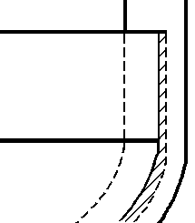
Application for IVR
VVER-1000
Stratified molten pool
Fragment
1500°C
Metal melt
1090°C
Metal melt
m_{st}^{max}
Oxide melt
Oxide melt

Slide 26
Application for IVR
VVER-1000 (2)
- МС8
- VVER-1000

Slide 27
Requirements to the test on checking the influence of interface orientation
      ● Prototype with a horizontal specimen positioning– МС8
  ● Exact thermometry of the specimen
  ● Melt oxidation index – С-30
  ● Added 12 mass% of steel → С-70 oxidation index
  ● Corium crust on the oxidic melt surface,
  ● Establishment of the specimen’s stationary temperature condition
  ● Numerical modeling to determine , at which
  ● Adjustment of stationary regime
  ● Regime duration – until corrosion front stabilizes

Slide 28
Conclusions
      ● Completed analysis explains the МСР-1 results; the interface orientation is not taken into account
      ● If the corrosion of steel at its interaction with suboxidized corium melt depends only on the chemical equilibrium, the interface orientation assumably does not influence the final corrosion depth
      ● Experiments on checking the possible influence of interface orientation are to have identical conditions:
  - С_{n}
  -
  - presence of crust on the molten corium surface
      ● In order to verify the presented model it is advisable to make an experiment at the horizontal position of the interface with corium
      C-90 (С-95) or С-30 (С-70) and increased value of in comparison with с МС6, МС8 in order to get Т_{В} ≈ 1300 - 1350°С

