Slide 1
Oxidation kinetics of metallic melt containing uranium and zirconium. MCP-6 test
A.P. Alexandrov Research Institute of Technology (Russia)
Presented by A. Sulatsky
5th METCOR-P Meeting
St. Petersburg, Russia,
June 7, 2011

Slide 2
Contents
Objectives of METCOR-P project
Objectives of MCP-6 test
Furnace schematics
Crucible charge
Experimental procedure
Surface view during the test
Crust surface view after test
Post-test analysis
2D numerical modeling
Results of SEM-EDX analysis of oxidic crust
Conclusions

Slide 3
Objectives of METCOR-P project
Qualification and quantification of physicochemical phenomena of corium melt interaction with reactor vessel steel with particular interest to:
Interaction characteristics at the vertically positioned interface
Peculiarities of interaction with European vessel steel
Corium melt oxidation transients

Slide 4
Objectives of MCP-6 test
Study of oxidation kinetics of the U- and Zr- containing metallic melt through the oxidic surface crust after neutral atmosphere replacement by steam

Slide 5
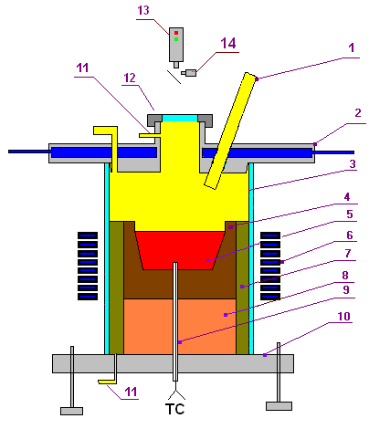
Furnace schematics
Crucible (4) was made of ZrO₂ concrete
To prevent melt oxidation through crucible walls, its outer surfaces were coated with alumosilicate binder with ZrO₂ filling.
The crucible outer surface was separated from the water-cooled inductor with thermal insulation (7)
To reduce steam condensation on the water-cooled furnace cover (2), its thickness was increased
The molten pool surface was located at the crucible upper top
The furnace volume including thermal insulation (7) was separated from the ambient atmosphere with quartz tube (3)
1 – two ports of corrosion-resistant tube: for steam supply and for the introduction of W/Re thermocouple in a tungsten sheath; 2 – water-cooled furnace cover; 3 – quartz tube; 4 – crucible made of ZrO₂ concrete; 5 – metallic melt; 6 – inductor; 7 – thermal insulation; 8 – lightweight bottom; 9 – two W/Re thermocouples in the ZrO₂ sheath; 10 – corrosion-resistant bottom; 11 – Ar supply port; 12 – lid of monitoring window; 13 – pyrometer; 14 – video camera

Slide 6
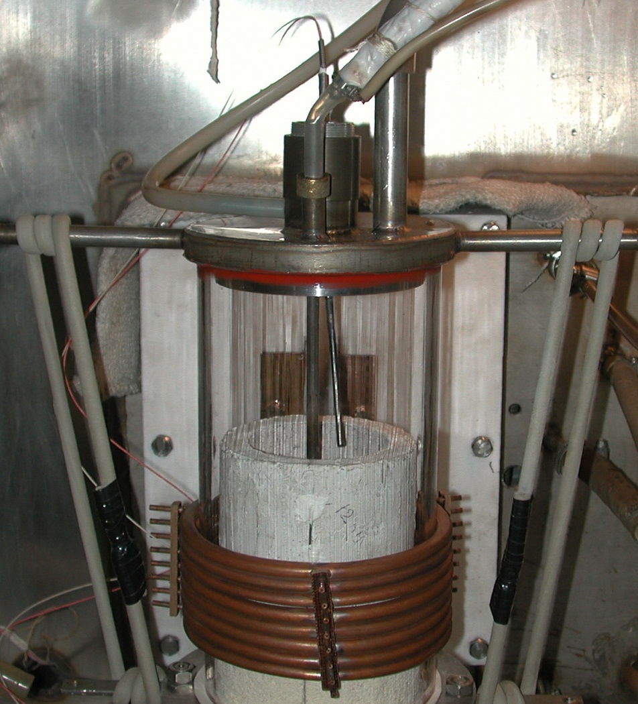
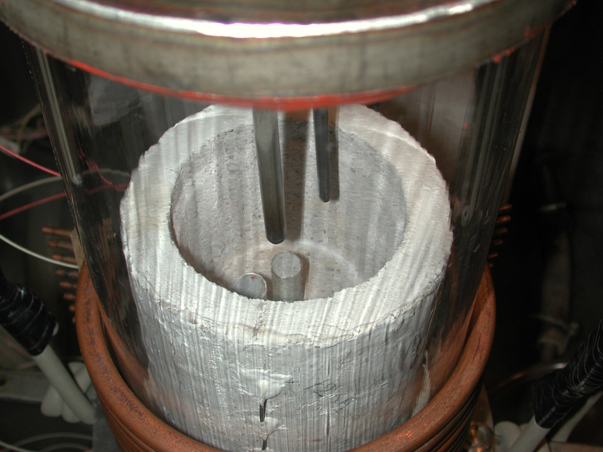
Furnace schematics (2)
Pt/PtRh thermocouple in alumina sheath
Steam supply
Steam supply
Pt/PtRh thermocouple in alumina sheath
2 W/Re thermocouples in the ZrO₂ sheath
Alumosilicate coating with ZrO₂ filling
2 W/Re thermocouples in the ZrO₂ sheath
Ar supply line

Slide 7
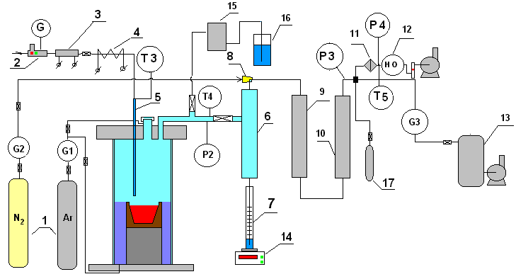
Gas-aerosol sampling system
1 – Ar, N₂ tanks; 2 – water regulator – flow rate meter to the direct-flow steam generator; 3 – direct-flow once-through steam generator; 4 – heated steam supply line; 5 – corrosion-resistant tube of steam supply into the furnace; 6 – steam condenser; 7 – condensate collector; 8 – ejector; 9 – large-area filter (LAF); 10 – silica gel dehumidifier; 11 – Petrianov filter (AFA); 12 – electrochemical sensors of O₂ and H₂; 13 – vacuum receiver; 14 – tensiometric weight sensor; 15 – medium-area filter (MAF); 16 – hydrolock

Slide 8
Crucible charge
Component | Mass, g
SS: 08Kh18N10T | 1475
U | 487
Zr | 324
Total mass | 2286

Slide 9
Experimental procedure
1. 0…560 s – furnace deoxygenation by argon
2. 560…6550 s – smooth heating up, charge melting, melt heating up to ≈1500°C
3. 6550…6800 s – addition of metallic zirconium into the melt followed by the melt exposure, monitoring of the melt temperature condition
4. 6800…9700 s – cleaning of the melt surface from crust
5. 9700 s – steam supply into the furnace at 103 g H₂O/hr, start of melt
oxidation (melt temperature within 1380 – 1580°C), steam-gas mixture sampling into vacuum burettes
6. 9900 s – crust surface temperature measurement by the Pt/PtRh thermocouple
7. 10696 s – registration of the beginning of condensate accumulation in the collector
8. 16200 s – an increase in steam flow rate up to 197 g H₂O/hr
9. 20037 s – steam supply replacement by argon
10. 22036 s – HF heating disconnection after the concrete crucible drying

Slide 10
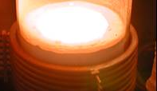
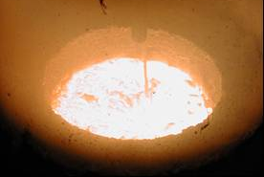
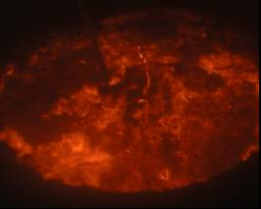
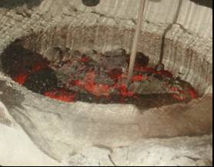
Surface view during the test
Molten pool preparation, 5000 s
Beginning of the oxidation, 10000 s
Thick crust with cracks, 20000 s
Melt crystallization, 25000 s

Slide 11
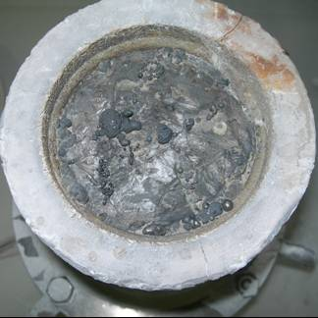
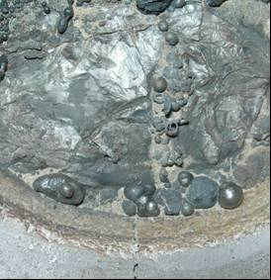
Crust surface view after test
Solidified slag drops along cracks in the crust
Abundant metallic and slag extrusions on the oxidic crust surface, as well as the melt outflows/outbursts visually observed during the test evidence the presence of a large number of pores and cracks in the oxidic crust
Metallic extrusions
Notes:
Многочисленные металлические и шлаковые выделения на поверхности оксидной корки, как и вспышки/всплески расплава, визуально наблюдавшиеся во время теста, свидетельствуют о большом количестве пор и трещин в оксидной корке

Slide 12
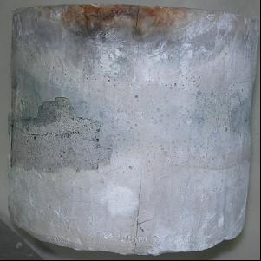
Post-test analysis
Crucible external view
Enamel peeling off the crucible lateral surface occurred during the crucible cooling due to thermomechanical strains
Single cracks observed on the crucible upper top
In general, the enamel meant for preventing steam penetration through the crucible lateral surface into the melt maintained its integrity
Crack
Enamel peeling off

Slide 13
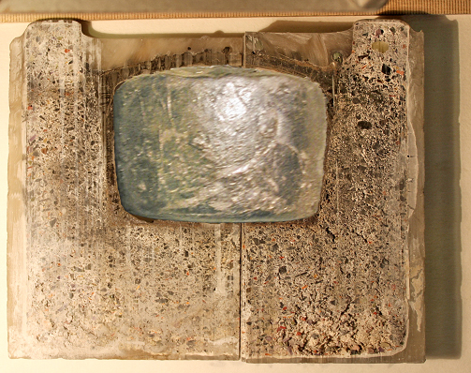
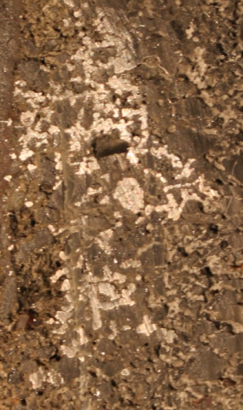
Post-test analysis (2)
Metallic ingot, cross-sections of crucible and oxidic crusts
No visible crucible walls erosion
Crust thickness:
upper surface – 5…6 mm,
lateral – 3…4 mm,
bottom – about 2 mm
Metallic inclusions in crucible walls
Metallic ingot
Metallic inclusions

Slide 14
Post-test analysis (3)
Beginning of steam supply
Increase of steam flow rate
TCs readings
End of steam supply
HF heating disconnection
The differences in thermocouple readings in bulk melt (TC05 and TC06) is explained by the eutectic nature of molten pool production, i.e., starting from the central area, where U and SS from the charge were in contact with each other
Readings of TC05 are not given after its destruction
During oxidation, the melt temperature was within the 1380–1580°C range
After the supply of steam into the furnace, pyrometer readings practically coincide with TC measurements of the crust temperature due to the low absorption of radiation by the superheated steam

Slide 15
Post-test analysis (4)
Estimation of a thickness of an oxidic crust on TCs to indications
Beginning of steam supply
Increase of steam flow rate
End of steam supply
Crust thickness is calculated assuming equality of heat flux from the melt through the crust due to thermal conduction and of that radiated from the crust upper surface:
An approximate equality between the temperature of the oxidic crust lower surface
and is supposed
The final crust thickness is

Slide 16
Post-test analysis (5)
Beginning of steam supply
Increase in steam consumption
Steam supply termination
Steam absorption calculated from steam/condensate balance
Oxidation of the melt by steam can be fairly well approximated by the linear interpolation with the steam absorption rate which equals
23 (±3) mg H₂O/s
Some decrease in the oxidation rate was observed at the beginning of steam supply (until 16200 s) when the oxidic crust growth occurred

Slide 17
Post-test analysis (6)
Gas analysis result
The table does not contain volume fractions of carbon mono- and dioxide and of methane, as their total content does not exceed 1 vol.%
The presence of nitrogen in the sampled furnace gases is explained by strong rarefaction in the gas line during pipettes switching to it due to the preliminary vacuumization of pipettes
The difference between the H2/O2 ratio in furnace gases from that in the steam supplied into the furnace indicates the active absorption of oxygen by the melt
The growing hydrogen content is an evidence of the initial stage of melt oxidation → Oxidation kinetics cannot be evaluated using these measurements
Composition of the dried furnace gases sampled with pipettes at the initial oxidation stage
Pipette No. | Exposure time, s | Volume fraction, vol.%
 |  | H₂ | O₂ | N₂ | Ar
1 | 9710…9720 | 14.5 | 7.2 | 32.1 | 45.7
2 | 9725…9735 | 33.7 | 6.2 | 30.4 | 29.1
3 | 9740…9750 | 40.8 | 6.0 | 30.7 | 21.9
4 | 9755…9765 | 47.1 | 5.5 | 28.6 | 18.1
5 | 9770…9780 | 49.5 | 5.3 | 28.8 | 15.6

Slide 18
Post-test analysis (7)
Gas analysis results (2)
Hydrogen and carrier gas (N2) content in the furnace gases mixture during melt oxidation
The mass flow rate of steam spent on melt oxidation:
Beginning of steam supply
Increase of steam flow rate
End of steam supply
where: Q_{N2} = 820 l/hr = 2.28∙10^{–4} m³/s is the carrier gas flow rate; x_{H2} is the hydrogen volume fraction in the gas mixture, vol.%; p is the pressure, Па; M_{H2} and M_{H2O} are the molecular masses of hydrogen and steam, respectively, kg/mol; R = 8.314 J/(mol∙K) is the universal gas constant; T is the temperature of the mixture, K
G_{H2O} = 6…20 mg/s, i.e., 1.2…4 times less than according to the balance between the supplied steam and collected condensate
A possible explanation:
An uncontrolled loss/leak of hydrogen from the gas line section between the furnace and electrochemical sensors→ Oxidation kinetics cannot be evaluated using these measurements
No significant change in H2 concentration in the gas mixture (i.e., in oxidation rate) was observed at steam flow rate variation

Slide 19
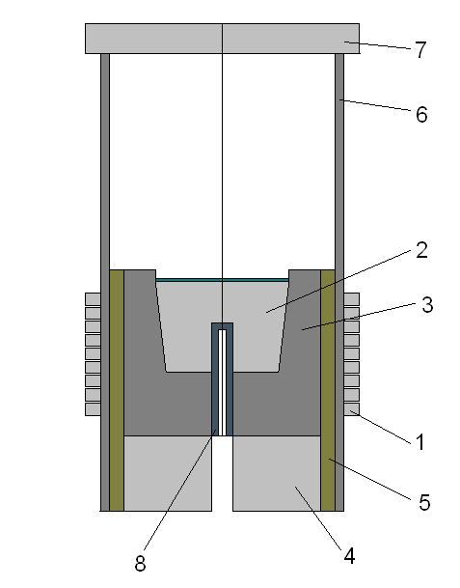
2D numerical modeling
Computational domain diagram
Initial parameters
Melt heat conduction: λ = 20 W/(m⋅K)
Melt density (kg/m3): ρ = 9100–0.47∙T [K]
Melt heat capacity: с = 500 J/(kg∙K)
Melt electrical conduction: σ = 3∙105 1/(Ohm⋅m)
Coefficient of melt dynamic viscosity:
μ = 0.0065 Pa⋅s
Crucible heat conduction : λ = 1 W/(m⋅K)
Heat insulator 1 heat conduction : λ = 0.2 W/(m⋅K)
Heat insulator 2 heat conduction : λ = 0.185 W/(m⋅K)
Crust heat conduction : λ = 3 W/(m⋅K)
Crust thickness: h = 2 mm
Quartz heat conduction: λ = 0.4 W/(m⋅K)
Heat-transfer coefficient at the inductor/quartz tube boundary: 20 W/(m²⋅K)
Power in the melt: 2.026 kW
1 – inductor, 2 – melt, 3 – crucible, 4 – heat insulator #1, 5 – heat insulator #2, 6 – quartz tube, 7 – cover, 8 – thermocouple metallic sheath
metallic inclusions

Slide 20
2D numerical modeling (2)
Results of calculations at t = 12084 s
Comparison of experimental and calculated temperatures
Thermocouple | Temperature, °C |  | ΔT, °C
 | Experiment | Calculation
TC01 (in crucible wall) | 1223 | 1231 | +8
TC04 (in crucible bottom) | 1398 | 1347 | –51
TC06 (in melt) | 1584 | 1522 | –62
TC07 (upper crust) / Pyrometer | 1407 / 1398 | 1395 | –12 / –3

Slide 21
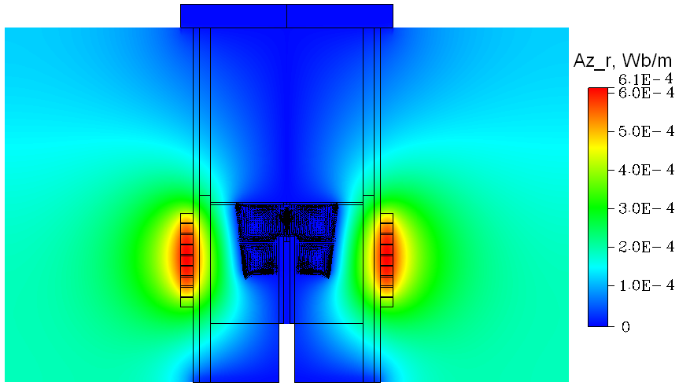
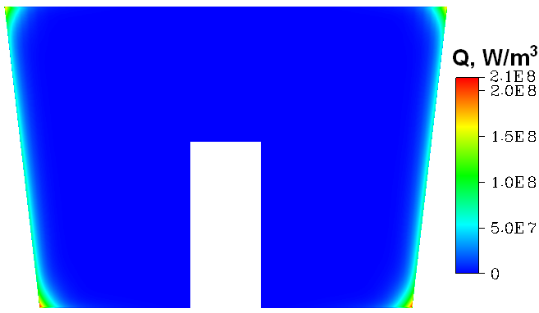
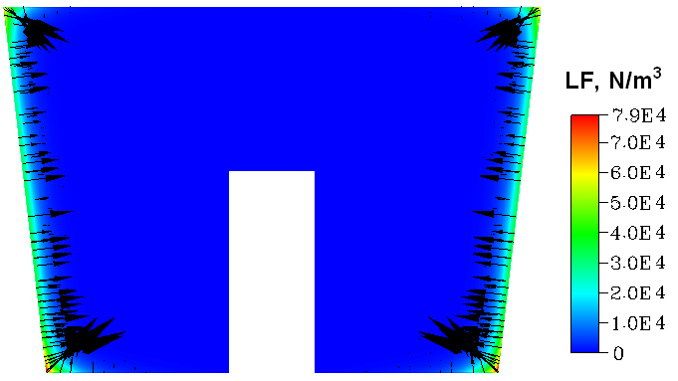
2D numerical modeling (2)
Results of calculations at t = 12084 s (2)
Vector potential of the entire computational domain
Volume power in the melt
Lorentz force distribution in the melt

Slide 22
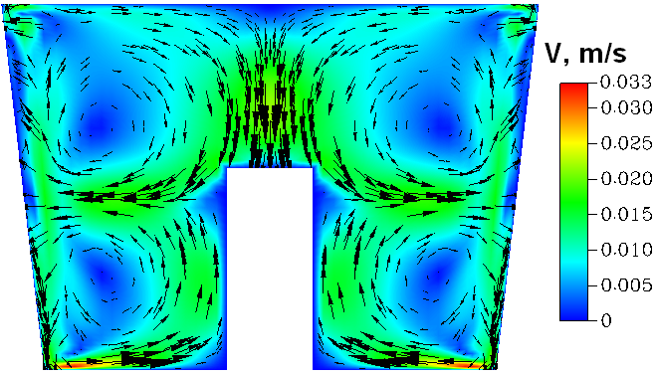
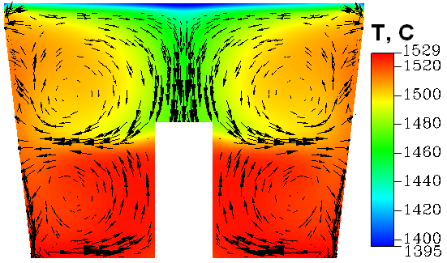
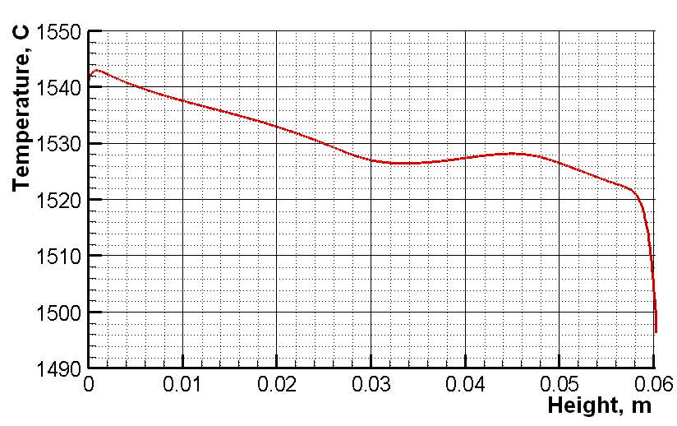
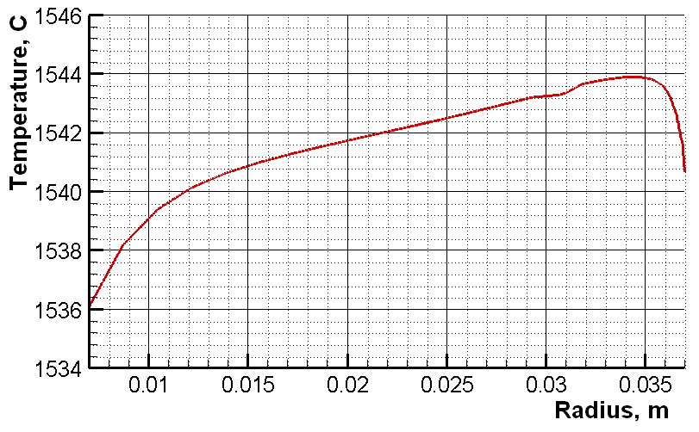
2D numerical modeling (3)
Results of calculations at t = 12084 s (3)
Melt velocity field
Melt and crusts temperature field
a)
b)
Temperature distribution along the melt lateral boundary height (a) and the melt bottom radius (b)

Slide 23
Results of SEM-EDX analysis of oxidic crust
A lateral crust area as an example
No. | Composition, at.% |  |  |  |  | Phase
 | U | Zr | Fe | Cr, Ni | O
SQ1 | 16.8 | 28.3 | 2.6 | 1.2 | 51.2 | –
SQ2 | 15.5 | 29.9 | 2.6 | 1.4 | 50.7 | –
SQ3 | 14.7 | 23.7 | 1.9 | 0.2 | 59.6 | –
SQ4 | 19.5 | 27.4 | 2.4 | 1.3 | 49.4 | –
SQ5 | 18.1 | 24.4 | 1.3 | – | 56.2 | –
SQ6 | 19.4 | 36.4 | 2.2 | 0.8 | 41.3 | –
SQ7 | 18.9 | 27.4 | 2.7 | 1.3 | 49.7 | –
SQ8 | 19.8 | 37.5 | 2.4 | 1.3 | 39.1 | –
P1 | 19.4 | 27.3 | – | – | 53.3 | (U,Zr)O₂
P2 | 18.6 | 25.3 | – | – | 56.1
P3 | 1.1 | 75.6 | – | – | 23.3 | α-Zr
P4 | 38.4 | 5.1 | – | – | 56.5 | (U,Zr)O₂
P5 | 1.2 | 55.8 | 27.3 | 12.1 | 3.7 | Zr₂Fe
P6 | 7.0 | 37.6 | 17.0 | 8.4 | 30.0
It means that oxidic crusts consist of an urania and zirconia mixture with some amount of α-Zr and intermetallids

Slide 24
Conclusions
Even in the relatively small scale experiments the oxide crust on the metal melt surface is found to be broken
Kinetics of oxidation of U- and Zr-containing metallic melt with steam through the slag crust follows the linear law at the steam absorption rate of
23 (±3) mg H2O/s
The constancy of oxidation rate regardless of the slag crust thickness growth with time is an evidence of the decisive influence of cracks formation in the crust
In the realized regime of oxidant starvation (when the rate of steam absorption, i.e., the rate of melt oxidation, is determined by conditions of steam supply directly to the melt surface), the presence of oxidic crust leads to a substantial decrease in flow density of the absorbed steam:
0.38 mg H₂O/(cm²s) – MCP-6
3.1 mg H₂O/(cm²s) – MA9 (molten suboxidized corium without crust)
Notes:
1. Даже в относительно маломасштабных условиях эксперимента оксидная корка на расплаве металла растрескивается существенным образом
2. Кинетика окисления паром расплава металла, содержащего уран и цирконий, сквозь шлаковую коркуи соответствует линейному закону окисления при скорости поглощения пара
23 (±3) мг H2O/с
3. Постоянство скорости окисления в независимости от толщины оксидной корки – свидетельствует о решающей роли трещинообразования в корке
4. В реализованном режиме голодания по окислителю (когда скорость поглощения пара, т.е. скорость окисления расплава, определяется условиями подвода пара к поверхности расплава), наличие корки приводит к существенному снижению плотности массового потока поглощаемого пара:
0.38 мг Н2О/ (см2с) - MCP-6
3.1 мг H2O / (см2с) - MA9 (расплав субокисленного кориума без корки)

