Slide 1
Oxidation kinetics of suboxidized corium melt in the steam atmosphere. MCP-7 test
A.P. Alexandrov Research Institute of Technology (Russia)
Presented by A. Sulatsky
5th METCOR-P Meeting
St. Petersburg, Russia,
June 7, 2011

Slide 2
Contents
Objectives
Furnace schematics
Gas-aerosol sampling system
Crucible charge
Experimental procedure
Crust surface after experiment
Post-test analysis
Conclusions

Slide 3
Objectives
Study of oxidation kinetics of the suboxidized molten pool through surface oxidic crust after neutral atmosphere replacement by steam

Slide 4
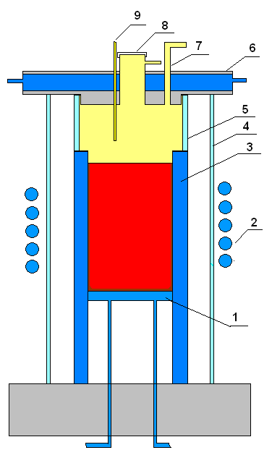
Furnace schematics
Measures to reduce steam condensation:
rise of melt surface to the crucible top
separation of above-melt volume from the furnace volume by quartz tube (5)
seal of the gaps between cold crucible tubes
increase of thickness of water-cooled furnace cover (6)
To suppress meniscus the melt surface was moved above the top inductor
To form the oxidic crust the melt surface temperature was reduced
1 – water-cooled bottom calorimeter, 2 – inductor, 3 – water-cooled crucible, 4 – quartz tube, 5 – quartz ring, 6 – water-cooled furnace cover with down-looking hot surface, 7 – gas-aerosol out, 8 –observation port, 9 – steam supply pipe

Slide 5
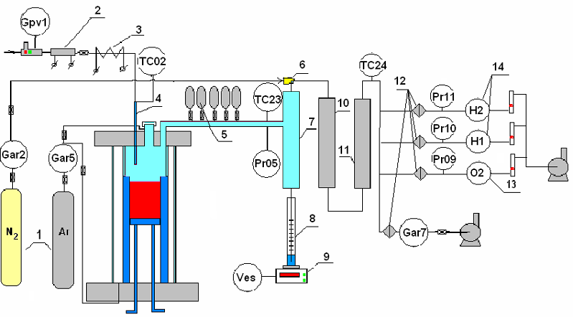
Gas-aerosol sampling system
1 –Ar, N₂ tanks; 2 – direct-flow once-through steam generator; 3 – heated steam supply line; 4 – stainless steam supply pipe; 5 – vacuum burettes; 6 – ejector; 7 – steam condenser; 8 – condensate collector; 9 – tensiometric weight sensor; 10 – large-area filter (LAF); 11 – silicagel dehumidifier; 12 – Petrianov filter (AFA); 13–14 electrochemical sensors of oxygen and hydrogen

Slide 6
Crucible charge
Component | Mass, g
UO₂ | 772.5
ZrO₂ | 94.0
Zr | 147.9
Total mass | 1014.4
C-32, U/Zr = 1.2

Slide 7
Experimental procedure
1. 0…190 s – furnace deoxygenation by argon
2. 190… 3586 s – gradual heating, charge melts, the pool is formed
3. 3586…4500 s – crust is formed on the surface, its temperature is 2030°C
4. 4500 s – steam is supplied into the furnace at the flow-rate of 59.2 g H₂O/hr; melt oxidation starts. Steam-gas mixture is sampled into vacuum burettes.
5. 4800 s – readings of hydrogen sensor gradually go up
6. ≈5000 s – readings of condensate weight sensor go up
7. 4998, 5236, 5296, 5395, 5521, 5811 s – flow-rate of carrier gas is adjusted
8. 5911…7860 s – carrier gas flow-rate is steady, at this H₂ concentration in furnace gases shows instability; cracks on the oxidic crust surface appear and disappear
9. 7900…8319 s – sharp increase in H₂ concentration followed by the carrier gas regulation
10. 8134…8507 s – decrease of H₂ content in furnace gases
11. 8935 s – sharp increase of H₂ content accompanied by the observed crust bulging and crumbling
12. 9042 s – steam supply is replaced by argon
13. 9479 s – HF heating is disconnected, ingot is frozen
Notes:
1. 0…190 s – предстартовая продувка печи аргоном в течение 190 s
2. 190… 3586 s – плавный нагрев, плавление загрузки, формирование расплава и
шлаковой корки на поверхности расплава необходимых кондиций
3. 3586…4500 s – образование на поверхности расплава шлаковой корки с
температурой 2030°C
4. 4500 s – начало подачи пара в объём печи с расходом 59.2 g H2O/hr и окисления
расплава. Отбор парогазовых проб из печи в вакуумные бюретки.
5. 4800 s – плавный рост показаний датчика водорода
6. ≈5000 s – рост показаний датчика веса конденсата
7. 4998, 5236, 5296, 5395, 5521, 5811 s – регулирование расхода газа-носителя в
связи с изменениями концентрации водорода в печных газах
8. 5911…7860 s – расход газа-носителя постоянен при этом наблюдается
немонотоннное изменение содержания H2 в печных газах и
образование/исчезновение трещин на поверхности оксидной корки
9. 7900…8319 s – резкое возрастание содержания H2 и возобновление регулировки
расхода-газа носителя
10. 8134…8507 s – рост температуры корки с 1736 до 2250°C при снижении
содержания H2 в печных газах
11. 8935 s – резкое возрастание содержания H2 при визуально наблюдавшемся
вспухании и осыпании корки
12. 9042 s – прекращение подачи пара в печь, подача в печь аргона
13. 9479 s – прекращение ВЧ-нагрева, кристаллизация слитка

Slide 8
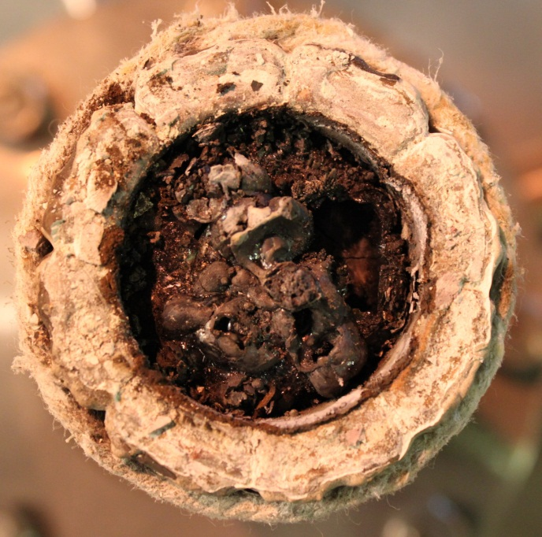
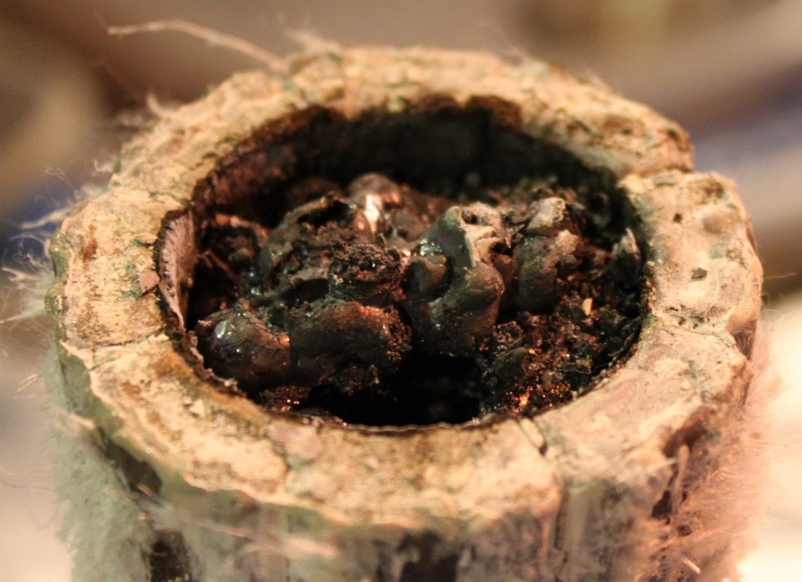
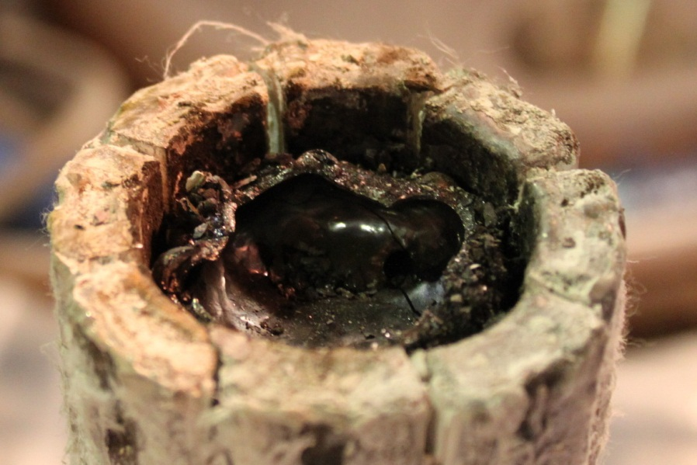
Crust surface after experiment
Crust irregularity, its mechanical weakness, melt ejections and spillages observed during the test, as well as its bulging, testify to a large number of pores and cracks in the crust, i.e. to its permeability
Notes:
Нерегулярность корки, её механическая непрочность, а также визуально наблюдавшиеся в ходе опыта вытекания/выбросы расплава, вспухание корки свидетельствуют о наличии большого количества пор и трещин в ней, и, т.е., о том, что она не является серьёзным препятствием на пути окислителя к расплаву

Slide 9
Post-test analysis
Crust formation
Steam supply start
Flow-rate of carrier gas is not regulated
Steam supply is stopped
HF heating is disconnected
Pyrometer readings
Due to weak absorption of radiation by superheated steam it is possible to measure the oxidic crust surface with pyrometer (MCP-6 results)
At oxidation the crust temperature regime was unstable: measured temperature of its surface varied from 1470 to 2330°C
Notes:
При подаче пара наблюдается быстрый спад (порядка 100с) температуры поверхности, обусловленный НЕ поглощением теплового излучения, а захолаживанием поверхности корки. Это было видно визуально.
Нестабильность корки обусловлена её растрескиванием, вспуханием и т.п.

Slide 10
Post-test analysis (2)
Pyrometric measurement of surface temperature in steam
Spectral transmittance of steam at 0.8…1.1 μm wavelengths has been determined for a horizontal path at the sea level
Wavelength, μm | Thickness of condensed water level, mm
 | 0.1 | 0.2 | 0.5 | 1 | 2
0.8 | 0.989 | 0.984 | 0.975 | 0.965 | 0.950
0.9 | 0.965 | 0.951 | 0.922 | 0.890 | 0.844
1.0 | 0.990 | 0.986 | 0.977 | 0.968 | 0.955
1.1 | 0.970 | 0.958 | 0.932 | 0.905 | 0.866
In the considered case, the pyrometer operating wavelengths are 0.85 and 1.05 μm, while the calculated thickness of the precipitated water level is below 0.1 mm → The measurement error is below 10ºС → The influence of steam on the measured color temperature can be neglected
Notes:
Криксунов Л.З. Справочник по основам инфракрасной техники. Изд. Советское радио. 1978г.

Slide 11
Post-test analysis (3)
Evaluation of the oxidic crust thickness from the measured crust temperature
Steam supply start
Carrier gas flow rate is not regulated
Steam supply is stopped
Crust thickness is calculated from the assumption about the equality of heat flux from the melt through the crust and heat flux radiated from the crust top:
An assumption about the approximately equal temperatures of the oxidic crust bottom and melt solidus temperature is used
Evaluation indicates a considerable instability of oxidic crust

Slide 12
Post-test analysis (4)
Steam supply started
Steam supply stopped
Melt oxidation by steam is rather well approximated by the linear interpolation with the steam absorption rate equal to
11 (±1) mg H₂O/s
Small deviation from the linear law observed in the beginning (from 4500 to 5400 s) is probably explained by the effect of delay in condenser

Slide 13
Post-test analysis (5)
Results of gas analysis
Composition of dried furnace gases collected by pipettes during the initial oxidation stage
# pipettes | Time of exposition, s | Volumetric fraction, vol.%
 |  | H₂ | O₂ | N₂ | Ar
1 | 4551…4561 | 38.5 | 6.0 | 32.3 | 23.2
2 | 4566…4576 | 43.1 | 4.1 | 25.2 | 27.6
3 | 4581…4591 | 31.1 | 7.5 | 37.5 | 23.9
4 | 4596…4606 | 38.1 | 4.3 | 25.2 | 32.4
5 | 4611…4621 | 37.2 | 4.2 | 24.6 | 34.0
Table does not give volumetric fractions of carbon, methane and ethane mono- and dioxide, the total content of which does not exceed 1 vol.%
Relatively constant hydrogen content indicates an approximately steady melt oxidation rate, which corresponds to the linear law
The difference between the H2/O2 ratio in furnace gases from that in the steam supplied into the furnace indicates the active absorption of oxygen by the melt
The presence of nitrogen in the sampled furnace gases is explained by strong rarefaction in the gas line during pipettes switching to it due to the preliminary vacuumization of pipettes
Notes:
Разброс данных по содержанию водорода: от -17 до +15 относ.% от среднего значения. И он определяется не погрешностью химического/хроматографического анализа, которая достаточно мала – порядка (но не ниже) 5 отн.%, а самим процессом – в среднем постоянным на данном временном интервале, но имеющим существенный разброс. Такой разброс не представляет чего-то необычного для процессов с фазовыми переходами и химическими реакциями, осложнённых такими стохастическими процессами, как трещинообразование и т.п.

Slide 14
Post-test analysis (6)
Results of gas analysis(2)
Steam supply started
Carrier gas flow-rate is not adjusted
Steam supply stopped
Hydrogen content in the mixture of furnace gases and carrier gas (N₂) at melt oxidation
A considerable change of H₂ concentration in the gas mixture was observed even in absence of changes in the carrier gas flow-rate. This testifies to the instability of crust condition
The content of hydrogen in the gaseous mixture varied in this test in a very complex way in a very wide range, therefore interaction kinetics cannot be reliably evaluated using these on-line measurements
Notes:
Кислородный датчик Oxic, стоящий на конце газовой магистрали, на протяжении всего опыта показывал отсутствие кислорода в смеси газа-носителя и осушенных печных газов. Этот НОЛЬ здесь не приводится

Slide 15
Conclusions
Kinetics of suboxidized corium melt oxidation by steam through the crust is described by the linear law with the steam absorption rate of
11 (±1) mg H₂O/s
Constant oxidation rate, in spite of the growing crust thickness, testifies:
oxidant starvation regime in the test conditions
influence of crust cracking
Formation of cupola-shape crust with the gap between the crust and the melt surface can be explained by mechanical loads from the forming crystallites or/and gas (hydrogen) release from the melt surface
In the achieved regime of oxidant starvation the presence of oxidic crust causes a considerable reduction of the absorbed steam flow density :
1.0 mg H₂O/(cm²s) – MCP-7
3.1 mg H₂O/(cm²s) – MA9 (suboxidized corium melt without crust)

