Slide 1
Interaction of SS – Zr – U melt with vertically positioned vessel steel specimen.
Test MCP - 8
A.P. Alexandrov Research Institute of Technology (Russia)
Presented by V. Granovsky
5th METCOR-P Meeting
St. Petersburg, Russia
June 7, 2011

Slide 2
Contents
Objectives
Schematics
Experimental procedure
Test results
Post-test analysis
Physicochemical analysis
Corrosion kinetics
Conclusions

Slide 3
Objectives
Determine corrosion kinetics and final corrosion depth of vertically positioned vessel steel specimen at its interaction with SS-Zr-U melt
Test parameters :
SS-U-Zr melt corium
15Kh2NMFA vessel steel
Pure argon above the melt
10 h exposition

Slide 4
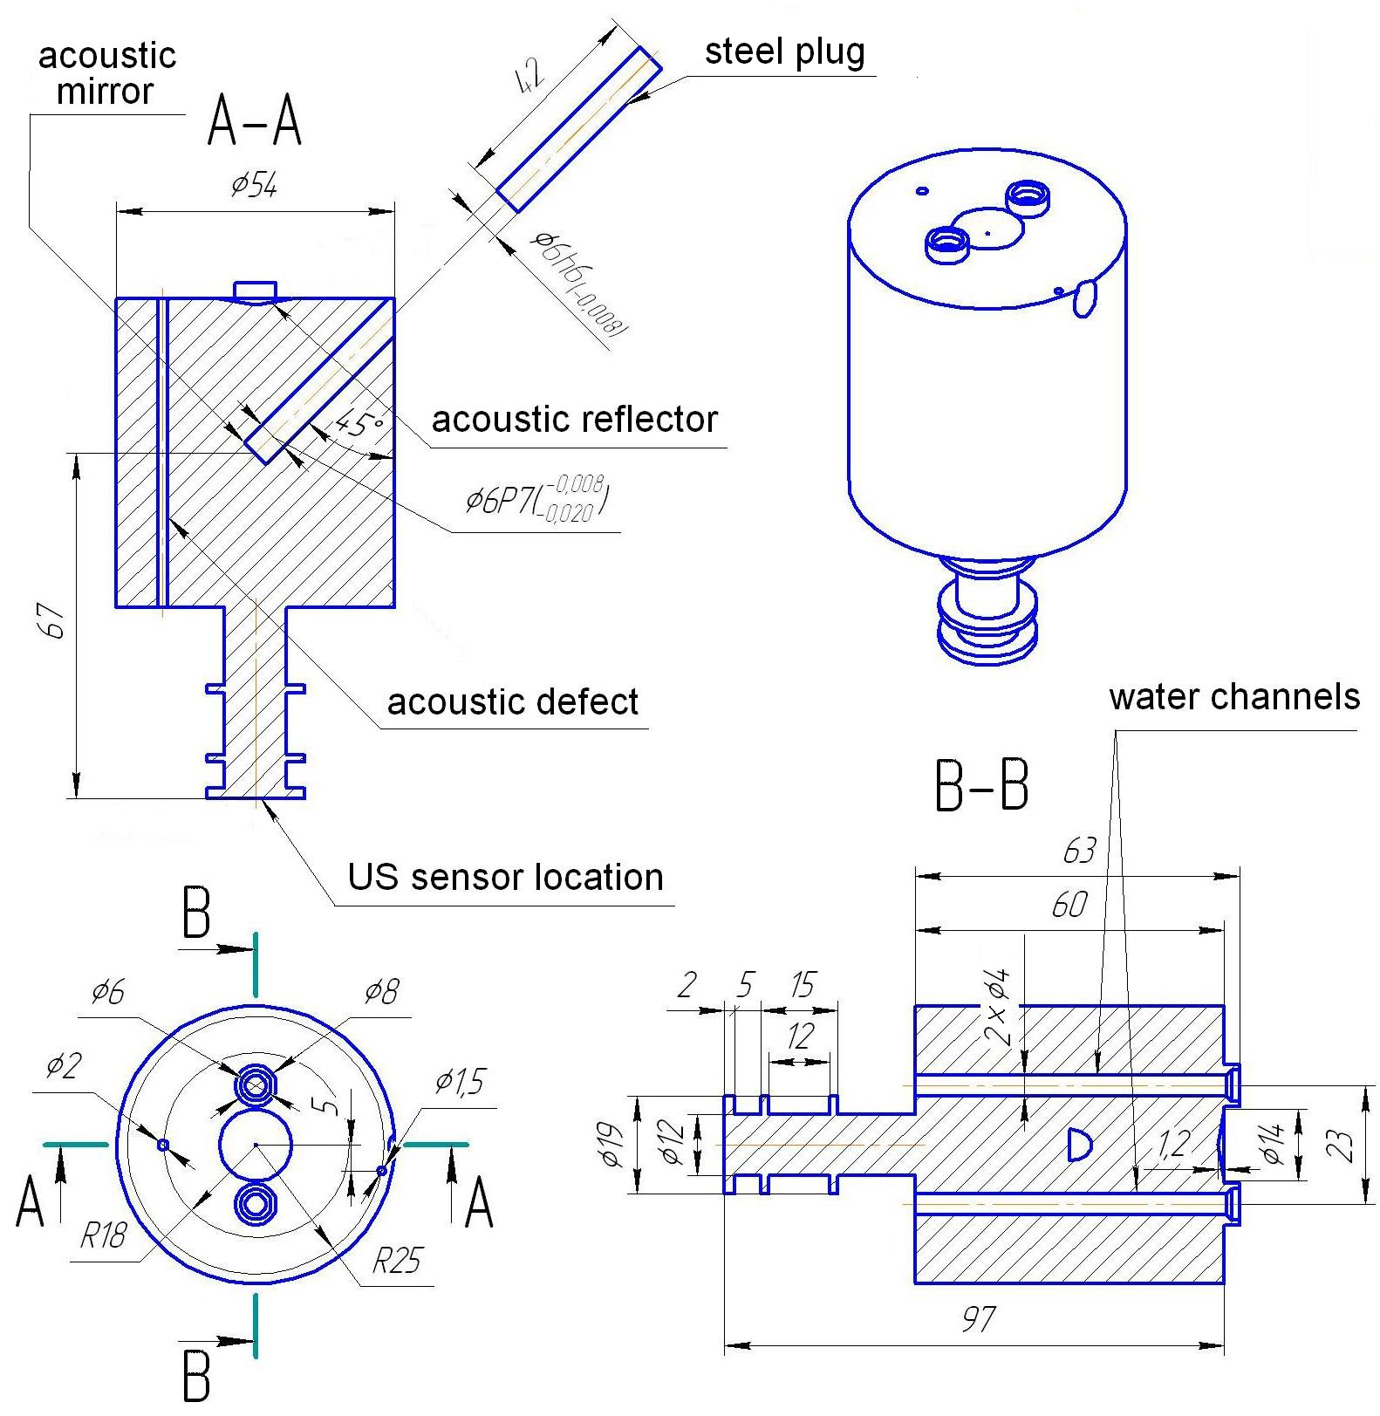
Specimen schematics

Slide 5
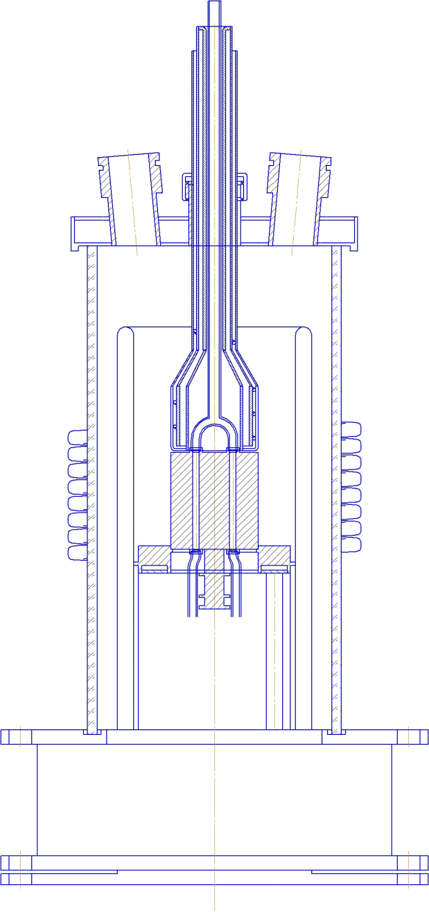
MCP-8 furnace schematics
1
1 – cooled SS cover
2 – quartz tube
3 – cooled copper screen
4 – specimen
5 – inductor
6 – bottom calorimeter
7 – supporting screen
8 – crucible sections
9 – crucible collector
– melt
– US sensor
2
3
4
10
5
6
11
7
8
9

Slide 6
TC locations in the specimen
Specimen section
Coordinates of hot junctions

Slide 7
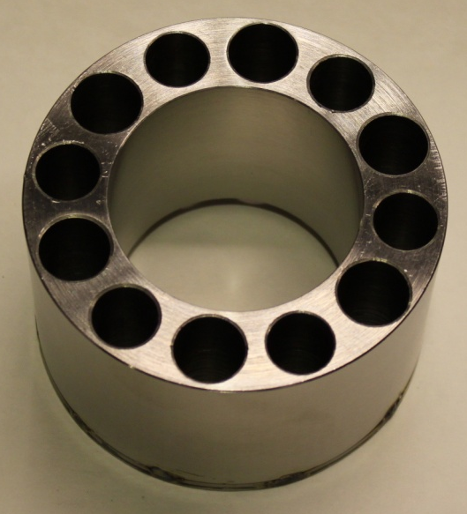
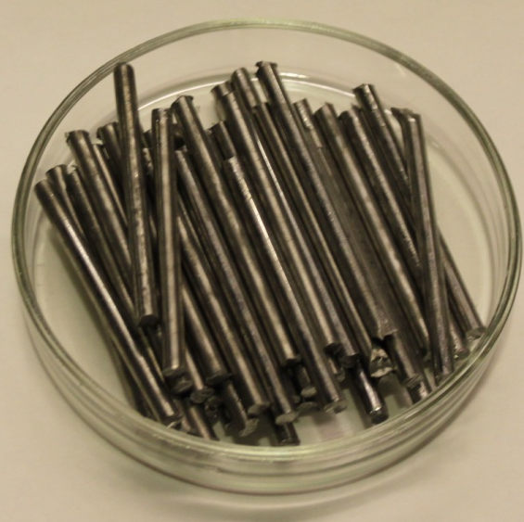
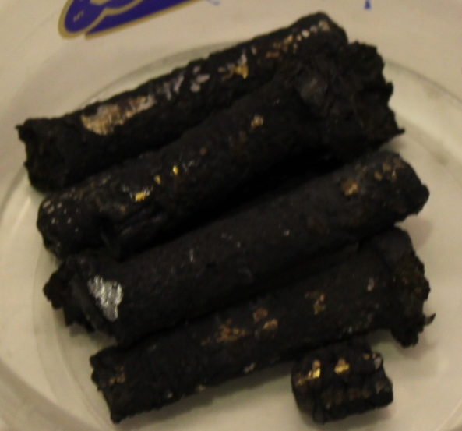
Crucible charge
SS
Zr
U
Oxidic powders were placed around SS body (except the gap with specimen)

Slide 8
Test procedure
Time, s | Stages in the experimental procedure
0-300 | Furnace deoxygenation by argon flow
300-7200 | Formation of the molten pool. Increase of power in the melt to get local maximum of 1400ºC of the specimen surface
7200-39300 | Keeping constant specimen temperature by inductor voltage control during ~ 10 hr
39300-41000 | Heating disconnection, melt solidification and ingot cooling in argon

Slide 9
Test results: TC readings
Damaged thermocouples continue to operate but in a wrong way
(new junction is formed to replace the defect one)

Slide 10
Test results: Powers extracted from the crucible, specimen and bottom calorimeter
Practically constant power into the specimen

Slide 11
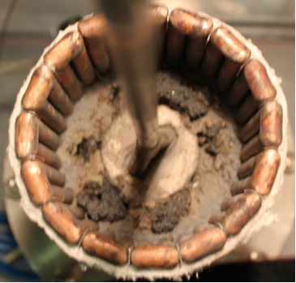
Test results: Ingot view during furnace disassembling
Specimen
Metallic corium ingot
Surface oxidic crust

Slide 12
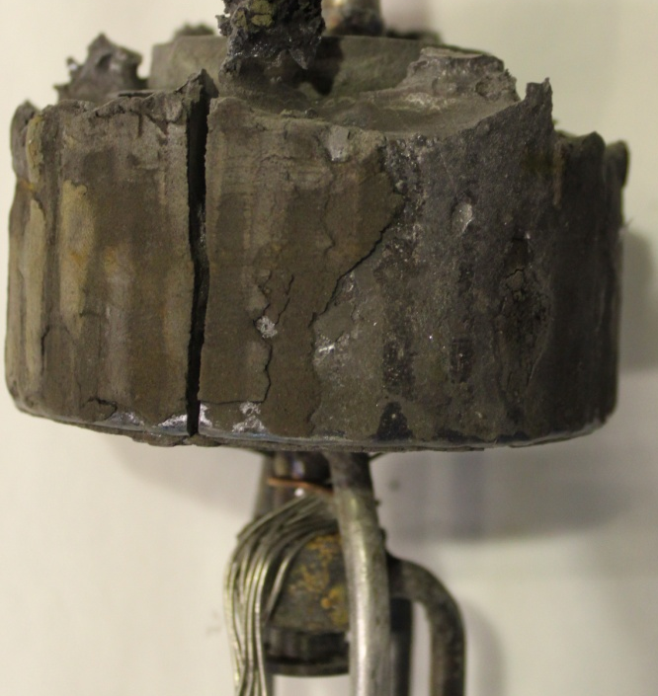
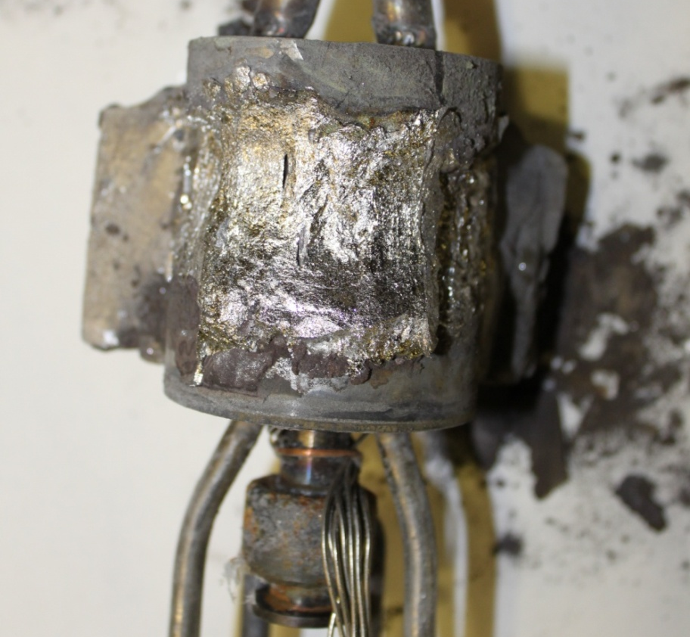
Test results: Ingot side views
Ingot
Specimen top
Specimen surface with corium
US sensor calorimeter
TC cables

Slide 13
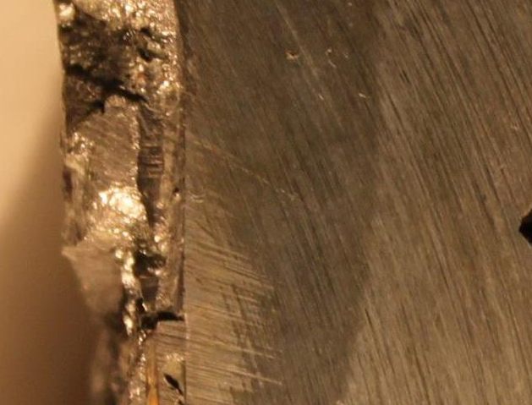
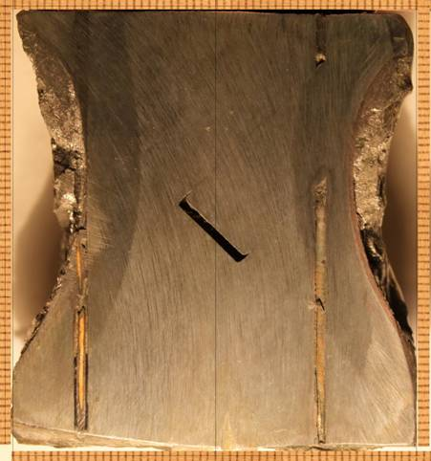
Posttest analysis
Specimen axial section (0º, see slide 6)
2
1
2
3
Acoustic ‘mirror’
Acoustic defect
Thermocouple
1 – Steel of initial structure 2 – Zone of thermal influence 3 - Interaction zone
Maximum corrosion depth – 9 mm at the elevation of 40 mm

Slide 14
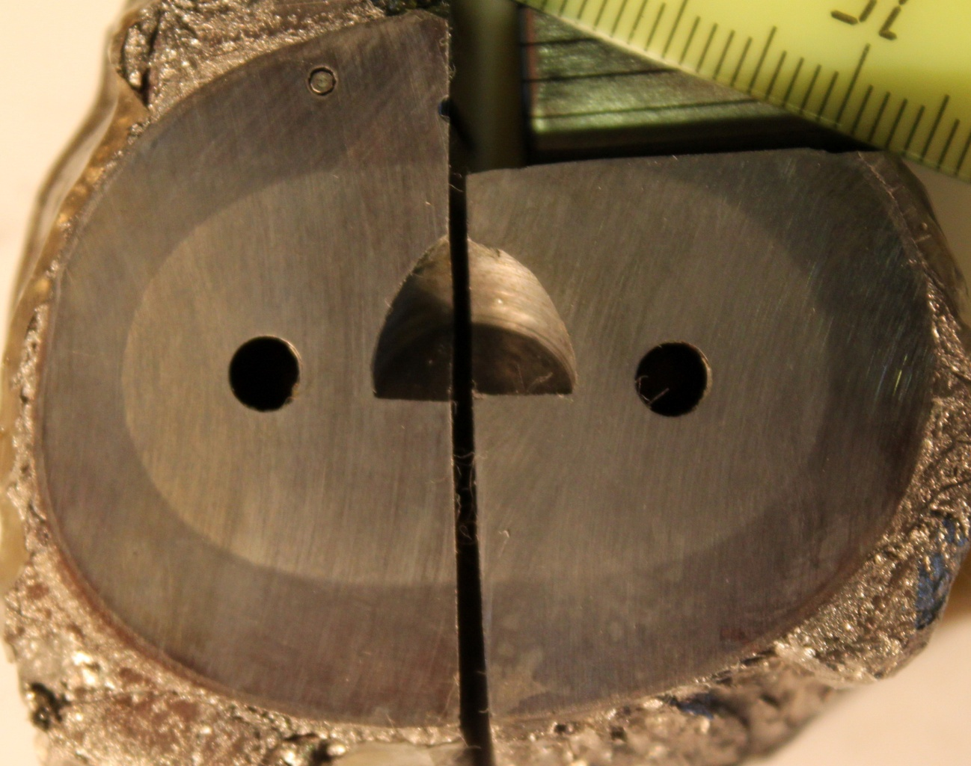
Post-test analysis (2)
Cross section, 30 mm elevation (reconstruction)
Specimen
Isotherm of Fe-Fe₃C
eutectic formation
(727°C)
Metallic corium crust

Slide 15
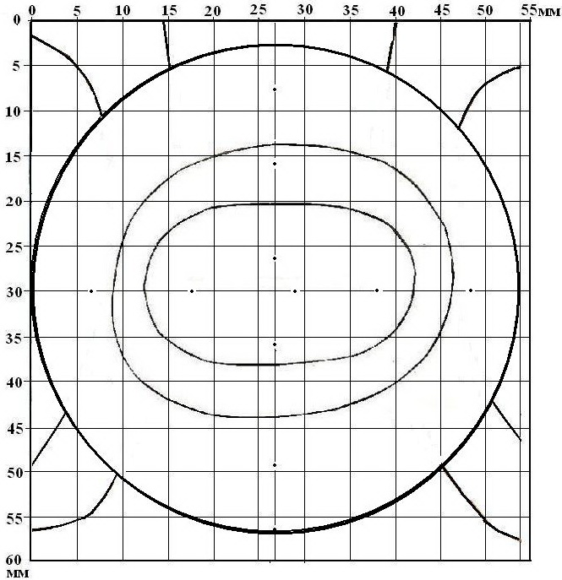
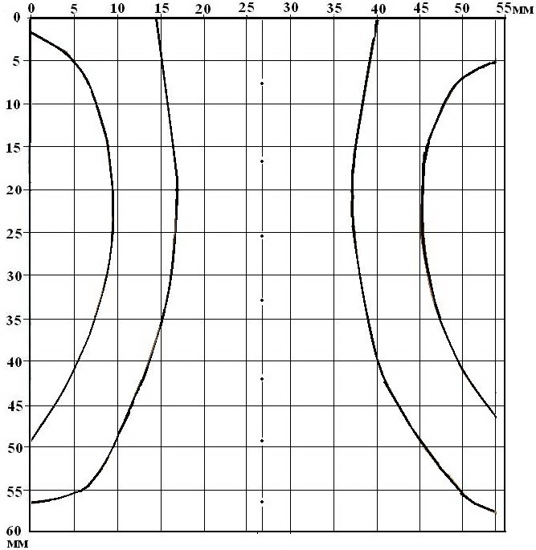
Post-test analysis (3)
Axial section schematics
Cross section schematics
Isotherm of Fe-Fe₃C
eutectic
Final boundary
Initial boundary

Slide 16
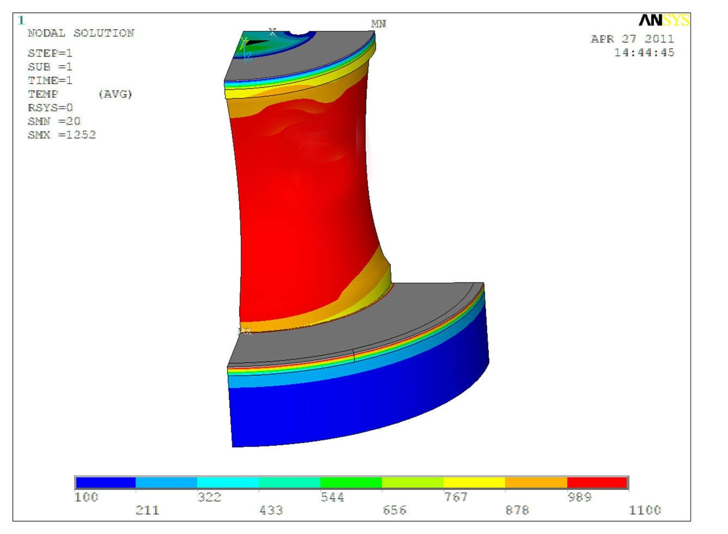
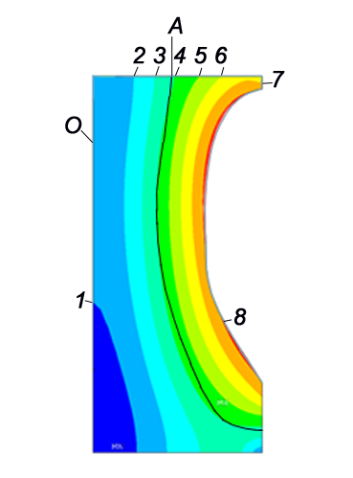
Post-test analysis (4)
Temperature conditions calculated by ANSYS
Axial section
T, °C
Radial distribution I
O –specimen axis
А – isotherm of Fe-Fe₃C eutectoid formation (727°C)
1 – 400; 2 – 500; 3 – 600; 4 – 700; 5 – 800; 6 – 900; 7 – 1000; 8 - 1100 °C
Temperature of corrosion boundary final position is in the range of 1050…1150 °C

Slide 17
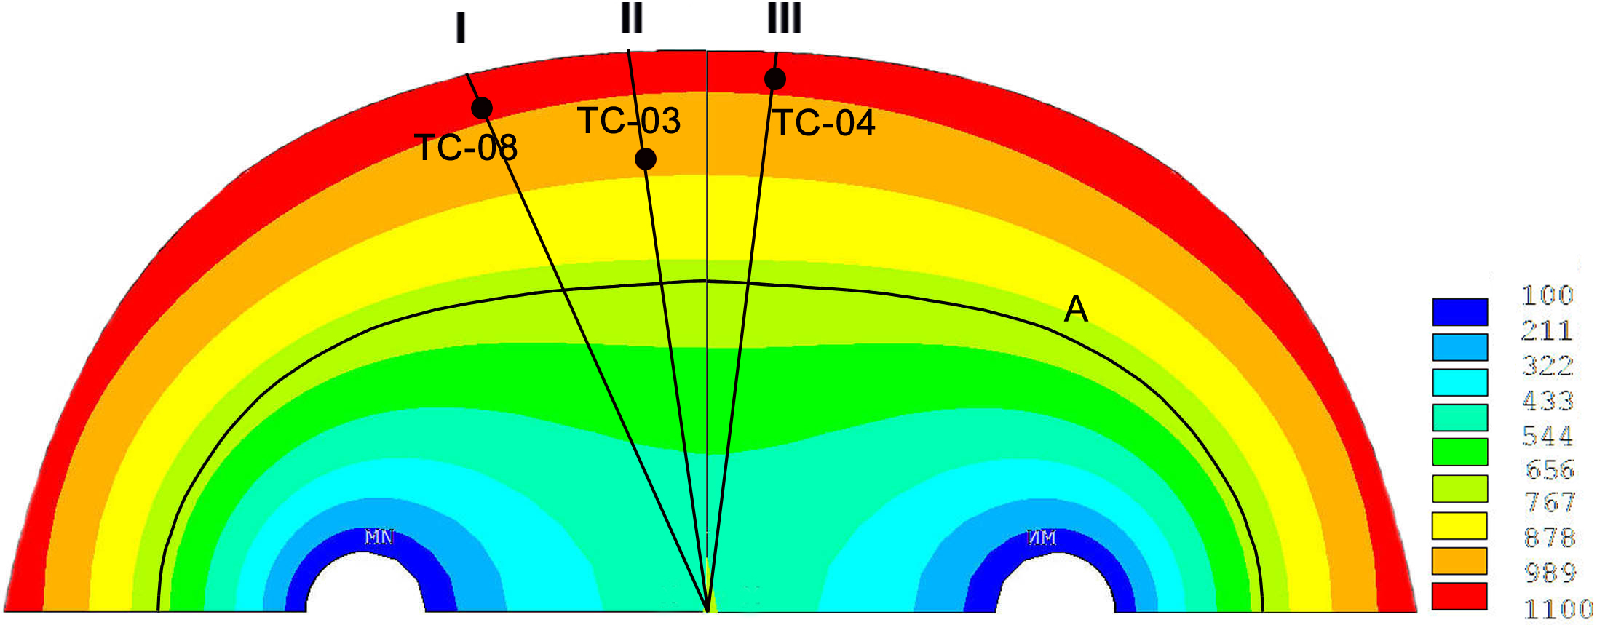
Post-test analysis (5)
Temperature field of the specimen cross section
(elevation of TC location: 30 mm)
T, ⁰C
T, °C
Radial distribution I
Radial distribution II
Radial distribution III
T, °C
T, °C
r, mm
r, mm
r, mm

Slide 18
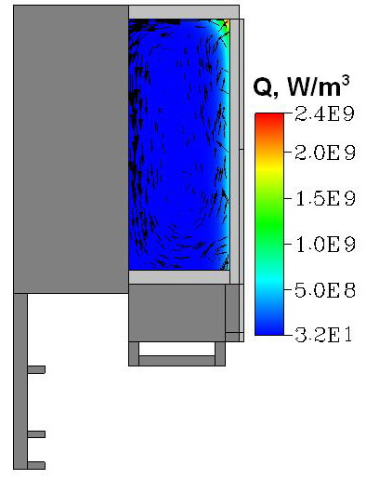
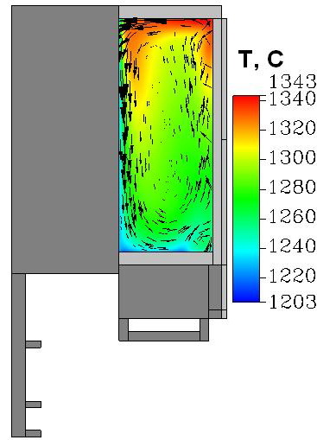
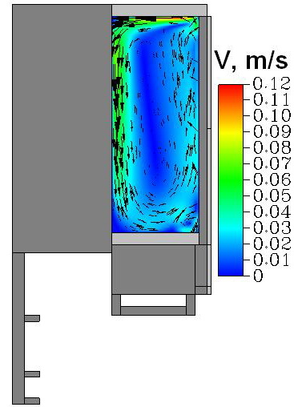
Post-test analysis (6)
Molten pool modeling
Temperature at the surface of the specimen – T_{liq} of the melt (∼1220°C, see slide 19)
Average melt temperature (~1280°C) is higher than liquidus temperature by approx. 50°C

Slide 19
Physicochemical analysis
Section of phase diagram (GEMINI 2, v.3.41 / NUCLEA 10.1)
T, º C
Ingot (melt) composition
Temperature of specimen
final boundary
Ingot composition, mass% (XRF)
U | Zr | Fe | Cr | Ni | Si
35.2 | 14.2 | 36.7 | 8.6 | 5.0 | 0.3
U, Zr, Cr, Ni
mass. %
Fe
Minor oxygen content in metal due to low melt temperature
Temperature of specimen final boundary is equal to the minimal value of liquidus temperature of the phase diagram section

Slide 20
Physicochemical analysis(2)
Froment K., Seiler J. M. et al. Physico-Chemistry and Corium Properties
for in-Vessel Retention. In-Vessel Core Debris Retention and Coolability
Workshop Proceedings, 3–6 March, 1998, Garching near Munich, Germany
 | Zr | Sn | Cr | Ni | Fe | U
M, kg | 8000 | 300 | 5000 | 3000 | 18000 | 8600
Temperature limit of Fe dissolution - 1100ºC
T, ºC
U, Zr, Cr, Ni
Fe
mass. %
Probably Seiler defined the Fe dissolution limit as a minimal liquidus temperature.

Slide 21
Physicochemical analysis(3)
Interaction of the vessel steel with suboxidized corium melt
Sections of U-Zr-Fe phase diagram
- experiment
⎯ - calculation
If the composition of interaction zone is in the initial crystallization zone of U, Zr, the temperature at the final corrosion boundary is equal to solidus temperature.

Slide 22
Physicochemical analysis(4)
SEM/EDX MCP-8
 | Mass %
 | U | Zr | Fe | Cr | Ni
SQ2 | 20.9 | 10.7 | 56.6 | 9.1 | 2.1
SQ3 | 24.2 | 15.4 | 49.5 | 6.6 | 3.5
SQ4 | 24.4 | 22.1 | 43.8 | 5.0 | 4.7
Ingot | 35.2 | 14.2 | 36.7 | 8.6 | 5.0
The content of iron in the melt at the boundary with specimen achieves the value corresponding to the minimal liquidus temperature (55%) . Therefore, further dissolution of steel is impossible.

Slide 23
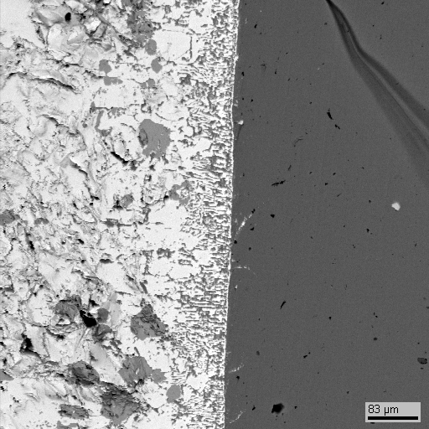
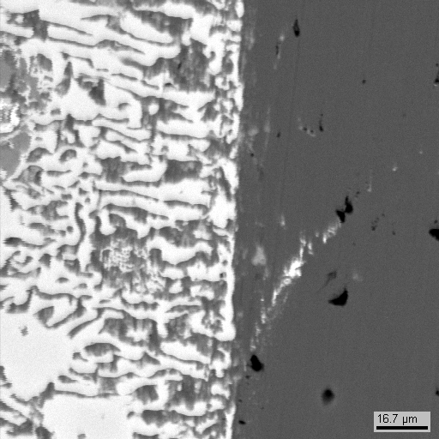
Physicochemical analysis(5)
SEM/EDX MCP-1
• P1
• P2
U – 38.3; Zr – 6.9; Fe – 51.2; Cr – 1.9; Ni – 0.8, mass %
The content of iron in the melt at the boundary with specimen is less than the value corresponding to the minimal liquidus temperature (65%) , i.e. the composition is in the initial crystallization zone of U, Zr. Therefore, Fe dissolution occurs to solidus temperature.

Slide 24
Сorrosion kinetics
h, mm
Correlations for corrosion rates
2
MCP-8 (metallic melt, vertical interface)
1
MC6, MC7, MC8, MC9 (oxidic melt, horizontal interface)
t, s
No tests with metal melt and horizontal interface
(+8800)
 - direct post-test measurement
- post-test processing of on-line US-measurement

Slide 25
Conclusions
No indications of interaction interface orientation effect on steel corrosion by U-Zr-Fe-Cr-Ni metal melt. Physicochemical effects are governing.
The lowest corrosion temperature limit is determined by the minimal liquidus-temperature value of the phase diagram section, which corresponds to the melt composition. For MCP-8 conditions it was ~1100°C.
The correlation describing the “fast” corrosion period under interaction of steel vessel with metal melt is close to that previously derived for interaction with suboxidized corium melt.

