Slide 1

Progress Report on the ISTC project #833.2
“Investigation of corium melt interaction with NPP reactor vessel steel”
(METCOR-2)
A.P. Alexandrov Research Institute of Technology
Presented by S. Bechta
10th CEG-SAM meeting

Slide 2
Contents
METCOR project general information
Project meetings
Experimental matrixes
Experimental methodology
Tests with suboxidized corium
Tests with oxidized corium
Example of plant application
Reporting
Publications
Proposals for studies continued within a new project
Conclusions

Slide 3
METCOR project general information
Project objectives:
Qualification and quantification of physicochemical phenomena
of corium melt interactions with reactor vessel steel
Experimental data application:
Analysis of in-vessel corium retention (IVR)
Analysis of ex-vessel retention (EVR) in the core catcher of a cold
crucible type

Slide 4
METCOR project general information
Project participants and coordination
Collaborators
FZK, Germany
FORTUM, Finland
ITU,
EK
CEA,
France
Framatome ANP, Germany
FZR, Germany
IRSN,
France
Coordinator
ISTC, Moscow
Steering committee
Operation Agent: A.P. Alexandrov RIT, Russia
ISC RAS,
Russia
SPb Electrotechnical State University, Russia

Slide 5
Meetings of METCOR.2 projects
▼ 1st meeting of the Steering Committee, 3 October 2002, Karlsruhe, Germany
▼ 2nd meeting of the Steering Committee, 29 January 2003,
Aix-en-Provence, France
▼ 3rd meeting of the Steering Committee, 16 September 2003, St. Petersburg, Russia
▼ 4th meeting of the Steering Committee, 10 February 2004, Paris, France
▼ 5th meeting of the Steering Committee, 14 September 2004, Dimitrovgrad, Russia
▼ 6th meeting of the Steering Committee, 12 July 2005,
St. Petersburg, Russia
▼ 7th meeting of the Steering Committee, 14 June 2006,
St. Petersburg, Russia

Slide 6
Experimental matrix of METCOR
Phase 1: Tests with fully oxidized melts

Slide 7
Experimental matrix of METCOR
Phase 2: Tests with suboxidized corium and
tests with oxidized corium in steam

Slide 8
Experimental methodology: Furnace section
Technology of the
induction melting in a
cold crucible
Atmosphere – high-purity
argon
Long-term expositions in
a stationary regime
On-line measurements:
specimen temperature
melt surface temperature
specimen ablation depth
electric parameters
power in the furnace
components
1 – pyrometer shaft; 2 – cover; 3, 18, 19 – electromagnetic screens; 4 – quartz tube; 5 – crucible sections; 6 – inductor; 7 –melt; 8 – acoustic defect; 9 – fused ZrO₂ grains; 10 – ZrO₂ powder insulation; 11 – vessel steel specimen; 12 – top specimen calorimeter; 13 – bottom specimen calorimeter; 14 – kaolin wool insulation; 15 –ultrasonic sensor; 16 – thermocouples; 17 – crust; 20 – cylindrical support of the specimen

Slide 9
Experimental methodology: Posttest analyses
Calculation of the whole electromagnetic system
Power deposition in the melt and its electric resistivity are determined
Measured electric parameters of the system and power deposited into the furnace
components are used in the numeric modeling
Integrated calculation of the electromagnetic system and melt
thermohydrodynamics
Radial heat flux distribution in the specimen top is determined.
Calculations of the whole electromagnetic system and boundary conditions on the
crucible and specimen surfaces are used
Calculation of the specimen temperature conditions
Results of previous calculations, boundary conditions on the crucible surface and
specimen calorimeters are used. The adequate agreement between calculations and
thermocouple measurements is achieved by varying heat flux into the specimen and
thermal resistance of the specimen side insulation
Physicochemical analysis of the ingot, specimen and interaction zone
XRF; SEM/EDX; optical microscopy; chemical analyses.
Elemental and mass balances, initial and final compositions of the system and its
components are determined

Slide 10
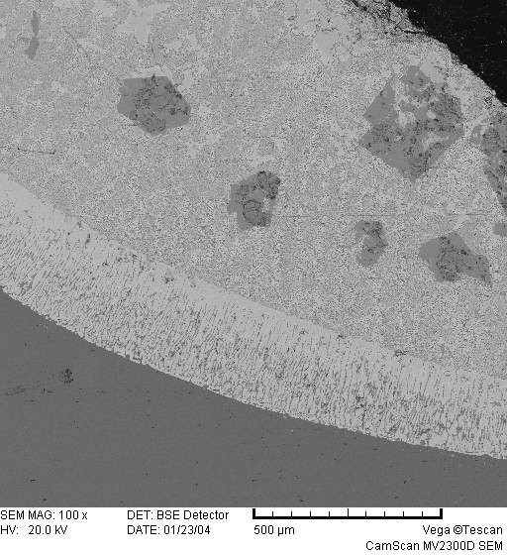
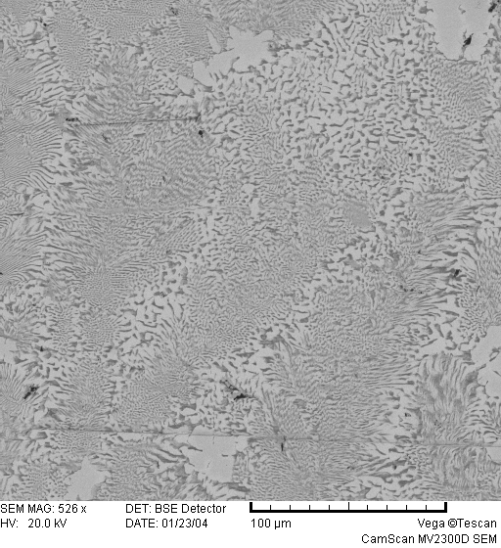
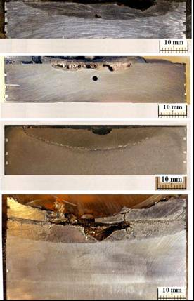
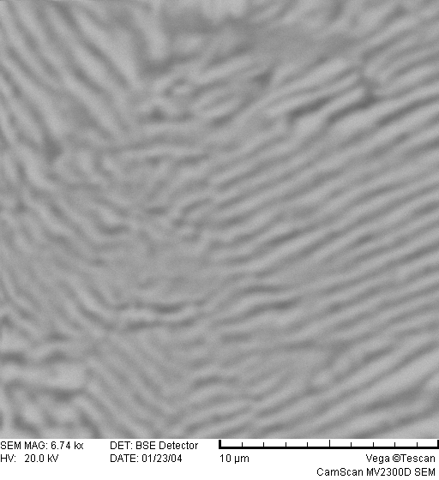
Tests with suboxidized corium
Identified phenomenon of steel corrosion: U, Zr, O partitioning and partial eutectic melting (dissolution) of the vessel steel , IZ depth is limited by position of isotherm 1090 ºC
Axial sections of specimens
EDX images of Interaction Zone
МС6
Acoustic
defect
МС7
МС8
500 µm
100 µm
DTA of IZ in MC-8
Shrinkage
cavity
МС9
T_{eut}~1090ºC (DTA)
10 µm
Chip

Slide 11
Tests with suboxidized corium (continued)
Model of ablation kinetics
2 main periods of ablation:
incubation and fast ablation
fast ablation resulting in saturation
, mm/s
T_{int} – current temperature of steel surface 1090 ≤ Тint ≤ 1440°C
T_{B} – final temperature of steel surface after interaction termination
(1090 ºC for reactor application)
Incubation period:
- oxidic melt
t_{inc}=8000+200 (70-C_{n}), s
30 ≤ C_{n} ≤ 70
- metallic melt
t_{inc}=0

Slide 12
Tests with suboxidized corium (continued)
Thermal gradient Influence on chemical equilibrium:
Final concentrations of elements in metallic melt vs. steel mass fraction and C_{n}
C_{n} ≈ 30%
Analogous results for solid/liquid and liquid/liquid interactions obtained in METCOR
and MASCA projects
Due to thermal gradient U and Zr concentrations in the interaction zone (METCOR)
are lower than in the metallic melt (MASCA)

Slide 13
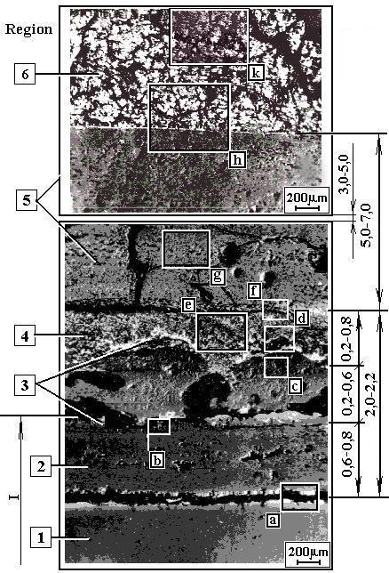
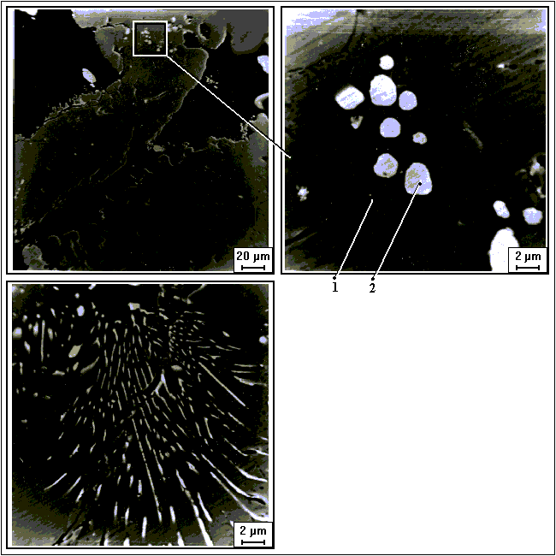
Tests with oxidized corium
Identified phenomenon of steel corrosion:
Surface oxidation of vessel steel; corrosion layer thickness and
stability is effected by corium composition and crust temperature
Example of Interaction Zone structure in MC-2
Elemental phase composition
Element/ Phase 1 Phase 2
oxide w% w%
U Mα - 83.78
Zr Kα - 0.243
Fe Kα 70.00 3.85
O 29.00 12.11
UO₂ - 95.00
ZrO₂ 0.30 0.40
Fe₂O₃ 99.70 4.6

Slide 14
Tests with oxidized corium (continued)
IZ structures at different temperatures and corium compositions
UO_{2+x}- ZrO₂ - FeO_{y} corium
UO_{2+x}- ZrO₂ (С-100 corium)
T
sol
T
sol
melt
melt
T
eut
crust
liquification
crust
T
δ
Δ
Δ
corrosion layer
δ
T
=T
corrosion layer
δ
δ
eut
steel
steel
T
°
s
<1230
C
T
≥
1230
°
s
C

Slide 15
Tests with oxidized corium (continued)
Corrosion model
No eutectic interaction between corium and corrosion layer
Eutectic thinning of corrosion layer
W/q,
W/q
,
mm
m
2
h
МW
10
7
1
Corium B, air
6
Corium A, steam
5
0.1
Corium B, steam
4
1230
°
С
3
1050
°
С
0.01
2
0.001
1
0.65
0.75
0.85
0.95
1.05
0
1/K
3
5
7
9
11
1000
,
1/K
1613
−
T
S
Corrosion rates in air and in steam are similar
Decrease of corrosion rate following increase of iron oxides content in corium melt
Intensification of corrosion after reaching eutectic temperature of the interface between
corrosion layer and corium

Slide 16
Tests with oxidized corium (continued)
Corrosion model: modified Tamman equation for:
1) UO_{2+x}- ZrO₂ - FeO_{y} corium
FeO_{y}=20…30%, U/Zr=0.11…1.05
2) UO_{2+x}- ZrO₂ (С-100 corium),
U/Zr ≈ 1.0
T_{s} <1050⁰C
T_{s} <1230⁰C
1340>T_{s} >1050⁰C
1340>T_{s} >1230⁰C
T_{s}=720…1200⁰C
q =0.30…1.29MW/m²
T_{s} = 1035…1235⁰C
q = 0.95…1.1MW/m²
W – mm/h; q - MW/m² ; T - K

Slide 17
Example of plant application
For suboxidised corium, VVER-1000 – type reactor, low pressure scenario, homogeneous molten pool, initial temperature of corium is 1500ºК. Calculation 1 – without physicochemical interactions Calculation 2 – the interactions have been evaluated by the empirical correlations
Mass of ablated vessel steel vs. time
Lower head region after 20 h
a) ablation depth of the lower head from the
сalculation 2, grey: ablated steel
b) temperature conditions of the vessel
Blue: calculation 1, red calculation 2
the evaluated thickness of undamaged vessel wall is much smaller,
if the vessel steel ablation is taken into account
vessel strength calculations are in progress

Slide 18
Reporting

Slide 19
Published papers
S.V. Bechta, V.B. Khabensky, S.A. Vitol, E.V. Krushinov, D.B. Lopukh, Yu.B. Petrov, A.Yu. Petchenkov, I.V. Kulagin, V.S. Granovsky, S.V. Kovtunova, V.V. Martinov, V.V. Gusarov. Experimental studies of oxidic molten corium – vessel steel interaction // Nucl. Eng. Design
210 (2001) 193-224.
S.V. Bechta, V.B. Khabensky, V.S. Granovsky, E.V. Krushinov, S.A. Vitol, V.V. Gusarov, V.I. Almiashev, D.B. Lopukh, W. Tromm, D. Bottomley, M. Fischer, G. Cognet, O. Kymäläinen.
New Experimental Results on the Interaction of Molten Corium with Reactor Vessel Steel //
Proceedings of ICAPP’04, Pittsburgh, PA USA, June 13-17, 2004, Paper 4114
S.V. Bechta, V. B. Khabensky, V.S. Granovsky, E.V. Kroushinov, S.A. Vitol, V.V. Gusarov, V.I. Almiashev, L.P. Mezentseva, Yu.B. Petrov, D.B. Lopukh, M. Fischer, D. Bottomley, W. Tromm, M. Barrachin, E. Altstadt, P. Piluso, F. Fichot, S. Hellmann, F Defoort. CORPHAD and METCOR ISTC projects / Proc. of the first European Review Meeting on Severe Accident Research (ERMSAR-2005), Aix-en-Provence, France, 14-16 November 2005
S.V. Bechta, V.B. Khabensky, S.A. Vitol, E.V. Krushinov, V.S. Granovsky, D.B. Lopukh, V.V. Gusarov, A.P. Martinov, V.V. Martinov, G. Fieg, W. Tromm, D. Bottomley, H. Tuomisto.
Corrosion of vessel steel during its interaction with molten corium. Part 1: Experimental // NED, vol.236, 2006, pp 1810-1829
S.V. Bechta, V.B. Khabensky, S.A. Vitol, E.V. Krushinov, V.S. Granovsky,D.B. Lopukh, V.V. Gusarov, A.P. Martinov, V.V. Martinov, G. Fieg, W. Tromm, D. Bottomley, H. Tuomisto.
Corrosion of vessel steel during its interaction with molten corium. Part 2: Model development // NED, vol.236, 2006, issue 13, pp 1362-1370,
S.V. Bechta, V.B. Khabensky, V.S. Granovsky, E.V. Krushinov, S.A. Vitol, V.V. Gusarov, V.I. Almiashev, D.B. Lopukh, W. Tromm, D. Bottomley, M. Fischer, P. Piluso, A. Miassoedov, E. Altstadt, H.G. Willschütz, F. Fichot. Experimental Study of Interactions Between Suboxidized Corium and Reactor Vessel Steel //Proceedings of ICAPP’06, Reno, NV USA, June 4-8, 2006,
Paper 6054

Slide 20
Papers in preparation
Tentative titles:
Interactions of oxidized corium melt with vessel steel of VVER reactor
(Analysis of the tests done in air and steam )
Corrosion of VVER vessel steel in conditions of in-vessel corium melt retention
(Summarized results of the 1st and 2nd phases of METCOR, examples of plant application)

Slide 21
Experimental matrix* for a new project: METCOR-P #3592
*) Letters of project support have been received from: - Dr J.H. Song, KAERI, Korea;
- Dr H. Tuomisto, Dr O. Kymalainen, FORTUM, Finland; - Dr W Tromm, Dr A. Miassoedov, Forschungzentrum Karlsruhe (FZK),Germany; - Dr D. Bottomley, EUROPAISCHE KOMISSION, Institut fur Transurane (JRC ITU),Germany; - Mr. M. Fischer, AREVA NP GmbH, NEPR-G, Germany;
- Dr E. Altstadt, FZR (FORSCHUNGSZENTRUM ROSSENDORF), Germany; - Dr H. Chalaye, CEA, France

Slide 22
Conclusions
VVER steel corrosion mechanisms have been clarified for different
melt compositions
The developed correlations can be used in the analyses of IVR with
oxidized and suboxidized coria under different above-melt atmospheres
Finalization of corrosion studies requires the following experiments
- for oxidized corium:
in the temperature range of the specimen surface exceeding
1200 ºС,
- for suboxidized corium:
at the vertical orientation of the specimen surface
- for vessel steel used in European reactors
METCOR-P project proposals #3592 has been prepared and distributed
by ISTC in August 2006

