Slide 1

METCOR
Programme Status
A.P. Alexandrov Research Institute of Technology
ISTC METCOR Project
#833.2
Presented byS. Bechta
5th CEG-CM Meeting

Slide 2
ISTC
PROJECT-833.2-2003
Investigation of Corium Melt
Interaction with NPP Reactor
Vessel Steel
(METCOR2)
January 1, 2003 - December 31, 2005

Slide 3
Project contractors
Contractor
      Alexandrov Research Institute of Technologies (RIT)
      of the RF Ministry of Atomic Energy
Subcontractors
      Grebenschikov Institute of Silicate Chemistry
      of the Russian Academy of Sciences
      St. Petersburg State Electrotechnical University
      Efremov Scientific Research Institute of Electrophysical Apparatus

Slide 4
Experimental matrix of METCOR2

Slide 5
Scope of technical work during the 1st year
New experimental installation RASPLAV-3 has been designed, built and installed
DAC for RASPLAV-3 has been upgraded. LabView 5.5 package is currently used for control and measurements
Higher sensitivity ultrasonic measurement system has been built
The following post test analysis methodologies have been introduced:
  Fotocalorimetrical determination of U^{+4,+6}
  Gas volumetric determination of Zr⁰

Slide 6
Auxiliary tests from the 1st series performed during the first year
№ | Test | Experimental series | Melt composition | Above-melt atmosphere | Notes
1 | Pr1-MC5 | Study of suboxidized molten corium oxidation by atmospheric oxygen. Experimental testing of the modernized facility parameters | С27/C100 | Argon Air
2 | Pr2-MC5 | Preparation of charge for producing crust in the main MC5 test | ≈ C 30 UO₂/ZrO₂/Zr | Argon
3 | Pr-MC6 | Preparation of charge for producing crust in the main MC6 test. Determination of the radial distribution of heat flux into the steel specimen | ≈ C 30 UO₂/ZrO₂/Zr | Argon | The molten pool bottom was made as radially sectionned calorimeters
4 | Pr-MC7 | Study of the interaction mechanism at the initial latence period | ≈ C 30 UO₂/ZrO₂/Zr | Argon | Isothermal conditions at ≈1300°С

Slide 7
Main tests from the 1st series performed during the first year

Slide 8
Deliverables for the first year

Slide 9
4th METCOR Project Meeting
List of presentations:
Project status
Pr1-MC 7 and MC 7 experiments
  Results of Pr1-MC 7 and МС 7 posttest analysis
  Future plans
Results of the liquified cladding - fuel interaction tests for the COLOSS project

Slide 10
Pr1-MC-7 and MC 7 Experimental objectives

Slide 11
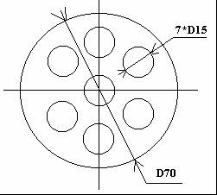
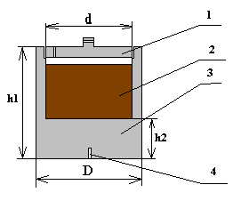
Pr1- MC 7 Scheme
Furnace
Crucible
A-A
A
A
1. Water-cooled cover. 2. Vessel steel specimen.
3. Cylindrical steel heater. 4. Inductor.
5. K-type thermocouples. 6. Quartz plate under the heater.
7. Insulating quartz tube. 8. Metallic bottom
1. Cover. 2. Corium. 3. Crucible.
4. Thermocouple boreholes.

Slide 12
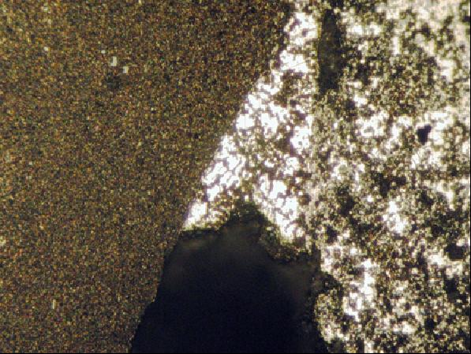
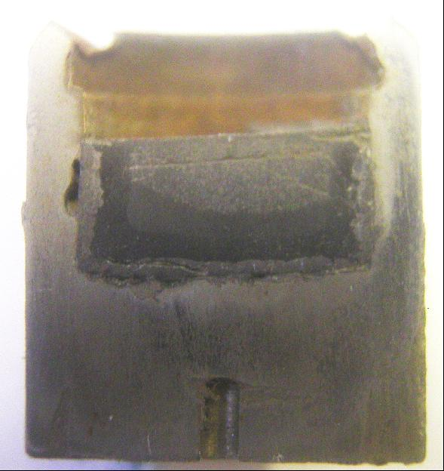
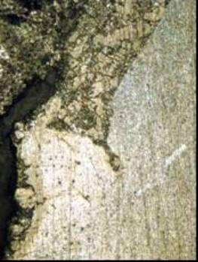
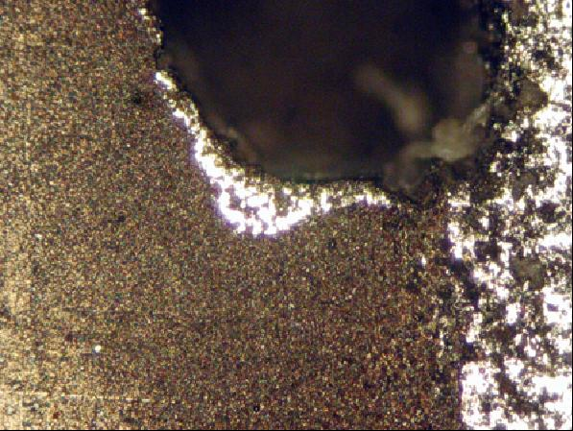

Post - test analysis of Pr1-MC 7
Example of microstructures of the corium-steel interaction zone after 10-hour exposition (Crucible № 6)
Four characteristic layers in the interaction zone (analysis is in progress)
A sidewall pit with interaction traces
The process develops on the grain boundaries

Slide 13
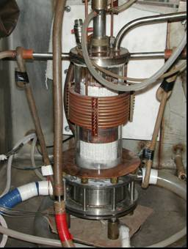
MC-7 Furnace design and schematics
1 – water-cooled pyrometer shaft; 2 – water-cooled cover; 3 – water-cooled electromagnetic screen; 4 – quartz tube;
5 – crucible section; 6 – inductor; 7 – melt; 8 – acoustic defect; 9 – molten ZrO2; 10 –ZrO2 insulation;
11 – vessel steel specimen; 12 – specimen top calorimeter; 13 – specimen bottom calorimeter; 14 – kaolin wool insulation; 15 –ultrasonic sensor; 16 – thermocouples; 17 – crust, 18 – electromagnetic screen;
19 – uncooled electromagnetic screen; 20 – cylindrical support of the specimen

Slide 14
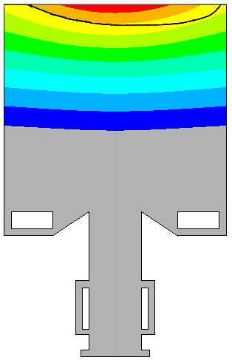
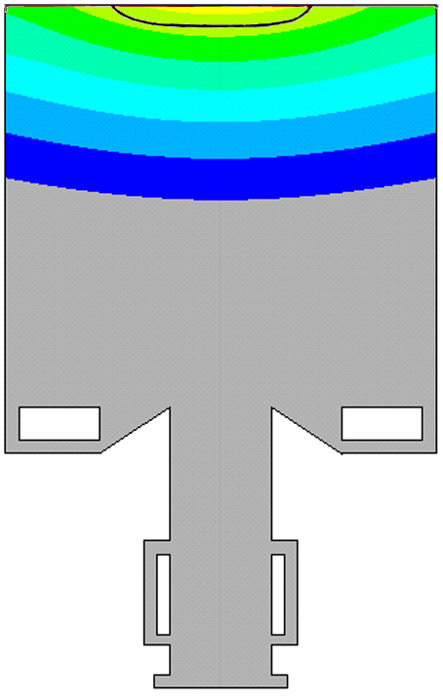

Specimen temperature distribution and interaction zone boundary location
MC6
MC7
Т, °С
Temperatures of the interaction zone boundary are found to be in the range:
МС-7 – 1030...1100°С; МС-6 – 1120...1200°С
! The variation of thermal conductivity of the near-surface metal in the ±30% range has not resulted in relevant changes of the calculated boundary temperature

Slide 15
Comparison of specimen temperature conditions in MC 6 and 7
МС 7 maximum temperature on the steel surface is lower by 240 ºС
Heat flux density into the specimen near its axis is lower by 20%

Slide 16
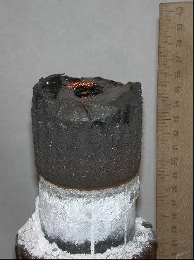
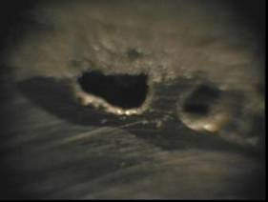
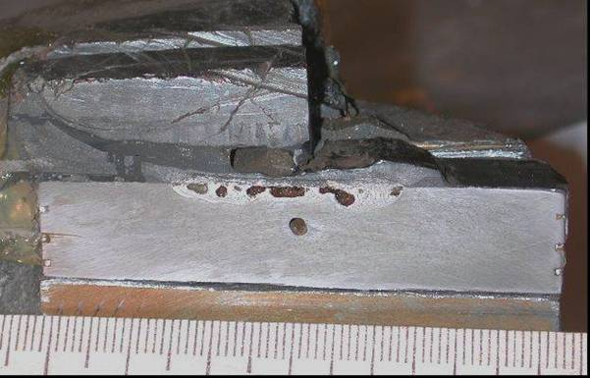
Corium ingot after the furnace disassembling and its cross-section

Slide 17
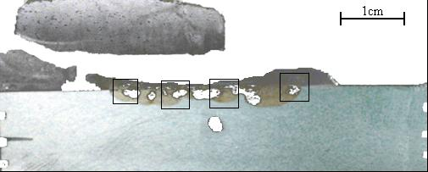
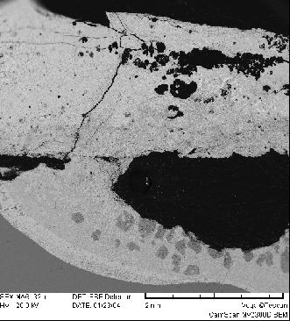
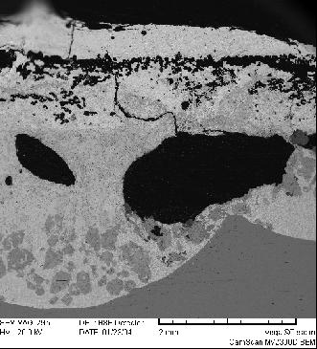
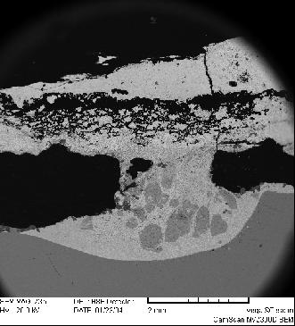
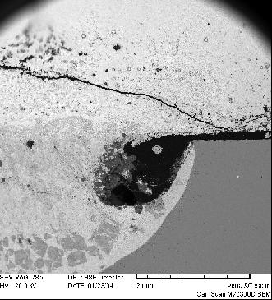
Microstructure of corium-steel interaction zone
The interaction front is nonuniform
Large pores are found in the interaction zone

Slide 18
Eutectics temperature and composition for the conditions of C 30 corium interaction with vessel steel
Eutectics temperature
1120- 1200 °С МС 6 (determined by calculating temperature at the final position
of interaction boundary)
1030- 1100 °С МС 7 (determined by calculating temperature at the final position
of interaction boundary)
1060-1090 °С from DTA/DSC of MC 6 melt samples
Eutectics composition

Slide 19
Conclusions from the tests of the 1st serie
Under conditions of the three tests (MC 6, Pr1-MC 7 and MC 7)
the eutectics character of suboxidised corium C 30 with steel is confirmed; the interaction is accompanied by the Fe-U-Zr-O melt formation
The interaction kinetics is stipulated by the inter-related
processes of reagent and interaction product diffusion through
the crust
The interaction acceleration after a certain “incubatory period”
can be explained by the intensification of U and Zr transport into the
reaction zone after the impregnation (pore filling) of the crust
by the forming melt
The maximum ablation depth of steel cooled from the outside
is not expected to exceed the isotherm position, which
corresponds to the eutectics temperature in the Fe-U-Zr-O
system
In accordance with preliminary data this temperature is in the
range of 1060-1090 С
!After Pr1-MC 7 and MC 7 post-test analysis is completed the conclusions may change!

Slide 20
Proposals for activities within METCOR 2 project until the end of 2004
To complete analyses of Pr – MC7 and MC 7 tests
Deadline: October 2004
To prepare reports on the results of Pr – MC 7, MC 7 and MC 6
Deadline: October 2004
To perform test MC 8: Investigation of the interaction between the
suboxidized corium melt and vessel steel during an additional introduction
of steel into the melt. Test MC 8 specification: Т spec.surf. ≈ 1150°С;
Msteel /Mcor = 0,1; composition ≈С 30
Deadline: October 2004
To perform test MC 9: Investigation of the interaction between the
suboxidized corium melt and vessel steel with an additional introduction
of steel into the melt. Test MC 9 specification *⁾: Т spec.surf. ≈ 1400°С;
Msteel /Mcor = 0,1; composition ≈С 30
Deadline: end of 2004
*⁾ Test MC 9 specification is finalized after the discussion of MC 8 results at the 5th METCOR meeting

Slide 21
Concussions and recommendations of the 3rd CORPHAD Project Meeting
Following the discussion it was decided to modify the contractor proposal on the future plans up to the end of 2004.
In MC 8 tests the interaction of suboxidised C-70 corium with the vessel steel will be studied, as it is important for in-vessel retention. The other test parameters will be according to MC 6 test.
MC 9 test proposal is accepted without any modifications.
*⁾ Test MC 9 specification is finalized after the discussion of MC 8 results at the 5th METCOR meeting

