Slide 1
International Science and Technology Center
Progress Report on the Project # 2936
Modelling of Reactor Core Behaviour under Severe Accident Conditions. Melt Formation, Relocation and Evolution of Molten Pool
(Reactor Core Melting)
Presented by
A.V.Palagin
10th Meeting CEG-CM
Kurchatov-City, Republic of Kazakhstan
IAE NNC 5-8 September 2006

Slide 2
General Information
Leading Institution: | IBRAE, Moscow (Nuclear Safety Institute of Russian Academy of Sciences)
Duration: Commencement: | 3 years August 2004
Total cost: | $ 200 000

Slide 3
Non-CIS Collaborators
FZK | Forschungszentrum Karlsruhe GmbH | Germany Karlsruhe
ITU | European Commission Joint Research Centre Institut für Transurane | Germany Karlsruhe
IRSN | Institut de Radioprotection et de Sûreté Nucléaire | France Cadarache
KAERI | Korea Atomic Energy Research Institute | Korea Taejon
FZR | Forschungszentrum Rossendorf GmbH | Germany Rossendorf
CEA | Commisariat à l’Energie Atomique | France Cadarache

Slide 4
Organizational Structure and Managerial Responsibilities
Project Manager
Prof. M. Veshchunov
Laboratory for Condensed Matter Theory (IBRAE)
(Head: Prof. M. Veshchunov)
Tasks 1-5
Laboratory for Computational Heat and Hydrodynamics (IBRAE)
(Head: Dr. V. Chudanov)
Tasks 6-8
-

Slide 5
Project Objectives
On the base of detailed analysis of available and new experimental data, to update, improve and verify models on reactor core molten materials behaviour at consecutive stages of a severe accident:
  • from the early stage, when melt formation and progression during core degradation occur (SVECHA/MELT code),
  • to the late stage, when the core is completely degraded and a molten pool is formed in lower head of the PRV (CONV code),
and to prepare them for benchmarking of simplified models and for implementation in the existing SA system codes

Slide 6
Main Physical Processes
Melt formation, onset of melt relocation:
  Simultaneous dissolution of ZrO₂ crust and UO₂ pellet by molten Zircaloy
  Cladding oxide shell failure
  Release of U-Zr-O mixture from the cladding breach
Melt relocation:
  Candling (drops and rivulets)
  Formation, oxidation and downward relocation of massive channel blockage (slug)
Physical-chemical behaviour of molten pool in the lower head of the RPV:
  Molten pool oxidation, phase segregation, stratification, 3D turbulent flows

Slide 7
Technical Schedule (1)
Task Completion
Quarter | 4 | 7 | 8 | 10 | 12
Task №№ | 1, 6 | 2 | 7 | 3 | 4, 5, 8
Completed:
Task 1: Modelling of melt formation and onset of melt relocation (reported at the 7-th CEG-SAM Meeting)
Task 3: Modelling of slug relocation – (reported at the 8-th and 9-th CEG-SAM Meetings)
Task 6: Development of the three-dimensional CFD code and adaptation to the LIVE project (reported at the 7-th and 8-th CEG-SAM Meetings)
Task 7: The numeric-theoretical analysis of the flows in a boundary layer adjacent to cooled boundaries (reported at the 8-th and 9-th CEG-SAM Meetings).

Slide 8
Technical Schedule (2)
Partially completed:
Task 2: Modelling of candling process – analytical part completed (reported at the 8-th and 9-th CEG-SAM Meetings)
Task 4: Verification of the newly developed SVECHA/MELT code against available experimental data – will be presented
Task 5: Analytical support for the ITU tests on MOX-Zr dissolution and U-Zr-O melting points determination - (reported at the 9-th CEG-SAM Meeting)
Task 8: Thermal-hydraulic model with accounting for the crust formation - will be presented

Slide 9
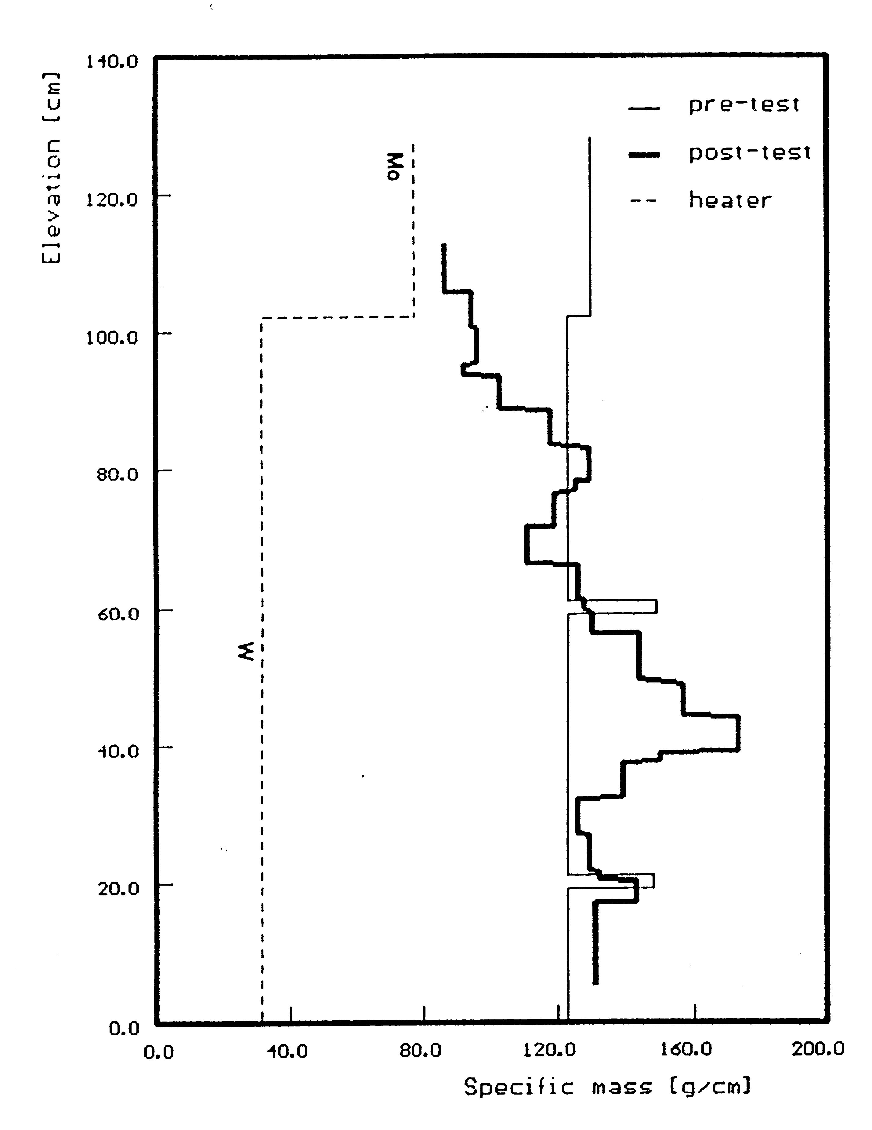
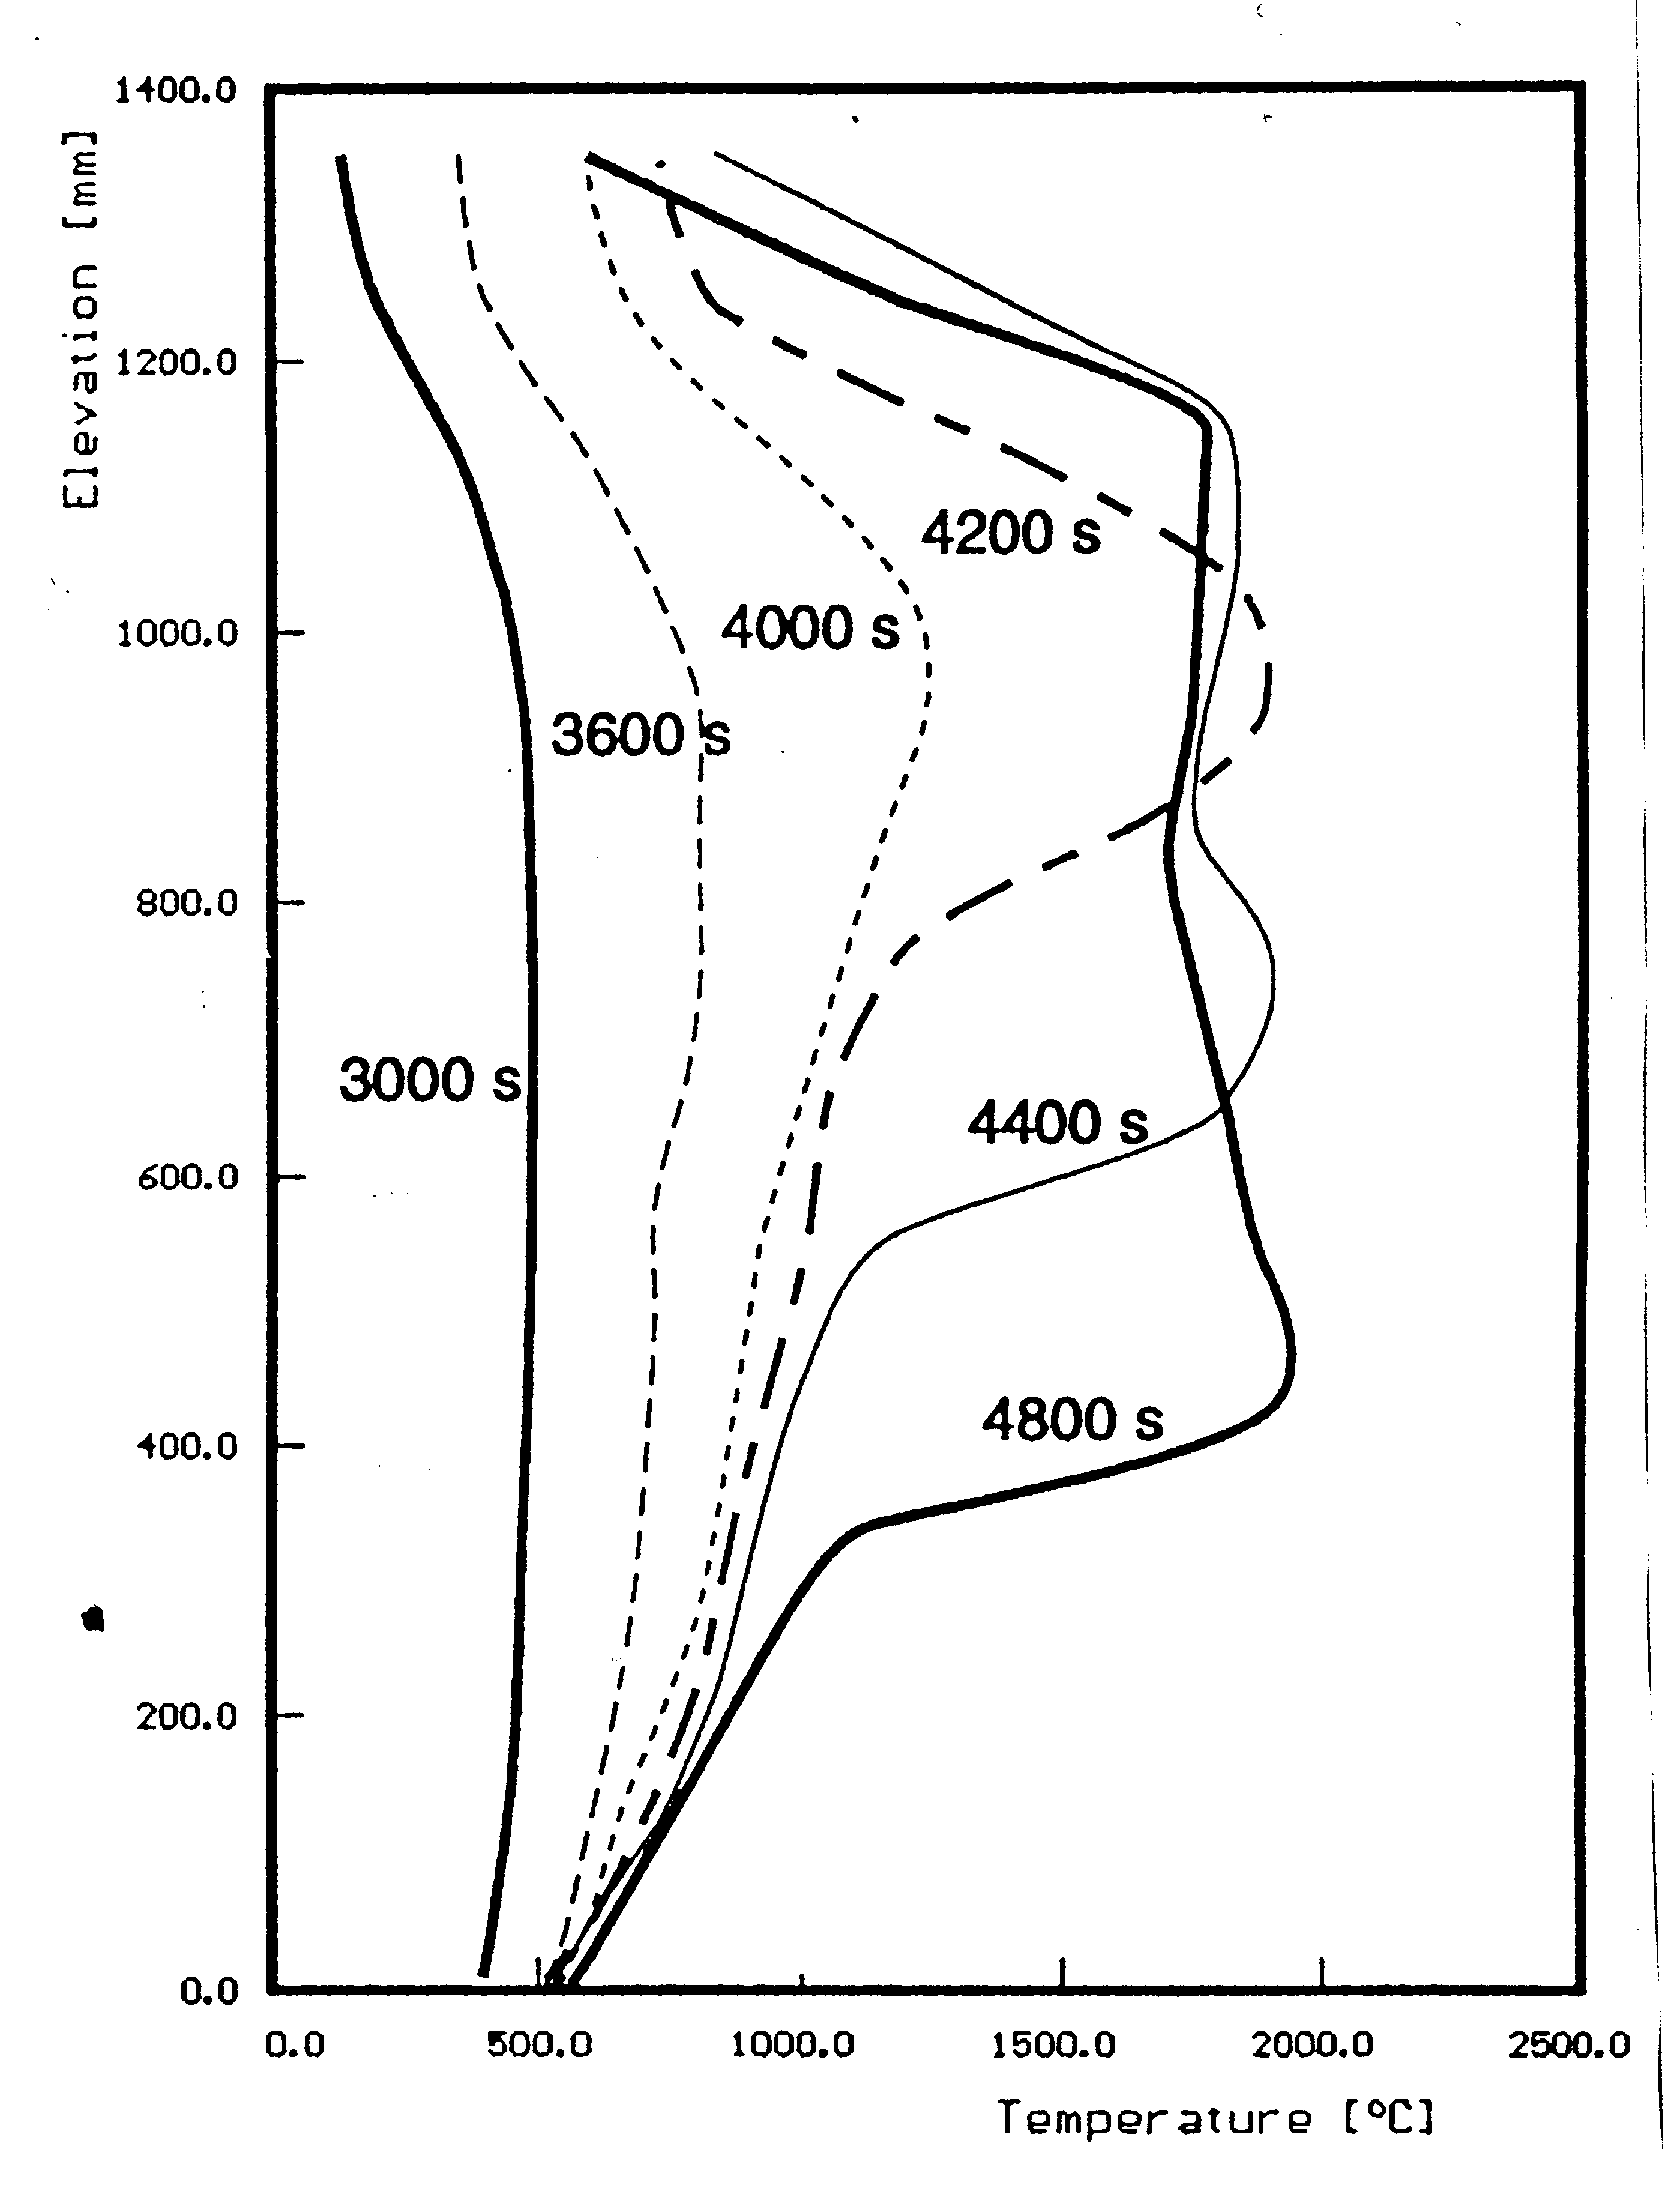
Task 4. Phenomenology of slug relocation
Axial mass distribution after the test and axial temperature distribution during the transient phase of the FZK bundle test CORA-W1 (from S.Hagen, P.Hofmann, V.Noack, G.Schanz, G.Schumacher and L.Sepold, Test Results of Experiment CORA W1, KfK 5212, 1994)
High and low temperature regions observed at t > 4200 s are separated by a rather pronounced temperature front. This front relocates downward with a characteristic velocity 1-2 mm/s which is extremely small in comparison with the velocities of rivulets and droplets (0.5 m/s).

Slide 10
Phenomenology of slug relocation
At the initial stage of the core degradation process the molten materials begin to flow down from some upper hot elevation in the form of separate drops and rivulets and stop at some lower (and colder) elevation.
As a result at some rod elevation with the temperature close to T_{sol} a mixture slug begins to develop which may form a partial blockage of the coolant channel.
Physical-chemical interactions of the slug materials with steam leads to the heat generation and heating up of the slug.
This, in turn, leads to a decreasing of the solid fraction and viscosity and beginning of flowing down to the lower (and colder) elevations, resulting in continuous slow relocation of the slug coherently with the temperature front.
During the slug motion the mass exchange process including the mass income from the hot upper elevations in the form of drops, UO₂ pellets and ZrO₂ cladding dissolution and oxidation by steam occurs.
Effective viscosity of the molten mass gradually increases in the course of the ceramic precipitates growth leading to the increase of solid fraction. This additionally prevents the molten mass from quick downward relocation.

Slide 11
Single Rod Code
SVECHA/MELT
Axial Mesh
SVECHA/QUENCH code simulates fuel rod behaviour under severe accident conditions.
Fuel rod is divided into a number of meshes along axial and radial directions.
Mesh contains UO₂ fuel pellet and the multilayered oxidized Zr cladding.
Pellet
Gap
Coolant flow:
H₂O(l), H₂O(g), O₂, Ar, H₂
Cladding

Slide 12
Slug model object
Melt blockage is modeled as a cylindrical volume with the vertical length - L_{sl} and radius - R_{sl} .
Melt blockage is in contact with N fuel rods.
Slug consists of the main (liquid) part and a high viscosity crust scale at lower surface
Fuel rod
Shroud
Slug
L_{sl}
2·R_{sl}
Steam flow

Slide 13
Slug module implementation in the SVECHA/MELT code (1)
The main points of slug module:
Conditions of a melt blockage formation control and first call initialization of a slug behaviour
Mass and heat balance in the moving melt blockage
Vertical temperature distribution in the slug
Slug viscosity as a function of slug composition, volume fraction of solid precipitates and temperature
Slug relocation velocity dependence of mass and viscosity
Interface with the dissolution-oxidation module at the local time step of calculations
Local time step adjusting and iteration procedure convergence check-up
The melt properties (enthalpy, density, specific heat capacity, thermal conductivity) are determined using MATPRO data base

Slide 14
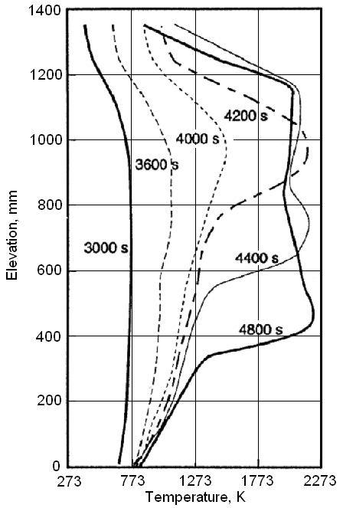
Axial temperature distribution in CORA-W1 test
Measured evolution
of temperature axial profile
Fuel rod temperature vertical profile evolution emulated in calculations

Slide 15
Slug velocity and mass behaviour
(simulation results)

Slide 16
Slug composition evolution
(calculation results)

Slide 17
Slug geometry evolution
(calculation results)

Slide 18
Slug composition: final status
Experimental measurements of material chemical composition at different locations at the elevation 605 mm of the CORA-W2 test bundle
Calculation results for final slug position at the elevation 465 mm
Element | Loc.1 | Loc.2 | Loc.3
O (at%) | 66.7 | 65.1 | 66.3
Zr (at%) | 25.4 | 27.3 | 25.3
U (at%) | 7.1 | 7.6 | 8.4
Element | Slug main part
O (at%) | 63.0
Zr (at%) | 34.0
U (at%) | 3.0

Slide 19
Task 4: the main results obtained
Computer module describing simultaneous relocation and oxidation of a massive blockage (slug) was developed and implemented in the code SVECHA/MELT.
The basic data relative to oxidation and dissolution (components mass flows) is provided by the ‘melt oxidation - fuel dissolution’ module coupled with the slug relocation module on the local time step. Developed module allows self-consistent calculation of the slug relocation velocity.
Preliminary validation of the slug model was performed using experimental data of CORA-W1 and CORA-W2 tests. Calculations demonstrate the capability of the model to simulate adequately the main features of the massive blockage behaviour in the course of core degradation. Intensive validation of the slug module is under way.

Slide 20
Task 8. Thermal-hydraulic model of heat generating fluid
Heat generating fluid demonstrates temperature stratification depending on boundary conditions at the upper boundary (isothermal or adiabatic).
The obtained numerical estimations of the heat transfer dependence on dimensionless parameters (eg. Rayleigh number) are compared with semi-quantitative theoretical model evaluations as well as with corresponding experimental data.
[B1] L.A. Bolshov, P.S. Kondratenko, V.F. Strizhov, A semi-quantitative theory of convective heat transfer in a heat generating fluid, Int. J. Heat and Mass Transfer, Vol.41 (1997), № 10, pp.1223-1227.
[B2] L.A. Bolshov, P.S. Kondratenko, Limiting angular characteristics of heat transfer and stratification in a heat-generating fluid, International Journal of Heat and Mass Transfer, Vol.43 (2000), № 20, pp.3897-3905
[B3] L.A. Bolshov, P.S. Kondratenko, V.F. Strizhov. Buoyancy-induced convection of heat generating liquid. Uspehi Fiz. Nauk Vol.171 (2001), №10, pp.1051-1070

Slide 21
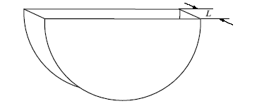
Free convection of a heat generating fluid in a quasi 2D geometry
Analytical evaluation
Numerical predictions
The correspondence of heat transfer in quasi 2D volume and the one in prototypical 3D volume is reached under the condition [B3]
L- thickness of vertical section,
R – curvature radius,
Ra_{i} – modified Rayleigh number.

Slide 22
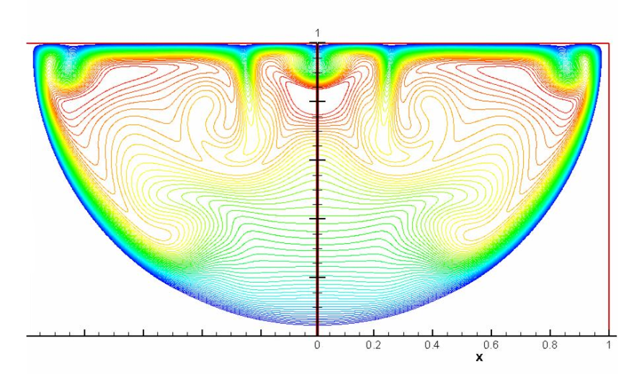
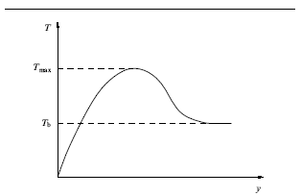
Temperature profile in BL in the case of stratification in the bulk
Analytical evaluation
Numerical predictions
Temperature profile of a normal BL (in case of absence of stratification in the bulk) is monotonous in the vicinity of vertical wall.
The temperature distribution in the bulk in case of stratification is formed as a result of a recurrent liquid flow from BL; maximum value of temperature inside BL exceeds the bulk temperature T_{b} by the same value [B3]:
Isotherms
Numerical predictions of the natural convection:
Temperature profile. Ra=10¹⁰
Temperature profile for the converged BL: T – temperature, y - coordinate normal to the boundary, T_{max} - maximum temperature in BL, T_{b} – temperature of BL/bulk interface

Slide 23
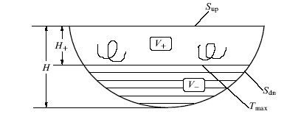
Heat exchange of a heat generating fluid in a prototypical volume
T_{b} vs z
Central vertical slit filled with fluid:
S_{up} and S_{dn} are the upper horizontal and lower boundaries, respectively; T_{max} – imaginary horizontal plane, passing through a point of a maximum temperature; V₊ and V₋ - domains of volume located above and below plane T_{max}; H- vertical size (height) of all volume; H₊ - height of domain V₊.
Analytical evaluation for heat flux q at the boundary and temperature distribution T_{b} in the bulk for laminar boundary layer (BL) at θ* <<θ <<1 and δ << z << R [B3]
Heat fluxes in BL demonstrate a dependence close to square-law: q~a+bθ² in correspondence with theoretical analysis [B2]. This result was reported on the 9th CEG-CM Meeting in Paris, in March 7-9, 2006.
z – vertical coordinate, R – radius of a boundary curvature, δ – thicknesses of BL.

Slide 24
Convection of a cooled down fluid without internal heat sources (1)
Analytical evaluation
Temperature distribution in the bulk [B3]
T₀ – temperature value, counted form the temperature on the boundary, z – vertical coordinate, R – radius of a boundary curvature, t – time, k – dimensionless value.
Numerical predictions
T_{b} vs z
Temperature filed
k=4

Slide 25
Convection of a cooled down fluid without internal heat sources (2)
Analytical evaluation
Heat flow density distribution at the boundary [B3]
θ – angle, q_{min} – minimum value of heat flow density at the boundary point θ = 0,
t – time, p – dimensionless parameter.
Numerical predictions
Temperature filed
q vs θ
p=2

Slide 26
Task 8: the main results obtained
Theoretical analysis and numerical simulation of temperature stratification in a heat generating fluid with accounting for different boundary conditions (isothermal and adiabatic) was performed.
The results of numerical simulation are in good agreement with the results of theoretical analysis:
  Description of free convection in quasi 2D volume;
  Temperature profile in the BL and in the bulk of a fluid with internal heat sources
  Temperature distribution in the bulk of a cooled down fluid without internal heat sources and heat flow density at the boundary;

Slide 27
Topical Meeting on ISTC Project #2936
Moscow, July 5, 2006
IBRAE, Nuclear Safety Institute of Russian Academy of Science
9.20 M. Veshchunov, IBRAE. Status and Progress Report on the Project #2936 “Modelling of Reactor Core Behaviour under Severe Accident Conditions. Melt Formation, Relocation and Evolution of Molten Pool”
9.40 V. Chudanov, IBRAE. Numerical Simulation of Natural Convection - 3D CONV Code Current Status
10.40 E. Altstadt. FZR Activities on in-Vessel Melt Retention
11.20 A. Palagin. Physical Model for Massive Melt Oxidation and Downward Relocation in the Course of the Second Stage of Melt Relocation Process (Slug Model)
12.10 V. Shestak, IBRAE. Slug Model Numerical Realization and Implementation in the SVECHA/MELT Code
14.00 M. Veshchunov, IBRAE. The SVECHA Code Model for Corium Melt Oxidation; Application to the Confined Geometry
15.00 V. Chudanov, IBRAE. Two-Phase Flow Numerical Simulation: (i) 3D Unified CFD Approach to Modeling Gas-Liquid Phenomena; (ii) Thermo-Solutal Numerical Models
16.20 M. Veshchunov, IBRAE. Interpretation of the ITU Measurements on High-Temperature Phase Transformations in U-Zr-O System
16.50 Discussion on the ISTC Project #2936

Slide 28
General conclusions
Scientific investigations within the framework of the ISTC project #2936 are being successfully performed in accordance with the project Technical Schedule.
Tasks 1, 3, 6 and 7 have been fulfilled; intensive work on the tasks 4 and 8 is under way.
The progress in the Project realization was reported in details at the topical meeting in Moscow last July.

