Slide 1

Preliminary analysis of oxidation kinetics for the suboxidized molten corium based of METCOR-P, MASCA and EVAN project results
A.P. Alexandrov Research Institute of Technology
International Science and Technology Center
Presented by V. Khabensky
3rd METCOR-P project meeting
May 27, 2009, St. Petersburg

Slide 2
Relevance of suboxidized melt oxidation kinetics
Molten melt composition and structure are very sensitive to the oxygen potential in the system
In-vessel molten pool can be oxidized by water, steam and air, which get into the reactor vessel. This results in the principal changes of the molten pool formation dynamics
Vessel steel corrosion at its interaction with molten corium is intensified, if the melt contains iron oxides and in presence of oxidizing atmosphere above the melt

Slide 3
Objectives of experiments
Evaluate oxidation kinetics and aerosol release rate
Determine compositions of oxidic and metallic parts of corium ingot
Estimate thermal effects and influence of non-isothermicity

Slide 4
Experimental conditions of МСР-3, МА-7, МА-9, EV-1
Conditions | Preparatory stage |  |  |  | Oxidizing atmosphere | Oxidation time | Experimental objective | Note
Experiment | Charge composition and mass | Target location | Time of exposure | Above-melt atmosphere
МСР-3 | C-31.8 Simulated crust 150 g UO₂-1271.7 g ZrO₂-150.6 g Zr-250 g | Cooled vessel steel specimen similar to МС6 | 11 h | Ar | Steam (Ar→ steam) | 8000 s | Oxidation kinetics of molten pool and interaction zone (IZ) | Crust between pool and IZ
МА-7 | Mass of oxides 1800 g UO₂-76 mass% ZrO₂-9 mass% С-32 Zr-15 mass% Steel – 200 g m_{steel}/m_{cor} ≈ 0.1 | Bottom calorimeter | 0,5 h | Ar | Air (Ar→Air) | 320 s | Oxidation kinetics and changed stratification of layers | Regime termination criterion – inversion of layers
МА-9 | Mass of oxides 1800 g UO₂-76 mass% ZrO₂-9 mass% С-32 Zr-15 mass% Steel – 200 g m_{steel}/m_{cor} ≈ 0.1 | Bottom calorimeter | 0,5 h | Ar | Steam (Ar→ steam) | 1050 s | Oxidation kinetics and changed stratification of layers | Regime termination criterion – zero hydrogen flow rate
EV-1 | Mass of oxides 1800 g UO₂-72.64 mass% ZrO₂-19.38 mass% Zr-6.15 mass% C-70 | Bottom calorimeter |  | Ar | Argon-oxidic mixture Ar→Ar/O₂ | 1000 s + 1300 s | Release of fission products | Oxidation in two stages: С-70 – С-85 С-85 – С-100

Slide 5
Steam Oxidation Effect on Zone of Interaction of C-32 Corium with Vessel Steel: MCP-3 Test
Objectives
Qualification and quantification of steam oxidation effect on interaction zone

Slide 6
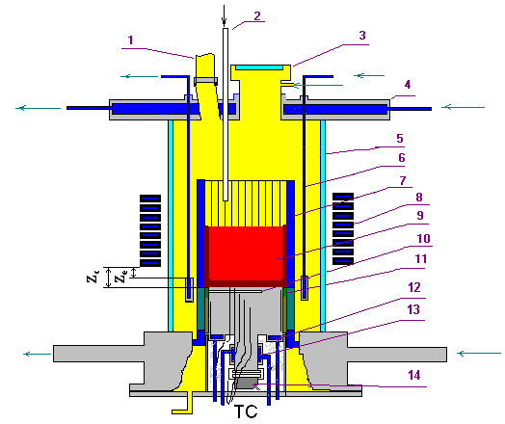
Experimental Setup
1 – steam vent from the furnace, 2 – steam line,
3 – lid, 4 – water-cooled cover, 5 – quartz tube,
6 – water-cooled electromagnetic screen,
7 – crucible sections, 8 – inductor, 9 – melt,
10 – acoustic defect, 11 – thermal insulation of the specimen, 12 – top specimen calorimeter,
13 – bottom specimen calorimeter, 14 – US sensor
Furnace Charge
Component | Mass, g
UO₂ | 1385.7
ZrO₂ | 164.1
Zr | 272.5
Total | 1822.3
C_{n} = 31.8
U/Zr = 1.188 at.
RASPLAV-3 Furnace

Slide 7
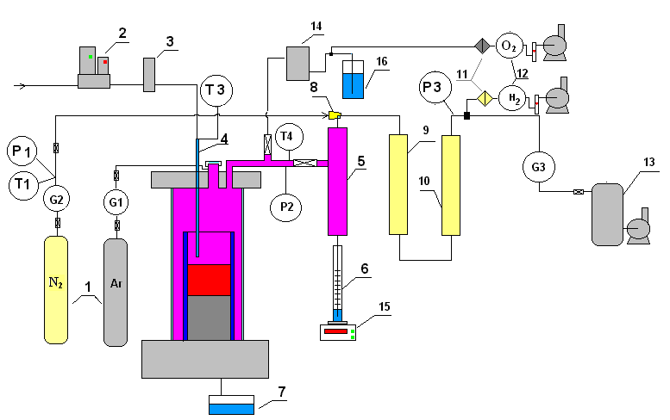
Experimental Setup (2)
Gas-Aerosol Sampling System
1 – tanks with N₂ and Ar
2 – water controller
3 – steam generator
4 – quartz tube for
steam supply into
the furnace
5 – steam condenser
6 – condensate
collector
7 – condensate drop
catcher
8 – ejector
9 – large-area filter
(LAF - steam)
10 – silica gel drier
11 – analytical filter
(AF)
12 – electrochemical
sensors of oxygen
and hydrogen
13 – vacuum receiver
14 – large-area filter
(LAF - Argon)
15 – weight sensor
16 – hydro lock

Slide 8
Experimental Procedure
Stage | Time interval, s | Description
A | 0…38300 (≈ 11 h) | Molten pool and interaction zone (IZ) formation
B | 38300…42500 | Vessel steel temperature is decreased, crust above the IZ is formed
C | 42500…44300 | Molten pool is oxidized by steam
D | 44300…49200 | Specimen temperature is increased, crust above the IZ dissolves
E | 49200…50490 | Interaction zone and specimen are oxidized

Slide 9
Experimental Results
Thermocouple Readings and Anode Voltage
During all experiment
Fragment: Oxidation period
A B C D E
A B C D E

Slide 10
Experimental Results (2)
Power into Cold Crucible and Upper Calorimeter
During all experiment
Fragment: Oxidation period
A B C D E
A B C D E

Slide 11
Experimental Results (3)
Nitrogen Flow Rate and Hydrogen Concentration
Steam Ingress
C
D
E
Blowing of furnace

Slide 12
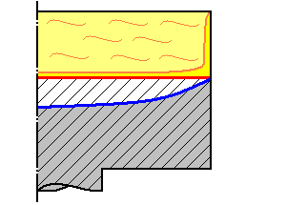
Experimental Results (4)
Corrosion kinetics
A
D
E
Melt
IZ
Specimen
Melting of specimens in the end of regime E
References:
[1] S.V. Bechta, V.B. Khabensky,
V.S. Granovsky etc. EXPERIMENTAL
STUDY OF INTERACTIONS BETWEEN
SUBOXIDIZED CORIUM AND REACTOR VESSEL STEEL. Proc. of ICAPP’06, Reno, NV USA, June 4-8, 2006, Paper 6054

Slide 13
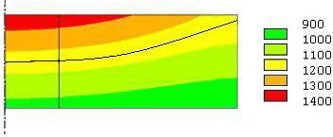
Ablation and steam absorption kinetics
Specimen temperatures during it interaction with suboxidized corium
1 cm
T, ºC
US sensor
sighting spot
Final position of the interaction
zone (IZ)
Comparison of MC6 and MCP-3 Test Results
Parameter | Test
 | MC6 | MCP-3
Final Corrosion Depth, mm | 6.2 | 7.6
Temperature of Lower Boundary of IZ at Final Position (T_{B}), ºC | 1180 | 1160

Slide 14
Ablation and steam absorption kinetics (3)
Hydrogen Generation
Average rates of hydrogen liberation:
6.9 mg/s – at stage C
3.6 mg/s – at stage E
Hydrogen liberation rates at the steady regime:
9.7 mg/s – at stage C
5.0 mg/s – at stage E
Crust dissolves at stage D

Slide 15
Ablation and steam absorption kinetics (4)
Heat Generation at Corium Pool Oxidation Stage (Stage C)
Reactions on the melt/furnace atmosphere boundary:
Zr + 2H₂O = ZrO₂ + 2H₂ + 530 kJ
UO₂ + H₂O = UO₃ + H₂ – 160 kJ
Fe + H₂O = FeO + H₂ – 30 kJ
2Fe + 3H₂O = Fe₂O₃ + 3H₂ – 120 kJ
Heat of chemical reactions generated at stage C:
≈ 1370 kJ
Corresponding average heat power:
≈ 0.759 kW

Slide 16
Ablation and steam absorption kinetics (5)
Heat Generation at Interaction Zone and Specimen Oxidation Stage (Stage E)
Reactions in the interaction zone:
Zr + O₂ = ZrO₂ + 1090 kJ
U + O₂ = UO₂ + 1060 kJ
2U + O₂ = 2UO₃ + 2360 kJ
Fe + O₂ = FeO + 500 kJ
4Fe + 3O₂ = 2Fe₂O₃ +1440 kJ
Heat of chemical reactions generated at stage E:
≈ 888 kJ
Corresponding average power of heat release:
≈ 0.505 kW
Estimation of heat power to the specimen surface both from the melt and generated by chemical reactions ≈ 2.5 kW
( 2 kW – from the melt, 0.5 kW – chemical reactions)

Slide 17
Preliminary Conclusions
Posttest analysis is still in progress, but the following can be noted:
Before the oxidation start, in the conditions close to MC6 interaction
between the С-30 corium melt with steel, the MCP-3 interaction zone
depth in the USS sighting spot was deeper by approx. 1.4 mm, and the
incubation period – shorter by approx. 6000 s
The oxidation rate and hydrogen generation rate measured during the
pool oxidation regime were close to MA-9 test (MaSca program).
The oxidation is controlled by the steam supply to the molten pool
surface
The most conservative regime was realized in the test, i.e. the IZ was
oxidized by corium melt, which have been oxidized in advance
A partial melting of the steel surface layer took place in the end of
oxidation regime. This was caused by uncontrolled increase of heat
transferred from the melt (setup-specific factor) and/or additional heat
generated by chemical reactions. The mentioned heat powers have been
evaluated as 2 and 0.5 kW respectively

Slide 18
Oxidation of stratified corium pool:
Experiments MA-7 and MA-9
Test objectives:
Determine the influence of oxidation in air ( MA-7) and in steam (MA-9) on the component repartitioning and structure of the pool formed during the interaction of molten C-32 corium with steel
Get experimental data on the oxidation kinetics of molten corium

Slide 19
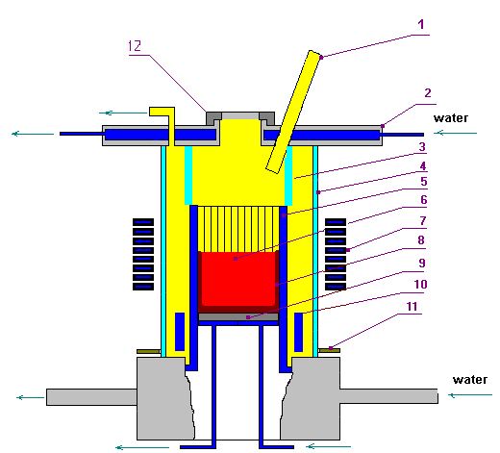
MA-9 test facility
Furnace schematics
1 – steam supply
2 – water-cooled furnace cover
3 – quartz wall
4 – quartz tube
5 – crucible section tubes
6 – corium melt
7 – inductor
8 – crust
9 – bottom calorimeter
10, 11 – electromagnetic screens
12 – cover of the monitoring port
Different from MA-7:
quartz tube (1) in cover (2) for supplying superheated steam
quartz wall (3) to separate the above-melt space
absence of pyrometer shaft to exclude steam condensation on its cooled surface
Notes:
MA-7 furnace schematics has been shown before.
Pyrometer shaft was introduced shortly for measuring the melt surface temperature immediately before the steam supply.

Slide 20
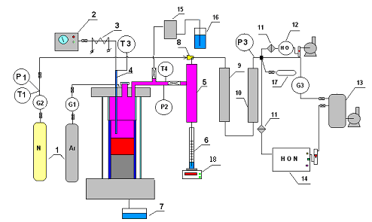
MA-9 test facility (2)
Schematics of gas-aerosol system
1 – tanks with Ar, N₂
2 – steam generator
3 – heated steam supply line
4 – quartz tube for steam in
5 – steam condenser
6 – condensate collector
7 – condensate drip collector
8 – ejector
9 – large-area filter (LAF)
10 – silica gel drier
11 – medium-area filter (MAF)
12 – sensors of O₂ and H₂
13 – vacuum receiver
14 – mass spectrometer
15 – medium-area filter (MAF)
16 – hydro lock
17 – vacuum gas burettes
18 – weight strain sensor
Different from MA-7:
Mass spectrometer (14) for measuring the off-gas composition
Sensors of O₂ and H₂ (12) used for monitoring of transients
Sensor (18) to measure mass of condensate
Notes:
MA-7 gas-aerosol system schematics has been shown before.

Slide 21
MA-7 result
1 – steel input; 2 –melt sampling; 3 – air sparging;
Q_{cc}- power in the crucible; Q_{bc} – power in the calorimeter

Slide 22
MA-9 results
Pyrometer readings (T) and
HF generator current (I_{a})
Before steam is supplied the molten pool
temperature is evaluated by a fixed correction of
pyrometer readings, this is a measure to
compensate for the absence of pyrometer shaft and
aerosol influence
Pyrometer cannot be used after the steam is
supplied, because one of the operational
wavelengths is in the steam absorption spectral
range
Notes:
MA-7 experimental results have been given before.
Due to the absence of pyrometer shaft the measured temperature of the melt surface (grey curve) was considerably lower than the actual one, the brief shaft installation enabled to measure the actual temperature and the determined temperature delta enabled to plot a realistic temperature curve (pink line).

Slide 23
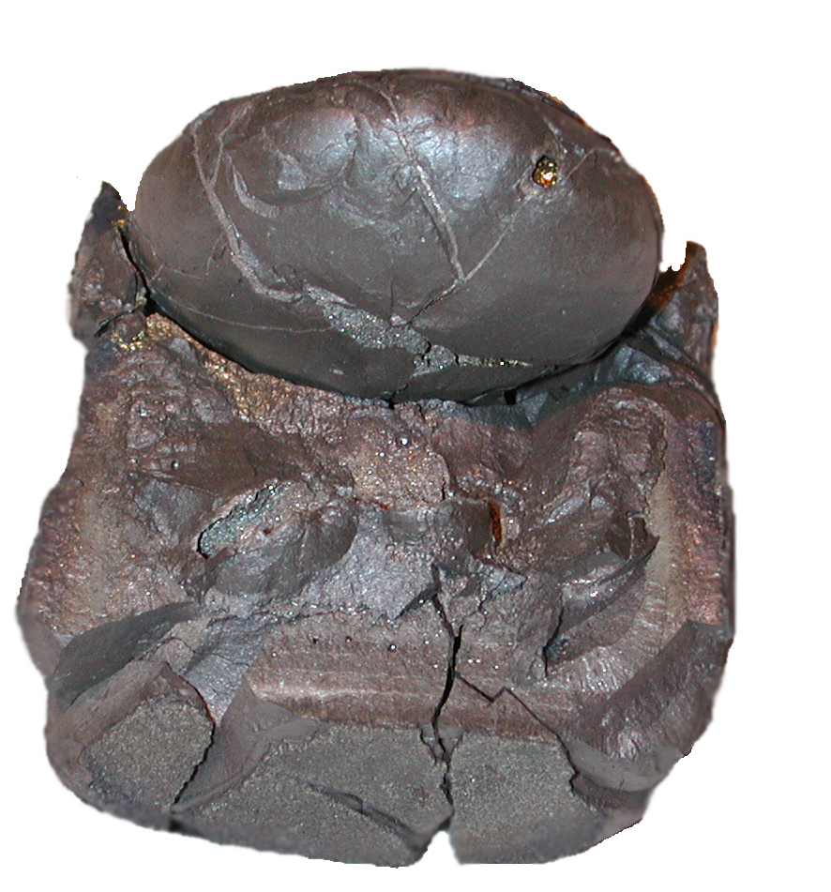
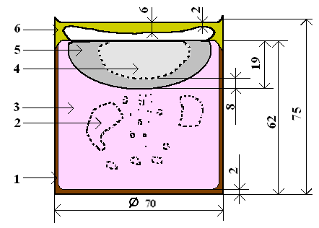
Post-test analysis
MA-7 ingot and its axial section schematics
1 – side and bottom crust
2, 4 – pores and voids
3 – oxidic part
5 – metallic part
6 – above-melt crust
  Mass of metallic ingot 215.4 g
  Large shrink cavity in the top part of the metallic ingot
  Numerous pores in the oxidic part of the ingot

Slide 24
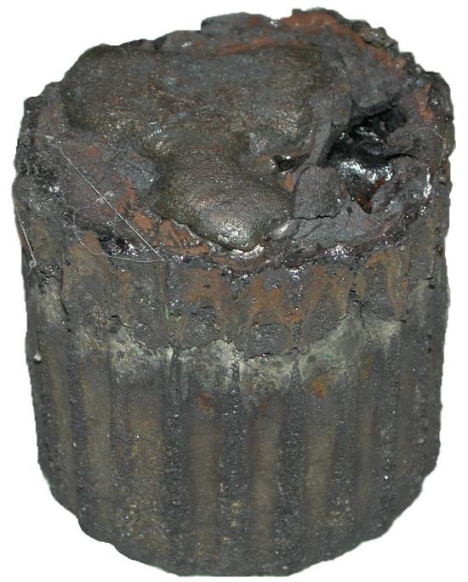
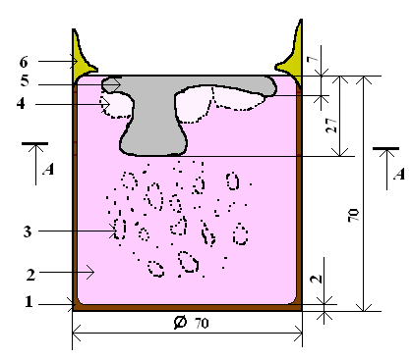
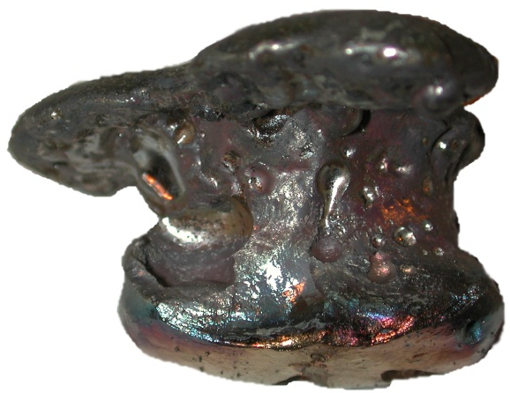
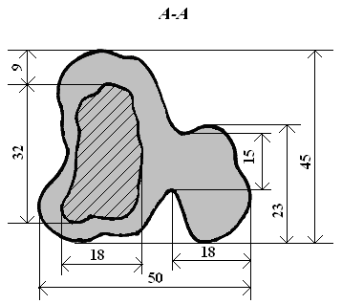
Post-test analysis (2)
MA-9 ingot and its schematics
1 – side and bottom crust
2 – oxidic part
3 – pores
4 – shrink cavity
5 – metallic part
6 – top crust
Mass of metallic ingot – 126.5 g
(2.7 g of it was found in the
oxidic ingot)
Shrink cavity is in the oxidic, not
metallic part
Many pores in the oxidic part of
the ingot

Slide 25
Post-test analysis (3)
Air-melt interaction kinetics in MA-7
Measured furnace gas composition
Mass of gases absorbed by the melt
0 – air is supplied into the furnace and analytical gas line is connected to the mass spectrometer
1 – crust is observed on the melt surface
2 – furnace heating is disconnected

Slide 26
Post-test analysis (4)
Rates of oxygen and nitrogen absorption by the melt in MA-7
Two parallel reactions:
(1) Zr + O₂ = ZrO₂
(2) 2Zr + N₂ = 2ZrN
If the crust is absent, the oxidation rate is
0.045 (±0.002) g/s for O₂ and 0.144 (±0.002) g/s
for N₂:
The interaction process is controlled by the supply of air to the melt surface
If the crust is formed, the absorption rate of the
both components is below 0.04…0.06 g/s, it
decreases as the crust grows
0 – air is supplied into the furnace and analytical gas line is connected to the mass spectrometer
1 – crust is observed on the melt surface
2 – furnace heating is disconnected

Slide 27
Post-test analysis (5)
Dynamics of corium oxidation index and Zr binding index during the experiment

Slide 28
Post-test analysis (6)
Oxidation kinetics in MA-9 determined from steam mass balance
1 – Mass of incoming steam
2 – Mass of collected condensate
3 – Mass of steam at the furnace
outlet, transport delay is
considered
4 – Start of steam supply
5 – Disconnection of steam
Rate of steam absorption by the melt is 0.12 (±10%) g/s
Notes:
Можно заметить, что запаздывание по моменту подачи пара (140…160 с), отличается от запаздывания по прекращению подачи пара (70…100 с). Это можно объяснить некоторым различием теплогидравлических процессов заполнения и осушения конденсатора.

Slide 29
Post-test analysis (7)
Oxidation kinetics in MA-9 determined from analysis of gas:
Н₂ volumetric concentrations
Н₂ mass flow rates
1 – On-line measurements
2 – Chromatography
3 – Start of steam supply
4 – Disconnection of steam
1 – Total interaction period
2 – Periods of stable conditions
3 – Average value: 0.011 (±20%) g/s
Average rate of steam absorption is 0.10(±20%) g/s (less accurate value)
Notes:
Between 4300 - 4730 s and 4900 - 5200 s the flow rate of carrier gas is approximately constant, and the flow rate of generated hydrogen is ≈ 0.011 (±20%) g/s, which testifies to the constant rate of redox reactions

Slide 30
Post-test analysis (8)
Oxidation kinetics in MA-9 determined:
Masses of absorbed steam and of released hydrogen
1 – hydrogen, 2 – steam
The rate of steam absorption is
nearly constant: 0.12 (±10%) g/s
(move accurate value from H₂O
balance)
The hydrogen release rate is also
constant: 0.013 (±10%) g/s
Both rates do not depend on the
concentration of unoxidized Zr and U
in the melt
Notes:
Zr activity determined by this method can be lower than actual, because this component had been spent before the experiment was completed

Slide 31
Release rates and aerosols composition in MA-7

Slide 32
Release rates and composition
of aerosols in MA-9
Uncertain data due to low rate of carrier gas (steam)
Increase of release rates during oxidation
Significant releases of Fe and Cr
Notes:
MA-7 aerosol release rates have been presented before.
MA-9 results:
Before steam supply the aerosol mass was not evaluated. For this reason the aerosol release rate during the exposition of oxidic-metallic melt can be evaluated using MA-7 results.
In the regime of oxidic-metallic melt oxidation a part of supplied steam got into the condenser without interaction with the melt, due to this it became a carrier for produced aerosols, During this some aerosols were likely to get back into the melt with partially condensed steam (drops). Low flow rates of carrier gas (steam) at the MA-9 oxidation phase prevented the reliable sampling of formed aerosols. Therefore the corresponding values are lower than actual.

Slide 33
CONCLUSIONS
In MA-7 it was determined that simultaneously with reaction of Zr by air oxygen a reaction between Zr and N took place, which resulted in formation of Zr nitrides and/or oxinitrides. Due this reaction the rate of U and Zr repartitioning from the metallic melt increased considerably, and secondary inversion took place earlier than expected
The rate of air absorption by metal-oxidic melt has been determined, the flow-rate of air into the furnace was 0.201 g/s, which corresponds to the flow-rate of oxygen 0.046 (±0.002) g/s, and average temperature on the melt surface 2600ºC. The rate of oxygen absorption by the melt was approx. 0.045 (±0.002) g/s, and nitrogen – 0.144 (±0.002) g/s in absence of crust on the melt surface. If the crust is present the absorption rate of these components does not exceed 0.04…0.06 g/s and it falls as the crust grows
The rate of steam absorption by the melt having 2600ºC on the surface has been determined. At the flow-rate of steam into the furnace 0.231 g/s the steam absorption rate was steady, it was 0.12 (±0.01) g/s. It has been shown that the oxidation rate of metallic melt components depends on their activity

Slide 34
CONCLUSIONS (2)
The Zr oxidation index after melt oxidation with steam was 100. U and Zr got fully oxidized and repartitioned into the oxidic melt. Part of iron, chrome, nickel, specifically 1.38; 1.12 and 0.14 mass.%, from their initial charge got oxidized – the corresponding amounts of oxides of these elements were found in the oxidic part of the ingot
The final index of Zr oxidation by air in MA-7 was 0.95.
It should be noted that the difference in the final oxidation ingot is explained by the difference in criteria for MA-7 and MA-9 termination. In the first case it was the occurrence of secondary inversion, in the second – guaranteed oxidation of all free Zr

Slide 35
CONCLUSIONS (3)
As the long-term oxidation of oxidic-metallic melt by steam results both in the oxidation of free Zr and U and steel components, eventually it can be the cause of fully-oxidic molten pool formation. The experimentally provided steel component oxidation rates, equal to Zr oxidation rate, are a conservative evaluation and cannot be reached in the IVR conditions. Among the objectives of planned experiments we should mention the evaluation of the oxidation rate of molten steel at its lower temperatures and influence of the surface crust or a layer of liquid oxides on the kinetic characteristics of the process
Due to a considerable absorption of air/steam by the melt their flow-rates at the furnace exit were too little for aerosol transport into the sampling system. For this reason it was not possible to evaluate the influence of oxidation on the aerosol release rates

Slide 36
Fission product (FP) release at oxidation of С-70 corium with Ar/O₂ mixture in EV-1
Objective:
Influence of oxidation kinetics on FP release

Slide 37
EVAN-1FP test results
Mass of adsorbed oxygen and evolution of corium oxidation index
EV1-1
EV1-2
1st oxidation phase
2nd oxidation phase
Rate of oxygen adsorption by the melt at a constant flow rate does not depend on the Zr concentration in the melt and equals to 15 (±0,8) mg/s.
No influence of the melt surface temperature on the oxygen adsorption rate has been registered.

Slide 38
Main results
Melt oxidation index increased from С-70 to С-100 leads to a reduced release rate of strontium and barium ~ 20 and ~ 10 times, respectively
Total mass rate of aerosol release is decreased by ~ 5 times
Ruthenium volatilization rate is insignificantly sensitive to the oxidation index
Molybdenum release rate is increased by ~ 5 times

