Slide 1
Some remarks to results of corium pool in RPV model calculation for INVECOR project
By Vladimir Zhdanov
10th CEG-SAM meeting
Kurchatov, Kazakhstan

Slide 2
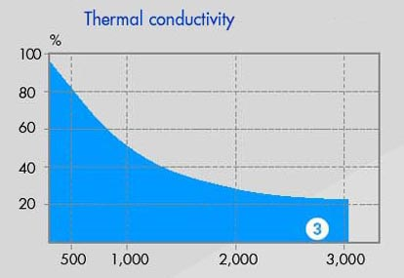
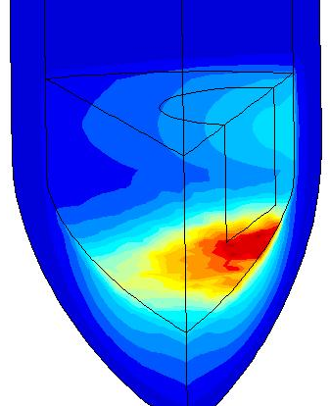
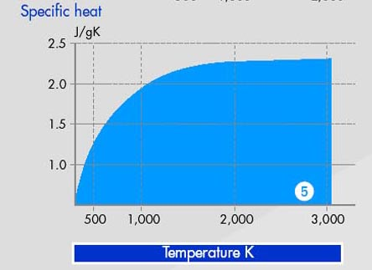
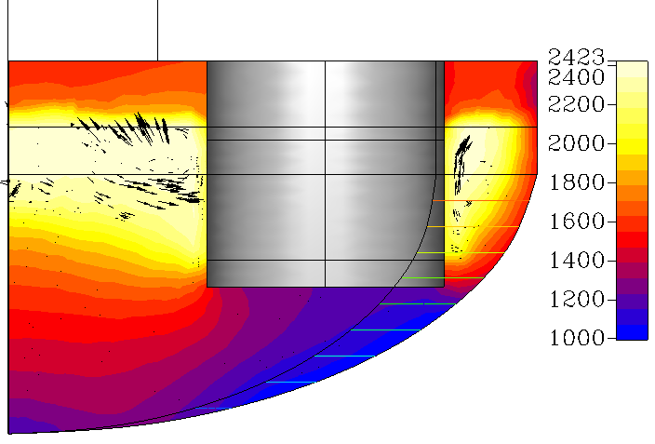
Comparison of results
Essential difference in resulting temperature fields by results of calculations NNC and NITI
NNC calculation
Hottest spot on the RPV wall placed below electrode bottom end
NITI calculation
Coldest spot on the RPV wall placed below electrode bottom end
It is necessary to find out the reason of this difference and to consider thermal properties
of graphite

Slide 3
Physics of an electric arch
It is necessary to mean, that electric arc is moving to the coldest zone at the steady gap between electrodes (effect of self-regulation)
It is impossible to consider this effect in calculations, its influence can be estimated only by results of measurements of the temperature field in RPV model wall during experiment

Slide 4
Shape of RPV model
Cylindrical model with flat bottom leads to the diminution of corium pool depth in the central zone
Heat loss from the central part of corium pool will be maximum due to necessity of provide the corium melt discharge (absence of thermal screen in the central part)
Notes. 1) Decrease of RPV model inner diameter is impossible due to corium jet character
2) Thin walled model (low mass of the model) will allow to add some corium components in the experimental section before corium melt discharge from EMF (addition of corium mass to be estimated)

Slide 5
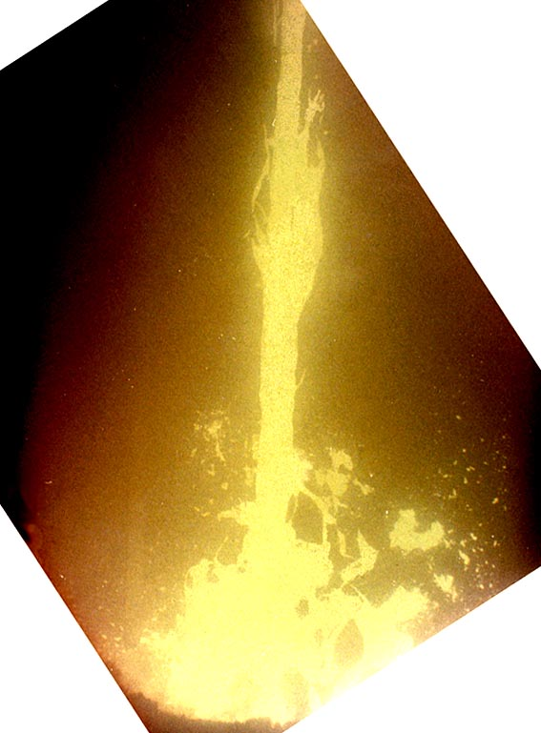
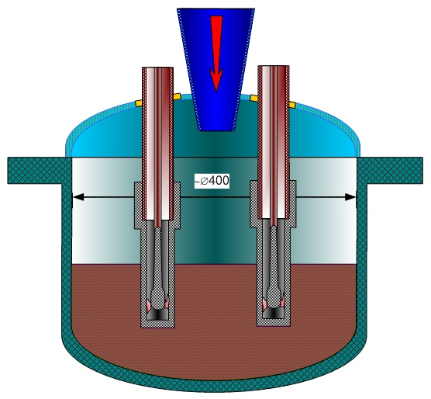
Shape of RPV model (2)
Too large value of cone angle can cause the blockage on the corium jet way
It is desirable to increase the corium pool depth in central part of pool due to absence of thermal screen
Corium jet view

Slide 6
Multi layer wall of RPV model
It is necessary to calculate thickness of a layer of ZrO2 which is necessary for maintenance of temperature on the external surface of an internal (reacting) steel insert up to about 600 deg. C
Influence of change of a gap width owing to thermal expansion will be then less, than more the thickness of intermediate (thermal insulating) layer
Notes. 1) Design of thermocouples will be more complex because we have to measure temperature field in the inner layer of steel mainly
2) The external layer of RPV model can be made of cheaper kind of steel since the internal layer will be investigated only
3) It is necessary to invent the method of ZrO2 layer thickness in several critical points during the test

Slide 7
Preliminary summary
Two-layer design of RPV model with hemi-elliptical bottom is more preferable from due to several reasons:
  Possibility of temperature increase in corium steel interface at existing parameters of LAVA-B facility
  More safe procedure of experiment performance in comparison with gas cooling an external surface of RPV model
It is necessary to distribute the results of discussion to the absent collaborators
It is necessary to perform ASAP additional calculation for elaboration some dimensions of two-layer model (thickness of inner steel layer interacting with corium; thickness of ZrO2 layer; thickness of outer steel layer)
Problem of RPV model design is open for discussion, but time for final decision is limited (up to middle of October 2006)

