Slide 1
FSUE SRI SIA “LUCH”
IBRAE RAS
OKB “GIDROPRESS”
I S T C
Status of the ISTC project #3690 on the “Fuel assemblies behaviour under severe accident top quenching conditions in the PARAMETER-SF test series”
(PARAMETER-SF3 and PARAMETER-SF4 experiments)
Presented by V. Nalivaev
CEG-SAM – 15, Villigen, Switzerland, March 10-12, 2009.

Slide 2
Progress reports
1. Status of the ISTC project #3690 on the “Fuel assemblies behaviour under
severe accident top quenching conditions in the PARAMETER-SF test series”
(PARAMETER-SF3 and PARAMETER-SF4 experiments):
Results of PARAMETER-SF3 experiment. (V. Nalivaev).
Results of SF3 pre- and post-test numerical modeling. (A. Kiselev).
Post-test examination of the SF2 and SF3 fuel assemblies. (T. Yudina).

Slide 3
FSUE SRI SIA “LUCH”
IBRAE RAS
OKB “GIDROPRESS”
I S T C
The results of the PARAMETER-SF3 experiment
(Status of ISTC Project # 3690)
Presented by V. Nalivaev

Slide 4
Objective of the PARAMETER-SF3 Test
The study of peculiarities of cooling and change in the structure of
materials of FA of VVER-1000, completed with standard reactor
structural materials (fuel rod claddings of alloy Zr+1%Nb, fuel pellets
of uranium dioxide, spaсer grids and shroud of alloy Zr+1%Nb),
under severe accident during top quenching of the assembly heated
to the temperature below 1600°С.

Slide 5
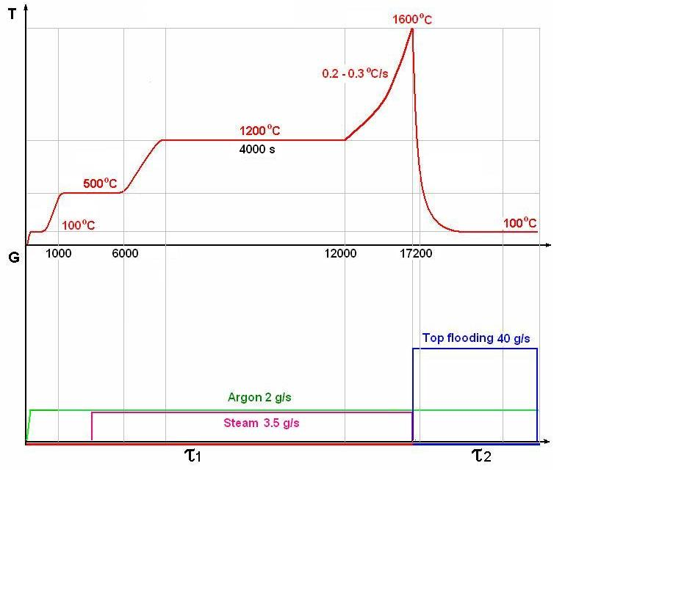
The PARAMETER-SF3 Test Scenario
Main parameters of the experiment
Sequence diagram of the experiment
Coolant | Steam/ argon
Flow rate of coolant, g/s | 3.5/2
Temperature of coolant, °C | ∼500
Heating rate of cladding, °C /s | 0.2- 0.3
Temperature of cladding at the pre-oxidation phase, °C | ∼1200
Duration of the pre-oxidation phase, s | ∼ 4000
Maximal temperature of cladding, °C | 1600
Quenching phase | Top flooding
Flow rate of top flooding, g/s | ∼ 40

Slide 6
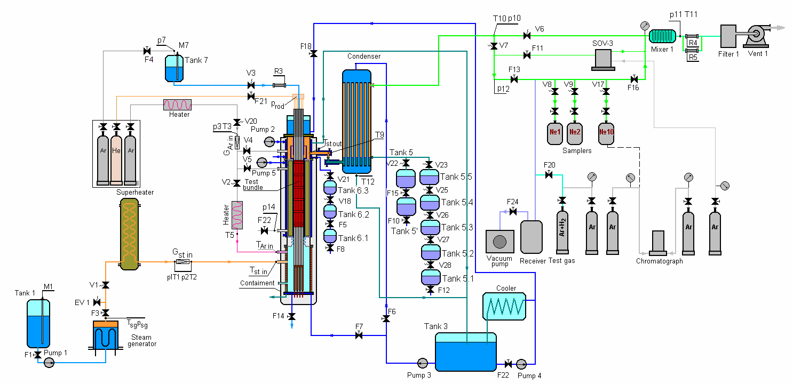
PARAMETER Facility
Main technological systems:

Slide 7
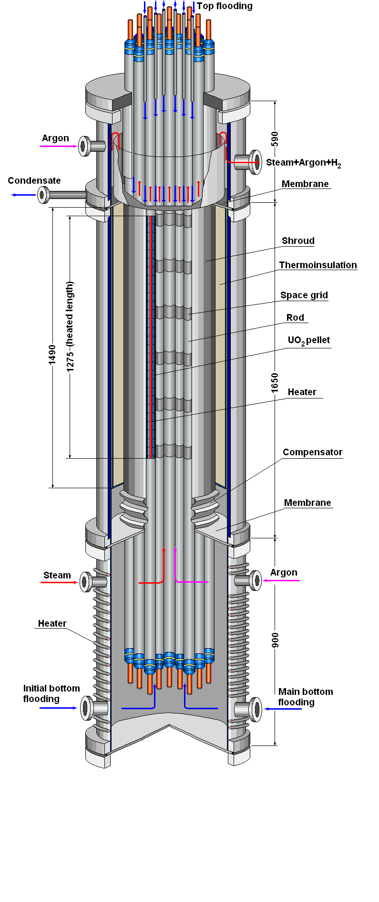
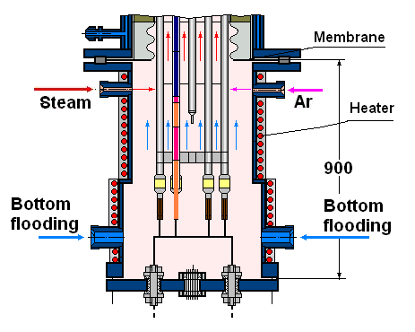
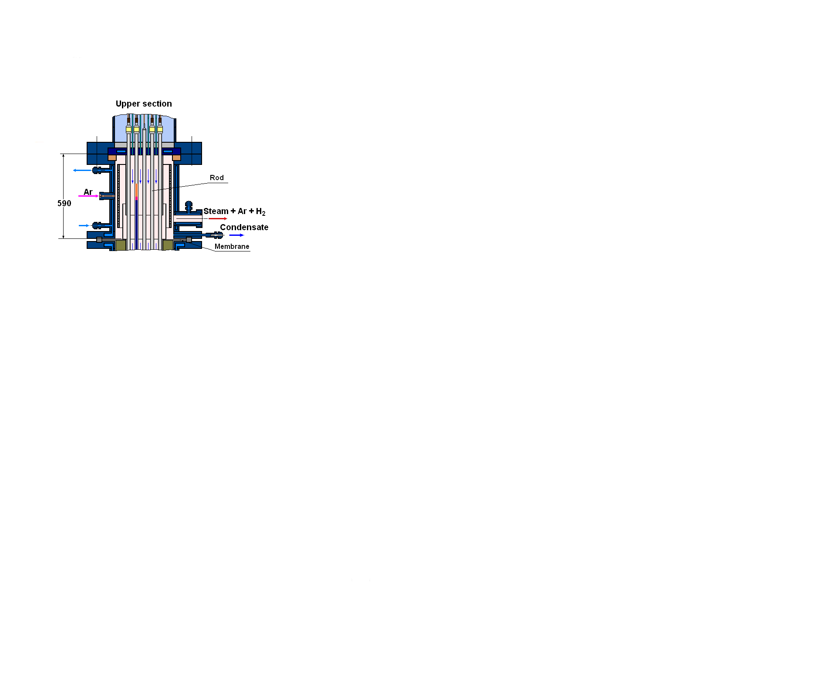
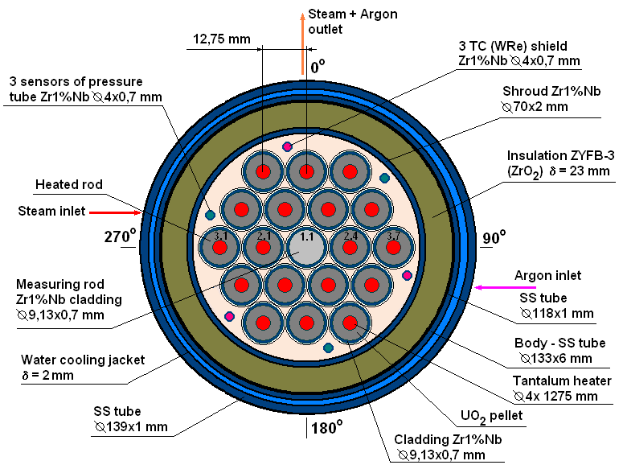
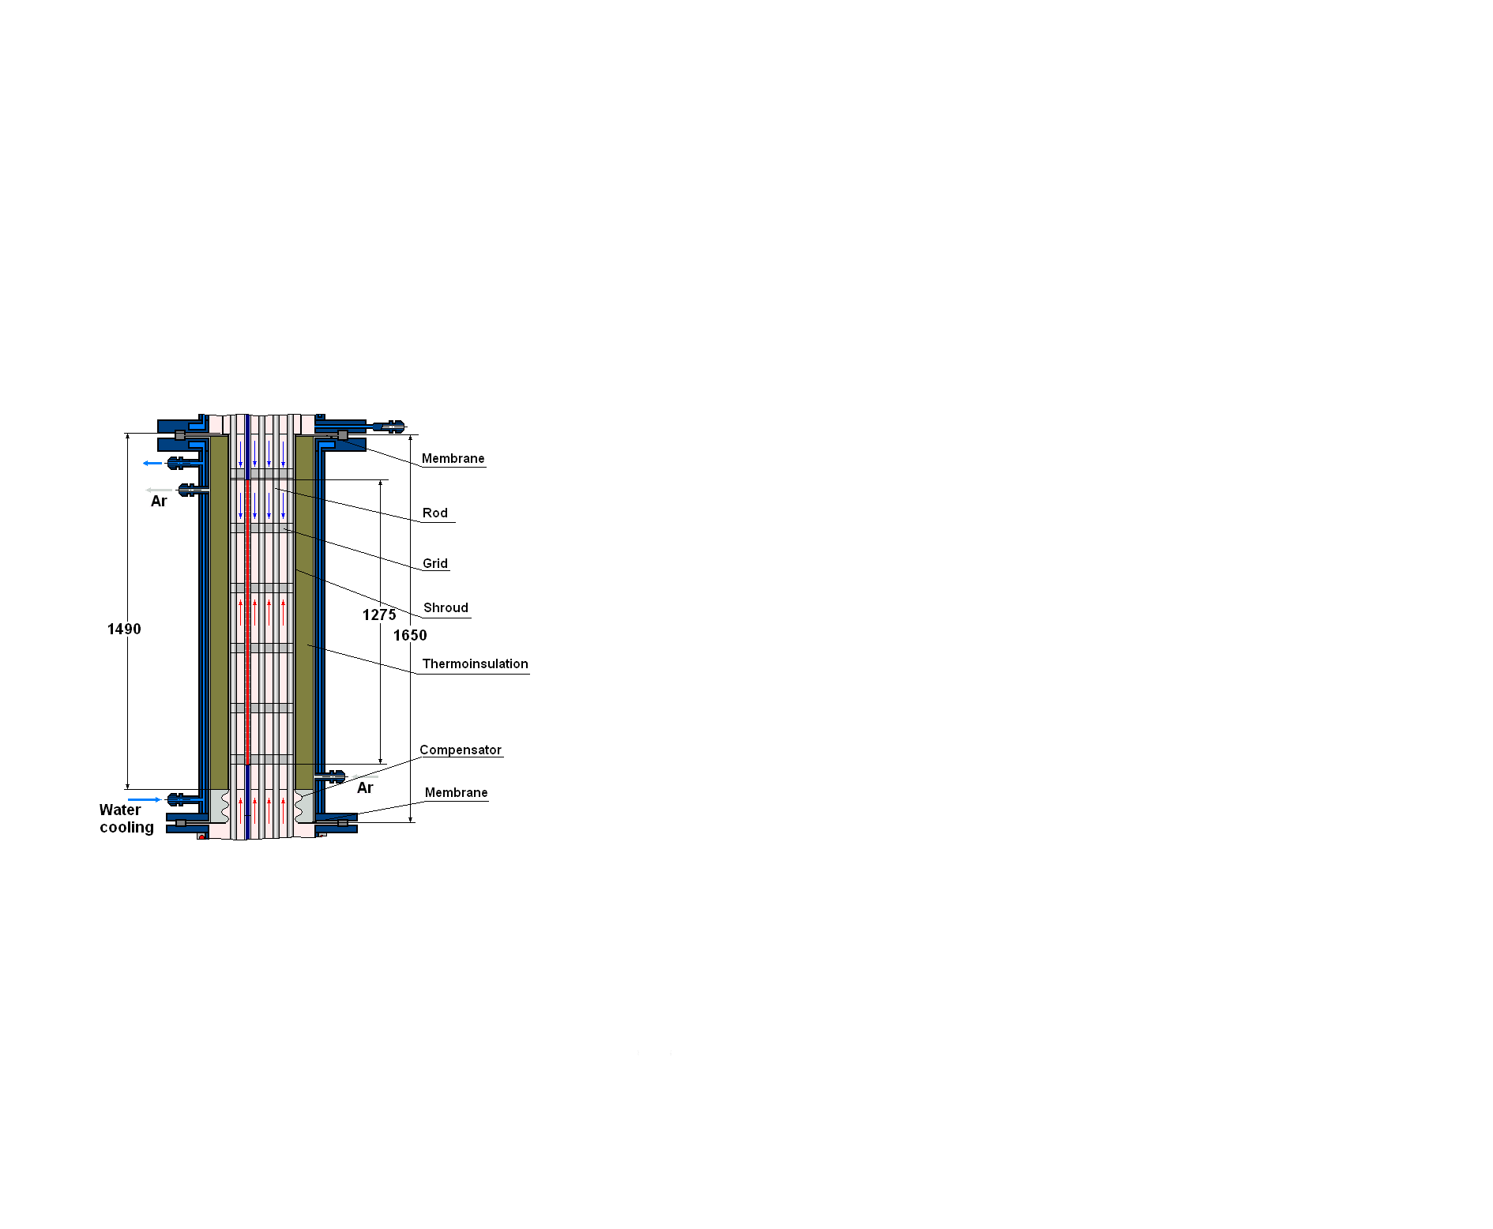
Test facility
1. Test section
Lower part
Middle part
Upper part
The upper water-cooled part provides:
- input rods and TC;
- top flooding;
- input of argon at quenching phase;
- output steam-gas mixture;
- gathering of a condensate and the control of volume of emission of water of the top flooding;
- tight division of the top and middle parts.
The lower heated part
provides:
- separate input steam and argon;
- heating up to temperature
of steam saturation
(Т ∼ 400-410 K at p ∼ 0,30-0,35 МПа);
- bottom flooding.
The middle water-cooled part provides:
- pass steam-gas mixture only through the bundle;
- tightness thermoinsulation and the control of pressure of argon inside of the free space of the thermoinsulation;
- compensation of temperature axial displacements of the shroud .

Slide 8
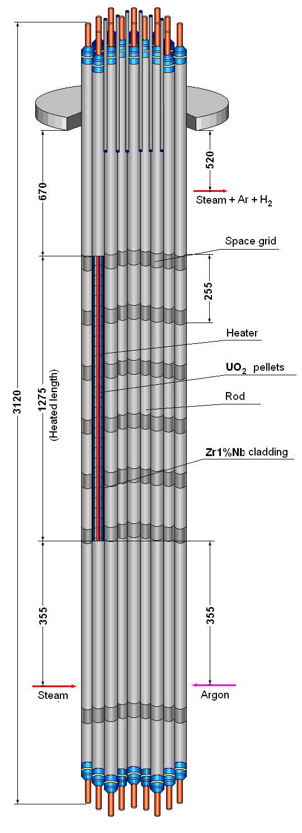
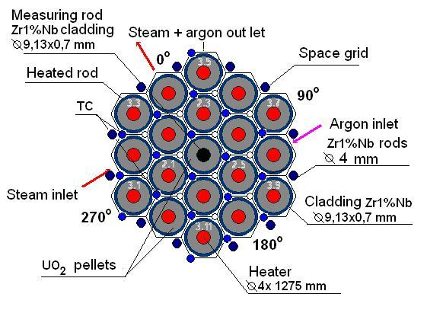
Test Bundle
The main technical characteristics
General view
Type VVER-1000
Number of rods 19
- heated 18
- unheated 1
Rods
- cladding, mm ∅ 9,13/7,73 (Zr1%Nb)
- pellets UO2
- heater ∅ 4/1275 (Ta)
Grid type triangle
- grid pitch, mm 12.75
Spacing grid Zr1%Nb
- height, mm 20
- spacing, mm 255
Shroud Zr1%Nb
- thickness, mm 1,2
- diameter/height, mm 69,7/1450
Thermoinsulation ZrO2 ZYFB-3
- thickness, mm 23
- diameter/height, mm 116/1450

Slide 9
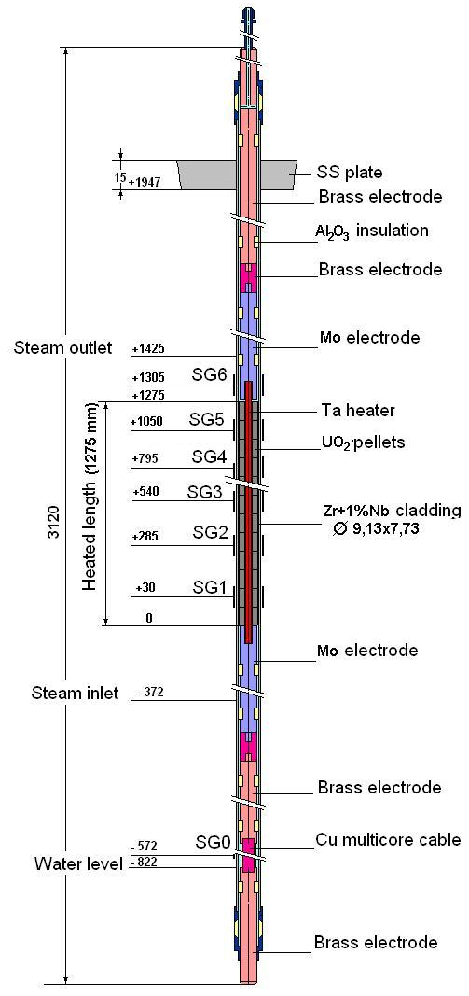
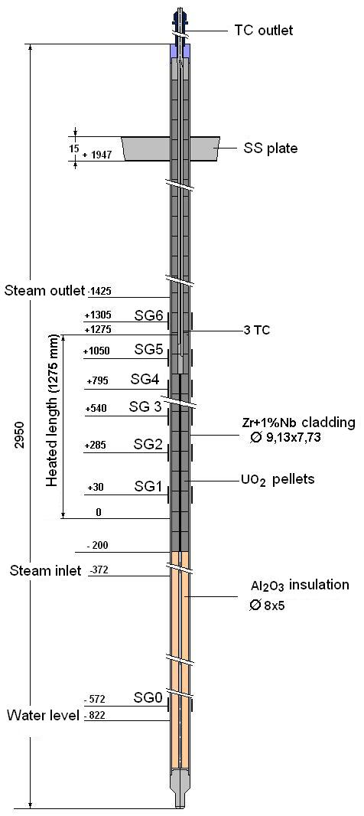
Test rods
Heated rod
Unheated rod

Slide 10
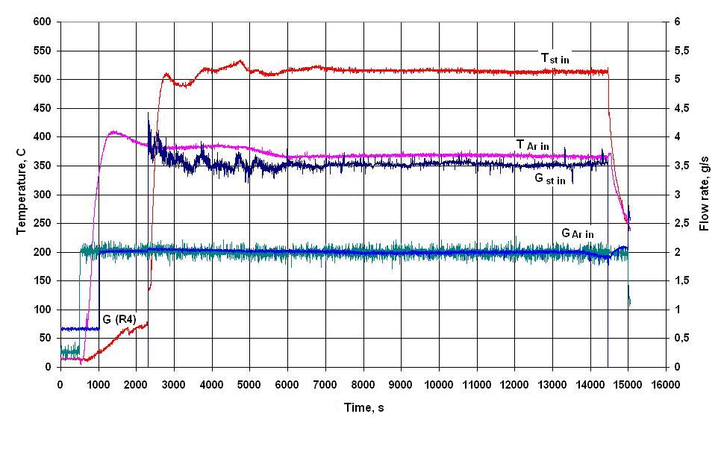
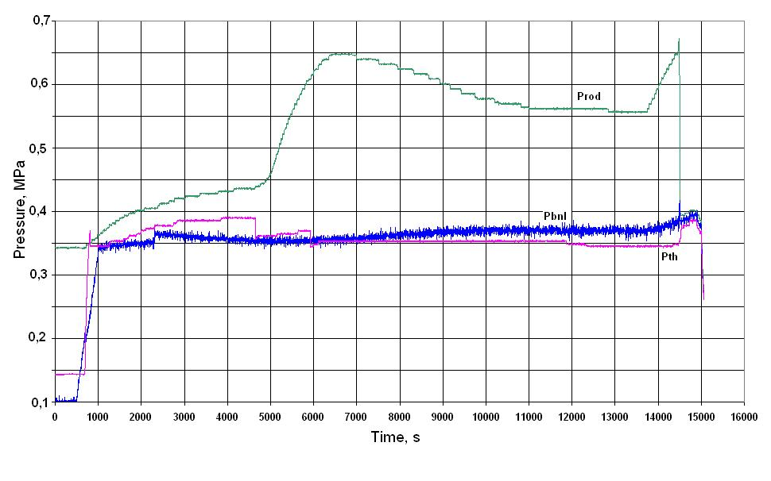
Some results of the PARAMETER-SF3 Test
1. Steam and argon parameters
Gst in = 3.5 g/s Tst in = 500 °C
Gar in = 2.0 g/s Tar in = 400 °C
pbnl = 0.37 MPa
pth = 0.35 MPa

Slide 11
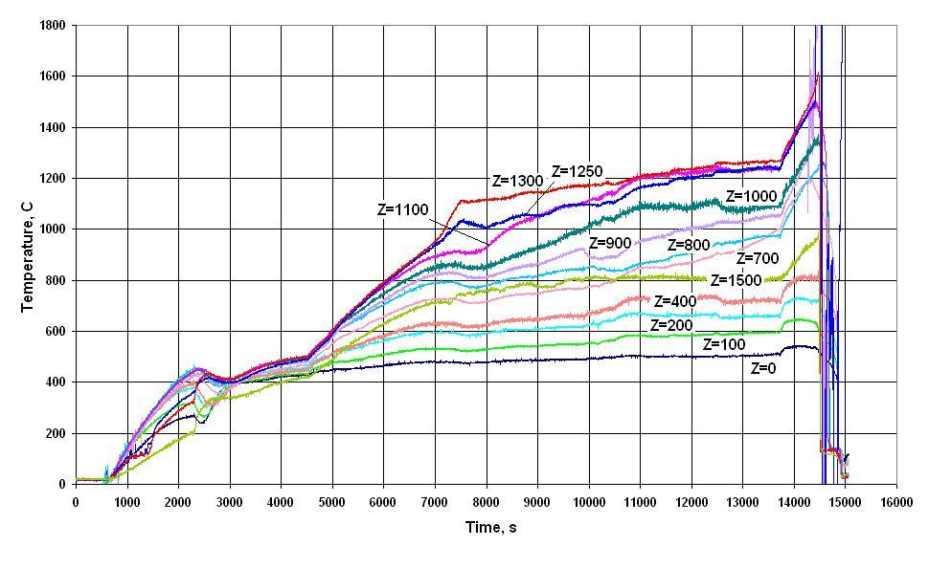
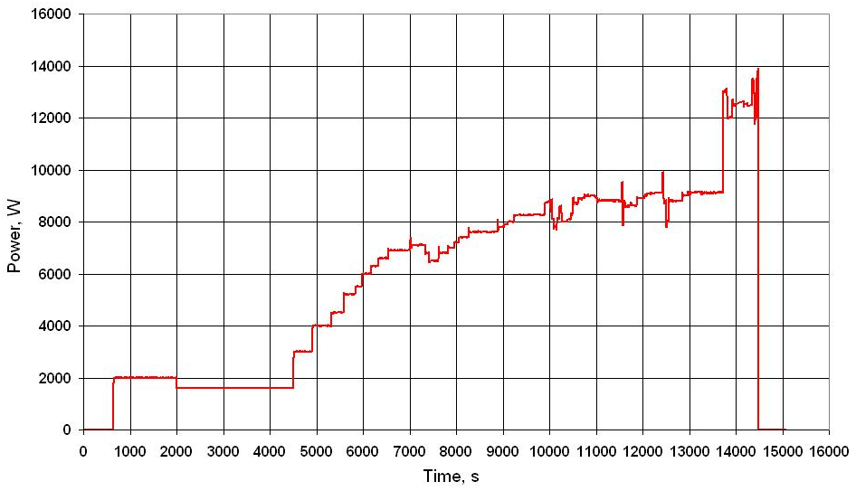
2. Main Test parameters
Bundles temperature
Electrical power

Slide 12
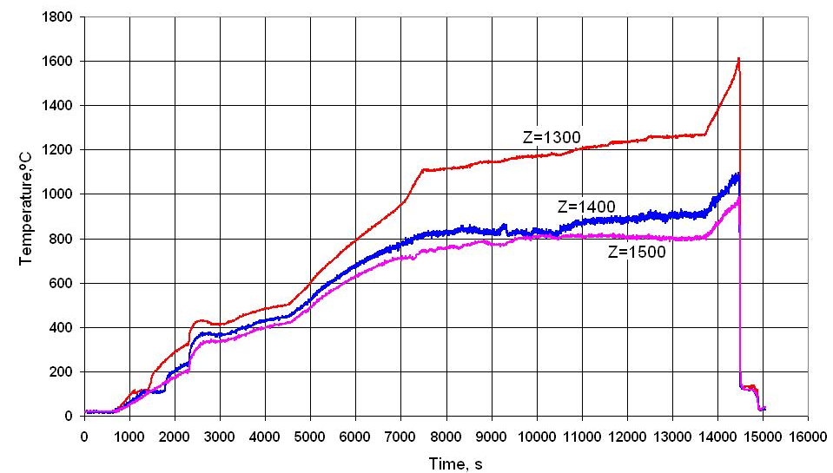
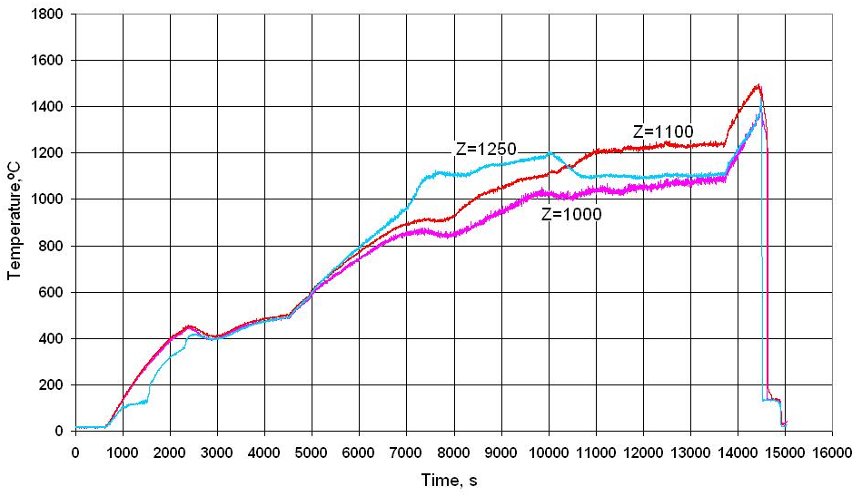
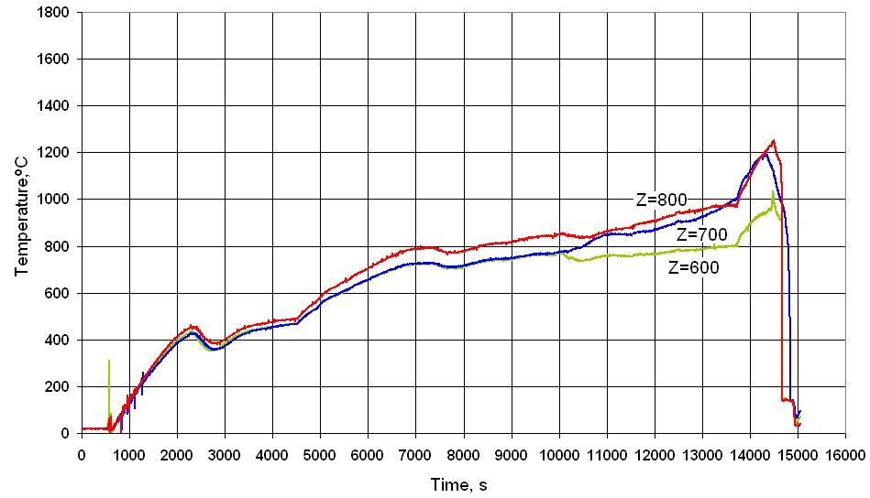
3.1. The claddings temperature during a pre-oxidizing and transient stages
Elevations 1300 – 1500 mm
Elevations 1000 – 1250 mm
Elevations 600 – 800 mm

Slide 13
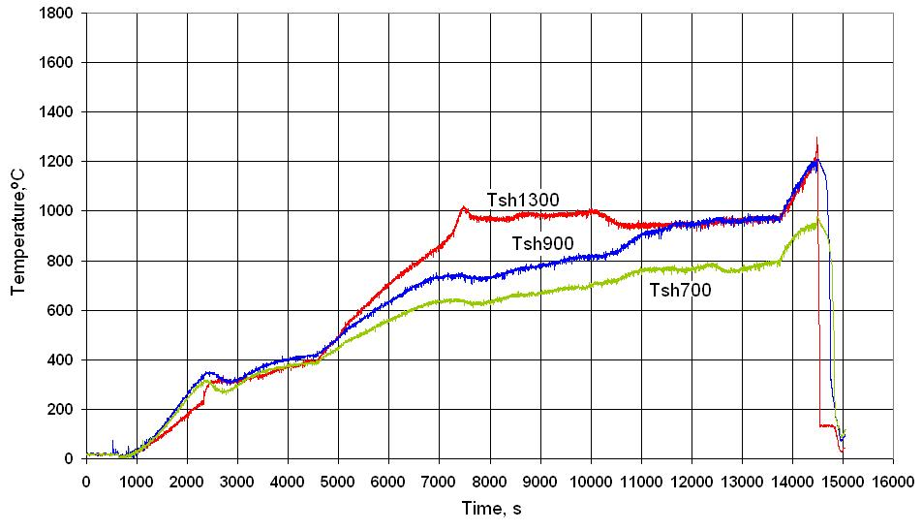
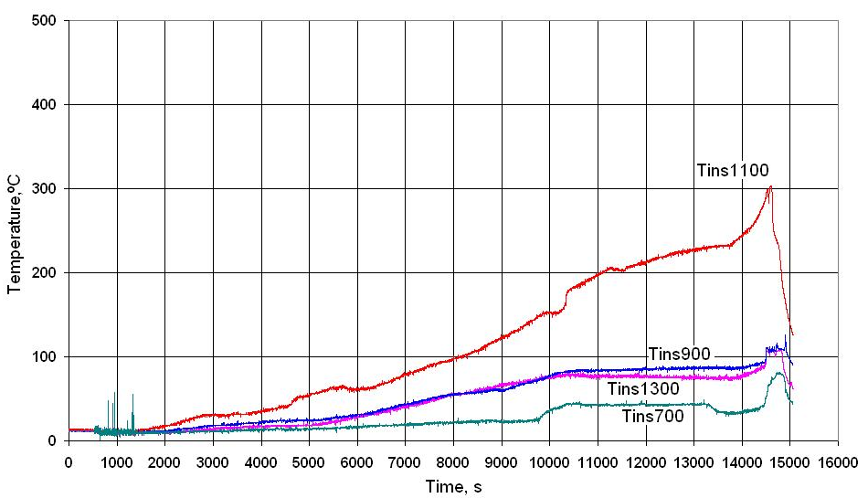
3.2. The bundle component temperature during
a pre-oxidizing and transient stages
Shroud (Tsh) temperature
Thermoinsulation
(Tth) temperature

Slide 14
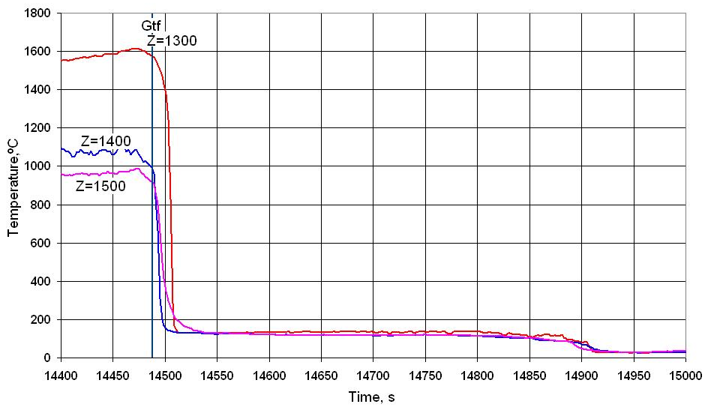
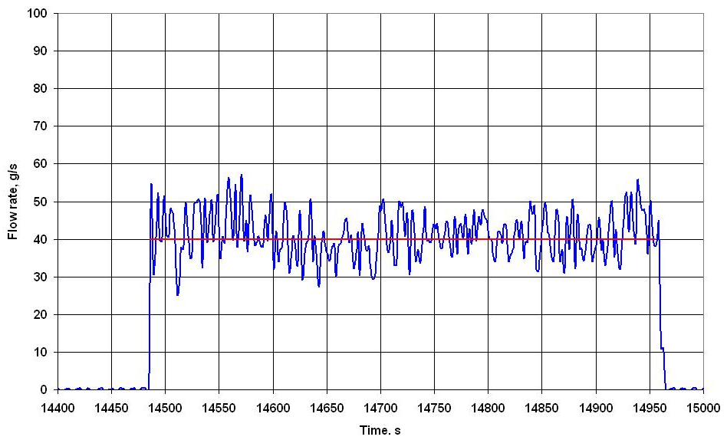
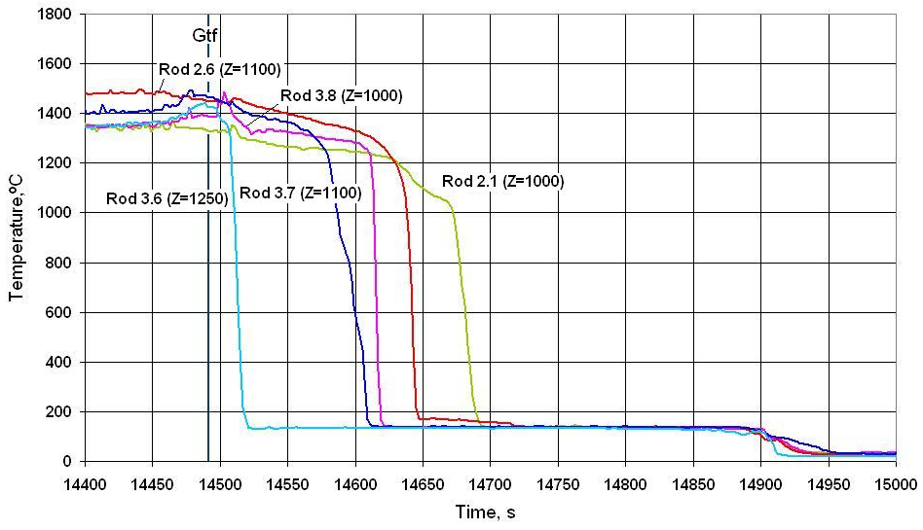
4. Top flooding
4.1. The claddings temperature during quench stage (elevations 1000 – 1500 mm)
Elevations 1300 – 1500 mm
Top flooding Gtf ≈ 40 g/s
Elevations 1000 – 1250 mm

Slide 15
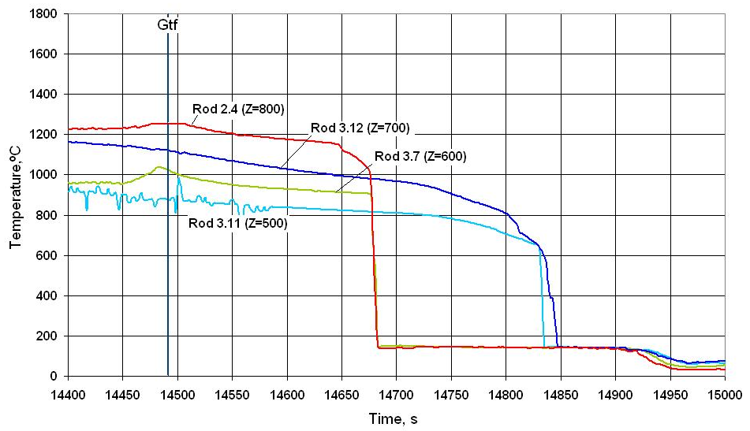
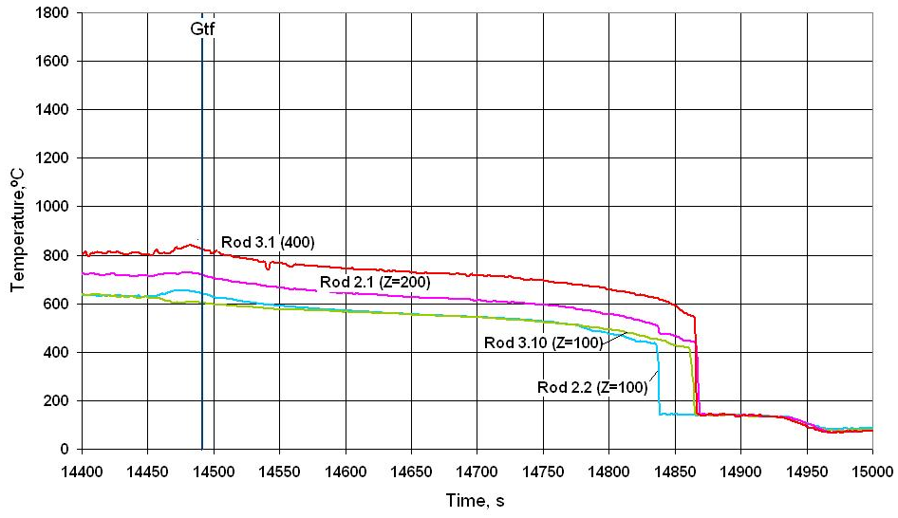
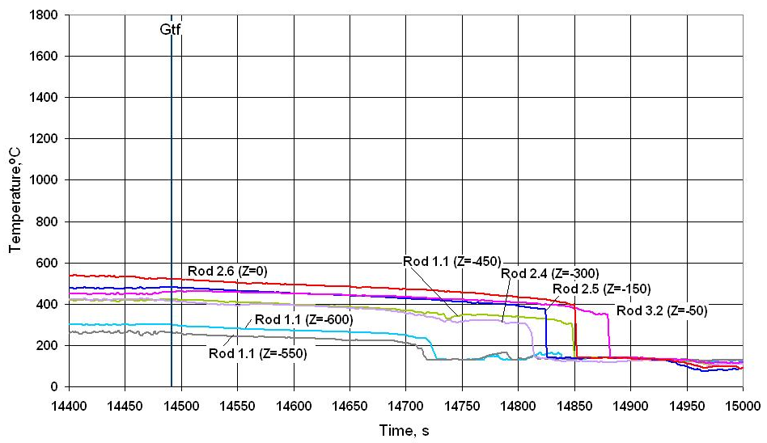
4.2. The claddings temperature during quench stage (elevations -600 – 800 mm)
Elevations 500 – 800 mm
Elevations 100 – 400 mm
Elevations - 600 – 0 mm

Slide 16
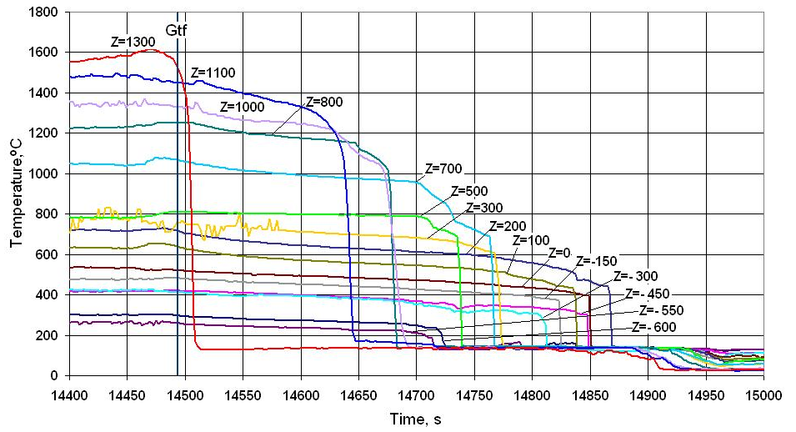
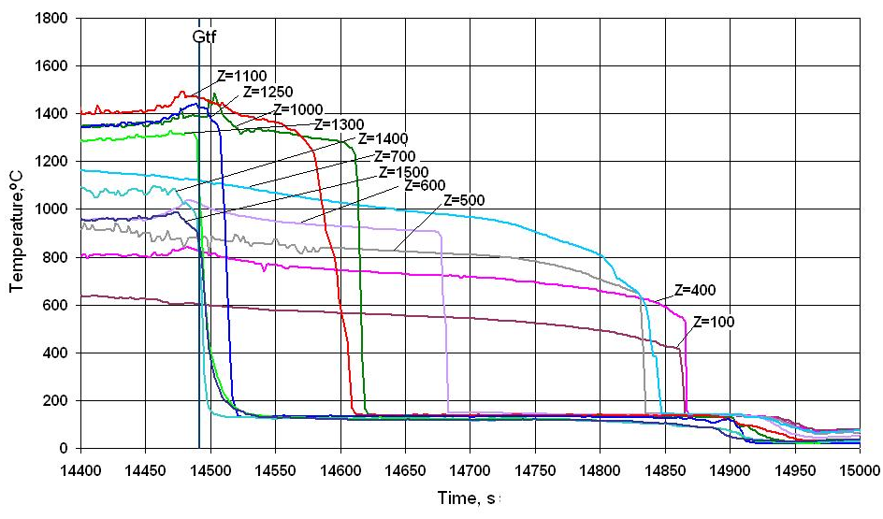
4.3. The cladding temperature history during quench stage
(second and third rows)
Rods of 2nd row
Rods of 3th row
Operating time of top flooding system 470 s.
Time of cooling of FA up to ~ 130°С - 360 s.
[

Slide 17
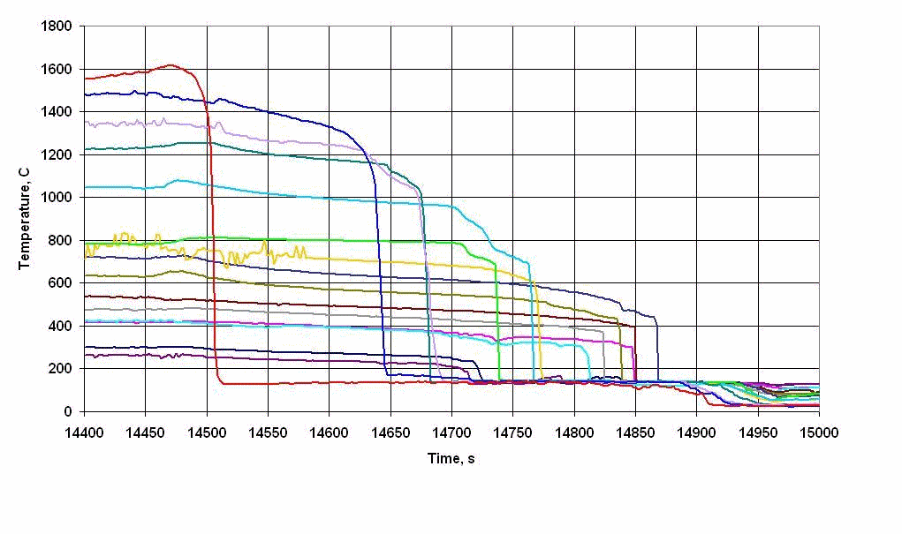
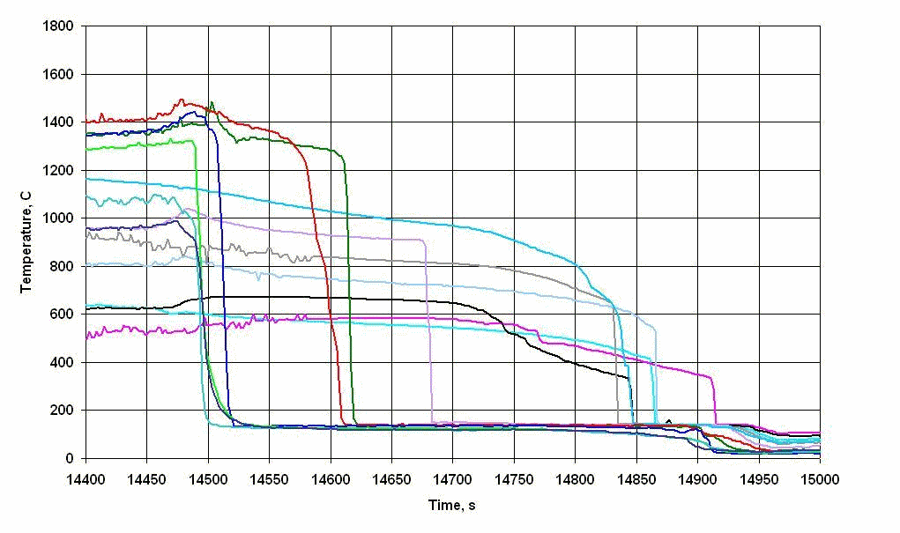
4.3. The cladding temperature history during quench stage
(second and third rows)
Rods of 2nd row
Rods of 3th row
Operating time of top flooding system 470 s.
Time of cooling of FA up to ~ 130°С - 360 s.
Z
[

Slide 18
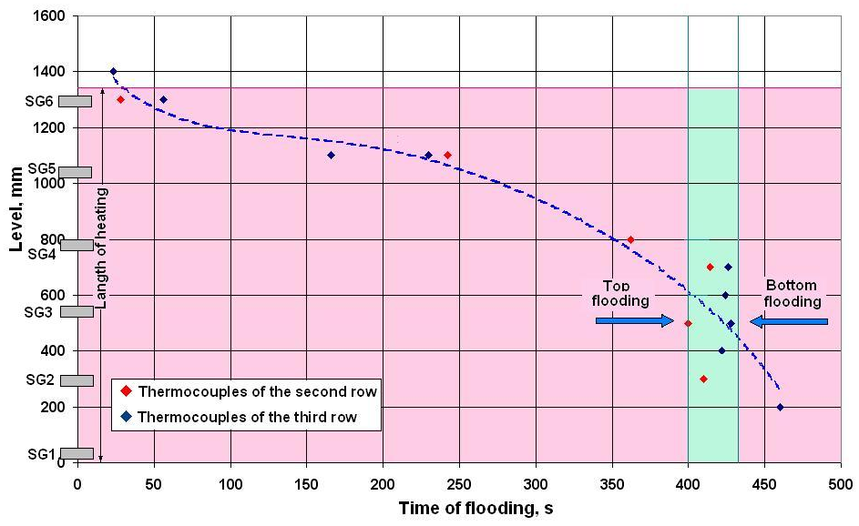
4.4. The top flooding of bundle up to ∼130°С
Z

Slide 19
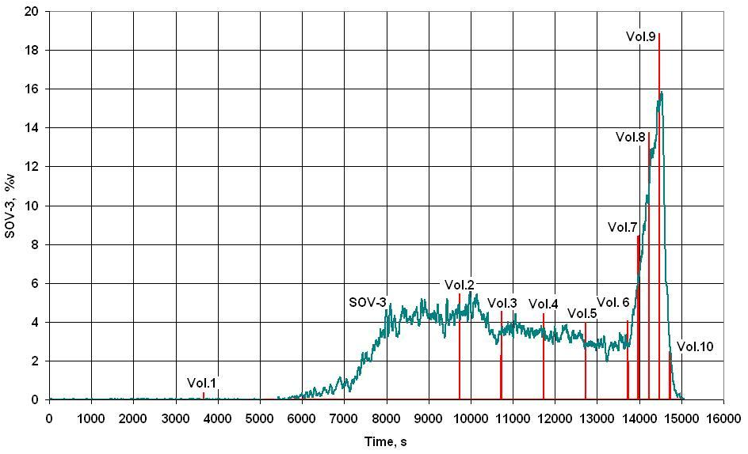
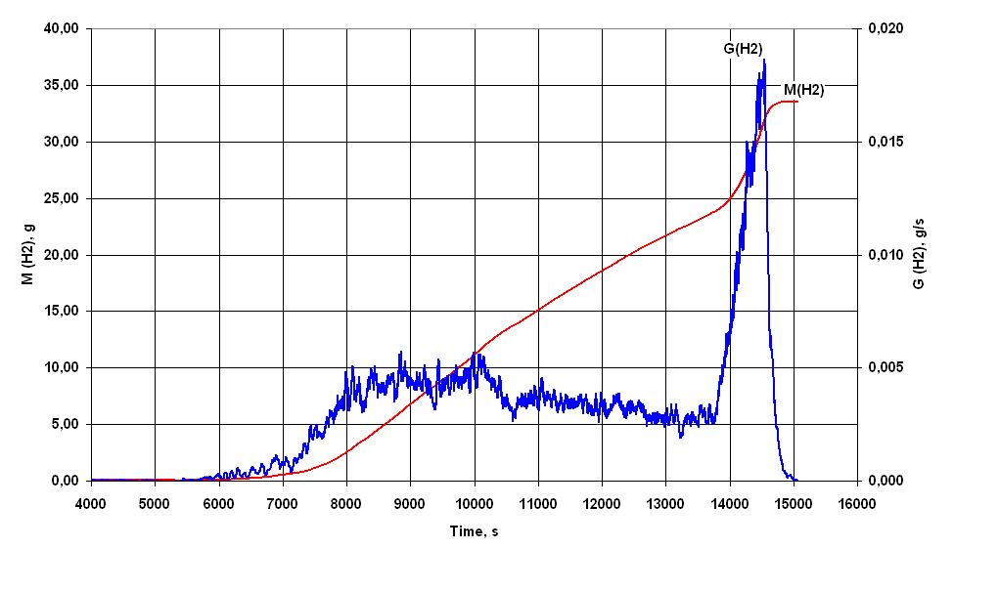
5. The results of measuring of the hydrogen generation
Variation of volumetric hydrogen
concentration versus time
№ | Time, s | Volumetric hydrogen concentration (Vol.), % | Volumetric hydrogen concentration (SOV-3), %
Vol.1 | 3662 | 0.37 | -
Vol.2 | 9735 | 5.46 | 2,7
Vol.3 | 10727 | 4.55 | 3,43
Vol.4 | 11727 | 4.46 | 3,54
Vol.5 | 12726 | 4.00 | 2,9
Vol.6 | 13728 | 4.06 | 2,73
Vol.7 | 13978 | 8.43 | 6,26
Vol.8 | 14228 | 13.78 | 10,3
Vol.9 | 14478 | 18.84 | 15,2
Vol.10 | 14728 | 2.47 | 2,85
Regeneration rate and
mass of evolved hydrogen

Slide 20
CONCLUSIONS
1. Experiment PARAMETER-SF3 on simulating the initial stage of severe accident, including the stage of the top flooding, has been carried out.
2. The main parameters of experiment:
- the steam flow rate ~ 3.5 г/с at temperature ~ 500 °С;
- the argon flow rate ~ 2.0 г/с at temperature ~ 400 °С;
- the duration of the pre-oxidation stage ~ 3970 s at temperature ~ 1200 °С;
- the maximal temperature of the bundle - 1600°С at maximal heating rate ~ 0.5 °С/с.
3. The total of hydrogen measured by continuous monitoring systems of hydrogen (SOV-3), has not exceeded ~34 g.
4. The cooling overheated up to ~ 1600°C of the bundle has been achieved for
~ 470 s at the water flooding from top with flow rate ~ 40 g/s.
5. Conservation and preliminary cutting of the bundle has been carried out.

Slide 21
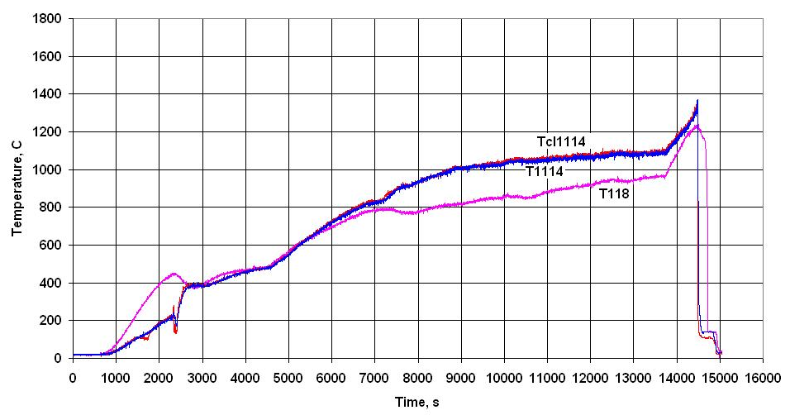
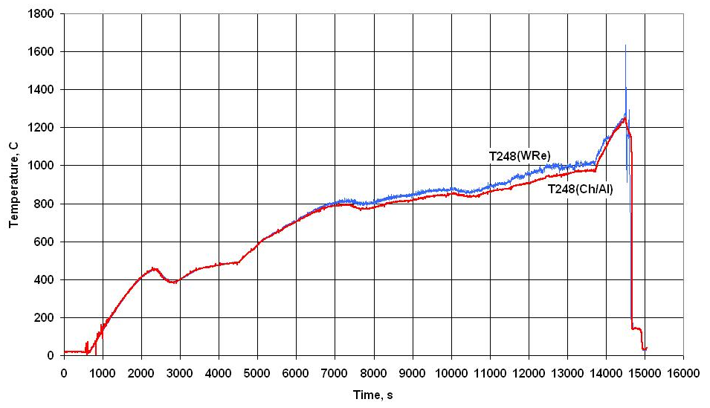
3.3. The bundle component temperature during
a pre-oxidizing and transient stages
The indications of thermocouples
on cladding and
inside of rod 1.1 at a level 1400 mm
The indications of thermocouples
(WRe) and (Ch/Al) of rod 2.4
at a level 800 mm

Slide 22
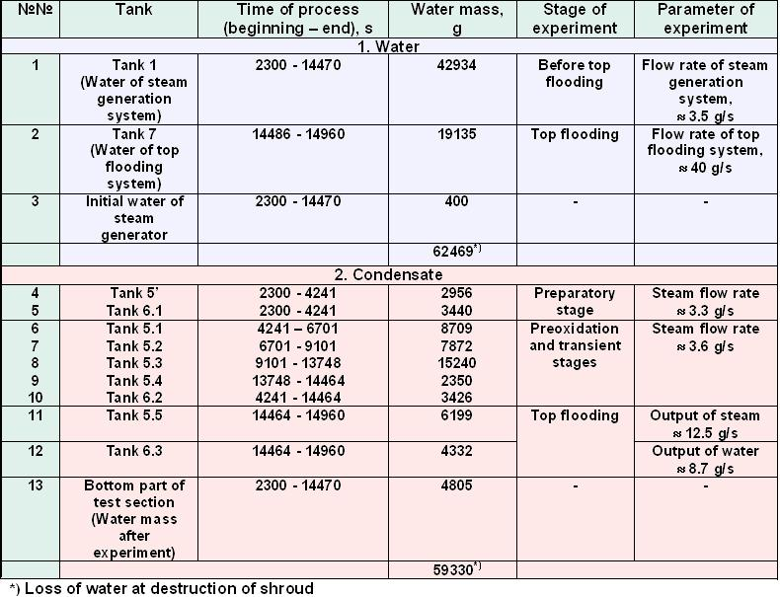
4.4. Results of measurement of weight of water in control tanks

