Slide 1
FSUE SRI SIA “LUCH”
IBRAE RAS
FSUE EDO “GIDROPRESS”
I S T C
Study of fuel assemblies under severe accident
top quenching conditions
in the PARAMETER-SF test series
(Project status # 3690 ).
Presented by W. Nalivaev
14th CEG-SAM Meeting , Kiev, Ukraine,
September 9-11, 2008.

Slide 2
The Structure of Project
1. The basis:
- The decision on financial support of the Project # 3690 from ISTC 13.07.2007,
- The agreement under the Project # 3690 between ISTC and FSUE SRI SIA “LUCH” 01.12.2007.
2. The basic participants:
FSUE SRI SIA “LUCH”
IBRAE RAS
FSUE EDO “GIDROPRESS”
3. Another participants:
A.A. Bochvar FSUE VNIINM,
A. I. Leipunsky SSC RF-IPPE,
RSC “Kurchatov Institute”
4. Foreign collaborators: FZK, GRS, EdF, INRNE, ITU, PSI, AEKI, CEA

Slide 3
Objective of Project
The study of behaviour of two 19-fuel rod model FAs of WWER-1000,
completed with standard reactor structural materials
(fuel rod claddings of alloy Zr+1%Nb, fuel pellets of uranium dioxide,
spaсing grids and shroud of alloy Zr+1%Nb), under the initial stage
of severe accident with top quenching.

Slide 4
Work Plan of Project
Task 1. The post-test material analysis of WWER-1000 model FA,
subjected to tests in experiment PARAMETER-SF2 under severe
accident with top and bottom quenching.
(December 2007 – November 2008).
Task 2. The study of peculiarities of cooling and change in the structure
of materials of FA of WWER-1000 under severe accident during top
quenching of the assembly heated to the temperature below 1600°С
(PARAMETER-SF3).
(December 2007 – November 2008).
Task 3. The study of behaviour of FA of WWER-1000 under severe
accident during top quenching of the assembly heated up to the
temperature 1800°C in the environment of air (PARAMETER-SF4).
(December 2008 – November 2009).

Slide 5
Program of ISTC SAM-Workshop (topical meeting)
14-17.07.2008, Moscow-Podolsk (project # 3690).
1. Study of Fuel Assemblies under Severe Accident Top Quenching
Conditions in the PARAMETER-SF Test Series. V. Nalivaev (LUCH).
2. Specification of the PARAMETER-SF3 experiment. T. Yudina (IBRAE).
3. Comparison results of post-test calculations of the PARAMETER-SF2 test.
T. Yudina (IBRAE).
4. PARAMETER-SF3 pre-test calculation with ATHLET-CD.
W. Erdmann (GRS).
5. PSI analytical support for PARAMETER SF-4: Status and plans.
J. Birchley (PSI).
6. PARAMETER facility presentation. V. Konstantinov (LUCH).
7. The annual ISTC Workshop, devoted to the ISTC projects/ related to
SEVERE ACCIDENT MANAGEMENT (in the frames of the CEG-SAM
THE CONTACT EXPERT GROUP. L. Tocheny (ISTC).

Slide 6
Participants of meeting
Birchley Jonathan, (PSI), Switzerland
Bottoley Paul David, (ITU), Germany
Erdmann Walter, (GRS), Germany
Groβe Mirco, (FZK), Germany
Stuckert Juri, (FZK), Germany
Lamy Jean Sylvester, (EdF), France
Beuzet Emilie, (EdF), France
Vimi Andras, (AEKI), Hungary
Windberg Peter, (AEKI), Hungary
Tocheny Lev, (ISTC), Russia
Bychkova Anna, (ISTC), Russia

Slide 7
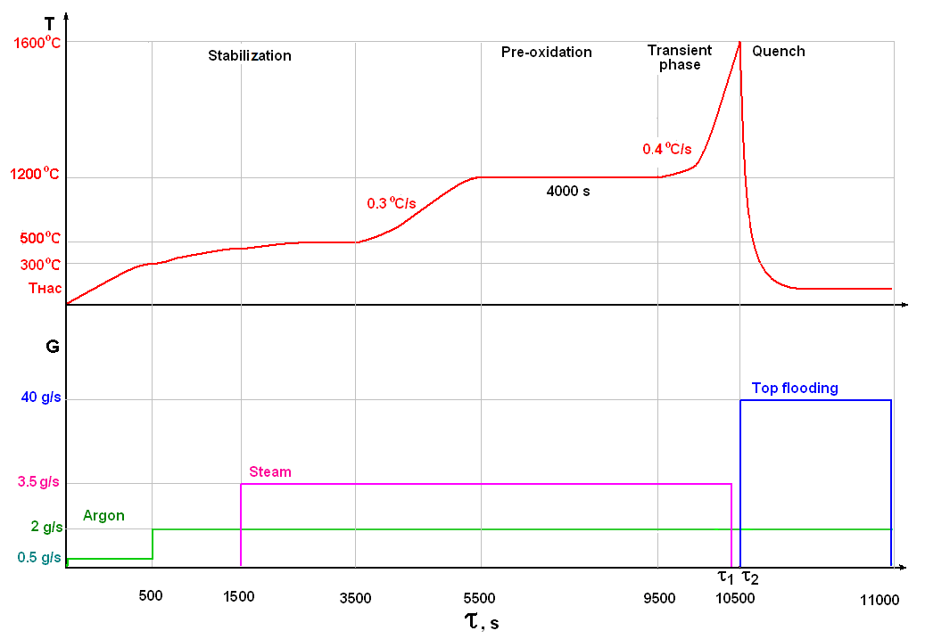
PARAMETER-SF3 experiment
Diagram of PARAMETER-SF3 Test

Slide 8
The scenario of experiment PARAMETER-SF3
No. | Stage | Main parameters
 |  | FA temperature, K | Medium | Heating rate | Time, s
1 | Joule heating up of FA in argon flow | ∼300-670 | Argon flow at temperature to 720K (argon flow rate - 2 g/s) | - | 0-1500
2 | Joule heating up of FA in the flow of steam-argon mixture | 670∼770 | Steam-argon mixture (argon/steam flow rate - 2/3,5 g/s, at temperature of 720/770K) | - | 1500-3500
3 | FA heating up to 1470 K | 770∼1470 | Steam-argon mixture (argon/steam flow rate - 2/3,5 g/s, at temperature of 720/770К) | 0,3 K/s | 3500-5500
4 | FA pre-oxidation | ~ 1470 | Steam-argon mixture (argon/steam flow rate - 2/3,5 g/s, at temperature of 720/770K) | - | 5500-9500
5 | Assembly heating up to maximum temperature (transient phase) | 1470∼1870 | Steam-argon mixture (argon/steam flow rate - 2/3,5 g/s) | 0.4 K/s | 9500-10500
6 | Top flooding of the assembly (as soon as FA will reach Tmax=1870 К) | Up to saturation | Water (flow rate 40 g/s, water temperature ~ 290K) | - | As soon as design temperature will be reached

Slide 9
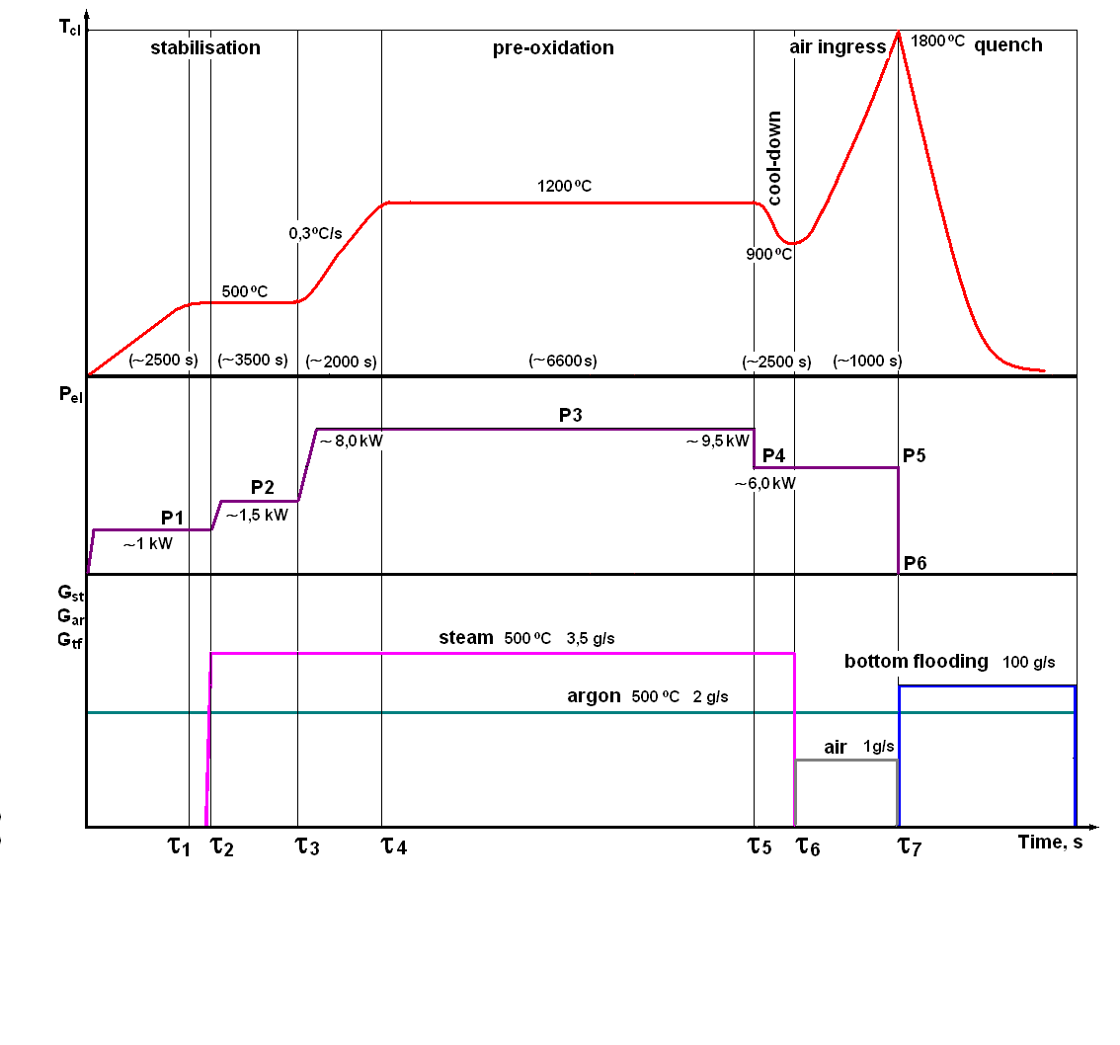
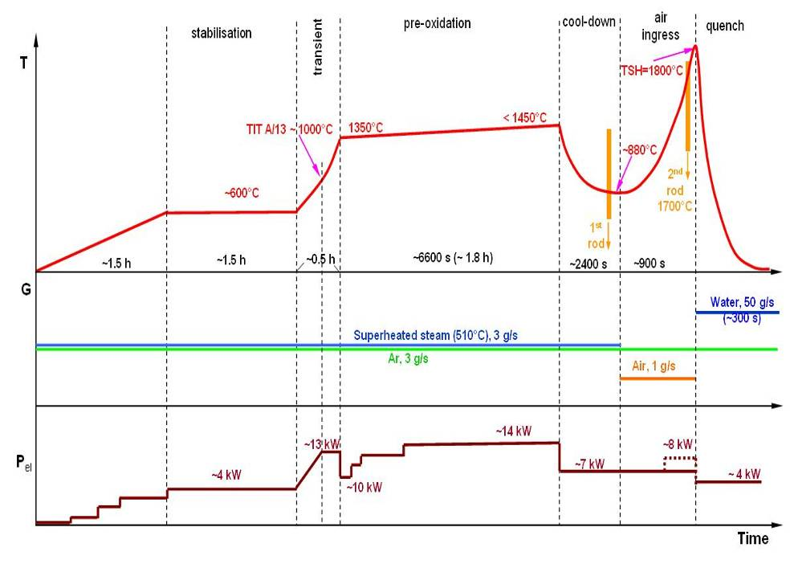
The scenarios of PARAMETER-SF4 and QUENCH-10
experiments
PARAMETER-SF4
experiment
QUENCH-10
experiment

