Slide 1
FSUE SRI SIA “LUCH”
IBRAE RAN
OKB “GIDROPRESS”
ISTC
The main results and conclusions
of the VVER fuel assemblies tests
under severe accident conditions
in the large-scale PARAMETER test facility
Ignatiev D.N., Konstantinov V.S., Soldatkin D.M., Nalivaev V.I.
FSUE SRI SIA “LUCH”, Podolsk
Kiselev A.E.,
IBRAE RAN, Moscow
Semishkin V.P.
OKB “GIDROPRESS”, Podolsk
CEG-SAM – 18, St. Petersburg, Russian Federation, September 28-30, 2010

Slide 2
The Structure of Project
The basis:
- The decision on financial support of the Project #3690 from ISTC 13.07.2007;
- The agreement under the Project #3690 between ISTC and FSUE SRI SIA “LUCH” 01.12.2007
The basic participants:
FSUE SRI SIA “LUCH”
IBRAE RAS
OKB “GIDROPRESS”
Another participants:
JSC “VNIINM”
SSC RF-IPPE
RSC “Kurchatov Institute”

Slide 3
Foreign Collaborators :
STUCKERT, Juri
(FZK) Germany
TROMM, Thomas-Walter
(FZK) Germany
BOTTOMLEY, David
(ITU) Germany
LAMY, Jean-Sylvestre
(EdF) France
ALLELEIN, Hans-Josef
(GRS) Germany
TRAMBAUER, Klaus
(GRS) Germany
BIRCHLEY, Jonathan
(PSI) Switzerland
SEILER, Jean-Marie
(CEA) France
GROUDEV, Pavlin
(INRNE) Bulgaria
HÓZER, Zoltán
(AEKI) Hungary

Slide 4
Objective, scope of activities , technical approach
THE OBJECTIVE
The objective of the Project is the study of behaviour of two 19- rod model FAs
of VVER-1000 type, made of standard reactor structural materials (fuel
rod claddings of alloy Zr+1%Nb, fuel pellets of uranium dioxide, spaсing grids
and shroud of alloy Zr+1%Nb), under the initial stage of severe accident with
top (experiment PARAMETER-SF3) and bottom quenching
(experiment PARAMETER-SF4).
THE SCOPE OF ACTIVITIES
Post-test material analysis of VVER-1000 model FA, tested in experiment PARAMETER-SF2 under severe accident conditions with top and bottom quenching
Study of peculiarities of cooling and change in the structure of materials of VVER-1000 FA under severe accident conditions during top quenching of the assembly heated to ∼1600°С (PARAMETER-SF3)
Study of behavior of a 19-rod model fuel assembly of VVER-1000 type under severe accident conditions with air ingress (PARAMETER-SF4)

Slide 5
The methodology of the tasks realization under the Project includes the following main stages:
development of the scenario and main goals of the experiments;
development of nodalization scheme and performing planning, pre- and posttest using SOCRAT, RELAP/SCADSIM, ICARE/CATHARE; ATHLET-CD; MAAP4; SCDAP/RELAP/IRS codes;
preparation of the model fuel assembly and facility process systems for the test conduction;
starting-up and adjustment (functional check of the process and information- measuring systems of the test facility systems, adjustment of test conditions for the process systems and technical parameters of model FA);
performing the experiments, processing of results;
materials studies.

Slide 6
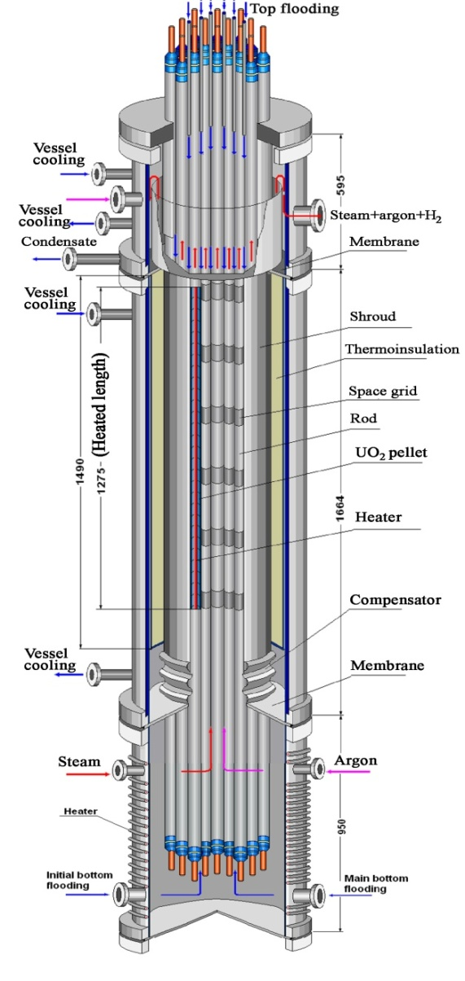
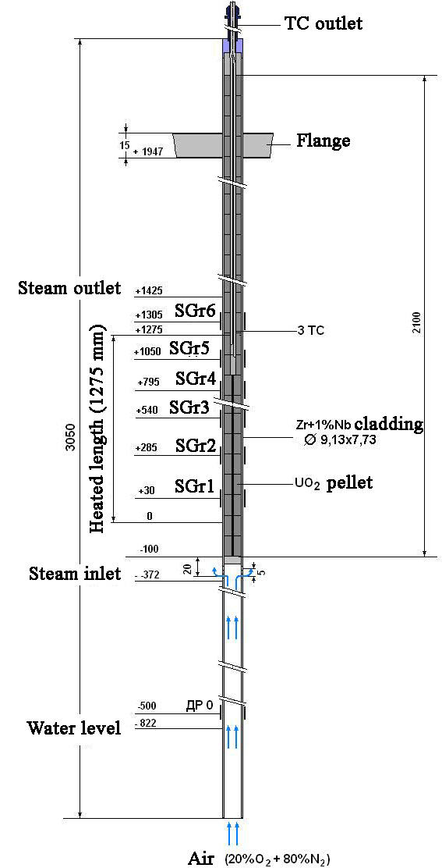
Model FA and fuel rod simulators
Test bundle
Heated rod
Unheated rod

Slide 7
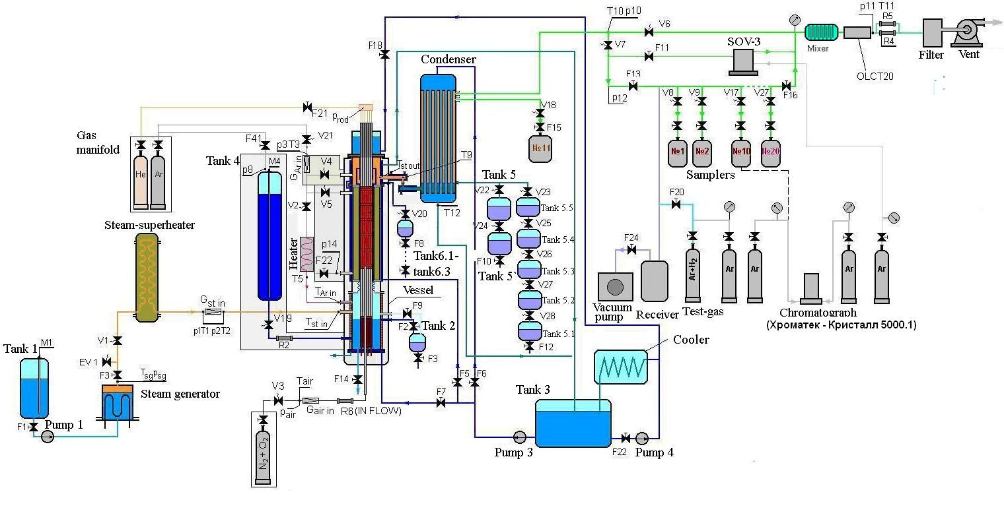
Functional diagram of the PARAMETER test facility

Slide 8
The main technical characteristics of test facility
Type of FA – VVER;
Electrical capacity – 30 KW;
Number of fuel rods – 19 pcs.;
Heated length – 1275 mm
The main technological systems:
separate lines for steam and water injection;
balance control of steam and water mass;
the top and bottom quenching ;
the hydrogen control;
the oxygen control.
Environment –superheated steam, argon, air;
Steam flow rate – to 0,2 g/s per rod;
The maximum of temperature – 2000°С;
Water flow rate for:
-bottom quenching – 100 g/s;
-top quenching - 50 g/s.

Slide 9
The hydrogen measurement system
Main design parameters of SOV-3:
gas mixture:
-carrier gas – argon;
-monitored gas – hydrogen;
- mixture pressure – 0.15 – 0.35 MPa;
- mixture flowrate – (8 – 25)⋅10⁻⁵ m³/min;
- effective range - 5⋅10⁻⁴ – 80 vol.%;
- transition time within the concentration range:
5⋅10⁻⁴ – 1⋅10⁻¹ vol.% ∼ 2 min;
≥1⋅10⁻¹ vol.% – 1 min.

Slide 10
The air monitoring system
Oxygen measurement
OLCT-20D
Gas monitored - О₂
Effective range 0 - 30 % v.
Main error ± 5%
Measurement of air flow rate
IN - FLOW
Control gas - (20 %) O2 + (80 %) N2
Range of measurements - 0 - 3,75 kg/h
Accuracy of measurements - ±0,5 %

Slide 11
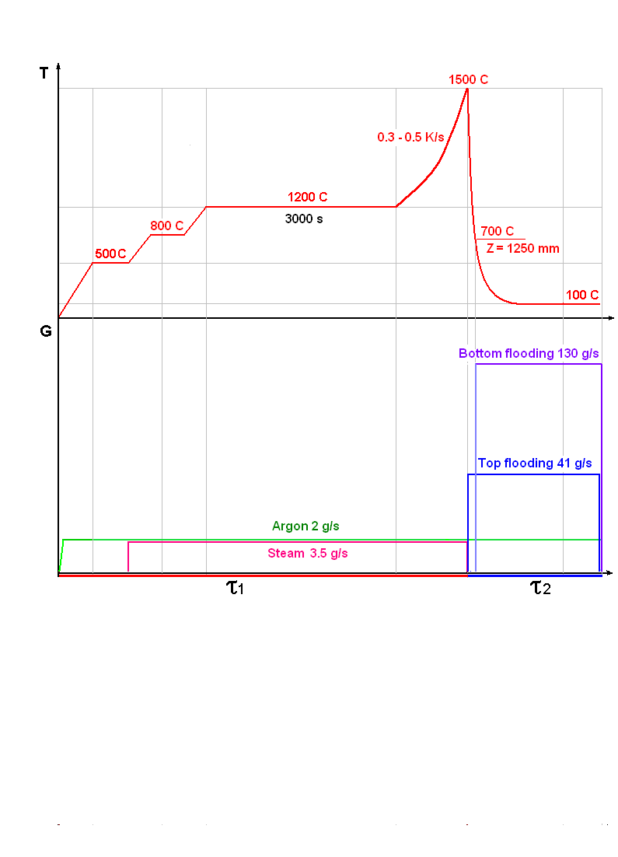
Main results of experiments
The experiment PARAMETER-SF2
The objective : study of behaviour of a 19-rod model assembly of VVER-1000 type under the conditions of initial stage of severe accident with the combined (top and bottom) quenching of FA overheated to 1500 C.
PARAMETER-SF2 test scenario
Main parameters of experiment
Coolant | Steam/ argon
Flow rate of coolant, g/s | 3/2
Temperature of coolant, К | ∼773
Heating rate of cladding, К/s | 0.3
Temperature of cladding at the pre-oxidation phase, К | 1473
Duration of the pre-oxidation phase, s | 4000
Maximal temperature of cladding, К | 1773
Quenching phase | Top and bottom flooding
Flow rate of flooding, g/s: - top - bottom | ∼ 40 ∼ 130
30с

Slide 12
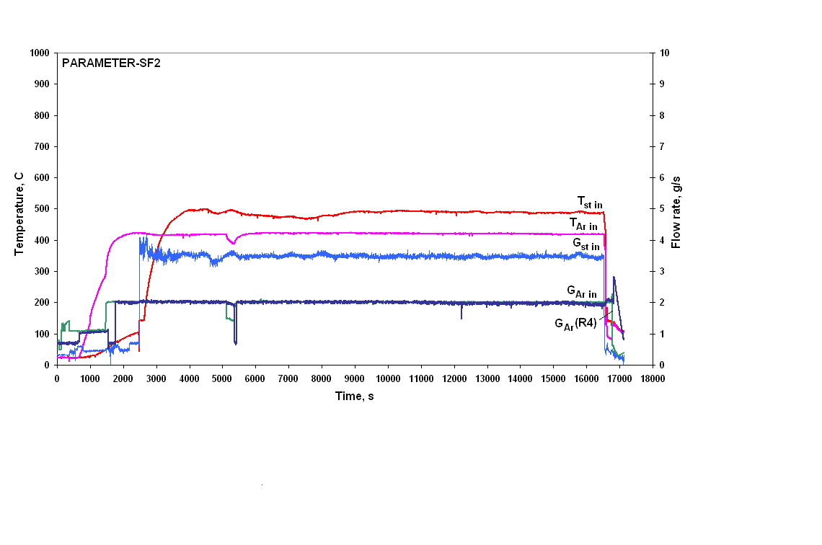
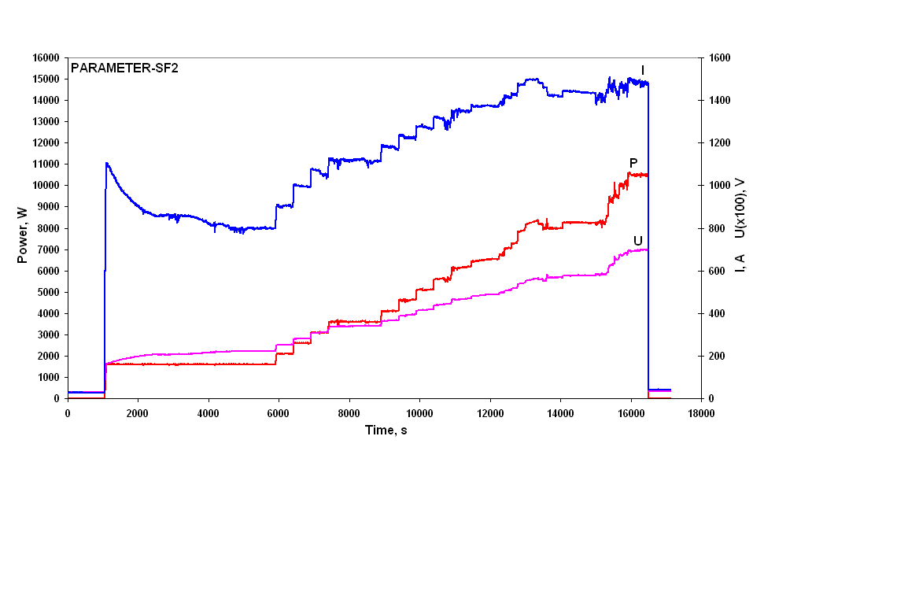
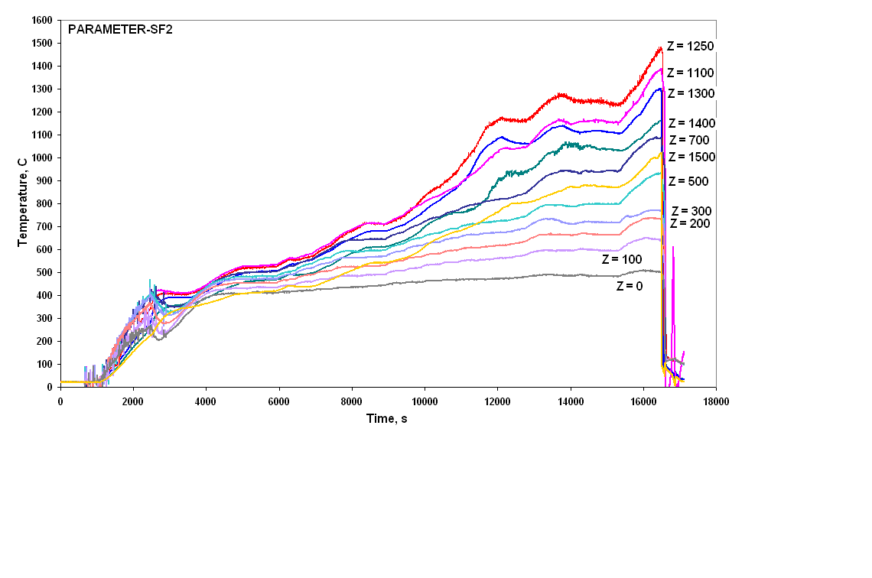
Main results of PARAMETER-SF2 experiment
Flow rate of steam and argon
Electrical power
The claddings temperature

Slide 13
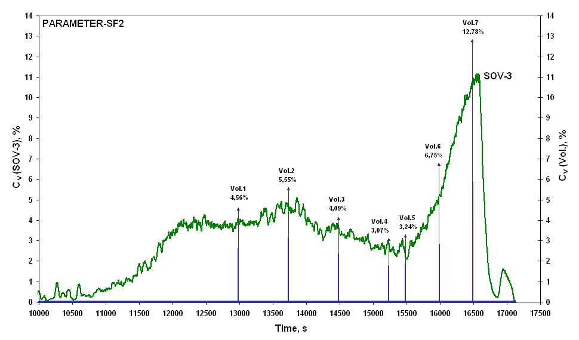
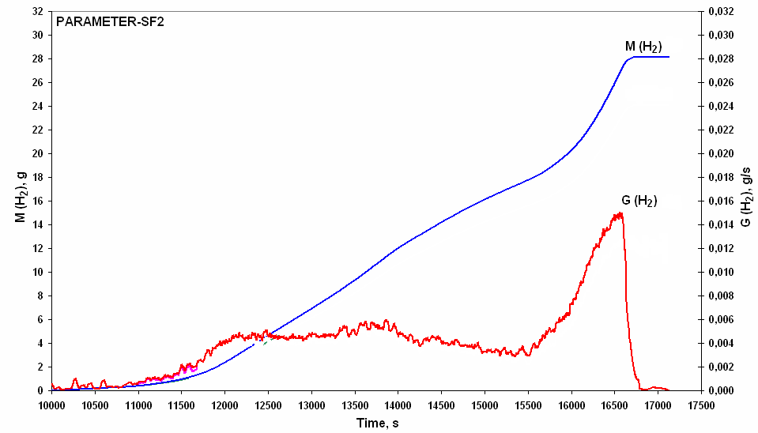
Evolution of volumetric hydrogen concentration
measured by hydrogen measurement device SOV-3
(continuous method) and sampling (Vol., discrete
method)
Released hydrogen mass
and flowrate

Slide 14
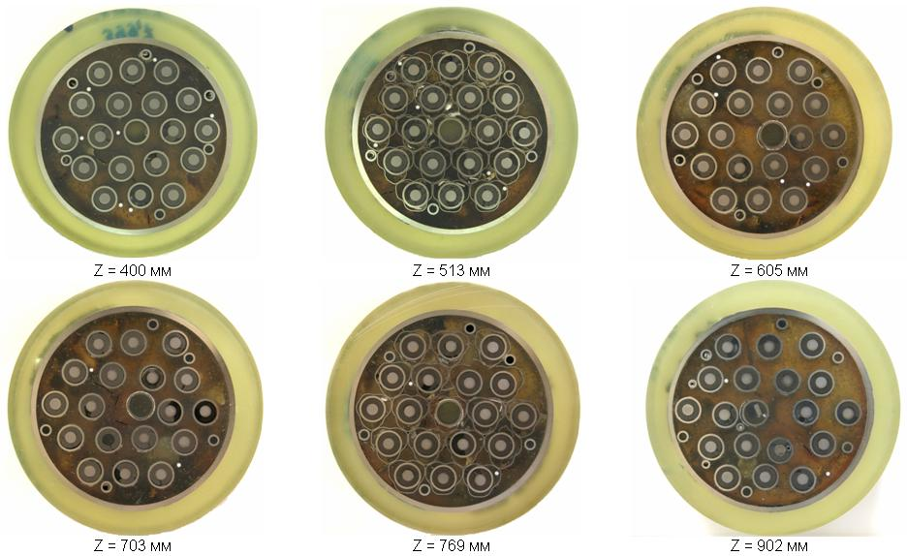
Results of material studies of PARAMETER-SF2 bundle
Photos of the assembly cross-sections slabs within the elevations of Z ∼ 400…900 mm.

Slide 15
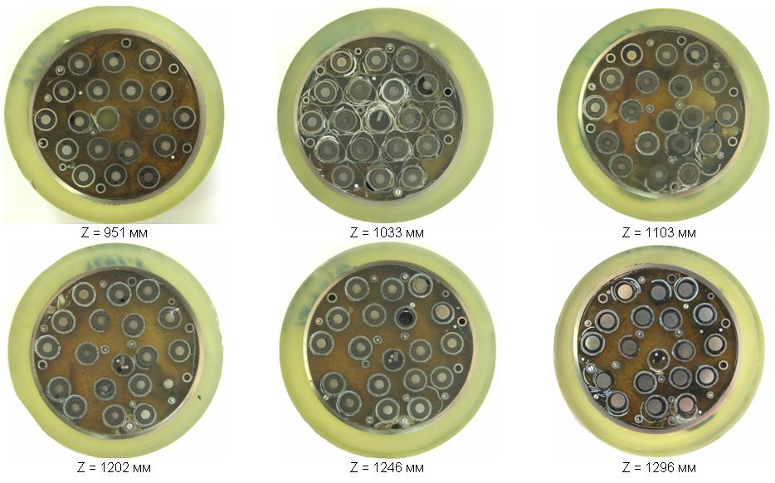
Photos of the assembly cross-sections slabs within the elevations of Z ∼ 950…1300 mm.

Slide 16
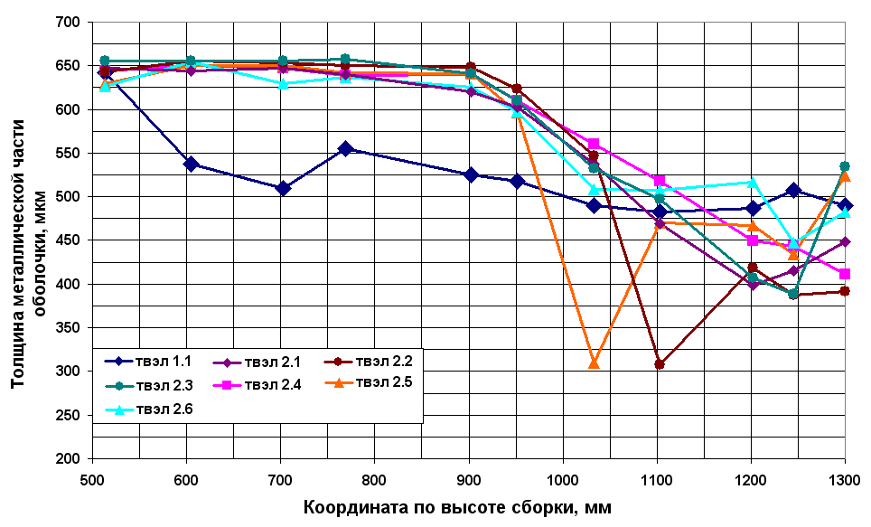
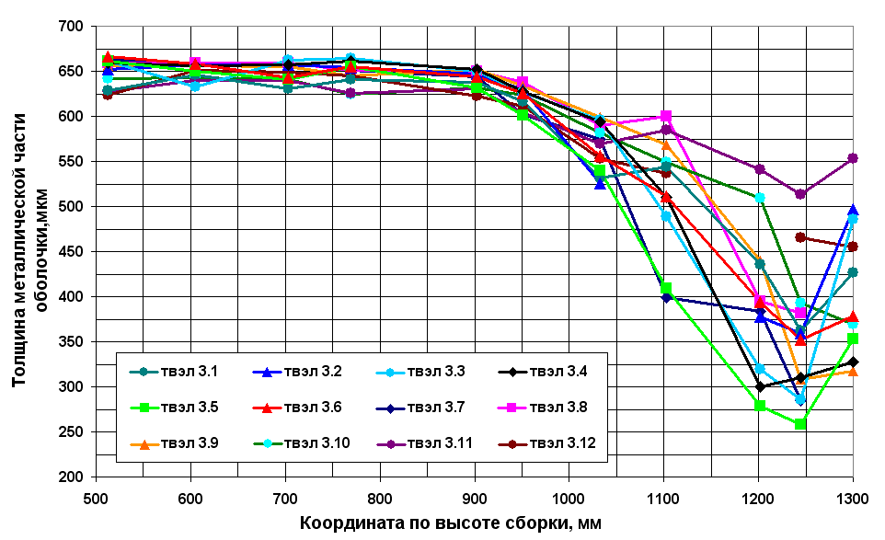
Distribution
of claddings remained metallic
layer thickness
in the second row over
heated zone.
Distribution
of claddings remained metallic
layer thickness
in the third row over
heated zone.

Slide 17
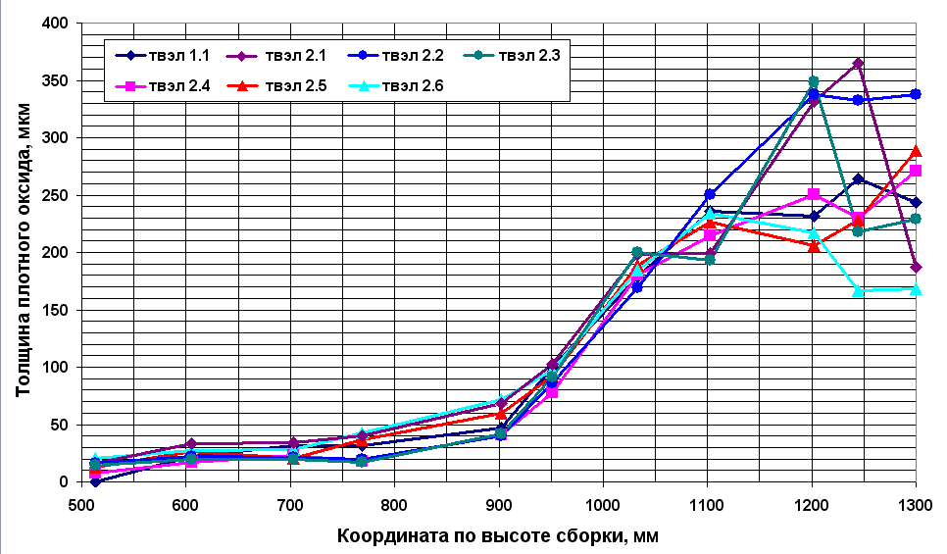
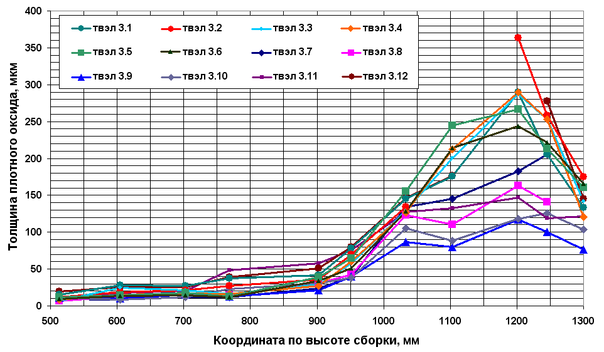
Distribution of the compact
ZrO₂ layer thickness on external surface
of claddings in the second row over
heated zone.
Distribution of the compact
ZrO₂ layer thickness on external surface
of claddings in the third row over
heated zone.

Slide 18
Main results of material studies PARAMETER-SF2
Analysis of the results of post-test material studies showed that temperature gradient over the bundle
length caused different degree of its damages.
1. The state of the assembly lower part (Z = 0…400 mm) does not practically differ from the
original state, and oxide thickness on the outer surface does not exceed 5…10 μm.
2. At 500…1300 mm elevations, a multilayered spalling off zirconium dioxide was found.
3. In the middle part of the assembly (Z=500…800 mm) the fuel rod simulators are displaced relative
to the original arrangement in the assembly cross-section, the outer cladding surface is covered with
multilayered zirconium dioxide, separating from metal substrate, but its thickness does not
exceed~100μm.
4. In the upper part of the assembly (Z = 900…1300 mm) the original arrangement is greatly distorted.
The claddings are oxidized both on the outer (to 650 μm), and on the inner (to 50 μm) surfaces.
Zirconium dioxide has different morphology.
On the basis of the results of metallographic studies the evaluation was done for the maximum possible hydrogen mass that could release into steam-gas environment during the experiment. Taking into account the results of measurements of hydrogen content in the shroud, the upper limit of released hydrogen mass is estimated to be 31 g. The obtained value is in a good agreement with the results of measurements (∼ 28 g),

Slide 19
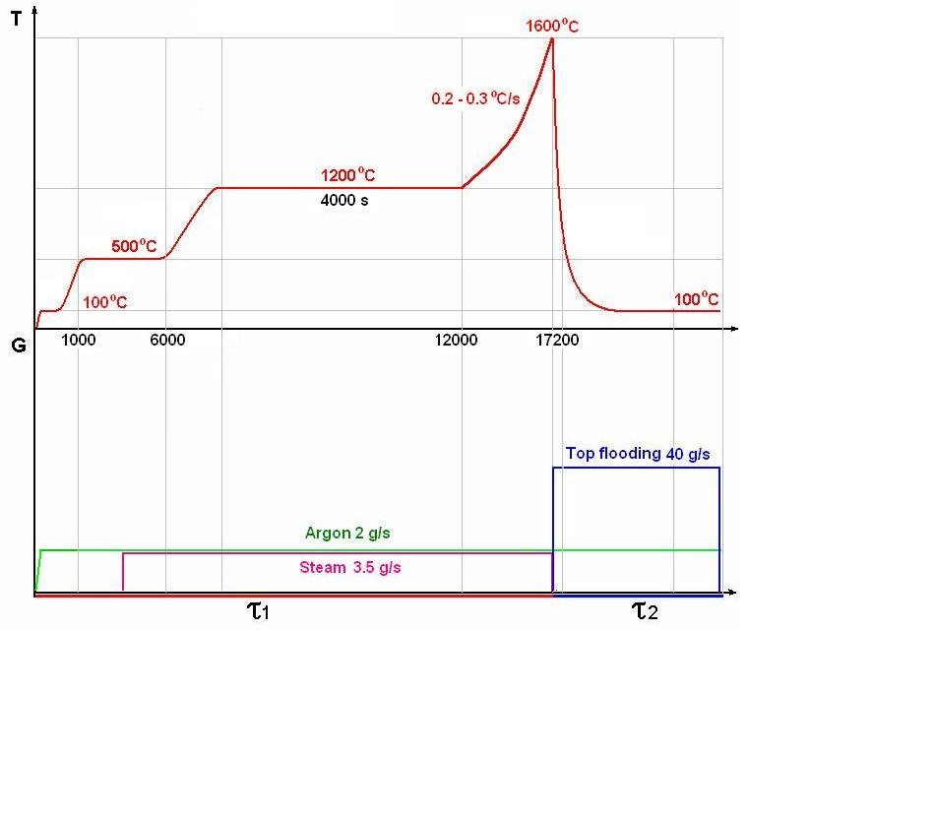
The PARAMETER-SF3 experiment
The objective
The study of peculiarities of cooling and change in the structure of materials of VVER-1000 FA made of
standard reactor structural materials (fuel rod claddings of alloy Zr+1%Nb, fuel pellets of uranium dioxide,
spaсer grids and shroud of alloy Zr+1%Nb) under severe accident conditions during top quenching of
the assembly overheated to the temperature 1600°С.
PARAMETER-SF3 test scenario
Main parameters of the experiment
Coolant | Steam/ argon
Flow rate of coolant, g/s | 3.5/2
Temperature of coolant, °C | ∼500
Heat up rate of cladding, °C /s | 0.2- 0.3
Temperature of cladding at the pre-oxidation phase, °C | ∼1200
Duration of the pre-oxidation phase, s | ∼ 4000
Maximal temperature of cladding, °C | 1600
Quenching phase | Top flooding
Water flow rate, g/s | ∼ 40

Slide 20
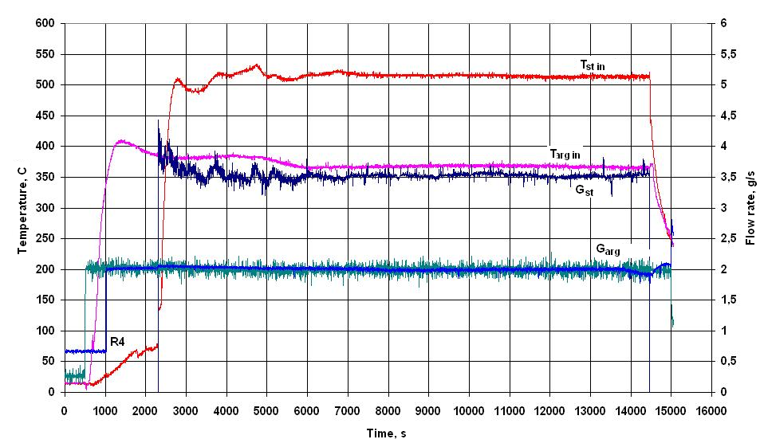
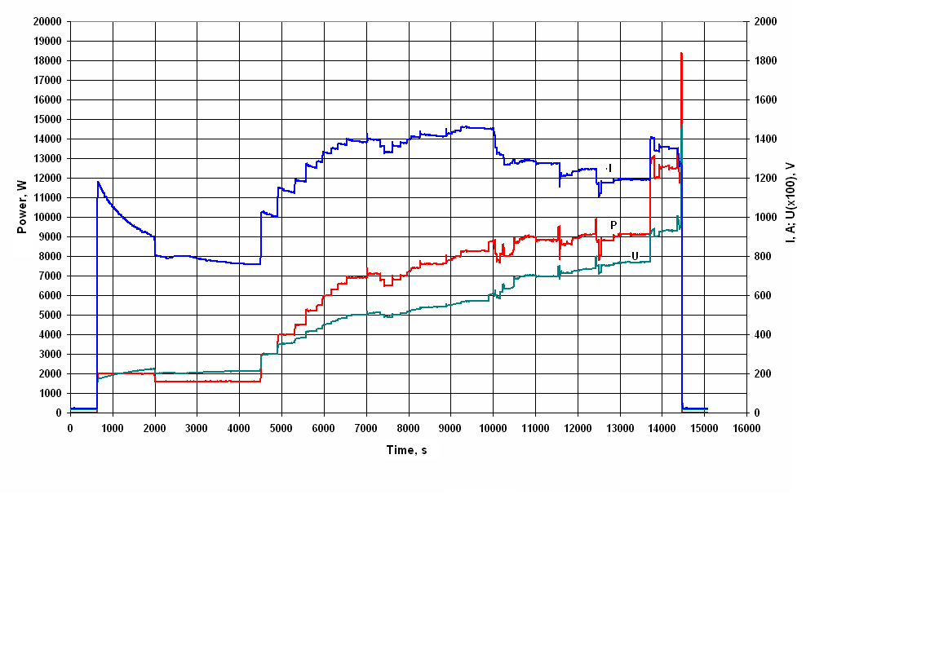
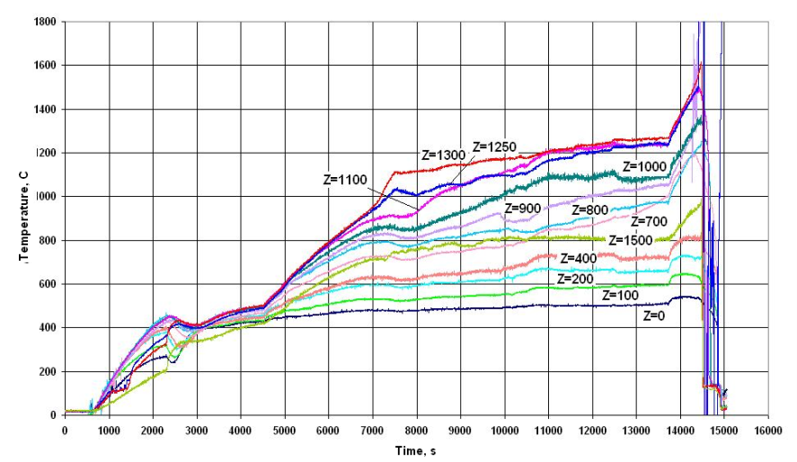
Main results of PARAMETER-SF3 experiment
Flow rate of steam and argon
Electrical power
Claddings temperature

Slide 21
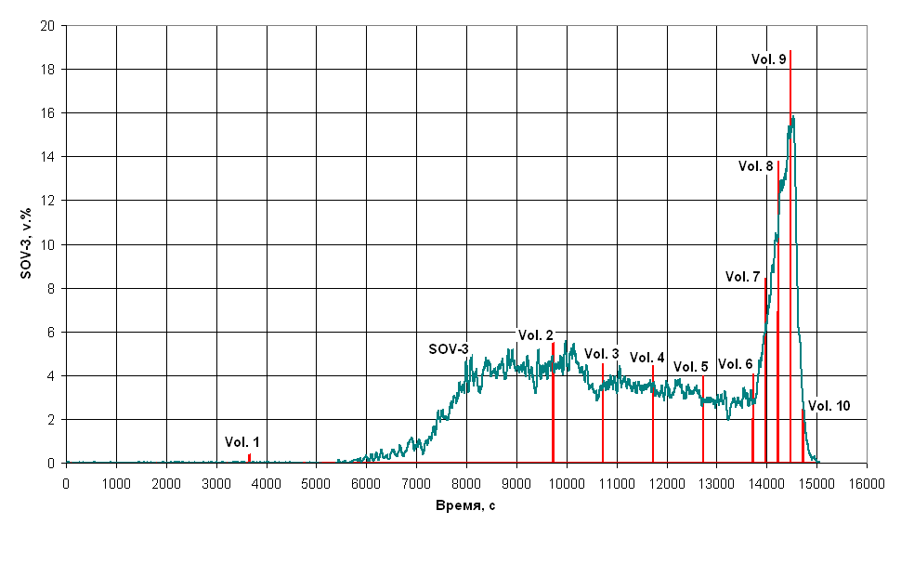
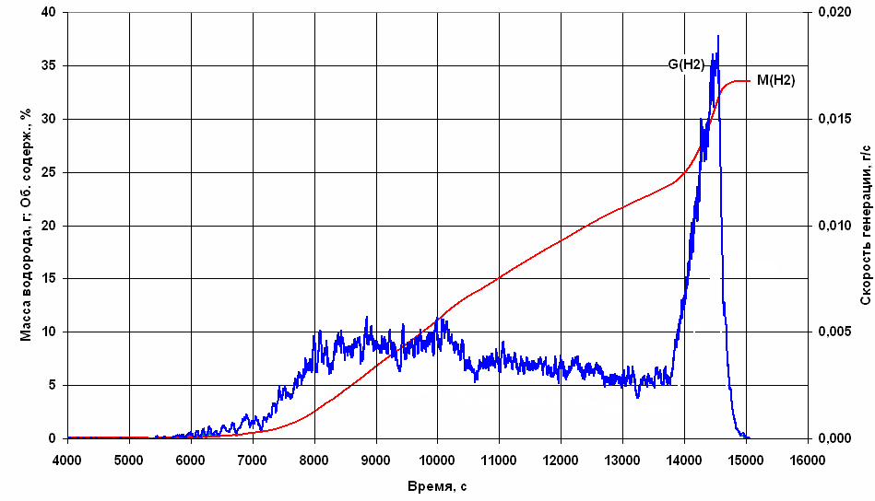
Evolution of volumetric hydrogen concentration
measured by hydrogen measurement device SOV-3
(continuous method) and sampling (Vol., discrete
method)
Released hydrogen mass
and flowrate

Slide 22
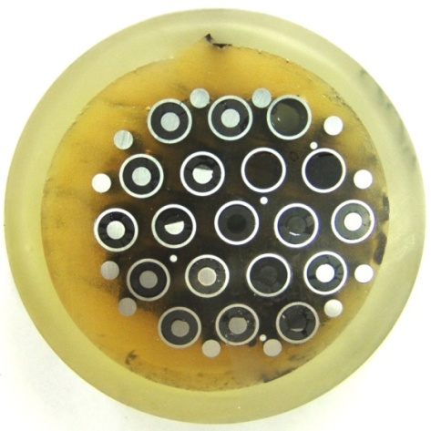
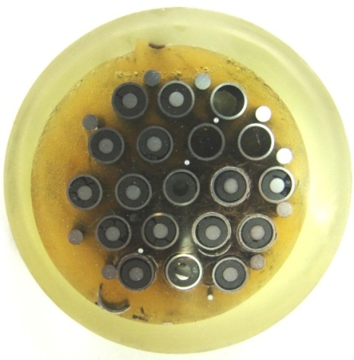
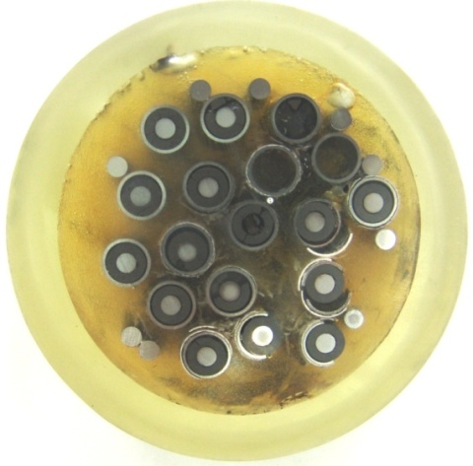
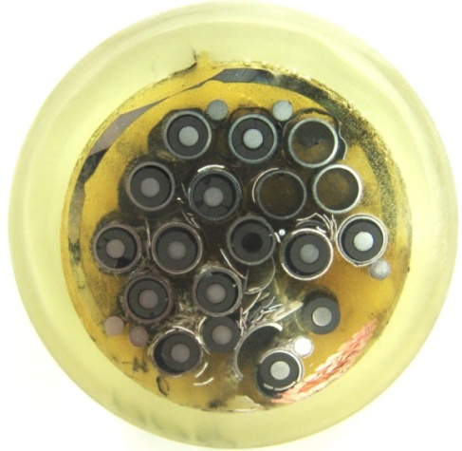
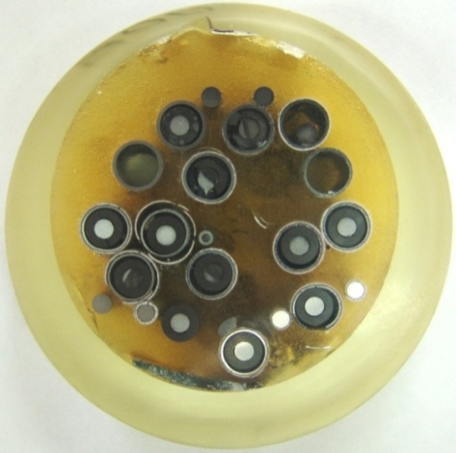
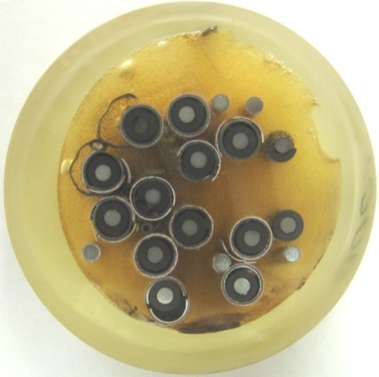
Results of material studies of PARAMETER-SF3 experiment
500 мм
600 мм
700 мм
800 мм
900 мм
1000 мм
Photos of the assembly cross-sections slabs within the elevations of Z ∼ 500…1000 mm.

Slide 23
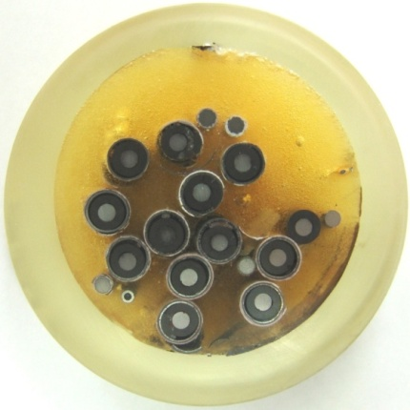
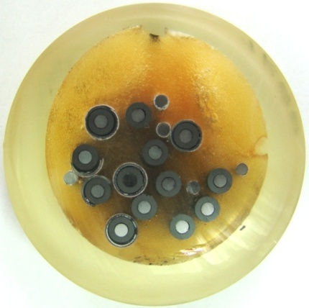
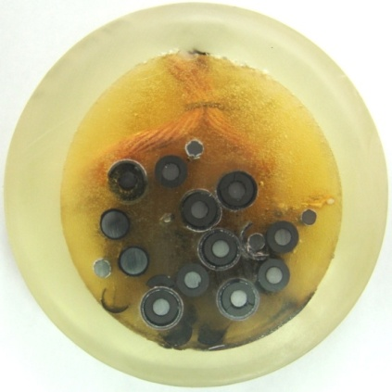
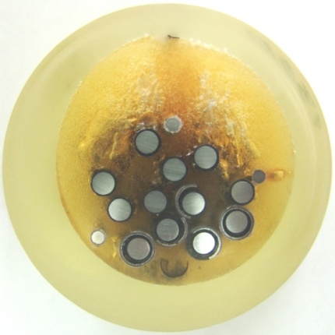
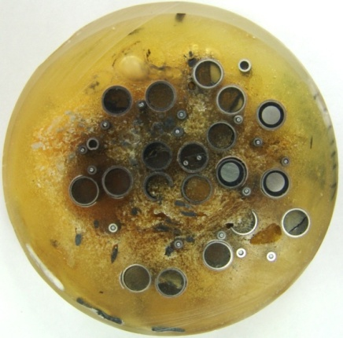
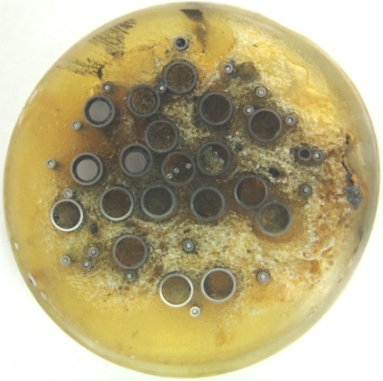
1100 мм
1200 мм
1250 мм
1300 мм
1400 мм
1500 мм
Photos of the assembly cross-sections slabs within the elevations Z ∼ 1100…1500 mm.

Slide 24
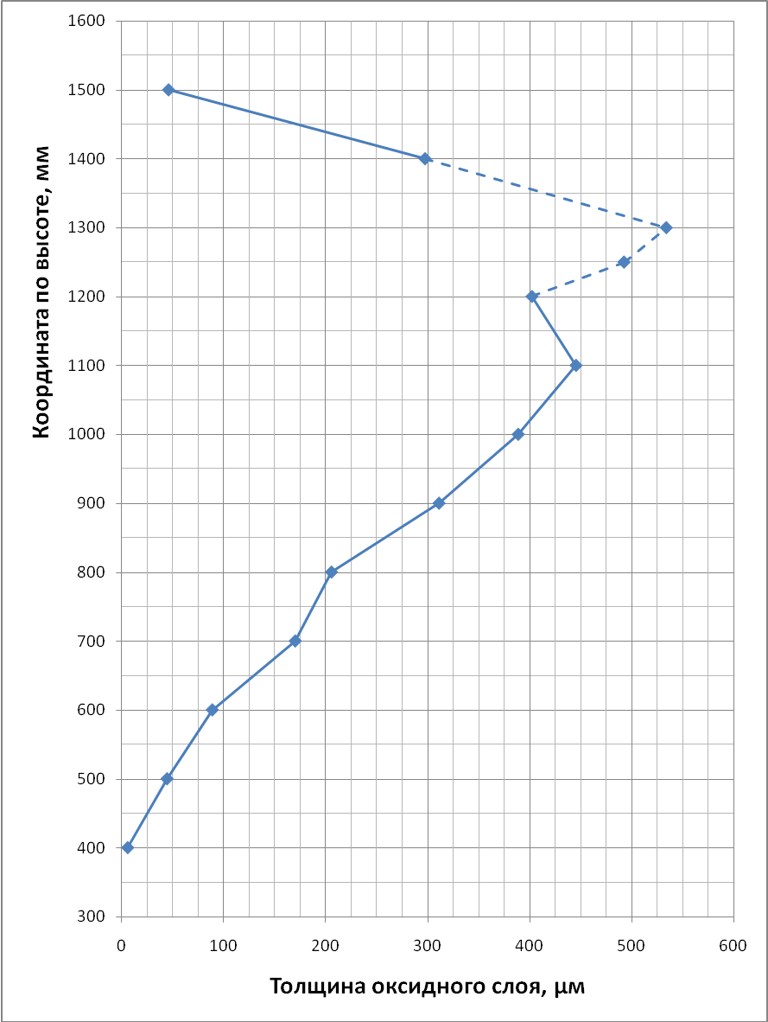
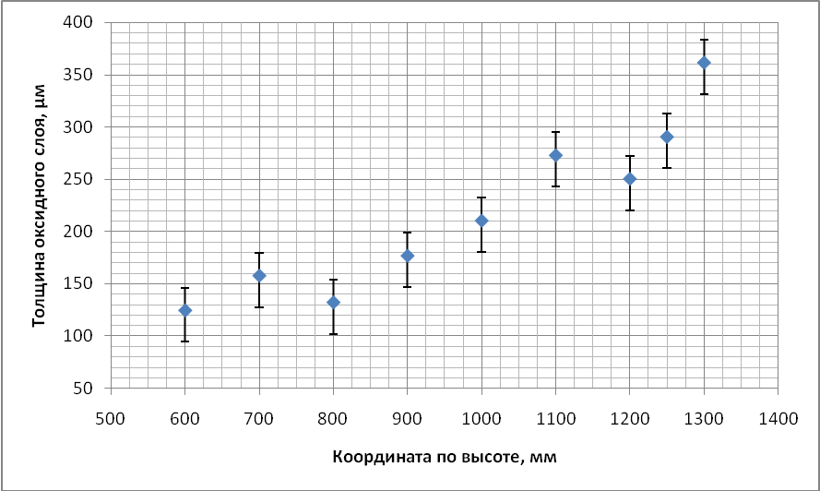
Distribution of the calculated ZrO2 thickness on
internal surfaces of the shroud (minimum and maximum
values corresponds to minimum and maximum
shroud wall thickness measured) over SF3 assembly length
Distribution of the averaged thickness
of calculated oxide scale on external
cladding surface over SF3 assembly length.

Slide 25
Main results of material studies of SF3 bundle
Analysis of post-test material studies showed that:
1. The state of the assembly lower part (Z = 0…400 mm) does not practically differ from the original state, and oxide thickness on the outer surface does not exceed 2-10 μm;
2. Within the range of 500…1300 mm elevations there is a multilayered zirconium dioxide spalling off on the fuel rod claddings;
3. In the middle part of the assembly (Z = 500…800 mm) the fuel rod simulators are displaced relative to the original position in the assembly cross-section, the outer cladding surfaces are
covered with multilayered zirconium dioxide, separating from metal surface, and its thickness
on some fuel rods (at 800 mm elevation) reaches ~ 400 μm.
4. In the upper part (Z = 900…1300 mm) the assembly state is greatly distorted. The claddings
are oxidized both on the outside (to 550 μm), and on the inside (to 50 μm) surfaces.
Zirconium dioxide has different morphology. The inside part of the oxide scale is a compact, well-bound with the metal part, zirconium dioxide of columnar structure that was formed, evidently, at the transient stage. Its thickness increases at higher elevations and reaches the maximum value at the elevations of 1250-1300 mm, and distribution of its thickness over the assembly section at these elevations is greatly irregular and varies within the range of 100…350 μm. No fuel-clad interaction is revealed in the assembly. The hydrogen mass estimated using material investigation results corresponds to the value of ∼42 g.

Slide 26
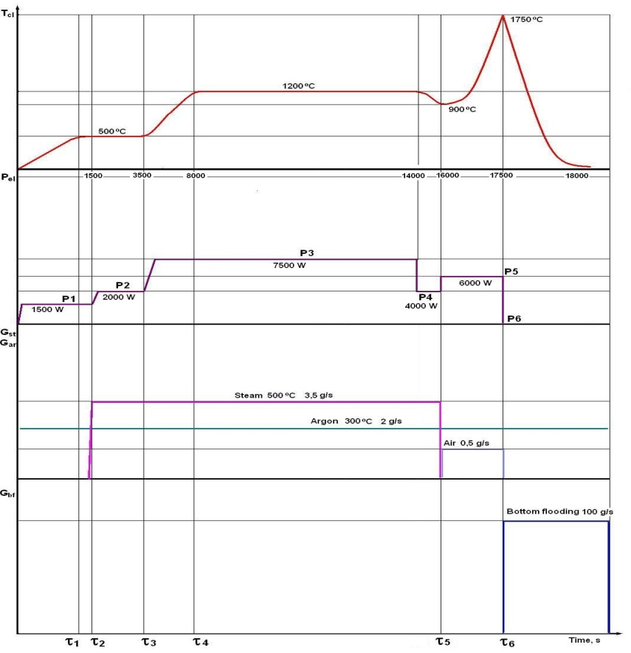
PARAMETER-SF4 experiment
The objective
The study of VVER-1000 FA under severe accident conditions with air ingress, including:
-study of temperature behaviour of FA under conditions of air oxidation and during top quenching;
-study of evolution of oxygen consumption and hydrogen generation
Main parameters of the experiment
Test scenario

Slide 27
Main results of PARAMETER-SF4 experiment
Flow rate of steam and argon
Electrical power
The claddings temperature

Slide 28
Monitoring of oxygen concentration
Volumetric oxygen concentration measured with the systems of continuous (OLCT20)
and discrete (Sampling) oxygen monitoring and air flow rate at the test section inlet G(R6).

Slide 29
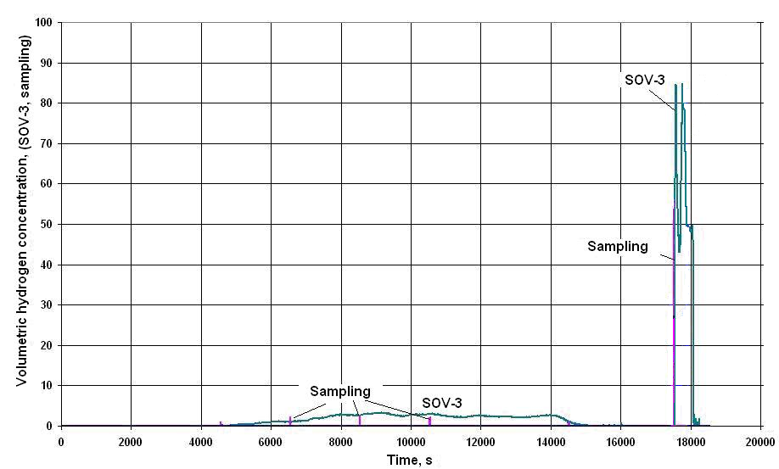
Monitoring of volumetric hydrogen concentration
Volumetric hydrogen
concentration
Hydrogen mass and
flow rate.

Slide 30
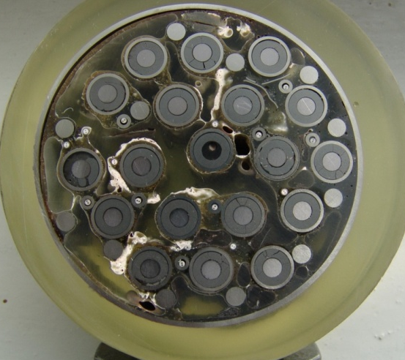
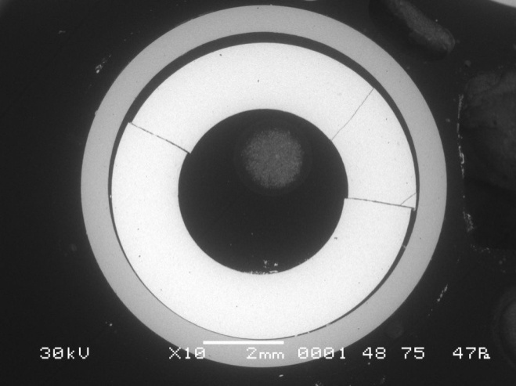
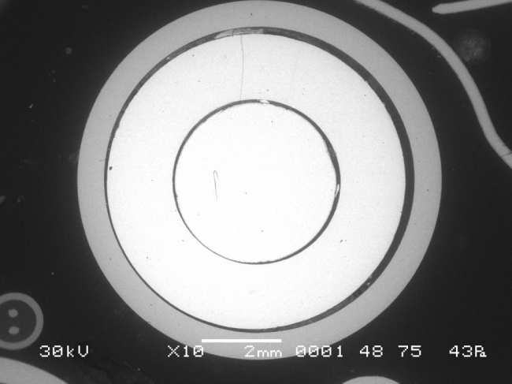
Results of material studies. PARAMETER-SF4 experiment
Assembly cross-section at the elevation of Z = 130 mm
(top view).
Photos of fuel rod simulators at the elevation of Z = 130 mm: a – fuel rod 1.1; b – fuel rod 2.4.
а
б

Slide 31
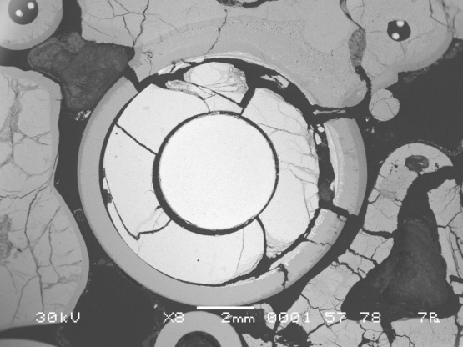
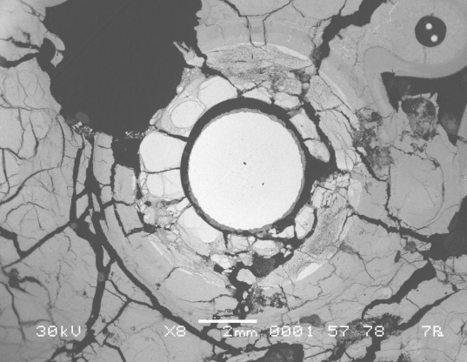
Assembly cross-section at the elevation of Z = 260 mm
(top view).
Cross-section of fuel rod simulators at the elevation of
Z = 260 mm: a – fuel rod 2.1;
b – fuel rod 2.4;
c – fuel rod 2.5;
d – fuel rod 3.8. .
а
б
в
г

Slide 32
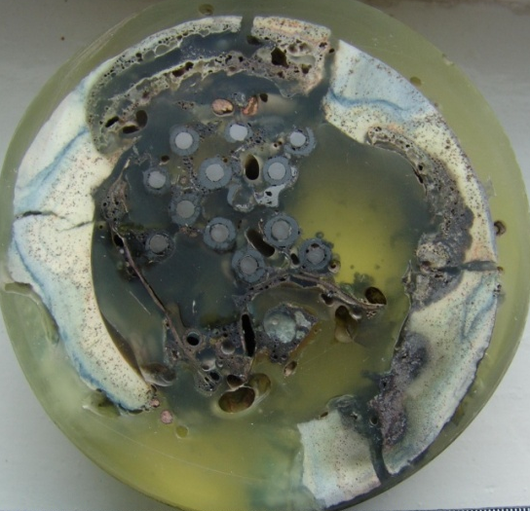
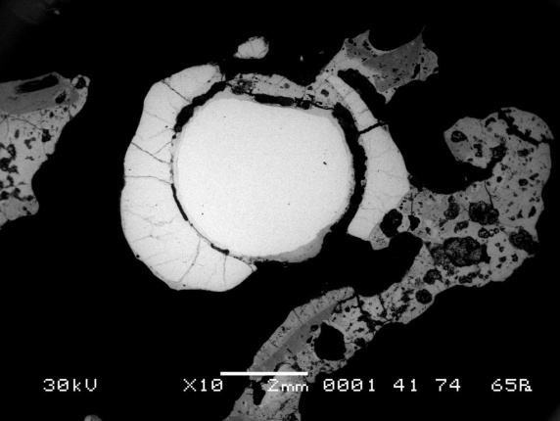
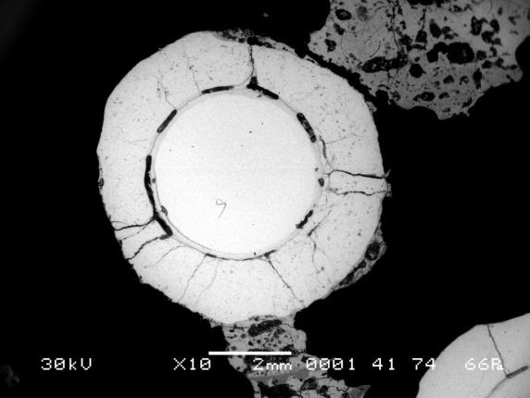
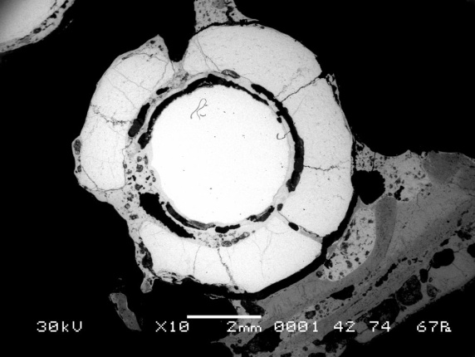
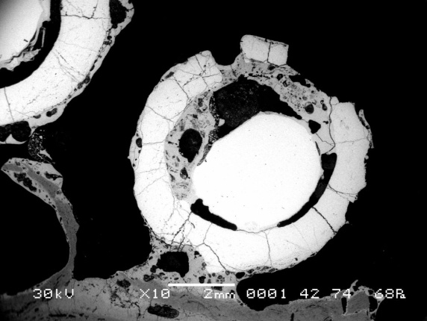
Assembly cross-section at the elevation of Z = 1200 mm
(bottom view).
Cross-section of fuel rod simulators at the elevation of Z = 1200 mm

Slide 33
Conclusions
The performed experiments of PARAMETER series have allowed:
to receive the information on behaviour of structural component of 19-rods model VVER-1000 FA,
superheated up to (1600-1750°C) during top, bottom and combined quenching;
to investigate temperature behaviour of model VVER-1000 FA under conditions of air ingress
and the subsequent bottom quenching;
to receive the information on the oxidation degree of structural component model VVER-1000 FA
and structural - phase changes in cladding of model FA by results of posttest researches;
to investigate oxygen consumption and hydrogen generation
Results of the tests are intended for improvement of understanding of phenomenology of
the processes occuring during quenching of the superheated core during severe
accident at LWR NPP, and can be used for verification of computer codes.

Slide 34
List of published papers and reports
1. Report on research work under the ISTC Project #3690 “Analysis of material studies of WWER-1000 model assembly tested at the PARAMETER-SF2 experiment under the conditions of severe accident with top and bottom flooding”, 2008.
2. Protocol of PARAMETER-SF3 Experiment Results, 2008.
3. Report “Pre- and post-test calculations of experiments of a series PARAMETER-SF within the framework of the ISTC project #3690”. Annex 1 to final report under Project No.3690, 2009.
4. Report “Post-test analysis of material studies of VVER-1000 model assembly tested at the PARAMETER-SF3 experiment under the conditions of severe accident with top flooding”. Annex 2 to final report under Project No.3690, 2009.
5. Protocol of PARAMETER-SF4 Experiment Results, 2009.
6. L.S. Degtyareva, V.P. Deniskin, D.N. Ignatiev, V.S. Konstantinov, V.I. Nalivaev, N.Ya. Parshin, E.B. Popov, D.M. Soldatkin, V.N. Turchin (FSUE “SRI SIA “LUCH”), A.D. Vasilev, A.E. Kiselev, D.Yu. Tomashchik, T.A. Yudina (IBRAE RAS), V.P. Semishkin, E.A. Frizen, V.V. Shchekoldin (OKB “GIDROPRESS”). Final Report on scientific work under ISTC Project No.3690 “Studies of fuel assemblies under severe accident top quenching conditions in the PARAMETER-SF test series”, 2009.
7. V. Nalivaev, A. Kiselev, J.-S. Lamy, S. Marguet, V. Semishkin, J. Stuckert, K. Trambauer, T. Yudina, Yu. Zvonarev. Paper “The PARAMETER test series”. ERMSAR 2008, Nesseber, Bulgaria.

Slide 35
8. M. Steinbrück, M. Grosse, J. Stuckert, J. Birchley, T. Haste, Z. Hozer, N. Vér, V.I. Nalivaev, V.P. Semishkin, A.V. Goryachev, C. Duriez, A.E. Kisselev, M.S. Veshchunov. Paper “Comparative studies of high-temperature oxidation and quench behaviour of Zircaloy-4 and E110 cladding alloys”. ERMSAR 2008, Nesseber, Bulgaria.
9. M. Steinbrück, J. Birchley, A.V. Boldyrev, A.V. Goryachev, M. Grosse, T.J. Haste, Z. Hózer, A.E. Kisselev, V.I. Nalivaev, V.P. Semishkin, L. Sepold, J. Stuckert, N. Vér and M.S. Veshchunov. High-Temperature Oxidation And Quench Behaviour Of Zircaloy-4 And E110 Cladding Alloys. PROGRESS IN NUCLEAR ENERGY Volume: 52 Issue: 1 Pages: 19-36, Published: JAN 2010.

Slide 36
List of presentations at conferences and meetings
1. Post-test examination of the SF2 fuel assembly. D.N. Ignatiev. 13th International QUENCH Workshop, November 20-22, 2007, Karlsruhe, Germany.
2. Pre- and post-test calculations on PARAM-TG code in basis of model FA tests regimes in conditions DBA and BDBA at the PARAMETER test facility. L.S. Degtyareva, N.Ya. Parshin, E.B. Popov, D.N. Soldatkin. 13th International QUENCH Workshop, November 20-22, 2007, Karlsruhe, Germany.
3. Related thermal-mechanical and heat transfer processes in WWER core during LOCA. E. Frizen, V. Semishkin, A. Churkin. 13th International QUENCH Workshop, November 20-22, 2007, Karlsruhe, Germany.
4. Computational assessment of PARAMETER-SF experiments. T. Yudina. 13th International QUENCH Workshop, November 20-22, 2007, Karlsruhe, Germany.
5. Status of the ISTC project #3690 on the “Fuel assemblies behaviour under severe accident top quenching conditions in the PARAMETER-SF test series (PARAMETER-SF3 and -SF4 experiments). V.I. Nalivaev, T.A. Yudina. 13-th CEG-SAM Meeting, March 5-7, 2008, Budapest, Hungary.
6. PARAMETER-SF3 test scenario and results of SF3 pre-test numerical modeling. A.E. Kiselev. 13-th CEG-SAM Meeting, March 5-7, 2008, Budapest, Hungary.
7. Specification for numerical simulation of PARAMETER facility; Tests SF3 and SF4. T.A. Yudina. 13-th CEG-SAM Meeting, March 5-7, 2008, Budapest, Hungary.

Slide 37
8. Status of the ISTC project #3690 on the “Fuel assemblies behaviour under severe accident top quenching conditions in the PARAMETER-SF test series (PARAMETER-SF3 and -SF4 experiments). V.I. Nalivaev. 14-th CEG-SAM Meeting, September 9-11, 2008, Kiev, Ukraine.
9. Results of post-test examinations of SF2 fuel bundle and numerical simulations of the experiments PARAMETER-SF3 and -SF4. A. Kiselev. 14-th CEG-SAM Meeting, September 9-11, 2008, Kiev, Ukraine.
10. Results of PARAMETER-SF2 material investigations. A. Kiselev. 14th International
QUENCH Workshop, 4-6 November, 2008, Karlsruhe, Germany.
11. Results of pre- and posttest calculations of PARAMETER-SF experiments. T. Yudina. 14th International QUENCH Workshop, 4-6 November, 2008, Karlsruhe, Germany.
12. Status of the ISTC project #3690 on the “Fuel assemblies behaviour under severe accident top quenching conditions in the PARAMETER-SF test series (PARAMETER-SF3 and PARAMETER-SF4 experiments); Results of PARAMETER SF3 experiment. V.I. Nalivaev. 15th CEG-SAM Meeting, 10-12 March 2009, Villigen, Switzerland.
13. Results of PARAMETER –SF3 pre- and post-test numerical modeling. A. Kiselev. 15th CEG-SAM Meeting, 10-12 March 2009, Villigen, Switzerland.
14. Post-test examination of the PARAMETER-SF2 and –SF3 fuel assemblies. T. Yudina. 15th CEG-SAM Meeting, 10-12 March 2009, Villigen, Switzerland.
15. ISTC project #3936 proposal on “Study of fuel assemblies with boron carbide absorber rods under severe accident conditions in the PARAMETER-SF tests series” V.I. Nalivaev. 15th CEG-SAM Meeting, 10-12 March 2009, Villigen, Switzerland.

Slide 38
16. Experimental results of complex starting-up and adjustment actions on preparation of the PARAMETER-SF4 Experiment. V.S. Konstantinov. PARAMETER Status Meeting. 29 July, 2009, Podolsk, Russian Federation.
17. Preliminary results of the PARAMETER-SF4 test. V.I. Nalivaev. PARAMETER Status Meeting. 29 July, 2009, Podolsk, Russian Federation.
18. PARAMETER-SF4 pretest calculations. D. Tomashchic. PARAMETER Status Meeting. 29 July, 2009, Podolsk, Russian Federation.
19. Pretest studies of PARAMETER SF4 scenario with ICARE/CATHARE V2. A. Volchek, Yu. Zvonarev, O. Coindreau (IRSN), F. Fichot (IRSN). PARAMETER Status Meeting. 29 July, 2009, Podolsk, Russian Federation.
20. Studies of VVER-1000-type fuel rods under BDBA conditions with top, bottom and combined flooding in the PARAMETER facility. Degtyareva L.S., Konstantinov V.S., Nalivaev V.I., Parshin N.Ya., Kiselev A.E., Yudina T.A., Semishkin V.P. International scientific and technical meeting «Computational and experimental studies of LWR fuel element behavior under beyond design basis accidents and reflood conditions», July 27-28, 2009, IBRAE RAS, Moscow, Russian Federation.
21. Status of the ISTC project #3690 on the “Fuel assemblies behaviour under severe accident top quenching conditions in the PARAMETER-SF test series (PARAMETER-SF3 and PARAMETER-SF4 experiments); Results of PARAMETER-SF4 experiment. V.I. Nalivaev. 16th CEG-SAM Meeting, September 8-9, 2009, Moscow, Russian Federation.

Slide 39
22. Results of PARAMETER–SF3/SF4 pre- and post-test numerical modeling. D. Tomashchic. 16th CEG-SAM Meeting, September 8-9, 2009, Moscow, Russian Federation.
23. Post-test examinations of the PARAMETER-SF fuel assemblies. T. Yudina. 16th CEG-SAM Meeting, September 8-9, 2009, Moscow, Russian Federation.
24. Short overview on the PARAMETER program at LUCH. A. Kiselev. 15th International QUENCH Workshop, November 3-5, 2009, Karlsruhe, Germany..
25. Post-test examination of the PARAMETER-SF4 fuel assembly. D. Ignatiev. 15th International QUENCH Workshop, November 3-5, 2009, Karlsruhe, Germany.
26. Comparison results of pre-test PARAMETER-SF4 test numerical modeling. T.Yudina. 15th International QUENCH Workshop, November 3-5, 2009, Karlsruhe, Germany.
27. Main results of RELAP/SCDAPSIM calculation analysis of the PARAMETER-SF experiments.
V.V. Shchekoldin, V.P. Semishkin. 15th International QUENCH Workshop, November 3-5, 2009, Karlsruhe, Germany

