Slide 1
FSUE SRI SIA “LUCH”
IBRAE RAS
OKB “GIDROPRESS”
ISTC
Status of the ISTC project #3690 on the “Fuel assemblies behaviour under severe accident top quenching conditions in the PARAMETER-SF test series”
(PARAMETER-SF3 and PARAMETER-SF4 experiments)
CEG-SAM – 16, Moscow, Russia, September 8-9, 2009

Slide 2
Progress reports
Status of the ISTC project #3690 on the “Fuel assemblies behaviour
under severe accident top quenching conditions in the
PARAMETER-SF test series (PARAMETER-SF3 and PARAMETER-
SF4 experiments):
The results of the PARAMETER-SF4 experiment. V. Nalivaev;
Results of PARAMETER-SF3/SF4 pre and post-test numerical modeling. A. Kiselev;
Post-test examinations of the PARAMETER-SF fuel assemblies.
T. Yudina

Slide 3
The Structure of Project
The basis:
- The decision on financial support of the Project #3690 from ISTC 13.07.2007;
- The agreement under the Project #3690 between ISTC and FSUE SRI SIA “LUCH” 01.12.2007
The basic participants:
FSUE SRI SIA “LUCH”
IBRAE RAS
OKB “GIDROPRESS”
Another participants:
JSC “VNIINM”
SSC RF-IPPE
RSC “Kurchatov Institute”
Foreign collaborators:
FZK, JRC-ITU, GRS (Germany)
PSI (Switzerland)
EdF, CEA (France)
AEKI (Hungary)
INRNE (Bulgaria)

Slide 4
Acknowledgement
Ch. Bals, K. Trambauer (GRS)
E. Beuzet, J.-S. Lamy (EdF)
J. Burchley (PSI)
O. Coindreau, F. Fichot (IRSN)
Notes:
4
4

Slide 5
FSUE SRI SIA “LUCH”
IBRAE RAS
OKB “GIDROPRESS”
ISTC
Experimental results of the PARAMETER-SF4 Experiment
(Status of Project # 3690)
Presented by V. Nalivaev
CEG-SAM – 16, Moscow, Russia, September 8-9, 2009
Notes:
5
5

Slide 6
Objective
The study of behaviour of FA of VVER-1000 under severe accident during bottom quenching of the assembly heated up to the temperature 1750°C in the environment of air

Slide 7
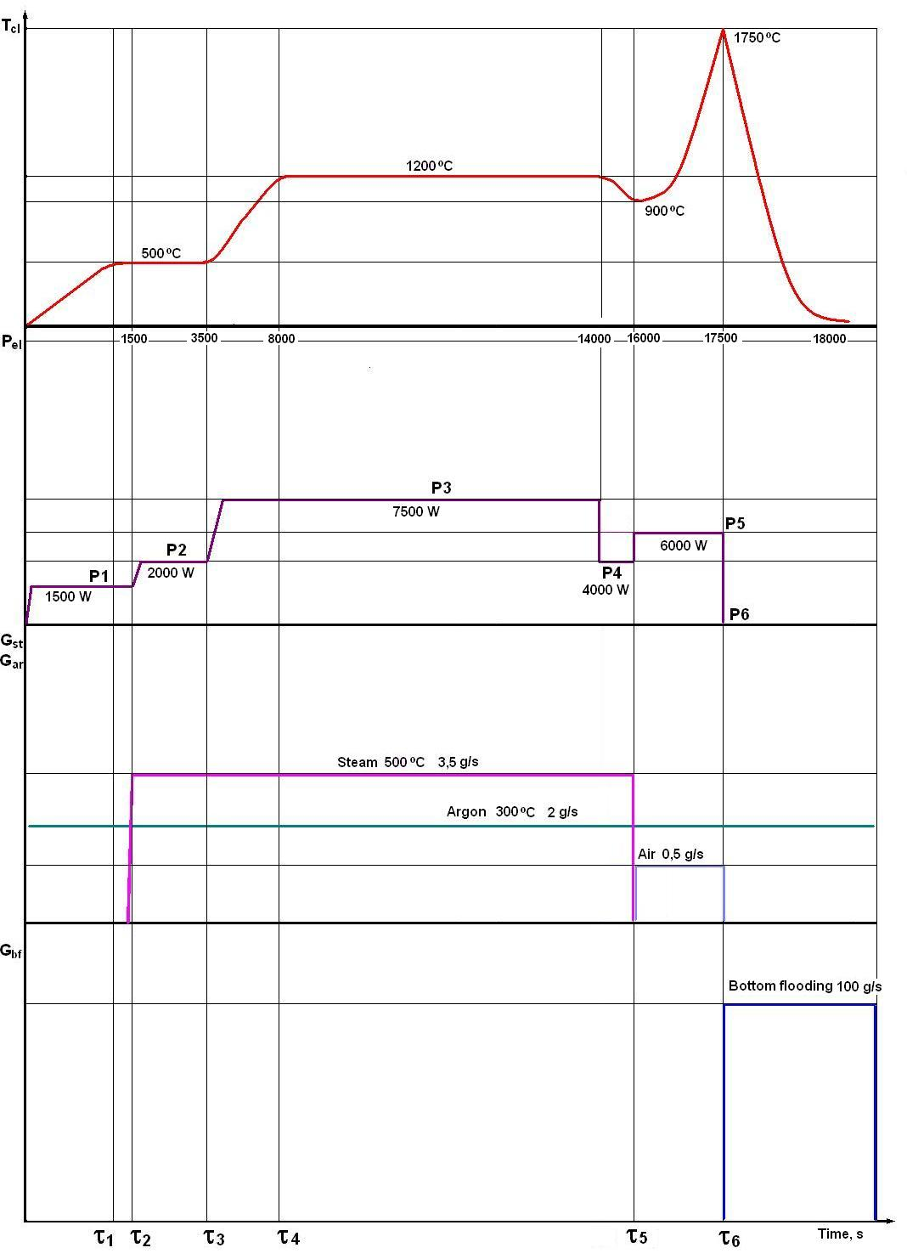
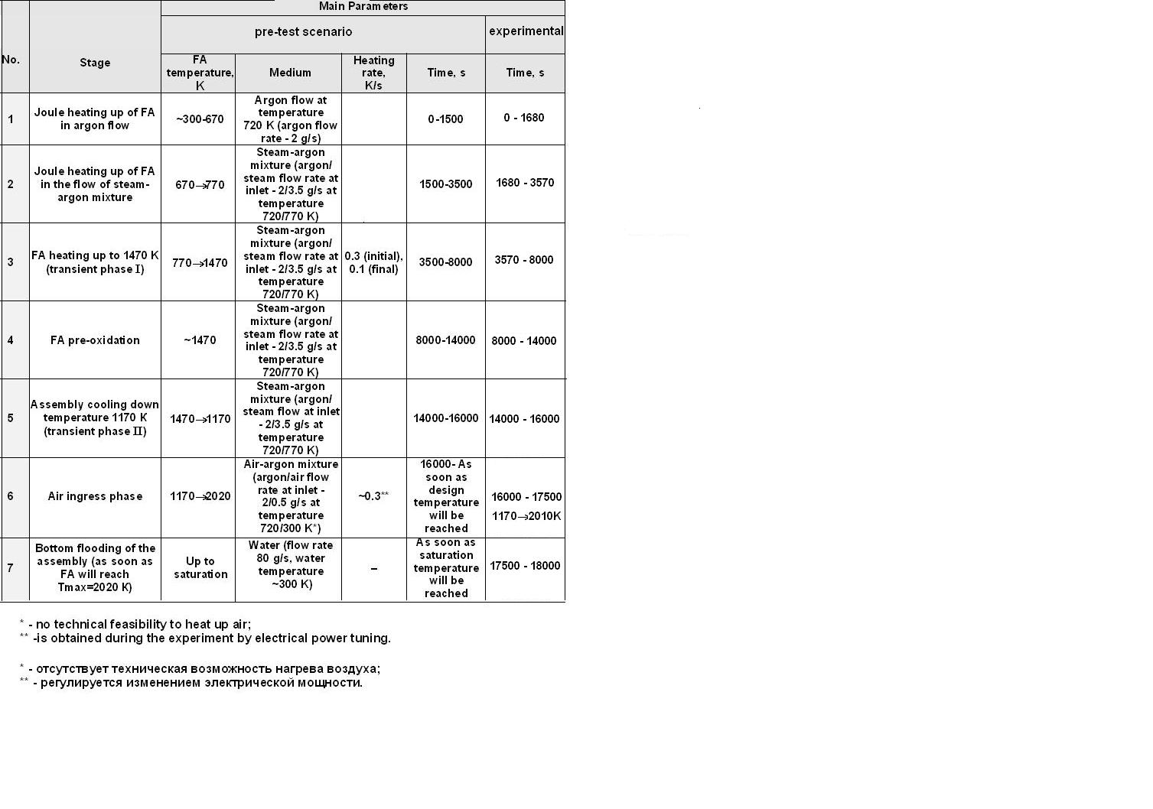
Scenarios of PARAMETER-SF4 experiment

Slide 8
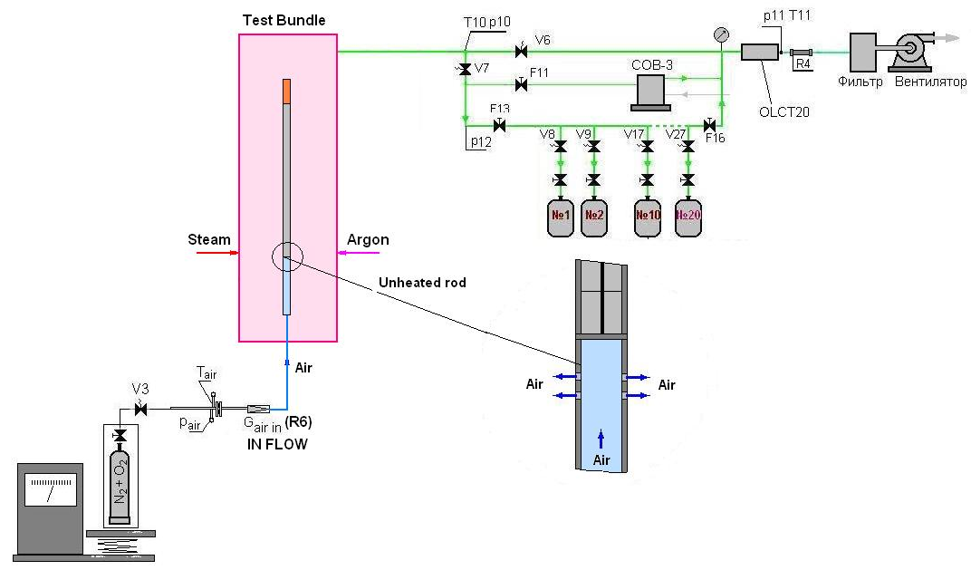
The monitoring system of air
The analysis of oxygen
OLCT-20D
Controll gas - О2
Range of measurements - 0 - 30 % v.
The basic error:
Resulted 0 - 5 %v. - ±5 %;
Relative - 5 - 30%v. - ±5 %
Measurement of air flow rate
IN - FLOW
Controll gas - (20 %) O2 + (80 %) N2
Range of measurements - 0 - 3,75 kg/h
Accuracy of measurements - ±0,5 %

Slide 9
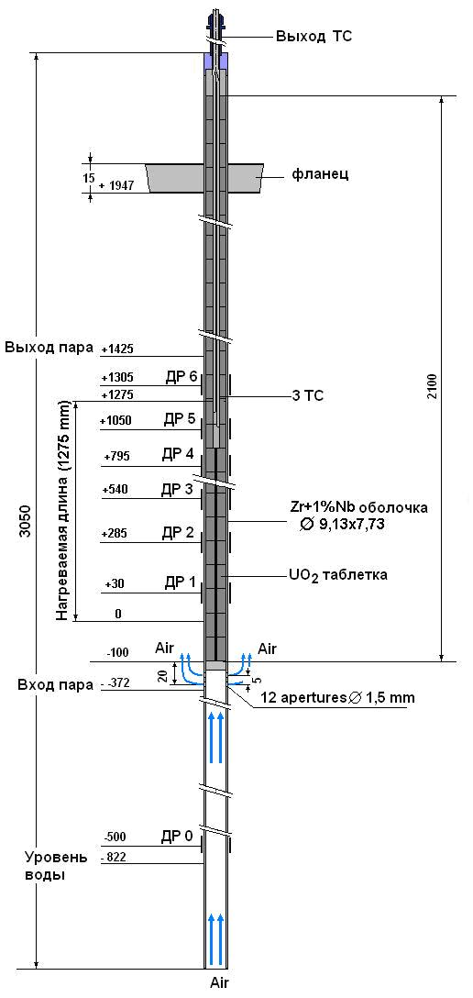
Central rod of monitoring system of air

Slide 10
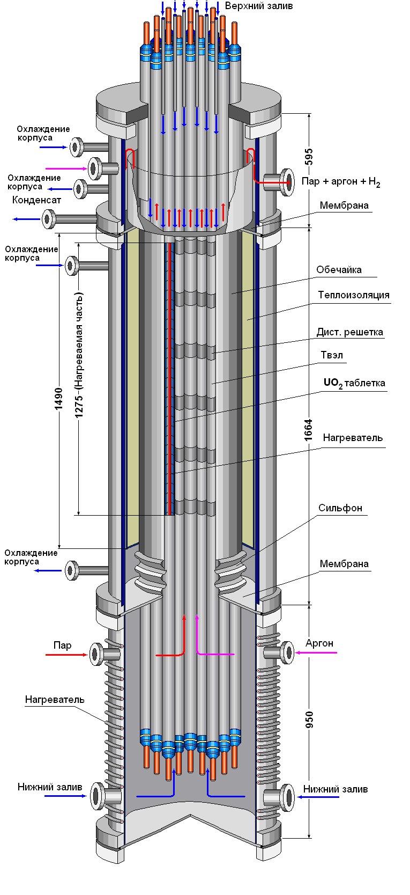
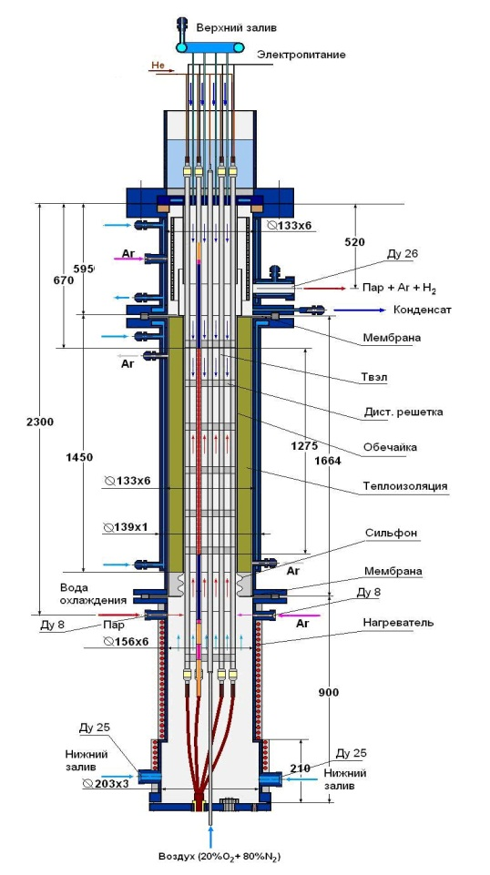
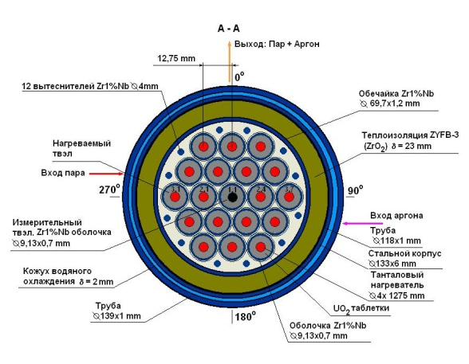
Test bundle
Main technical characteristics
Main technical characteristics
Bundle type VVER-1000
number of fuel rods 19
- heated 18
- unheated 1
Grid type triangle
Grid pitch, mm 12.75
Spacing grid Zr1%Nb
- height, mm 20
- spacing, mm 255
Shroud Zr1%Nb
- shape cylinder
- height, mm 1450
Thermal insulation ZrO2 ZYFB-3
- thickness, mm 23
- height, mm 1450

Slide 11
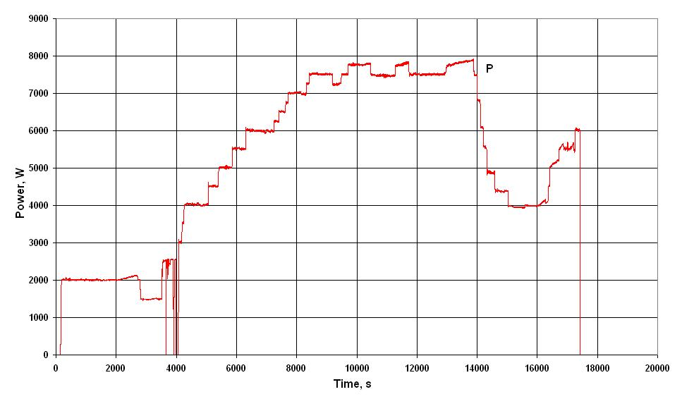
Some results of PARAMETER-SF4 experiment
Electrical power

Slide 12
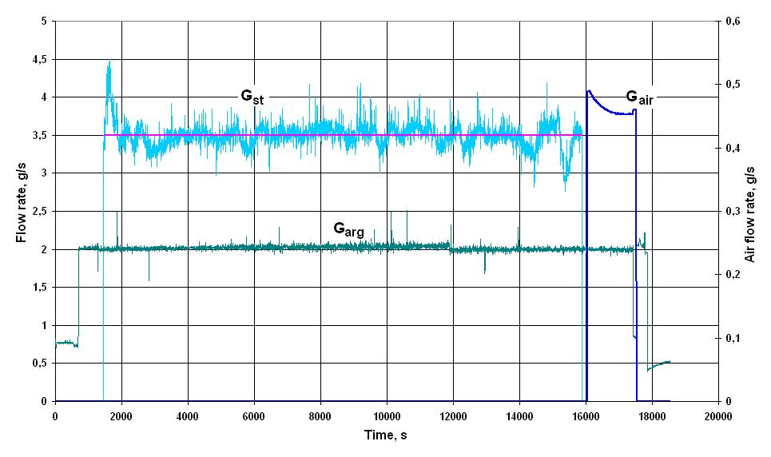
Flow rate of steam, argon and air

Slide 13
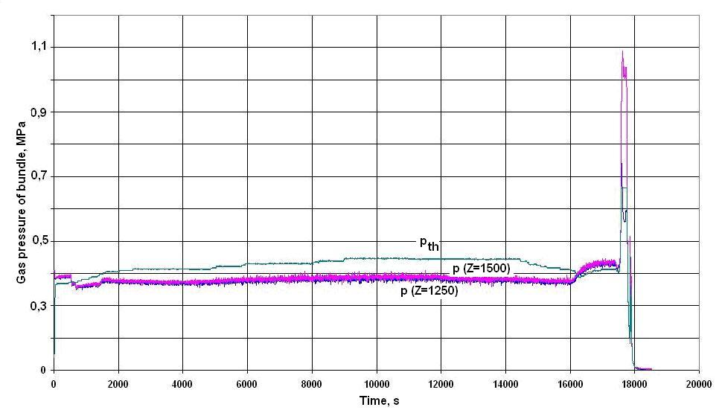
Gas pressure of test bundle

Slide 14
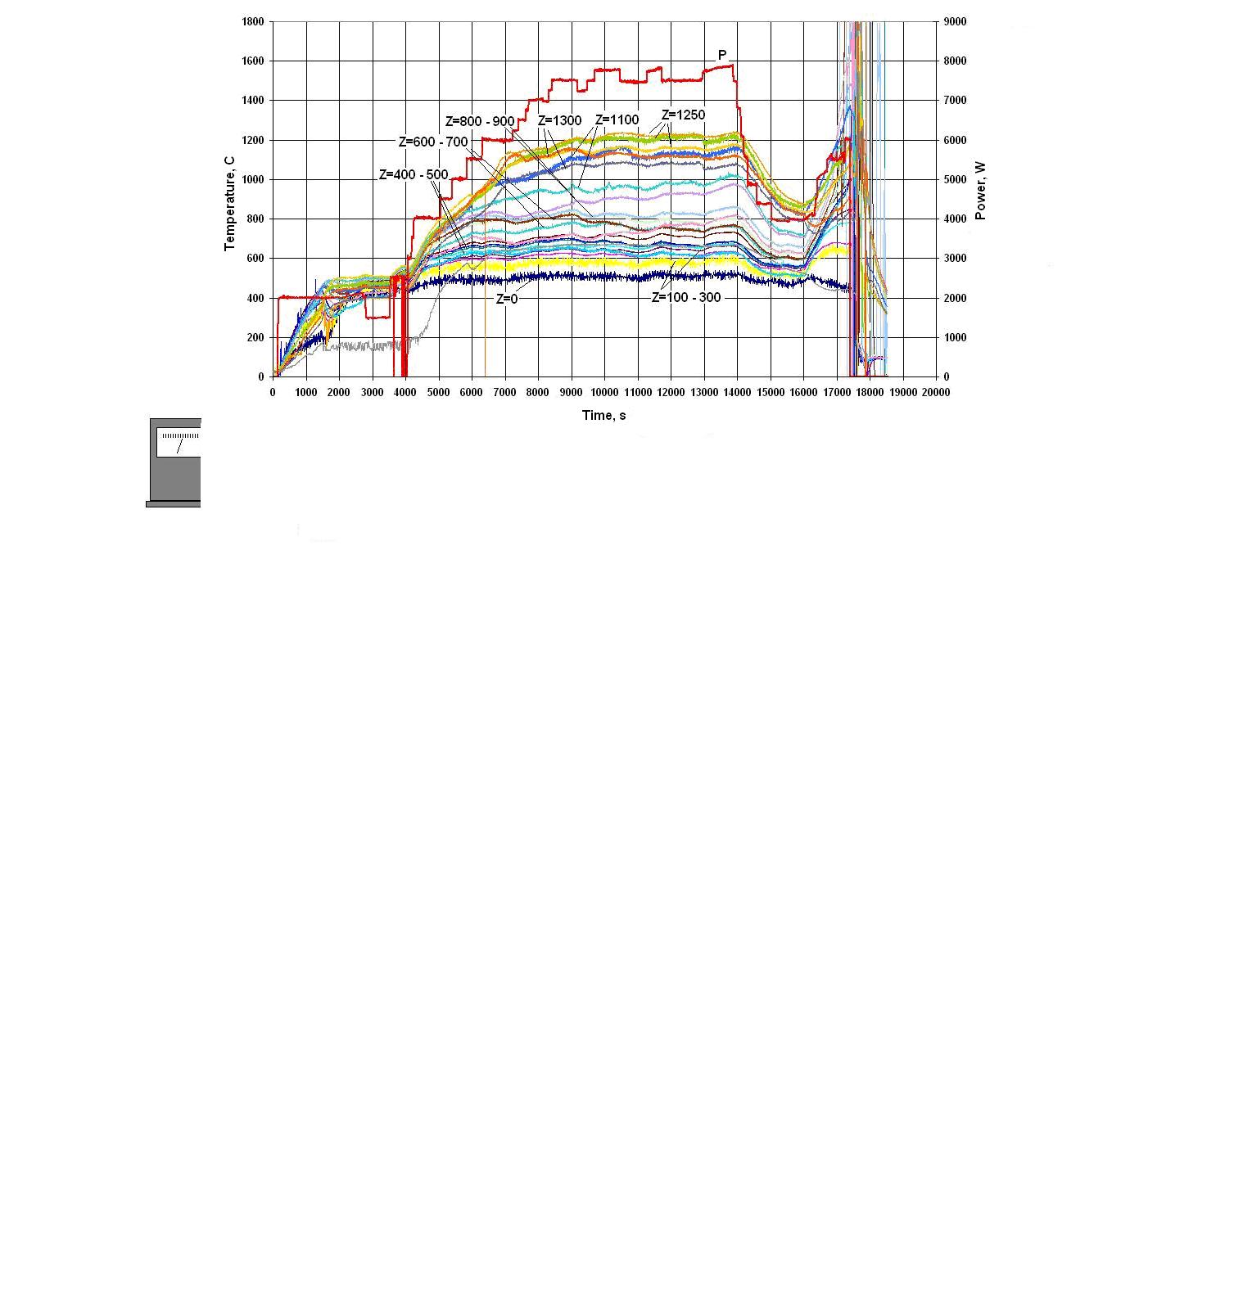
Claddings temperature

Slide 15
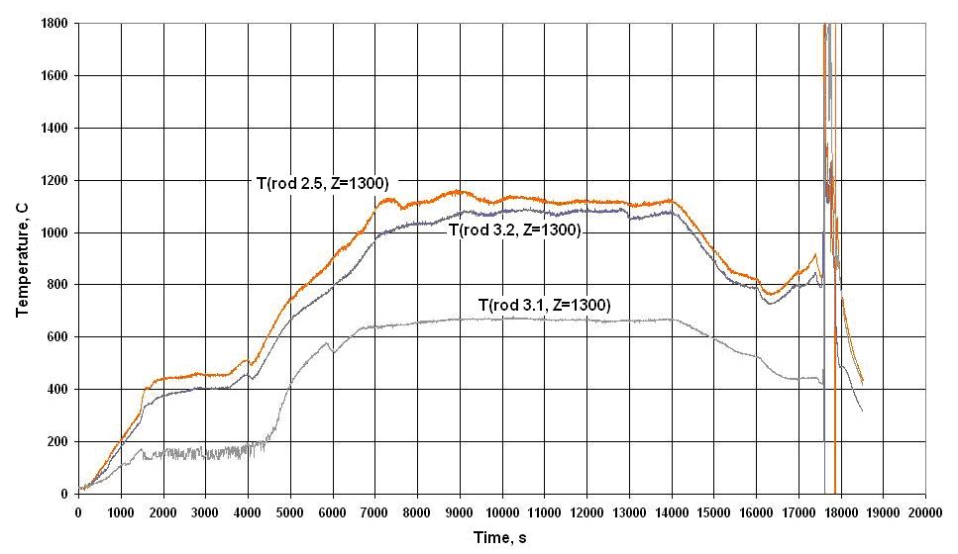
Claddings temperature at level Z=1300

Slide 16
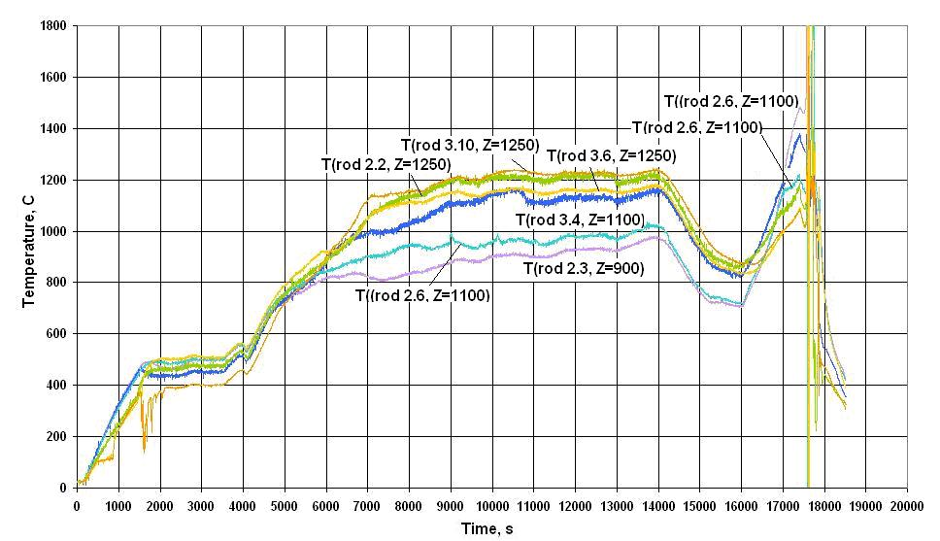
Claddings temperature at level Z=900-1250

Slide 17
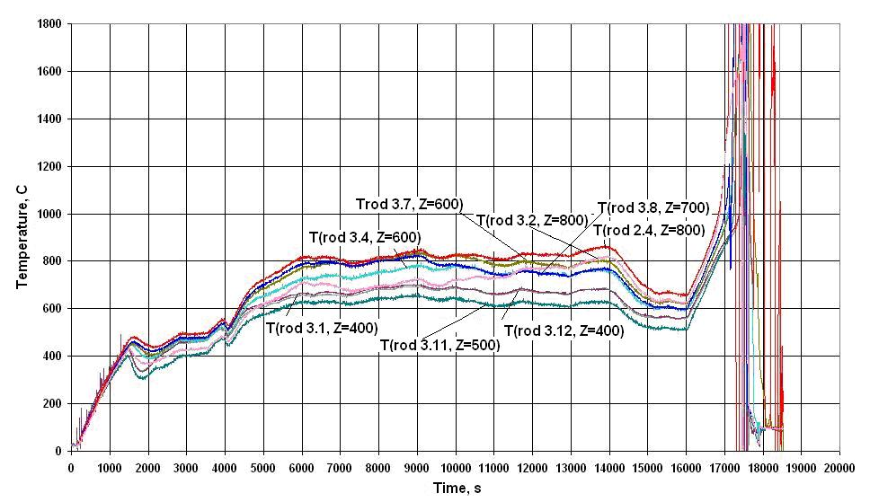
Claddings temperature at level Z=400-800

Slide 18
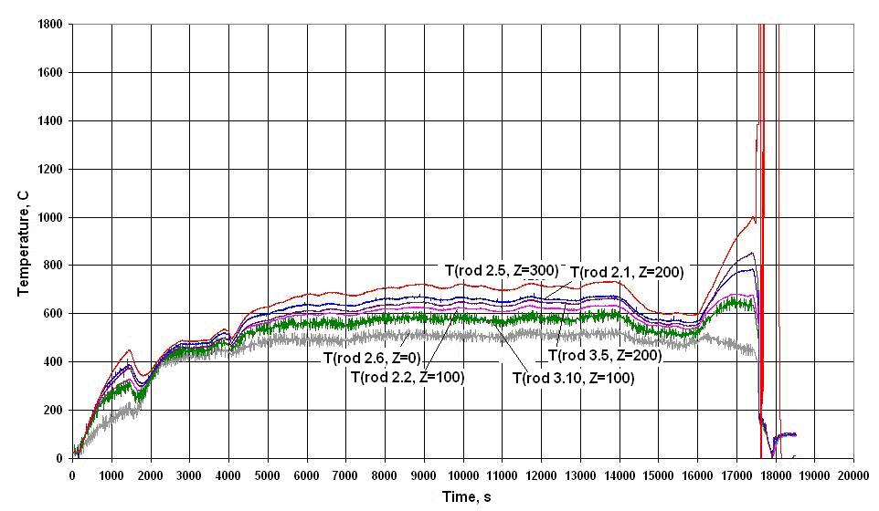
Claddings temperature at level Z=0-300

Slide 19
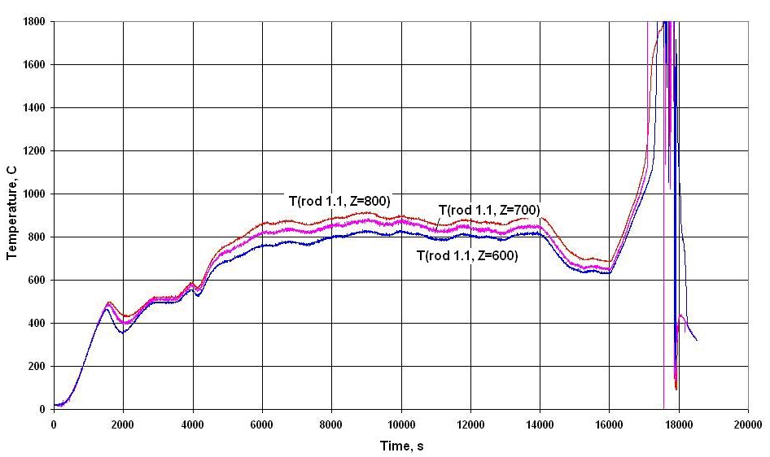
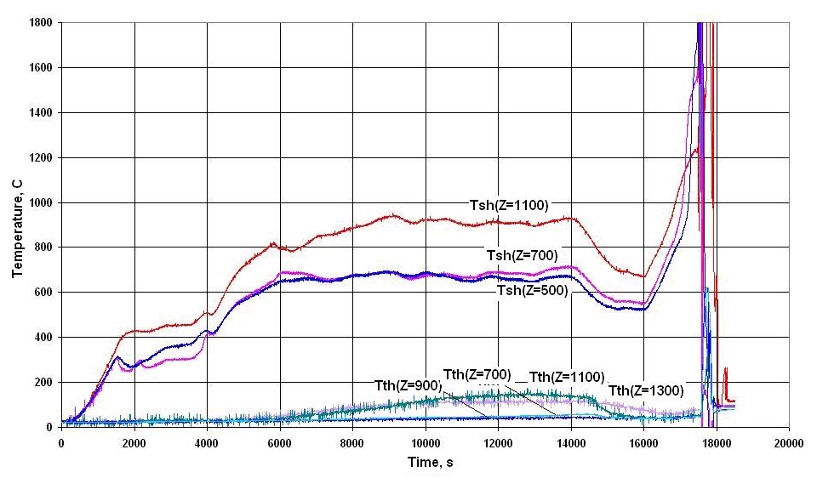
Temperature of central rod, shroud and thermoinsulation
Temperature of central rod
Temperature of shroud
and thermoinsulatin

Slide 20
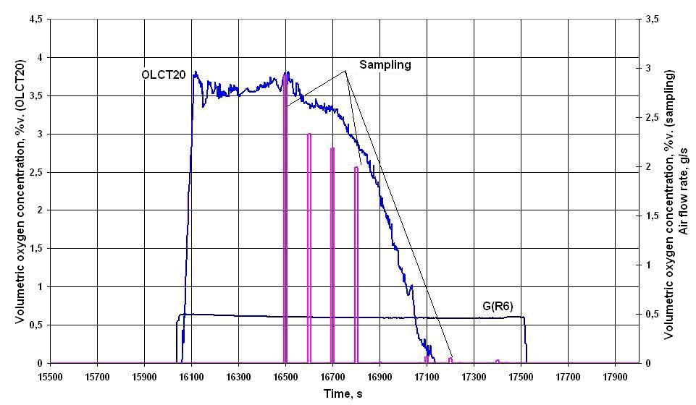
Measuring of volumetric oxygen concentration

Slide 21
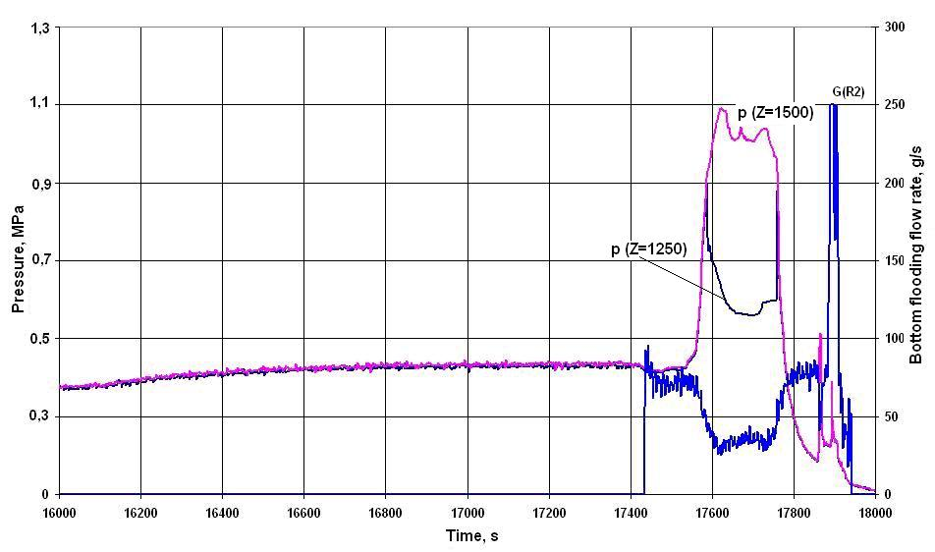
Pressure into the bundle during bottom flooding

Slide 22
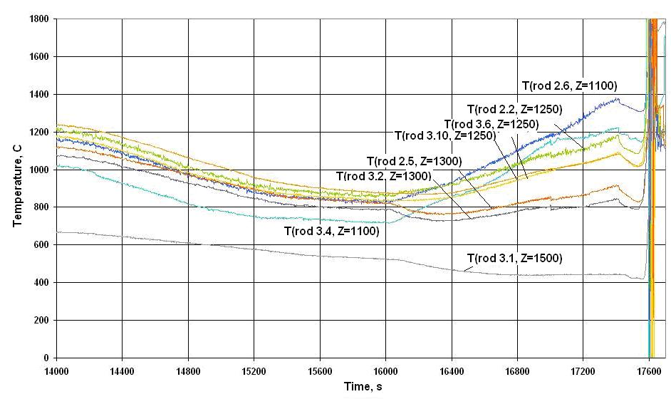
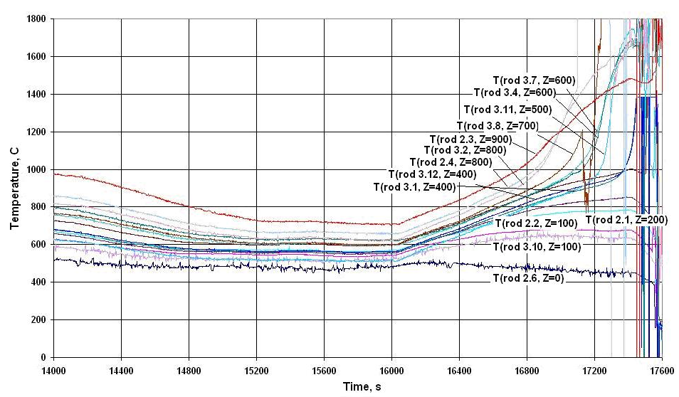
Temperature of upper and bottom parts of bundle
Claddings temperature
of upper part of test
bundle
Claddings temperature
of bottom part of test
bundle

Slide 23
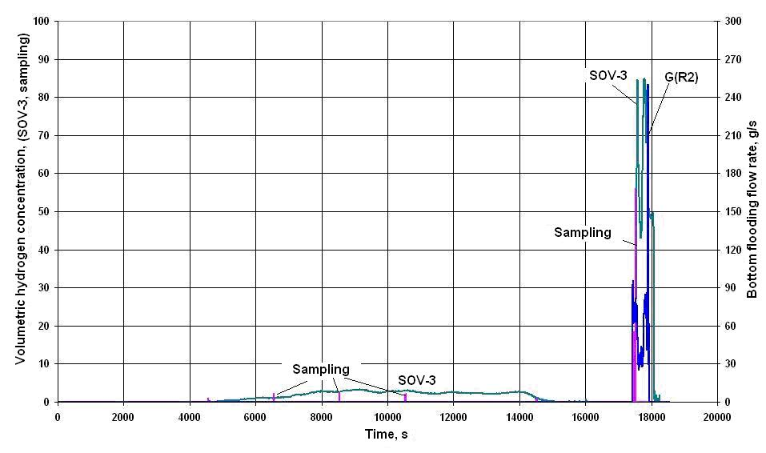
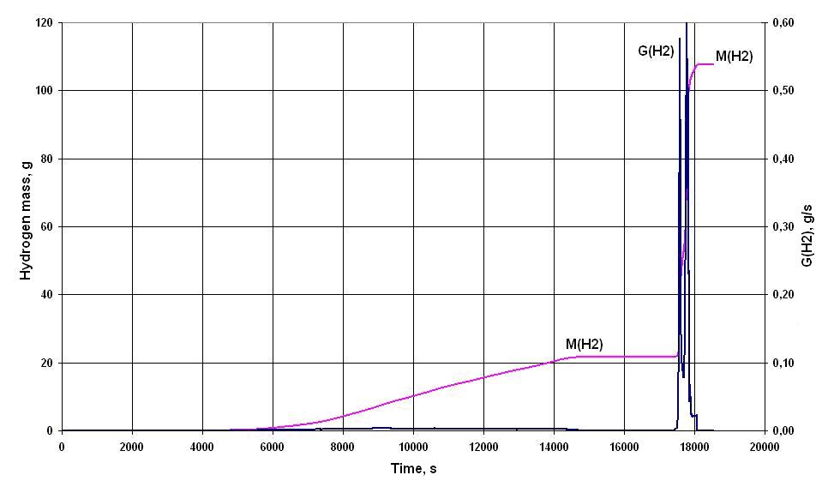
Measuring of volumetric hydrogen concentration
Volumetric hydrogen
concentration
Mass of hydrogen

Slide 24
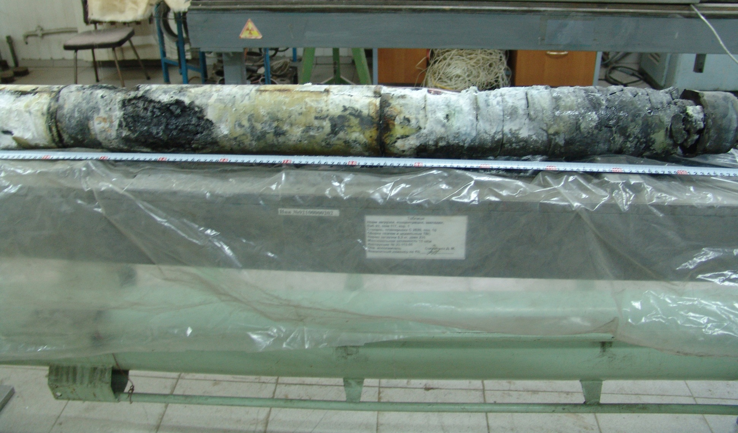
Appearance of bundle after tests
bottom part
(100 – 500)
central part
(500 – 1000)
upper part
(1000 – 1300)

Slide 25
CONCLUSIONS
1. Experiment PARAMETER-SF4 on simulating the initial stage of severe accident, including the stages of the air ingress and the bottom flooding, has been carried out.
2. The main parameters of experiment:
- the steam flow rate ~ 3.5 g/s at temperature ~ 500 °С;
- the argon flow rate ~ 2.0 g/s at temperature ~ 300 °С;
- the air flow rate ∼ 0.5 g/s;
- the duration of the pre-oxidation stage ~ 6000 s at temperature ~ 1200 °С;
- the temperature of bundle at the moment of switching on the system of the bottom flooding – 1740 °С.
3. The total of hydrogen measured by continuous monitoring systems of hydrogen (SOV-3), has not exceeded ~110 g. The hydrogen measured the duration of the pre-oxidation stage has not exceeded ~21 g.
4. The cooling overheated up to ~ 1740°C of the bundle has been achieved for
~ 1000 s at the water flooding from bottom with flow rate ~ 80 g/s.
5. Conservation and preliminary cutting of the bundle has been carried out.

