Slide 1
FSUE SRI SIA “LUCH”
IBRAE RAS
OKB “GIDROPRESS”
I S T C
Study of Fuel Assemblies with Boron Carbide Absorber Rods under Severe Accident Conditions
in the PARAMETER-SF Test Series
(The Project ISTC #3936)
Presented by W. Nalivaev
CEG-SAM – 15, Villigen, Switzerland, March 10-12, 2009.

Slide 2
Objective:
The study of behaviour of two 18-rods simulators fuel assembly VVER-1000 completed with standard constructional materials (constructional, fuel and absorber elements on basis of B4C) under severe accident conditions at the top flooding.

Slide 3
The mane tasks of the Project
Task 1. The first year of the Project.
The study of change of structure of materials of fuel assembly VVER-1000
with absorber element under initial stage of severe accident conditions
at the top flooding of assembly, heated up to temperature less 1250°С
(PARAMETER-SF5):
- Preparation and carrying out of PARAMETER-SF5 experiment.
- Post-test the material analysis.
- Processing results of PARAMETER-SF5 experiment.
Task 2. The second year of the Project.
The study of change of structure of materials of fuel assembly VVER-1000 with
absorber elements under severe accident conditions at the top flooding
of assembly, heated up to temperature less 1450°С (PARAMETER-SF6):
- Preparation and carrying out of PARAMETER-SF6 experiment.
- Post-test the material analysis.
- Processing results of PARAMETER-SF6 experiment.
- Preparation and release of the final report.

Slide 4
The technical approach and methodology, codes
The methodology of realization of tasks of the Project includes the mane
stages:
Preparation and carrying out of experiment:
- Development of the script and the basis tasks of experiment;
Development of settlement model and carrying out of calculations
of modes and parameters of tests of experiment on the basis of settlement
codes СОКРАТ/В1, PARAM-TG, ТЕЧЬ - M, RELAP/SCADSIM,
ICARE - CATHARE;
- Assembly, installation fuel assembly and preparation of technological systems
the facility for carrying out of experiment;
- Complex starting-up and adjustment works;
Carrying out of experiment.
Post-test the material analysis:
Cutting on fragments fuel assembly, past tests in experiment, and
preparation templets;
- Optical and electronic microscopy;
- X-rays the analysis.
Processing results of experiment and release of reports with results:
Measurements of parameters fuel assemblies, controllable in process
experiments;
- Post-test material researches of fuel assemblies.
Preparation and release of the final report.

Slide 5
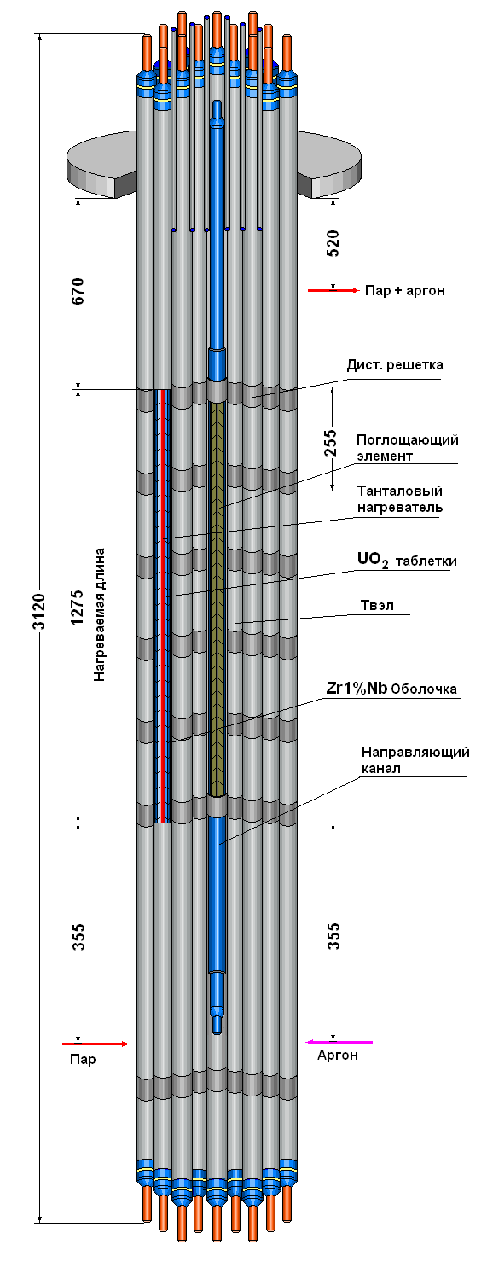
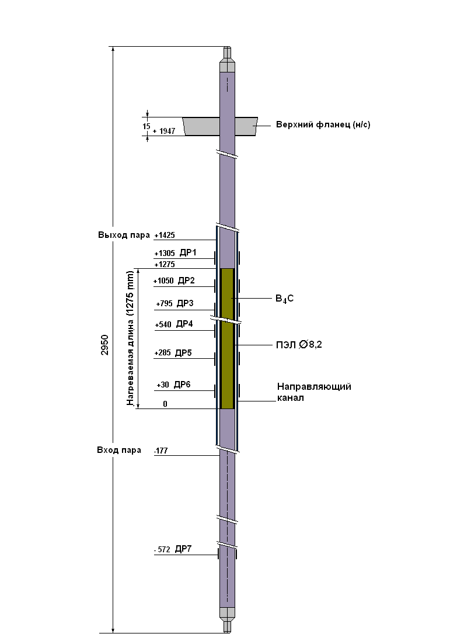
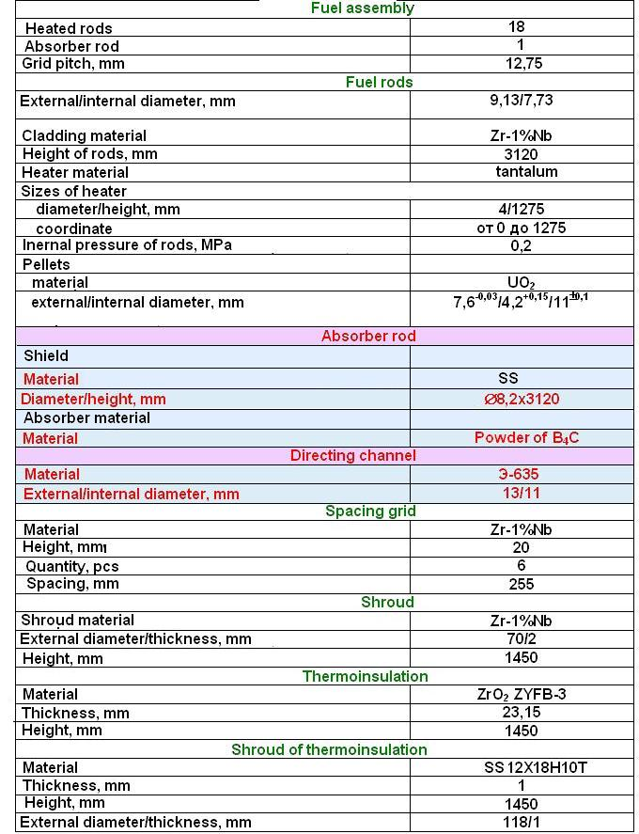
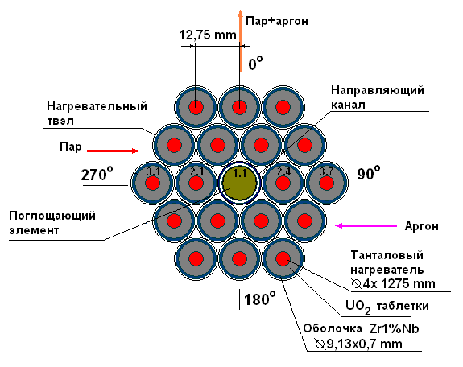
Main characteristics of bundle with absorber rod.

Slide 6
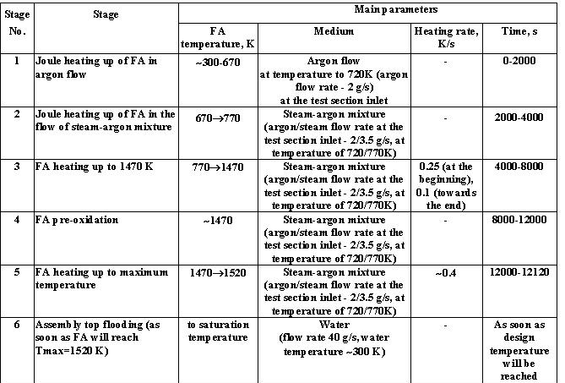
Suggested scenarios of experiments
1) The scenario of SF5 experiment

Slide 7
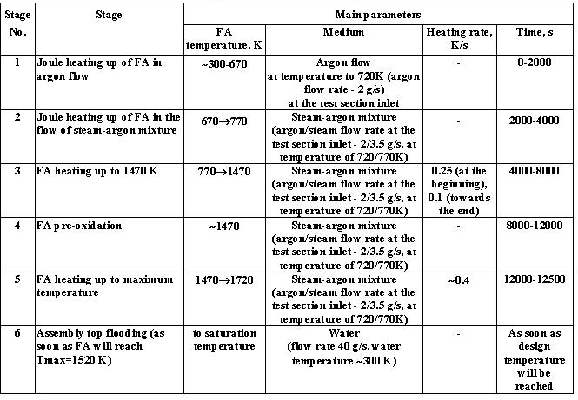
2) The scenario of SF6 experiment

Slide 8
Expected results under the Project
At realization of the Project:
- The information on behaviour of fuel assembly with absorber rod on a basis B4C under accident conditions at the top flooding is received and systematized.
- Are investigated a degree of oxidation of cladding on length absorber rod depending on temperature and a degree of fusion of metal of the cladding directing pipes and materials of the absorber rod.
- The structure of the hardened mixes after running off fusion is received.
- The database for verification accident codes (СОКРАТ/В1, ATHLET, ICARE-CAТHARE, etc.) is expanded.
The received results can be used for a substantiation of safety of reactors such as VVER (PWR)

Slide 9
Participants of the Project
The mane participants
FSUE SRI SIA “LUCH”– carrying out of experiments, рost-test calculation and material analysis;
IBRAE RAS – development of scenario of experiments, the pre-test and post-test analysis;
OKB “GIDROPRESS” – development of scenario of experiments, the analysis of a degree of conformity of experiments, pre-test and post-test analysis

Slide 10
Participants of the Project
Leading experts of the organizations:
A.A. Bochvar FSUE VNIINM,
A.I. Leipunsky SRC RF - IPPE,
RRC “Kurchatov institute”,
Open Society «Moscow factory of polymetals»

Slide 11
Time of realization of the Project - 24 months
The expected volume of financing - $ 600 thousand

