Slide 1

Numerical simulation of Oxidation
of the Suboxidated corium melt
Presented by Sergey Smirnov
D.V. Efremov Scientific Research Institute of Electrophysical Apparatus
A.P. Alexandrov Research
Institute of Technology
METCOR-P Seminar 2010
St-Petersburg , Russia
June, 1, 2010

Slide 2
Objective:
Prove the possibility of correct numerical simulation
of the oxygen deposition rate on the melt free surface
Reason:
Preparation a paper
“Oxidation kinetics of the corium melt under a hard accident PWR”
based on materials presented on METCOR-P Seminar
May, 2009
St-Petersburg , Russia

Slide 3
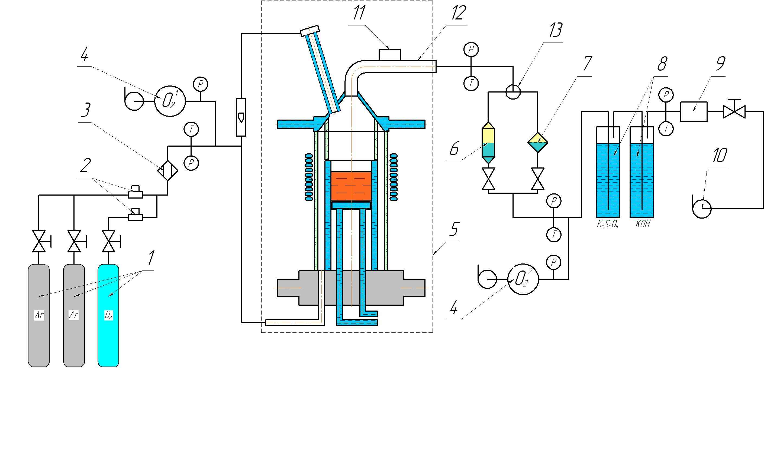
Furnace Schematic
1 – Tanks with Ar and O₂; 2 – Mass flow controller; 3 – Mixing device; 4 – Electrochemical oxygen sensor; 5 - Inductor furnace; 6 – Middle area filter; 7 – Analytical filter; 8 – Scrubber; 9 – Gas flow meter; 10 – Fan; 11 – Vibrator; 12 – Copper gas main

Slide 4
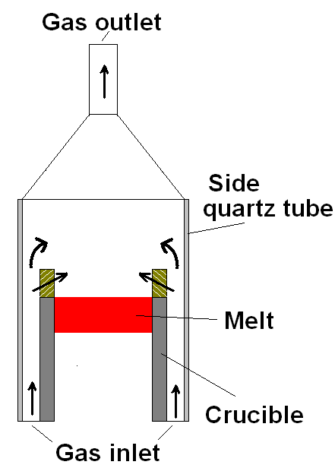
Pr1-EV1 experiment
(Geometry without inner quartz tube)
Experimental Oxygen deposition rate is 9.3±0.3 mg/s
Ar flow rate (G_{ar5}),
O₂ flow rate (G_{ar6}),
Inlet oxygen component part (O_{x1}),
Outlet oxygen component part (O_{x2}),
Outlet gas temperature (ТС₂₂)

Slide 5
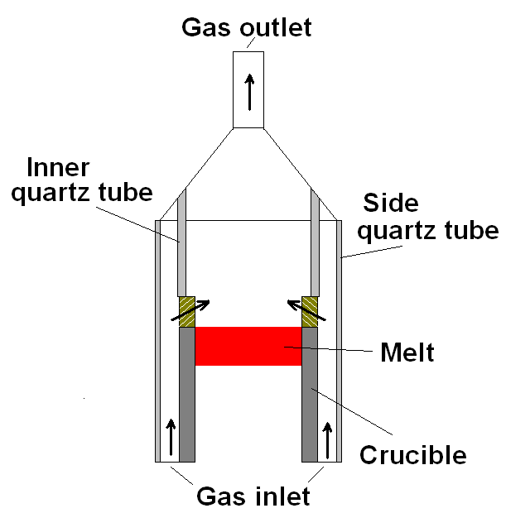
2. EV1 experiment
(Geometry with inner quartz tube)
Experimental Oxygen deposition rate is 15±1 mg/s
Ar flow rate (G_{ar5}),
O₂ flow rate (G_{ar6}),
Inlet oxygen component part (O_{x1}),
Outlet oxygen component part (O_{x2}),
Outlet gas temperature (ТС₂₂)

Slide 6
Mathematical model describes
3D unsteady flow of Ar:O₂ gas mixture
taking into account:
Heat and mass transfer (convection, radiation, molecular heat conductivity, molecular diffusion and thermal-diffusion);
Gravitation forces (free convection);
Turbulence (Large Eddy Sumulation);
Oxygen deposition on the free melt surface

Slide 7
Governing equations for modeling heat and mass transfer
1
(1)
Continuity
(2)
Navier-Stokes
equation with effective viscosity
Heat transfer
(3)
Mass transfer
(4)

Slide 8
Governing equations for modeling
of the heat and mass transfer
2
Smagorinsky model for turbulent viscosity – Large Eddy Simulation
(5)
Radiative heat transfer along opaque/transparent boundary
(6)
Heat transfer along solid/solid interfaces, gas/liquid interfaces
(7)

Slide 9
Equations for the oxygen deposition rate on the melt surface
3
Hertz–Knudsen equation for
deposition rate
on a surface
Sticking coefficient
Oxygen partial pressure on the melt surface

Slide 10
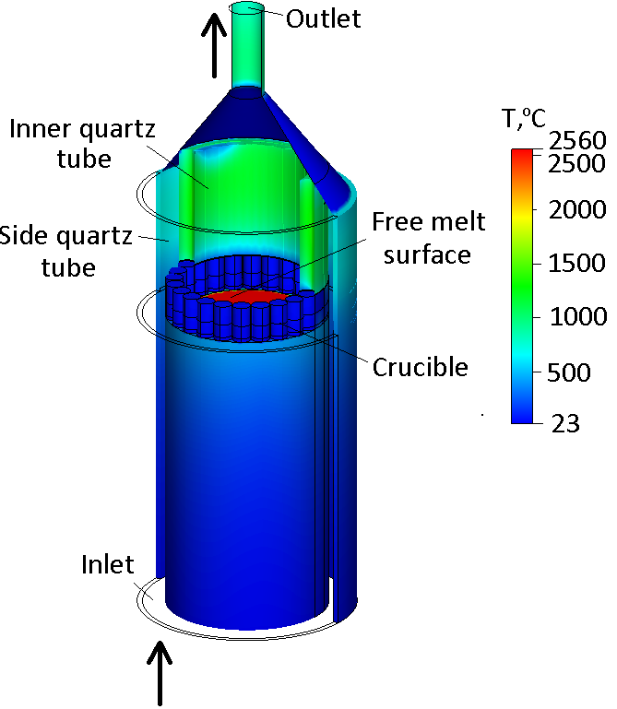
Boundary conditions
(1) Inlet gas mixture – Ar:O₂ = 0.8:0.2;
Geometry with
inner quartz tube
(2) Inlet total flow rate – Q_{inl} = 10 slm;
(3) Inlet gas temperature – T_{inl} = 27 ºC;
(4) Outlet pressure – ;
(5) Side wall temperature – T_{w} = 27 ºC;
(6) Gas velocity on the walls – ;
(7) Melt free surface temperature – T_{surf} = 2560 ºC

Slide 11
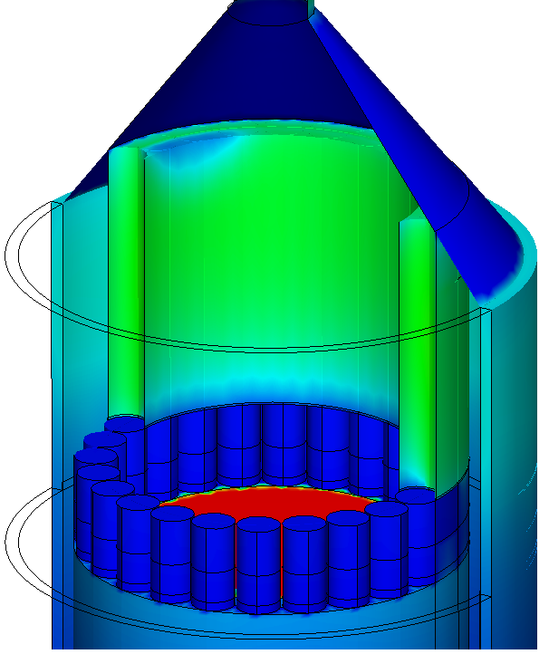
Computational domain
Gaps between tubes of the cold crucible are inlets for gas flow into the volume over the free melt surface

Slide 12
COMPUTATIONS
RESULTS

Slide 13
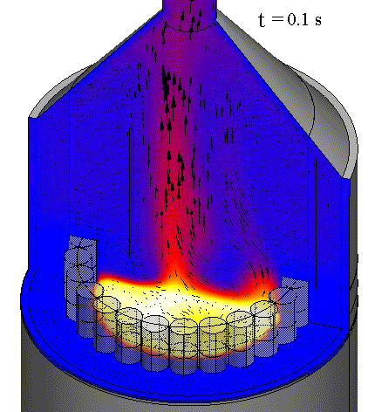
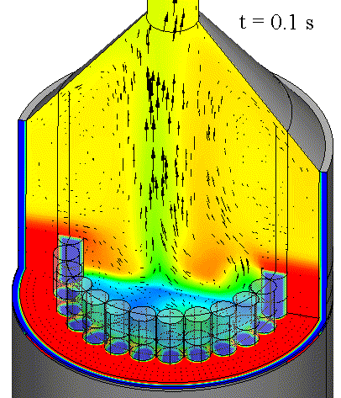
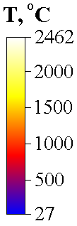

Animations without quartz tube -
Pr1-EV1
Temperature, Δy = 1 mm
Oxygen fraction, Δy = 0 mm
13
Δy – the distance of the horizontal cross section from the melt free surface

Slide 14
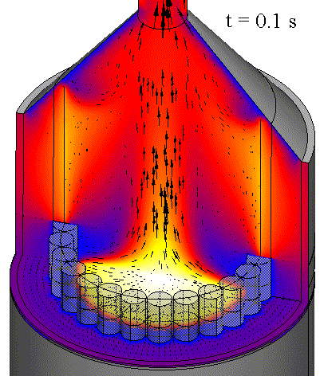
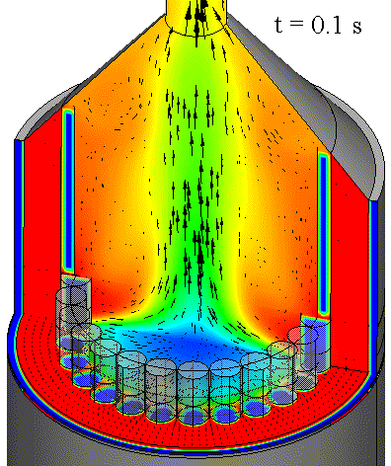
Animations with quartz tube -
EV1
Temperature, Δy = 1 mm
Oxygen fraction, Δy = 0 mm
14
Δy – the distance of the horizontal cross section from the melt free surface

Slide 15
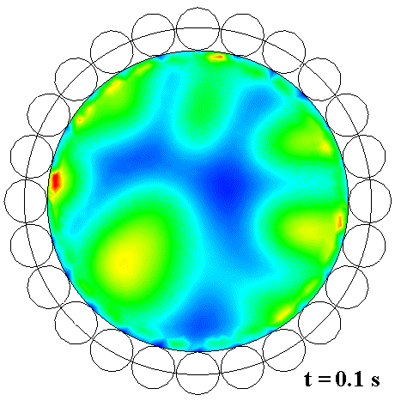
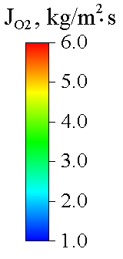
Animations of the oxygen deposition rate without quartz tube - Pr1-EV1
Dynamic evolution
Free melt surface
15

Slide 16
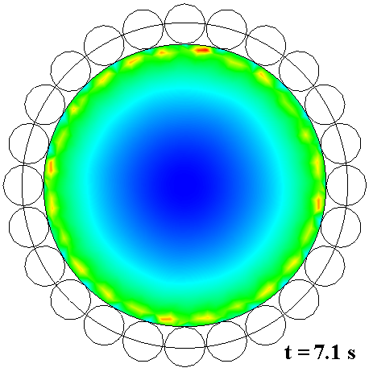
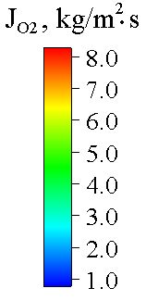
Oxygen deposition rate with quartz tube - EV1
Quasi -Steady
Distribution
Free melt surface
16

Slide 17
Comparison of the experimental data
and computations results
Pr1-EV1
EV1
Computations
mg/s
10.80 (±0.6)
12.80 (±0.05)
Experiment
9.3 (±0.3)
15.0 (±0.8)
Relative deviation
%
+15
-16
Possible reasons for divergence of experimental data and calculations:
Non-uniform temperature distribution on the melt free surface
Different gaps between crucible sections
Insufficiently accurate description of conditions near crucible sections
17

Slide 18
Conclusions:
Installation of internal quartz tube stabilizes above-melt gas flow.
Calculated and experimental data of oxygen deposition rate on the melt free surface have a good agreement.
Perspectives for numerical model development:
Take into account the sensitivity of equilibrium pressure and oxygen sticking coefficient to local parameters of the melt free surface.
Describe multi-component gas mixtures with heterogeneous and gas-phase chemical reactions.
18

Slide 19
Thank you for the attention!
19

