Slide 1
PROBLEM OF URANIUM AND TRANSURANIC ELEMENTS ACCUMULATION IN «SHELTER» OBJECT AQUEOUS CLUSTERS AS NUCLEAR AND RADIATION HAZARD FACTOR
(Status of Project № 4207)
Viktor Krasnov
Aleksey Odintsov
Institute for safety problems of nuclear power plants
Ukraine’s NAS
2008 г

Slide 2
Purpose of work :
- obtaining new experimental data characterizing leaching processes of uranium, ²³⁸Pu, ²³⁹⁺²⁴⁰Pu, ²⁴¹Am and ²⁴⁴Cm carry over by water flows in ChNPP Unit 4 rooms;
- research of peculiarities and correlations of uranium and transuranium elements isotope content of liquid radioactive waste (LRW) clusters on “Shelter” object bottom marks;
- estimate of radionuclide and fissionable elements accumulation velocity in bottom sediments on lower Unit marks;
- study of main physicochemical properties and radionuclide content of bottom sediments in non-organized aqueous clusters of «Shelter» object.

Slide 3
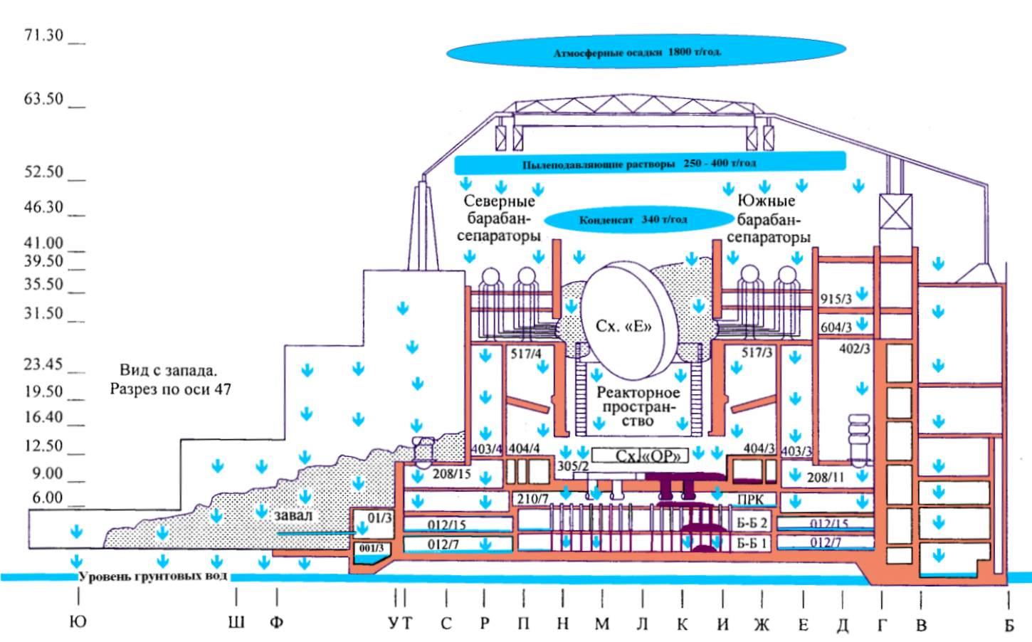

Slide 4
Main sources of water penetration in «Shelter» object :
Atmospheric precipitation - ∼ 1500 m³;
Condensate moisture - ∼ 1600 m³;
Work of dust suppression system – 150 - 200 m³.
Water consumption :
Evaporation in autumn-winter period - ∼ 2000 m³;
Spill over outside «Shelter» object - ∼ 1000 m³.
In bottom mark rooms there are constantly, depending on season 380 - 400 m³ LRW .

Slide 5
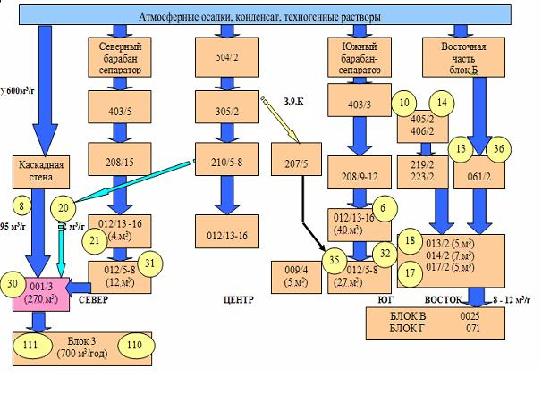

Slide 6
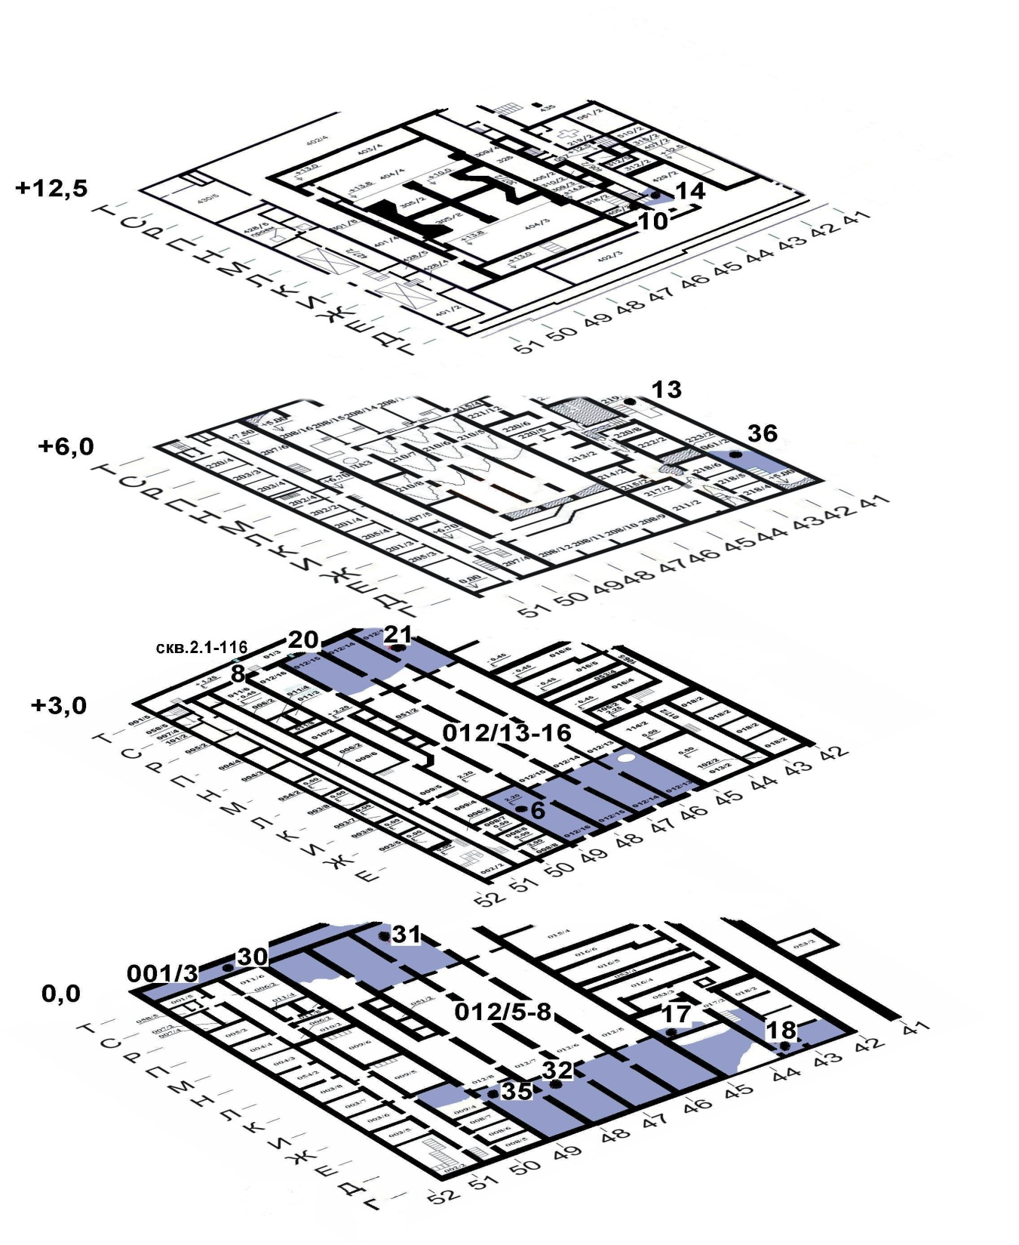

Slide 7
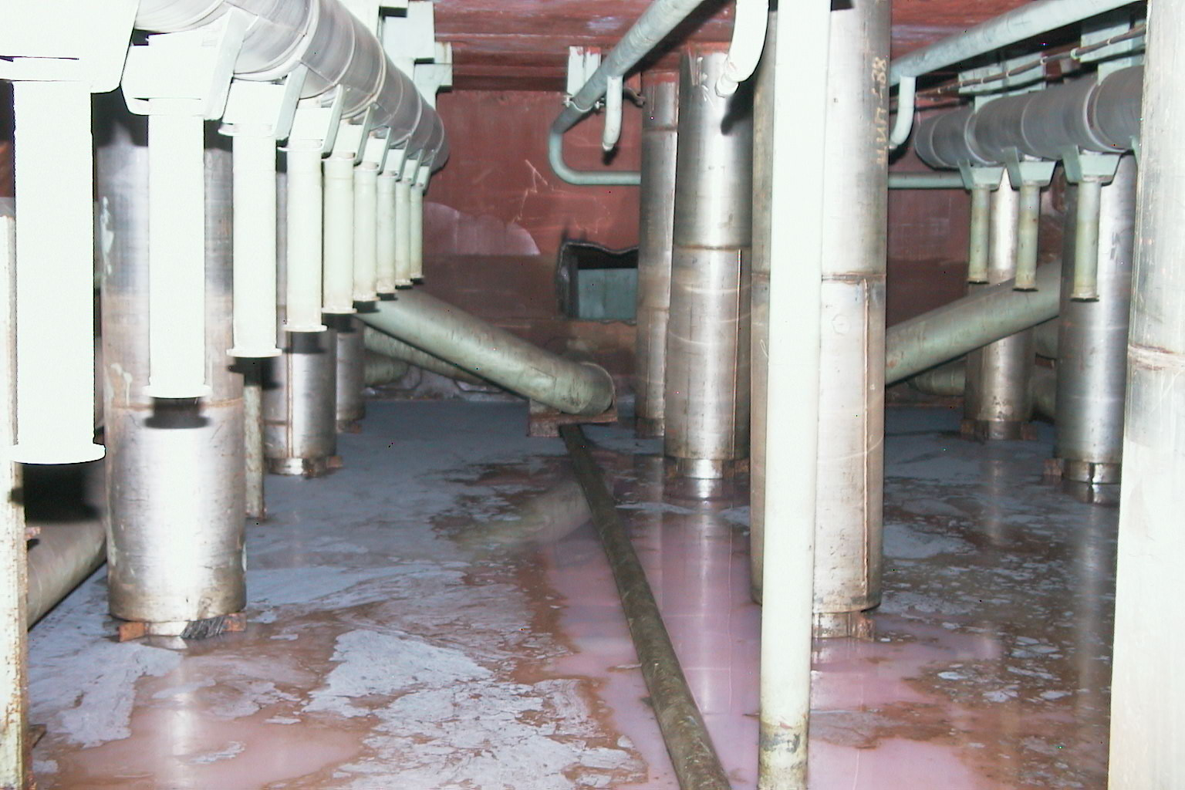
Fig. 4. LRW cluster in southern part of pressure suppression pool

Slide 8
Fig. 5. Seasonal changes of uranium concentration in LRW cluster
in room 001/3 (point 30)

Slide 9
Fig. 6. Dynamics of ⁹⁰Sr and ²³⁸⁺²³⁹⁺²⁴⁰Pu concentrations in LRW cluster in room 001/3 (point 30), Bq/m³

Slide 10
Fig. 7. Annual average uranium concentration in LRW from
steam distribution corridor (SDC, point 20), g/m³

Slide 11
Table 1. Mass contents of uranium isotopes in «Shelter» object LRW, %
Sampling point | ²³⁴U | ²³⁵U | ²³⁶U | ²³⁸U
6 | 0,0192 | 1,074 | 0,189 | 98,72
17 | 0,0154 | 1,162 | 0,173 | 98,65
18 | 0,0167 | 1,191 | 0,175 | 98,62
20 | 0,0165 | 1,064 | 0,181 | 98,74
21 | 0,0172 | 1,085 | 0,188 | 98,71
30 | 0,0181 | 1,083 | 0,186 | 98,71
31 | 0,0179 | 1,067 | 0,192 | 98,72
32 | 0,0161 | 1,058 | 0,177 | 98,75
35 | 0,0152 | 0,905 | 0,173 | 98,91

Slide 12
Fig. 8. Dynamics of activity change of transuranic elements in room
001/3 (volumetric activity, kBq/m³)

Slide 13
Fig. 9. Dynamics of seasonal changes of transuranic elements concentration in room 01/3, SDC tube, sampling point 20, volumetric activity, kBq/m³

Slide 14
Table 2. Radionuclide volumetric activity in “Shelter” object liquid radioactive waste, as of June 01, 2008, Bq/m³
Radionuclide | Room 012/16 (p. 6) | Room 01/3 tube from SDC (p. 20) | Room 001/3 (p. 30) | Room 012/7 (p. 32)
²³⁸Pu | (3,9 ± 0,4) · 10⁶ | (5,2 ± 0,5) · 10⁶ | (1,6 ± 0,2) · 10⁶ | (3,6 ± 0,4) · 10⁶
²³⁹⁺²⁴⁰Pu | (7,5 ± 0,7) · 10⁶ | (1,1 ± 0,1) · 10⁷ | (3,1 ± 0,5) · 10⁶ | (7,5 ± 0,1) · 10⁶
²⁴¹Am | (8,9 ± 0,5) · 10⁷ | (1,3 ± 0,2) · 10⁸ | (3,1 ± 0,4) · 10⁷ | (1,1 ± 0,2) · 10⁸
²⁴²Cm (^{242m}Am) | (2,2 ± 0,5) · 10⁵ | (2,3 ± 0,4) · 10⁵ | (1,2 ± 0,4) · 10⁵ | (2,6 ± 0,6) · 10⁵
²⁴⁴Cm | (3,5 ± 0,7) · 10⁶ | (4,5 ± 0,5) · 10⁶ | (2,1 ± 0,4) · 10⁶ | (4,8 ± 0,8) · 10⁶

Slide 15
Fig. 10. Scheme of aqueous leakages and clusters with different values of ²³⁸Pu/²³⁹⁺²⁴⁰Pu relation

Slide 16
Table 3. Relations of TUE activities in LRW of «Shelter» object different rooms, rel. un
 | Room | ²³⁸Pu/²³⁹⁺²⁴⁰Pu | ²⁴¹Am/²³⁹⁺²⁴⁰Pu | ²⁴⁴Cm/²³⁹⁺²⁴⁰Pu
North | 01/3 | 0,491 | 7,5 | 0,31
 | 012/13 | 0,448 | 2,1 | 0,098
 | 001/3 | 0,502 | 11 | 0,51
South | 012/16 | 0,519 | 12 | 0,55
 | 012/7 | 0,520 | 11 | 0,54
East | 061/2 | 0,466 | 5,6 | 0,43
 | 406/2 | 0,446 | 3,7 | 0,13
South-east | 017/2 | 0,453 | 2,9 | 0,10
ChNPP Unit 4 “average” fuel |  | 0,504 | 1,5 | 0,078

Slide 17
Fig. 11. Relation of ²⁴¹Am activity to ²³⁹⁺²⁴⁰Pu activity in «Shelter» object LRW

Slide 18
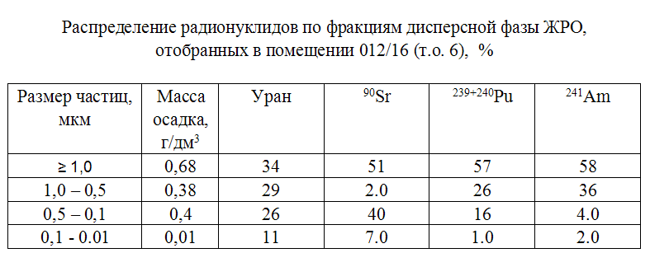
Table 4. Distribution of radionuclides in disperse phase fractions of LRW sampled in room 012/16 (s. p. 6) %

Slide 19
In «Shelter» object LRW localization places, bottom sediments and dried colloid forms containing uranium, fission products and transuranic elements, are produced.
Due to last estimates, bottom sediment volume in room 001/3 can exceed 90 m³.
Estimated uranium content in room 001/3 bottom sediment is more 80 kg, on top of that, ²³⁵U and ²³⁹Pu fissionable materials amount makes around 860 and 430 g correspondingly, that can not be unconsidered in assessing «Shelter» object nuclear safety.

Slide 20
Table 5. Fractional distribution of activity in bottom sediments sample from room 001/3, Bq/kg
Radionuclide | Size of particle
 | D.≥100 µm 65,4 % mass | D =10-100 µm 30,3 % mass | D=1-10 µm 1,3 % mass | D= 0,1-1 µm 1,9 % mass | D= 0,01-0,1 µm 1,1 % mass
²⁴¹Аm | 1,7 · 10⁶ | 4,5 · 10⁶ | 2,1 · 10⁷ | 9,5 · 10⁷ | 5,6 · 10⁷
⁶⁰Со | 1,6 · 10⁵ | 1,6 · 10⁵ | - | 2,4 · 10⁶ | 1,5 · 10⁶
¹³⁷Cs | 1,0 · 10⁹ | 1,0 · 10⁹ | 9,7 · 10⁸ | 6,7 · 10⁹ | 3,8 · 10⁹
¹⁵⁴Eu | 7,0 · 10⁵ | 1,4 · 10⁶ | 3,9 · 10⁶ | 3,0 · 10⁷ | 2,0 · 10⁷
²³⁸⁻²⁴⁰Pu | 4,8 · 10⁵ | 1,3 · 10⁶ | 5,3 · 10⁶ | 2,1 · 10⁷ | 1,2 · 10⁷
²⁴⁴Cm | 6,1 · 10⁴ | 1,8 · 10⁵ | 1,2 · 10⁶ | 4,6 · 10⁶ | 2,6 · 10⁶
⁹⁰Sr | 2,9 · 10⁹ | 4,5 · 10⁹ | 6,3 · 10⁶ | 6,6 · 10⁹ | 6,5 · 10⁷
U, g/kg | 1,9 | 1,1 | 1,0 | 4,2 | 5,8

Slide 21
Table 6. Radionuclide leaching velocity from LFCM by solution imitating «unit» water, g ∙ cm ^{–2} ∙ day ^{–1}
LFCM | ¹³⁷Cs | ⁹⁰Sr | ²³⁹⁺²⁴⁰Pu | ²⁴¹Am
Polychromatic ceramics | 3,4 · 10 – ⁷ | 4,9 · 10 – ⁷ | 4,2 · 10 – ⁷ | 2,9 · 10 – ⁷
Brown ceramics | 5,6 · 10 – ⁷ | 8,5 · 10 – ⁷ | 5,0 · 10 – ⁷ | 3,0 · 10 – ⁷
Black ceramics | 7,0 · 10 – ⁷ | 5,6 · 10 ⁻ ⁷ | 3,9 · 10 ⁻ ⁷ | 1,8 · 10 ⁻ ⁷
Average | (5,3 ± 1,8) · 10 – ⁷ | (6,3 ± 1,9) · 10 ⁻ ⁷ | (4,4 ± 0,6) · 10 ⁻ ⁷ | (2,6 ± 0,7) · 10 ⁻ ⁷

Slide 22
SUMMARY :
Main moisture sources are atmospheric precipitation and condensate producible in period May – August due to difference of temperature and moisture content of atmospheric air of Unit bottom mark’s rooms, whose summary volume exceeds 3000 m³/year.
Basically, in «Shelter» object aqueous clusters (in room 001/3 the LRW volume makes 270 m³) ⁹⁰ Sr, uranium and TUE content has been considerably grown.
Concentration of alpha-emitting nuclides in LRW is more than 20 fold exceeds admissible limit established for normal handling procedure of Chornobyl nuclear power plant LRW.
Main input in alpha-activity (to 85 %) brings ²⁴¹Am.
Ratios between transuranic element activities in each aqueous cluster has its specific meaning conditioned for plutonium isotopes by fuel burning depth, and for plutonium, americium and curium – by specificity of their chemical behaviour in alkaline-carbonate solutions.
Transformation (dissolution) of diverse types of «Shelter» object fuel-containing masses occurs with different speed and rate. Over 100 years, in soluble and colloid forms, approximately 4 % fuel (not more 1000 kg) is transformed, which is contained within fuel pellets and major fuel particles, and less 0,02 % fuel contained within fuel assembly and fuel rod fragments.

Slide 23
Status of Project № 4207
(as of September 2008)
1. According to above information, importance and priority in implementing works for additional researches, as well as «Shelter» object LRW characterization and management, is evident.
2. Project № 4207 works were assumed to perform jointly with Kyiv Institute «Silhospradiologiya» beginning from 2007 year.
3. All required materials for Project № 4207 have being forwarded to UNTC since 2006 year.
4. Unfortunately, until now the issue of funding Project № 4207 is not yet solved, that delayed acquisition of needed materials and equipment.
5. In spite of above, ISP NPP, initiative in order, is carrying out some works in this field.

