Slide 1
OPTICAL METHODS FOR INVESTIGATION OF PROCESS IN PIPE

Slide 2
OPTICAL INVESTIGATIOM METHODS FOR KINEMATIC FLOW CHARACTERISTICS
Measured data
Profile velocity (average value of two components across the tube) in four cross section along the tube
Pulsation component of velocity

Slide 3
VELOCIMETER SYSTEM
v
Sending
optics
Receiving
module
Laser
TRAVERSING SYSTEM
Aperture
Doppler
signal
processor
PC

Slide 4
LDA SYSTEM WITH BRAGG CELL AND LASER BEAM EXPANDER
1 - laser; 2,4 – beam splitter; 3 – Bragg cell; 5 – beam expander;
6 – frontal lens; 7 – working portion; 8 – LD receiving lens;
9 – photoelectric multiplier.

Slide 5
BLOCK-DIAGRAM OF THE LDA DATA ACQUISITION MEASUREMENT SYSTEM
1 – light detector device; 2 – working portion; 3 – optical forming system; 4 – laser; 5 – PEM power supply; 6 - Bragg cell driver; 7-laser power supply; 8- stepper; 9 – stepper power supply and control

Slide 6
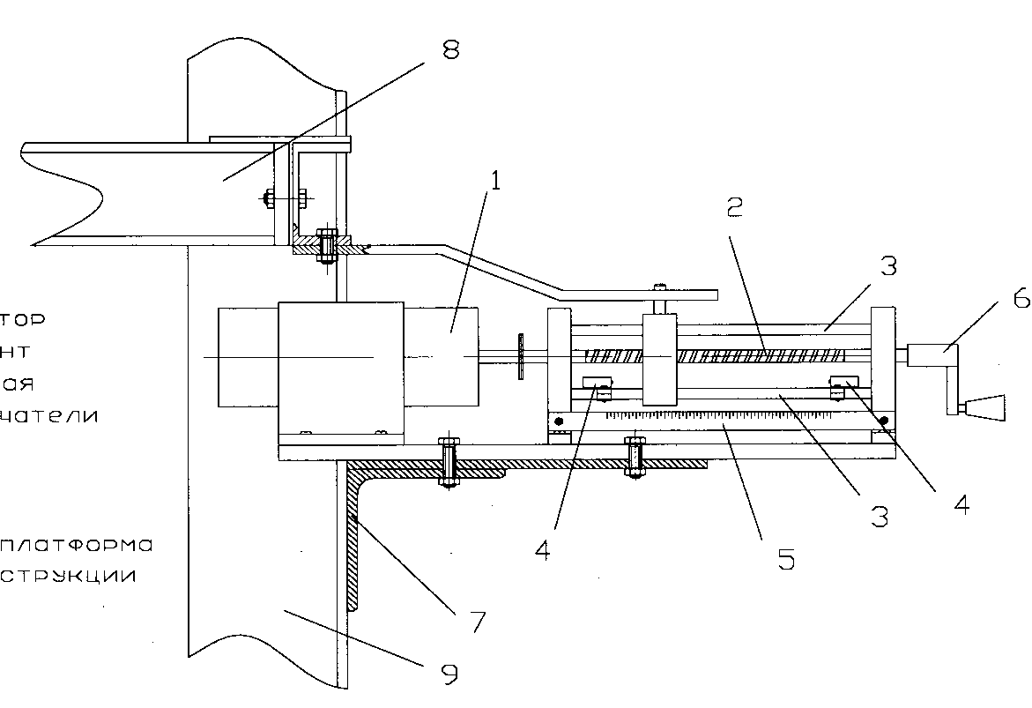
REMOTE CONTROL ACTUATOR
1 – stepper; 2 – lead screw; 3 – guide; 4 – microswitches;
5 – scale bar; 6 – handle; 7 – bracket; 8 – movable platform;
9 – steel structure.

Slide 7
Tansmission system focal distance F, mm
BASIC SPECIFICATIONS OF LDA OPTICAL MODULES
Level | I | II | III |  | IV
Laser type | Semiconductor | He-Ne | Semiconductor | Semiconductor
Laser wavelength λ, μm | 0.69 | 0.6328 | 0.69 | 0.69
Laser power, mW | 20 | 25 | 20 | 20
Bragg cell | - | + | + | -
Beam expanding ratio Е | 1 | 1.94 | 1,94 | 1
Transmission system focal distance F, mm | 150 | 310 | 310 | 310
Light detector optics focal distance, mm | 300 | 300 | 220 | 220
Beam convergence angle, degrees | 10.5 | 13.8 | 13.8 | 15.6
Characteristic dimension of the measurement space 2b, μm | 131.8 | 117 | 140.4 | 272,35
Fringe step, μm | 3.77 | 2.63 | 2.87 | 2.54
Fringe number, ea. | 35 | 44 | 49 | 107
Velocity range, m/s | +0.05 to+11.0 | -8.0 to 8.0 | -1.0 to +8.5 | +0.005 to +7.0

Slide 8
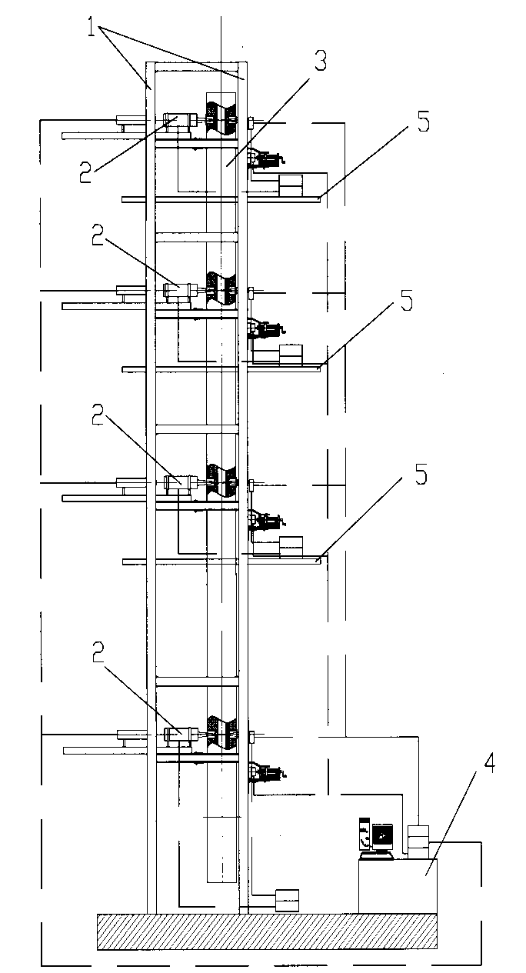
LDA SYSTEM FOR RECORDING THE VELOCITY FIELDS
1 – Steel structure;
2 – measurement set;
3– working portion;
4 – control panel;
5 – service platform

Slide 10
OPTICAL METHODS FOR DISPERSE ANALYSIS OF TWO PHASE FLOWS
Measured data
mean size of particles (particle size distribution)
volume (mass) concentration of particles

Slide 11
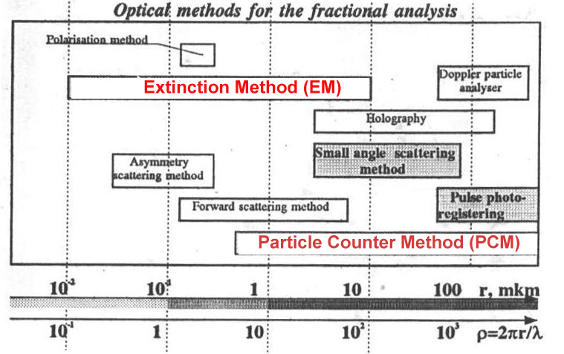
OPTICAL METHODS FOR THE FRACTIONAL ANALYSYS
Extinction method
Particle counter method (PCM)

Slide 12
EXTINCTION METHOD (EM)
Sending
optics
Laser
Receiver
(PM tube)
PC
Analog to digital
converter

Slide 13
PRINCIPAL OF MEASUREMENT AND CALCULATION

Slide 14
DEPENDING OF LIGHT EXTINCTION ON MASS CONCENTRATION OF PARTICLES (r=1μm, L=100mm) (estimation)

Slide 15
PARTICLE COUNTER METHOD (PCM)
Sending
optics
Receiving
module
Laser
PC
Pulse amplitude
analyzer

Slide 16
COMPARISON OF EXTINCTION AND PARTICLE COUNTER METHOD
 | EXTINCTION METHOD | PARTICLE COUNTER METHOD
Principle of method | Absolute method | Calibration of the probe is necessary
Droplet sizing | Average size. Preliminary information about type of distribution is necessary (two waves method). Size distribution (multi waves method) | Size distribution. Opportunity of measuring bimodal size distribution
Concentration measurement | Measurement of “frozen” value of concentration (1/m³) | Measurement of “rate” (velocity related) concentration (1 /m ²/s). Velocity value is necessary to calculate “frozen” value of concentration
Range of measurement | 0.1-1.2 μm | 0.2-10 μm
Time resolution | On-line measurement | Measurement duration is necessary to obtain the statistic
Space resolution | ≈100mm³ | Less then 0.01mm³

Slide 17
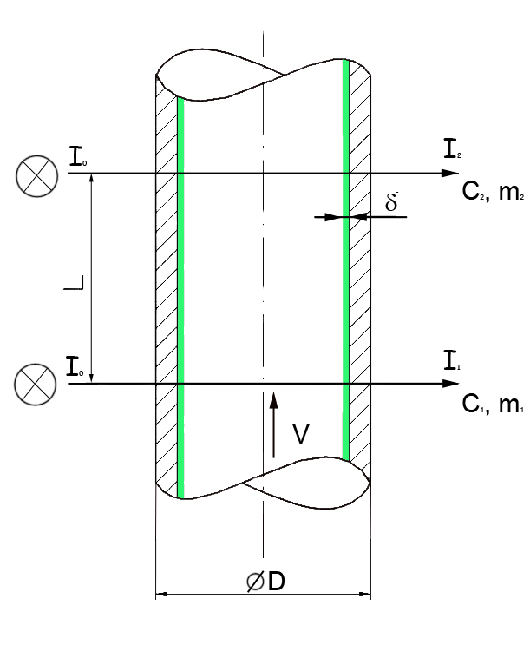
DEPOSITION THICKNESS MEASUREMENT ON THE BASE OF MEASUREMENT OF DROP’S CONCENTRATION
Velocity of deposition

Slide 18
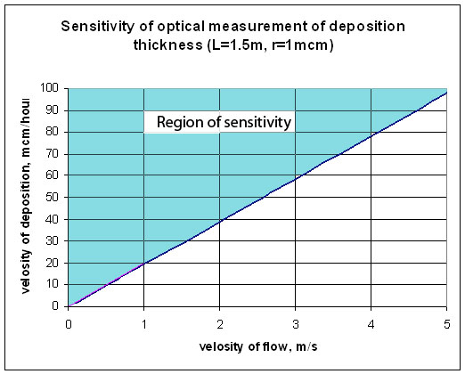
1μm)
μ
(estimation)
μm/h

