Slide 1
Cooperation between ISTC and SARNET in the Source Term Area
M. Veshchunov
Nuclear Safety Institute (IBRAE)
Russian Academy of Sciences
52 B. Tulskaya st., Moscow, 115191 – Russia
ERMSAR 2007
FZK, Karlsruhe, Germany
12-14 June 2007

Slide 2
International Science and Technology Center
An international organization dedicated to the non-proliferation of weapons and technologies of mass destruction
Founded in 1992 by an International agreement by the European Union, Japan, Russia, the USA and in 2004 by Canada
The main goal of ISTC is non-proliferation through science cooperation by integration of Russian and CIS scientists into the international scientific community, to foster the interaction between Russian and European scientists
An important asset in the Source Term and Corium areas is the expertise of the CEG-SAM (Contact Expert Group on Severe Accident Management) members supported by external EC-SARNET experts to select ISTC project proposals and to provide technical assistance as foreign collaborators

Slide 3
Cooperation between ISTC and EC Projects in Source Term Area
EC Projects
ISTC Projects
#1648.2: VVER-QUENCH
COLOSS (5th FP)
#3345: EVAN
SARNET (6th FP)
Proposal: VERONIKA

Slide 4
  Project #1648.2 “Examination of VVER Fuel Behaviour under Severe Accident Conditions. Quench Stage” (VVER-QUENCH)
Leading Institute: RIAR (State Scientific Centre "Research Institute of Atomic Reactors”)
Supporting Institutes: IBRAE (Nuclear Safety Institute of Russian Academy of Sciences),
JSC MSZ (Joint Stock Company "MASHINOSTROITELNY ZAVOD")
EC Collaborators: FZK, ITU, IRSN, CEA
Stage A. Spent ROD-QUENCH: Study of irradiated fuel rod segments behavior under reflood conditions
STAGE B. Fresh FA-QUENCH: Integral experiment of QUENCH type using model bundle with 31 fuel rod simulators under reflood conditions
STAGE C. FA Quench Model: Development of models and codes to describe VVER core behaviour under severe accident reflood conditions

Slide 5
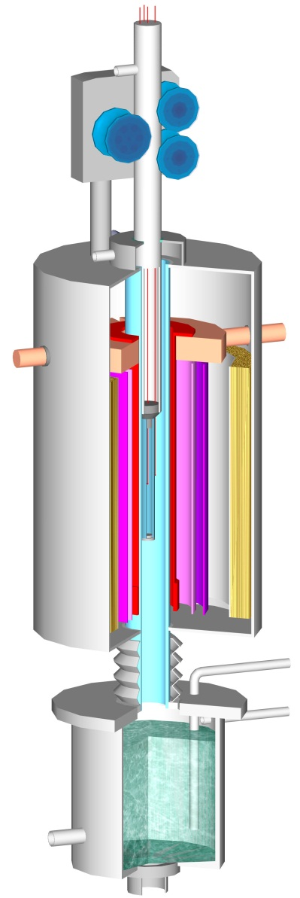
  Project #1648.2 Stage A:
  Study of Irradiated Fuel Rod Segments Behaviour under Reflood Conditions
5
6
Objectives:
Extension of the experimental database for irradiated
VVER fuel rods behaviour during reflooding:
Pre-oxidized cladding failure behaviour
Hydrogen generation
Fission products release
7
4
3
8
2
1
9
Scope of Work:
Test rig designing and manufacturing
Tests with un-irradiated fuel rod simulators:
  – to check the working capacity of the test rig
  – to compare with FZK similar tests results
  – to create the data base for comparison with irradiated fuel rod simulator tests
Tests with irradiated fuel rod simulators
10
11
15
12
14
13

Slide 6
RIAR Tests with Fresh Fuel Rod Simulators
Group | Test № | Initial temp., °С | Oxide thickness,μm | Metal thickness,μm | Elevation, mm | Cladding state after the test
I | 12 | 1400 | 201 | 574 | 57 | Net of through wall cracks in the central part of the rod.
 | 14 | 1600 | 216 | 571 | 77 | One circumferential through wall crack.
 | 15 | 1600 | - | - | - | One circumferential through wall crack. Breakdown into 2 parts.
II | 21 | 1400 | 13 | 703 | 127 | Intact. No through wall cracks.
 | 22 | 1400 | - | - | -
 | 23 | 1400 | 155 | 605 | 27
 | 24 | 1400 | 127 | 618 | 127
III | 25 | 1700 | 251 | 530 | 80 | Breakdown into 3 parts due to heater failure.
 | 26 | 1700 | 144 | 614 | 77 | Intact.
 | 27 | 1700 | 83 | 656 | 141 | Intact after test. Broken during handling.
 | 28 | 1700 | 124 | 619 | 77 | Intact.
IV | 31 | 1700 | 140 | 636 | 75 | Broken during handling. Net of the cracks is observed for wetted with water sample.
 | 32 | 1700 | 288 | 508 | 77 | Breakdown into 2 parts. Net of the cracks is observed for wetted with water sample.
 | 35 | 1400 | 99 | 636 | 77 | Intact. No through wall cracks.

Slide 7
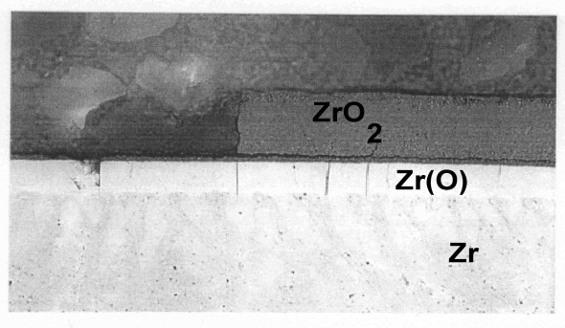
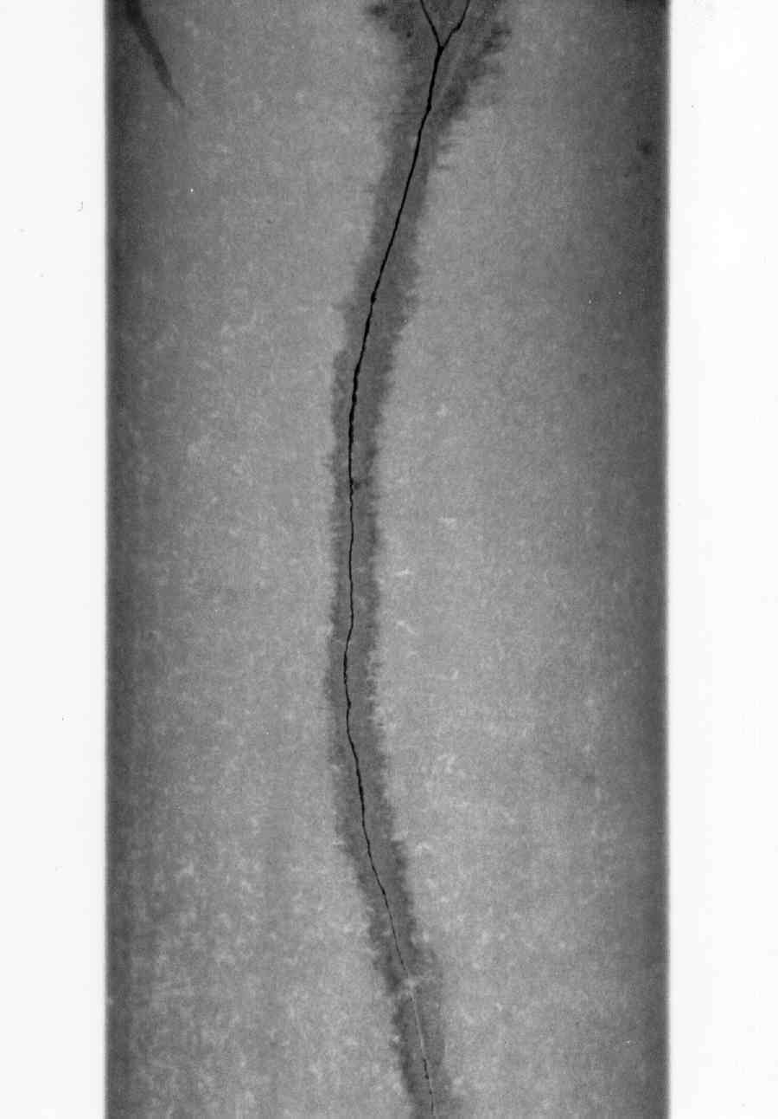
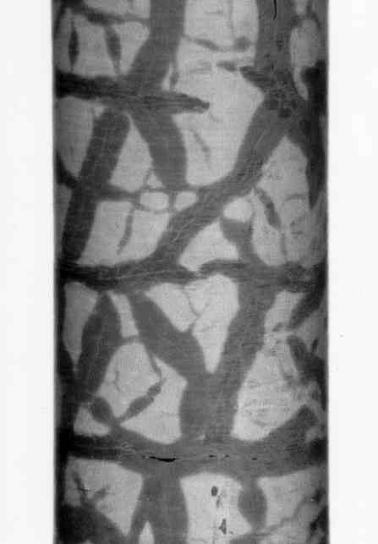
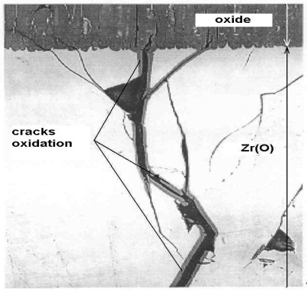
Comparison with the FZK Small Scale Quench Tests (cracks formation)
Oxide thickness, | Initial temperature, °C
μm | 1200 | 1400 | 1600
0 | Cracks in Zr(O). | Cracks in Zr(O). Local spalling (water). | Cracks in Zr(O). Local spalling (water).
100÷150 | No through wall cracks. Cracks in Zr(O). Local spalling (water). | No through wall cracks. Cracks in Zr(O). Local spalling (water). | A few through wall cracks. No cracks and inner surface oxidation.
150÷350 | Net of through wall cracks. Cracks and inner surface oxidation. | Net of through wall cracks. Cracks and inner surface oxidation. | A few through wall cracks. Crack surfaces partially oxidized.

Slide 8
Test results for irradiated simulator

Slide 9
Simulators post-test appearance

Slide 10
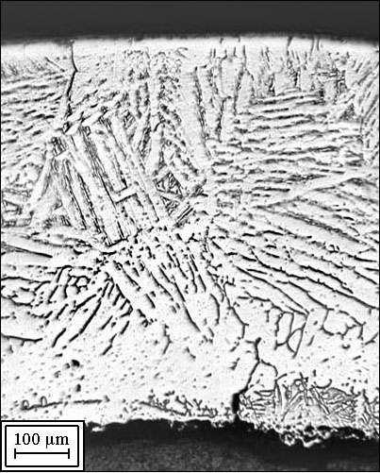
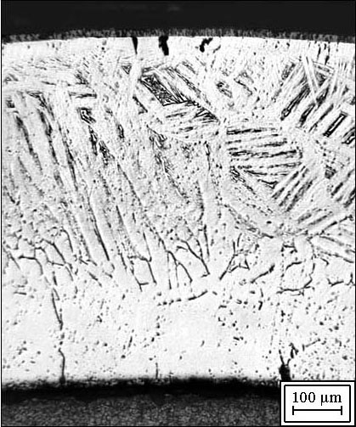
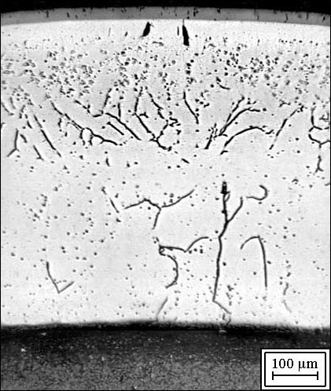
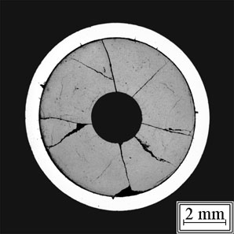
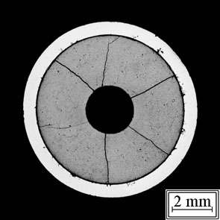
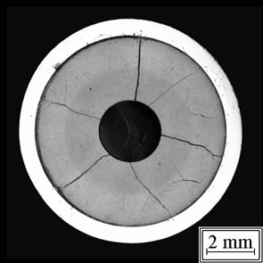
Cladding embrittlement due to inner αZr(O) layer grow
1400 °C
1600 °C
1700 °C

Slide 11
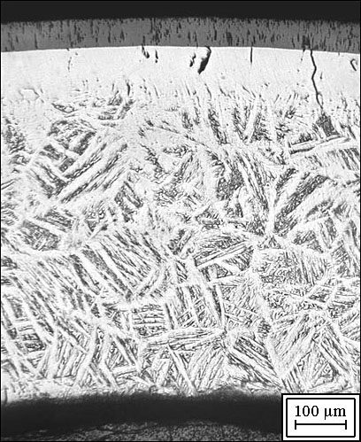
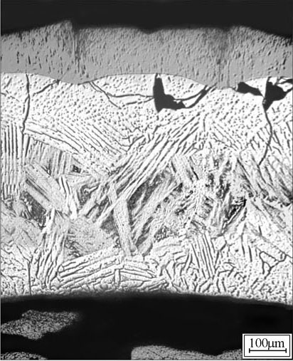
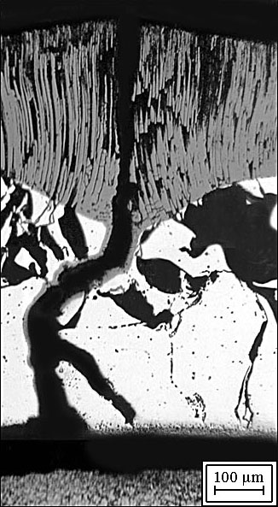
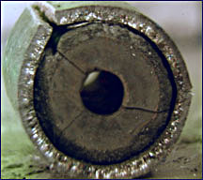
Longitudinal cracks formation
cracking
60 μm
100 μm
oxidation at 1400 °C – 1100 s
quench temperature – 1400 °C
300 μm

Slide 12
Fission product release
Kr-85 Release vs isothermal holding time at 1400°C
Kr-85 release during the quench
(annealing time 240 s)
⁸⁵Kr release
⁸⁵Kr release during quench

Slide 13
Single Rod Code
SVECHA/QUENCH
Axial Mesh
Advanced mechanistic SVECHA/QUENCH code was developed by IBRAE in collaboration with FZK for theoretical support and modelling of FZK single rod quench tests
Pellet
Gap
Coolant flow:
H₂O(l), H₂O(g), O₂, Ar, H₂
Cladding

Slide 14
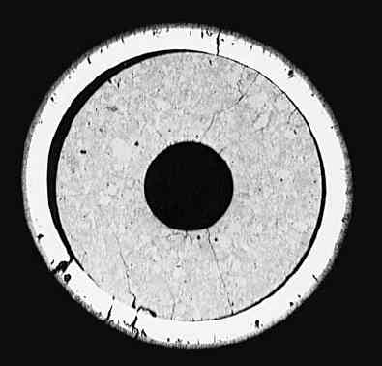
Simulation of Zr-1%Nb Fuel Rod Deformation Behaviour in RIAR Tests
Test #12 observations:
Gap disappearance and fuel-to-cladding interaction were observed in some areas of the cladding inner surface
Sample had a net of through wall cracks in the middle axial zone
Comparison of experi-mental and calculated states of the quenched fuel rod simulator
Cross section at elevation 57 mm.
Evolution of the cladding layers at elevation 57 mm.

Slide 15
Conclusions on simulation of RIAR quench tests with irradiated fuel rods
Analysis of the results of RIAR quench tests with irradiated fuel rods show that for high burnups the gap between the fuel pellet and the cladding completely disappears at operation temperatures.
Simulations by the SVECHA/QUENCH (S/Q) code confirm test observations of a good pellet-cladding contact in the case of further temperature escalation.
On the base of the FZK separate-effect tests observations, S/Q predicts in this case chemical interactions of zirconium cladding with uranium dioxide that result in formation of internal α-Zr(O) layer and embrittlement of the cladding.
Thus, the fuel rod cladding embrittlement can take place even lacking external oxidation. Basing on the Chung-Kassner criterions, for such test conditions the S/Q code correctly predicts fuel rods failure during handling after the test.
Additional external cladding oxidation considerably enhances cladding embrittlement. Basing on the Chung-Kassner criterions, for such test conditions the S/Q code predicts fuel rods failure during quenching.
Thermo-mechanical consideration of the S/Q code confirms this conclusion and demonstrates formation of through-wall cracks in fuel rods during quenching, owing to high tensile stresses induced by the fuel pellet in both α-Zr(O) and oxide layers of the cladding. This essentially reduces conservatism of the Chung- Kassner criterion (in comparison with the case of unirradiated fuel rods).

Slide 16
  Project Proposal “VVER Experiments on Release due to Over-heating: Normalization and Knowledge Augmentation” (VERONIKA)
Leading Institute: RIAR (State Scientific Centre "Research Institute of Atomic Reactors”)
Supporting Institutes: IBRAE (Nuclear Safety Institute of Russian Academy of Sciences)
Objectives:
To obtain detailed experimental data on fission products behaviour and release from highly irradiated VVER fuel along with fuel micro-structure evolution under severe accident conditions
To use these results for the development (and validation) of the physical models and numerical codes describing fuel behaviour and fission products release (MFPR code)
VERONIKA is seen as complementary Programme to the previous (VERCORS) and future (VERDON) European Projects

Slide 17
Scope of VERONIKA Project Tests
Investigation of fission products release from fuel with high burnup of 60 MW⋅d/kgU in steam, air and hydrogen environments in the temperature range of 1400 - 2300ºC typical for severe accidents at NPP (and in steam-hydrogen in the 2nd stage of the Project)
Investigation of the release of a wide list of fission products including short living isotopes: ⁸⁵Kr, ¹³³Xe, ¹³¹I, ¹³⁷Cs, ¹³⁴Cs, ¹⁰⁶Ru, ¹⁰³Ru, ¹⁴⁴Ce, ⁹⁹Mo, ¹⁴⁰Ba, ⁹⁵Zr and other (provided by pre-irradiation of the specimens in the research reactor MIR)
Accurate representation of evolution of high burn-up fuel microstructure under tests conditions (by pre- and post-test microanalysis of samples)
Determination of hydrogen generation and extent of fuel oxidation
Performance of tests with and without cladding and using a "systematic" grid with variation of only one parameter from one test to another

Slide 18
VERONIKA Test Matrix (1st stage)
# Test | Sample type | Environ-ment | Test temperature,°С | Post-test examination
 |  |  |  | Metallo-graphy | EPMA, SEM | Oxygen factor
1 | Bare fuel | Н₂ О/Ar | 1700 | + | - | +
2 | Bare fuel | Н₂ /Ar | 1700 | + | + | -
3 | Bare fuel | Н₂ О/Ar | 1400 | + | - | +
4 | Bare fuel | Н₂ О/Ar | > 2000 | + | - | +
5 | Bare fuel | Н₂ /Ar | 1400 | + | + | -
6 | Bare fuel | Н₂ /Ar | > 2000 | + | + | -
7 | Bare fuel | Air/Ar | 1400 | + | - | +
8 | Bare fuel | Air/Ar | 1700 | + | - | +
9 | Fuel rod segment | Н₂ O/Ar | 1700 | + | - | +
10 | Fuel rod segment | Air/Ar | 1700 | + | - | +

Slide 19
VERONIKA Test Rig
Hot cell
Filter-
dehydrator
Condenser
Carrier gas line
(in the case
of pure steam
environment)
Additional filter
Main filter
Water collector
Pressure
transducer
Gamma-spectrometer
(FP measurement
in the filter)
Specimen
Ceramic tubes
(ZrO₂, Al₂O₃, Al₂O₃)
Flow meter
Gamma-spectrometer
(GFP measurement)
Gamma-spectrometer
(FP measurement
in the specimen)
HF coil
Main channel
(ZrO₂)
Steam overheater
(800°С)
Mass spectrometer
Specimen
holder
Protective gas line
Heater(150°С)
Intel steam line
H₂
Inlet gas line
Pyrometer
He

Slide 20
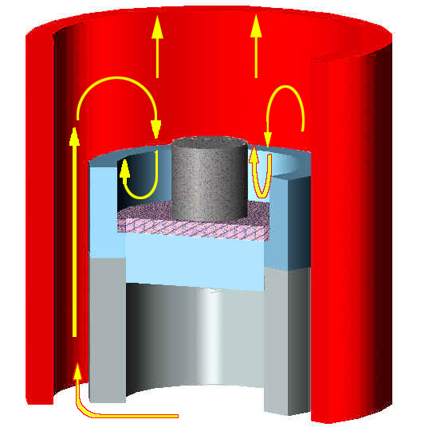
VERONIKA Crucible and Test Regimes
Channel tube (ZrO₂ )
Specimen UO₂(Zr-UO₂ )
Insulating plate (Y₂O₃ )
Crucible ZrO₂

Slide 21
MFPR Code
Development
- IBRAE-IRSN co-operation (1995-2006)
Mechanistic description
of FP behavior in irradiated UO₂ with intact geometry:
  In irradiation regime : steady state and transients
  In annealing regime : steady state and transients
  In accidental conditions: LOCA, severe accidents
Three groups of models (tightly coupled)
  Fission gases and gas bubbles
  Chemically active elements
    Fuel oxidation/vaporisation in steam/hydrogen/air atmospheres
  Evolution of fuel microscopic defect structure

Slide 22
MFPR Basic Models
Intragranular gas atoms
Grain
-
diffusion towards grain boundary (
С
concentration)
-
growth & boundary sweeping
-
bubble nucleation & capture by bubbles
-
capture by dislocations
-
directio
nal diffusion by
С
T
-
grain
-
boundary sweeping, dislocation creep
Intragranular bubbles
Intragranular
-
nucleation and coalescence
zone
-
capture of gas atoms
-
loss of gas atoms by re
-
solution (thermal & recoil)
-
di
ffusion towards grain boundaries (face bubbles):
directional diffusion by
С
T, grain
-
boundary sweeping,
dislocation creep, vacancy gradient.
-
Face bubbles
-
fed by gas atoms, intragranular bubbles
& vaporizati
on of condensed
-
phase species
-
growth & interconnection leading to release
into edge bubbles
Edge bubbles
Intergranular
-
supplied by face bubbles
zone
-
swelling until a critical threshold
-
release into open porosities
Precipitates
Dislo
cations
-
fed by intragranular diffusion of non
-
gas FPs
-
creep towards grain boundaries
-
formation of 3 condensed phases at grain boundary:
-
trapping of intragranular gases
ternary (e.g.
Cs
2
MoO
4
),
CsI
& metallic (
Ru
,
Mo, Sb
)
(atoms & bubbles)
-
equilibrium between precipitates, face bubbles,
UO
2+x

Slide 23
Conclusions
The main results are presented of the VVER-QUENCH project, and also the VERONIKA proposal at present under detailed consideration for execution in the near future.
The projects promotes the ISTC goals to let Russian weapon scientists and specialists to apply their knowledge to peaceful applications, to facilitate their integration to the global NPP accident analysis community, and also to support the applied research in the field of environment protection, energy generation, and nuclear safety.
The work on the projects is carried out in close cooperation with EC collaborators. The results of all these activities are and will be of considerable mutual benefit to ISTC and SARNET members.
It is foreseen that this fruitful cooperation will continue into the future.

