Slide 1
Parameter test SF-1
Sensitivity study with ATHLET-CD
Klaus Trambauer, GRS
Gesellschaft fuer Anlagen- und Reaktorsicherheit, Garching (DE)
CEG-SAM, 10th meeting
IAE NNC, Kurchatov-City, Republic of Kazakhstan, September 5-8, 2006

Slide 2
Contents
Motivation
Recall of some measured data
ATHLET-CD model of test section
Boundary conditions
Varied parameter
Calculation results
Conclusion
Acknowledgement

Slide 3
Motivation of pre- and post-test calculations
Proof of the code capabilities
Detection of model deficiencies
Hints for modelling of the reactor calculations
Test interpretation
Hints for further test
  Boundary conditions
  Measurements needed for test interpretation
  Test matrix

Slide 4
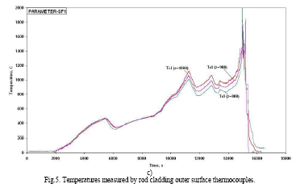
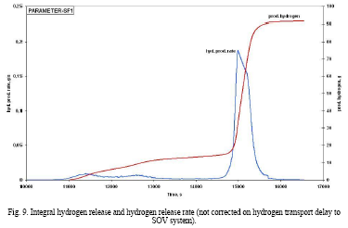
Experimental data (Summary report from 30th May 2006)
Temperatures at elevation 800 – 1000 mm and hydrogen generation
T = 0 ÷ 2000 °C vs t = 0 ÷ 18000 s
m = 0 ÷ 100 g vs t = 10000 ÷ 17000 s

Slide 5
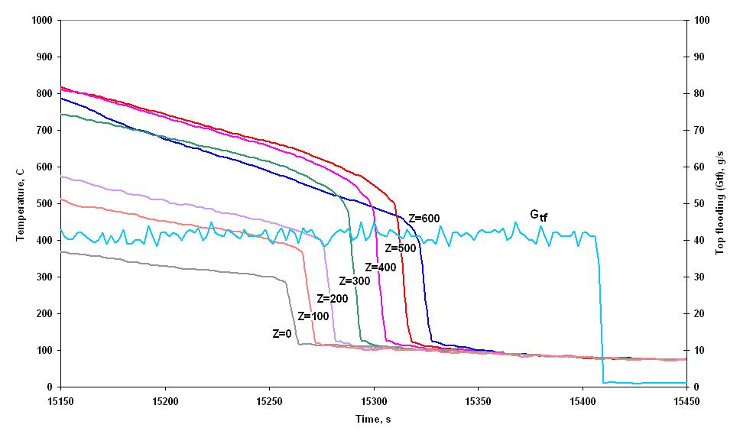
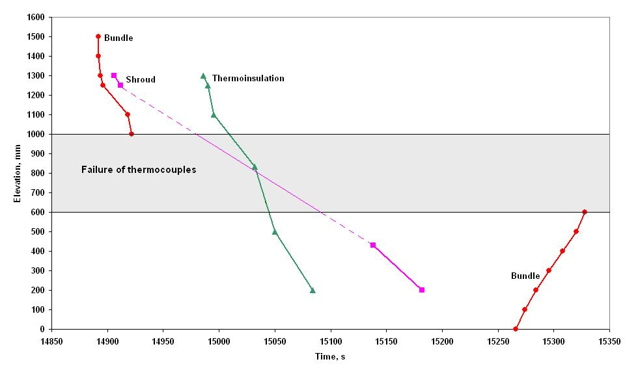
Experimental data (Test proposal from 24th August 2006)
Temperatures at elevation 0 – 600 mm and quench front progression
T = 0 ÷ 1000 °C vs t = 15150 ÷ 15450 s
z = 0 ÷ 1600 mm vs t = 14850 ÷ 15350 s

Slide 6
ATHLET-CD model of test section

Slide 7
Boundary conditions
Flow boundary conditions
  Mass flow of water, steam, and argon in
    Test section and
    Cooling jacket
  Temperatures
Pressure boundary conditions
Electrical heater power
Heat losses at top and bottom of the test section
Material properties

Slide 8
Variation of parameters and main results

Slide 9
ATHLET-CD post-test calculation (Case para_sf1_44.r21c121)
Temperatures at elevation 800 – 1000 mm and hydrogen generation
200 mg/s
T = 0 ÷ 2500 °C vs t = 0 ÷ 16000 s
m = 0 ÷ 100 g vs t = 10000 ÷ 16000 s

Slide 10
ATHLET-CD post-test calculation (Case para_sf1_44.r21c121)
Temperatures at elevation -250 – 600 mm and quench front propagation
T = 0 ÷ 2500 °C vs t = 14600 ÷ 15600 s
z = -0.4 ÷ 1.8 m vs t = 14600 ÷ 15600 s

Slide 11
ATHLET-CD post-test calculation (Case para_sf1_44.r21c011)
Temperatures at elevation 800 – 1000 mm and hydrogen generation
200 mg/s
T = 0 ÷ 2500 °C vs t = 0 ÷ 16000 s
m = 0 ÷ 100 g vs t = 10000 ÷ 16000 s

Slide 12
ATHLET-CD post-test calculation (Case para_sf1_44.r21c011)
Temperatures at elevation -250 – 600 mm and quench front propagation
T = 0 ÷ 2500 °C vs t = 14600 ÷ 15600 s
z = -0.4 ÷ 1.8 m vs t = 14600 ÷ 15600 s

Slide 13
ATHLET-CD post-test calculation (Both cases)
Relative rod mass distribution and oxide layer at the end of the test
elevation = -0.5 ÷ 1.5 m; relative mass = 0.5 ÷ 2.0 (-); oxide layer = 0 ÷ 500 µm

Slide 14
Conclusion
Top flooding is well predicted
Calculation results are sensitive with respect to
  Boundary conditions
  Nodalisation, in particular to lower test section and out-flow
  Model options
Additional measurements
  Temperature in lower test section
  Water out-flow or water inventory in test section

Slide 15
Acknowledgement
The research an developmental work of GRS is sponsored by the German Federal Ministry of Economics and Technology, BMWi.
Thank you for your attention

