Slide 1
FSUE SRI SIA “LUCH”
IBRAE RAS
OKB “Gidropress”
Numerical simulation of top flooding test on PARAMETER facility
Project # 3194,
(Results of calculations)
March, 2006, Paris

Slide 2
PARTISIPANTS:
IBRAE RAS – RATEG/SVECHA
OKB “Gidropress” – RELAP, MELCOR 1.8.5
RNC KI – RELAP, ICARE/CATHARE
FSUE SRI SIA “LUCH” - PARAM TG + RAPTA-5
EDF – MAAP4
GRS - ATHLET

Slide 3
Initial And Boundary Conditions (modeling)
Inlet gas temperature
Argon and steam inlet flow rate
Bundle coolant pressure
Total electric power

Slide 4
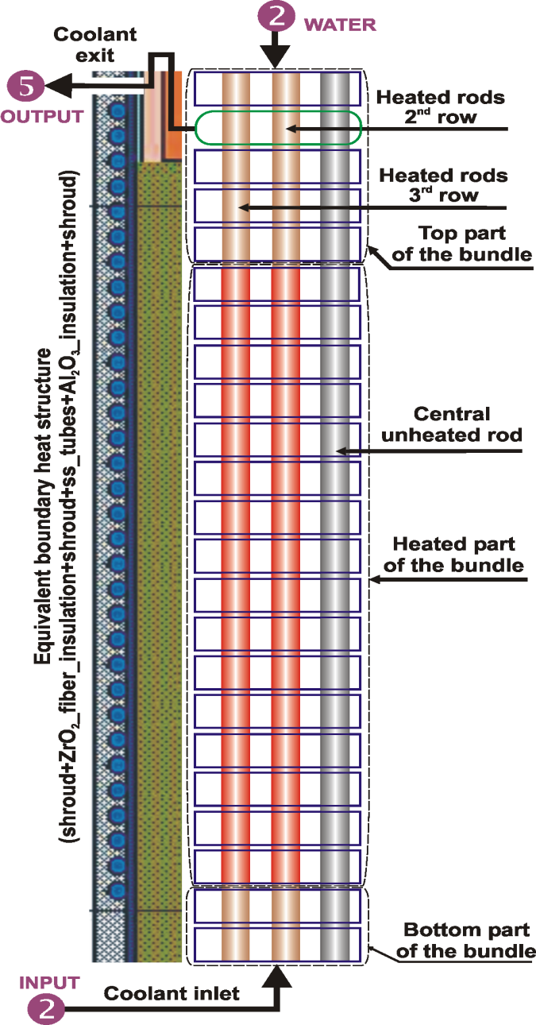
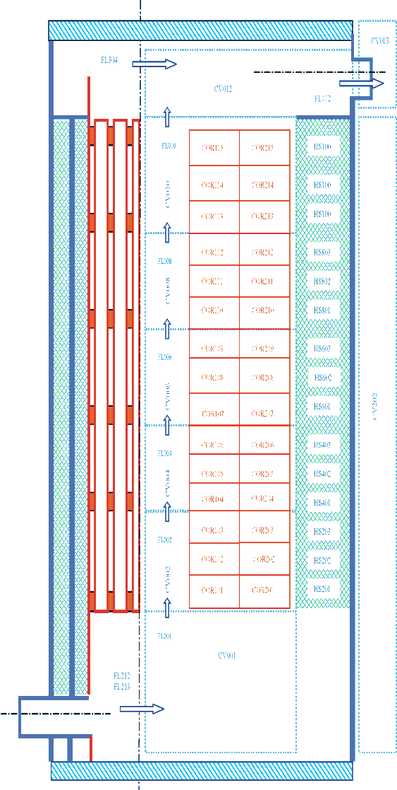
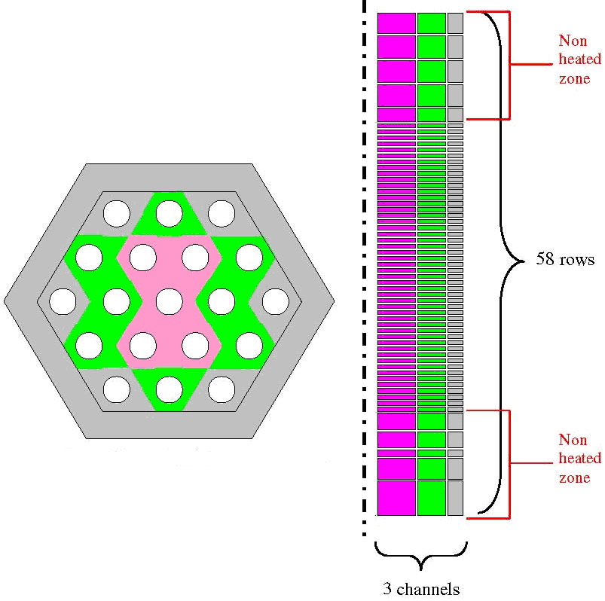
Typical nodalizations
RATEG MAAP4 MELCOR

Slide 5
Typical nodalizations
RELAP ICARE/CATHARE

Slide 6
Pre-test calculations
RATEG/SVECHA and PARAM-TG
Cladding temperature of second row
Total electrical power

Slide 7
Oxidation heat release and steam consumption

Slide 8
Axial temperature profiles
After pre-oxidation
Before flooding

Slide 9
ZrO₂ axial profiles
After pre-oxidation
Before flooding

Slide 10
Total hydrogen production

Slide 11
Assessment of nodalization schemes
Modeling of start-and adjustment test 16.02.06
Heat balance
Rod temperature

Slide 12
Heat balance

Slide 13
Coolant temperature

Slide 14
Conclusions
Pre test calculations were done using number of codes: RATEG/SVECHA, RELAP, MELCOR, PARAM-TG, ICARE/CATHARE (ongoing)
There is good fit between codes (even with deviations in nodals)
It was demonstrated good fit of measurements with simulated data for start-and-adjustment test
.

