Slide 1
PARAMETER-SF4 post-test calculation with MAAP4.07
Emilie Beuzet
March 2010

Slide 2
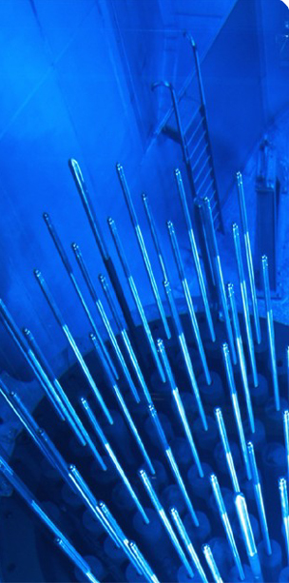
Sommaire
1. PARAMETER-SF4 test section
2. Specification of PARAMETER-SF4 test
3. Model parameters used in MAAP
4. First results of PARAMETER-SF4 post-test calculation
➔ Temperatures at different elevations
➔ Hydrogen production
➔ O₂ flow rates
5. First conclusions

Slide 3
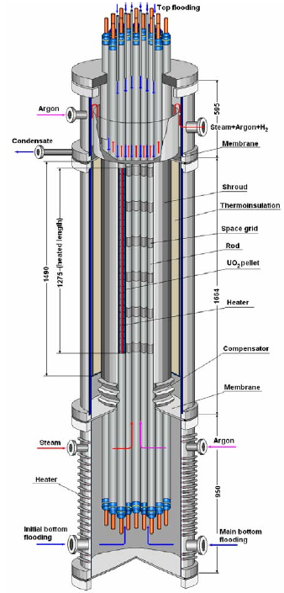
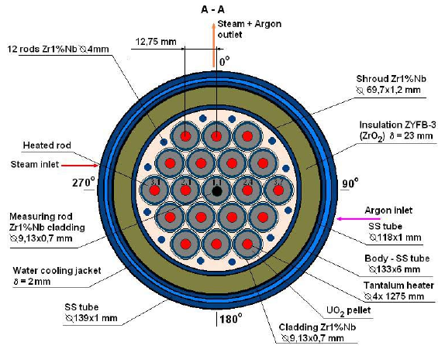
PARAMETER-SF4 test section
PARAMETER cross section
PARAMETER test facility

Slide 4
Specification of PARAMETER-SF4 test
Post-test calculation for PARAMETER SF4 has been carried out with a local version of MAAP4.07, containing extensions developed by EDF, specifically :
- Zr oxidation by air,
- introduction of material properties of the heater element materials (tantalum, molybdenum and brass) used in PARAMETER.
The simulation covers :
- establishment of a stable pre-oxidation plateau,
- power reduction,
- air ingress phase,
- bottom reflood.

Slide 5
Specification of PARAMETER-SF4 test
~2020 K
Argon 2g/s
Air 0.5g/s
Steam 3.5g/s
~1470 K
~1170 K
~770 K
Bottom reflood 80g/s
1500 s
16000 s

Slide 6

Model parameters used in MAAP
Steam pre-oxidation = Cathcart + Urbanic correlation
Air oxidation = NUREG correlation
External resistance : 4.5mΩ / rod
Distribution in : - 3 rows : 1 unheated rod / 6 rods / 12 rods + 12 ‘little’ rods , - 58 axial meshes : 5 for the lower plenum, 48 for the core and 5 for the upper plenum.
58 meshes
3 rows

Slide 7
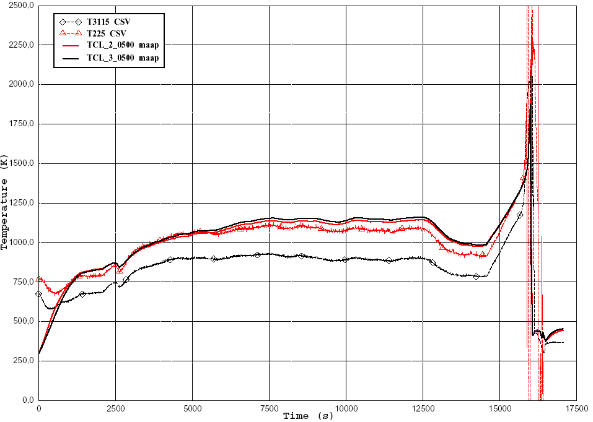
Cladding temperatures at 500 mm high

Slide 8
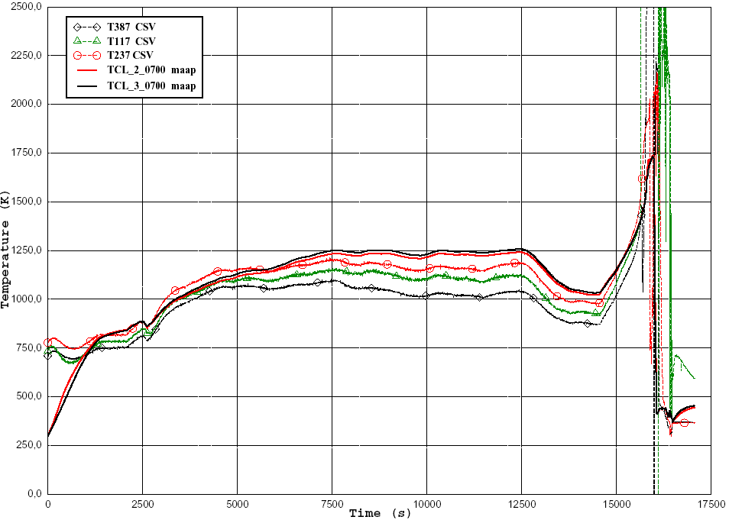
Cladding temperatures at 700 mm high

Slide 9
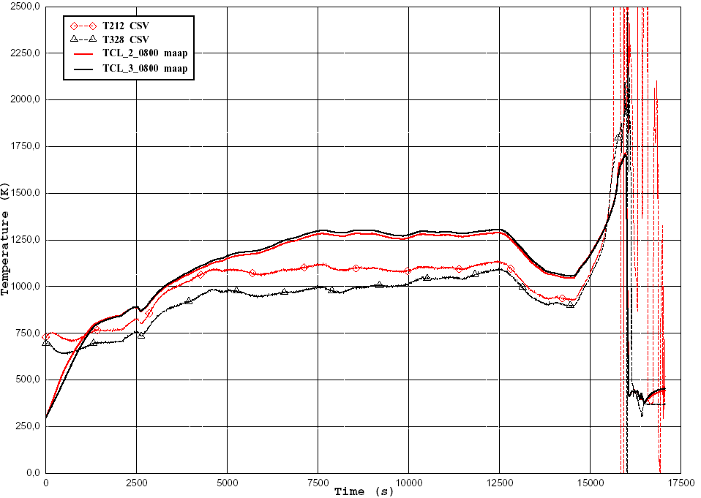
Cladding temperatures at 800 mm high

Slide 10
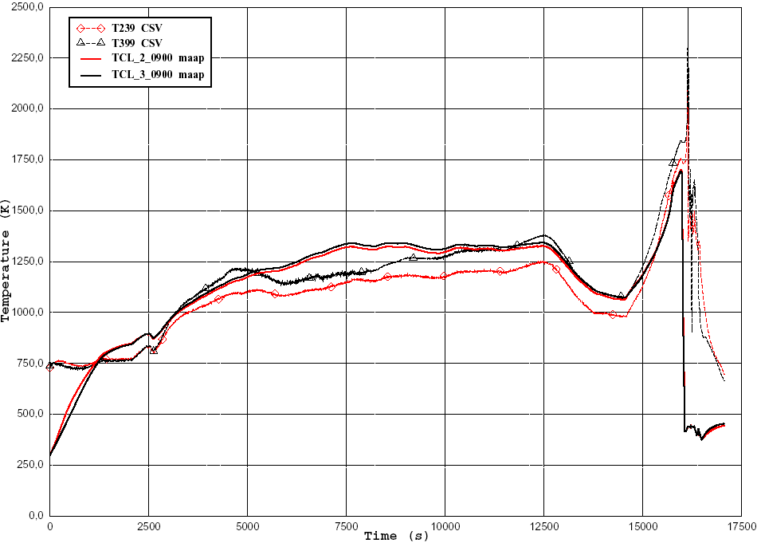
Cladding temperatures at 900 mm high

Slide 11
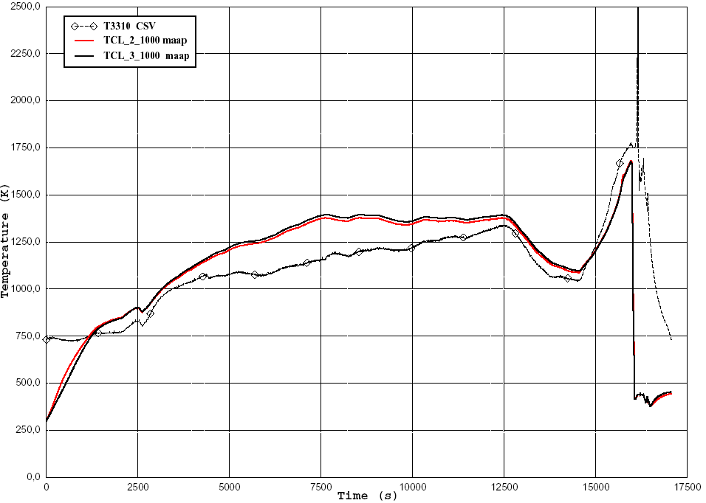
Cladding temperatures at 1000 mm high

Slide 12
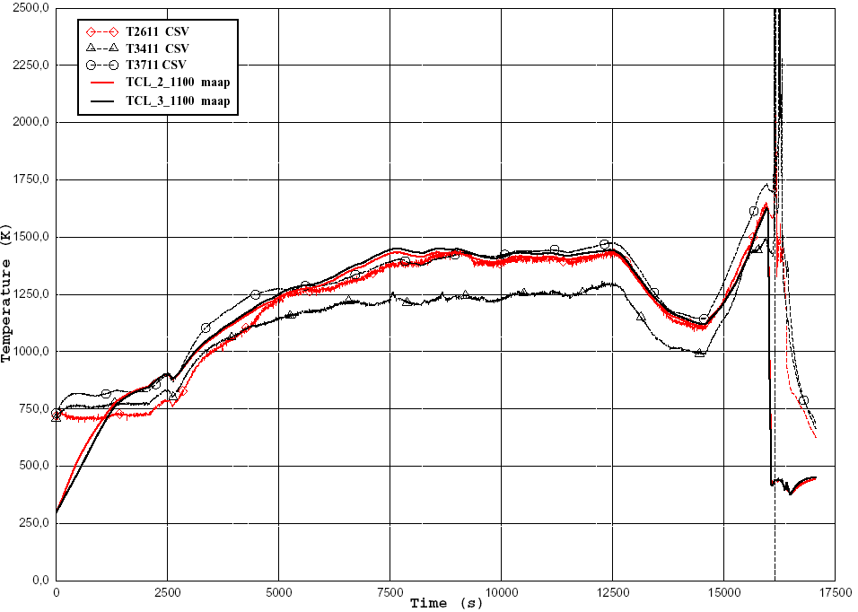
Cladding temperatures at 1100 mm high

Slide 13
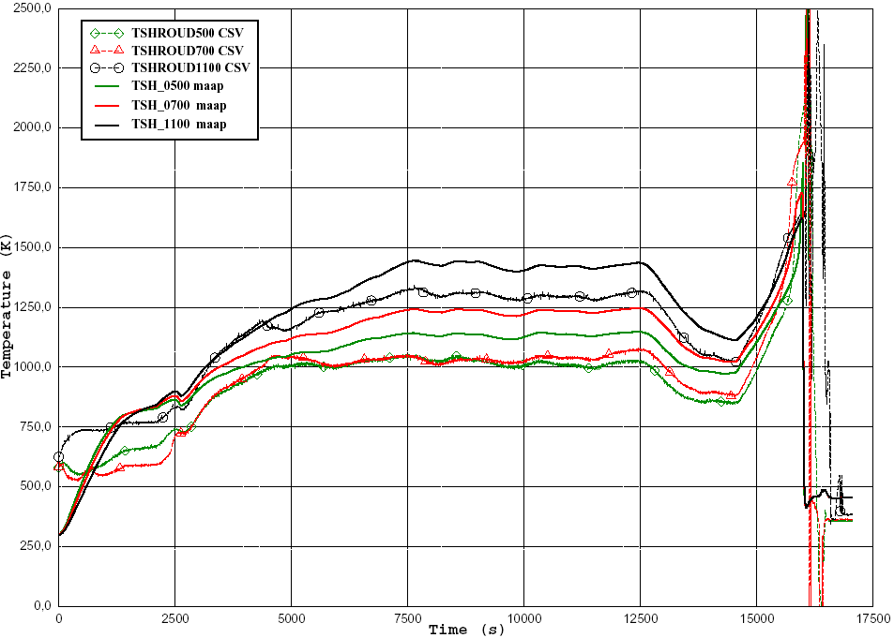
Shroud temperatures

Slide 14
Hydrogen production
good prediction of the hydrogen production during pre-oxidation phase

Slide 15
O₂ flow rates during air ingress
Modelling does not predict O₂ starvation during air ingress

Slide 16
First conclusions
Thermal behaviour :
- bigger difference for 3rd rod = impact of the 12 external rods ?
- better precision in the 2nd rod
Hydrogen production :
- good prediction during pre-oxidation phase
- simulation does not cover reflood yet
Modelling does not predict O₂ starvation (which is probably not correct)

