Slide 1

PARAMETER SF4 preliminary post-test calculation
Jon Birchley and Leticia Fernández Moguel, PSI
Presented by Salih Güntay, PSI
CEG-SAM Meeting
March 2010
Madrid, Spain

Slide 2
  Outline
  ● Background
  ● Modelling
  ● Boundary conditions
  ● Results
  ● Summary

Slide 3
  Background
  ● PARAMETER experiment SF4 performed July 2009
  ● Approximate counterpart of QUENCH-10
  ● Air ingress phase at low flow rate leading to oxygen starvation
  ● First report of test conduct received a few weeks ago
  ● Preliminary post-test calculations based on pre-test analysis and information received

Slide 4
  Modelling
  ● PSI version(s) of SCDAP/RELAP5/irs as used in pre-test analysis
  - properties for Ta, Mo and brass
  - steam:
  → Cathcart-Pawel/Urbanic-Heidrick (standard)
  → Sokolov
  - “air”: oxidation heat release; kinetic correlation from MELCOR
  ● Input model
  - based on SF4 pre-test calculation
  - no changes to noding or model options
  - modified treatment of heat transfer through shroud (coding error suspected in gap radiation model)
  - input reflects actual boundary conditions
  - event times as reported (steam/air/water, power trip)
  - simplified time histories for (power, etc)

Slide 5
  Boundary conditions
  ● Pre-oxidation (0 - 13886 s)
  - 2 g/s Ar; 3.5 g/s steam (start at 1716 s)
  - power staged increase to 7900 W
  ● Cooling phase (13886 - 16022 s)
  - power reduced to 4000 W
  ● Air ingress (16022 - 17511 s)
  - 0.48 g/s air simulated with steam
  - number of O atoms and total volume flow preserved
  - air oxidation kinetics and Zr+O heat of reaction
  - power increased to 6000 W during this phase, tripped at 17412 s
  ● Reflood (17434 - 17908 s)
  - bottom injection: 80 g/s water (midway period at 40 g/s)
  - switch Ar injection to upper volume

Slide 6
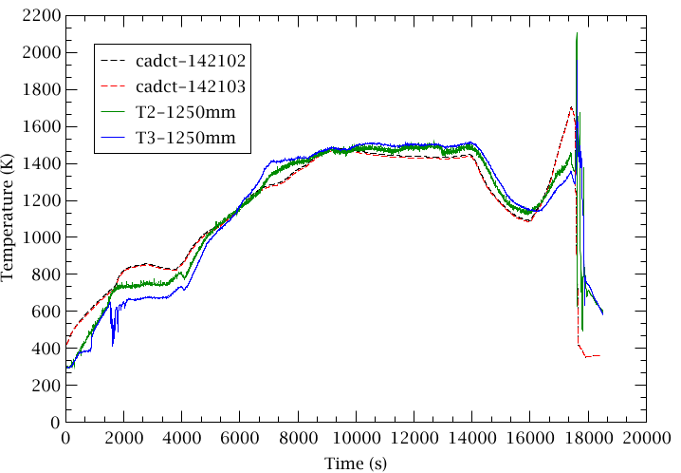
  Heater temperature at 1250 mm

Slide 7
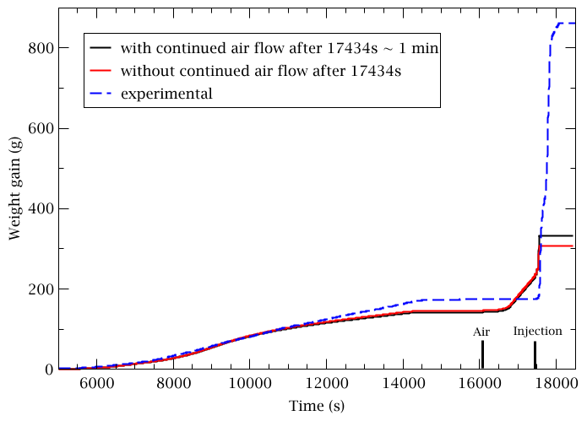
  Oxidation weight gain

Slide 8
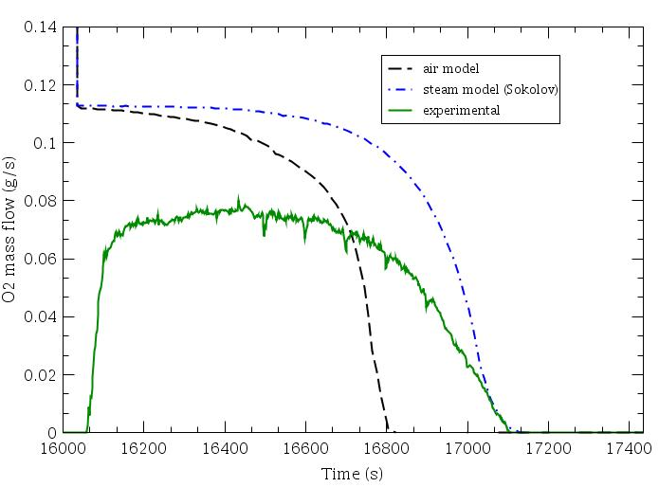
  Oxygen starvation - exit flow

Slide 9
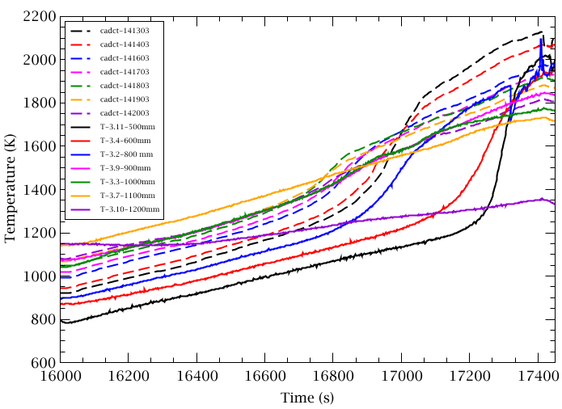
  Propagation of starvation front

Slide 10
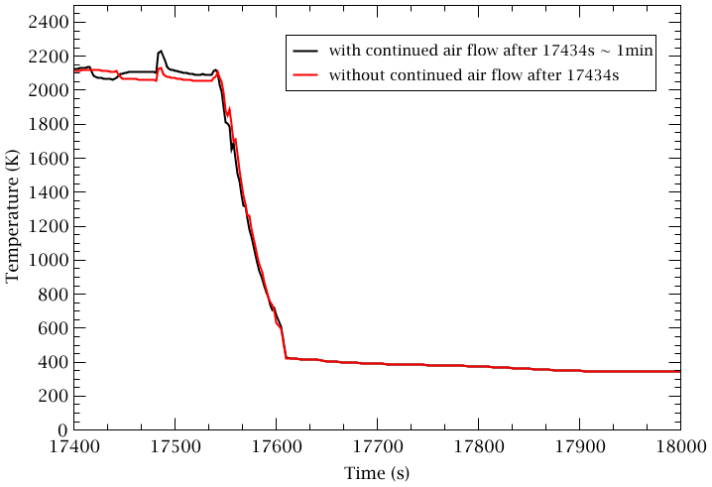
  Reflood excursion

Slide 11
  Summary
  ● First post-test calculation performed
  - input based on pre-test model and reported experiment conduct
  ● Pre-oxidation transient in fair agreement with experiment
  - oxidation and temperatures overestimated with Cathcart-Pawel (premature excursion, results not shown)
  - better agreement using Sokolov correlation
  ● “Air” model predicts earlier oxygen starvation than observed
  - starvation front propagates to bundle mid-elevation
  - discrepancy in oxygen exit flow not yet resolved
  ● Moderate reflood excursion with temperature up to 2600 K in experiment
  - effect of air flow continuing ca. 1 min during water injection (in calculation)
  - some UO2 liquefaction and candling (in experiment)

