Slide 1
FSUE SRI SIA “LUCH”
PARAMETER facility
Presented by W. Konstantinov
Podolsk, Russia,
July 16, 2008.

Slide 2
The main tasks of experimental researches
In imitating conditions of the BDBA (Тcladding ≤ 1200 °С):
Research of parameters of deformation and tightness of rod claddings;
Research of conditions of formation of blocking of cross section of FA;
- Posttest material analysis of claddings and space grids.
2. In imitating conditions of the DBA (Тcladding > 1200 °С):
Researches of an output of hydrogen during experiments;
Research of processes of degradation of FA;
- Research of processes of FA cooling at a top and bottom flooding;
Material analysis of products of interaction of constructional, fuel and absorbing materials.

Slide 3
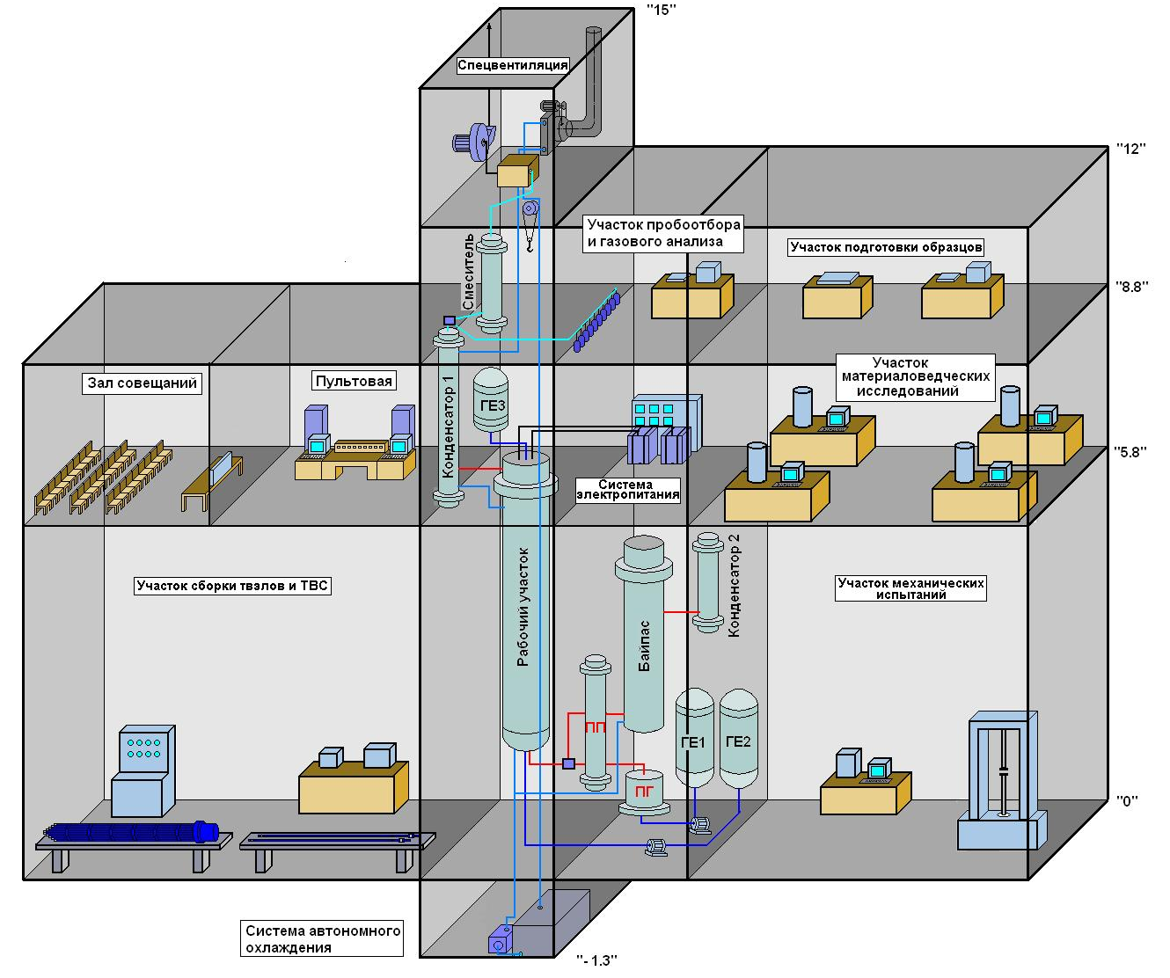
Structure of the PARAMETER facility

Slide 4
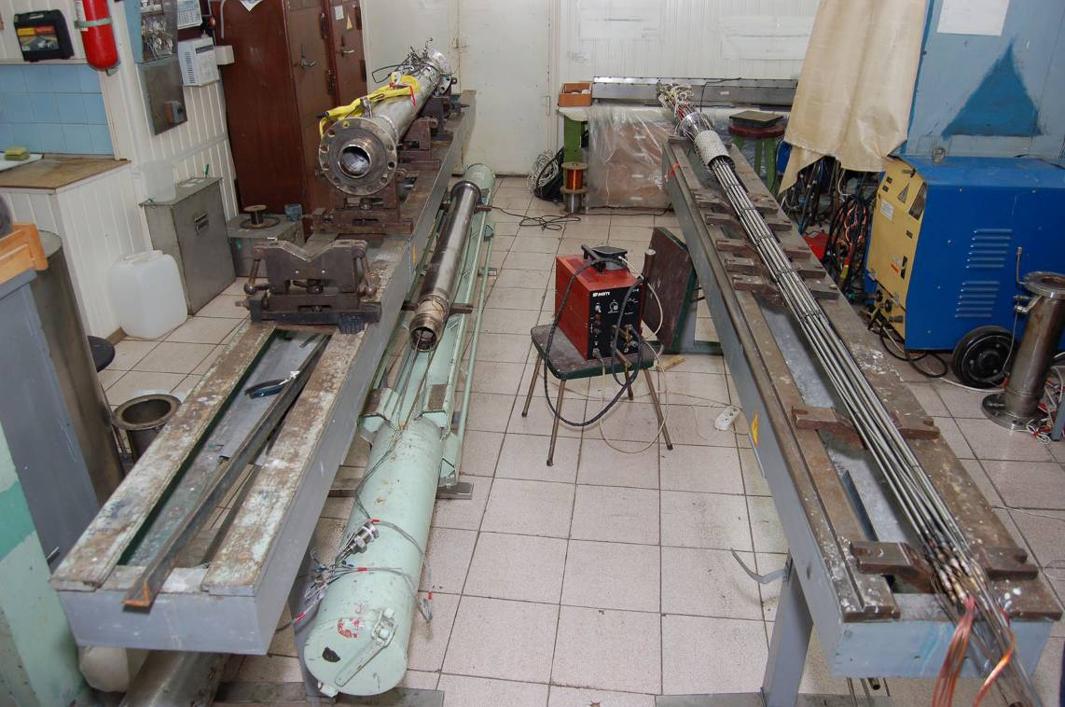
Structure of the PARAMETER facility
Manufacturing of rods and
test bundles

Slide 5
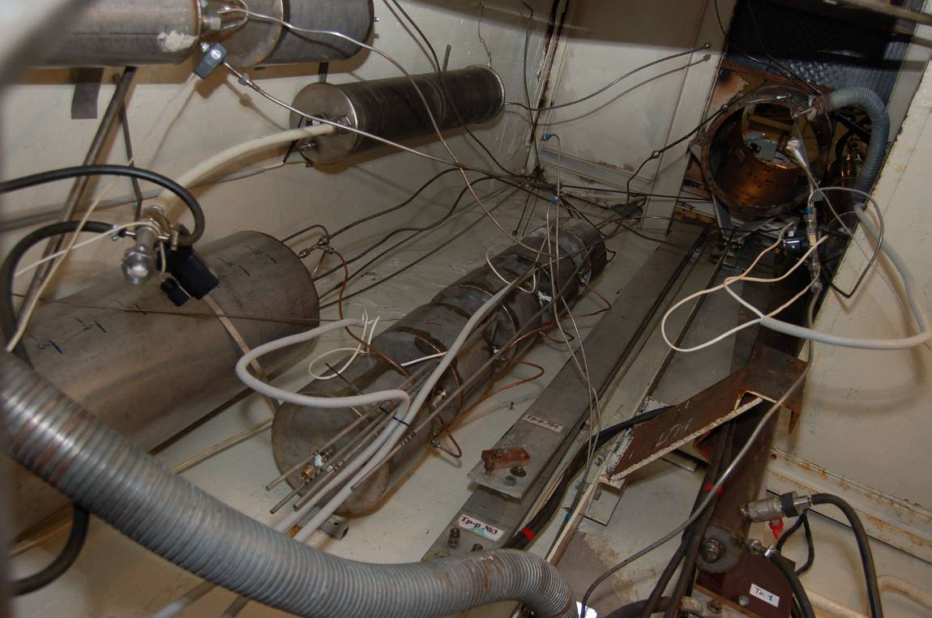
Structure of the PARAMETER facility
The bottom part of the facility
and system of bottom flooding

Slide 6
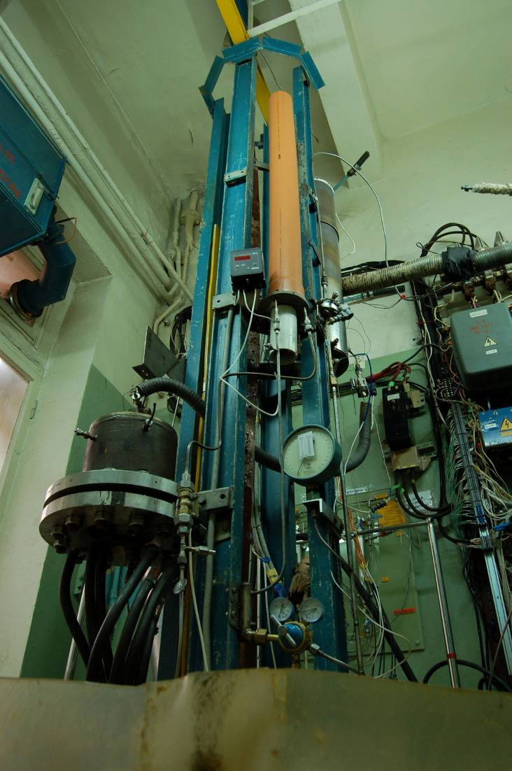
Structure of the PARAMETER facility
System of steam generation

Slide 7
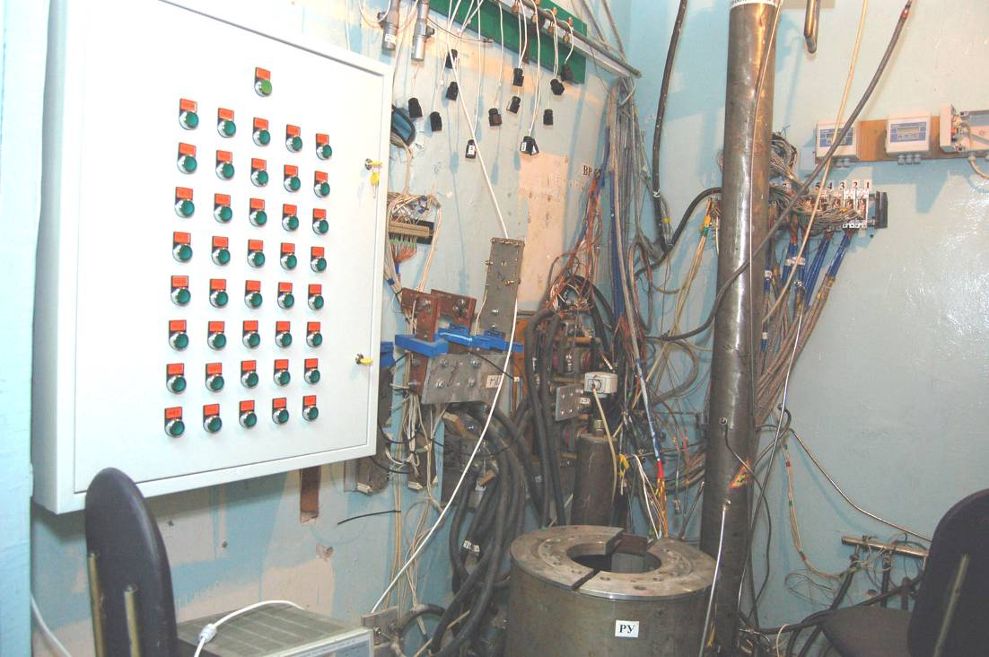
Structure of the PARAMETER facility
The upper part of the facility

Slide 8
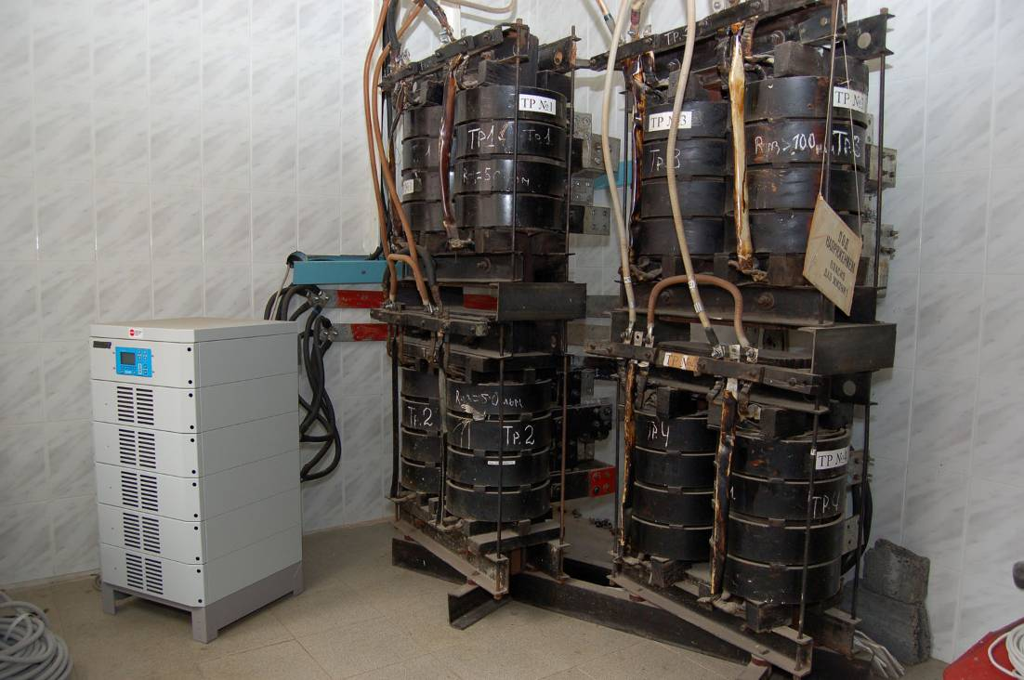
Structure of the PARAMETER facility
System of power supply

Slide 9
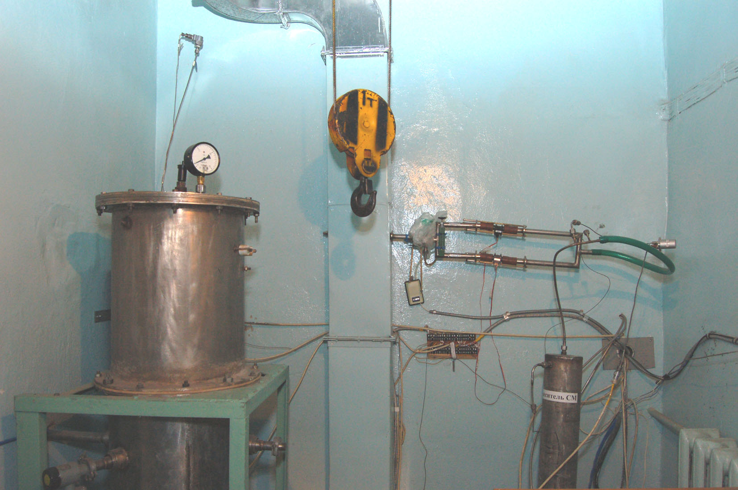
Structure of the PARAMETER facility
Systems of top flooding and
control of output gas mixture

Slide 10
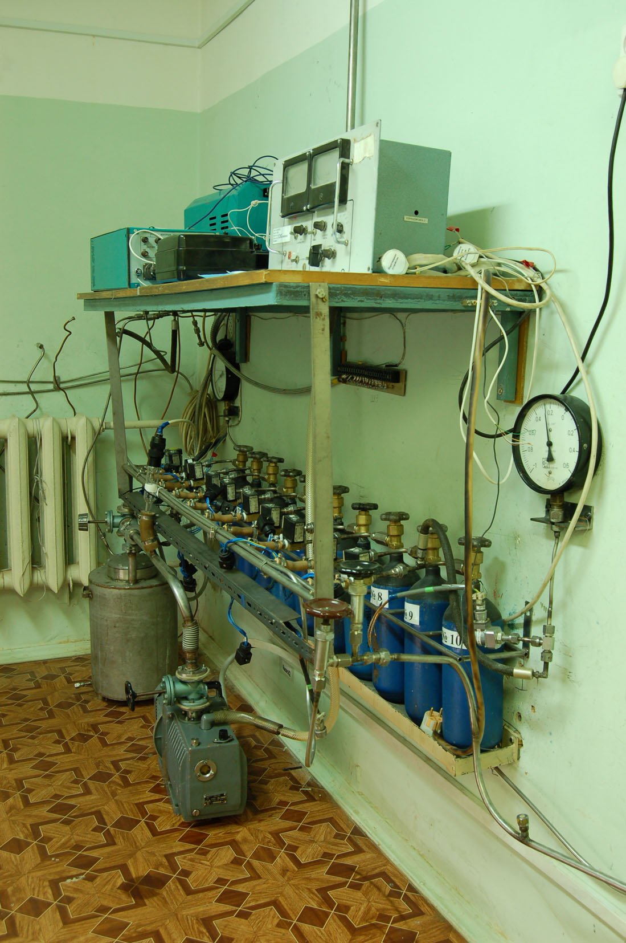
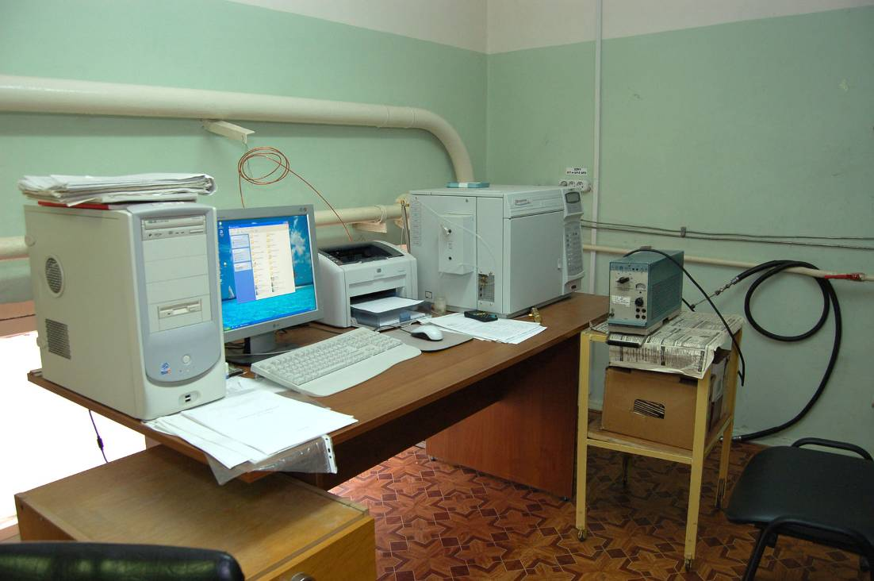
Structure of the PARAMETER facility
System of hydrogen
measurement

Slide 11
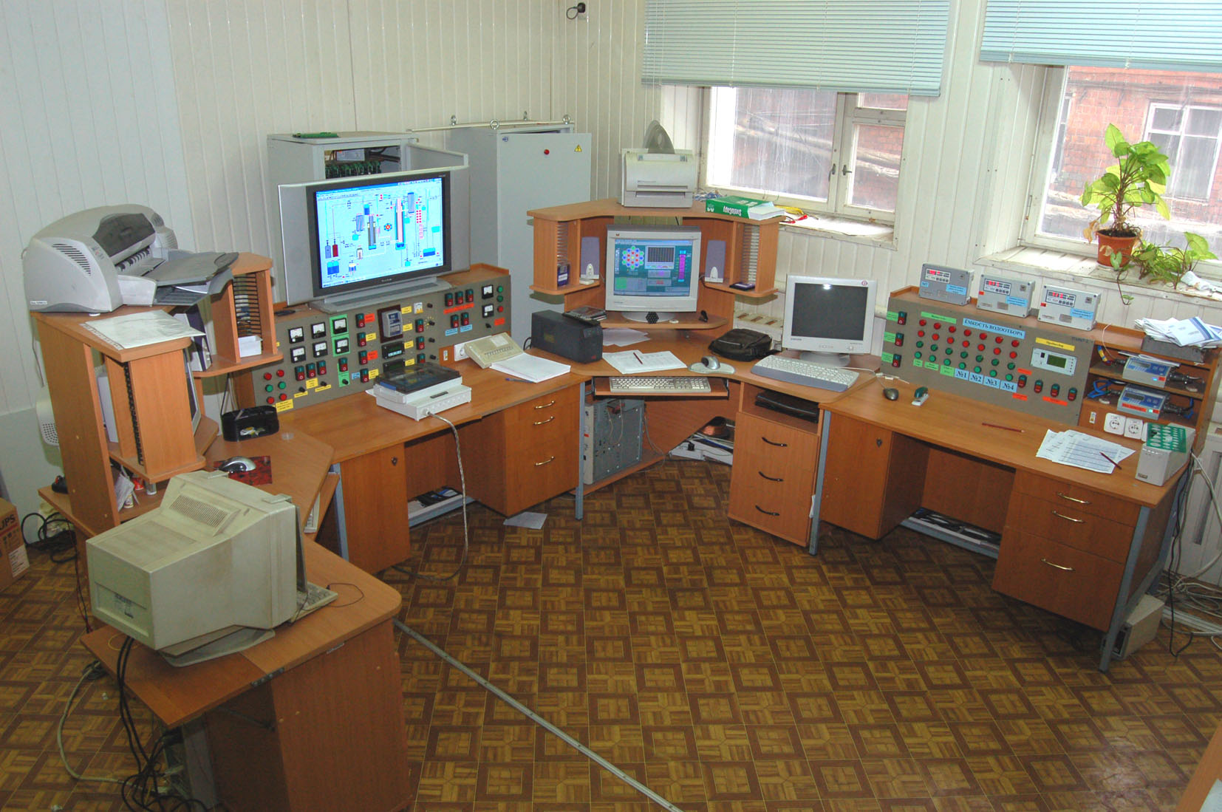
Structure of the PARAMETER facility
Control system of test parameters

Slide 12
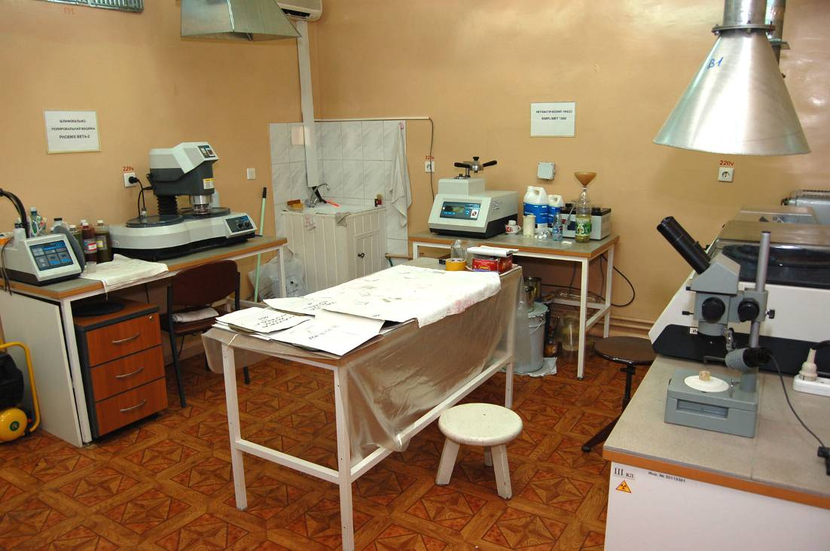
Structure of the PARAMETER facility
Posttest preparation of samples

Slide 13
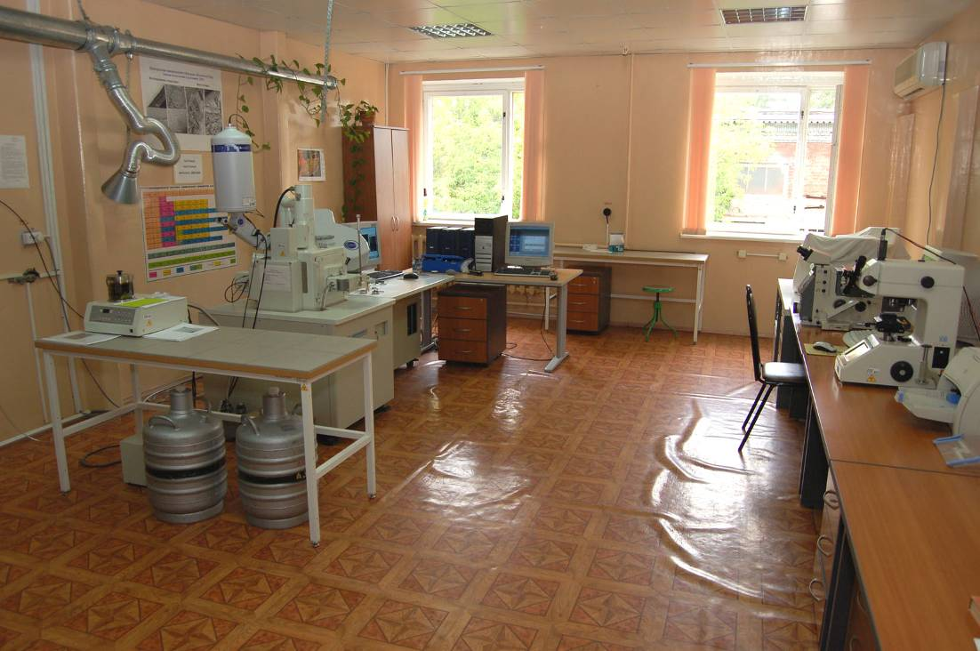
Structure of the PARAMETER facility
Posttest material analysis of samples

Slide 14
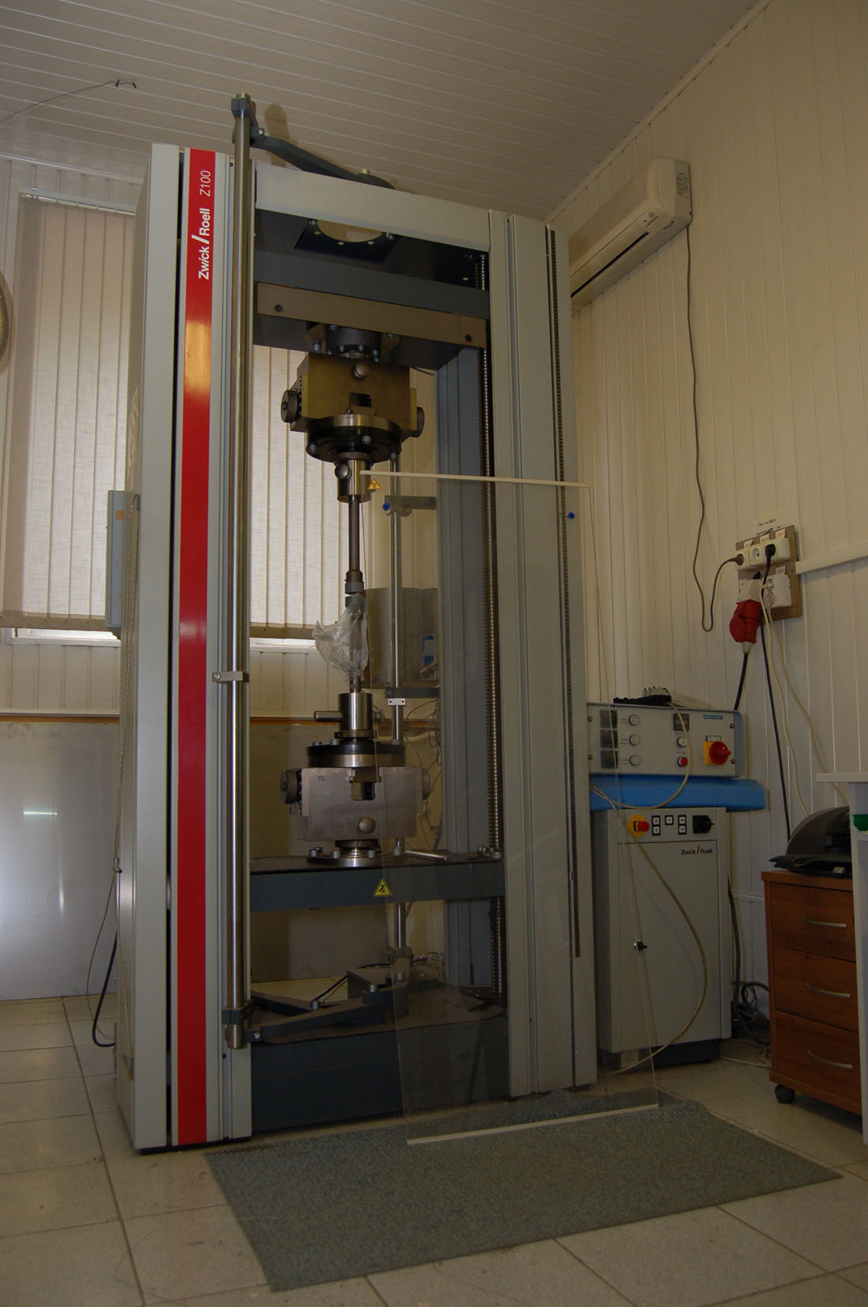
Structure of the PARAMETER facility
Mechanical tests

Slide 15
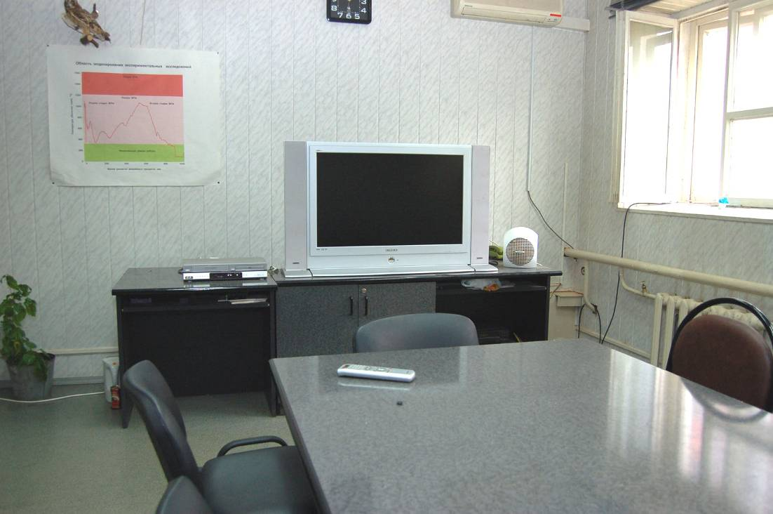
Structure of the PARAMETER facility
Carrying out of meetings

Slide 16
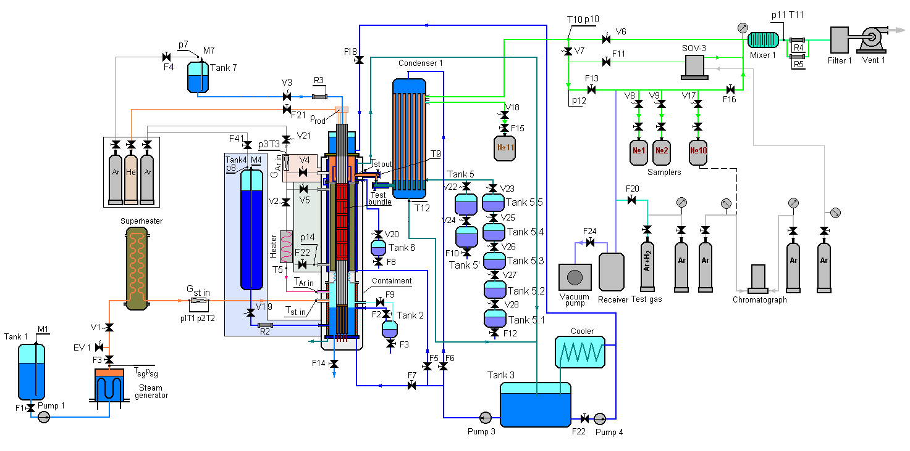
PARAMETER Facility

Slide 17
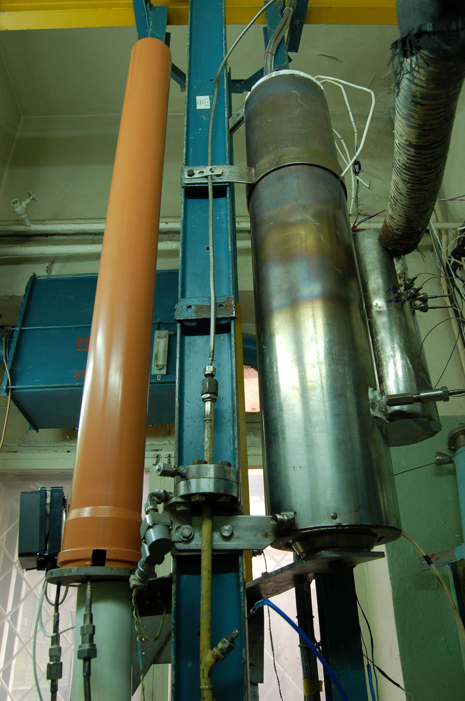
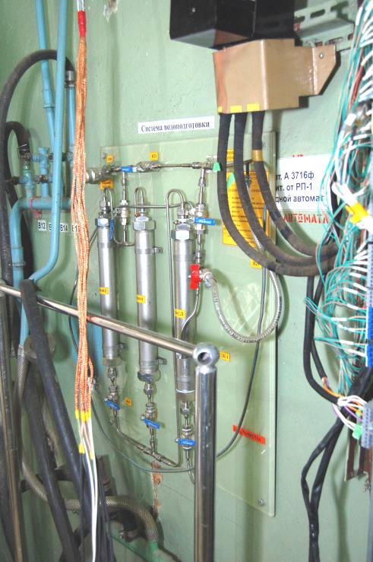
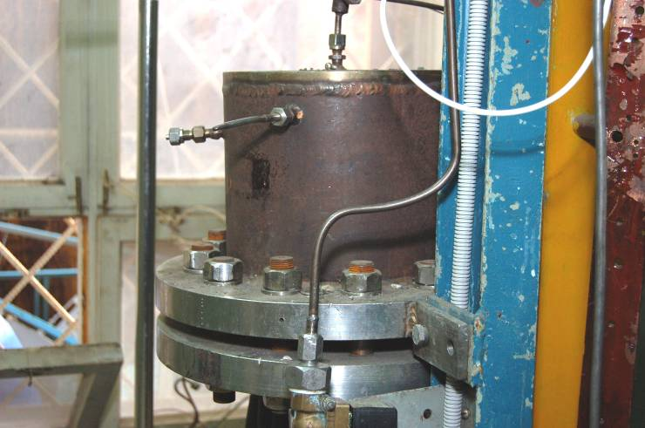
PARAMETER Facility
System of steam– and argon flow input

Slide 18
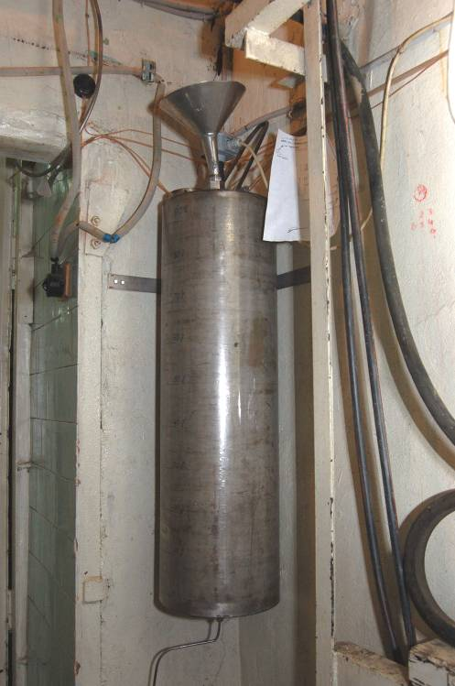
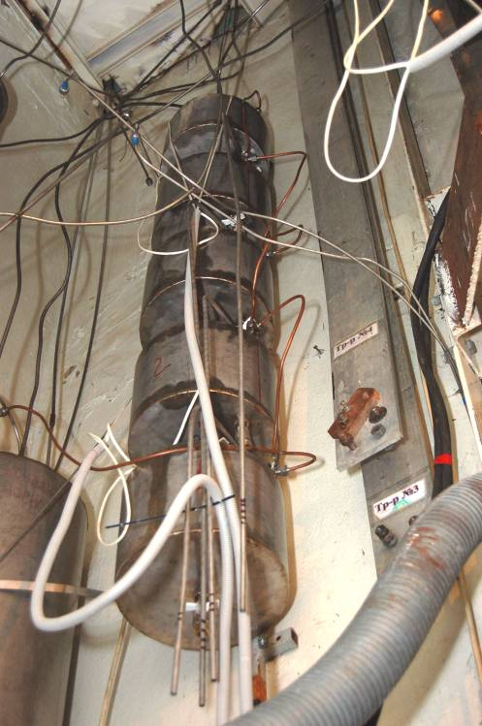
PARAMETER Facility
The monitoring system of balance of steam and water

Slide 19
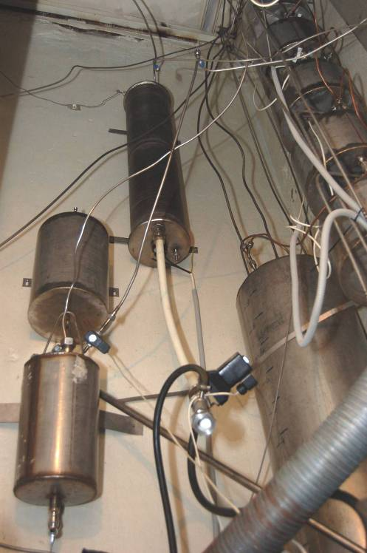
PARAMETER Facility
System of the top and bottom flooding

Slide 20
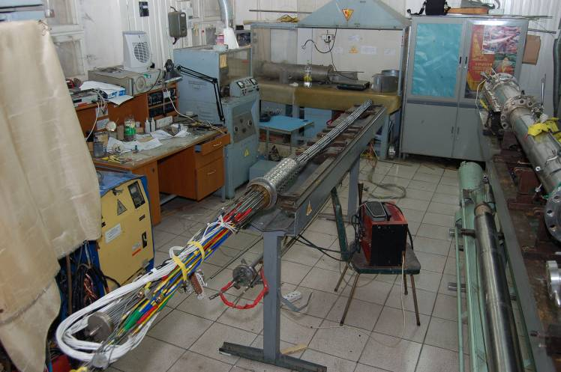
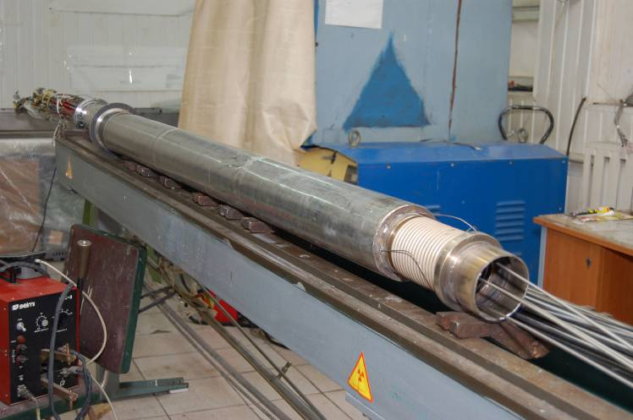
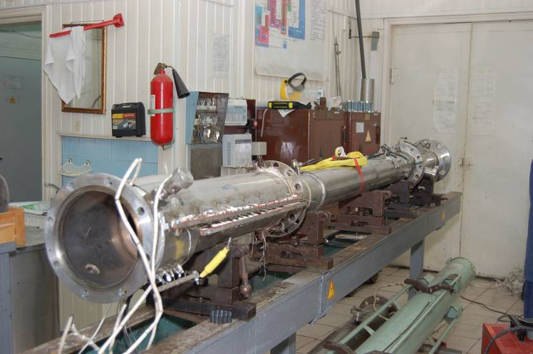
PARAMETER Facility
Test bundle and test section
Test bundle
Shroud and thermoinsulation
Test section

Slide 21
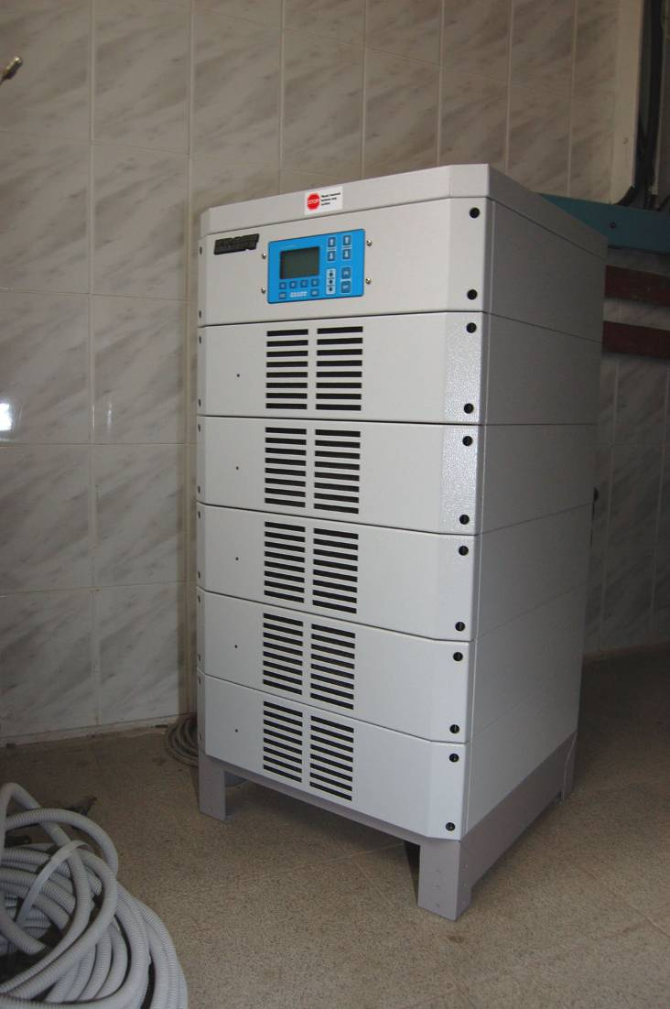
PARAMETER Facility
System of power supply
The generator of a direct current 1000A/15V “Flex Kraft”
The generator of a direct current “Flex Kraft”

Slide 22
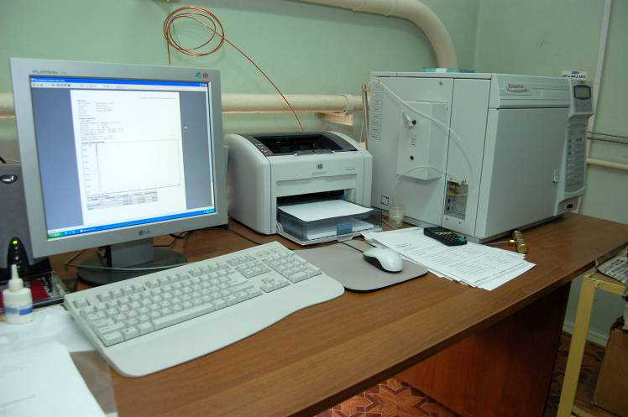
PARAMETER Facility
System of hydrogen measurement

Slide 23
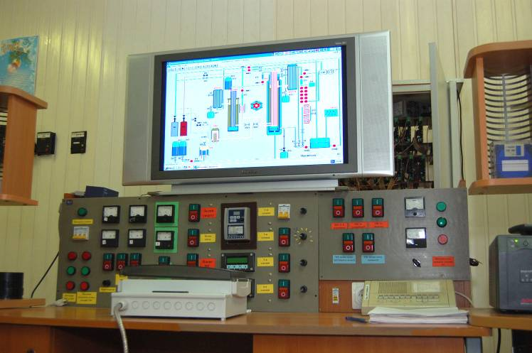
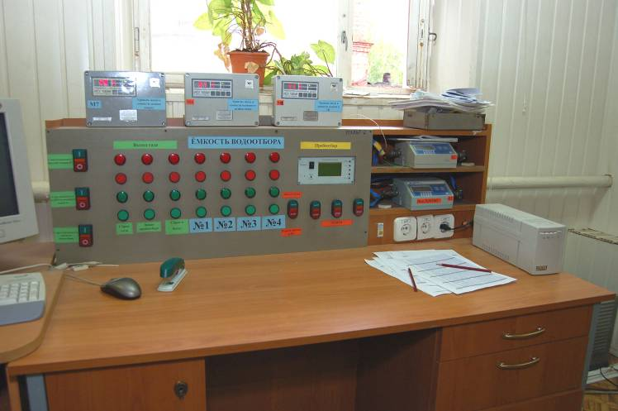
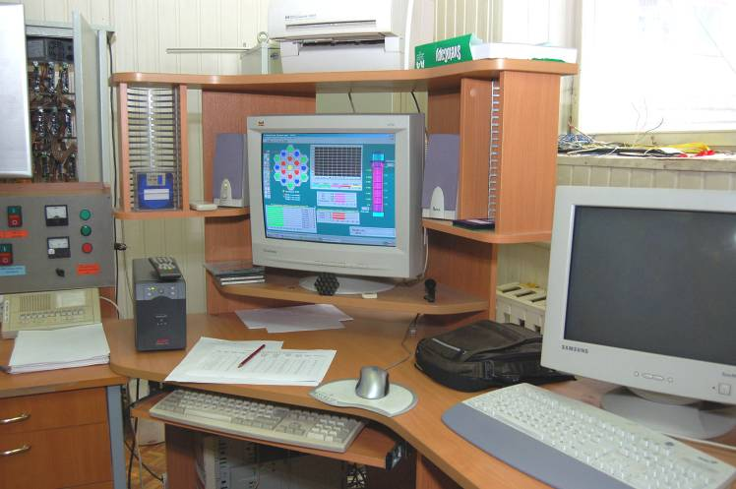
PARAMETER Facility
Control system of test parameters
Control system pneumatic
and hydraulic systems
Control system of
technological parameters
System of gathering
of parameters of tests

Slide 24
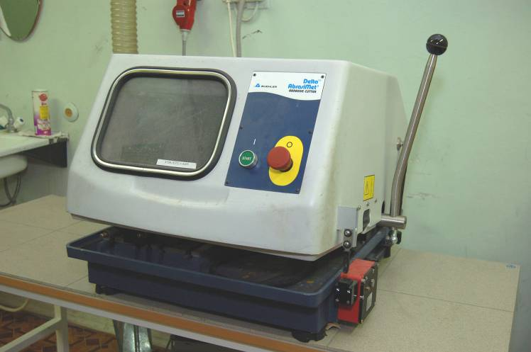
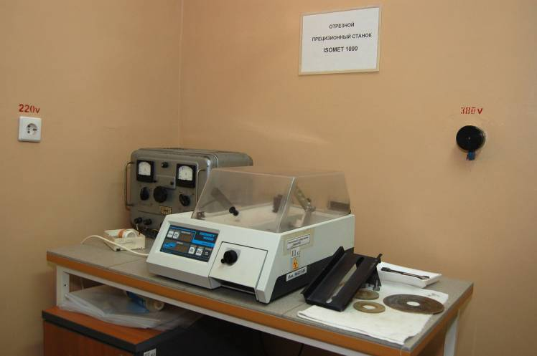
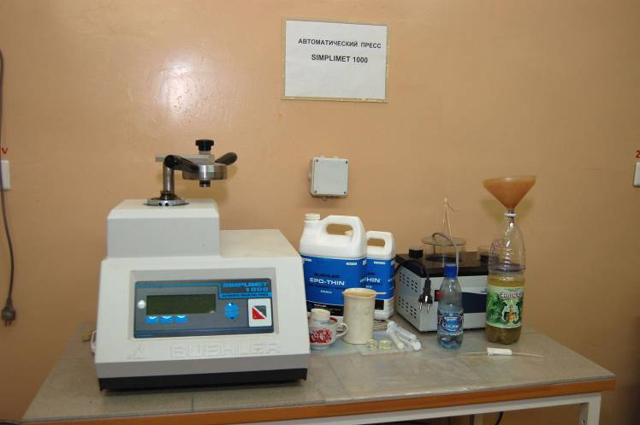
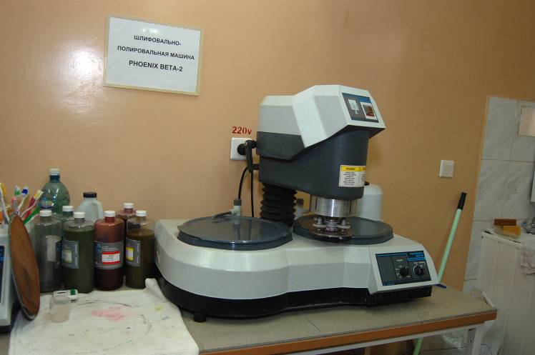
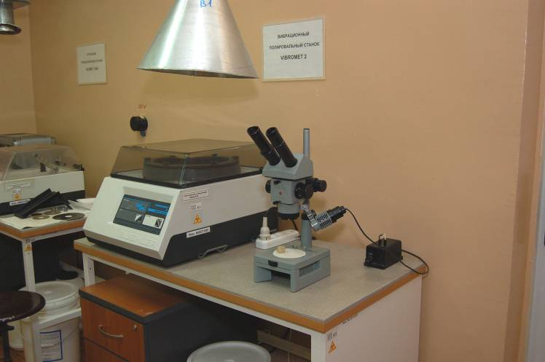
PARAMETER Facility
Material analysis
Material analysis
1. Preparation of samples
1. Preparation of samples
Cutting of samples
Fixing of samples
Delta AbrasiMet
ISOMET1000
SIMPLIMET 1000
Polishing of samples
PHOENIX BETA-2
VIBROMET 2

Slide 25
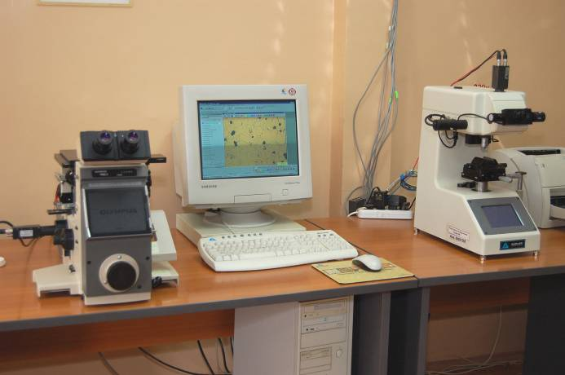
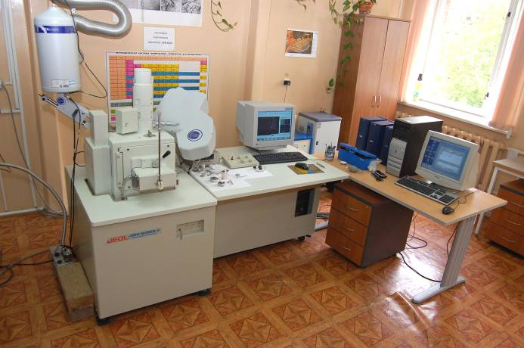
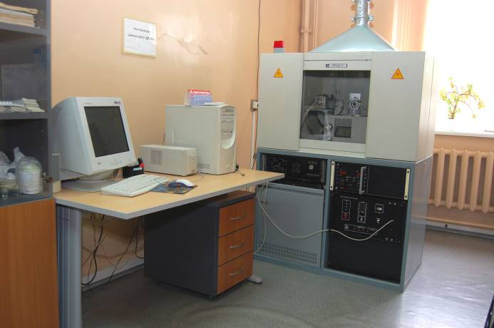
PARAMETER Facility
Post-test material analysis of samples
The optical and electronic microscopy
JSM-6460
OLYMPUS
MICROMET 2103
X-ray structure studies
Mechanical tests
ДРОН-6
Zwick100

Slide 26
Conclusion
The preparation and check of all technological systems of the
PARAMETER facility is carried out now.
Carrying out of a complex spadework for carrying out of
PARAMETER-SF3 experiment comes to the end

