Slide 1
FSUE SRI SIA “LUCH”
IBRAE RAS
FSUE EDO “GIDROPRESS”
Fuel assembly tests
under severe accident conditions
Status of Project # 3194
Presented by W. Nalivaev
March, 2006, Paris

Slide 2
Progress reports
Experimental results of complex starting-up and
adjustment actions on preparation of the PARAMETER-SF1 Experiment.
2. Numerical simulation of the PARAMETER-SF1
Experiment.
3. Presentation of specification on simulation of PARAMETER facility by collaborators.
Presented by W. Nalivaev
Presented by A. Kisselev
Presented by T. Judina

Slide 3
FSUE SRI SIA “LUCH”
IBRAE RAS
FSUE EDO “GIDROPRESS”
Experimental results of complex starting-up and adjustment actions on preparation of the PARAMETER-SF1 Experiment
Presented by W. Nalivaev
March, 2006, Paris

Slide 4
Main Tasks:
- Development of technological systems for carrying out of Experiment
- Check up of technological systems
- Carrying out of control test up to 1000 C
- Program of the PARAMETER-SF1 Experiment

Slide 5
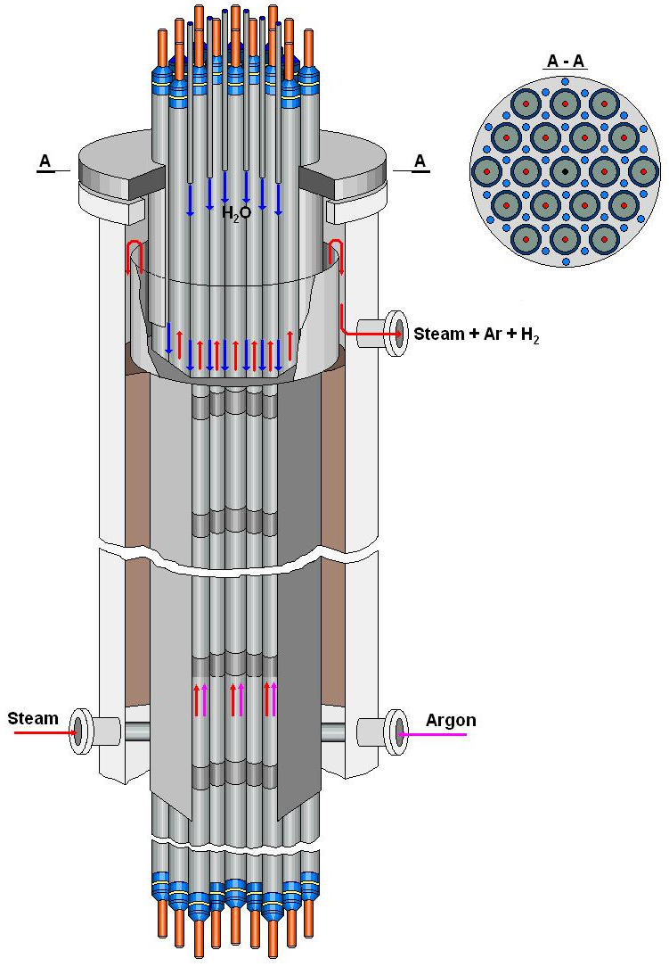
Test bundle
Main technical characteristics
Bundle type VVER-1000
number of fuel rods 19
- heated 18
- unheated 1
Grid type triangle
Grid pitch, mm 12.75
Spacing grid Zr1%Nb
- height, mm 20
- spacing, mm 255
Shroud Zr1%Nb
- shape hexahedron
- height, mm 1650
Thermal insulation ZrO2 ZYFB-3
- thickness, mm 29/24,5
- height, mm 1525

Slide 6
Test instrumentation

Slide 7
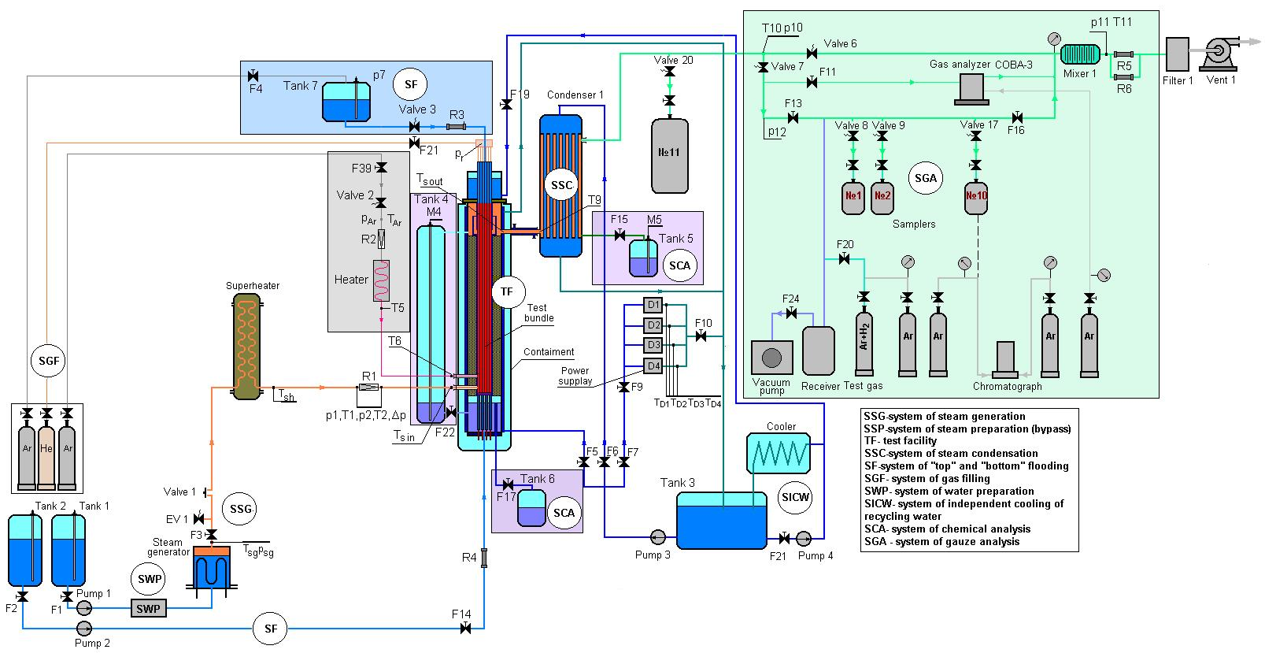
Test facility
Functional scheme
Main technological systems for carrying out of Experiment:
System of separate input of argon;
The monitoring system of balance of steam and water;
System of top flooding;
The monitoring system of hydrogen

Slide 8
The rate of argon and hydraulic characteristics steam-gas a path
№№ items | Parameter | Size of parameter
1 | Gar | ∼ 2 g/s
2 | par | 1,0 MPa
3 | T6 | 450 C
4 | p bn | 0,34 MPa
5 | p10 | 0,34 MPa
6 | p11 | 0,1 MPa
7 | p12 | 0,17 MPa
8 | R5 | ∼ 2 g/s

Slide 9
Parameters of a steam flow
№№ items | Parameter | Size of parameter
1 | T1 | 570 C
2 | p1 | 0,8 MPa
3 | p2 | 0,4 MPa
4 | T2 | 550 C
5 | Gs | 3±0,1 g/s
6 | Tst in | 420 C

Slide 10
Monitoring system of balance of steam and water
№№ items | Parameter | Size of parameter
1 | Gs | 3±0,1 g/s
2 | Mass (M5) | 18,4 kg
3 | Time | 6000 s
4 | Gs (M5) | 3,07 g/s

Slide 11
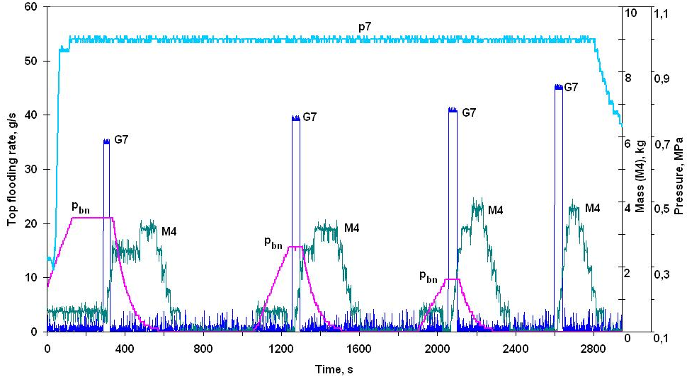
Parameters of the top flooding system
№№ items | Parameter | Size of parameter
1 | G7, g/s | 44,4; 40,5; 39,5; 35,8
2 | p7, MPa | 1,0
3 | p bn, MPa | 0,1; 0,26; 0,36; 0,45
4 | Mass (M4), kg | 3,82; 3,56; 3,32; 2,94
5 | Time, s | 86; 88; 84; 82

Slide 12
Monitoring system of hydrogen on reference gas mixtures (Ar + X%H2)
№№ Items | Reference gas mix. (Ar + X %H2), X%
1 | 0,5
2 | 4,0
3 | 10

Slide 13
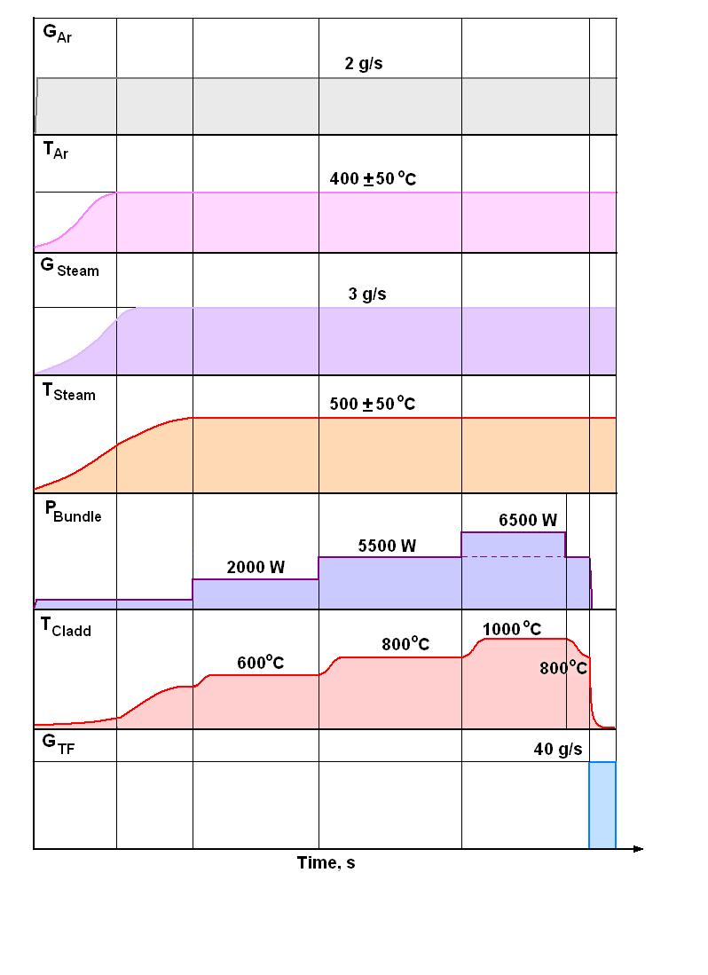
Some experimental results of control Test
Sequence diagram of tests

Slide 14
Test Bundle parameters
Electrical Power
Measuring rod
Bundle Temperature
Shroud and Thermoinsulation Temperatures

Slide 15
Results of top flooding
№№ items | Parameter | Size of parameter
1 | G7, g/s | 40 - 38
2 | p7, MPa | 1,0
3 | p bn, MPa | 0,30 – 0,34
4 | T bn, C | 800
5 | Time, s | ∼180

Slide 16
The PARAMETER-SF1 Experiment
Stage | Stage substance | Main parameters
 |  | Bundle temperature, С | Medium | Heating/ cooling rate | Time, s
1 | Electric heating of the fuel bundle within argon | 500 | argon with flow rate of 2 g/s | 0.16 | 0-3000
2 | Electric heating of the fuel bundle within the steam and argon flow | 500 | steam and argon with flow rate of 3/2 g/s | 0 | 3000-5000
3 | Heating of the fuel bundle (phase I) | 500-1200 | steam and argon with flow rate of 3/2 g/s | ∼0.2 K/s | 5000- 8500
4 | Pre-oxidation of the fuel bundle | ∼ 1200 | steam and argon with flow rate of 3/2 g/s | 0 | 8500-11500
5 | Heating of the fuel bundle (phase II) | 1200-1900 | steam and argon with flow rate of 3/2 g/s | 0,1-0,3 K/s | Define experimentally as deign temperature will be reached
6 | Flooding of the fuel bundle from the top (~5 s after Tmax=1900 C reached) | up to saturation | water with flow rate of 40 g per bundle | 100 – 10 K/s | ∼300

