Slide 1
First Results of Laser-Heating Experiments Using New Experimental Facilities at the Institute for High Temperatures (IVTAN), Moscow
Mikhail Sheindlin
m-sheindlin@ihed.ras.ru

Slide 2
Brand-new modern laboratory has been set up at IVTAN a few months ago in order to perform studies of various nuclear relevant materials at very high pressures and temperatures.
First set-up was put into operation in June 2008 in order to perform measurements according to the PRECOS work program.
The tasks for the first, preparatory part of the work, are the following:
- Development of the laser power control for regulation of the laser power according to the arbitrary set power-time profile.
- Development and tests of the ad-hock made laser focusing unit.
- Tests of the Oscillating Directional Reflectometer (ODR).
- Preliminary measurements on Fe-Zr-O sub-oxidized system to define laser power density and behaviour of different type of samples during intensive laser heating.

Slide 3
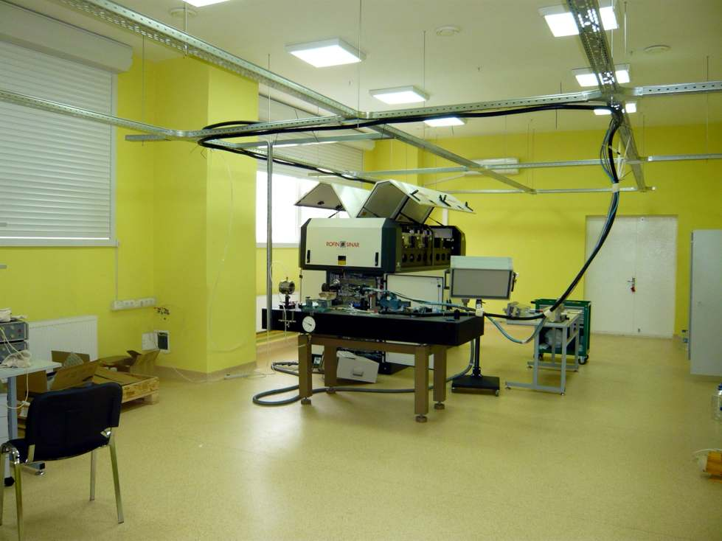
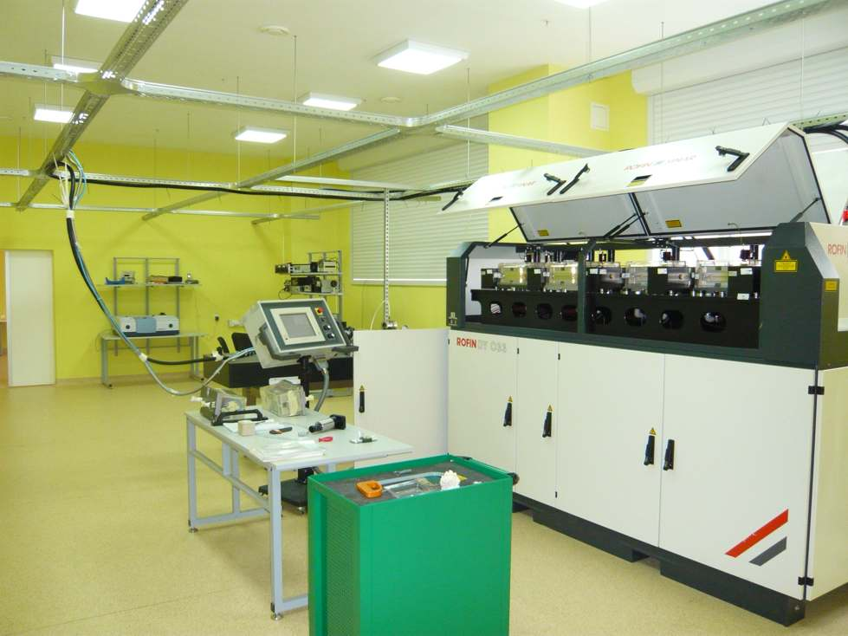
New experimental facilities
with 3.3 kW CW-YAG laser
- Special ventilation with micro-filtering of the incoming air
- Continuous close cycle dust removal
- Air conditioning
- Thermo stabilized water supply to all experimental set-ups
- Motor-driven jalousie for complete darkening
- Two fibre laser-beam delivery systems
- Laser power regulation according to arbitrary function (time response of ca 1 ms)

Slide 4
Laser-melting is an alternative approach for studying melting behavior of two-component systems. It was recently demonstrated that it has some advantages in respect to the conventional methods (melting in a crucible):
  No phase segregation due to gravitation forces
  No convection
  No contamination with a crucible material (self-crucible melting)
  Heating with arbitrary power vs time
  Very fast and controllable cooling of melt (quenching) can be performed
  Melting of the surface is local down to about 200-500µm depth. The material’s maximum temperature is seen with depth below the surface
  Large possibilities for various optical measurements (temperature, state of the surface etc.)
  Complex behaviour of material can be easily compared with computer code modelling

Slide 5
Schematic of the set-up

Slide 6
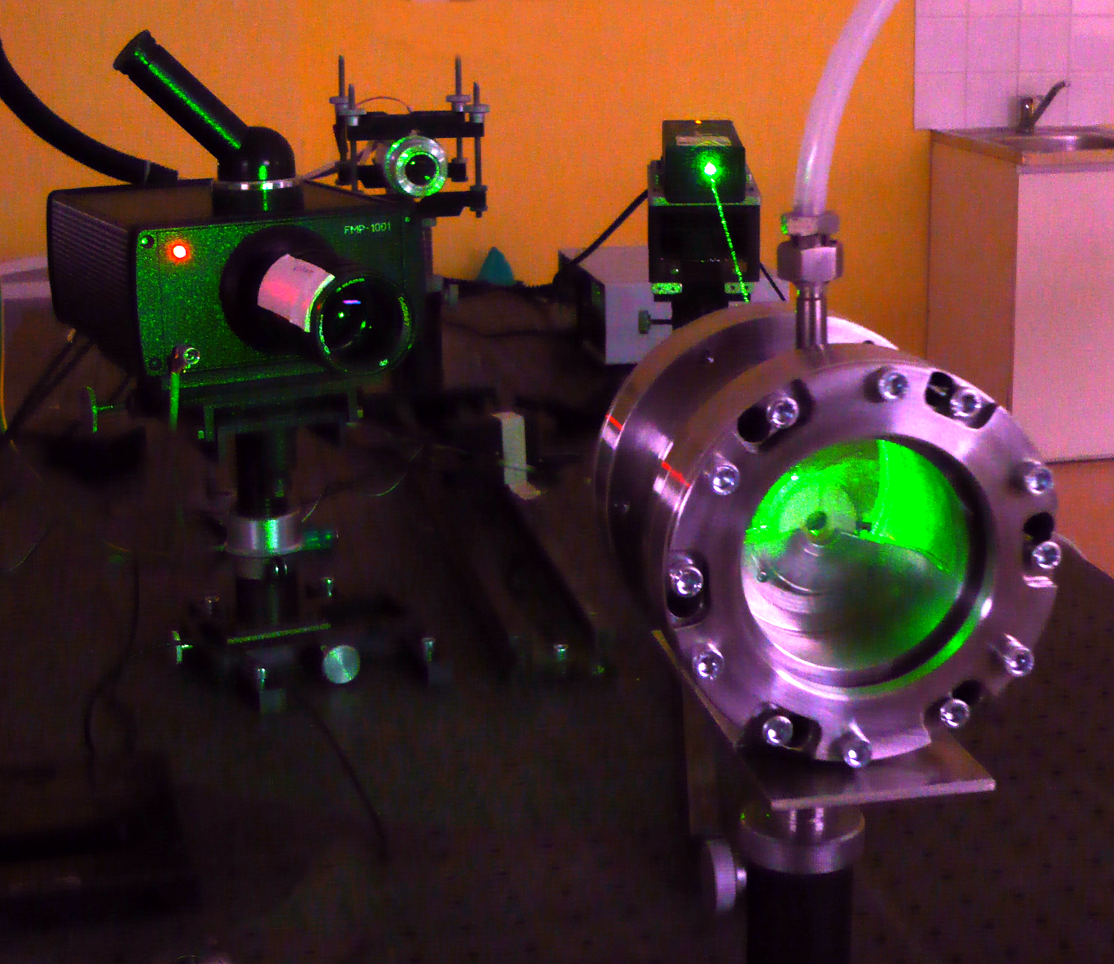
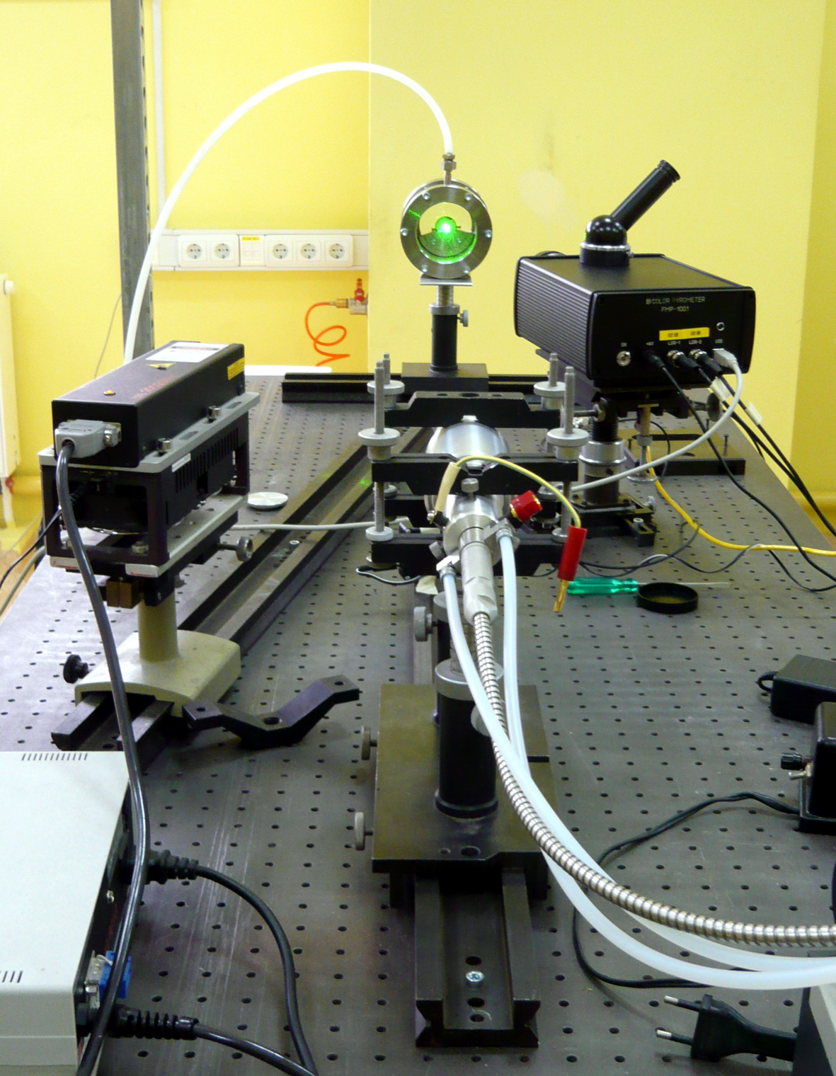
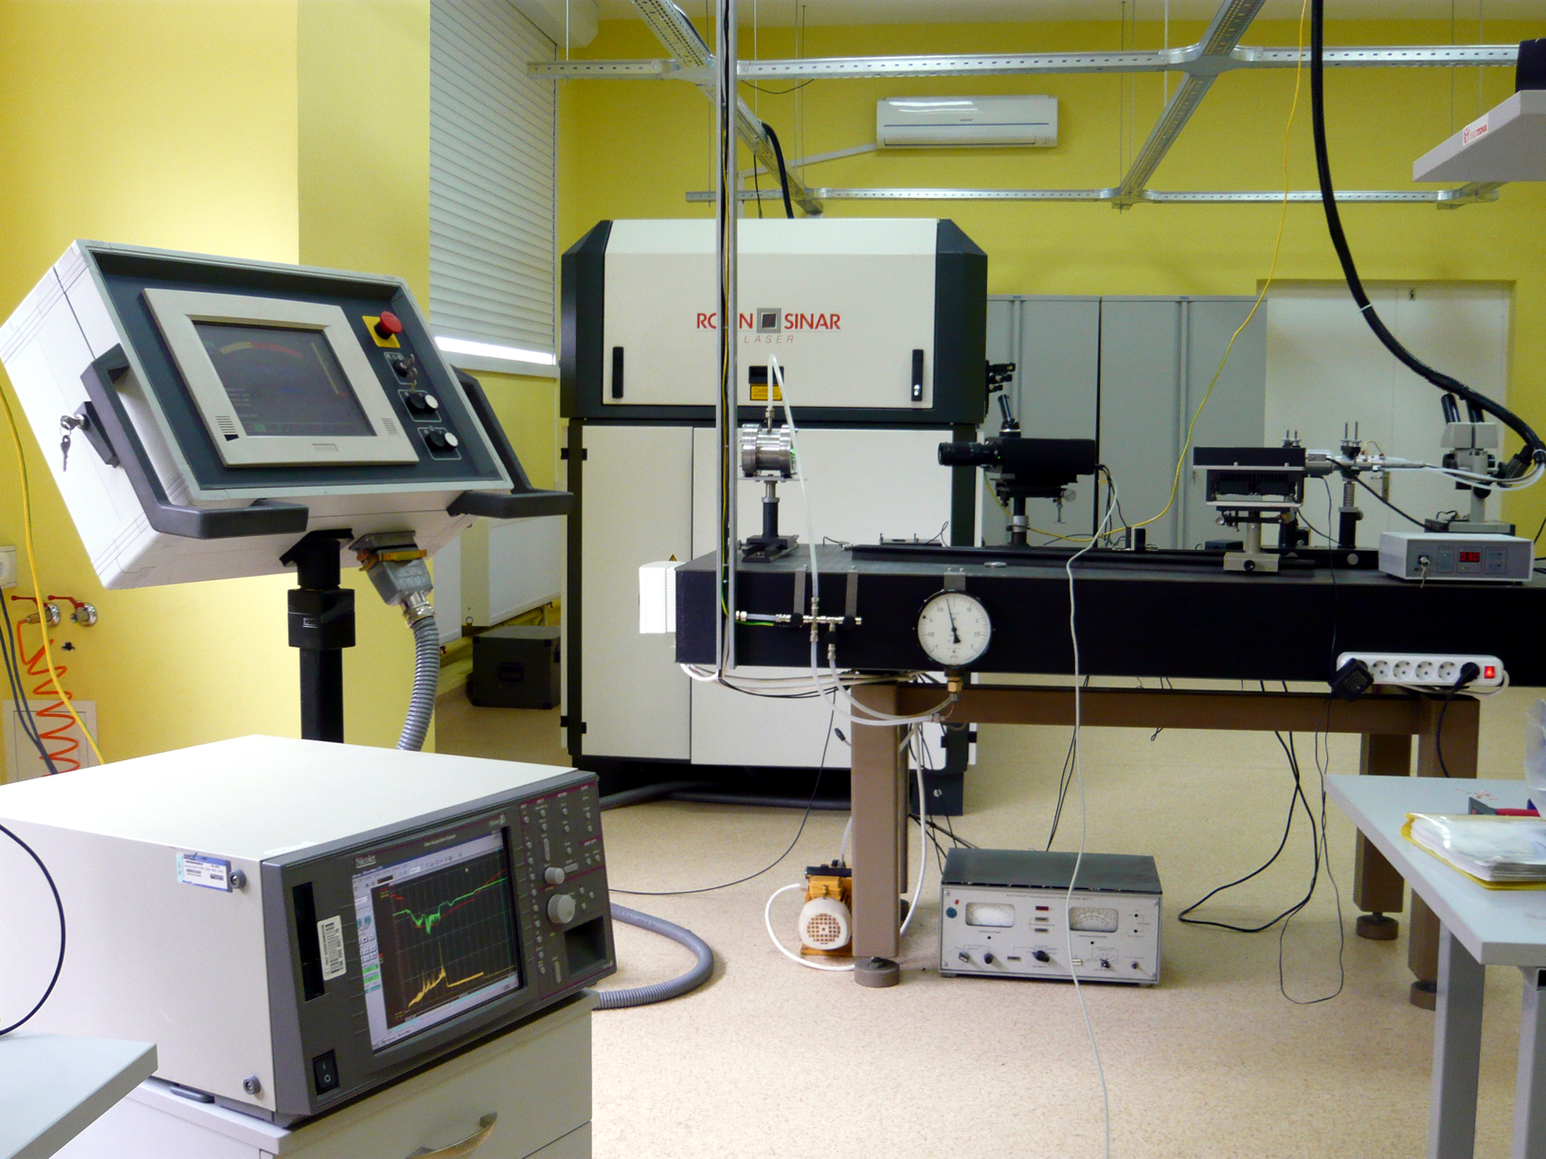
New set-up

Slide 7
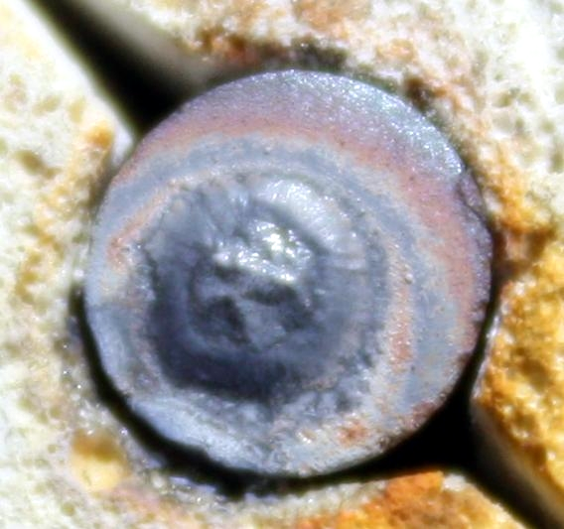
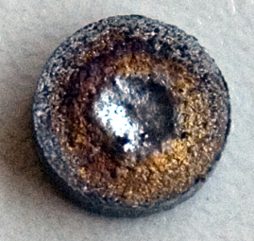
Samples after heating
Specimen, cut out from ingot of CORPHAD test
Pressed (but not sintered) sample
5 mm
5 mm
Zr=59.9 at% Fe=19.9 at% O=20.2 at%
(ZrO_{0.337})_{0.751}Fe_{0.249}
Zr0₂ - 28.57 m%, Zr - 48.26 m%, Fe - 23,17 m%
Zr_{0.464} Fe_{0.253} O_{0.283}
[0.89(ZrO_{0.43})+0.11(ZrO₂)]_{0.65}Fe_{0.35}

Slide 8
Thermogram of the first test with pressed sample: Zr_{0.464} Fe_{0.253} O_{0.283}
?
T_{melt} (eutect. Zr+ZrO₂) ?
T_{melt} (Fe) ?

Slide 9
Conclusion
New set-up for investigation of phase transitions in multicomponent corium systems is put into operation.
The apparatus is used for preliminary testing of sub-oxidized Fe-Zr-O system with high metallic content both for previously melted and dense sample and sample made by pressing of the blended powder.
It turns out that the behavior of both types of samples is similar: they do not show any failure due to the possible low resistance to the thermal shock. However, new tests with less "metallic" samples are needed in order to see if just pressing of the powder is sufficient to keep sample intact during laser heating.
It is realized that the probe laser for ODR has to be replaced with a new one, the latter will require some additional time and unexpected expenditures.
The set-up will be additionally equipped with multiwavelength pyrometer and high-speed video camera by the end of October 2008.

Slide 10
END

Slide 11
Для экспериментального исследования высокотемпературного поведения металлооксидной системы U-Zr-Fe-O, наряду с методами, применяемыми в проекте МНТЦ CORPHAD2, будет использован метод, основанный на лазерном нагреве, который будет проводиться Участником Проекта ИТЭС ОИВТ РАН. Этот метод, использованный ранее для изучения сверхстехиометрического диоксида урана (Manara & Sheindlin) и системы Zr-U-O (Bottomley & Sheindlin), будет усовершенствован путем повышения информативности для определении солидуса и ликвидуса с помощью дополнительной скоростной видеосъемки поверхности образца.
Таким образом, для исследования фазовых диаграмм используются следующие методы:
Визуальный политермический анализ в холодном тигле (ВПА ИПХТ);
Дифференциальный термический анализ (ДТА) и дифференциальная сканирующая калориметрия (ДСК);
Визуальный политермический анализ в микропечи Галахова (МГ);
Высокотемпературная микроскопия (ВТМ);
Метод импульсного лазерного нагрева образца (ИЛН).
Эти методы прошли апробацию при выполнении проектов COLOSS, METCOR, CIRMAT, CIT, ENTHALPY, ECOSTAR, OESD/MASCA.
Для физико-химического анализа используются следующие методы:
1. Анализ элементного состава
• Рентгенофлуоресцентный анализ (XRF)
• Химический анализ (ChA)
2.Анализ фазового состава
• Рентгенофазовый анализ (XRD)
• Микрорентгеноспектральный анализ (EDX)
3. Металло- и керамография (Opt M)
• Оптическая микроскопия
• Сканирующая электронная микроскопия (SEM)
4 Определение кислорода методом карботермического восстановления проб

Slide 12
Radial Temperature Distribution vs Time: New Possibilities
In practice radial temperature distribution will be measured by line-scan camera

Slide 13
Laser-heating thermogram of UO₂- 40mol% Zr

