Slide 1
Results obtained with laser pulse heating facility
M.Brykin, E.Pakhomov, M.Sheindlin, D.Knyasev
Joint Institute for High Temperatures, Moscow
sheindlin@yandex.ru

Slide 2
Main tasks for the second year:
- High-speed multichannel pyrometer: blackbody calibration and data evaluation,
- High-speed precise temperature field measurements
Measurements of phase transitions of Zr-O system with emphasis on its metallic-rich and ZrO₂-rich domains
Manufacturing of ZrO₂–FeO samples in the wide composition range from ZrO₂ to the eutectic point
Preliminary study of ZrO₂–FeO phase transition above eutectic temperature
Melting point measurements of CaO
Further development of mathematical model of the noncongruent melting and solidification of two component materials
Development of model of melting of uranium dioxide on the basis of its crystalline lattice defects

Slide 3
Licensing of the laboratory for performing tests with natural uranium
The work done so far:
1) Definition of main requirements for the laboratory room (contract work is paid by IVTAN)
2) The preliminary choice of suitable laboratory room is done
3) The specification requirements for the special laboratory are issued
4) The necessary agreement of Presidium of the Russian Academy of Sciences is received
5) The proper choice of a room for the special laboratory is officially confirmed by an authorized company (contract work is paid by IVTAN)
6) Training of laboratory personnel (contract work is paid by IVTAN)
7) Medical examination of personnel is almost completed
8) The project of the special laboratory is executed by an authorized company (contract work is paid by IVTAN)
9) Special additional maintenance work in the laboratory room according to recommendations of the licensing authorities is almost completed. The room is equipped with special power supplies, separate water supply and drain, ventilation with a special filtering. It has a metal door with two locks and alarm system, etc…. The separate room for storage of a radioactive waste is equipped
10) Necessary means for the individual control of contamination are leased
11) An authorized company having the right to perform an expertise of the project is defined
The remaining work:
1) Receiving an expertise of the project of the lab
2) Receiving the decision about suitability of the laboratory to perform work with natural uranium
3) Purchasing of means for radiation control
4) Collect a number of technical documentation

Slide 4
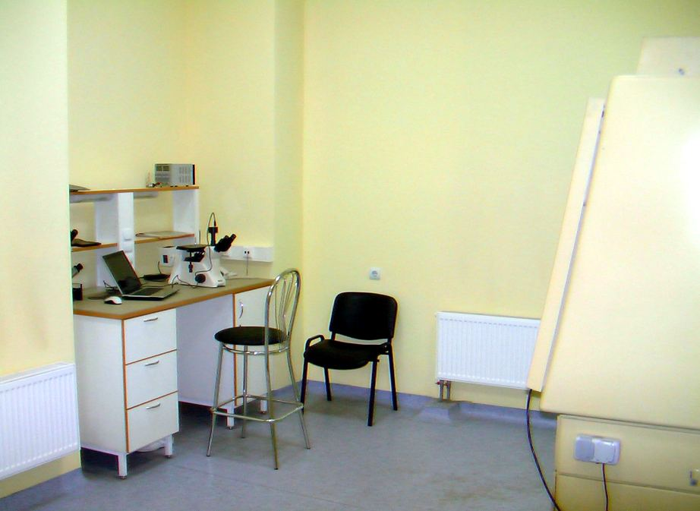
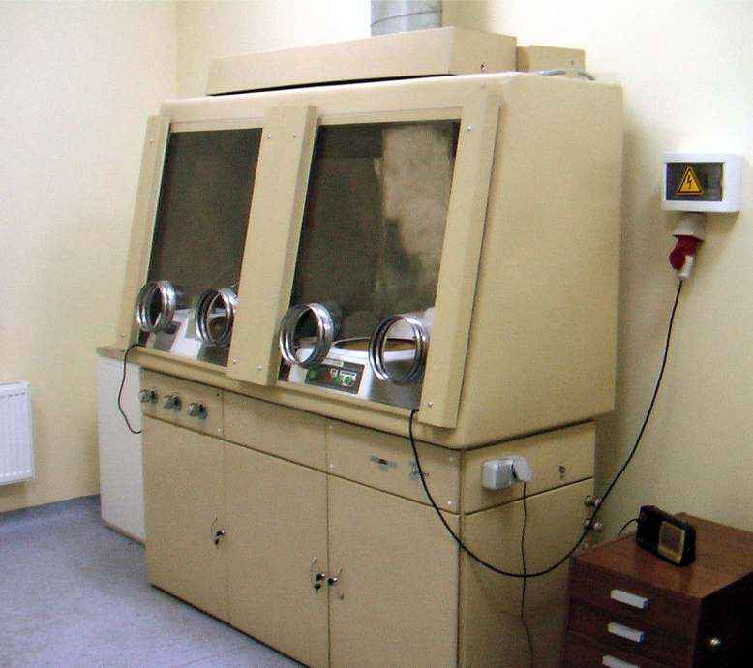
Laboratory Room Dedicated for Handling of Natural Uranium Samples

Slide 5
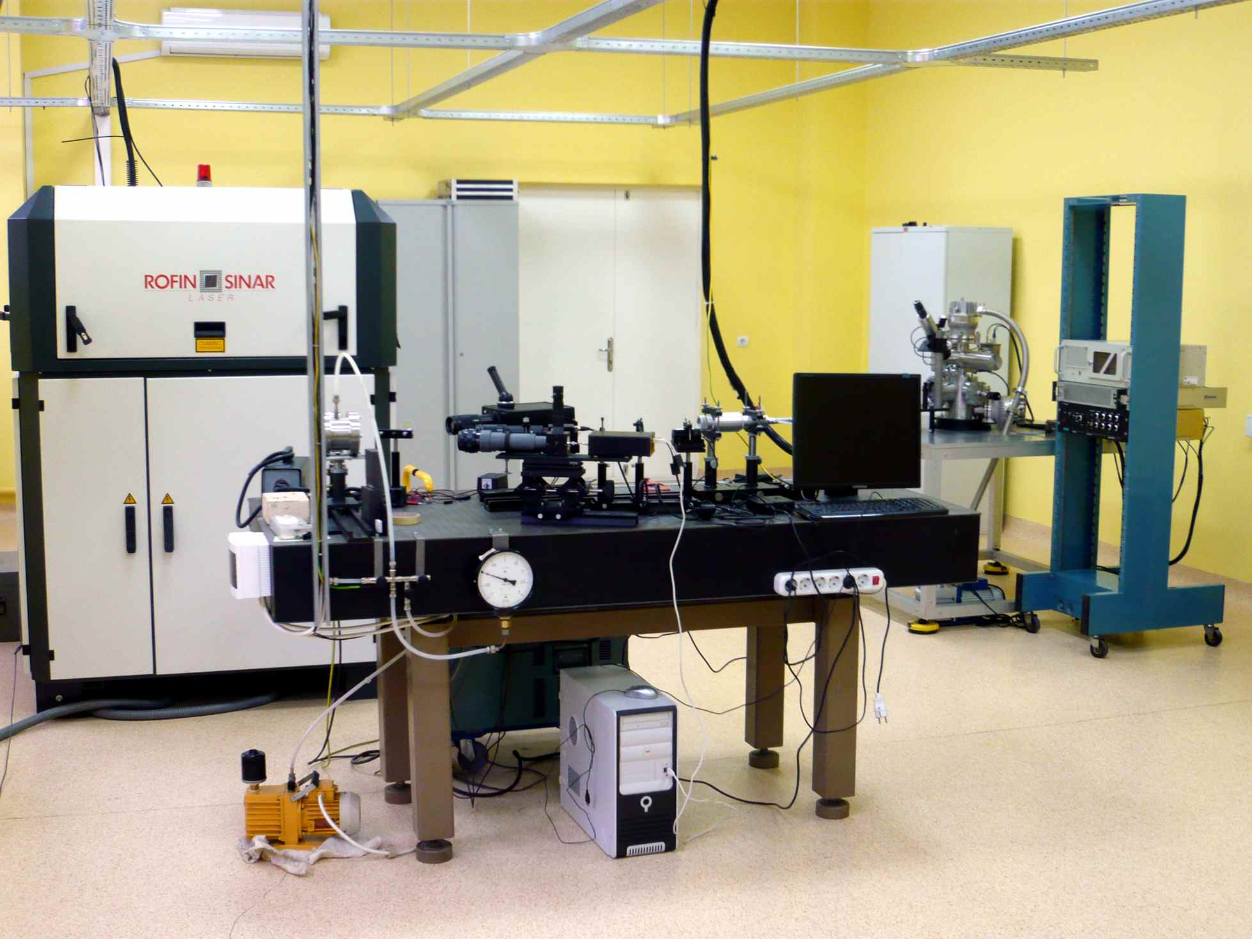
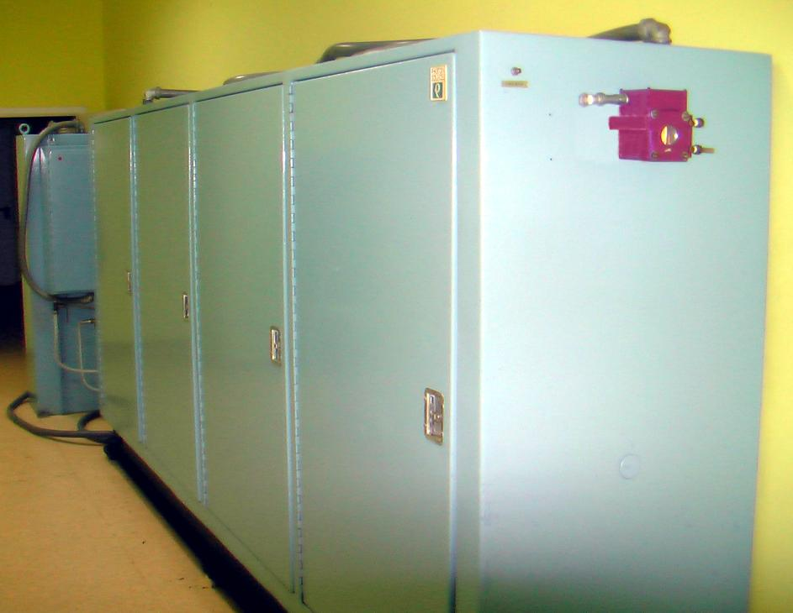
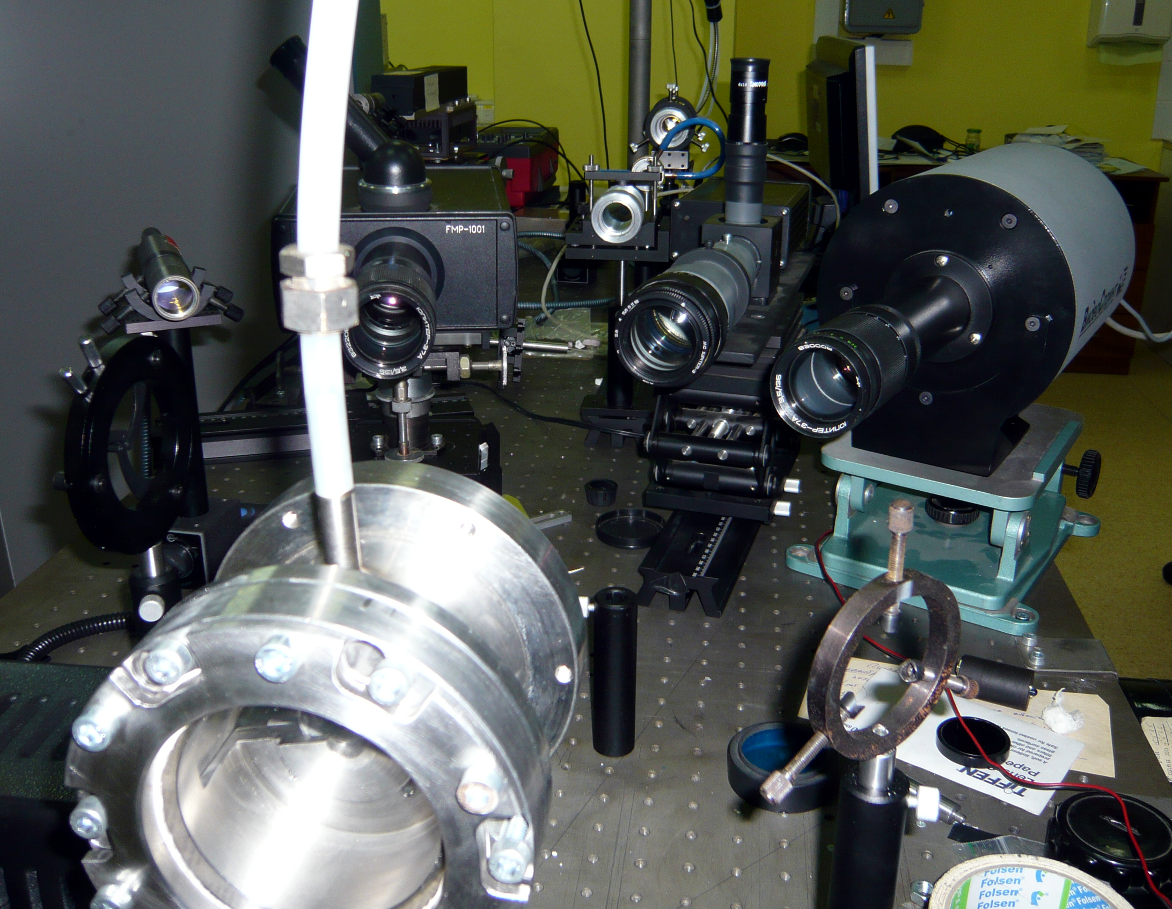
Present View of the Experimental Set-Up
Laser power regulation according to arbitrary function (time response of ca 1 ms)
Multichannel pyrometer, 1000 sp/s, wavelength range 450-900 nm
2 channel pyrometer, response time: 10 us
High-speed CMOS-camera: 1000 frames/s, max. resolution 1000x1000 pix.
Power CO₂-laser in the laboratory

Slide 6
Schematic of the Set-Up
Modification of laser-heating unit for low power experiments

Slide 7
Zr-O System: Experimental Results
It is assumed that emissivity is linear vs. atomic percent in the range between well adopted values for Zr and ZrO₂

Slide 8
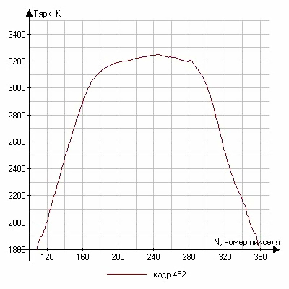
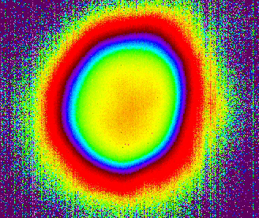
Temperature Fields: Solidification Dynamics of Zirconia

Slide 9
The Method of Polichromatic Pyrometry is based on the spectral analysis of the thermal radiation over a sufficiently broad wavelength interval (typically 500-900 nm).
The thermal radiation, Ψ(λ,T), detected by a fast spectrometer is analysed
by an on-line computer programme as follows:
    A function is selected to approximate the expected physical features of ε(λ,T) based on different criteria such as analogies with known materials, theoretical predictions, etc.
    The product ε(λ) P(λ,T) is parameterised as ε_{λ}^{α1…αk} .P_{λ}^{T} , k≥1, and the functional Φ =|(Ψ - ε.P)²dλ is finally searched for a minimum in the R_{k+1} space {α₁…α_{k}, T} by means of a recursive algorithm.
    The numerical robustness of the solution is checked and, if stability conditions are satisfied, k is increased by one, and the procedure restarts from 2). Else, the programme stops, giving the last calculated temperature and spectral emissivity function with the best-reached uncertainty.

Slide 10
General Scheme of the Polychromatic Pyrometer

Slide 11
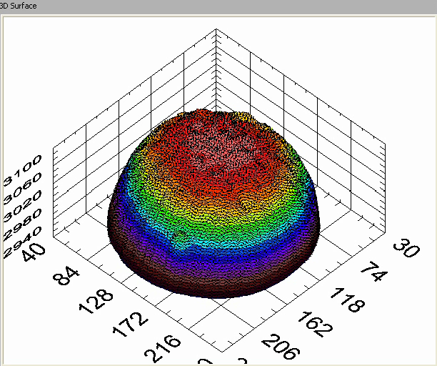
ZrO₂ Melting Test:
True Temperature Measurements by Polichromatic Pyrometer and Dynamics of 2D Temperature Distribution in the Vicinity of the Freezing Point

Slide 12
Laser-Pulse Melting of CaO

Slide 13
ZrO₂-FeO System
Main tasks:
Verification of the laser-heating technique on relatively well studied binary system
Testing of applicability of the mixed oxide samples prepared by blending followed just by pressing without any heat treatment
Definition of number of the laser-melting cycles for complete homogenization of initially inhomogeneous low density samples
Prepared samples:
Three batches of cylindrical samples (dia 12x3 mm) are prepared by blending followed by pressing. The compositions are: 8.3; 30 and 53 mol % of FeO. The samples have, respectively, light gray to grey color; the density is about 70% to the theoretical density.

Slide 14
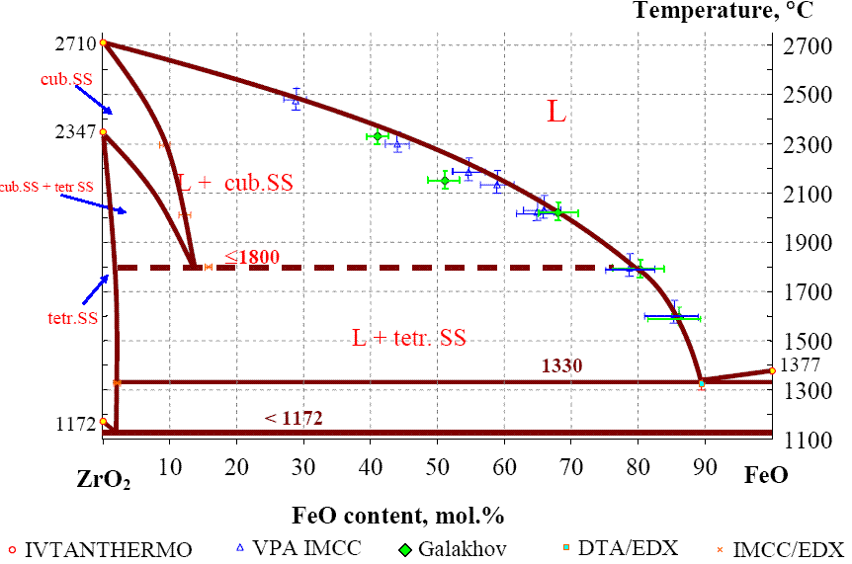
ZrO₂-FeO System: Preliminary Results
- IVTAN (2010), laser-heating
- IVTAN (2010), laser-heating

Slide 15
Numerical simulation of noncongruent melting and solidification of two component materials taking into account the existence of two phase region.
Main assumption: existence of the local thermodynamic equilibrium over all sample
Noncongruent phase transitions lead to redistribution of composition between phases in the vicinity of their moving boundaries.
Disturbance in initially homogeneous composition leads to diffusion assisted mass transfer
The basic equations are equations for heat transfer and for mass transfer. They define mass fraction C and temperature T
Numerical calculation is based on the through scheme without definition of the phase boundaries

Slide 16
Numerical Results
Laser pulse and surface thermograms
Peculiarities of the mass transfer model does not effect the theoretical thermogram (see comparison with x=constant model)
Surface stoichiometric parameter x versus time
Variation of phase state at surface leads to fast disturbance of starting stoichiometry.
However at melting and freezing deviations from starting stoichiometry are acceptable.

Slide 17
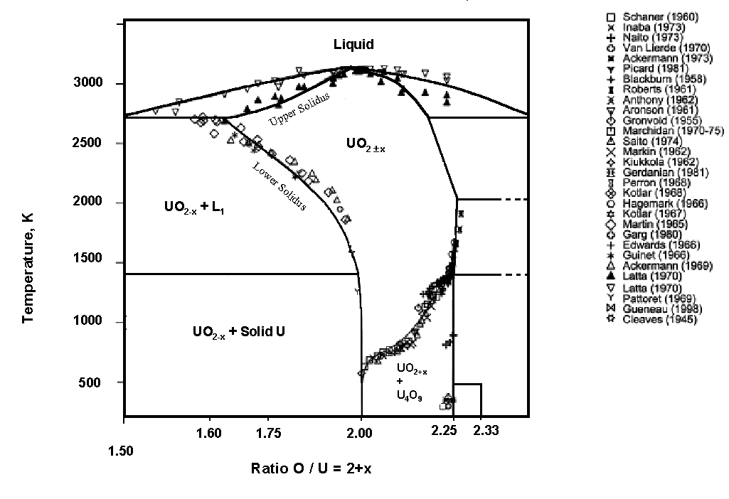
UO_{2±x} Phase Diagram
3500
Traditional Methods:
Problems in the hyperstoichiometric region:
- sample contamination from the crucible metal.
- important oxygen losses (strongly non congruent evaporation).
Liquidus and solidus lines are hard to measure in this domain.
?
3000
2500
UO_{2+x}
₊
O₂
Temperature, K
2000
UO_{2+x} + L₁
UO_{2 + x}
1500
UO_{2+x}
₊
U₃O_{8-y}
1000
UO_{2+x} + Solid U
500
U₃O₇
After: C. Guéneau et al., J. Nucl. Mater. 304 (2002), 161.
1.25
1.50
1.75
2.00
2.25
2.50
O/U ratio

Slide 18
Model of Melting of Uranium Dioxide on the Basis of its Crystalline Lattice Defects
The uranium dioxide crystal lattice defects are analyzed and the type and the number of these defects are defined. The latter makes it possible to find solidus temperatures of non-stoichiometric uranium dioxide in a wide range of its oxidation states and also to find the physical mechanisms defining area of existence of a cubic fluorite-type uranium dioxide phase.
Basic propositions and approaches:
1. Appearance-annihilation of defects in a crystal lattice of uranium dioxide is a result of its chemical interaction with surrounding oxygen;
2. The type of defects in the lattice is related to the experimentally defined dependence of sample stoichiometry on the partial pressure of oxygen at a given temperature;
3. When the number of the defects in a lattice interstitial cannot be increased any more the lattice collapses. In other words the lattice arrive to its melting point.
References:
Pakhomov E.P., High-Temperature Thermophysics 44, No 6, (2006) p. 861-867 (in Russian)
Pakhomov E.P., High-Temperature Thermophysics 47, No 6, (2009) p.1-15 (in Russian)

Slide 19
Calculated Solidus and Solid-Phase Transitions in UO_{2±x}
Latta&Frixel
Manara &
Sheindlin
calculated
Temperature, К
UO_{2 - x}
?
х = 2 – О/U

Slide 20
Conclusion
Experimental set-up is considerably improved and can be used now for study of highly reflected materials (as for example CaO) with a help of a special preheating system. It is also equipped with additional CO₂ CW power laser, which can be used for controlled heating of semitransparent oxide ceramics. High-speed camera is capable to record temperature distributions over the laser-heated zone at 1000 frames/s.
New sets of ZrO₂ –FeO and CaO - samples for the laser-melting experiments are manufactured.
There are still problems with licensing but there are now good chances to start transfer of uranium containing samples to IVTAN in October 2010. It means that the experiments on U-Zr-O system are shifted to the end of 2010.
Some more measurements are performed on various compositions for the Zr-O system.
Melting point measurements of CaO are performed. The obtained value is significantly higher than presently adopted.
First laser-melting experiments are performed on ZrO₂ –FeO system. It turns out that liqudus values for three compositions are in acceptable agreement with the conventional methods (Galakhov microfurnace, etc).

Slide 21
END

