Slide 1


Problems and perspectives of SEM/EDX and chemical analyses of corium samples
A.P. Alexandrov
Research Institute of Technology
ISTC PRECOS
Project #3813
Alexandrov
RIT
Presented by Sergey Vitol, Vyacheslav Almjashev and Vladimir Knauf
3rd PRECOS Meeting
ETU
Saint-Petersburg
NATI Research
Saint-Petersburg

Slide 2
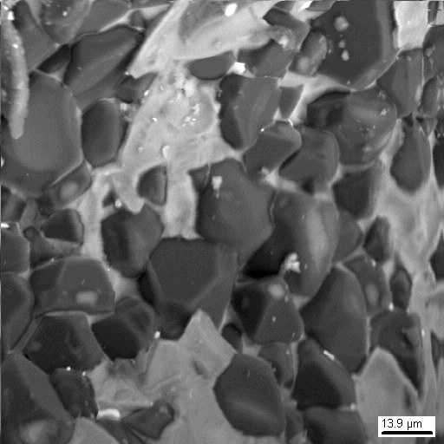
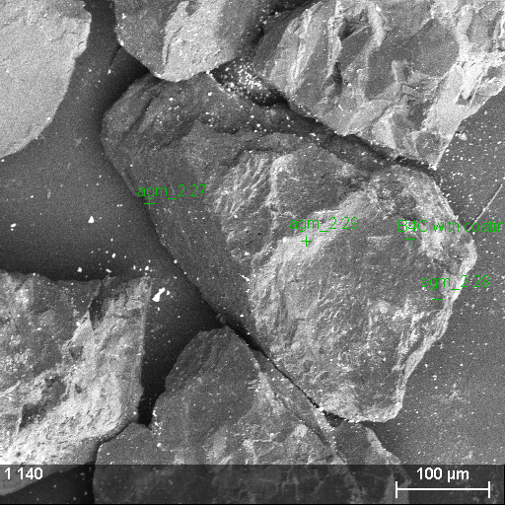
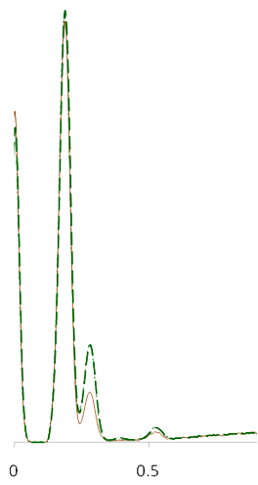
B₄C measurement
B
• B₄C
• B₄C
at.% | B | C
measurement | 74.4 | 25.6
stoichiometry | 80.0 | 20.0
difference | -5.6 | 5.6
C
at.% | B | C
measurement | 79.2 | 20.8
stoichiometry | 80.0 | 20.0
difference | -0.8 | 0.8
O
B₄C chemical agent granules
B₄C ceramic material

Slide 3
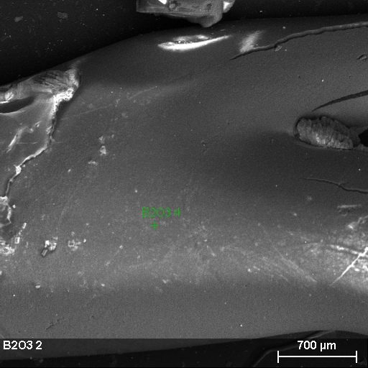
B₂O₃ measurement
at.% | B | O
stoichiometry | 40.0 | 60.0
measurement 1 | 37.4 | 62.6
difference 1 | 2.6 | -2.6
measurement 2 | 39.8 | 60.2
difference 2 | 0.2 | -0.2
measurement 3 | 44.2 | 55.8
difference 3 | -4.2 | 4.2
• B₂O₃
• B₂O₃
• B₂O₃
B₂O₃ fiber

Slide 4
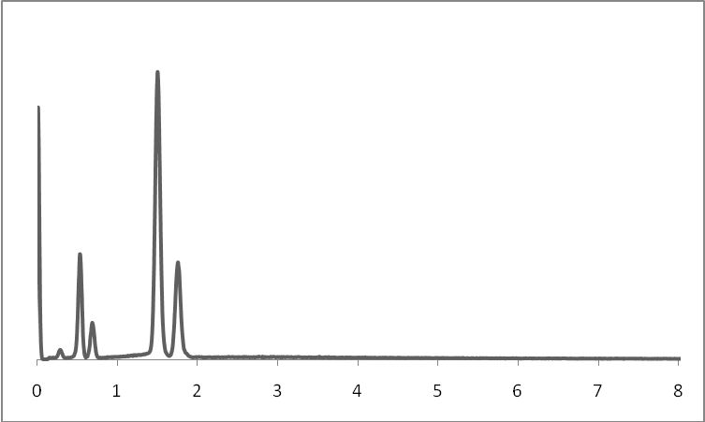
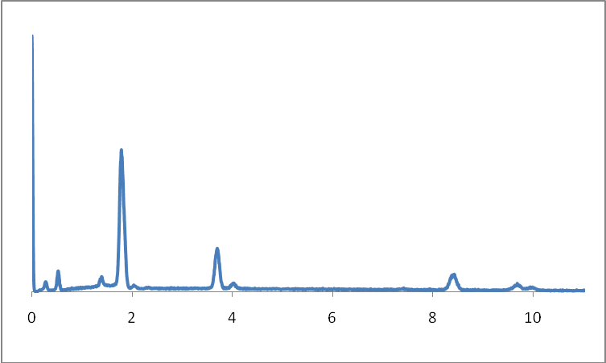
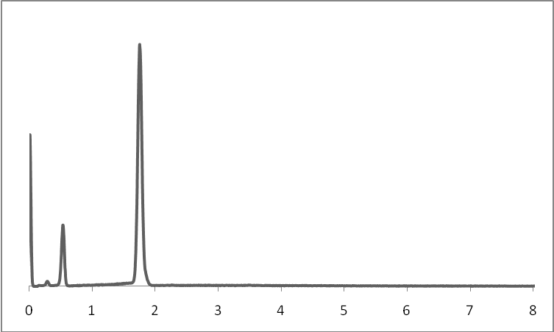
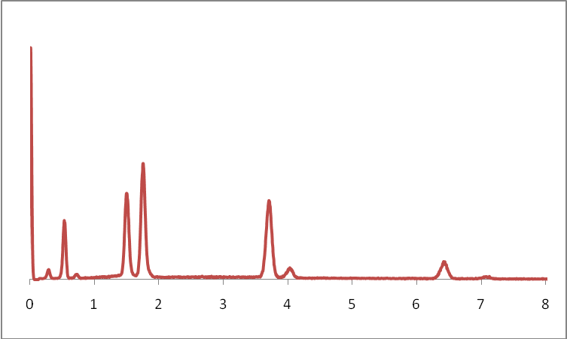
Etalons measurement (FPM ϕρΖ)
Topaz (Al₂[SiO₄](F,OH)₂)
Scheelite (CaWO₄)
at.% | Al | Si | F | O
measurement | 22.12 | 10.10 | 22.51 | 45.27
stoichiometry | 22.22 | 11.11 | 22.22 | 44.44
difference | -0.10 | -1.01 | 0.29 | 0.82
at.% | Ca | W | O
measurement | 17.36 | 16.40 | 66.24
stoichiometry | 16.67 | 16.67 | 66.67
difference | 0.69 | -0.27 | -0.42
Quartz(SiO₂)
Epidote (Ca₂(Al,Fe)Al₂Si₃O₁₂(OH))
at.% | Si | O
measurement | 32.94 | 67.06
stoichiometry | 33.33 | 66.67
difference | -0.39 | 0.39
at.% | Ca | Al | Fe | Si | O
measurement | 8.63 | 10.61 | 3.25 | 14.11 | 63.39
stoichiometry | 9.52 | 10.81 | 3.48 | 14.29 | 61.90
difference | -0.89 | -0.20 | -0.22 | -0.17 | 1.49

Slide 5
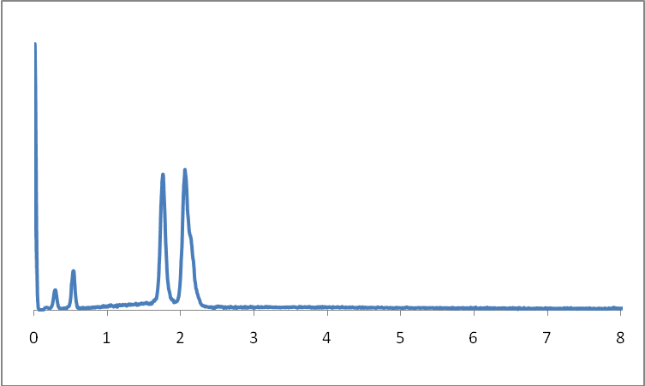
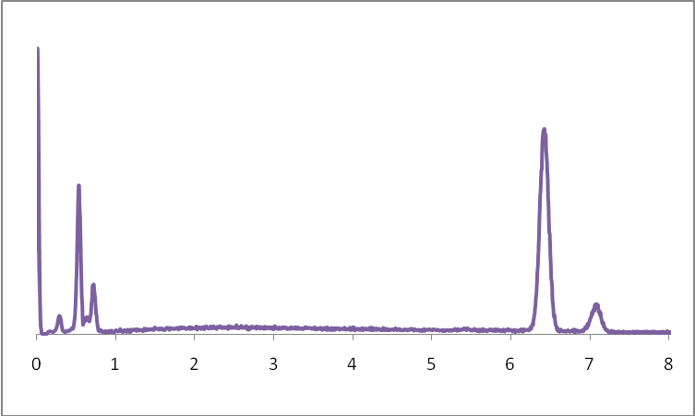
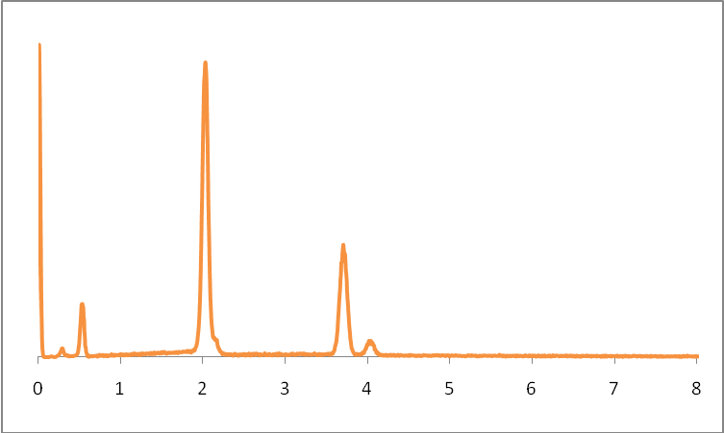
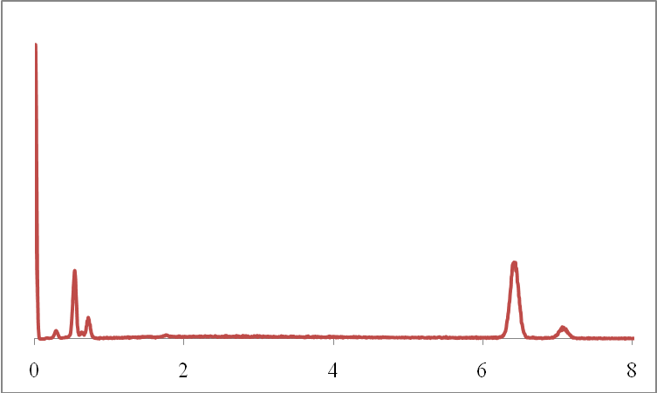
Etalons measurement (FPM ϕρΖ)
Zircon (ZrSiO₄)
Magnetite (Fe₃O₄)
at.% | Zr | Si | O
measurement | 18.81 | 18.12 | 63.06
stoichiometry | 16.67 | 16.67 | 66.67
difference | 2.14 | 1.46 | -3.60
at.% | Fe | O
measurement | 42.64 | 57.36
stoichiometry | 42.86 | 57.14
difference | -0.21 | 0.21
Calcium metaphosphate (Ca(PO₃)₂)
Hematite (Fe₂O₃)
at.% | Ca | P | O
stoichiometry | 11.11 | 22.22 | 66.67
measurement 1 | 11.20 | 22.95 | 65.85
difference 1 | 0.09 | 0.73 | -0.82
measurement 2 | 11.13 | 22.82 | 66.05
difference 2 | 0.02 | 0.60 | -0.62
at.% | Fe | O
measurement | 38.23 | 61.77
stoichiometry | 40.00 | 60.00
difference | -1.77 | 1.77

Slide 6
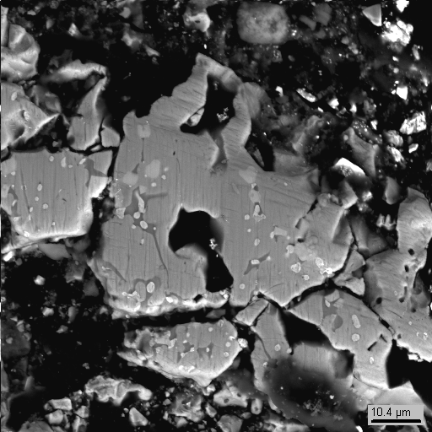
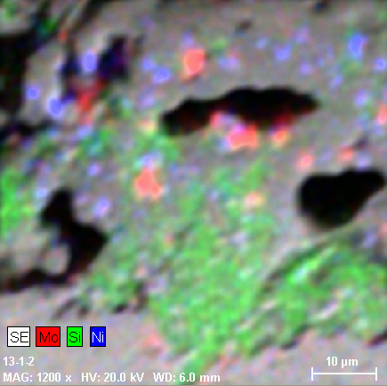
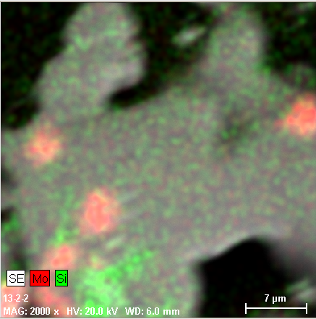
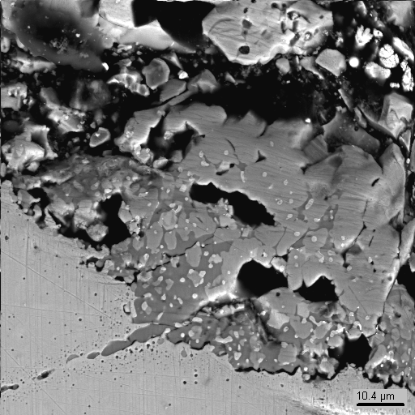
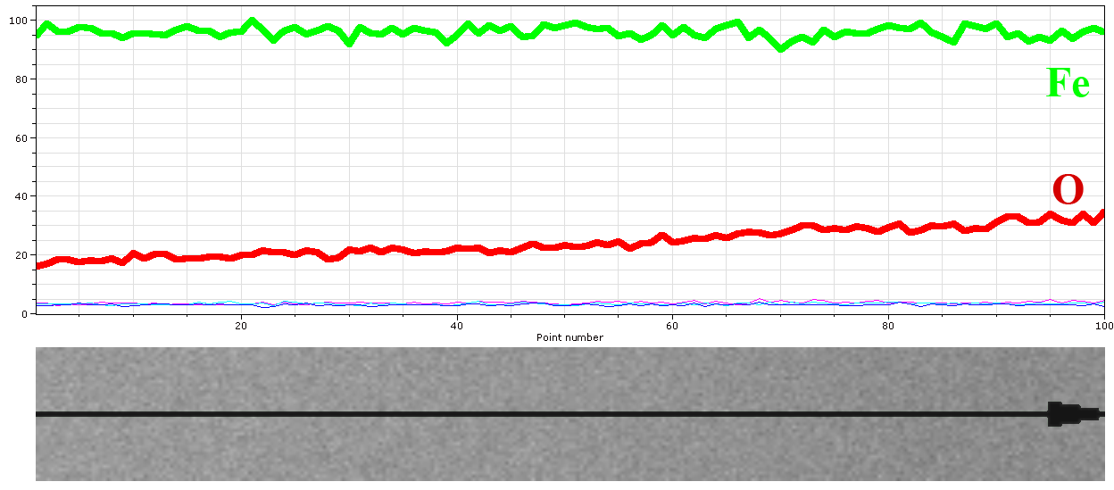
Dot mapping and concentration profile possibilities
Mo
Si
Ni
6-2-1 dm
6-2-1 dm
6-2-1 dm
6-1-1 dm
6-2
6-1-1 dm
Fe_{1-x}O concentration profile
6-1

Slide 7
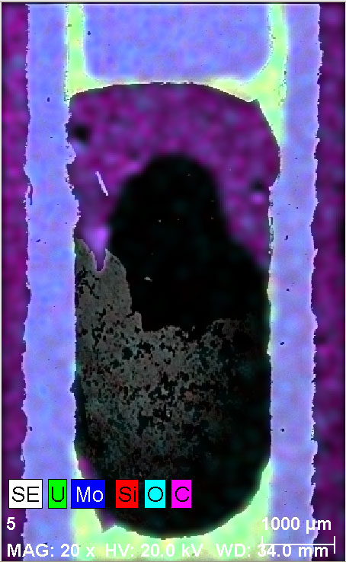
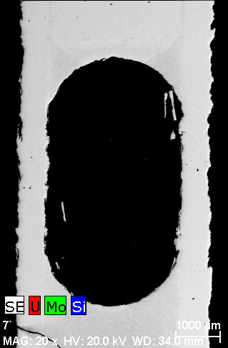
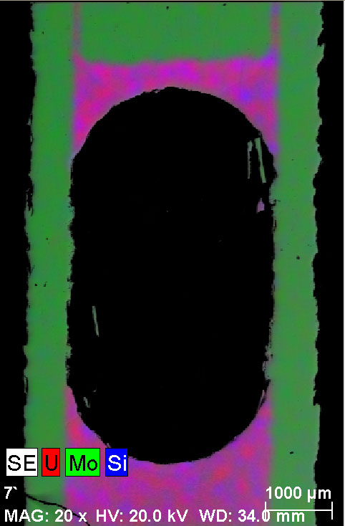
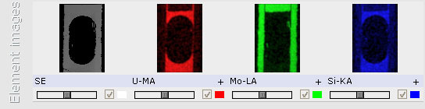
Dot mapping
Pore-phase identification problem solving
Low phase contrast problem solving

Slide 8
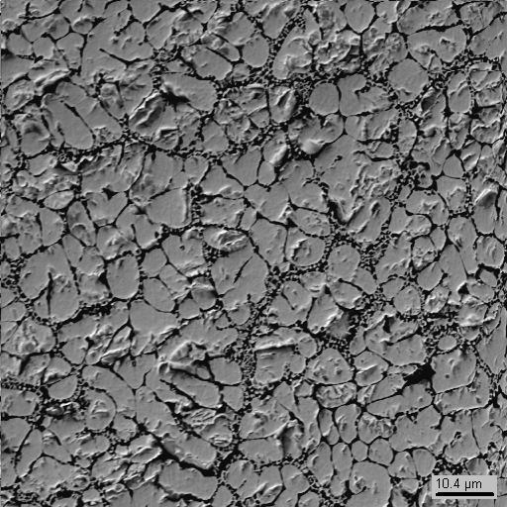
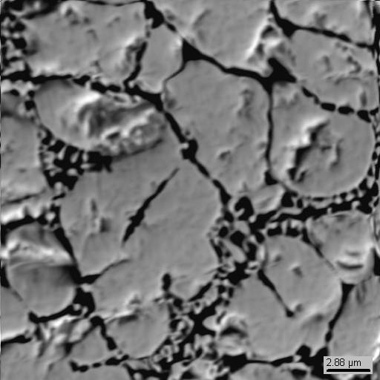
EDX vs ChA
PRS9 | Content, mass % (EDX) |  |  |  | Content, mass %
 | before repolishing |  | after repolishing |  | (ChA)
 | UO₂ | SiO₂ | UO₂ | SiO₂ | UO₂ | SiO₂
Probe 1 | 88.6 | 11.4 | 93.4 | 6.6 | 94.77 | 4.39
Probe 2 | 92.4 | 7.6 | 95.0 | 5.0 | 95.79 | 3.64
Probe 3 | 91.4 | 8.6 | 95.5 | 4.5 | 95.63 | 3.25

Slide 9
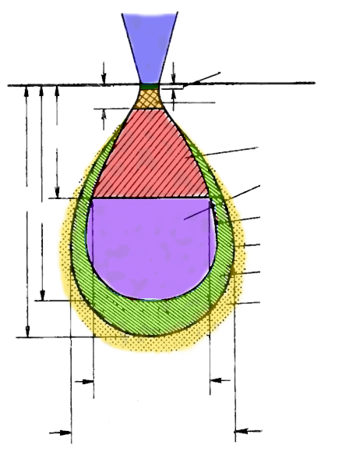
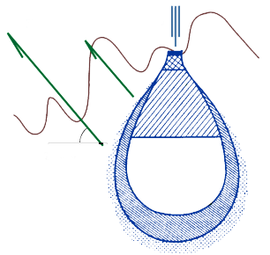
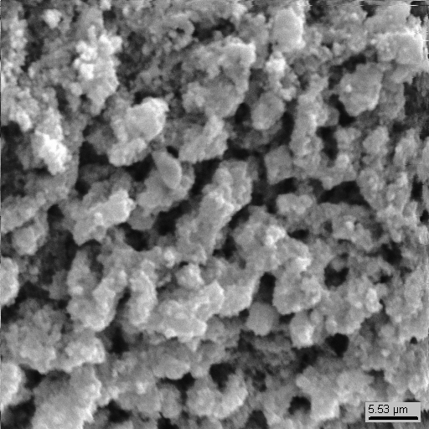
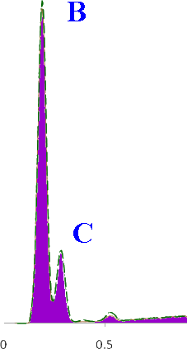
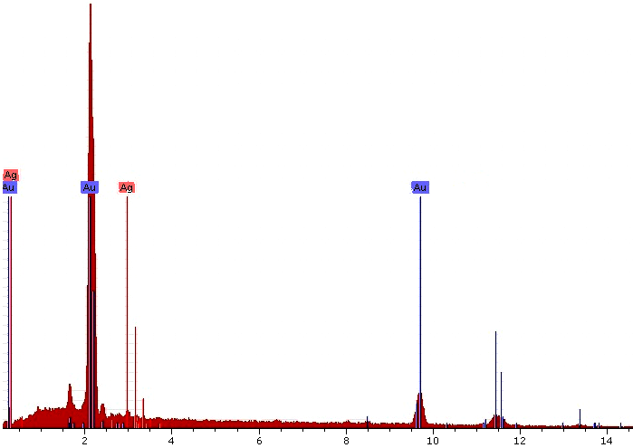
Measurement = Value ± Inaccuracy
Errors:
- Physical model
- Equipment
- Sample features (surface, coating)
- . . .
- . . .
- Algorithmic errors
- Programming errors
E₀
d₃
10 Å, Auger electrons
ē
50-500 Å
Secondary electrons
X-Ray
x_{d}
Backscattered electrons
X-Ray
Surface
R
R_{(x)}
E=E_{cr}
E=E₀
Bremsstrahlung X-Ray
Take off angle
Secondary X-Ray fluorescence
BSE
resolution
X-Ray resolution
at.% | B | C
measurement | 74.4 | 25.6
stoichiometry | 80.0 | 20.0
difference | -5.6 | 5.6
B₄C or B₃C ??
PRECOS project meeting
9

Slide 10
Conclusions
Under the typical scheme working the correctness of analytical data is determined by the harmonicity of “man-machine complex” elements: measurement tool + analyst + researcher
The chemical analysis well-set error estimation is possible under the transition to etalon analysis scheme
The correct sample’s gross analysis made by EDX method can be reliable only in the case of well-prepared surface
Under results getting it is necessary to apply the more available number of methods and techniques the better to get data which can be relied on

