Slide 1
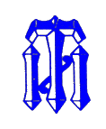


Progress report on the
UO₂ – CaO system
A.P. Alexandrov Research Institute of Technology
International Science and Technology Center
SPbSIT
(TU)
ETU
Saint-Petersburg
Presented by E. Krushinov
3rd PRECOS Project Meeting
June 2, 2010, St. Petersburg

Slide 2
Contents
Available binary diagrams
Experimental matrix
Test procedures
Test results
Conclusions

Slide 3
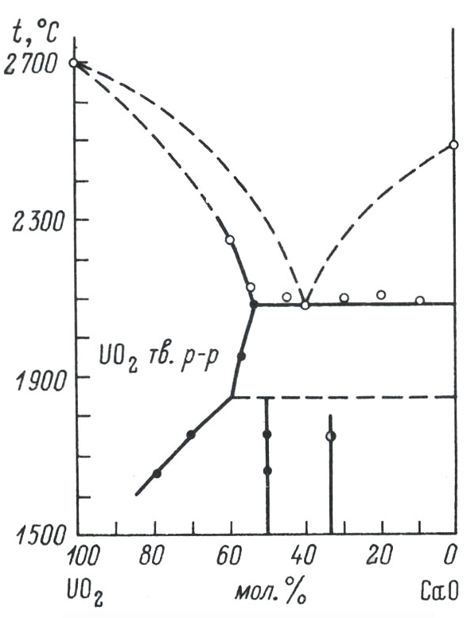
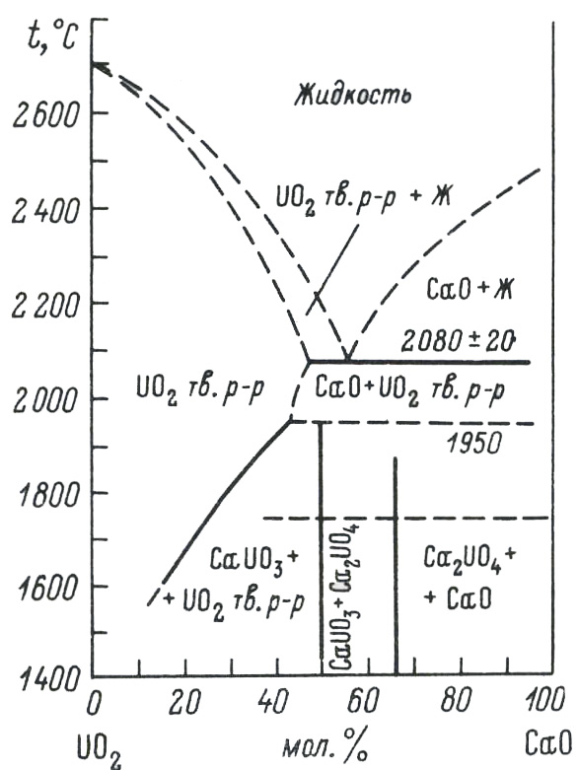
Available UO₂-CaO phase diagrams
Alberman K.B., Blakey R.C.,
Anderson J.S.
(1951)
Amato I.
(1966)
T_{eut} =2080±20 °C
(eut) – 55%mol.CaO
UO₂(ss) – 47%mol.CaO

Slide 4
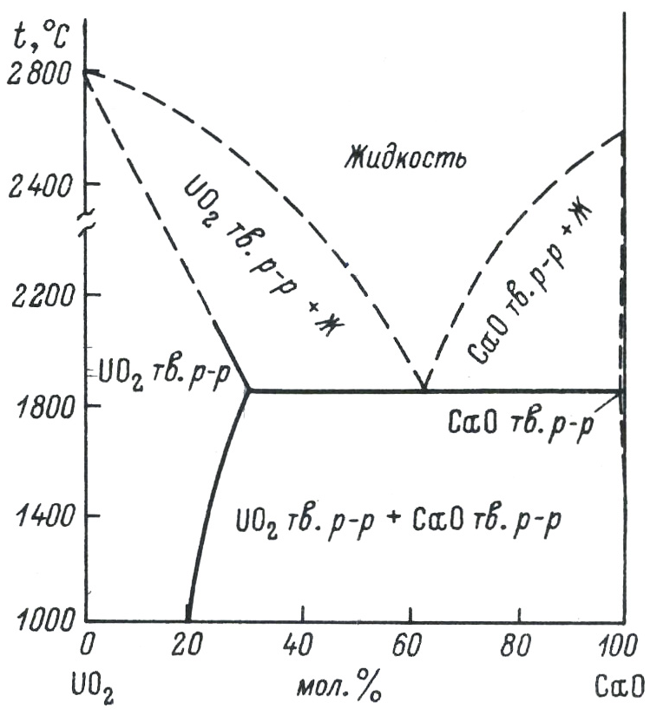
Available UO₂-CaO phase diagrams (2)
The published versions of the phase diagram differ by:
the CaO melting temperature and
T_{liq} curve position
presence/absence of chemical
compounds
limits of components solubility in
solid solutions and compositions
of the latter
eutectic point coordinates
T_{eut} =1850±20 °C
eut – 63%mol.CaO
UO₂(ss) – 30%mol.CaO
CaO (ss) – 0.35%mol.UO₂
Holc J., Kolar D.
(1986)

Slide 5
Experimental matrix
Experiment | Content, mol.% |  | Atmosphere | Experimental objectives
 | UO₂ | CaO
PRS4 | 50.0 | 50.0 | Nitrogen | Determination of the liquidus temperature. Determination of the components final solubility in the formed solid solutions
PRS5 | 1.0 | 99.0 |  | Determination of the liquidus temperature.
PRS6(1) | 17.2 | 82.8
PRS6(2) | 10.2 | 89.8
PRS10 | 36.2 | 63.8 |  | Determination of the liquidus temperature. Determination of the components final solubility in the formed solid solutions
PRS11 | 30.0 | 70.0
PRS12(1) | 60.0 | 40.0 |  | Determination of the liquidus temperature
PRS12(2) | 70.0 | 30.0
LPH |  | 100 | Air | Determination of the CaO melting temperature
- Carried out during the reported quarters

Slide 6
Test procedures
Of the tests in the PRS series included the following operations:
Molten pool production and homogenization
Molten pool depth and bottom crust thickness measurement
Molten pool surface shifting above the inductor upper coil, registration of liquid/solid regions formation on the melt surface
Molten pool returning to the initial position, pool exposure at this position for the restoration of heat and electromagnetic losses in cooled components of the furnace
Melt sampling
Shifting the molten pool surface above the inductor upper coil to the previously fixed position, video recording of formation of liquid/solid regions on the melt surface
Repetition of operations 4,5,6
Of the tests aimed at the eutectic nucleus formation the additional operations included:
Molten pool shifting below the inductor lower coil until a noticeable change of the induction heating parameters
Switching-on of the mechanism of molten pool pulling out from the inductor at 8-10 mm/h
HF heating disconnection after the complete melt crystallization

Slide 7
PRS 10 test results
Experimental objectives
T_{liq} determination
Determination of the components final solubility in the formed solid solutions
Charge composition
Mol% 36.2UO₂ + 63.8CaO
Samples
Tliq
From 4000 s, the pool was pulled
out from inductor at 8.5 mm/h for 2
hours. This has ensured close to
equilibrium crystallization and the
eutectic liquid displacement into the
ingot upper part
T_{liq} was measured 2 times by VPA IMCC with melt sampling

Slide 8
PRS 10 test results (2)
VPA IMCC: Example of thermogram 2 from the test showing
melt surface
Sample | ChA | XRF
 | UO₂ mol.%
№1 | 38.1 | 41.4
№2 | 35.7 | 38.6
    Results of T_{liq} measurements: 1876, 1886ºC

Slide 9
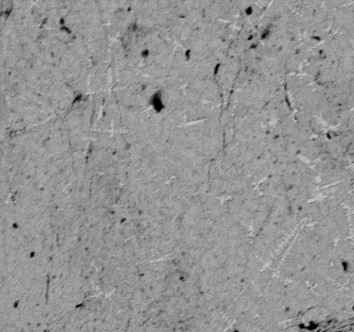
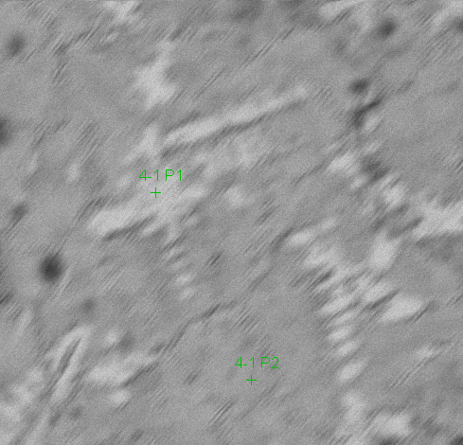

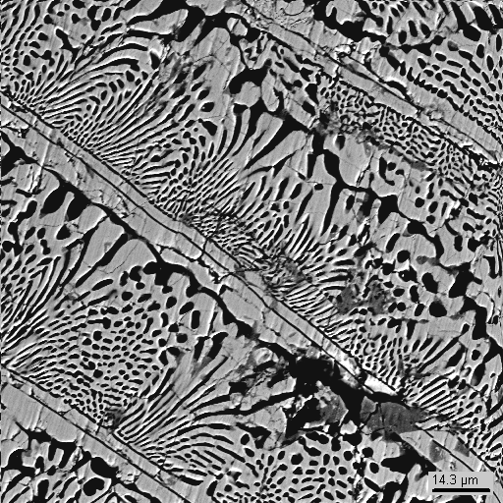
PRS 10 test results (3)
SEM/EDX analysis of the melt sample (top) and ingot periphery (bottom)
Dendritic microstructure of the melt sample
Primary crystallization phase
Quenched
sample
 | UO₂ | CaO
 | mol.%
P1 | 53.8 | 46.2
300µm
70µm
Sample | ChA | XRF | EDX
 | UO₂ mol.%
№1 | 38.1 | 41.4 | 34.9
№2 | 35.7 | 38.6 | 33.9
CaUO₃ |  | UO₂ | CaO
EDX | mass % | 84.5 | 46.9
 | mol% | 53.1 | 68.7
CaO |  | UO₂ | CaO
EDX | mass % | 8.4 | 91.7
 | mol% | 1.9 | 98.1
Compositions of melt samples of the unsaturated solid solution have been determined
There is a discrepancy between the results of SEM/EDX and (XRF+ChA)

Slide 10
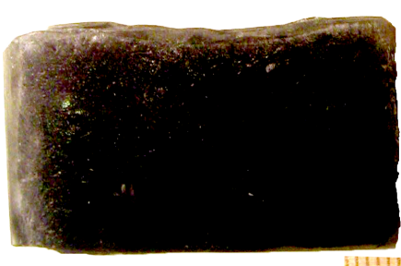
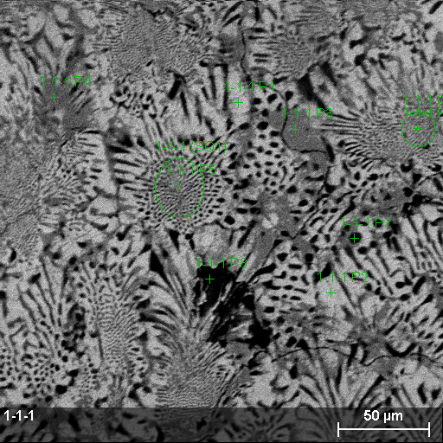
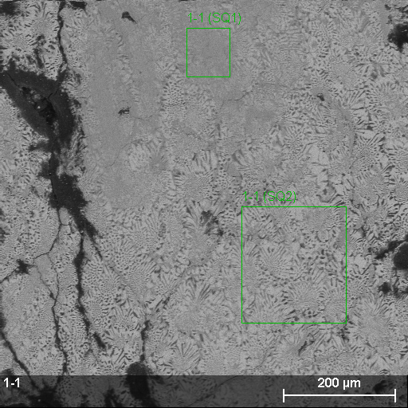
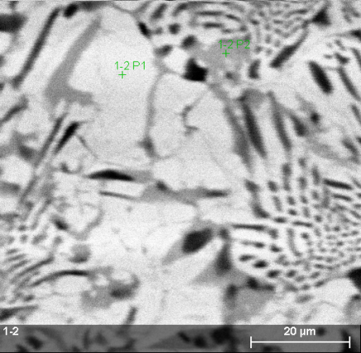
PRS 10 test results (4)
SEM/EDX analysis of the ingot (central zone)
Eutectic |  | UO₂ | CaO
EDX | mass % | 70.4±1.0 | 29.6±1.3
 | mol% | 33.1±0.2 | 66.9±1.3
Ca₂UO₄ |  | UO₂ | CaO
EDX | mass % | 68.7 | 31.3
 | mol.% | 31.3 | 68.7
UO₂ ss |  | UO₂ | CaO
EDX | mass % | 83.3 | 16.7
 | mol.% | 50.8 | 49.2
Phase mix |  | UO₂ | CaO
EDX | mass % | 61.0 | 39.0
 | mol.% | 24.5 | 75.5
UO₂ ss |  | UO₂ | CaO
EDX | mass % | 81.1 | 18.9
 | mol.% | 47.2 | 52.8
Eutectic |  | UO₂ | CaO
EDX | mass % | 69.1±0.7 | 30.9±0.2
 | mol.% | 31.8±0.3 | 68.2±0.3
Composition of the final solid solution
A eutectic crystallization zone with the final solid solution has been formed.
Compositions of the eutectics and the solid solution have been determined

Slide 11
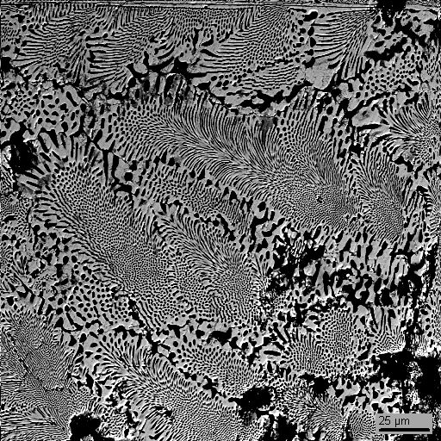
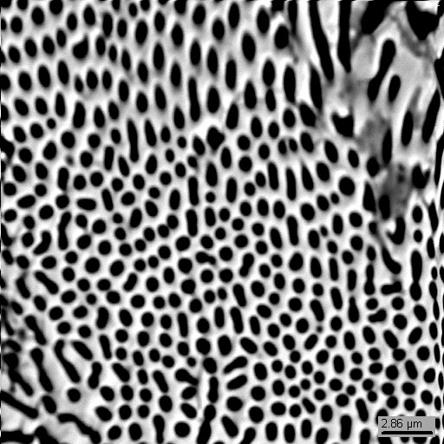
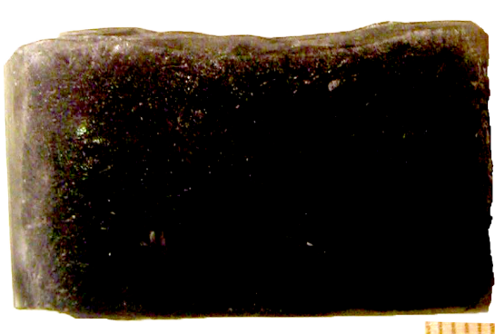
PRS 10 test results (5)
SEM/EDX analysis of the ingot (eutectic zone)
25µm
2.86µm
Eutectic |  | UO₂ | CaO
EDX | mass % | 72.0±1.8 | 28.0±1.4
 | mol.% | 34.8±0.6 | 65.2±1.6
The eutectic composition has been determined by EDX in the eutectic
crystallization zone without solid solutions

Slide 12
PRS 11 test results
Experimental objectives
T_{liq} determination
Determination of the components final solubility in the formed solid solutions
Charge composition
mol.% 30UO₂ + 70CaO
Tliq
Samples
From 4829 s, the pool was pulled
out from inductor at 8.5 mm/h for
2.4 hours. This has ensured close
to equilibrium crystallization and
the eutectic liquid displacement
into the ingot upper part
T_{liq} was measured 3 times by VPA IMCC with melt sampling

Slide 13
PRS 11 test results (2)
VPA IMCC: Example of thermogram 3 from the test showing
melt surface
Melt samples
composition
Sample | Cha | XRF
 | UO₂ mol.%
№1 | 30.5 | 32.0
№2 | 30.1 | 32.9
№3 | 30.8 | 34.5
    Results of T_{liq} measurements:
    1912, 1910, 1907ºC
SEM/EDX in progress

Slide 14
PRS 12 test results
Experimental objectives
T_{liq} determination at high UO₂ content
Charge composition
mol.% 60UO₂ + 40CaO
Tliq
Samples
Tliq
Samples
Two melt compositions have been
realized within one melting cycle
6 melt samples were taken and T_{liq} was
measured 6 times by VPA IMCC

Slide 15
PRS 12 test results (2)
Charge composition, mol.% 60UO₂ + 40CaO
VPA IMCC: Fragment of the experiment thermogram 3 showing
melt surface
Melt samples composition
Sample | Cha | XRF
 | UO₂ mol.%
№1 | 57.3 | 55.03
№2 | 52.3 | 56.3
№3 | 59.3 | 55.1
    T_{liq} was measured 3 times:
    2440, 2420 and 2432ºC
SEM/EDX in progress

Slide 16
PRS 12 test results (3)
Charge composition (after CaO addition into the melt)
mol.% 70UO₂ + 30CaO
VPA IMCC: Fragment of the experimental thermogram 4 showing
melt surface
Melt samples composition
Sample | Cha | XRF
 | UO₂ mol.%
№4 | 71.6 | 70.3
№5 | 64.8 | 70.1
№6 | 64.0 | 68.6
    T_{liq} was measured 3 times:
    2589, 2620 and 2595ºC
SEM/EDX in progress

Slide 17
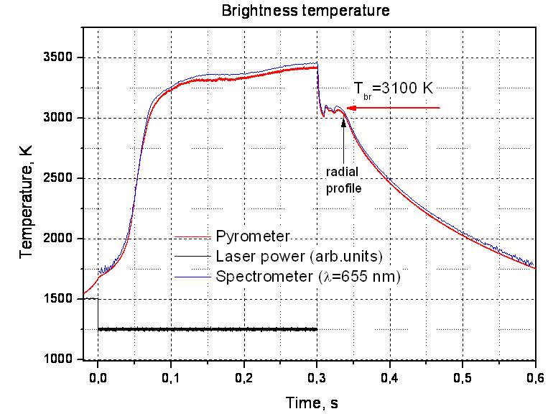
CaO Melting Point Measured by LPH in IVTAN
Experimental Thermogram
Peculiarities of CaO:
Low absorption coefficient below
1500-2000K
Boiling temperature of
approximately 3300K, which is
close to the melting temperature
Specimens melting procedure:
- Preliminary heating up to 1750K
- Controlled heating with a
profiled laser pulse
- Coupling temperature
measurement with a high-speed
spectropyrometer
- Melt surface temperature fields
registration with a high-speed
camera
- Thermograms mathematical
processing
Supposing that ε=0.85-0.9→T_{melt}= 3160 ± 30K
ε for CaO will be refined in a different test

Slide 18
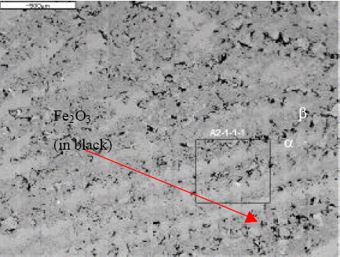
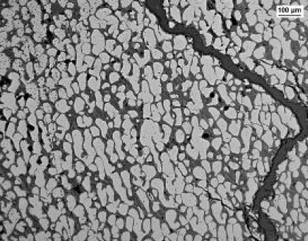
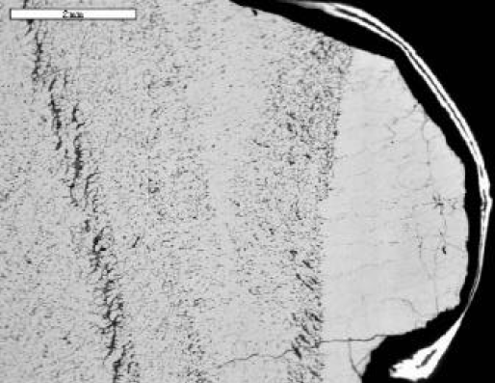
Comparison of CaO solubility with CEA data
BSE images of the URAN3 ingot
BSE images of the URAN7 ingot
Micrograph of the VP-U1 test
α –phase: U_{0.40}Zr_{0.38}Ca_{0.22}O_{1.6}.
α-phase: U_{0.44}Zr_{0.28}Ca_{0.28}O_{1.8}
α-phase: U_{0.35}Zr _{0.37}Ca _{0.26}O _{1.7}
According to GEMINI2 and the TDBCR001 modeling (Chevalier, 1997) the first solid phase
(a-phase) has the following compositions: U_{0.59}Zr_{0.22}Ca_{0.19}O_{1.80} for the URAN3 composition
(without silica), U_{0.76}Zr_{0.21}Ca_{0.02}O_{2.02} for the URAN7 composition (with 12%wt silica) and
U_{0.42}Zr_{0.45}Ca_{0.11}O_{1.86} for the VP-U1 composition
One phase for the VP-U1 composition depleted in zirconium with a general composition:
“UCaO₃”
U_{0.47}Ca_{0.53}O_{1.78}
UCaO₃
The PRECOS tests with the UO₂-CaO system,
as well as similar CEA tests, have shown a
high degree of CaO solubility in UO₂ and
discovered such a chemical compound as
UCaO₃

Slide 19
Test results on the UO₂ - CaO system
Compositions of the final solid solutions and the eutectics will be refined after SEM/EDX has been
performed for PRS12
The posttest analysis of samples from the corium ingot from VULCANO VP-U1, an ECOSTAR test,
has detected CaO solubility in UO₂ (aproximately 47.9 мол.%) in one of the samples

Slide 20
Test results on UO₂ - CaO system
Test | Sample No. | Content, mol.% |  | T_{liq}, °С
 |  | UO₂ | CaO*
PRS-4 | Sample 1 | 49.80±3.5 | 50.20 | 2188±33
 | Sample 2 | 50.05±3.5 | 49.95 | 2195±33
PRS-6 | Sample 1 | 26.05±1.7 | 73.95 | 2417±36
 | Sample 2 | 26.25±1.7 | 73.75 | 2370±36
 | Sample 3 | 17.37±1.1 | 82.63 | 2550±38
PRS-10 | Sample 1 | 39.75±2.8 | 60.25 | 1876±28
 | Sample 2 | 37.15±2.6 | 62.85 | 1886±29
PRS-11 | Sample 1 | 31.25±2.2 | 68.75 | 1912±29
 | Sample 2 | 31.50±2.2 | 68.50 | 1910±29
 | Sample 3 | 32.65±2.3 | 67.35 | 1907±29
PRS-12 | Sample 1 | 56.17±3.9 | 43.83 | 2440±36
 | Sample 2 | 54.30±3.8 | 45.70 | 2420±36
 | Sample 3 | 57.20±4.0 | 42.8 | 2432±36
 | Sample 4 | 70.95±4.9 | 29.05 | 2589±39
 | Sample 5 | 67.45±4.7 | 32.55 | 2620±39
 | Sample 6 | 66.30±4.6 | 33.70 | 2595±39
*) determined from the residue
The table presents compositions of samples averaged on the basis of chemical and XRF analyses
The EDX analysis is still underway, therefore the table does not contain final compositions of the
eutectics and solid solution

Slide 21
Conclusions
Experimental results confirm the Holc’s version of the UO₂-CaO phase
diagram in the liquidus domain and allow its refinement.
The preliminary results on CaO solubility in UO₂, as well as the
discovered chemical compounds, confirm the subsolidus part of the
diagram by Amato
Investigations of this system are to be concluded in Quarter 9 by:
- refining compositions of the final solid solutions and of the eutectics
(samples have been already prepared, however problems with
SEM/EDX exist)
- refining the degree of CaO emissivity and its melting point (at IVT RAN)
Upon completing SEM/EDX for PRS11 and 12, a decision about the
necessity in additional tests will be taken

