Slide 1



A.P. Alexandrov Research Institute of Technology
International Science and Technology Center
SPbSIT
(TU)
ETU
Saint-Petersburg
First results on
UO₂ – FeO – SiO₂ and
UO₂ – FeO – CaO
systems
Presented by S. Kotova
3rd PRECOS Project Meeting
June 2, 2010, St. Petersburg

Slide 2
Contents
Available binary diagrams and test planning
UO₂ – FeO - SiO₂ system
- thermodynamic prediction
- experimental matrix
- description of PRS 13 test
- posttest analysis for PRS 13
- GPRS 33-36 test results
UO₂ – FeO - СаО system
- thermodynamic prediction
- experimental matrix
- description of PRS 14 test
- posttest analysis for PRS 14

Slide 3
UO₂–FeO–SiO₂ system
Pt | UO₂ | FeO | Objectives
 | mol %
1 | 5.0 | 63.3 | eutectic (5 UO₂ – 95 Fe₂SiO₄)
2 | 30.0 | 46.7 | liquidus solidus
3 | 70.0 | 20.0
4 | ~3 | ~71 | eutectic
5 | ~3 | ~58
6 | 15.0 | 46.7 | liquidus solidus
7 | 35.0 | 20.0
8 | 20.0 | 7.0 | miscibility gap
9 | 10.0 | 10.0
10 | 5.0 | 25.0
T, °C
Published
In progress
2500
L
2100
1700
L+SS
UO₂
1300
SS
UO₂
20
40
60
80
FeO
FeO, mol. %
?
3
CORPHAD+PRECOS
CORPHAD
7
2
8
6
?
5
10
9
1
4
SiO₂
Fe₂SiO₄
FeO
T, °C
1800
T, °C
1723
L₁ + L₂
1350
1377
1600
crystobalite
+ L
2FeO⋅SiO₂
1250
T, °C
1400
Fe₂SiO₄
1377
1204±2
2800
?
SiO₂
tridymite + L
1150
1177±2
2500
FeO
2200
1200
L +
wustite
1900
tridymite + fayalite
fa + w
1600
20
40
60
80
SiO₂
70
80
90
FeO
Воwen N. L., J. P. Sсhairer, Amer. Journ. Sci., 24, 141, 177, 1932.
FeO, mol. %
1300
Allen W. C, R. B. Snow, Journ. Amer. Ceram. Soc, 38, № 8, 264,1955.
UO₂
20
40
60
80
Fe₂SiO₄
mol % Fe₂SiO₄

Slide 4
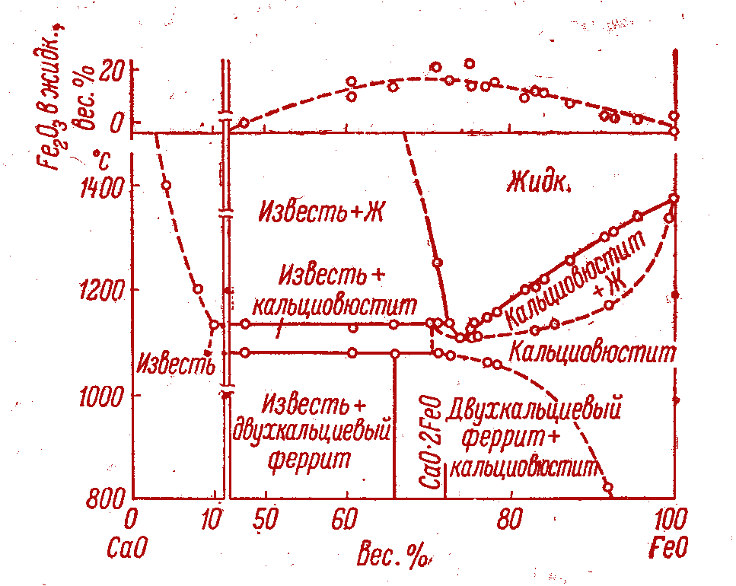
UO₂–FeO–CaO system
T, °C
Published
In progress
2500
L
Pt | UO₂ | FeO |  | Objectives
 | mol %
1 | 50.0 |  | 0 | CaUO_{4-x} Ca₂UO₄
2 | 33.3 |  | 0
3 | 20.0 |  | 50.0
4 | 6 |  | 75 | eutectic
5 | ?^{*)} |  | ?
6 | ? |  | ?
7 | ? |  | ? | liquidus solidus
8 | ? |  | ?
9 | ? |  | ?
10 | ? |  | ?
2100
1700
L+SS
1300
SS
UO₂
20
40
60
80
FeO
UO₂
FeO, mol %
CaUO_{4-x}
?
CORPHAD
Ca₂UO₄
3
CaO
FeO
Allen W. C, R. B. Snow, Journ. Amer. Ceram. Soc, 38, № 8, 264,1955.
*) – Compositions to be discussed

Slide 5
UO₂–FeO–SiO₂ system
Thermodynamic prediction of the eutectic point position calculated by GEMINI2+NUCLEA05
The composition was
determined using data on
the eutectic points of binary
systems. A point in the
center of a triangle that
forms at the ‘pure phase’
and ‘eutectics’ lines
intersection was taken as
the starting point
Presumably, the FeO–based
phase will be the phase of
primary crystallization in this
point
The eutectic temperature is
about 1110±50°С
PRS 13
?
Ternary eutectic

Slide 6
UO₂ – FeO – SiO₂ system
Experimental matrix

Slide 7
UO₂ – FeO – SiO₂ system: PRS 13 test results
Experimental objectives
T_{liq} determination by VPA IMCC.
Determination of the ternary eutectic composition
Charge composition
Mol% 30.00 UO₂ + 46.67 FeO +23.33 SiO₂
Samples
Tliq
From 3276 s, the pool was pulled out from inductor at 9 mm/h for 3.6 hours. This has ensured close to equilibrium crystallization and the eutectic liquid displacement into the ingot upper part
T_{liq} was measured 4 times by VPA IMCC and accompanied by melt sampling

Slide 8
UO₂ – FeO – SiO₂ system: PRS 13 test results (2)
Procedure

Slide 9
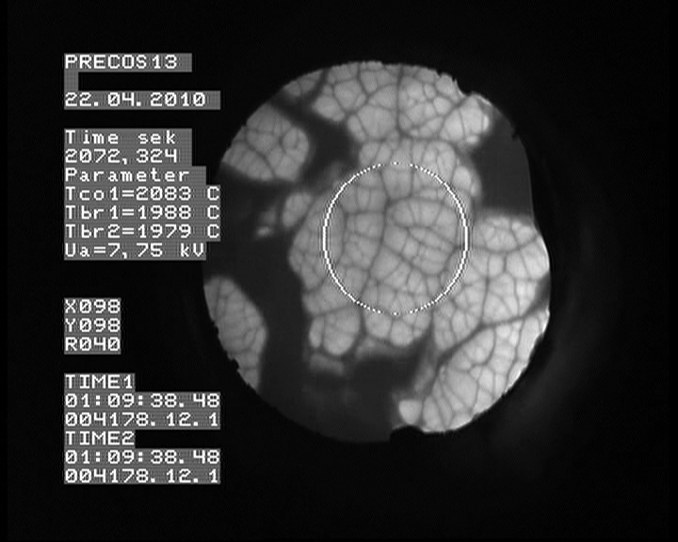
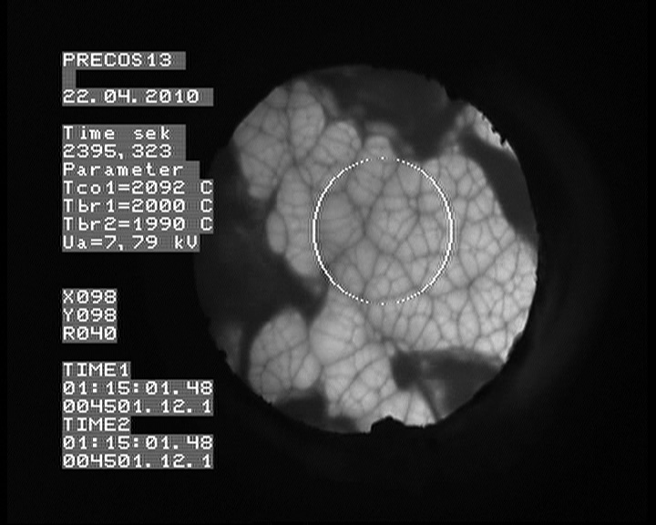
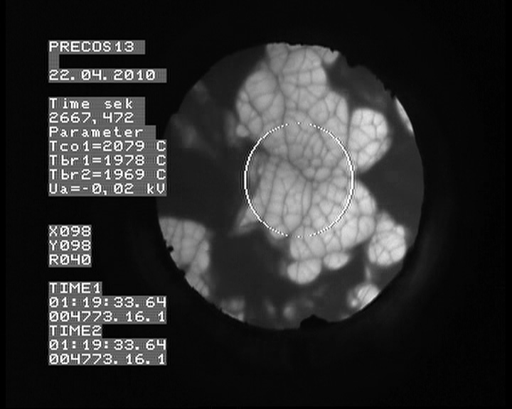
UO₂ – FeO – SiO₂ system: PRS 13 test results (3)
VPA IMCC: Example of thermogram 1 from the test
showing melt surface
# 2
# 3
# 4
    Results of T_{liq} measurements: 2055, 2083, 2092, 2079ºC

Slide 10
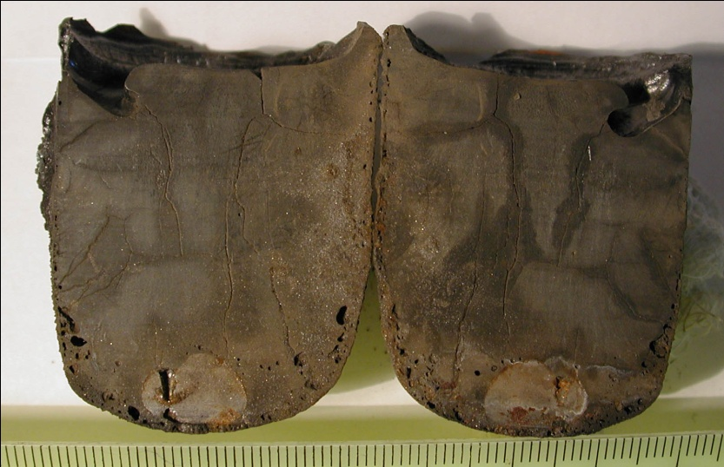
UO₂ – FeO – SiO₂ system: PRS 13 test results (4)
Posttest analysis
Corium ingot longitudinal section
Zone I
Material balance
Metallic inclusion
А flake was chipped out from zone I for an analysis in the Galakhov
microfurnace. A visual judgement of the microstructure allowed a
suggestion that it was the eutectic zone
A metallic inclusion with a mass of 1.1 g was discovered in the corium
ingot lower part (Fe content according to XRF is 98.35 mass %). This finding
proves the absence of Fe⁺³ in the ingot
The ingot mass is sufficiently smaller than that of the charge, therefore
melt composition cannot be correctly determined from the loaded charge

Slide 11
UO₂ – FeO – SiO₂ system: PRS 13 test results (5)
Chemical analysis of melt samples
In progress:
- SEM/EDX analysis of melt samples;
- chemical analysis of other fused products (ingot, crusts,
dry spillages and aerosols) for composing the elemental
material balance

Slide 12
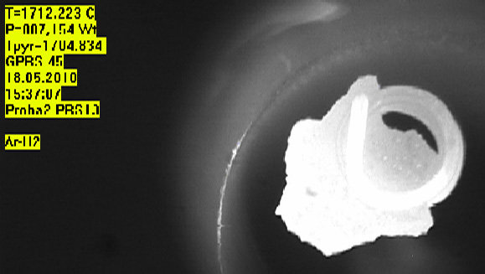
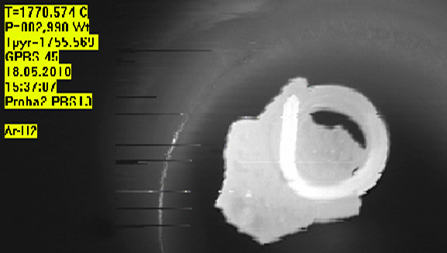
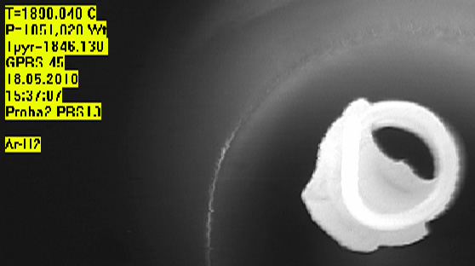
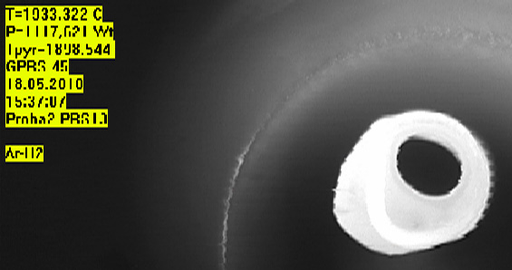
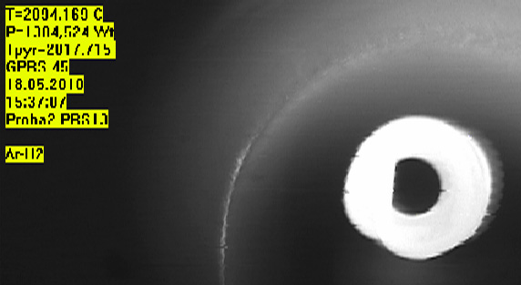
UO₂ – FeO – SiO₂ system: PRS 13 test results (6)
T_{liq} and T_{sol} determination in the Galakhov microfurnace
Sample 2
1704°C
1755°C
1846°C
Beginning of melting
Complete spreading
1898°C
2017°C
Visual polythermal analysis in the Galakhov microfurnace T_{sol}= 1755°С; T_{liq}=2017°С
T_{liq}, determined by the VPA IMCC (2083±30°С) and by the Galakhov method
(2017°С) for the composition in question differ by 66°С, presumably, due to the
interaction of the sample with the holder in the Galakhov microfurnace

Slide 13
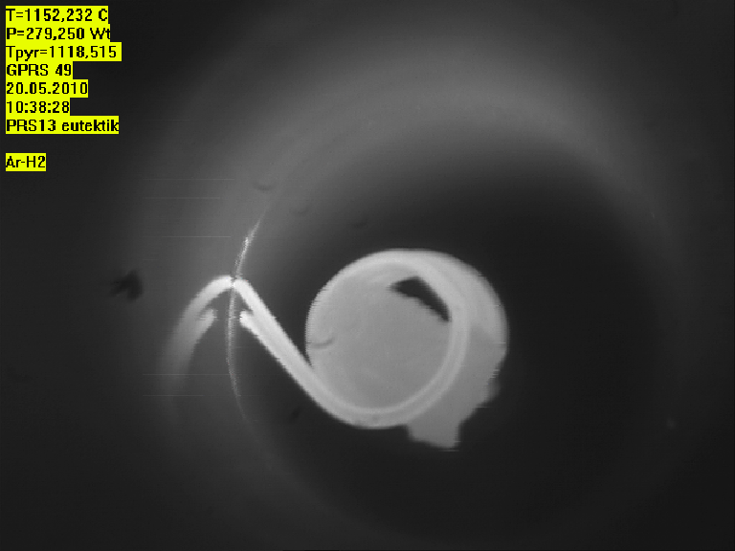

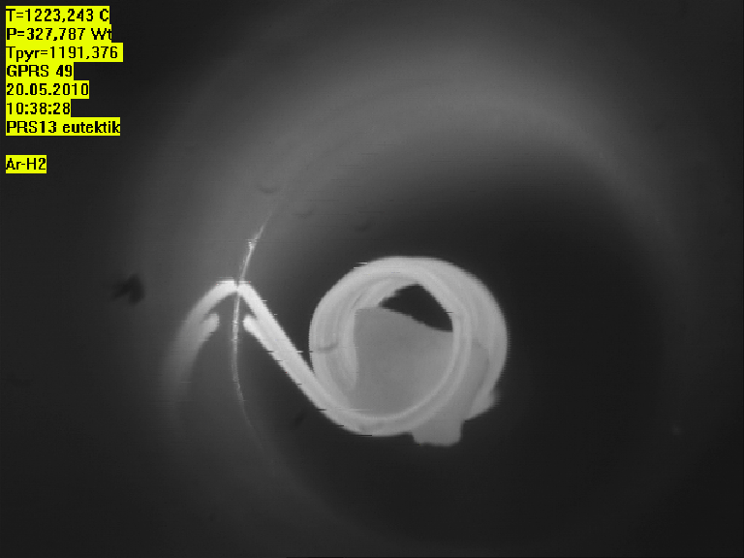
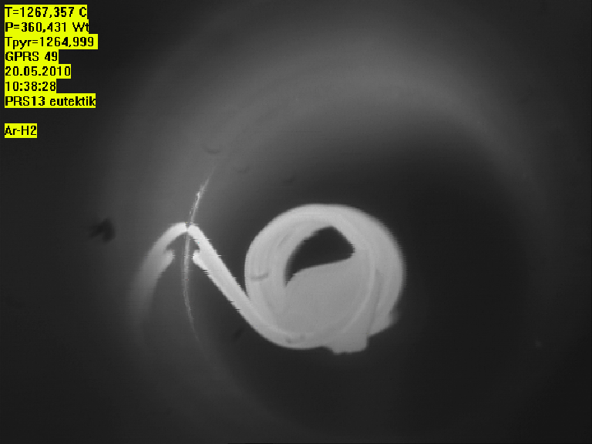
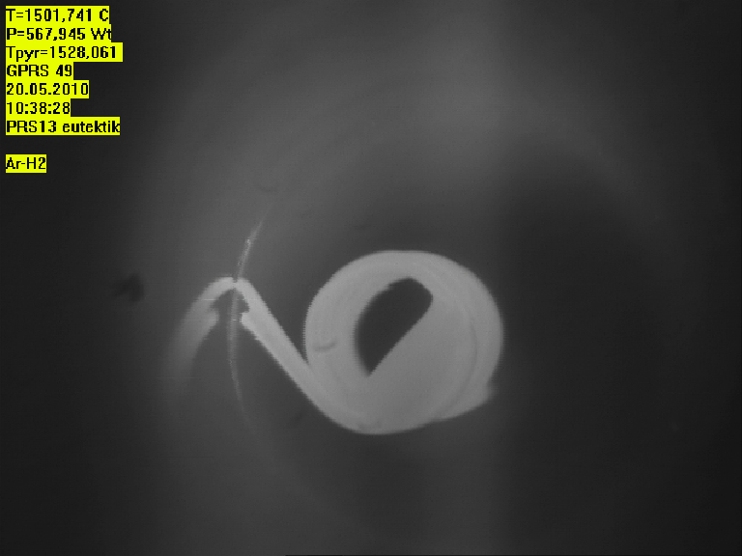
UO₂ – FeO – SiO₂ system: PRS 13 test results (7)
T_{liq} and T_{sol} determination of sample cut out from Zone 1 in Galakhov microfurnace
1118°C
1179°C
1191°C
Beginning of melting
Complete spreading
1264°C
1528°C
Visual polythermal analysis in the Galakhov microfurnace T_{sol}=1118°С; T_{liq}=1528°С
The difference of T_{sol} from T_{liq} indicates the noneutectic sample composition (e.g.,
the sample was chipped out from not eutectic zone)

Slide 14
UO₂-FeO-SiO₂ system:GPRS 33-36 test results(8)
UO₂
Experimental objectives
T_{liq} determination
Ternary eutectic point determination
GPRS36
GPRS35
Annealing, melting and quenching in the Galakhov
microfurnace (estimation of ternary eutectic position)
8
10
9
SiO₂
Fe₂SiO₄
FeO
Test | Content, mol.% |  |  | Tempera-ture, °С | Exposure time, min | Note
 | UO₂ | SiO₂ | FeO
GPRS33 | 5.0 | 70.0 | 25.0 | 1100 | 60 | Annealing
 |  |  |  | 2100 | 5 | Melting and quenching
GPRS34 | 10.0 | 80.0 | 10.0 | 1100 | 60 | Annealing
 |  |  |  | 1850 | 5 | Melting and quenching
GPRS35 | 20.0 | 73.0 | 7.0 | 1100 | 60 | Annealing
 |  |  |  | 1950 | 5 | Melting and quenching
GPRS36 | 1.7 | 65.5 | 32.8 | 1100 | 60 | Annealing
 |  |  |  | 1300 | 20 | Melting
 |  |  |  | 1300-900 | 240 | Cooling at 100°C/h
GPRS33
GPRS34
UO₂ of >99.0 % purity, SiO₂ of 99.99% purity, charge mass – 150 mg, molybdenum
crucibles ∅ 6 mm.

Slide 15
UO₂-FeO-SiO₂ system:GPRS 33-36 test results (9)
XRD of sample of GPRS 36 test
2θ
The analysis was done using FARAD desktop diffractometer with CrKα1 radiation (λ = 0.22897 nm)

Slide 16
UO₂-FeO-SiO₂ system:GPRS #33-36 test results(10)
SEM/EDX GPRS 33
SQ1
25 μm
.P3
.P2
Conditions:
Charge composition, mol% 5 UO₂ + 25 FeO +70 SiO₂
isothermal exposure at 1100°С for 1 h., heating up to 2100°С, 5-min. exposure, quenching
167 μm
.P1
0.92 μm
No macostratification was found in the oxidic part of the polished section
Microstructure resembling that of the ‘heavy’ liquid in the UO2-SO2 system.
As a result of the interaction between the melt and the crucible, the composition
got depleted in Fe, but no molybdenum was found in the oxidic part

Slide 17
SEM/EDX GPRS 34
UO₂-FeO-SiO₂ system:GPRS #33-36 test results(11)
Conditions:
Charge composition, mol% 10 UO₂ + 10 FeO +80 SiO₂
Isothermal exposure at 1100°С for 1 h., heating up to 1950°С and a 5-min. exposure, quenching
UO₂
Fe
SQ3
SiO₂ with inclusions
124 μm
100 μm
FeSiO₃
25 μm
SQ2
SiO₂ with inclusions
Mo(Fe)
SQ1
UO₂
100 μm
49.9 μm
12.5 μm
6.67 μm
Indication of MG
The microstructure is nonuniform. Inclusions
of irregular shape indicate that the melt
exposure time was insufficient (equilibrium
was not reached). The globules of heavy
liquid contain Femet drops

Slide 18
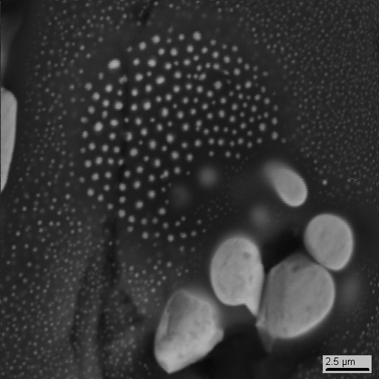
UO₂-FeO-SiO₂ system:GPRS #33-36 test results(12)
SEM/EDX GPRS 35
Conditions:
Charge composition, mol%
20 UO₂ + 7 FeO +73 SiO₂
Isothermal exposure at 1100°С for 1 h., heating up to 1850°С, 5-min. exposure, quenching
SQ1
Though the macrostructure
is uniform, the
microstructure is extremely
inhomogeneous and
resembles that in
UO₂-SiO₂ near the critical
point
4 μm
SQ2
167 μm
SQ3
2.5 μm
144 μm
6.67 μm

Slide 19
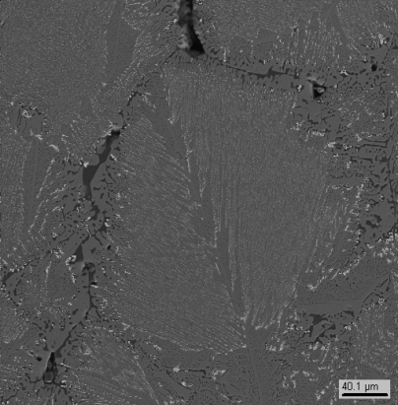
SEM/EDX GPRS 36
UO₂-FeO-SiO₂ system:GPRS #33-36 test results(13)
SQ1
SQ2
144 μm
40.1 μm
1.67 μm
Conditions:
Charge composition, mol% 1.7 UO₂ + 32.8 FeO +65.5 SiO₂
Isothermal exposure at 1100°С for 1 h., heating up to 1300°С, 20-min. exposure, chilling from 1300 down to 900°С for 240 min.
Microstructure in the lower part of the crucible shows the eutectic crystallization.
In terms of composition, this eutectics lies within a specific triangle
UO₂-Fe₂SiO₄-SiO₂.

Slide 20
UO₂-FeO-SiO₂ system: GPRS #33-36 test results(14)
SiO₂
Characteristic points of the diagram
Bulk composition of the total microstructure in GPRS 35
Initial composition of the charge
Composition of the liquid at T~Tq~1950C (above MG)
Bulk composition in GPRS 33 (no MG)
Light matrix composition in GPRS 35 (T is presumably around Tm)
‘Heavy’ liquid in GPRS 34 (T from Tq up to Tm)
Composition of globules in the light matrix in GPRS 35 (T is presumably around Tm)
Composition of the ‘light’ liquid with globules in GPRS 34 (T~Tq~1850C)
Triple eutectics composition in GPRS 36
Solid phase composition in GPRS 36
Composition of the light matrix in GPRS 34 (T~Tm)

Slide 21
UO₂-FeO-SiO₂ system
Summary:
Stratification has been confirmed for the compositions obtained in the tests GPRS 34 and 35. However, compositions of the coexisting liquids should be refined, since melt exposure in these test was insufficient for attaining equilibrium
The temperature in GPRS 35 was around the critical value
Melt composition in GPRS 33 is beyond MG
The problems with performing GPRS tests are connected with:
-SiO₂ evaporation (SiO);
-Fe - Mo interaction, which causes a shift in the composition relative to the initial charge
First data on ternary eutectic composition have been obtained in GPRS 36 test
It is proposed to carry out the following tests:
  A test with the composition (mol.%) 5 UO₂ + 25 FeO +70 SiO₂, though with a
  smaller content of Fe and quenching from a lower temperature of 1900°С
  A test with the composition (mol.%) 10 UO₂ + 10 FeO +80 SiO₂ at 1950°С with a
  longer exposure time and a smaller content of Fe
  Quenching of the composition (mol.%) 20 UO₂ + 7 FeO +73 SiO₂ from 1800°С
  for determining the monotectic temperature and composition of the phases
  that coexist in the vicinity of the monotectic composition
  Refinement of the monotectic composition (e3), synthesis of e1 and e2, since
  the question of the binary section Fe₂SiO₄-UO₂ is still open

Slide 22
UO₂–FeO–CaO system
Thermodynamic prediction of the eutectic point position calculated by GEMINI2+NUCLEA05
A Gemini calculation for the
proposed point predicts the
appearance of a liquid phase
composed of (mol.%) 68.7 FeO, 3.4
UO₂, 27.9 CaO at 1019ºС. The point
is located practically on the
boundary (adjoins the UO₂-CaO and
CaO-FeO binary eutectics) of a
triangle bounded by binary
eutectics
Ternary eutectic

Slide 23
UO₂–FeO–СаO system
Experimental matrix

Slide 24
UO₂ – FeO – CaO system: PRS 14 test results
Experimental objectives
T_{liq} determination by VPA IMCC.
Determination of eutectic composition
Charge composition
Mol.% 20.1UO₂ + 66.7FeO +13.2CaO
Samples
Tliq
From 4519 s, the pool was pulled out from the inductor at 9 mm/h for 5.9 hours. This has ensured close to equilibrium crystallization and the eutectic liquid displacement into the ingot upper part
T_{liq,},was measured by VPA IMCC 3 times; video record of one measurement could not be deciphered. Samples were taken 3 times

Slide 25
UO₂ – FeO – CaO system: PRS 14 test results (2)
PRS-14 test procedure

Slide 26
UO₂ – FeO – CaO system: PRS 14 test results (3)
VPA IMCC: Example of thermogram #2 showing melt surface
# 3
    Results of T_{liq} measurements: 1238, 1247ºC

Slide 27
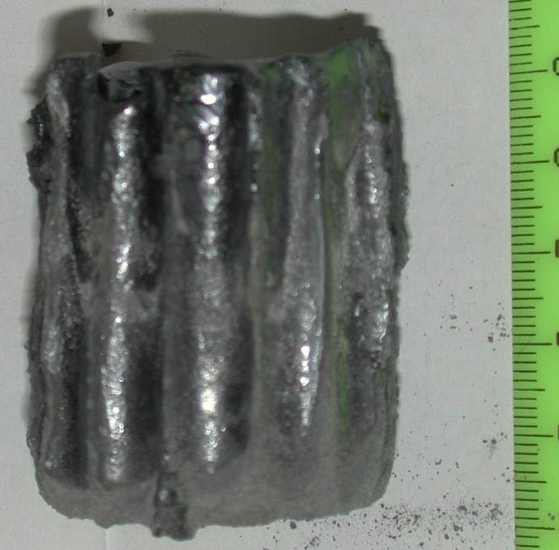
UO₂ – FeO – CaO system: PRS 14 test results (4)
Corium ingot
Material balance
Insignificant debalance and closeness in masses of the ingot and
charge make it possible to assess composition of the melt on the
basis of charge composition

Slide 28
UO₂ – FeO – CaO system: PRS 14 test results (5)
XRF and Chemical analysis of melt samples
* - determined from residue
The results of corium samples XRF and chemical analysis were found to differ
significantly
XRF results are believed to be more accurate, since the content of CaO was not
determined by chemical analysis, but calculated from the residue
In progress:
- the SEM/EDX analysis of melt samples;
- XRF and chemical analysis of other fused products (ingot, crusts, dry spillages and aerosols) for composing the elemental material balance.

Slide 29
UO₂ – FeO – CaO system
Summary:
The measured liquidus points:
19.3±1.0 mass % UO₂; 66.5±3.3 mass % FeO; 14.2±0.7 mass % CaO
T_{liq}= 1238±20 °C
19.3±1.0 mass % UO₂; 66.7±3.3 mass % FeO; 14.0±0.7 mass % CaO
T_{liq}= 1247±20 °C
A strategy for investigating a system may be devised only after clarity regarding compositions or solid solutions in the CaO-UO₂ binary system has been reached. The supposed eutectic point lies, on the one hand, within the eutectic triangle, and, on the other hand, within a triangle bounded by FeO-Ca₂UO₄-CaO. After the ingot has been cut and the zone of the final crystallization examined by SEM/EDХ, it will become clear if the eutectic composition had been synthesized or not. If not, then it is proposed to investigate a composition from the UO₂-CaUO_{4-x}-FeO subsystem, mol.%: 80 FeO, 15 UO₂, 5 CaO + 1 mass % of getter (carbonyl iron).

