Slide 1

PRECOS experimental matrix Logic of experimental process
Experimental program (1 ^{st} & 2 ^{nd} quarters)
A.P. Alexandrov Research Institute of Technology
ISTC PRECOS Project
#3813
Presented by Victor Gusarov
1st PRECOS Meeting
ISC RAS
Saint-Petersburg

Slide 2
PRECOS Matrix
Task | Composition | Atmosphere | Experimental data | Priority level | Pt N
1 | Different compositions in the U–Zr–Fe–O system | Argon | Selected points (liquidus, solidus, tie-lines in the miscibility gap) | 1 | 6
 | U–O
2 | ZrO₂–FeO_{y} | Air and oxygen | liquidus, solidus, solubility limits | 2 | 3
 | UO₂–SiO₂ | Argon | liquidus, solidus, tie-lines in the miscibility gap, eutectic point | 1 | 7
 | CaO–UO₂ |  | liquidus, solidus, solubility limits, eutectic point | 1 | 7
3 | UO₂–FeO–SiO₂ |  | liquidus, solidus solubility limits, tie-lines in the miscibility gap, ternary eutectic point | 1 | 10
 | UO₂–FeO–CaO |  | liquidus, solidus solubility limits, ternary eutectic point | 1 | 10
 | ZrO₂–FeO–SiO₂ |  | ternary eutectic point | 2 | 2
 | ZrO₂–FeO–CaO |  | ternary eutectic point | 2 | 2
4 | Eutectic composition measurement of a realistic complex corium mixture | Argon or Air | System (atmosphere) proposed by French partners (1 system), System (atmosphere) proposed by German partners (1 system), System (atmosphere) proposed by Russian partners (1 system) | 2 | 3

Slide 3
Logic and sequence of system study
known
unknown
simple
complex
systems
methods
Sequence of system study
Reliability of results
one
Number of components
many
use of complex methods
- methods have area of intersection (test of results according to convergence of data of different techniques)
well
studied
Study
little studied
developed
Experimental methods
not enough
developed
- methods complement each other
developement of methods
checked
Facilities
update and test are needed
invoke additional methods

Slide 4
Complex of methods
The determined parameters for phase diagram construction
Chemical composition of a system before, during a process and after experiment
Phase transformation depending on temperature and p_{O2}
Phase composition of a system (quantitative and qualitative analysis)
Chemical composition of the phases
Phase structure
Peculiarities of investigated systems (1st, 2nd quarters)
U-Zr-Fe-O – interaction with crucibles
– redistribution of oxygen between coexisting phases during heating-cooling
FeO_{x}, UO_{2±δ} – control of oxygen partial pressure in gas phase is required
– difficulty of oxygen content determination in non-stoichiometric phases
UO_{2±δ}, SiO₂ (SiO) – high volatility at high temperatures

Slide 5
Complex of methods
In situ measurements
Visual-polythermal analysis (Induction melting in the cold crucible, Galakhov microfurnace, high-temperature microscopy)
Complex thermal analysis (DTA(DSC)/TG/Mass-spectrometry)
Laser pulse method
Post-test analysis
Scanning electron microscopy/energy-dispersion X-ray analysis (wave- dispersion analysis)
X-ray powder diffraction
X-ray fluorescent analysis
Chemical analysis
Mössbauer spectroscopy
Reduction melting in carbon crucibles

Slide 6
Logic and sequence of system study
The systems
Metal-oxide systems |  | Oxide systems
binary | multicomponent | binary | ternary | multicomponent
 |  | UO₂-SiO₂
 |  |  | UO₂-SiO₂-FeO
 | U-Zr-Fe-O |  | ZrO₂-SiO₂-FeO
 |  | UO₂-CaO
 |  |  | UO₂-FeO-CaO
 |  |  | ZrO₂-FeO-CaO
 |  |  |  | realistic complex corium mixture
ZrO₂-FeO_{x}
U-O

Slide 7
1st & 2 ^{nd} quarter experimental work
UO₂-SiO₂
UO₂-FeO-SiO₂
T, °C
2800
UO₂
?
L
2600
?
2400
L₁ + L₂
ZrO₂-FeO_{y}
2200
?
2080
CORPHAD
?
ZrO₂
CORPHAD
2000
2070±10
?
UO₂ + L
?
?
1800
1719±10
ss
?
1600
UO₂ + SiO₂
UO₂
20
40
60
80
CORPHAD
?
SiO₂
mol % SiO₂
SiO₂
FeO
?
Fe₂SiO₄
?
FeO
Fe₃O₄
Fe₂O₃

Slide 8
1st & 2 ^{nd} quarter points
UO₂–SiO₂
PRECOS matrix – 7 points
T, °C
Pt | SiO₂, mol % | Objectives
1 | 97.5 | eutectic
2 | 95.0 | liquidus
3 | 90.0 | Miscibility gap determination (T=2080°C)
4 | 78.0 | Miscibility gap determination (T=2500°C) (T=2300°C)
5 | 70.0 | Miscibility gap determination (T=2080°C)
6 | 60.0 | liquidus
7 | 50.0
8 | 40.0
9 | 30.0
10 | 20.0
2800
L
10
?
2600
9
4
5
2400
8
?
3
7
L₁ + L₂
2200
?
6
2080
2
1
2000
2070±10
UO₂ + L
1800
?
1719±10
UO₂ + SiO₂
1600
UO₂
20
40
60
80
SiO₂
mol % SiO₂

Slide 9
1st & 2 nd quarter points
ZrO₂–FeO_{y}
PRECOS matrix – 3 points
Т, °C
2700
2900
T, °C
2500
Pt | FeO_{1.5,} mol % | Atmosphere | Objectives
1 | 95 | air | eurectic
2 |  | O₂
3 | 90 | air
 |  | O₂
4
5 | 20 | air | solid solutions
 |  | O₂
6
7 | 10 | air
8 |  | O₂
9 | 60 | air | Miscibility gap determination
10 |  | O₂
11 | 50 | air
 |  | O₂
12
13 | 40 | air
 |  | O₂
14
Published
2300
air
10⁵
2500
2100
2100
1900
1700
1700
10³
(1332±5)°C
10⁻¹
10¹
1300
1500
10⁻³
10⁵
ZrO₂
20
40
60
80
FeO
1300
10⁻¹
air
FeO (mol %)
ZrO₂
10⁻³
10³
1100
10⁻⁵
10¹
?
10⁻⁷
10⁻¹
900
10⁻³
700
10⁻⁵
ss
10⁻⁷
FeO
Fe_{0.938}O
FeO_{1.5}
20
40
60
80
CORPHAD
?
mol %
ZrO₂
?
FeO
FeO_{1.33}
FeO_{1.5}

Slide 10
1st & 2 nd quarter points
UO₂–FeO–SiO₂
PRECOS matrix – 10 points
T, °C
2800
?
T, °C
2500
2800
2200
Pt | UO₂ | FeO | Objectives
 | mol %
1 | 1 | 1 | eutectic
2 | 2 | 2 | liquidus solidus
3 | 3 | 3
4 | 4 | 4 | eutectic
5 | 5 | 5
6 | 6 | 6
7 | 7 | 7 | liquidus solidus
8 | 8 | 8 | stratification
9 | 9 | 9
10 | 10 | 10
2600
1900
1600
2400
1300
2200
1000
UO₂
20
40
60
80
Fe₂SiO₄
2000
UO₂
mol % Fe₂SiO₄
1800
T, °C
Published
1600
20
40
60
80
2500
L
UO₂
SiO₂
mol % SiO₂
CORPHAD
2100
?
3
CORPHAD
L+SS
7
1700
1300
SS
8
?
?
UO₂
20
40
60
80
FeO
5
2
FeO, mol %
9
4
10
6
1
SiO₂
Fe₂SiO₄
FeO
T, °C
1800
Ж₁ + Ж₂
1723
1600
кристоб. + Ж
1400
трид. + Ж
Fe₂SiO₄
1377
1200
Ж +
вюстит
SiO₂
трид. + фаялит
фаялит + вюстит
FeO
20
40
60
80
FeO, мол. %

Slide 11
1st & 2 ^{nd} quarter publications
UO₂–SiO₂ – manuscript preparation
Phase diagram of the UO₂–SiO₂ system – manuscript preparation and sending (JNM?)
ZrO₂–FeO_{y} – manuscript preparation
Eutectic crystallization in the ZrO₂–Fe₂O₃–Fe₃O₄ system
(Rus. J. Inorg. Chem?)
Structural and chemical transformations of the ZrO₂(FeO_{y}) solid solutions during heat treatment in different gas atmospheres
(J. Eur. Ceram. Soc.?)

Slide 12
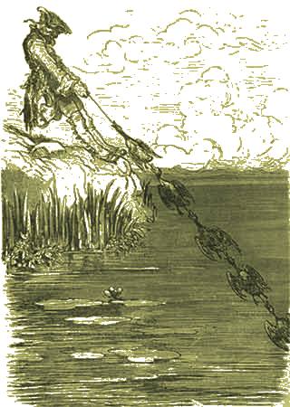



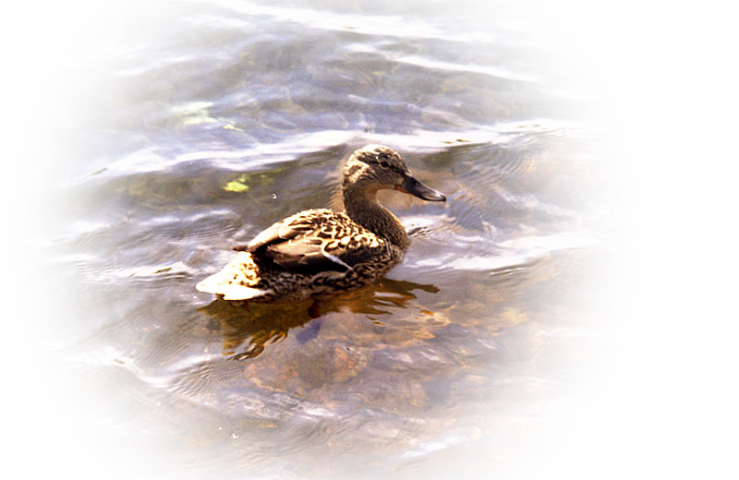
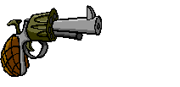

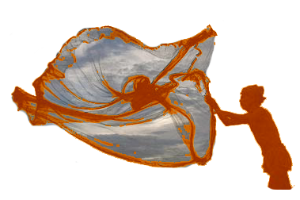
Conclusions

