Slide 1

Proposals on the Ternary Oxide System Study:
UO₂-FeO-SiO₂ and UO₂-FeO-CaO
A.P. Alexandrov Research Institute of Technology
ISTC PRECOS Project
#3813
Presented by Svetlana Kirillova
2nd PRECOS Meeting
ETU
Saint-Petersburg

Slide 2
PRECOS matrix
Task | Composition | Atmosphere | Experimental data | Priority level | Pt N
1 | Different compositions in the U–Zr–Fe–O system | Argon | Selected points (liquidus, solidus, tie-lines in the miscibility gap) | 1 | 6
 | U–O
2 | ZrO₂–FeO_{y} | Air and oxygen | liquidus, solidus, solubility limits | 2 | 3
 | UO₂–SiO₂ | Argon | liquidus, solidus, tie-lines in the miscibility gap, eutectic point | 1 | 7
 | CaO–UO₂ |  | liquidus, solidus, solubility limits, eutectic point | 1 | 7
3 | UO₂–FeO–SiO₂ |  | liquidus, solidus, solubility limits, tie-lines in the miscibility gap, ternary eutectic point | 1 | 10
 | UO₂–FeO–CaO |  | liquidus, solidus, solubility limits, ternary eutectic point | 1 | 10
 | ZrO₂–FeO–SiO₂ |  | ternary eutectic point | 2 | 2
 | ZrO₂–FeO–CaO |  | ternary eutectic point | 2 | 2
4 | Eutectic composition measurement of a realistic complex corium mixture | Argon or Air | System (atmosphere) proposed by French partners (1 system), System (atmosphere) proposed by German partners (1 system), System (atmosphere) proposed by Russian partners (1 system) | 2 | 3

Slide 3
Research objectives
To specify the binary and ternary eutectic points in the inert atmosphere
To determine the solidus and liquidus curves
To determine solubility limits of components in the formed solid solutions
To find the existence limits of compounds
To determine the tie-lines in the miscibility gap
PRECOS project meeting
3

Slide 4
Methods
In situ measurements
Visual-polythermal analysis
(Galakhov microfurnace, induction melting in the cold crucible)
Complex thermal analysis (DTA/TG)
Post-test analysis
Scanning electron microscopy/energy-dispersion X-ray analysis (wave-dispersion analysis)
X-ray powder diffraction
X-ray fluorescent analysis
Chemical analysis
PRECOS project meeting
4

Slide 5
UO₂–FeO–SiO₂ system
T, °C
In progress
2800
T, °C
PRECOS matrix – 10 points
2600
2800
?
2400
2500
2200
L₁ + L₂
2200
2080
1900
Pt | UO₂ | FeO | Objectives
 | mol %
1 | 5.0 | 63.3 | eutectic (5 UO₂ – 95 Fe₂SiO₄)
2 | 30.0 | 46.7 | liquidus solidus
3 | 70.0 | 20.0
4 | ~3 | ~71 | eutectic
5 | ~3 | ~58
6 | 15.0 | 46.7 | liquidus solidus
7 | 35.0 | 20.0
8 | 5.0 | 25.0 | miscibility gap
9 | 10.0 | 10.0
10 | 20.0 | 7.0
2000
UO₂ + L
2070±10
1600
1800
UO₂
1300
1719±10
1600
UO₂ + SiO₂
UO₂
20
40
60
80
Fe₂SiO₄
UO₂
20
40
60
80
SiO₂
mol % Fe₂SiO₄
mol.% SiO₂
T, °C
Published
?
3
2500
L
CORPHAD+PRECOS
CORPHAD
2100
7
1700
L+SS
8
6
2
1300
SS
?
5
9
1
4
UO₂
20
40
60
80
FeO
10
FeO, mol. %
SiO₂
Fe₂SiO₄
FeO
FeO_{1.5}, mol.%
FeO_{1.5}, mol.%
10
10
5
5
T, °C
T, °C
1800
L₁ + L₂
1377
1723
1350
1600
crystobalite
+ L
2FeO⋅SiO₂
1400
Fe₂SiO₄
1377
1250
1204±2
tridymite + L
L +
wustite
1177±2
1200
tridymite + fayalite
fa + w
1150
SiO₂
20
40
60
80
FeO
SiO₂
70
80
90
FeO
FeO, mol. %
FeO, mol. %

Slide 6
UO₂–FeO–SiO₂ system
Logic and sequence of system study
Binary section investigation
(UO₂-Fe₂SiO₄, inert atmosphere, without getter)
Fe₂SiO₄ synthesis
Eutectic point determination (Galakhov -> SEM/EDX, X-Ray -> IMCC -> SEM/EDX, DTA/TG)
Liquidus and solidus determination (Galakhov, VPA IMCC)
Ternary eutectics determination
(UO₂-FeO-Fe₂SiO₄, inert atmosphere, with getter)
(UO₂-Fe₂SiO₄-SiO₂, inert atmosphere, without getter)
Fe₂SiO₄ synthesis
Eutectic point determination (Galakhov -> SEM/EDX, X-Ray -> IMCC -> SEM/EDX, DTA/TG)
Liquidus, solidus and miscibility gap determination
(UO₂-Fe₂SiO₄-SiO₂, inert atmosphere, without getter)
Fe₂SiO₄ synthesis
Liquidus and solidus determination (Galakhov, VPA IMCC)
Tie-lines in the miscibility gap (Galakhov, VPA IMCC)
PRECOS project meeting
6

Slide 7
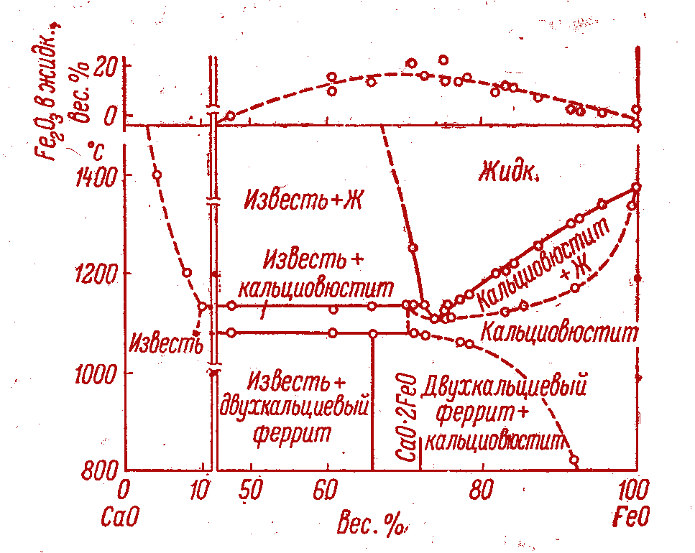
UO₂–FeO–CaO system
T, °C
In progress
2800
PRECOS matrix – 10 points
2500
2200
T, °C
Published
Pt | UO₂ | FeO | Objectives
 | mol %
1 | 50.0 | 0 | CaUO_{4-x} Ca₂UO₄
2 | 33.3 | 0
3 | 20.0 | 50.0
4 | - | - | eutectic
5 | - | -
6 | - | -
7 | - | - | liquidus solidus
8 | - | -
9 | - | -
10 | - | -
1900
UO₂
2500
L
1600
2100
1300
1700
L+SS
1300
SS
1000
?
CaO
20
40
60
80
UO₂
CaUO_{4-x}
mol.%
PRECOS
UO₂
20
40
60
80
FeO
CORPHAD
FeO, mol %
1
2
Ca₂UO₄
3
CaO
FeO

Slide 8
UO₂–FeO–CaO system
Conditions and sequence of system study
Composite oxides investigation
Sample preparation of CaO-enriched compositions
CaUO_{4-x} and Ca₂UO₄ upper the limit’s existence (Galakhov -> SEM/EDX, X-Ray)
Phase composition determination
(CaUO_{4-x}-Ca₂UO₄-FeO, inert atmosphere, with getter)
Sample preparation of CaO-enriched compositions
Phase composition determination (Galakhov -> SEM/EDX, X-Ray)
?
PRECOS project meeting
8

Slide 9
Conclusions
UO₂–FeO–SiO₂ system
The logic and sequence of system study are quite clear
UO₂–FeO–CaO system
The composition of points in the observed system is able to define more exactly after the UO₂–CaO system revision only

