Slide 1


Ag-In-Cd control rod behaviour in case of severe accident conditions
Thermodynamics of the Ag-In-Cd system in order to better estimate the SIC elements release
ISTC PRECOS Meeting, 26th May 2009, St Petersburg
P. Benigni, S. Hassam, J. Rogez, M. Barrachin, R. Dubourg

Slide 2
Outline of the presentation
Context
Control rod degradation and release mechanisms
Modelling of Ag-In-Cd release
Key chemical systems
Critical assessment of experimental thermodynamic data
Conclusion

Slide 3
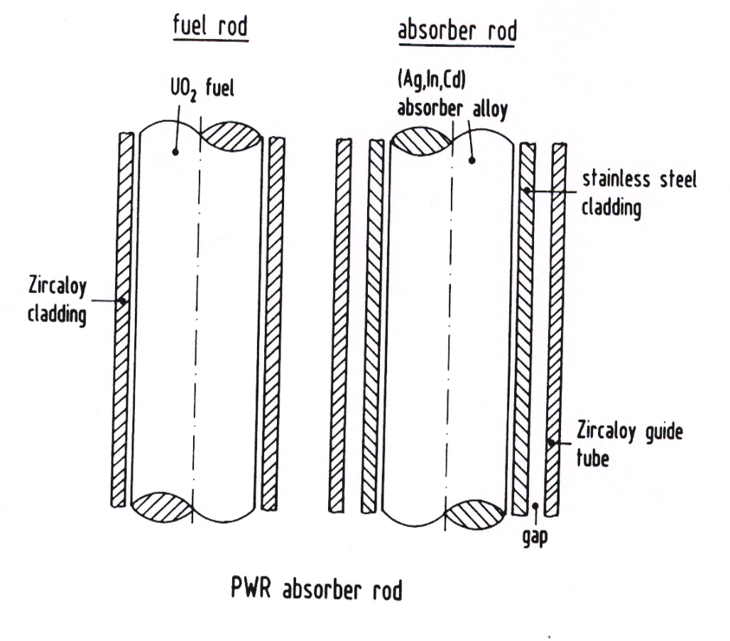
Ag-In-Cd control rod (PWR)
Potential consequences of SIC degradation in case in severe accident
Context
Control rod degradation
Modelling of release
Chemical systems
Data review
Experiments
Conclusion
SIC may contribute to the part of degradation of fuel rods (see for example the results of the PHEBUS FP tests)
the release of absorber elements impacts the transport of fission products and finally the source term (see see for example the results of the VERCORS tests).

Slide 4
Control rod degradation
Classical view of material releases (low pressure scenario)
Context
Control rod degradation
Modelling of release
Chemical systems
Data review
Experiments
Conclusion

Slide 5
Modelling of Ag-In-Cd releases
Simple model for the evaluation (ELSA Module in ASTEC code)
Evaporation rate of SIC materials
Context
Control rod degradation
Modelling of release
Chemical systems
Data review
Experiments
Conclusion
mass transfer coefficient
molar mass of i
surface of exchange
mole concentration of i
Assumption
New simplified equation
Necessity to have an accurate estimation
of the partial pressures P_{i} above representative compositions

Slide 6
Representative compositions
Chemical systems to be investigated
  The thermodynamic properties of absorber elements
    Activity of elements must be known for reliable calculation of the vapour pressure of elements :
      For Cd in the ternary system Ag-In-Cd prior rod rupture.
      For the Ag-In rich molten alloy after rod rupture in addition with Zr influence.
    The speciation of elements in mixed oxidising atmosphere (namely gaseous species) must be reviewed (especially for Ag).
Context
Control rod degradation
Modelling of release
Chemical systems
Data review
Experiments
Conclusion

Slide 7
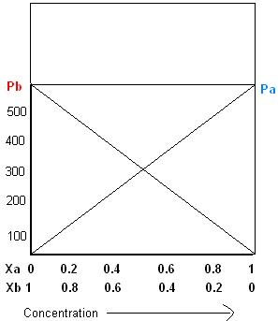
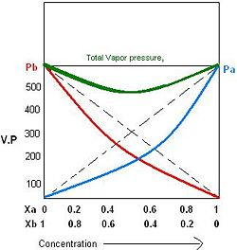
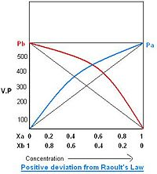
Thermodynamics of liquids
Some generalities
Case of a liquid solution : introduction of activity (coefficient) concept
3 possible situations
Ideal behaviour
Total vapor pressure
Total vapor pressure

Slide 8
Critical assessment of experimental data
Ag-In-Cd system (1)
Ag-In system
activity coefficient of In in Ag-In liquid
Context
Control rod degradation
Modelling of release
Chemical systems
Data review
Experiments
Conclusion
7 authors
400-1200°C
5 authors measured consistent values by different means, negative deviation to ideality (g_{i}< 1),
Two authors differ
    Nozaki (1966) : positive deviation to ideality
    Predel (1972) : indirect determinations from data in Ag-In-Zn
Experimental data do not indicate temperature variation of activity in the studied range

Slide 9
Critical assessment of experimental data
Ag-In-Cd system (2)
Ag-Cd system
Activity coefficient of Cd in Ag-Cd liquid
Context
Control rod degradation
Modelling of release
Chemical systems
Data review
Experiments
Conclusion
6 authors
410-950°C
At temperature < 500°C, negative deviation to ideality (g_{i}< 1), follows the Raoult’s law for X_{Cd}> 0.8
Data generally consistent except
    Volodin (2005) : very scattered measurements
    Schaefer (1954) : X_{Cd}> 0.9, deviation to the Raoult’s law
Experimental data not conclusive about temperature variation of activity

Slide 10
Critical assessment of experimental data
Direct method : to measure the activity (coefficient) above the liquid
Indirect method : to derive a thermodynamic model from which it is possible to calculate the activity (coefficient)
Context
Control rod degradation
Modelling of release
Chemical systems
Data review
Experiments
Conclusion
For metallic liquid solution, the regular approximation is usually pertinent
ΔH_{mix} is also an important quantity for the description of the thermodynamic of the liquid

Slide 11
Critical assessment of experimental data
Ag-In-Cd system (4)
Ag-Cd system
Mixing enthalpy of Ag-Cd liquid
Context
Control rod degradation
Modelling of release
Chemical systems
Data review
Experiments
Conclusion
1 author
450°C
One set of data from Kleppa (1956) for the Cd rich compositions

Slide 12
Critical assessment of experimental data
Ag-In-Cd system (5)
Ag-In system
Mixing enthalpy of Ag-In liquid
Context
Control rod degradation
Modelling of release
Chemical systems
Data review
Experiments
Conclusion
4 authors
450-1000°C
Consistent values between Castanet (1970) and Itag (1968) at around 1000°C over all the composition range
At lower temperature (400-500°C), Kleppa (1956), Beja (1968), Castanet (1970) are apparently in agreement.
  Solid Ag used as the reference for the mixing enthalpy determination in Kleppa and Beja
  Liquid Ag used as the reference for the mixing enthalpy determination in Castanet

Slide 13
Critical assessment of experimental data
Ag-In-Cd : a quick summary of the thermodynamic data related to the liquid phase
System | Ag-Cd | Ag-In | Cd-In (not presented) | Ag-In-Cd
Liquidus-solidus lines | Well known | Well known | Well known | Not known
Mixing enthalpy ΔH_{mixing} | Exoth. | Exoth. | Endoth. | Should vary inside the ternary section
Activity : deviation to ideality (g) | Cd < 0 | In < 0 | Cd > 0 | Should vary inside the ternary section
Thermodynamic modelling | No | Moser (2001) Chevalier (2003) | Dutkiewicz (1992) | No
Context
Control rod degradation
Modelling of release
Chemical systems
Data review
Experiments
Conclusion

Slide 14
Experimental investigation of the Ag-In-Cd system
Calorimetric measurements
Context
Control rod degradation
Modelling of release
Chemical system
Data review
Experiments
Conclusion

Slide 15
Experimental investigation of the Ag-In-Cd system
Calorimetric measurements : experimental procedure
Isothermal dissolution (Tian-Calvet calorimeter)
Successive solid Ag (T=273 K) drops in liquid Cd-In (at 450°C)
Ag 99.99% (Engelhard CLAL), Cd et In 99.9999% (Alfa Aesar)
Graphite crucible, continue flux of argon purified with Ti-Zr debris (acting as a oxygen getter)
Measurement of the partial mixing enthalpy of Ag in Ag-In-Cd
Context
Control rod degradation
Modelling of release
Chemical system
Data review
Experiments
Conclusion

Slide 16
Experimental investigation of the Ag-In-Cd system
Calorimetric measurements
Context
Control rod degradation
Modelling of release
Chemical system
Data review
Experiments
Conclusion
Measured partial mixing enthalpies of Ag in liquid Ag-In-Cd for different ratios X_{Cd}/X_{In}=1/9, 1/4, and 1/1 at 450°C

Slide 17
Experimental investigation of the Ag-In-Cd system
Calculations for the determination of the integral enthalpy of mixing
Context
Control rod degradation
Modelling of release
Chemical system
Data review
Experiments
Conclusion

Slide 18
Experimental investigation of the Ag-In-Cd system
Provisional representation of the Ag-In-Cd system à 450°C
Context
Control rod degradation
Modelling of release
Chemical system
Data review
Experiments
Conclusion

Slide 19
Conclusions
Partial presures of SIC elements above Ag-In-Cd and Ag-In-Zr+{O-H} liquids are important since they may impact fission product behaviour in the primary circuit
Assessments of thermodynamic data have been performed for the different pertinent systems
    Ag-In-Cd (finished)
    Ag-In-Zr (finished)
    Ag-In-Zr + {O-H} (under investiagtaion)
Measurements are foreseen to complete the experimental database (2009)
    Ag-In-Cd (enthalpy of mixing in the liquid)
    Ag-Zr (enthalpy of formation of compounds)

